Slide 1
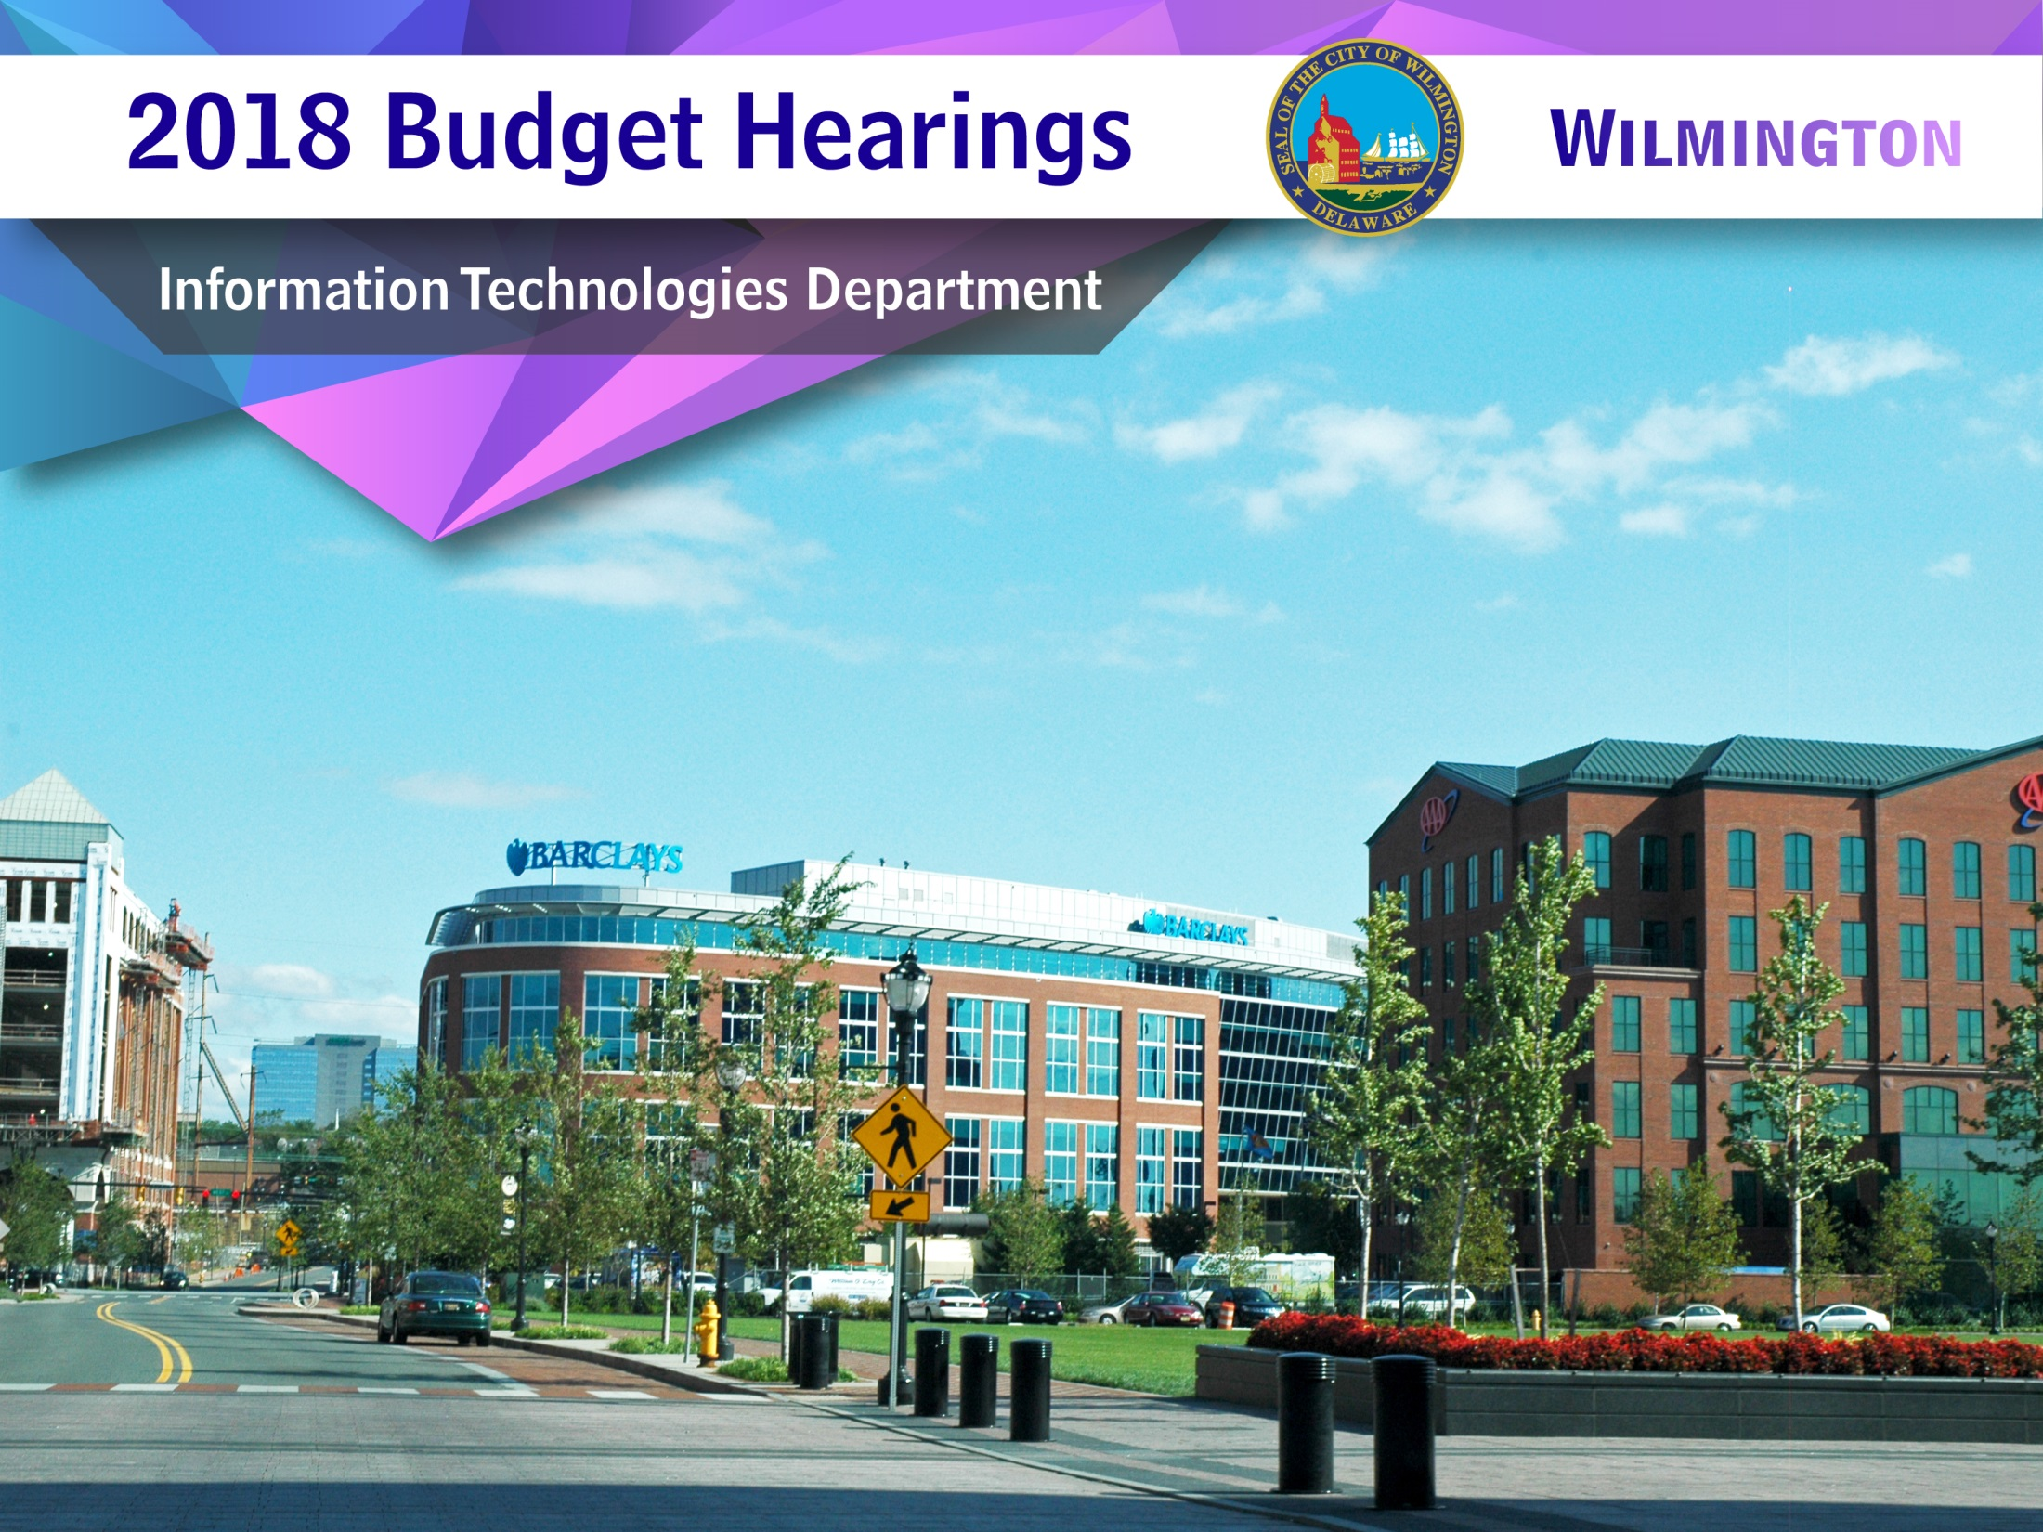

Slide 2
Department of Integrated Technologies
Admin
Strategic Planning
Records Management
Mail Services
Business Continuity
Applications
MUNIS Application Support
Data Analytics
Application Development and Support
Communications
911 Dispatch Center and Radio Systems
City Telephone Networks
Wireless (cell phones, tablets)
WAN communications
Helpdesk
Desktop and Device support
Procurement
Asset Management
Call Center
Desktop Virtualization
Kronos Support
Network
Network Access
Server Support
Remote Accessibility
Network Security
Backup and Restores
Server and Storage Virtualization
Mapping and Graphics
GIS
Document Design and Publishing
Document Management
2

Slide 3
Our Mission:
Enabling technology to increase the effectiveness and efficiency of services for the employees and citizens of the City of Wilmington.
3
3

Slide 4
Department Vision:
To provide a secure, efficient and flexible technical environment that will enhance the productivity of the City’s workforce.
4
4

Slide 5
FY 2018 Priorities
  Alignment of the IT Department and its resources to support the vision and initiatives of the Mayor’s Office
  Deployment of an Open Government portal by Fall 2017
  Update MUNIS to version 11.2 by December 2017
  Deployment of Windows 10 to all desktop systems by December 2017
  Complete a full Disaster Recovery exercise by December 2017
5

Slide 6
Questions
6
6

Slide 7
Changes to Positions
1
1. Discuss any changes to staffing positions (appeals, etc.)
7

Slide 8
Changes to Positions
1
Upgrade
During the 2016 bi-annual re-classification process, 4 positions were upgraded from class N to class O after a review by HR of their current responsibilities.
Information Helpdesk Engineer (3)
Information Systems Administrator (1)
8

Slide 9
Vacant Positions
2
2. As part of the FY 2017 Budget, there were 3 newly created positions: Help Desk Manager,
Application Support Specialist I, and Network Technician, discuss the current vacant
positions within your department.
9

Slide 10
Vacant Positions
2
We are in the process of working with HR to review the job descriptions and anticipate hiring before by the end of Summer 2017. The intent was to have the positions posted by close of Q3 2016, however, the administration transition delayed the process.
10

Slide 11
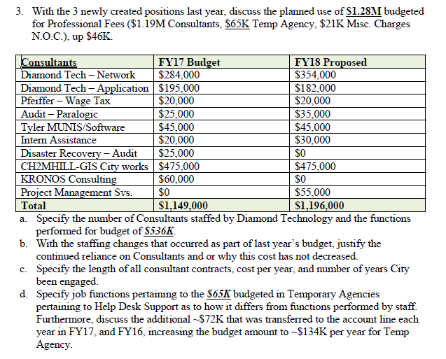
Consultants
3
11

Slide 12
Consultants
3
Creation of the Network Admin position served to reduce the overall amount budgeted for Network contracted services. The other positions do not have functions that overlap with the areas supported by the services contracted from Diamond Technologies.
The increase reflects the request for professional project management services.
12

Slide 13
Consultants
3a
There are currently 3 full-time consultants staffed by Diamond Technologies:
1 Network Team Lead and Network Consultant - $354K
1 Applications Developer - $182K
13

Slide 14
Consultants
3a
Network Team Completed Tasks
NetApp Upgrade – Completed the migration of city data at both MOB and Hosting locations to new NetApp SAN equipment and optimized storage for city data.
Retired the CityFile file server. Completed migration of data from the CityFile file server to the new City-File file server (upgraded to Windows 2008 R2).
Upgraded the Checkpoint Manager server for the city’s firewall platform.
Deployed new Domain Controller to replace one that had intermittent issues.
Upgraded the Active Directory Domain functional level from 2003 to 2008.
Assisted Apps Group with deployment of Paymentus.
Upgraded the Vmware Vsphere environment to 5.5 and installed current patches.
Worked with Downtown Visions to plan and configure network and firewall protocols for additional IP cameras being added to the City Building.
Consolidated 3 physical backup servers to 2 Virtual Servers and upgraded from Replay to Rapid Recovery.
Retired LeftHand SAN equipment.
Extended VLAN for Fuelmaster network to accommodate pumps at Public Safety building.
Built and configured ONBASE server for Public Works.
Deployed new media content server for Lobby screens (with Bud Finney – Helpdesk).
Assisted contractors with SCADA system upgrades.
Assisted and Resolved a long-time issue for Jeff Flynn regarding his email account and archiving.
Added SNMP configuration to all switch stacks for new Solarwinds Monitoring.
Deployed upgraded Solarwinds to new server and DB.
Consolidated multiple switch stacks at Hosting facility into a single core chassis.
Worked with vendor for GIS Interface systems (in progress).
Assisted with Office 365 deployment testing by creating a virtualized environment to conduct installation tests.
Responded and fulfilled several FOIA requests.
Implemented CITRIX server – Setup and config VM servers, racked physical hosts, set firewalls and switch stack configurations.
Assisted with MUNIS Virtualization process (Planning and VM server setup).
Conduct Security Risk assessment with Availability Guard Software and systems.
Assisted with Mayoral Administration transition as needed.
Configured 6th floor swing space area for network access for IT department.
Deployed and configured new TrendMicro Anti-Virus and Intrusion Detection platform of servers.
Retired old Kronos time keeping servers.
Tested and Evaluated an emergency backup for Internet connectivity plan using Cradlepoint systems.
14

Slide 15
Consultants
3a
Application Developer Completed tasks
L&I WEB/Mobile APP Development and Database Maintenance:
      Completed Multiple Reports using sql server reporting tool.
Completed Property Maintenance, Vacant Property, Vacant Bills interface for the L&I mobile application.
Completed updating related database objects.
Integrated Violation process to accommodate new violation codes.
Troubleshoot maintenance issues for L&I Database.
Updated nightly jobs to send out sql alerts.
Following are in the test environment waiting for approval to move into production.
Vacant Property Module.
    Vacant Bills Module.
    Property Maintenance updated Module.
    Related Database objects.
Harris Interface:
  Completed creating Harris framework to integrate Harris Database.
Munis Databse Maintenance/Administration/Development:
Completed automating posting customer’s utility bill payments on the Paymentus site after the data is generated from munis.
Completed creating process for cityworks to extract meter data from munis.
Automated process to create citymunis objects after MIU runs.
Completed moving munis objects to Virtual Server.
Completed creating data extract for users from munis based on the request.
Assisted in completing ROTR project.
15

Slide 16
Consultants
3b
The Network Admin position created in FY 17 served to decrease the network services contract cost by $72K. The Network contract cost remains consistent and will not increase in FY 18.
The Application Developer contract was also reduced by $15K and will not increase.
The remaining newly created positions do not include duties that impact the contracted services.
Technical Consultants perform tasks, administer technologies and implement solutions that are beyond the scope and capabilities of current City personnel.
16

Slide 17
Consultants
3c
  $536K for Diamond Technologies 11 Years
  $475K for CH2MHill Public Works GIS/City Works app 11+ Years
  Development Infrastructure and Database support, GIS
  $45K Tyler MUNIS/Software 10 Years
  $35K BTB Security (Security Audit) > 1 Years
  $20K For Bill Pfeiffer (Wage Tax Software Developer) 8 Years
  $20K For Intern Assistance 4 Years
  $65K For Temp Agency (Integrity Staffing Solutions Helpdesk Phone Support) 3 Years
  $22K For Misc. Charges N.O.C. (Iron Mountain Offsite Archival Services) 9 Years
17

Slide 18
Consultants
3d
The Help Desk support position is utilized to answer calls to the helpdesk, coordinate communications to staff and enter/assign/manage service tickets. The position also manages enterprise printing supplies. This frees the Help Desk Support Engineers to actively work on service requests and projects.
IT regularly receives in excess of 1000 calls to the helpdesk each month.
IT will be seeking to convert this position to full-time in FY 19.
The 72K transferred in FY 16 was done in anticipation of a larger cost, which did not occur.
The 72K transferred in FY 17 reflects funding for an additional temporary position which supports applications and paid interns as well.
18

Slide 19
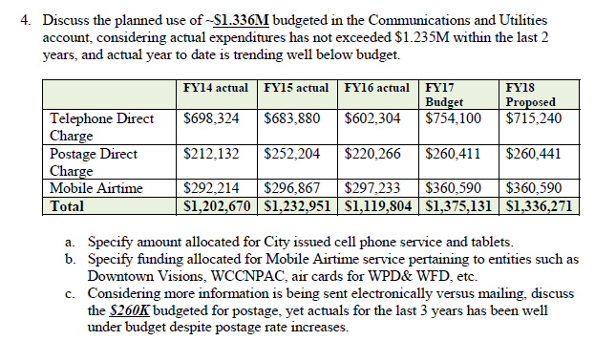
Communication & Utilities
4
19

Slide 20
Communication & Utilities
4
The Telephone Direct Charge contains much of our WAN connectivity. We tend to be cautious about cutting deeply into items that could possibly impact operations.
$40K was reduced from the FY17 request.
20

Slide 21
Communication & Utilities
4a
$191K is allocated for City issued cell phones and tablets.
21

Slide 22
Communication & Utilities
4b
Mobile Airtime Services | FY'18 Proposed
Downtown Visions | $125,000
WCCNPAC Mobile Airtime | $1500
WPD Mobile Command Trucks | $900
MPD Public Safety Building | $900
Verizon Wireless WPD Air cards | $105,700
Comcast Public Safety BLDG | $1,350
Comcast Public Safety BLDG-Cameras | $2,100
Verizon CABS Direct TV Cameras | $105,500
DELJIS High Speed Internet Access-WPD | $7,200
Verizon Public Safety T-1 Connection | $3,900
IPADS W/ANNUAL Usage WPD & PIO Office | $6540
TOTAL | $360,590.00
22

Slide 23
Communication & Utilities
4c
$260K Postage Direct Charge:
  Request is based on FY2015 and FY2016 actuals which trended at 96% and 85% respectively.
  Utilization is dependent on the number of direct and mass mailings requested, which can vary.
  Postage is increased in increments of 15K; total expenditures can rapidly increase.
  Should the current FY 17 trend hold, we will consider reducing the request next year.
23

Slide 24
Equipment
5
5. Discuss the ~$1.3M budgeted for equipment, up ~$94K over prior year’s budget.
a. Considering $30K has been transferred from the account line in FY17, justify additional $94K budgeted.
b. Specify the time parameters for implementing Permitting Technology Improvements budgeted for $210K.
c. Specify cost budgeted for replacement computers/laptops/tablets/servers based upon replacement schedule.
d. Specify cost for computers/laptops/tablets/servers that’s not part of the replacement schedule.
e. Specify the frequency for replacement of desktops.
f. Provide an update on the implementation and user status of Microsoft 365, which$275K budgeted in FY16, and $275K in FY17, and $365K proposed for FY18.
24

Slide 25
Equipment
5
  The additional $94K requested is for Phase 2 of the PC replacement project of systems 5 years and older.
25

Slide 26
Equipment
5a
  The $30K that was transferred represented a cost savings from a combination items that were no longer needed and not renewed.
26

Slide 27
Equipment
5b
  The permitting technology improvements are projected to take 9 months to complete, factoring in training for employees.
27

Slide 28
Equipment
5c
  $95K is requested to replace computers, laptops and tablets on schedule.
28

Slide 29
Equipment
5d
  $15K is requested to replace servers that are not part of the replacement schedule.
29

Slide 30
Equipment
5e
  The frequency for replacing desktops should be at least 4 years.
30

Slide 31
Equipment
5f
  The actual requested amount for Office 365 and services is $325K. Up $50K as a result of additional licenses needed for advanced filtering and security features.
31

Slide 32
Contracted Maintenance
6
6. Discuss the ~ $720K budgeted for Contracted Maintenance, considering actual expenditures has not exceeded ~$510K the last three years.
32

Slide 33
Contracted Maintenance
6
  Costs are down $40K over the requested amount from FY 17.
  Funds allocated for Netapp storage have yet to be spent as we await anticipated price reductions in flash storage technology. The funds will be utilized by June 30.
  Costs also reflect an anticipated increase in cloud service and hosting fees from Kronos, which were waived in FY 17.
33

Slide 34
Membership & Registrations
7
7. Discuss the planned use of ~$72K budgeted for Membership & Registrations.
a. Specify amount of funding budgeted for IT employees for training, certifications, and conferences per employee.
34

Slide 35
Membership & Registrations
7
The $72K request reflects:
50K for City-Wide IT training for Microsoft Office 365 products and cyber security awareness.
35

Slide 36
Membership & Registrations
7a
15K is budgeted for training and training and certifications ($3,750 per employee).
7K is budgeted for the annual Kronos, MUNIS and Motorola training
36

Slide 37
Office & General Supplies
8
8. Discuss the ~$138K budgeted for Office & General Supplies, considering current expenditures and past trends are well below budget.
37

Slide 38
Office & General Supplies
8
This request has been reduced $23K over last year’s request of $161K.
The majority of this cost is related to printer toner and maintenance kits.
38

Slide 39
9
Security
9. Discuss any platforms the City has in place to avoid and or prevent data breaches within the cyber community.
a. Specify how often the City’s back up plan to the network system is tested, and how it compares with the industry standards
39

Slide 40
9
Security
Security is a top priority for IT!
  Implementation and management of industry leading security products (firewalls, VPN, filters and virus protection).
  Consistent patching of desktops and servers.
  Aggressive network security models and access rights.
40

Slide 41
9
Security
The most significant improvement this year was the adoption of the Trend Micro Deep Security solution.
Trend is currently the #1 provider of endpoint security.
The system proactively monitors the City’s network for threats and abnormal system behavior and provides an automated response if an exploit is detected.
41

Slide 42
9a
Security
  The Network team performs regular monthly restores as well as monitoring backup logs. We have achieved a 100% recovery rate for this year.
  The City’s backup implementation currently exceeds industry standards.
42

Slide 43
10
Rentals
10. Discuss the $120K budgeted for Rentals.
a. Specify number of Canon copy machines that are rented City-wide, and the length of the contract.
43

Slide 44
10
Rentals
  The funding is allocated for the 37 Canon copy machines, used City-Wide
44

Slide 45
10a
Rentals
  The contract is associated with the State of Delaware and has recently been extended to January of 2018.
45

Slide 46
11
Storage
11. As the City continues to grow its technology infrastructure, discuss if this budget addresses the high demands such as storage capacity, etc.
46

Slide 47
11
Storage
$145K is requested to address future physical and cloud storage needs.
47

Slide 48
12
Technology
12. Discuss how this budget provides the technological growth and keeps the City of Wilmington on the cutting edge of technology.
48

Slide 49
12
Technology
The current budget proposal allows for the city to leverage several key enterprise technologies:
Virtualization (Desktop and Server)
Cloud-Based messaging and collaboration
Mobile Device Management
Application publishing/Remote accessbility
Advanced Security and Threat Management
49

Slide 50
13
Printing
13. Discuss the amount of funds budgeted and expended for printing of live paper checks for City pay payroll checks, vendor checks, etc. (FY18 budget, FY16 actual, FY15 actual).
50

Slide 51
13
Printing
The request for funds has been reduced to 26K for FY 18. This is due to a successful project to shift employee pay stubs online.
51

Slide 52
14
Internal Services Funds
14. Discuss the frequency of how often Internal Services charge backs are updated to reflect departments correct usage (such as postage, telephone, data processing, etc.).
52

Slide 53
14
Internal Services Funds
Telephone charges are reported to Finance on a quarterly basis
Internal Services charges for postage, Mapping and Graphics and Document Management are updated on a monthly basis
We are working with Audit to establish a new process for Data Processing with a yearly review.
53

Slide 54
All Departments
15
15. Provide FY18 proposed organizational chart with the total number of employees (i.e. permanent,
temporary, contract, vacancies).
a. Outline specific duties of each employee.
b. If there are multiple divisions, please ensure there are sub-org charts that enumerate all of
the above.
54

Slide 55
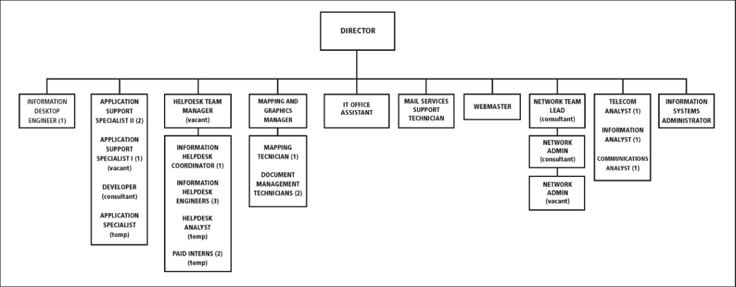
FY ‘18 Proposed Organization Chart
15
55

Slide 56
Positions
15
Director
  Responsible for the overall operation and function of the Office. Builds relationships with internal clients and vendors. Establishes policy and determines vision for the department. Aligns IT’s mission to the strategic goals of the organization.
Mapping/Graphics Manager
  Direct supervision of graphics and document management personnel. Designs organizational graphic communication correspondence.
IT Office Assistant
  Administrative support to Director. Processes contracts & invoices for office and project-related expenses.
Webmaster
  Manage website content and administration. Works closely with the office of communication. Administers internal SharePoint intranet site.
56

Slide 57
Positions
15
Mail Services Support Technician
  Receives, sends and delivers mail items. Coordinates Canon copier support calls.
Information Desktop Engineer (Fire)
  Supports WFD network and desktop support requests and projects.
Information Systems Administrator (Police)
  Supports WPD network and desktop support requests and projects.
Document Management Technician (2)
Scans reformats various documents as requested, designs layouts of various printed materialsusing current tools and technology, manage documents in the TCM and Worldox environments, mass duplication of documents and transcribes from VoiceWriter 1000 Digital Voice Recorder.
57

Slide 58
Positions
15
Helpdesk Manager (vacant)
  Responsible for the overall operation and function of the Helpdesk. Monitors established metrics to measure performance. Manages Helpdesk projects.
Information Helpdesk Coordinator
  Works with IT Admin office to gather specifications and procure technology related equipment for the organization. Supports the desktop technology needs of the City of Wilmington.
Information helpdesk Engineer (3)
  Supports the desktop technology needs of the City of Wilmington. Resolve issues, provide level 3 support, manage deployment of new computer devices, provide Kronos issue resolution
Helpdesk Analyst (Temp)
  Answers calls to the helpdesk, enters and assigns prioritized tickets to technicians, manages printer supplies
58

Slide 59
Positions
15
Application Support Specialist II
Manage the MUNIS ERP environment, provide assistance to clients for data requests, functionality improvements and resolve access issues.
Application Support Specialist I (Vacant)
  Provide level 1-2 support for application issues to users. Enter support tickets for application related issues with vendors. Processes electronic payments and print checks.
Developer (Consultant)
  Designs, implements and supports custom applications. Assists with client data requests. Provides level 3 support for application development issues and database administration duties.
59

Slide 60
Positions
15
Network Team Lead
  Responsible for the overall operation and function of the City’s network. Manages network projects. Administers and supports Storage and data network infrastructure.
Network Consultant
  Oversees network and system security, responsible for network firewalls and monitoring. Performs Storage and virtual network administration and high level active directory management.
Network Admin (Vacant)
  Manages AD Account creation, deploys switches and network devices. Performs admin duties and reviews system reports.
60

Slide 61
Positions
15
Telecom Analyst
  Responsible for the overall operation and function of the City’s phone system and WAN connections. Works with vendors to resolve issues and manages wireless phones.
Information Analyst
  Manages the City’s radio transmission infrastructure.
Communications Analyst
  Administrative support to the Telecommunications unit. Processes contracts & invoices for office.
61

Slide 62
THANK YOU!
11
62

