Slide 1
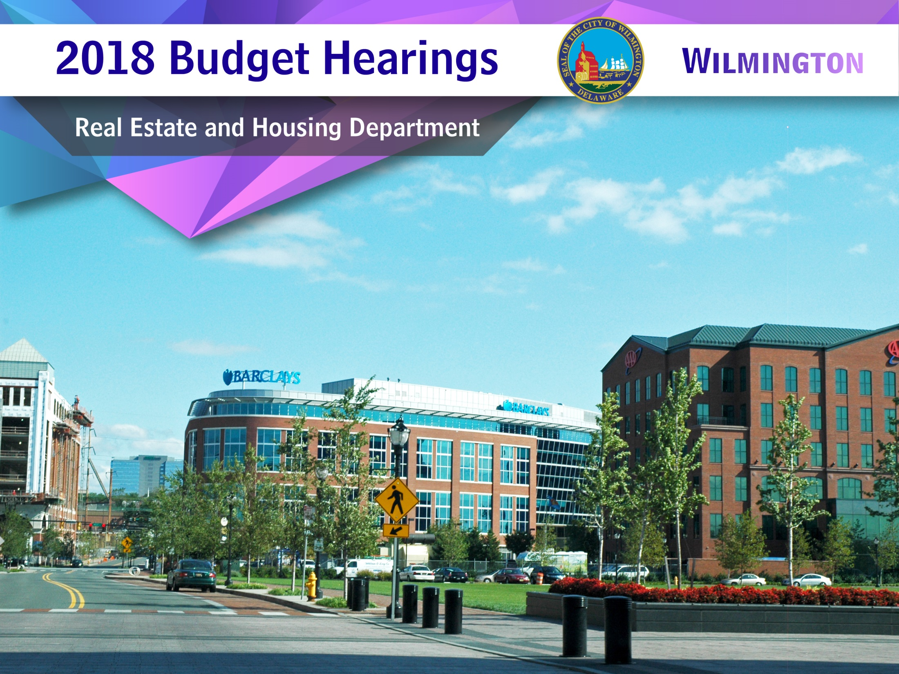

Slide 2
Vision
To improve the quality of life for residents in the City of Wilmington by increasing the supply of affordable homes, improving housing markets, preserving the quality of existing housing stock, promoting self-sufficiency, and engaging in activities to revitalize our City’s neighborhoods.
2

Slide 3
Top Three Priorities
Plan, allocate and prudently administer federal, state and local resources for the benefit of City residents and the neighborhoods in which they live, involving residents to the greatest extent feasible in decisions that affect their lives.
Promote using a combination of public and private financing and partnerships to develop housing that is integrated physically, socially and economical with the greater community, thus improving job availability, community services and self-sufficiency.
Work closely with the Department of Planning and Development to engage citizens in development of the City-wide Comprehensive Plan.
3

Slide 4
Questions
4
4

Slide 5
1.
Discuss current vacant positions.
We have one vacant position, Administrative Clerk II.
a. Specify duration of vacancy.
This position has been vacant for three months.
b. Specify time frame for filling this position.
In the process of filling this position.

Slide 6
2.
Discuss any changes to positions (upgrade).
The Senior Program Administrator’s classification was upgraded to reflect current level of responsibilities.
a. Specify the last time any changes were done for this position.
This position was last upgraded in 2015.
b. Specify why change was not submitted as part of the appeals process.
Earlier filing for appeal was submitted based on previous responsibilities.

Slide 7
3.
Discuss plans to address diminishing Federal Grant Funds so cost is not allocated to the General Fund.
The Department is closely monitoring annual reduction in federal funds.
Staff are being cross-trained to increase skills and abilities so costs can be covered by a variety of available, eligible fund sources.
We are looking at ways to recoup federal development awards by requiring loans in lieu of our historical grant model.
We are working to keep Material, Supplies and Equipment costs down, in order to increase the availability of administrative funds.
All staff are actively engaged in seeking new funding sources.

Slide 8
4i.
Discuss planned use of the approximately ~$3.027M budgeted
across CDBG, HOME, HOPWA, ESG and NSP Funds, down ~$161K.
Specify criteria and selection process.
The public is notified and informed of various programs, services and Request for Proposals that this department offers via:
  E-mail
  City’s website/WITN22
  Delaware Helpline
  Newspaper notification
  Social media and flyers
Project Criteria
Must address one or more targeted public service needs
Must serve primarily low to moderate income persons in the City of Wilmington
Must meet the established 65-point threshold

Slide 9
4i.
Discuss planned use of the approximately ~$3.027M budgeted
across CDBG, HOME, HOPWA, ESG and NSP Funds, down ~$161K.
Specify criteria and selection process.
Selection Process
Applications are reviewed by an Advisory Committee.
City Council representative
Real Estate and Housing staff
  Department of Planning and Development staff
  Representative from Delaware State Housing Authority
  Representative from New Castle County
  Representative from Continuum of Care
  Recommendations given to Mayor’s Office for final approval.

Slide 10
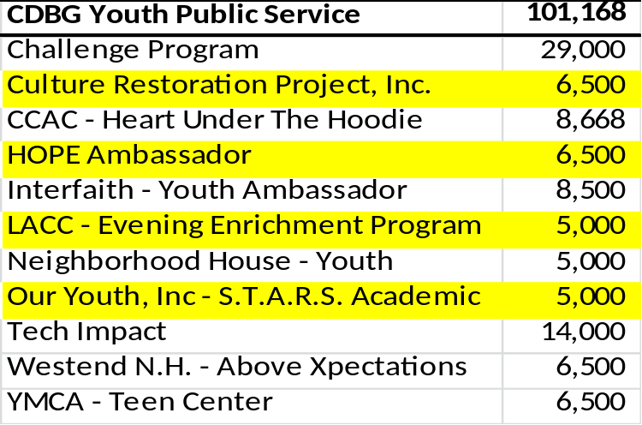
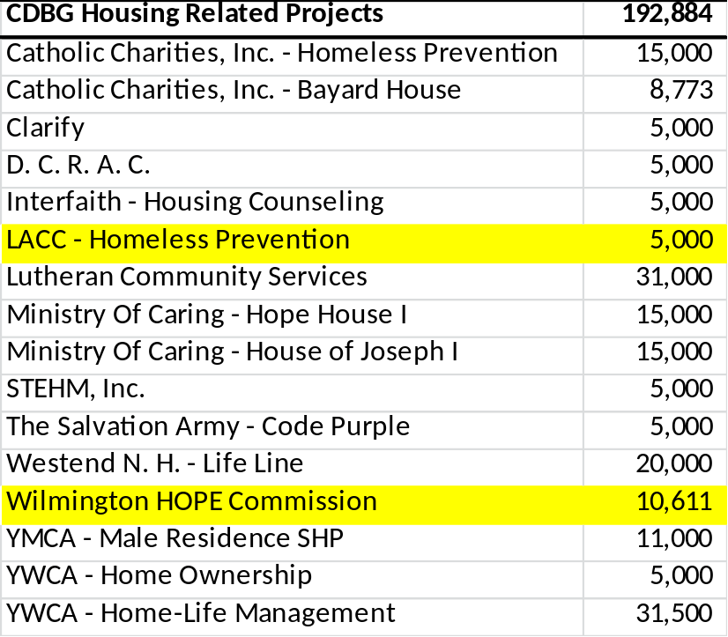
4ii.
Discuss planned use of the approximately ~$3.027M budgeted
across CDBG, HOME, HOPWA, ESG and NSP Funds, down ~$161K.
Specify any new recipients projected to receive funds.
New recipients are highlighted in yellow.

Slide 11
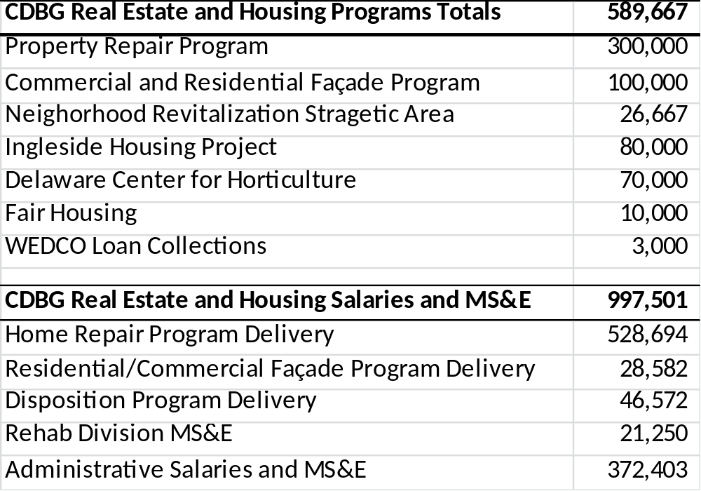
4ii.
Discuss planned use of the approximately ~$3.027M budgeted
across CDBG, HOME, HOPWA, ESG and NSP Funds, down ~$161K.

Slide 12
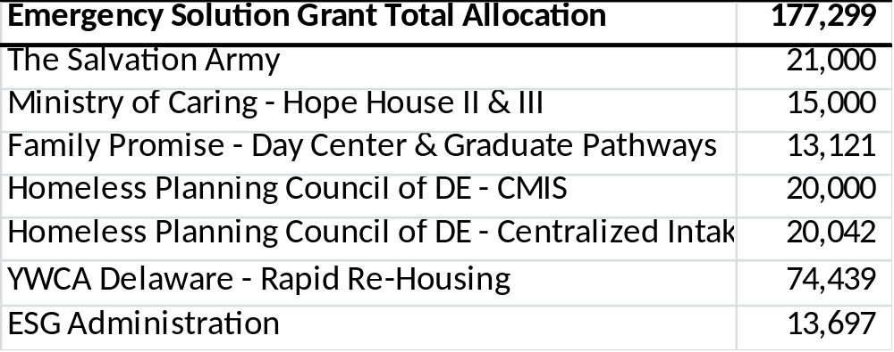
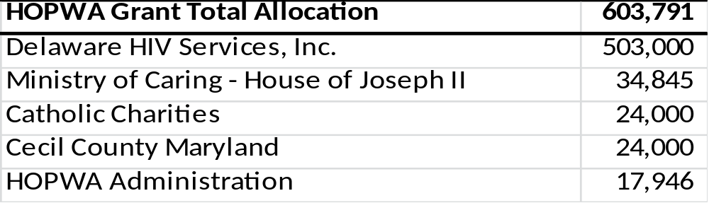
4ii.
Discuss planned use of the approximately ~$3.027M budgeted
across CDBG, HOME, HOPWA, ESG and NSP Funds, down ~$161K.
No new recipients projected to receive funds.

Slide 13
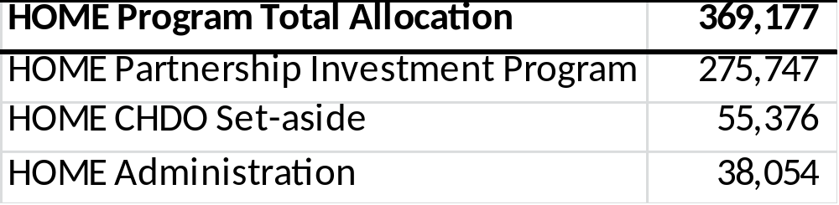
4ii.
Discuss planned use of the approximately ~$3.027M budgeted
across CDBG, HOME, HOPWA, ESG and NSP Funds, down ~$161K.

Slide 14
4ii.
Discuss planned use of the approximately ~$3.027M budgeted
across CDBG, HOME, HOPWA, ESG and NSP Funds, down ~$161K.
Specify total dollar amount of requests, and the total amount awarded.
Neighborhood Stabilization Program 1 and Neighborhood Stabilization Program 2 have no available funds. Therefore, at this time there are no new recipients projected to receive funding through these programs.

Slide 15
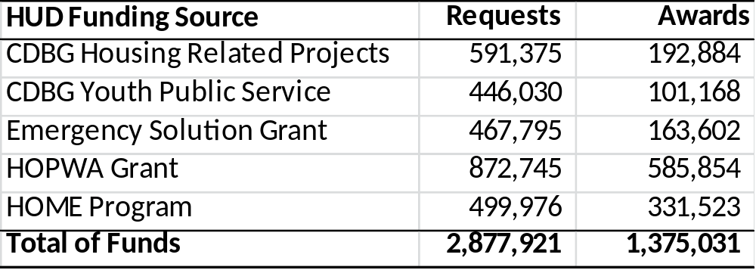
4iii.
Discuss planned use of the approximately ~$3.027M budgeted
across CDBG, HOME, HOPWA, ESG and NSP Funds, down ~$161K.
Specify total dollar amount of requests, and the total amount awarded.

Slide 16
5a.
Discuss City funding sources available to assist City residents with Affordable Housing
Community Development Block Grants
Catholic Charities
Lutheran Community Services
Home Loan and Emergency Repair Program
Housing Opportunity Fund
These funds are awarded to non-profit and for-profit partners for the purpose of constructing affordable homes for City residents.

Slide 17
5b.
Discuss City funding sources available to assist City residents with Home Repair
Community Development Block Grants
Home Loan Repair Program
Emergency Home Loan Repair Program
Ingleside Senior Safety and Repair Program
Emergency Repair Program
Milford Housing Development
Administering state-wide DSHA program

Slide 18
5c.
Discuss City funding sources available to assist City residents with De-lead
No funding is currently allocated for lead remediation.

Slide 19
5d.
Discuss City funding sources available to assist City residents with Pre-rental Inspections
The Department of Real Estate and Housing currently has no funding available for Pre-rental Inspections.
This responsibility falls within the purview of the Department of Licenses and Inspections.

Slide 20
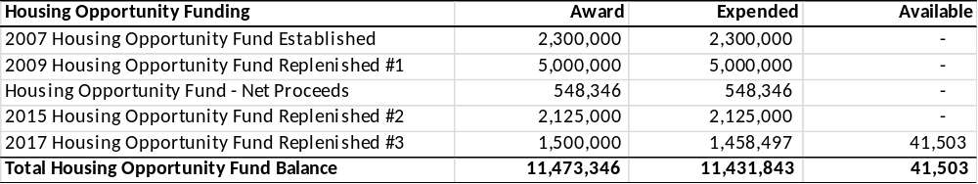
6a.
Discuss the available fund balance in the Housing Opportunity Fund.
Specify funding since inception.

Slide 21
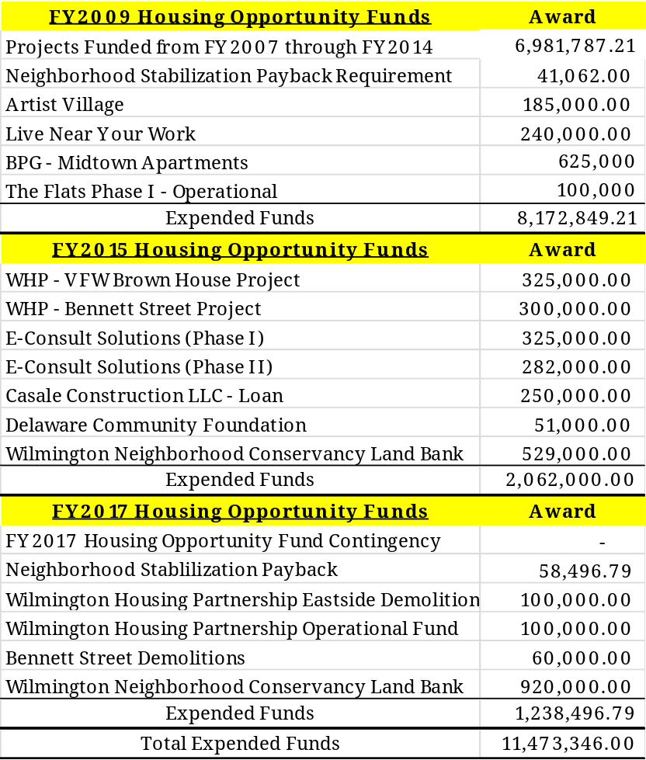
6b. - 6e.
Discuss the available fund balance in the Housing Opportunity Fund.
6b. Specify committed projects with correlating amount per project.
6c. Specify projects in the pipeline with correlating amount per project
6d. Specify amount allocated per project.
6e. Specify available balance
$41,503.00

Slide 22
6f.
Discuss the available fund balance in the Housing Opportunity Fund.
Specify any plans for replenishing the fund, and timing.
There exists a profound need to replenish the Fund.
Talks regarding replenishment of the Fund are underway.

Slide 23
7.
Provide high level update on the City’s Land Bank.
The Wilmington Neighborhood Conservancy Land Bank is a non-profit organization created to serve as the repository for vacant and abandoned properties that, left unaddressed, can contribute to crime, depress the local real estate market, and deplete the tax base of the City of Wilmington.
Non-profit status has been acquired
An Executive Director has been hired
The Governing Board meets monthly
The Technical Board meets monthly
The Land Bank is preparing to receive vacant and abandoned properties
The Land Bank is also focused on receiving open lots for greening
a. Amount of funding provided to the entity since inception.
$1.5M
b. Number of vacant housing in the Land Bank’s inventory.
None to date.

Slide 24
8.
Discuss the planned use of $125K budgeted for Disposition Cost in the General Fund.
FY18 Property Management Contract $82,000:
Snow Removal
Debris Removal
Grass Cutting
Property Boarding and Cleanouts
The remaining $42,000 will be used for:
Appraisals
Environmental studies
Roofing and Fencing
Tree Removal
Interior Demolitions

Slide 25
9.
Discuss the $324K increase in Debt Service.
The existing Debt Schedule’s principal payments increased above and beyond the savings due to the recent refinancing.

Slide 26
10.
Discuss the $1M capital budget request pertaining to acquisition and demolition.
The $1M capital budget request will enable the City to fund the acquisition of selected properties that facilitate revitalization of key parts of neighborhoods throughout the City.
a. Provide an update on all existing Capital Projects.
Existing Capital Projects
Infrastructure $500,000
Acquisition $668,000
201 Vandever Avenue $657,503
Diamond State Salvage Infrastructure $150,000

Slide 27
11.
Discuss the number of vacant properties acquired the last (2) two years for rehabilitation and homeownership.
a. Specify total cost per year, and amount of funds City recouped per year.
The Department of Real Estate and Housing acquired the following vacant properties over the last (2) two years.
FY2015 and 2016
Acquired 50 properties
Received revenue totaling $23,300
FY2017
Acquired 14 properties
Received revenue totaling $3,275

Slide 28
12.
Provide an update on City funds allocated to the
Wilmington Housing Partnership within the last (4) four years.
Bennett Street $300,000
East Side Demolition $160,000
Operational Funding $100,000
527-529 Vandever Avenue $192,000
VFW Browntown $325,000
a. Discuss the City’s role with the Wilmington Housing Partnership.
Since 1972, the City and the Partnership have been engaged in a collaborative effort to construct new housing and restore existing homes for affordable home ownership within the City.
Partnership Board includes six ex-officio members from City government.
Mayor’s Chief of Staff
Council Finance Committee, Chair
Department of Planning and Development, Director
Department of Real Estate and Housing, Director
Department of Finance, Director
Mayor’s Office of Economic Development. Director

Slide 29
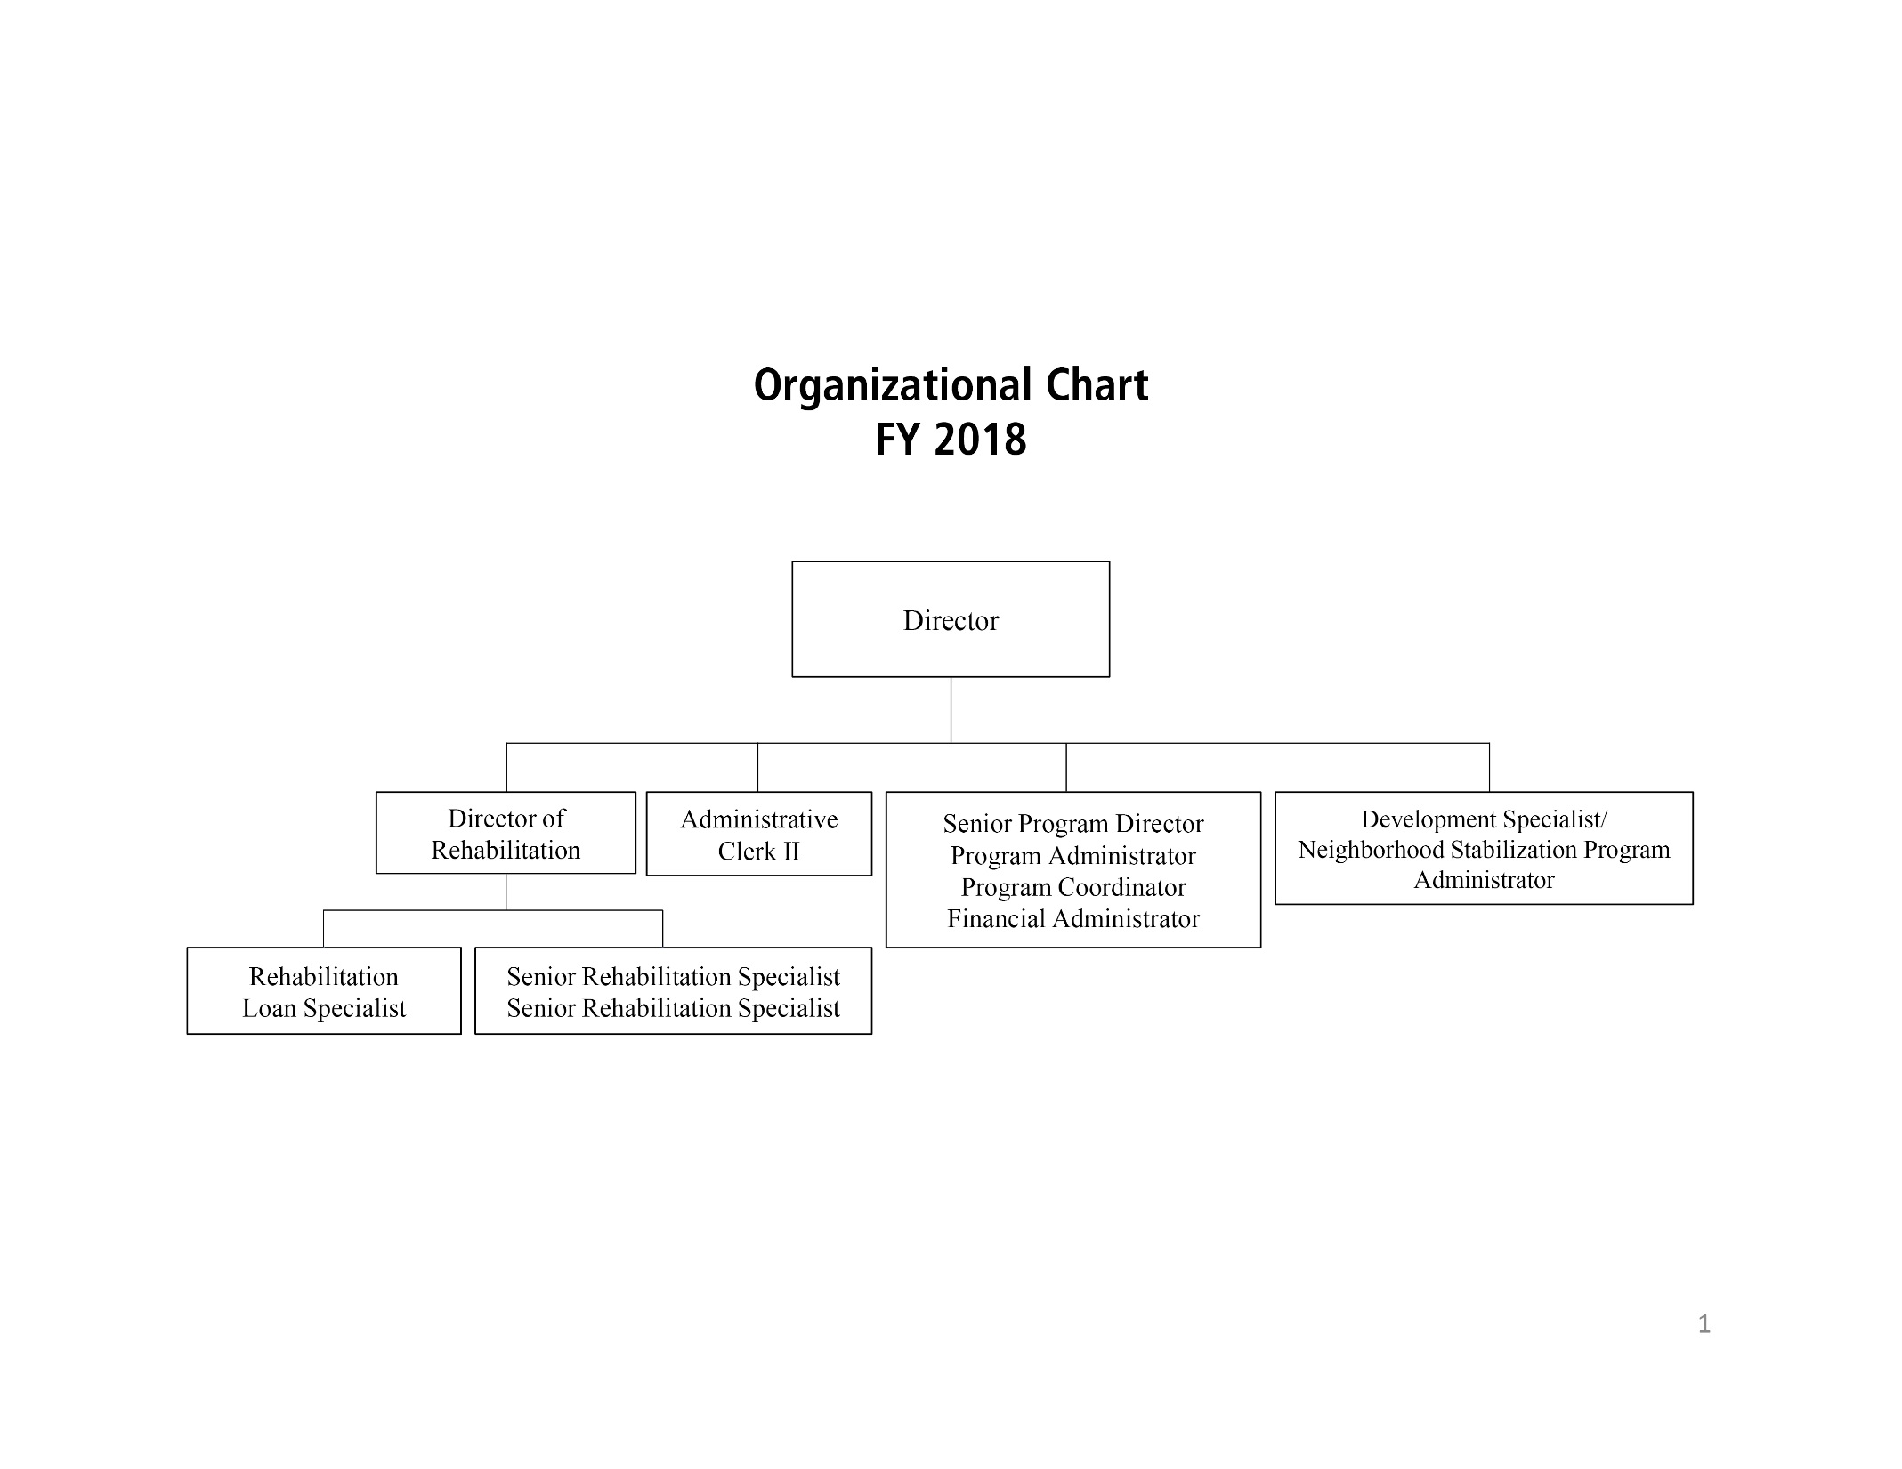
One Temporary Employee

Slide 30
Thank You.

