Slide 1
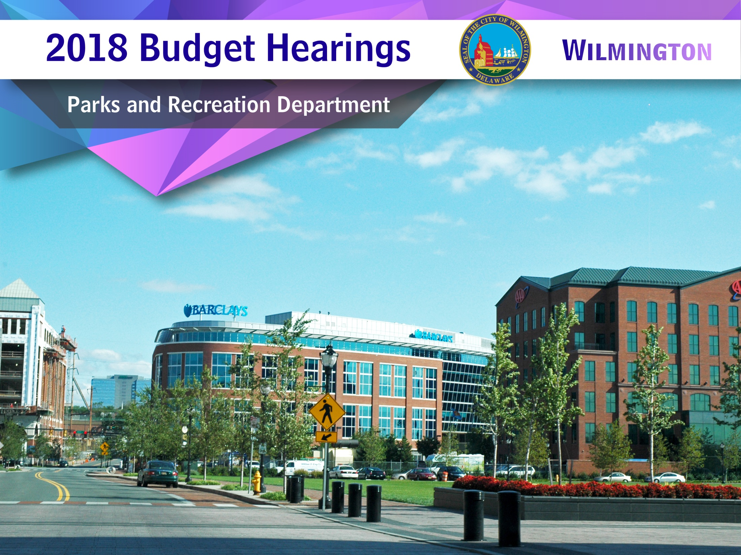

Slide 2
Questions
2
2

Slide 3
1
Discuss any changes to position (deleted, upgraded).
Project Manager – Deleted.
3

Slide 4
1a
1a. Specify any vacant positions and duration of the vacancy.
General Laborer II- Vacant since 01/2017 –Posted.
Clerk II- Vacant since 02/2017 – Posted.
Equipment Operator I- Vacant since 3/2017 – Pending posting.
4

Slide 5
2. Discuss the $1,126,810 budgeted for Temporary Salaries.
2
 | FY 16 Budget | FY 15 Actual | FY 16 Budget | FY 17 YTD | FY 18 Proposed
Administration | $376,473 | $58,029 | $45,972 | $28,685 | $57,320
Recreation | $290,576 | $334,015 | $290,756 | $209,508 | $304,320
W.H.A.C.C | $317,040 | $323,172 | $317,040 | $210,477 | $318,287
Youth & Families | $437,827 | $439,877 | $427,897 | $325,772 | $445,661
Maintenance |  | $341 |  | $1,031
TOTALS | $1,045,443 | $1,155,434 | $1,045,443 | $785,619 | $1,064,818
5

Slide 6
2a
  2a. Specify the number of Summer Youth jobs and correlating funds budgeted in the General Fund.
  General Fund-$309,375 250 Jobs
6

Slide 7
2b
2b. Specify the amount of grant dollars anticipated for summer youth for FY 2018, and anticipated number of summer youth jobs for City residents and number for non-City residents.
$65K from Bank of America.
$225K Department of Labor.
City Residents - 385 Youth.
Non-City Residents - 65 Youth (approx.).
Anticipated FY18 Summer Youth Jobs Total – 450
7

Slide 8
2c
2c. Specify the number of corporations, etc. that has sponsored summer youth jobs in FY 2017 and number anticipated for FY2018.
FY17 | FY 18
Bank of America | Bank of America
Lafferty- McHugh Award
8
Notes:
YF

Slide 9
2d
2d. Specify if any funding has been allocated for the Youth Leadership Project.
Funding for Wilmington Youth Leadership Commission is split between Admin. and WHACC. $31,944.00
Salary $27,144.00.
Food $3,000.00 allocated within Admin.
Clothing $1,800.00 Allocated within Admin.
9

Slide 10
2e
2e. Specify if any funding has been allocated for extended hours for W.H.A.C.C and the funding sources (i.e. grant funding, etc.).
We anticipate the Safe Haven grant from June 15th- October 2017 to be funded by the State of DE Dept of Services for Children Youth and Families.
Anticipated Funding Amount $22,500.
10

Slide 11
3
3. Discuss the planned hours of operations for all City pools and the correlating cost per site (Eden, Brown, Prices, W.H.A.C.C. and P.S).
 | Hours of Operation | Sunday | Monday | Tuesday | Wednesday | Thursday | Friday | Saturday
EDEN | CAMPS ONLY | OPEN SWIM | CAMP OPEN 3PM-6PM | CAMP | CAMP OPEN 3PM-6PM | CAMP | CLOSED | OPEN SWIM
PRICES | 1PM - 6PM | CLOSED | OPEN | OPEN | OPEN | CLOSED | OPEN | OPEN
BROWN | 1PM - 6PM | OPEN | OPEN | CLOSED | CLOSED | OPEN | OPEN | OPEN
WHACC | 1PM - 6PM | CLOSED | OPEN | OPEN | OPEN | OPEN | OPEN | CLOSED
P.S. DuPont | 1PM - 6PM | CLOSED | OPEN | OPEN | OPEN | CLOSED | OPEN | CLOSED
11
Notes:
In an attempt to gauge the progress of the program, a comparison between the previous years with the first year of CVW implementation will be conducted. Another analysis will be done to compare changes within specific zones to see if they experienced a decrease or increase. Finally, some explanation on why changes were made.
Copies of the final evaluation will be forwarded to City Council upon receipt from the University of Delaware.

Slide 12
3
Cost Per Site
OPERATING COSTS FOR CITY POOLS
EDEN POOL | $ 36,560 | Outdoor pool open only 8 weeks
FOSTER BROWN POOL | $ 36,560 | Outdoor pool open only 8 weeks
PRICES POOL | $ 35,560 | Outdoor pool open only 8 weeks
PS DUPONT POOL | $ 28,000 | Indoor pool open for 6 weeks
WHACC POOL | $ 90,000 | Indoor pool open year-round
12
Notes:
In an attempt to gauge the progress of the program, a comparison between the previous years with the first year of CVW implementation will be conducted. Another analysis will be done to compare changes within specific zones to see if they experienced a decrease or increase. Finally, some explanation on why changes were made.
Copies of the final evaluation will be forwarded to City Council upon receipt from the University of Delaware.

Slide 13
3a
3a. Specify any anticipated plans for Canby Pool.
There are no plans for Canby.
13

Slide 14
3b
3b. Provide site locations for City Spray Parks.
Helen Chambers Park
Judy Johnson Park
Brown Cihocki Park
Mack Park
Woodlawn Park
Father Tucker Park
Eastlake Playground
14

Slide 15
4
4. Discuss the planned use of $319K budgeted for Professional Fees for Consultants and Temporary Agency Cost up $58.5K.
Maintenance-$30K-(Temp Winter Staff).
Recreation- $28.5K- (Program Evaluations).
15

Slide 16
5
  5. Discuss the $165K Budgeted overtime.
DIVISION | AMOUNT | EXPLANATION FOR USE
ADMINSTRATION | $8.7K | Transportation.
RECREATION | $6K | Weekend and Holiday activities.
W.H.A.C.C. | $5K | 5K-Weekend and Holiday activities.
MAINTENANCE | $145K | Work required outside normal operation hours.
16

Slide 17
6. Discuss the $271.7K budgeted in Miscellaneous Services, up $56K.
6
DIVISION | AMOUNT | EXPLANATION FOR USE
Recreation | $500 | Recreational Activities
W.H.A.C.C. | $500 | Security, Extermination, Facility/Equipment Repair.
Maintenance | $55K | Contracted Maintenance, Mowing Contracts/Fountain up- keep.
17

Slide 18
6a. Specify funding allocated for Security Guard Service for W.H.A.C.C and whether armed and or unarmed and the number of guards.
6a
Gettier Security Service -(2 Armed Guards) (45Hrs per week) $65K
M-F 8am-1pm
M-F 4pm-8pm
18

Slide 19
6b. Justify the additional funds requested for upkeep of City fountains, and how that differs from Capital funds.
6b
These additional funds were requested for the care and maintenance of parks water infrastructure. (i.e. Decorative & Drinking fountains, Spray Showers, Pools, etc.) and in place of the creation of a new position originally requested.
These are operational funds to maintain infrastructure and not capital improvements.
19

Slide 20
7. Discuss the operating hours for the William Hicks Anderson Community Center W.H.A.C.C.
7
The center hours are:
Monday through Friday 8am – 8pm.
Safe Haven Program- June-October extended hours
Friday 8pm - 10pm
Saturday & Sunday 10am–2pm.
20

Slide 21
7a
7a. Specify any plans for having a WPD Officer at W.H.A.C.C.
An Officer is on site Monday-Friday 1pm-8pm.
21

Slide 22
8
8. Discuss the number of parks maintained by the Department of Parks & Recreation.
The next slides list all City Park Sites.
22

Slide 23
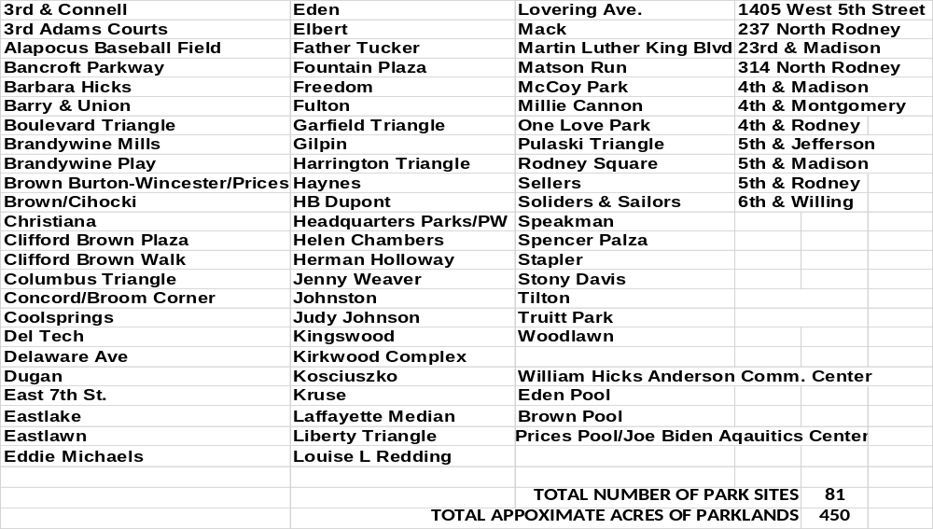
8
CITY PARKS LISTS
.
23

Slide 24
8a
8a. Specify the number of Parks maintained by the State.
.
State Maintained Parks
Alapocos Woods
Brandywine Park
Kentmere Parkway
Rockford Park
H. Fletcher Brown
24

Slide 25
9
9. Discuss the $194.4K budgeted between Misc. Mat.,Supp and Parts & Parts and Equipment account categories, up $28.7K.
DIVISION | AMOUNT | EXPLANATION FOR USE
Recreation | $7K | Expansion of after-school programs. (Tutoring)
WHACC | $6.1K | Expansion of Safe-Haven program Oct-Apr.
Youth & Family | $4.9K | Teen Summit & other summer programming to include food cost
Maintenance | $6.5K | Increase cost of equipment & Supplies
25

Slide 26
9a
9a. Specify the number of programs that encompasses $42K budget for Food.
DIVISION | AMOUNT
Administration | $4K
Recreation | $10K
W.H.A.C.C | $8K
Youth & Families | $18.3K
Maintenance | $1.5K
26

Slide 27
9a
9a. Specify the number of programs that encompasses $42K budget for Food.
Administration $4K | Maintenance $1.5K | Recreation $10K | Youth & Families $18K | WHACC $8K
Wilmington Youth Leadership Commission | Emergency Operations | 5K Run | Teen Summit | Summer Camps
 |  | Tennis in the Street | Holiday Giveaway | Senior Thanksgiving Luncheon
 |  | National Senior/ Health & Fitness | At-Risk Community Trips | Christmas Breakfast
 |  | All Awards Banquet | Summer Programs | Saturday Academy
 |  |  | SAT Prep Session
 |  |  | Youth & City Gov’t
 |  |  | College Tours
27

Slide 28
9b
9b. Provide an update on recreational equipment for W.H.A.C.C. that has been requested.
Stationary Bike
Elliptical Machine
(2) Pool Tables
28

Slide 29
10
10. Discuss the planned use of $154K budgeted between Rental and Contracted Maintenance account lines.
Maintenance | WHACC | Recreation | Youth & Families
$39.1K | $51.8K | $51K | $11.4K
Heavy Equipment Rental | Repairs to HVAC | Portable Toilets | Kitchen Repairs
Misc. Repairs | Building Repairs | Tables/Chairs | Summer Programs
29

Slide 30
10a
10a. Specify if the City is using shared services for portable toilet services, renting of chairs and tables for City events.
Parks and Recreation is paying full cost for these services. All funds are paid out of Parks and Recreation budget.
30

Slide 31
11
11. Discuss the planned use of $54K budgeted in Other fees.
Administration | Maintenance | Recreation | WHACC | Youth & Families
$0 | $15K | $38.5K | $0 | $0
 | Landfill Fees | Referees Umpire
31

Slide 32
11a
11a. Specify the amount of fees recouped for Sporting fees.
$2,250 (Softball registration fees).
32

Slide 33
12
12. Discuss the planned use of $47K budgeted in Community Activities.
Arts In the Parks: $44K
Delaware Nature Society: $3K
33

Slide 34
12a
12a. How is the Summer/Arts in the Parks program being measured to determine the success of the program? How is the program being marketed?
By it’s participation.
Through a collaborative effort by the City of Wilmington and the Grand Opera House.
34

Slide 35
13
13. Discuss the Park Trust Fund and how funds are allocated.
The Wilmington Park Trust Fund Commission (The Commission) was organized under an Act of Legislature of the State of Delaware on March 25 1935 for the park system within and around the city of Wilmington, Delaware. The Commission governed by three commissioners appointed by the City’s Mayor is authorized and empowered with the approval of Department of Parks and Recreation of the City of Wilmington to receive and hold in trust, grants of lands and gifts of money and other personal property for use by the department as specified in the respective bequest.
35

Slide 36
13a
13a. Specify the available amount.
The Total Park Trust Fund is: $6,246,698.00.
36

Slide 37
14.Provide an update on the William Hicks Anderson Community Center Task Force Report.
14a. Specify if any of the recommendation has been implemented.
14a
37

Slide 38
14b
14b. Specify the total amount of Capital funding available for this project.
Current capital improvement funding in the WHACC account code is $3,031,004.00 which will be used future development.

Slide 39
15a,b
15. Provide an update on all Parks & Recreation programs and the participation levels for the last 2 years.
a. Specify cost per program, if any.
b. Specify amount of funds collected per program, if any.
The next (2) slides will provide the information requested.
39

Slide 40
2016 Program Participation
15
Program | Participation FY 2016 |  | Program | Participation FY 2017
Family Matters | 2706 |  | Christmas Breakfast | 249
Food Program | 11743 |  | Community Trips | 142
Girls on the Run | 17 |  | SAT Prep Class | 40
Karate | 60 |  | Green Jobs | 14
Golf | 11 |  | WYLC | 16
Job Fair (2) | 143 |  | College Tours | 114
Camp Barnes | 154 |  | Tennis | 840
Boxing | 151 |  | Summer Youth Employment | 530
Chess | 20 |  | Summer Enrichment camp | 36
 |  |  | Hicks Summer Camp | 95
Teen Summit | 438 |  | Youth & City Government | 154
Men’s softball | 2253 |  | College/Career Fair | 40

Slide 41
2017 Program Participation
15
Program | Participation FY 2016 |  | Program | Participation FY 2017
Family Matters | 94 |  | Christmas Breakfast | 450
Food Program | 300 |  | Community Trips | 110
Girls on the Run | 17 |  | SAT Prep Class | 40
Karate | 60 |  | Green Jobs | 14
Golf | 11 |  | WYLC | 16
Job Fair (2) | 30 |  | College Tours | 141
Camp Barnes | 146 |  | Tennis | 935
Boxing | 30 |  | Summer Youth Employment | 548
Chess | 30 |  | Summer Enrichment camp | 46
 |  |  | Hicks Summer Camp | 95
Teen Summit | 516 |  | Youth & City Government | 163
Men’s softball | 2413 |  | College/Career Fair | 46

Slide 42
2016 Program Costs
15a
Program | Cost | Fees Collected | Program | Cost | Fees Collected
Family Matters | $0 | $0 | Christmas Breakfast | $2K | $0
Food Program | $0 | $0 | Community Trips | $10K | $55 pp
Girls on the Run | $0 | $0 | SAT Prep Class | $6.K | $0
Job Fair (2) | $0 | $0 | Green Jobs | $0 | $0
Camp Barnes | $17.2K | $0 | WYLC | 0 | $0
Boxing | $0 | $0 | College Tours | $20.4K | $350 pp
Chess | $0 | $0 | Tennis | $2.4K | $0
Teen Summit | $7K | $0 | Summer Youth Employment | $623.1K | $0
Men’s softball | $7.3K | $2.7K | Summer Enrichment camp | $11K | $55 pp
Youth & City Government | $6.7K | $0 | Hicks Summer Camp | $10K | $65
College/Career Fair | $398 | $0

Slide 43
2017 Program Costs
15a
Program | Cost | Fees Collected | Program | Cost | Fees Collected
Family Matters | $0 | $0 | Christmas Breakfast | $2K | $0
Food Program | $0 | $0 | Community Trips | $10K | $55pp
Girls on the Run | $0 | $0 | SAT Prep Class | $6.7K | $0
Job Fair (2) | $0 | $0 | Green Jobs | $6.7K | $0
Camp Barnes | $17.2K | $0 | WYLC | $0 | $0
Boxing | TBD | TBD | College Tours | $14.5K | $350pp
Teen Summit | $2K | $0 | Tennis | $2.4K | $0
Men’s softball | $7.3K | $2.4K | Summer Youth Employment | $654. 7K | $0
Youth & City Government | $6.7K | $0 | Summer Enrichment camp | $11.6K | $55pp
College/Career Fair | $419 | $0 | Hicks Summer Camp | $10K | $65pp

Slide 44
15c
15c. List the name of each event:
Ben Jones
Camp Barnes
College Tour
Crozier Summer League
Flag Football
Wednesday Night Track
SAT Training
Tennis Program, etc.
44
Notes:
Maintenance Division continues to work with any organization willing to participate in Park Clean-Up

Slide 45
16
16. Provide an update on the number of participants for the Summer Food Program and the Evening Feeding program for the last 2 years.
 | FY16 | FY17
Evening Feeding | 122841 | 123050
Summer Feeding | 125521 | 97092
45

Slide 46
17
17. Provide a program status update on all existing capital projects.
(See the next (2) slides for all existing capital projects)
46

Slide 47
17
Westside Parks Project – Est. $606,315
  This large scale neighborhood development project spearheaded by Westside Grows and the City has been moving forward. The project involves the complete renovation of two locations. Renovations at these sites will include new play equipment, paving, fencing, lighting and water feature. The two locations include 4th & Rodney St., and 3rd & Connell St. Work on this project was delayed due to an extended bid process. After rebidding a contractor has been selected and Purchase Order issued. Demo will begin this spring. Reimbursable State Bond funding is half of the funding structure.
Father Tucker Park – Est. $500,000
  Plans and specifications are being finalized. West Side Grows and the City are looking for additional funding sources for this project. Renovations will consist of new walkways and paths, play equipment, poured in place surfacing, benches, and water feature.
47

Slide 48
17
  Eden Park – Est. Unknown
    Currently the department is working with an Architectural & Engineering firm to produce conceptual plans and construction estimates for the renovations of the entire park. These renovations will include a new athletic field, playground, upgrades to the swimming pools and parking areas.
    Barbara Hicks Park – Est. Unknown
      The City working with the neighborhood committee to develop conceptual plans for improvements to the park.
Park Identification Signs - Est. $50,000
  The Department will continue to order new signs until all eighty two areas are sufficiently identified to the public at large. In many cases there is more than one sign needed in a site. We hope to complete this in the coming year.
48

Slide 49
18
  18. Provide FY18 proposed organizational chart with
  the total number of employees; i.e. permanent,
  temporary, contract, vacancies.
  a. Outline Specific duties of each employee.
49

Slide 50
Director of Parks & Recreation
Kevin F. Kelley Sr.
18
Deputy Director
Wayne B. Jefferson
Project Manager
(Vacant)
Equipment Transportation
LaShawn Grinnell
Administrative Assistant
Carmen Ferguson
Finance Administrator
Catrina Woody
Superintendent of Maintenance
Mark Sparagna
Executive Director of WHACC
Ugundi Jacobs
Superintendent of Recreation
Rashid Mustafa
Maintenance Supervisor
Leonard Williams
Asst. Maintenance
Supervisor
Matthew Emerson
Youth & Family Manager
Nicole Adams
Local 320
18 Employees
Local 1102
4 Employees
Program Administrator
Nichole Torrence
Physical Activity Coordinator
Ed Johnson
Program Coordinator
Shawn Baker
Account Administrator
Eric Cotton
Account Administrator
Katrina Dorsey
Clerk II
Open
General Laborer I
Franklin Moon
50
Notes:
Where does the Funds go ? to the general fund

Slide 51
Thank You!
51
Notes:
Where does the Funds go ? to the general fund

