Slide 1


FY 2026 Budget Hearing
AUDIT DEPARTMENT

Slide 2
General Fund – FY 2026 Budget
Audit Department Total All Funds | FY 2023 Actuals | FY 2024 Actuals | FY 2025 Budget | Proposed Budget FY 2026 | $ Change FY'26-25 | % Change FY'26-25
Personal Services | $710,046 | $744,756 | $772,131 | $932,387 | $160,256 | 20.8%
Materials, Supplies, and Equipment | 226,392 | 210,947 | 207,870 | 270,069 | 62,199 | 29.9%
Internal Services | 4,585 | 6,967 | 3,982 | 4,123 | 141 | 3.5%
Total | $941,023 | $962,670 | $983,983 | $1,206,579 | $222,596 | 22.6%
Staffing Level (All Funds FTEs) | 5.00 | 5.00 | 5.00 | 6.00 | 1.00 | 20.0%

Slide 3
General Fund – FY 2026 Budget
Audit Department General Fund | FY 2023 Actuals | FY 2024 Actuals | FY 2025 Budget | Proposed Budget FY 2026 | $ Change FY'26-25 | % Change FY'26-25
Personal Services | $710,046 | $744,756 | $772,131 | $932,387 | $160,256 | 20.8%
Materials, Supplies, and Equipment | 226,392 | 210,947 | 207,870 | 270,069 | 62,199 | 29.9%
Internal Services | 4,585 | 6,967 | 3,982 | 4,123 | 141 | 3.5%
Total | $941,023 | $962,670 | $983,983 | $1,206,579 | $222,596 | 22.6%
Staffing Level (General Fund FTEs) | 5.00 | 5.00 | 5.00 | 6.00 | 1.00 | 20.0%

Slide 4
Water/Sewer Fund – FY 2026 Budget
Audit Department Water/Sewer Fund | FY 2023 Actuals | FY 2024 Actuals | FY 2025 Budget | Proposed Budget FY 2026 | $ Change FY'26-25 | % Change FY'26-25
Personal Services | $0 | $0 | $0 | $0 | $0 | 0.0%
Materials, Supplies, and Equipment | 84,075 | 84,308 | 85,049 | 139,230 | 54,181 | 63.7%
Internal Services | 0 | 0 | 0 | 0 | 0 | 0.0%
Total | $84,075 | $84,308 | $85,049 | $139,230 | $54,181 | 63.7%
Staffing Level (Water/Sewer Fund FTEs) | 0.00 | 0.00 | 0.00 | 0.00 | 0.00 | 0.0%

Slide 5
Major Funding Changes (General & Water/Sewer Funds Proposed Budget)
Personal Services (General Fund)
Midyear FY 2025: compensation and classification revisions (↑ $41,700)
FY 2026 budget: Senior Auditor - IT position (↑ $118,451)
Temporary Salaries for admin assistant (↑ $23,000)
Materials, Supplies, and Equipment
General Fund: Contractual accounting costs, peer review (↑ $12,100)
General Fund: Subscriptions/Books - Gartner audit research and guidance (↑ $46,100)
Water/Sewer Fund: Indirect costs based on new cost study (↑ $51,300)

Slide 6
Audit Department Vision
Maintain an efficient approach to the overall audit process.
To provide an independent and objective perspective to an accountable government.
Provide efficient and effective audits and look for ways to help improve controls and processes at the City.

Slide 7
Top Three Priorities
To conduct quality audits.
Provide timely and consistent audit follow-ups with Management.
To promote awareness of the Fraud Hotline.

Slide 8
Top Three Performance Measures
Completed Audits
Reporting the Status of Management Action Plans
  Implemented
  Open
  Past due, action taken
  Past due, no action taken
Fraud Calls Investigated

Slide 9
1. Considering the court mandated Property Tax Reassessment for New Castle County that was done by Tyler Technologies, which the methodology used is based on market rate value, please share any budgetary or fiscal plans to audit the data file. Please explain why or why not.
Question: Specify if any possible consideration for use with Thirdline Software that is for Municipal Analytics, budgeted for $100,000.
  Answer: No, because we don’t have access to the County’s data and ThirdLine can only analyze data processed in MUNIS which is the city’s ERP system.
Question: Specify if any possible consideration with Gartner service, budgeted for~$46K.
  Answer: This will be our department’s first year using Gartner. Although they provide advisory services for various industries, I’m not sure if they’ll have any research or analysis that can help the city with the County’s Property Tax Reassessment.

Slide 10
2. Understanding the recent Indirect Cost Study done by Black & Vetch, share the new cost drivers used that resulted in cost in your Water Sewer Fund budget increasing ~384%.
Cost driver 1:
Audit Staff Time per FTE ( Total Time Spent 7,315)
Cost Driver 2:
Number of audited items per FTE ( Total Audited Items 19)
* This included FY22 to FY24.

Slide 11
3.Discuss the mechanisms in place to ensure that both internal and external clients are abreast of the City’s fraud hotline.
a) Share the amount of funds budgeted. Answer: $1,000
b) Specify the number of calls for FY23, FY24, and year to date.
  FY23 - 6 calls
  FY24 - 4 calls
  FY25 - 4 calls
c) Specify if any calls led to fraud investigation, per year, for the last 5 years.
  FY21 - 4 fraud investigations
  FY22 - 0 fraud investigations
  FY23 - 2 fraud investigations
  FY24 - 1 fraud investigation
  FY25 - 2 Fraud investigations
d) Share the number of Risk Assessments submitted FY23, FY24, and FY25.
  FY23 - 24 Respondents
  FY24 - 20 Respondents
  FY25 - 15 Respondents

Slide 12
4. Discuss any proposed changes to positions (new position, deleted position, upgrade, realignment, transition, downgrade, title change, salary changes, etc.).
  We have proposed the addition of a Senior IT Auditor position to ensure IT security and controls are in place and operating effectively, by focusing on assessing systems and controls that continue to change and evolve as part of departmental efforts to meet organizational goals.

Slide 13
5. Discuss the planned use of $248K budgeted in the Consultants account line (across both the General and Water Sewer Funds)
$198K is budgeted to cover the cost of the city’s external audit fees.
$35k is being budgeted for Annual Financial Reporting assistance to the finance department.
$9K is budgeted to fund additional auditing services provided by consultants, as needed.
$6k is budgeted to pay for peer review services provided through the Association of Local Government Auditors.
Specify vendor name, duration of the contract, and how long the City has been doing business with this vendor.
    Vendor name: Belfint, Lyons and Schuman
    Contract amount: $198,000
    Contract duration: Three-year contract with two possible one-year extensions.
    Length of contract & relationship: BLS is the firm we currently use for the city’s external audit. We have been doing business with them for eight years.
Specify if the vendor has affiliation with inclusion of DBE’s:
  No formal subcontractor relationships with DBEs (or non-DBEs).

Slide 14
6. Discuss the number of planned audits proposed for FY26, and the number of planned audits versus completed audits for FY24 and FY25.
We are still in the process of gathering responses to formulate the audit plan for FY26.
In FY25, we planned to conduct 13 audits*. We have completed four audits to date, and four audits are currently a work in progress.
For FY24, we planned 12 audits*, completed six and six were carried forward to FY25.
  a) Specify the number of audits that will be carried over to FY26:
    At this time, we anticipate 4 audits being carried over.
  b) Specify the number of audits that have been done externally per year, the last 3 years.
    Belfint, Lyons and Shuman conducted the City’s ACFR, Single Audit, as well as the Police and Fire Pension Audits over the last 3 years.
    UHY Conducted an audit of Emergency Solutions Grant to Delaware Center for Homeless Veterans in FY23
    Avenu Insights and Analytics conducted the City’s Comcast Franchise Audit in FY24.
    Victor Prospero conducted the City’s ARPA funding Audit in FY24 and completed the Wilmington Neighborhood Conservancy Land Bank audit in FY25.
* Staffing turnover directly impacts our ability to complete the total number of planned audits.

Slide 15
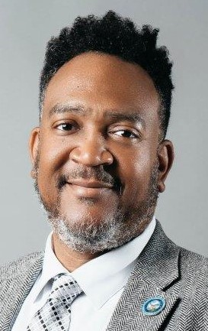
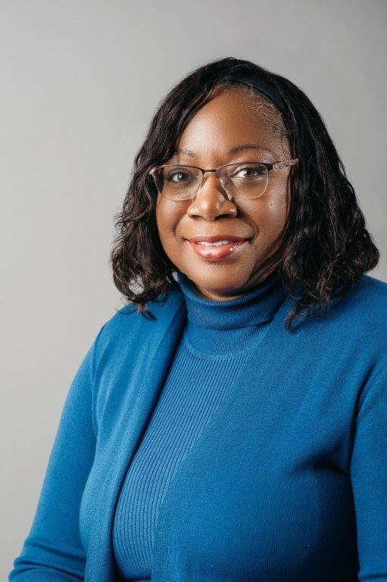
7. Provide FY26 proposed organizational chart with the total number of employees (i.e. permanent, temporary, contract, vacancies).
Audit Organizational Chart
Senior Auditor
Michael J. Maldonado
Office Assistance
Part-time
Rebecca Cruz
CITY AUDITOR
Terence J. Williams
Senior Auditor
Victoria Fuentes-Cox
Audit Manager
Tamara Thompson
Senior Auditor
Ariana M. Fleming
Senior IT Auditor
(Proposed)

Slide 16
Outline specific duties of each employee.
City Auditor-
  As the Chief Audit Executive, responsibilities include overseeing the department’s financial and operational activities and monitoring compliance of the established policies and procedures of the City. This is accomplished by conducting an annual risk assessment and presenting the annual audit plan to the Audit Review Committee. In addition, reporting results of completed audits and the status of risks being mitigated by City Management on a quarterly basis.
Audit Manager-
  Handles the day-to-day operations of the department. The Manager assists the City Auditor with planning the audit schedule, managing projects to ensure engagements are properly planned, staffed, and completed in accordance with Generally Accepted Government Auditing Standards. In addition, the Audit Manager ensures the staff are properly trained in the evolving needs of the audit profession and maintaining their continuing professional education requirements.
Office Assistant-
  Handles administrative, organizational and clerical support tasks.
Senior Auditor (3)-
  They are responsible for completing audit objectives by gaining an understanding of functional areas being audited. This is accomplished by interviewing process owners, documenting their understanding of the processes, identifying gaps / control weaknesses in processes and performing detailed testing. In addition, they are responsible for assisting Audit Management with developing audit reports and quarterly status updates for the Audit Review Committee.

