Slide 1


FY 2026 Budget Hearing
ECONOMIC DEVELOPMENT

Slide 2
FY 2026 Proposed Budget
General Fund | FY 2023 Actuals | FY 2024 Actuals | FY 2025 Budget | Proposed Budget FY 2026 | $ Change FY'26-25 | % Change FY'26-25
Personal Services | $417,973 | $476,246 | $578,087 | $620,951 | $42,864 | 7.4%
Materials, Supplies, and Equipment | 109,435 | 155,333 | 161,930 | 161,930 | 0 | 0.0%
Internal Services | 3,193 | 5,690 | 4,807 | 4,978 | 171 | 3.6%
Debt Service | 361,847 | 381,730 | 377,992 | 356,671 | (21,321) | -5.6%
SMBEO | 12,608 | 22,600 | 22,600 | 22,600 | 0 | 0.0%
Total | $905,056 | $1,041,599 | $1,145,416 | $1,167,130 | $21,714 | 1.9%
Staffing Level (FTEs) | 5.00 | 4.00 | 5.00 | 5.00 | 0.00 | 0.0%

Slide 3
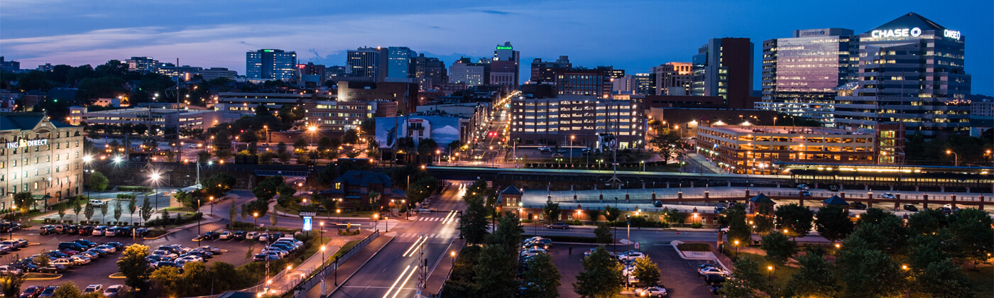
Departmental Overview
Identify Departmental Vision
  The Office of Economic Development (OED) is committed to ensuring a diversified local economy for the City by promoting and developing all varieties of industry and by initiating programs to increase job opportunities for residents of the City of Wilmington.

Slide 4
Departmental Overview
Top Priorities
  Complete DBE program updates
  Create and retain permanent private-sector jobs
  Stimulate private sector investment
  Increase productivity
  Increase the quality of life
  Grow the tax base
Notes:
Delaware Prosperity Partnership
OED Website
Regional Publications
Strategic Fund
Conversion of office to residential units
Downtown Development District
Architecture and Engineering Feasibility Studies
UDAG/CGC
Historic District Incentives
Property Tax Abatements

Slide 5
Question 1.
With the evolving changes regarding Federal Grant Funding, while understanding possible legal challenges, share if this budget addresses any contingency funds or planning for assisting small minority business programs and non-profits that could bare the most financial impact with regards to diversity, inclusion, etc. that perhaps could be on the chopping block for federal funding.
  a. Share the number of small minority businesses in the City of Wilmington.
  b. Share the number of businesses in the City of Wilmington.
  c. Share the number of non-profits in the City of Wilmington.

Slide 6
Question 1. Answer
Q: Share if this budget addresses any contingency funds or planning for assisting small minority business programs and non-profits
OED assistance for small minority businesses:
  Minority Business Strategic Fund Set-Aside
  SMBEO FY26 Budget: $22,600
  Consultant funds available to assist small businesses with business needs assessments, social media marketing strategy, funding application support
  Access to capital via WEDCO, True Access Capital, Grow Wilmington Fund
OED cannot offer funds for non-profit programming
Notes:
According to the SBA, small business is defined as less than 500 employees. In 2024, there were 104,457 small businesses in Delaware
78.68% of small businesses did not have employees
97.36% of small businesses had less than 20 employees

Slide 7
Question 1.a Answer
Q: Share the number of small minority businesses in the City of Wilmington
170 Minority Owned Small Businesses (Dun & Bradstreet, April 2025)
Notes:
According to the SBA, small business is defined as less than 500 employees. In 2024, there were 104,457 small businesses in Delaware
78.68% of small businesses did not have employees
97.36% of small businesses had less than 20 employees
DUNS number
Trade data
Data scientists
Public record
Business registration
SBA data sets

Slide 8
Question 1.b Answer
Q: Share the number of businesses in the City of Wilmington
2895 business licenses were issued in 2024
Industry Type | Business Licenses Issued in 2024
Construction | 231
Entertainment/Recreation | 158
Financial/Real Estate | 333
Non-Professional Services | 517
Professional Services | 1014
Retailers | 424
Travel/Lodging/Automotive Services | 136
Utilities/Public Services | 5
Wholesale/Manufacturer | 77
Total | 2895

Slide 9
Question 1.c Answer
Share the number of non-profits in the City of Wilmington.
922 active 501(c)(3) organizations in Wilmington (GuideStar, April 2025)

Slide 10
Question 2.
Considering that one of Council’s budget priorities is Economic Development, please share how this budget is in alignment with that priority by specifying the following:
a. Any funds specifically allocated for the Small Minority Business Program set aside from the Economic Development Strategic Funds.
b. Any fiscal budgetary funding set aside for fully implementing many of the recommendations from the Disparity Report that could perhaps increase business growth in Wilmington.
  i. Since this report has been issued, share if there has been any growth with Disadvantage Business Enterprise (DBE’s).
  ii. Provide list of certified DBE’s and the corelating industry.
  iii. Specify any funding set aside for tracking data.

Slide 11
Question 2.a Answer
Q: Any funds specifically allocated for the Small Minority Business Program set aside from the Economic Development Strategic Funds
Minority Business Strategic Fund Set-Aside: $350,000 approved in FY25

Slide 12
Question 2.b Answer
Q: Any fiscal budgetary funding set aside for fully implementing many of the recommendations from the Disparity Report that could perhaps increase business growth in Wilmington:
SMBEO FY26 Budget: $22,600
  Procurement events expected in FY26: True Access Capital Fair, SBDC Procurement Fair, New Castle County Diverse Vendor Fair, SBA Procurement Webinars, APEX Accelerator
  Turner Construction Class (Q3 2025)
  DBE Day Events with City Departments
Notes:
DBE Marketing Efforts
Continued participation in local vendor fairs and procurement related events
Targeted recruitment of DBE's using B2GNow data
Top vendor engagement events (4/16/2025)
Enhance OED and City websites to include procurement opportunities beyond bids
Engage local partners to help outreach and promote the DBE program
Actively matchmaking and conducing outreach to DBEs for opportunities
Supporting ecosystem partners procurement aligned activities (Wilm. Alliance, True Access Capital, WEDCO)
Department "DBE Days" - Public Works (May 6th)
Facilitate mentorships, partnerships and promote DBE participation on City supported projects
Work with local developers and successful prime contractors to source DBE participants on projects

Slide 13
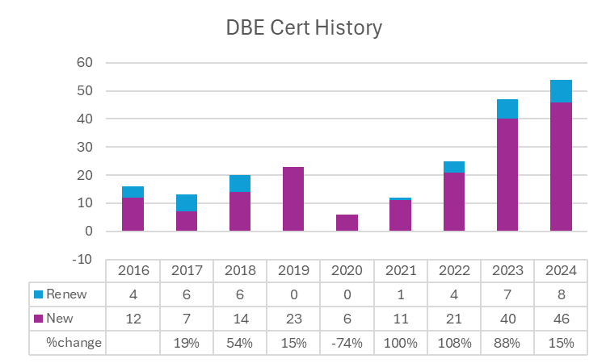
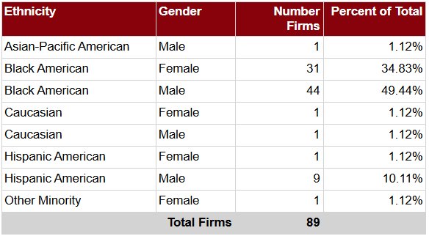
Question 2.b.i Answer
Q: Since this report has been issued (Feb 2023), share if there has been any growth with Disadvantaged Business Enterprise (DBE’s):
46 new DBE's certified CY 2024, 15% Increase YoY
8 renewals completed CY 2024

Slide 14
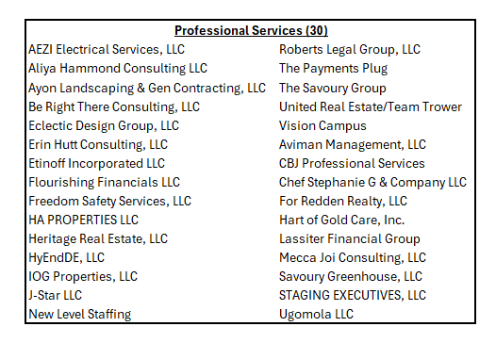
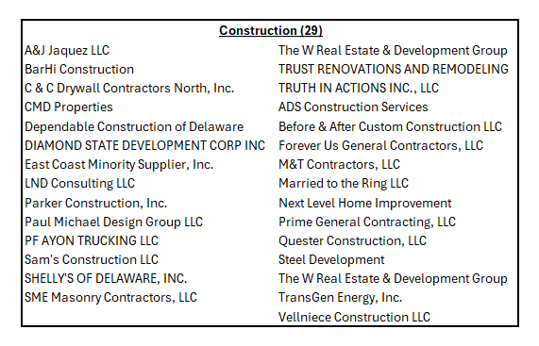
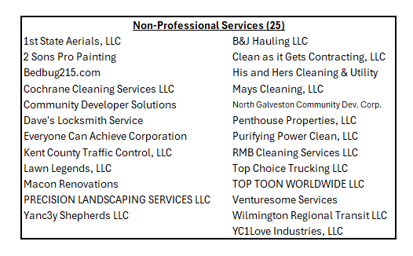

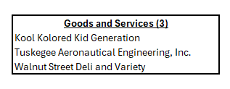
Question 2.b.ii Answer

Slide 15
Question 2.b.iii Answer
  Q: Specify any funding set aside for tracking data
  $40K within IT budget for FY ‘26 B2GNow subscription including the contract compliance module (implementation underway)
  ThirdLine to develop Procurement reporting including DBE dashboard
  DBE Administrator Position Hired FY '24: Salary moved from Finance into OED going forward
Notes:
OED utilized its remaining FY '24 SMBEO budget combined with our some of our consulting budget to implement B2GNow ($27,900). We are in the process of implementing the new online application, with expected release by July 1.
We worked with IT to move this expense ($40K) under the IT budget for FY '25 going forward. In addition to the yearly subscription, this brings us the online DBE certification module and a new contract compliance module, to be implemented mid FY '25.
Additionally, we have hired a DBE Administrator, who's salary initially fell under Finance dept., but going forward will report up within OED.
Lastly, we are considering ways to create a "DBE Fund" at WEDCO to create lines of credit for contractors bidding on or holding city contracts.

Slide 16
Question 3.
Since Wilmington UDAG Corp (WUC) entered into a Multi-Party Loan and Participation Agreement (MPLPA) with Grow America Fund, Inc. (GAF) and Discover Bank to establish a revolving loan fund (the Grow Wilmington Fund) intended to make loans to small businesses (Program Loans) in the City of Wilmington under the Small Business Act, please share the number of small businesses in Wilmington that has benefited from this collaboration within the last 2 years and the amounts.

Slide 17
Question 3. Answer
Q: Please share the number of small businesses in Wilmington that has benefited from this collaboration within the last 2 years and the amounts
Wilmington UDAG Corp entered into an agreement with Grow America Fund and Discover Bank in October 2014 to establish the Grow Wilmington Fund to make loans to small businesses in the City of Wilmington
  Total Loans Made: $4,287,000
  Number of Loans: 8
  Total Jobs Retained/Created: 78
  $481,773 in funds available to invest
Grow New Castle County Fund announced in April 2023
  $700,000 in loans approved for Wilmington businesses since April 2023
WEDCO loans within the last 2 years: $150,000, 5 businesses

Slide 18
Question 4.
Notwithstanding that OED’s FY2026 budget total ~$1.17M; share the percentage of this budget that are direct cost for the small minority business program.
a. Please specify all budgetary cost for the program.

Slide 19
Question 4.a Answer
Q: Please specify all budgetary cost for the program
SMBEO FY26 Budget: $22,600
  Procurement events expected in FY26: True Access Capital Fair, SBDC Procurement Fair, NCCo Diverse Vendor Fair, SBA Procurement Webinars, APEX Accelerator
  Turner Construction Class (Q3 2025)
  DBE Day Events with City Departments
Small Business Support:
  Support for property investment: Signage, Façade improvement, Architecture and Engineering Feasibility Studies, Critical Infrastructure (Strategic Fund)
  Business needs assessments (Consulting)
  Social media marketing strategy creation (Consulting)
  Program application support (Consulting)

Slide 20
Question 5.
Discuss the incentives the City of Wilmington offers to major and small businesses seeking to relocate to the City of Wilmington, as well as to attract and retains businesses to keep Wilmington competitive and on par.
a. Specify if any joint collaborative efforts with the State of Delaware, and if so, share if any funding allocations, etc.
b. Specify if any support for Cultural Restoration Project.
c. Specify number of new businesses within the last 2 years.
d. Any plans to make OED’s website more user friendly.
e. Share potential impact to Wilmington if SB# 33 passes:
  i. "This Act builds on the success of the Downtown Development Districts Act, Chapter 19 of Title 22 of the Delaware Code, by permitting a municipality with a population of 30,000 or more in the 2020 federal census, which includes Wilmington, Dover, and Newark, to designate an area in the municipality as a "Downtown Development Corridor". This Act also makes technical corrections to conform existing law to the standards of the Delaware Legislative Drafting Manual."

Slide 21
Question 5. Answer
Q: Discuss the incentives the City of Wilmington offers to major and small businesses seeking to relocate to the City of Wilmington, as well as to attract and retains businesses to keep Wilmington competitive and on par
Strategic Fund
Employment
Attraction
Retention
Property Investment
Architecture and Engineering Study
Façade Improvements
Operating Budget
Consulting
State Incentives
Delaware Prosperity Partnership
City Component Units
Local CDFIs
WEDCO
True Access Capital
Grow Wilmington Fund
Wilmington UDAG Corporation
Christina Gateway Corporation
Expansion
Capital Budget
Site Acquisition
Site Improvements
DCDC
Advertising
Division of Small Business
Transportation Infrastructure Investment Fund (TIIF)
Downtown Development District
Small business assistance
DETV
Strategic Planning
Business Xpansion Journal, Site Selector Magazine
Downtown Visions

Slide 22
Question 5.a Answer
Q: Specify if any joint collaborative efforts with the State of Delaware, and if so, share if any funding allocations
Delaware Prosperity Partnership
  Council on Development Finance
Division of Small Business
  Small Business Credit Initiative, EDGE grant
Transportation Infrastructure Investment Fund (TIIF)
  State Funds committed $4.67M for 7th Street Peninsula Infrastructure
Delaware State Housing Authority,
  Downtown Development District Round 16: $3,906,371 in reservation awards

Slide 23
Question 5.b Answer
Q: Specify if any support for Cultural Restoration Project
OED cannot offer funds for non-profit programming
  Cultural Restoration Project became a 501(c)3 organization in 2016
City ARPA funds committed: $150,000

Slide 24
Question 5.c Answer
Q: Specify number of new businesses within the last 2 years

Slide 25
Question 5.d Answer
Q: Any plans to make OED’s website more user friendly
OED will request a change in the City of Wilmington website to link to OED’s website: www.choosewilmingtonde.org.
In the first annual website audit conducted by Golden Shovel since the update was completed, the website received a letter grade of "A" in the categories of Usability, On-Page SEO, and Performance.
  Google Analytics for Q3 FY '25
    Total Users: 3,417
    Sessions per user: 1.23
    Engagement Rate: 55%
    Traffic from organic searches: 75%

Slide 26
Question 5.d Answer
Q: Share potential impact to Wilmington if SB#33 passes
According to the 2024 Delaware State Housing Authority Annual DDD report, since 2015 the State has invested $26.7M in completed projects leveraging $466M in Private Investment
  50 Large Projects, 54 Small Projects in Wilmington
  Current District Boundary: 275 Acres
Potential impact of SB#33 is contingent on the corridor location, increased acreage allowed, and State funding increases for the DDD program

Slide 27
Question 6.
Discuss the planned budgetary use for $1.8M fund balance in the Strategic Fund as of the latest Annual Comprehensive Financial Report, considering the fund balance has been a similar amount for the last 2 fiscal years.
a. Specify projects in the pipeline and anticipated revenues.
b. Specify the amount of cash infusions since inception.
c. Specify current amount committed.
d. Specify funding allocated for small business, minority business.
e. Specify amount of funds set aside for the Minority Business Development Program, and the available fund balance.
  i. Provide an update on amounts provided for program since inception.

Slide 28
Question 6.a Answer
Q: Specify projects in the pipeline and anticipated revenues
Of the three pipeline projects that are currently in progress, OED estimates that the City will receive roughly $40,685 in combined wage tax and permit fees.
These projects cumulatively account for about $1.9 million in private investment in the City.

Slide 29
Question 6.b Answer
Q: Specify the amount of cash infusions since inception
Strategic Fund
Established by legislation in 2002 to provide a “tool” to provide financial incentives to business
Purpose is to attract & retain jobs in city, modeled after State’s fund
Amounts based on number of jobs and wages
Payback from wage taxes
Performance requirements and claw-backs
Total Funding to date: $18,710,000
Total Returns to date: $158,804,171
2002
Initial Funding: $1.25M
2004
2007
Second Round: $1.53M
Third Round: $3.5M
2008
Fourth Round: $8.575M
2013
Fifth Round: $225K for Minority Business Set Aside
2020
Sixth Round: $1.25M ($250K Minority Business Set Aside)
2021
Seventh Round: $1.2M ($250K Minority Business Set Aside)
2023
Eighth Round: $1M ($300K Minority Business Set Aside)
2024
Tenth Round: $350K Minority Business Set Aside

Slide 30
Question 6.c Answer
Q: Specify current amount committed
Economic Development Strategic Fund
FY’25 Starting Fund Balance | $2,167,966
Expenditures | $(824,513)
Encumbrances | $(279,750)
Repayment | $300,000
Total Funds Available as of April 2025 | $1,363,703
Total Businesses FY '25: 20 Small/Minority Owned: 16 Minority Owned: 9

Slide 31
Question 6.d Answer
Q: Specify funding allocated for small business, minority business
Strategic funding allocated for small business, minority business in FY 2025.
Total amount of expenditures FY '25 | $824,513
Total amount of expenditure allocated to small/minority business FY '25 | $515,655
Percentage of total expenditures allocated to small/minority business FY '25 | 63%

Slide 32
Question 6.e Answer
Q: Specify amount of funds set aside for the Minority Business Development Program, and the available fund balance.
Minority Business Development Program
FY21 Infusion Set-aside | $250,000
FY22 Infusion Set-aside | $250,000
FY24 Infusion Set-aside | $300,000
FY25 Infusion Set-aside | $350,000
Total Set-aside | $1,150,000
FY21 Expenditures | -$211,370
FY22 Expenditures | -$81,316
FY23 Expenditures | -$153,424
FY24 Expenditures | -$370,000
FY25 Expenditures | -$371,743
(Additional Strategic Fund Contribution) | -$37,853
Total Expenditures | $1,187,853

Slide 33
Question 7.
Discuss the amount of revenues generated and collected directly as a result of the Office of Economic Development efforts for FY2023 through FY2025 year to date.

Slide 34
Question 7. Answer
Wage Taxes Collected from Strategic Fund Businesses
Calendar Year 2024 | $10,959,257.63
Calendar Year 2023 | $10,454,103.40
Calendar Year 2022 | $10,117,042.23
Total (2002-present) | $158,804,171.68

Slide 35
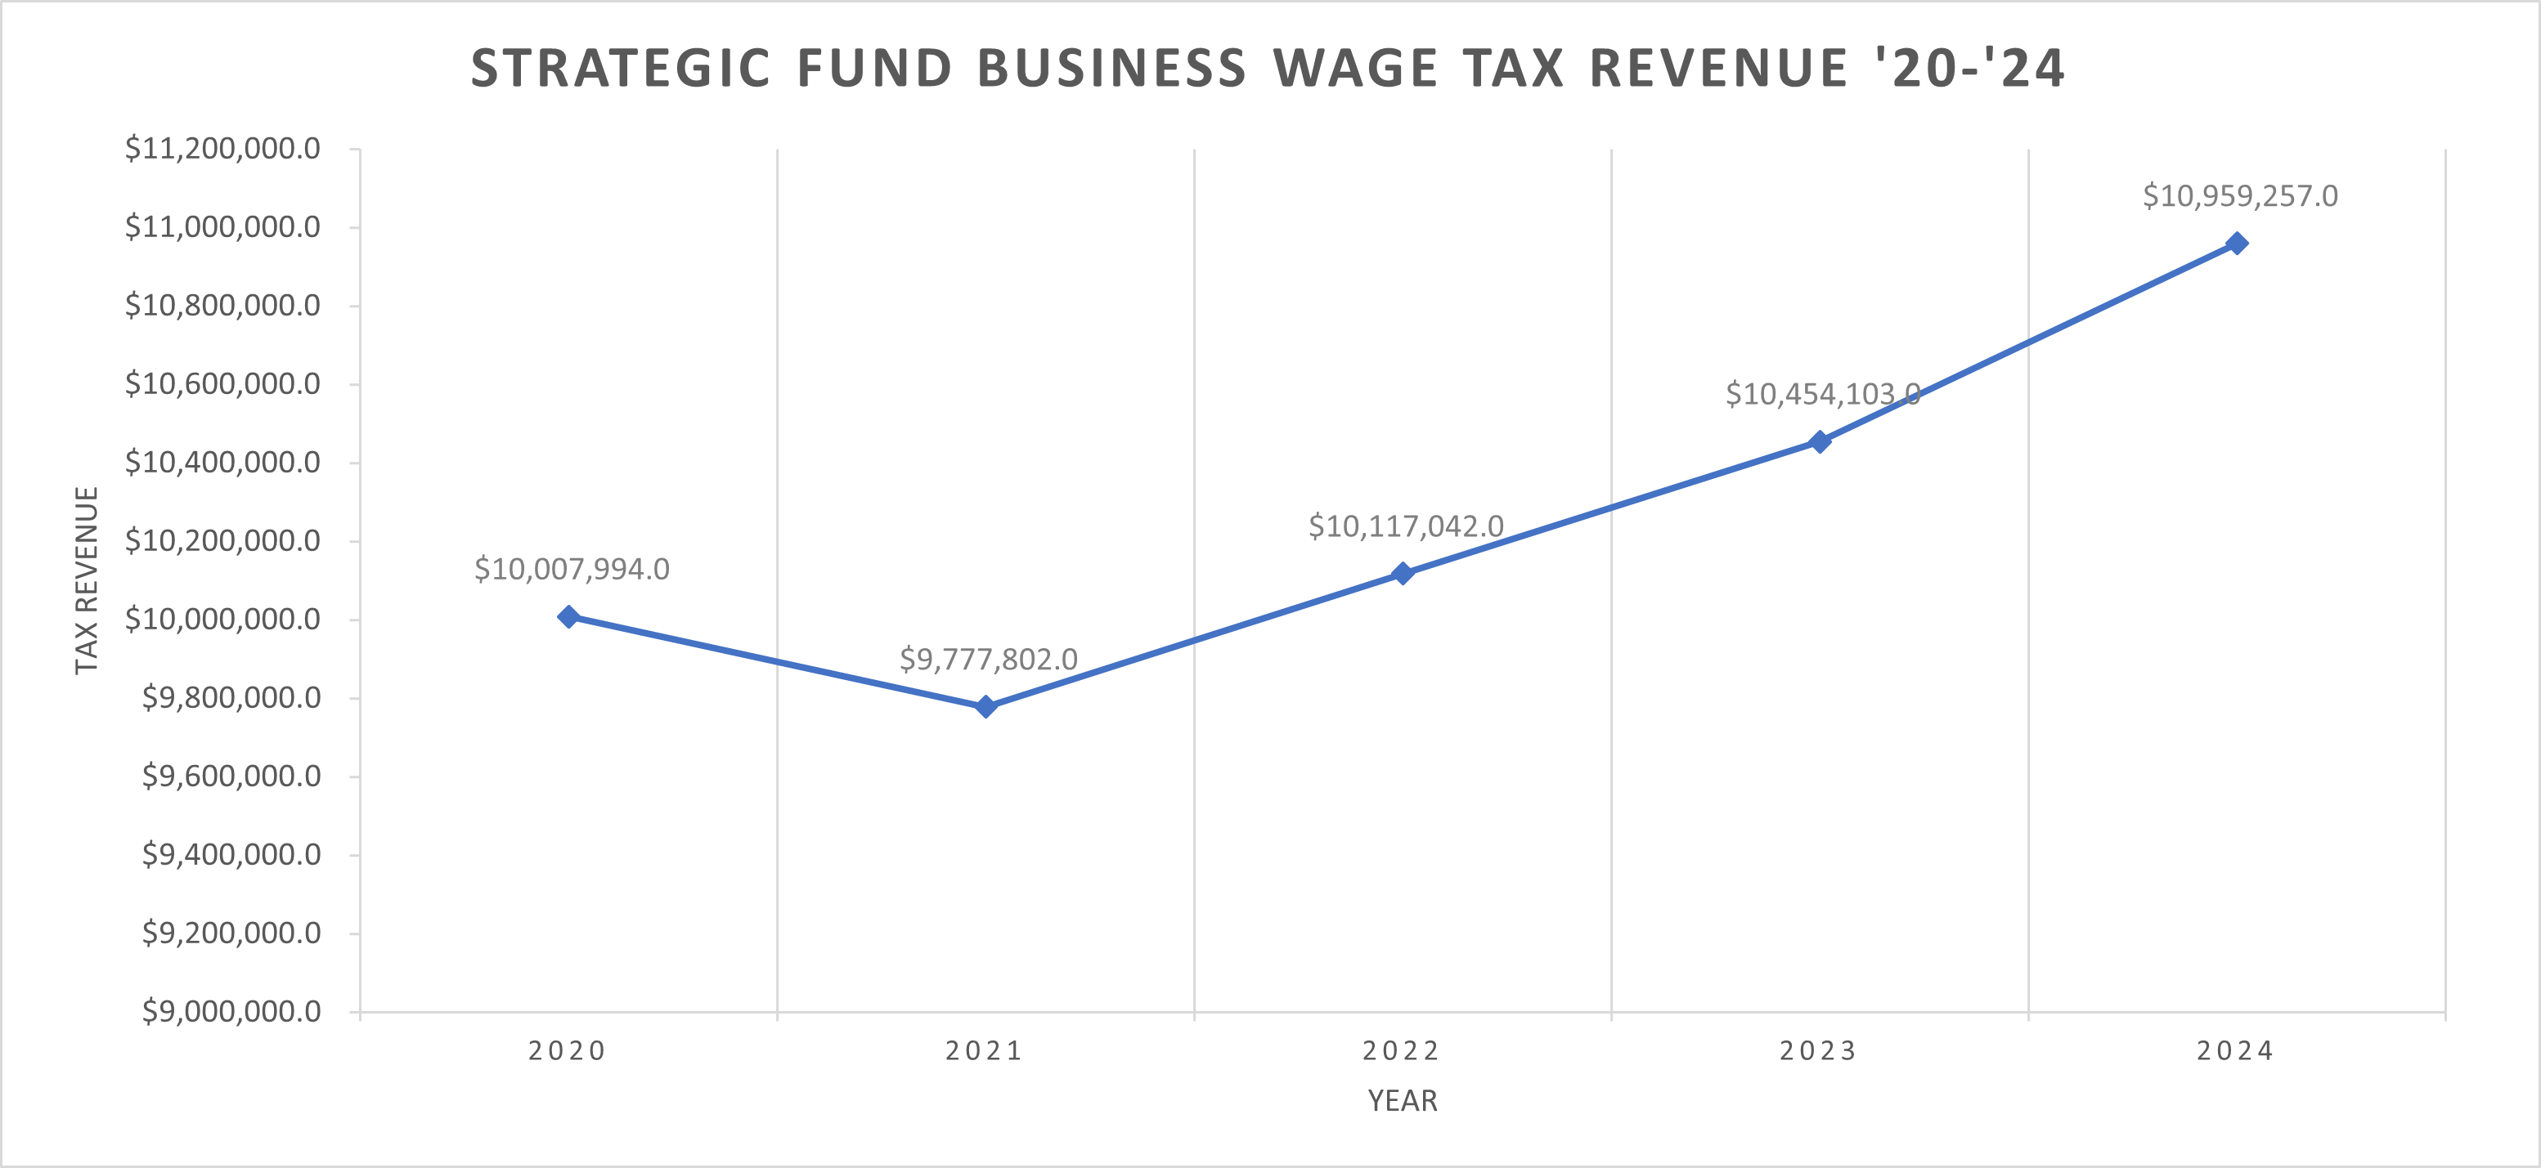
Question 7. Answer

Slide 36
Question 8.
Discuss the planned use of $110K budgeted for Consultants.
a. Specify any DBE’s.

Slide 37
Question 8. Answer
FY26 Consultants Proposed
Proposed Use | Amount
Consulting Support for Development & Infrastructure Projects | $95,000
Consultant services for SMBEO programing | $15,000
Total | $110,000

Slide 38
Question 8. Answer
Proposed Examples in FY26:
The Savoury Group (DBE): Business needs assessments
Aliya Hammond Consulting (DBE): Social Media Marketing Strategy development
Erin Hutt Consulting (DBE): Program application support
Golden Shovel: Economic Development website hosting and copywriting
Costar Realty Information: Real Estate software subscription
Dun & Bradstreet: Business Data subscription

Slide 39
Question 9.
Discuss the planned use for ~$16K budgeted for Advertising/Marketing.
a. Share the number of businesses the City marketed the last 2 years.

Slide 40
Question 9. Answer
FY26 Advertising Proposed
ADVERTISING
City-oriented advertising, website, & promotional content in local & regional publications | $12,000
Direct Billboard expense for LadyBug Festival 2025 | $1,700
Advertisement and promotion of City small & minority business initiatives classes and related outreach (in SMBEO) | $2,000

Slide 41
Question 9.a Answer
Q: Share the number of businesses the City marketed the last 2 years
Events:
  Restaurant Week FY24-25
  Black Restaurant Week FY24-25
  Lady Bug Festival FY24-25
  Brandywine Arts Festival FY24-25
Small Business Advertisement Support Partners:
  Greater Wilmington Convention and Visitors Bureau
  Downtown Visions
  King Creative
  DETV

Slide 42
Question 10.
Provide FY26 proposed organizational chart with the total number of employees (i.e. permanent, temporary, contract, vacancies).

Slide 43
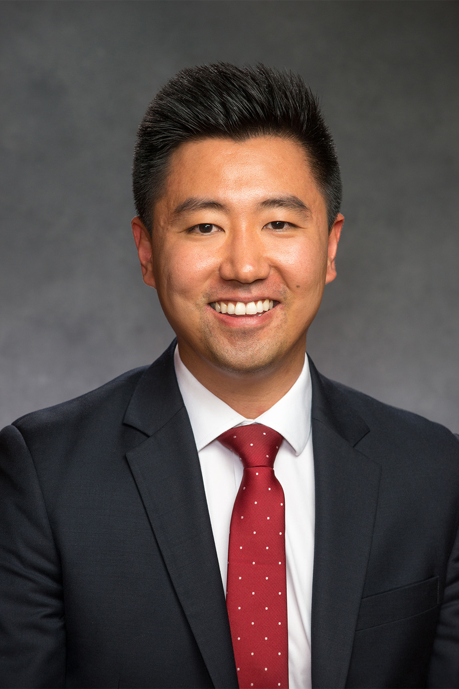
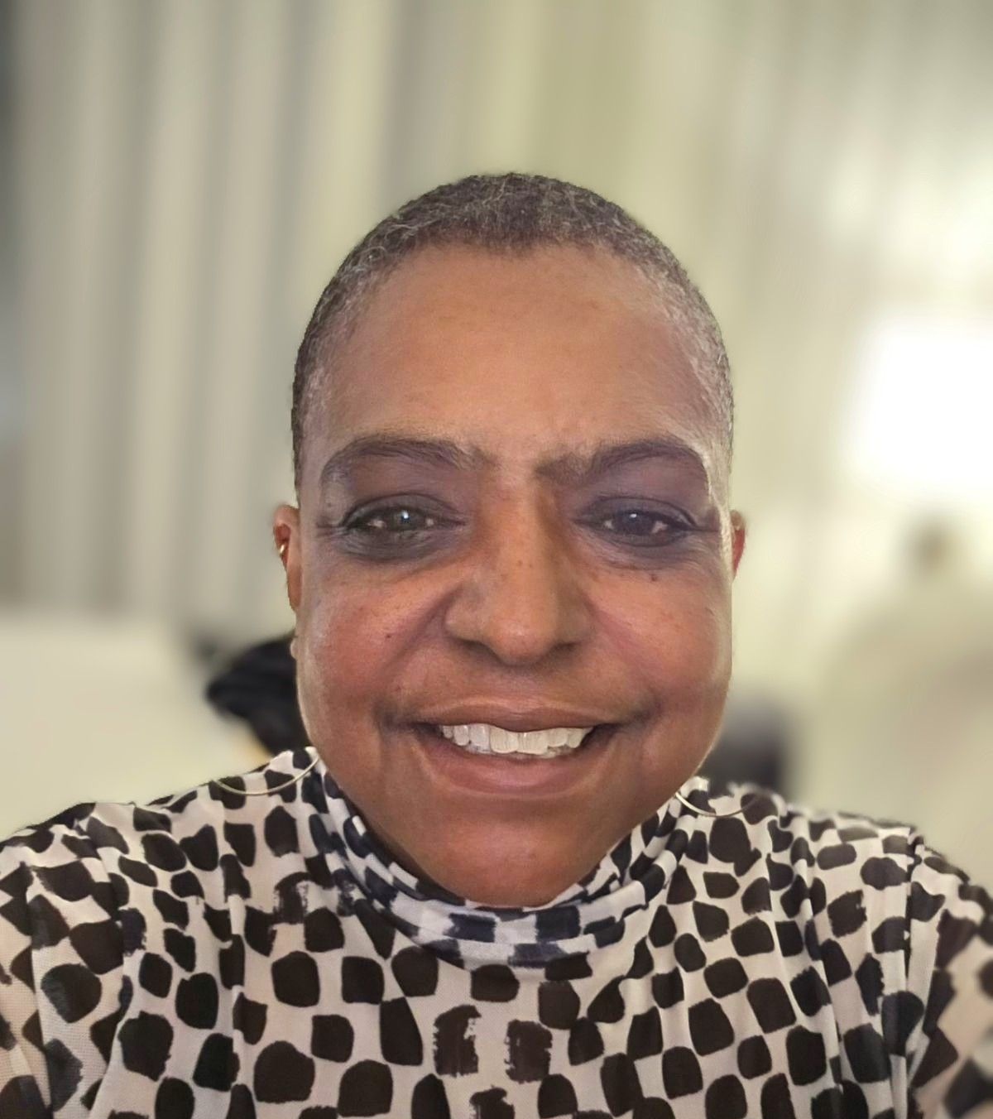
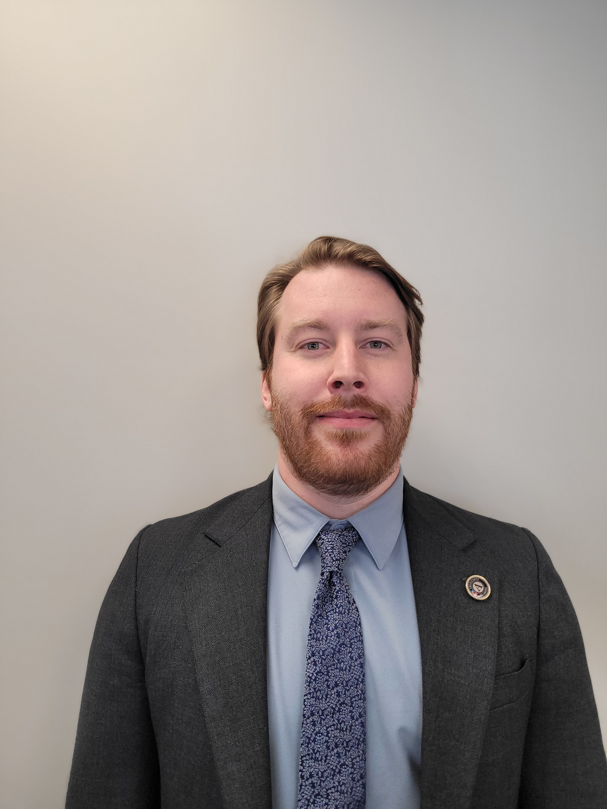
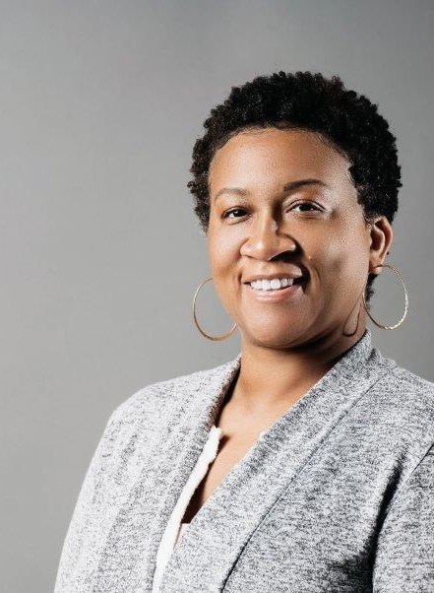
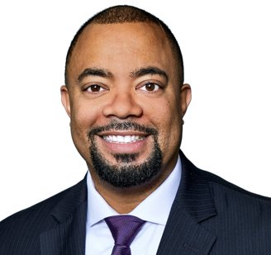
The Office of Economic Development Current Staff
Sean Park
Director*
5 Total Employees:
3 Appointed*
2 Merit
Marcie Moss
Administrative Assistant II*
Peter Weir
Economic Development Project Manager I*
James Williams
Small & Minority Business Development Manager
Shawnte Manning Disadvantaged Business Enterprise Analyst

Slide 44
Question 11.
Provide planned use of funding allocated for the following capital projects:
a. $500K Infrastructure and Site Improvement Closing Fund
b. $500K Site Acquisition

Slide 45
Question 11. Answer
a. $500K Infrastructure and Site Improvement Closing Fund
  Purpose: Provides funds for public infrastructure and site improvements. Eligible use include infrastructure expenses such as construction of new roads, utilities, site preparation work, and environmental remediation.
  Example: Right of way infrastructure improvements, Brownfields remediation
b. $500K Site Acquisition
  Purpose: Provides funds for land acquisition with a focus on preventing the expansion of undesirable commercial uses in underutilized and blighted areas.
  Example: Wetlands Park parcel acquisitions

