Slide 1


FY 2026 Budget Hearing
FINANCE DEPARTMENT

Slide 2
Combined Funds – Proposed FY 2026 Budget
Combined Funds | FY 2023 Actuals | FY 2024 Actuals | FY 2025 Budget | Proposed Budget FY 2026 | $ Change FY'26-25 | % Change FY'26-25
Personal Services | $7,514,874 | $7,994,938 | $8,614,437 | $9,044,308 | $429,871 | 5.0%
Materials, Supplies, and Equipment | 8,698,792 | 8,549,204 | 10,219,516 | 11,197,832 | 978,316 | 9.6%
Internal Services | 324,797 | 514,055 | 383,087 | 396,830 | 13,743 | 3.6%
Debt Service | 91,529 | 79,053 | 79,021 | 197,160 | 118,139 | 149.5%
Total | $16,629,992 | $17,137,250 | $19,296,061 | $20,836,130 | $1,540,069 | 8.0%
Staffing Level (Combined Funds FTE) | 81.00 | 84.00 | 83.00 | 84.00 | 1.00 | 1.2%

Slide 3
General Fund – Proposed FY 2026 Budget
General Fund | FY 2023 Actuals | FY 2024 Actuals | FY 2025 Budget | Proposed Budget FY 2026 | $ Change FY'26-25 | % Change FY'26-25
Personal Services | $5,007,848 | $5,361,817 | $5,595,232 | $5,784,322 | $189,090 | 3.4%
Materials, Supplies, and Equipment | 4,552,492 | 4,239,049 | 5,163,198 | 4,995,302 | (167,896) | -3.3%
Internal Services | 210,978 | 342,868 | 214,121 | 221,565 | 7,444 | 3.5%
Debt Service | 54,949 | 44,130 | 45,248 | 164,663 | 119,415 | 263.9%
Total | $9,826,267 | $9,987,854 | $11,017,799 | $11,165,852 | $148,053 | 1.3%
Staffing Level (General Fund FTE) | 55.40 | 56.60 | 54.80 | 55.15 | 0.35 | 0.6%

Slide 4
Major Funding Changes (General Fund Proposed Budget)
Personal Services Changes
Total positions up net 0.35 FTE
Database Manager position created (35% General Fund / 65% Water/Sewer Fund ) (↑$42,588)
Midyear Staff realignment (↑$43,553)
Regular Salaries (↑$166,042)

Slide 5
Major Funding Changes (General Fund Proposed Budget)
Materials, Supplies, and Equipment Changes: net (↓$167,900)
Temporary Agencies (↓ $15,000)
Consultants (↑ $70,000 )
Collection Expense-Legal, Sheriff Sale, & Other (↑ $200,000)
Collection Expense – Parking Citation Commissions (↓ $587,345)
Collection Expense - Red Light Camera Commissions (↑ $103,749)
Wage and Head Tax Audit (↑ $55,000)
Debt Service (↑ $119,415)

Slide 6
Water/Sewer Fund – Proposed FY 2026 Budget
Water/Sewer Fund | FY 2023 Actuals | FY 2024 Actuals | FY 2025 Budget | Proposed Budget FY 2026 | $ Change FY'26-25 | % Change FY'26-25
Personal Services | $2,507,026 | $2,633,121 | $3,019,205 | $3,259,986 | $240,781 | 8.0%
Materials, Supplies, and Equipment | 4,146,300 | 4,310,155 | 5,056,318 | 6,202,530 | 1,146,212 | 22.7%
Internal Services | 113,819 | 171,187 | 168,966 | 175,265 | 6,299 | 3.7%
Debt Service | 36,580 | 34,923 | 33,773 | 32,497 | (1,276) | -3.8%
Total | $6,803,725 | $7,149,386 | $8,278,262 | $9,670,278 | $1,392,016 | 16.8%
Staffing Level (Water/Sewer Fund FTE) | 25.60 | 27.40 | 28.20 | 28.85 | 0.65 | 2.3%

Slide 7
Major Funding Changes (Water/Sewer Fund Proposed Budget)
Personal Services Changes
Total positions up net 0.65 FTE
Database Manager position (65% Water/Sewer Fund/ 35% General Fund ) added (↑$79,091)
Midyear Staff realignment (↑$44,328)
Regular Salaries (↑$161,281)

Slide 8
Major Funding Changes (Water/Sewer Fund Proposed Budget)
Materials, Supplies, and Equipment Changes: net (↑$1,146,212)
Consultants (↑$30,000 )
Miscellaneous Charges-N.O.C (↓$75,000)
Contracted Maintenance Services (↑$147,808)
Collection Expense-Legal, Sheriff Sale, & Other (↑$60,000)
Indirect Cost Charges (↑$827,096)
Computer Software Licenses (↑$147,808)

Slide 9
Finance Department
Mission Statement
“Excellence in Financial Management”
The Financial Department preserves the financial integrity of
the City of Wilmington through excellence in accounting services,
customer service and financial management.

Slide 10
Vision Statement
Enhance community engagement and customer service to support residents in accessing City of Wilmington services and resources
Ensure reliable accounting practices with strong quality control and assurance.
Streamline collection processes to maximize revenue generation.
Implement best practices to improve business processes, optimize data management, and leverage technology effectively.

Slide 11
The Department of Finance processes over 1.3 million transactions each year
Bills Issued = 874,104
UB Payment processed= 586,178
Total Payment processed = 658,653
311 Calls = 63,152
Parking Tickets= 45,916
Redlight Tickets Issued = 59,065
Vendors Served = 21,323
Accounting Transactions = 42,723
AP Invoices = 9,668
Delinquent Accounts Processed = 12,677
Net Profits Processed =1,663
Move Ins Processed = 2,975
Vehicles Booted= 4,069
Cars Towed = 437
Settlements Processed = 6,800
Contracts Bid = 39

Slide 12
  Questions & Answers

Slide 13
Question 1.
Understanding the City has the responsibility to ensure that Indirect Cost adequately reflect the
best usage for services that are aligned with the Water Sewer Fund, please justify the ~$8.5M
(WSF) budgeted citywide for Indirect Cost, down ~$600K from the previous year’s budget, yet
while realizing the FY26 proposed Water and Sewer Rate Increase of 6.5% and Stormwater for
6%. Please explain, considering that Indirect Cost for the Finance Department has increased
~$827K (WSF).
a. Specify the frequency for how often the indirect cost study is done.
b. Specify the direct correlation to the impact of Water, Sewer, and Stormwater Rates, considering a rate increase has been done each year for the last 5 years.
c. Specify if the indirect cost allocation is a standard governmental best practice for cities of
a similar size as Wilmington with a water utility

Slide 14
Question 1.
A) Specify the frequency for how often the indirect cost study is done.
Comprehensive indirect cost allocation studies are commonly performed once every five years or so and/or whenever there are any material departmental changes within a municipal government’s organizational structure. The comprehensive study helps define an allocation plan which is then used by municipalities to update and allocate indirect cost budgets to the enterprise fund departments.
B) Specify the direct correlation to the impact of Water, Sewer, and Stormwater Rates, considering a rate increase has been done each year for the last 5 years.
The OMB uses its Indirect Cost Allocation Plan to first determine the O&M indirect cost budget allocation for each direct division of the 421 Water/Sewer Fund. Then, the water, sewer, stormwater O&M costs inclusive of the indirect costs along with all other revenue requirements such as capital costs and reserves determine the level of annual rate increases that are needed. Therefore, while the O&M indirect costs allocated each year to the water, sewer, and stormwater utilities are an integral part of the total water/sewer fund cost increases, the magnitude of the allocated indirect cost increase could be higher or lower than the annual water/sewer and stormwater rate increases.
C) Specify if the indirect cost allocation is a standard governmental best practice for cities of a similar size as Wilmington with a water utility.
The indirect cost allocation (referred also as pricing of internal services) is a governmental best practice that is adopted widely in the public sector, where an Internal Service Fund and/or General Fund provides services to an Enterprise Fund such as the utilities. Therefore, the operating budgets of water/sewer utilities include indirect costs. Attached are a couple of resources that provide an overview of governmental best practices for determining and allocating indirect costs to enterprise fund departments.

Slide 15
Question 2.
While understanding one of Council’s FY2026 Budget Priorities is Financial Sustainability, which is the reason Council codified Ord# 23-019, (“Funding for the water utility assistance program shall derive each fiscal year from an appropriation contained in that fiscal year’s annual operating budget ordinance. The amount of funding for each fiscal year's water utility assistance program shall be an amount that is no less than one percent of such fiscal year’s water/sewer fund operation and maintenance reserve.”), please discuss the $250K (WSF) budgeted for the Utility Assistance Program, considering $350K was budgeted in FY2025.
a. Specify the number of households that has used this program since inception, per fiscal year.
b. Specify the amount of funds expended for the Utility Assistance Program since inception, per fiscal year.
c. Justify if $250K is adequate.
d. Specify amount of funds in the water/sewer fund operation and maintenance reserve.
e. Specify how the program is advertised.

Slide 16
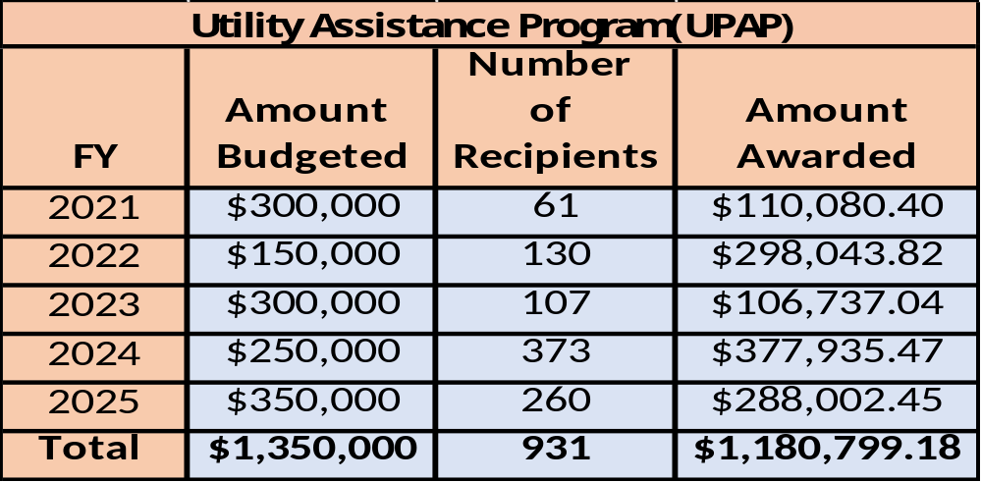
Question 2.
The Utility Assistance Program was launched in 2021 to help constituents facing difficult situations. Through advertisements in the City’s utility newsletter, on the City’s website, and through social media campaigns, this program has successfully assisted close to 1,000 households, distributing a total of $1.4 million. We will continue to use all awarded funds to support eligible constituents. Current unpaid utility over 90 days past due is $19,774,497.
Low Income Household Water Assistance Program (LIHWAP) January 2022 through July 2023
 | Amount Requested | Number of Recipients | Avg Amount Awarded
Total | $1,871,557.56 | 847 | $2,209.63

Slide 17
Question 3.
Realizing the challenges the City has endured with the MUNIS financial system over the years, discuss the $200K in the proposed budget for a new ERP System regarding a study in the Misc. Services account line (WSF), considering a similar amount for $200K was budgeted in the previous year.
a. Discuss the $2,970,000 in the FY26 Capital Budget for updating the ERP Financial Systems.
b. Specify the approximate timeframe schedule for implementation, considering the city is
typically delayed when going to the bond market.
Funding in FY 2025 was used to a) evaluate the current MUNIS system for efficacy and obsolescence and b) construct a gameplan, timeframe and cost estimate for a new ERP approach.
FY 2026 funding will be used for a) development of the solicitation for potential vendors for a new system; b) consultant services for project management; and c) actual ERP system components. Focus will initially focus on human resource and financial accounting functions. We will begin on July 1 utilizing Bond Anticipation Notes, which will be redeemed when we go to the public markets in the Fall of 2025.

Slide 18
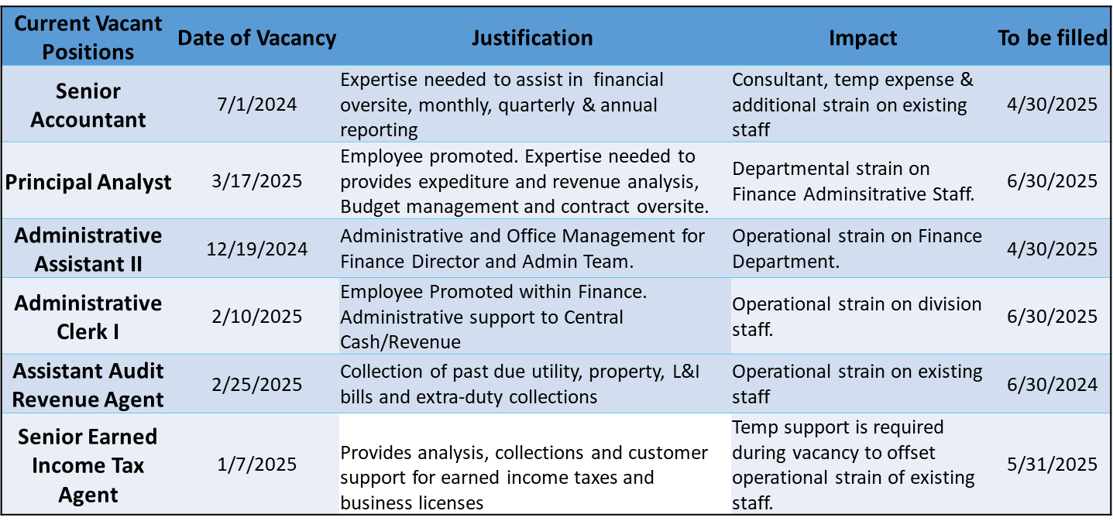
  Question 4.
Discuss current vacant positions.
a. Specify duration of the vacancy.
b. Specify timeframe for filling position.
c. Specify if position generates revenue, and if so, estimated amount.
d. Specify any impact to Overtime, Temp Agency, and or Consultants.
e. Justify the need for the position.

Slide 19
  Question 5.
Discuss any proposed changes to positions (new position, deleted position, upgrade, realignment,
transition, downgrade, title change, salary changes, etc.).
a. Specify if the new Database Manager position has any correlating impact with revenue generating, and if so,
please share.
b. Considering the FY26 proposed 6.5% water rate, and 6% stormwater increase, justify the necessity for the new Database Manager position particularly since the cost for this new position is split funded 65% Water Sewer
Fund and 35% General Fund, in other words heavily funded by the Water Sewer Fund.
This role is will focus on cleaning up the data, thereby provide efficiencies within our billing systems and making customer billing more accurate. Due to our operational frequency of monthly utility billing, the position funding allocation is appropriate. By optimizing our data management, we can enhance operational effectiveness and maximize profitability. It is expected that funds saved and recovered as a result of better data management will far exceed the cost of the position. In addition, having a qualified technologist to support a multi-million information system is necessary.
Position | General Fund | Water Fund | Total
Database Manager | $42,588 | $79,092 | $121,679

Slide 20
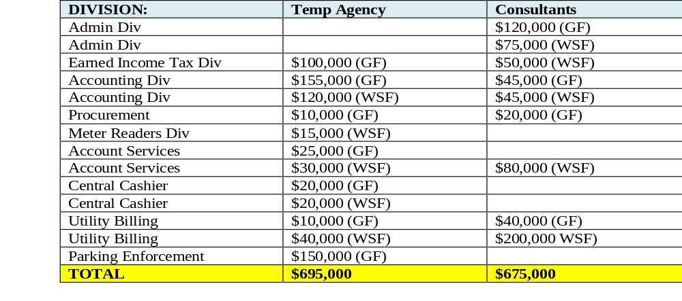
  Question 6.
Discuss the planned use for ~$1.370M in Professional Services (Temp Agencies and Consultants),
up ~$85K over the prior year’s budget ($745K General Fund, $625K Water Sewer Fund), in conjunction
with a proposed budget for 84 FTE’s.
a. Specify vendor name, length of contract, amount, and purpose for all Consultants.
b. Specify if any vendors are DBE’s.
c. Specify any reoccurring one-year agreements.
d. Specify number of Temps per Division.
e. Please explain funding allocated for the Water Billing Technology implementation, as well as the CIS
System Support for GO-Live.

Slide 21
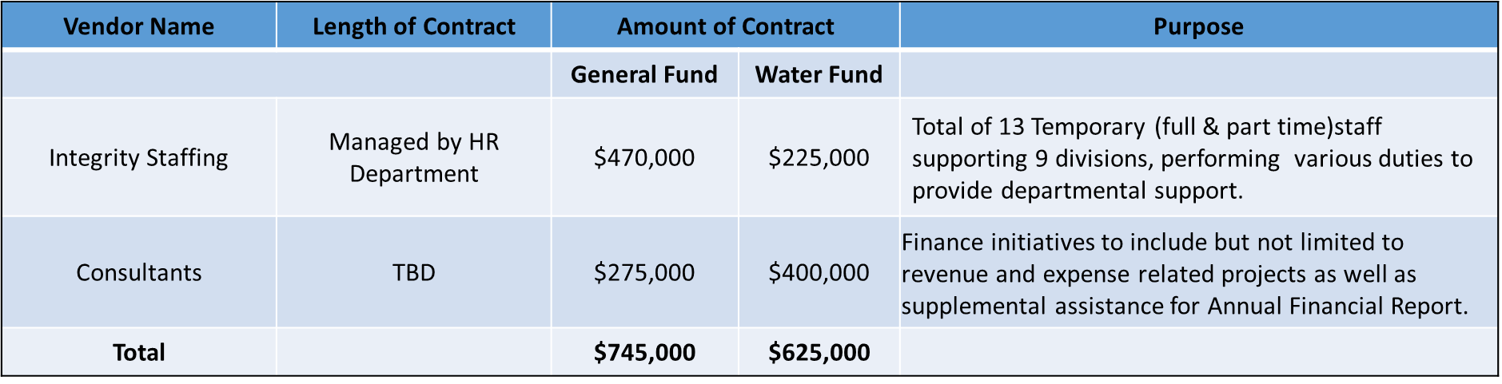
  Question 6.
Discuss the planned use for ~$1.370M in Professional Services (Temp Agencies and Consultants),
up ~$85K over the prior year’s budget ($745K General Fund, $625K Water Sewer Fund), in conjunction
with a proposed budget for 84 FTE’s.
a. Specify vendor name, length of contract, amount, and purpose for all Consultants.
To be answered later in presentation
b. Specify if any vendors are DBE’s.
Not at this time.
c. Specify any reoccurring one-year agreements.
Integrity Staffing (HR Contract)

Slide 22
  Question 6.
d. Specify number of Temps per Division.
Division | Allocated Temporary Support
Administration | 0
Earned Income Tax | 2
Accounting | 3
Procurement | 1
Account Services | 1
Central Cash | 1
Billing | 2
Parking | 3
Total | 13
e. Please explain funding allocated for the Water Billing Technology implementation, as well as the CIS
System Support for GO-Live.
The Utility Billing Customer Information System was funded through Capital Improvement Funds, which allocated $5.4 million for the project. We remain within budget and on schedule for a Go-live date of July 7th.

Slide 23
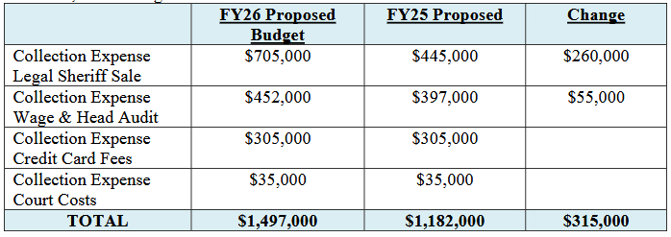
  Question 7.
While realizing the significance of the amount of funds that are overdue to the City of Wilmington from outstanding collections, which is partially accounted in the Revenue Projections, discuss the budgetary resources allocated for collection efforts across both General and Water Sewer Funds for ~$1.5M, and specify the return on investment for both internal and external costs, considering cost has increased ~$315K:
a. Specify vendor name, length of contract, amount, and purpose.
b. Specify if any DBE’s.
c. Specify any reoccurring one-year agreements.
d. Specify ROI for FY23, FY24 and year to date.
e. Specify the uncollectable amount for collections.

Slide 24
  Question 7.
a. Specify vendor name, length of contract, amount, and purpose.
b. Specify if any DBE’s. Not at this time
c. Specify any reoccurring one-year agreements.
Vendor Name | Length of Contract | Amount of Contract |  | Purpose
 |  | General Fund | Water Fund
Avenu Insights | 07/01/2024-06/30/2025 | $200,000 | $0 | Collections through audits and discovery of wages, heads, net profits, lodging taxes, and business licenses.
Thomas Reuter | 07/01/2024-06/30/2025 | $7,000 | $5,000 | Web – based skip tracing service
Manning, Gross + Massenburg, LLP | 07/01/2022 -06/30/2022 | $200,000 | $300,000 | To take necessary and reasonable actions to collect outstanding receivables owed to the City of Wilmington.
Paymentus | 07//2020-12/20/2023 w/ 3 one-year extensions | $125,000 | $180,000 | Online payment processing and bill presentment system.
Giordano, DelCollo, Werb & Gagne, LLC | 07/01/2024-06/30/2025 | 450,000 | $25,000 | Court cost associated with collections and sheriff sales
Blindsight | 08/01/2024-06/30/2025 | $100,000 | $350,000 | 311 services
Utility Assistance Program | TBD |  | $300,000 | Funding to assist constituents with water expenses

Slide 25
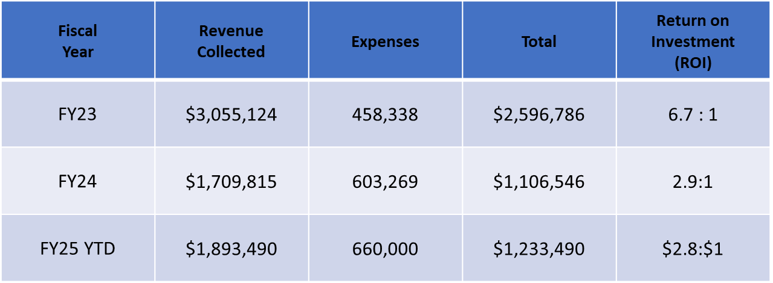
  Question 7.
Specify ROI for FY23, FY24 and year to date.
NOTE: For contracts only.
Specify the uncollectable amount for collections.
Total delinquency for the City, with accounts overdue 91 days or more, is $35,535,050. Of this amount,
$19,774,497 (55%) is related to water services. In FY 2024, our Account Services team collected
$16.1 million in arrears. Our Wage Tax team collected $1.7 million in back earned income taxes.

Slide 26
  Question 8.
Discuss the planned use for $525K (WSF) in the Central Cashier Division regarding the Citywide 311 Initiative, up $25K over the prior year’s budget.
a. Share rationale for why this cost is funded 100% WSF.
The Citywide 311 is funded 100% by the Finance Department Budget. Call inquiries for Finance and/or Public Works are primarily utility related which corelates to the allocation. [shift narrative to split funding]

Slide 27
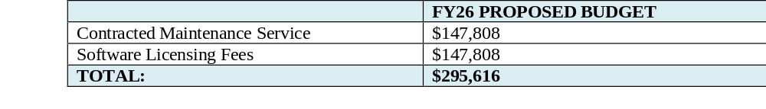
  Question 9.
For the UBCIS cost budgeted within the Contracted Maintenance and Computer & Software Licenses account line in the WSF for $295,616, please discuss this new additional cost:
Specify if this is item is a potential capital project.
This licensing and maintenance expense is for servicing and maintaining the UBCIS Software, and it will be included in future annual budgets for the next five years. Upgrades are included in the system, thereby saving money on changes to software versus on an ad-hoc basis.

Slide 28
  Question 10.
Discuss the planned use of ~$2.94M budgeted in Commissions account lines:
ACCOUNT LINE | FY24 BUDGET | FY25 PROPOSED | Change
False Alarms Commissions | $70,000 | $70,000 | $0
Parking Citations Commissions | $990,000 | $1,577,345 | -$587,345
Red Light Commissions | $1,853,702 | $1,749,953 | $103,749
Total | $2,913,702 | $3,397,298 | -$483,596
a. Specify vendor name, length of contract, amount, scope and purpose.
b. Specify if any vendors are DBE’s.
c. Specify any reoccurring one-year agreements.
d. Specify revenues collected for FY2023 to year to date and projected for FY26 per each commission category and
amount outstanding.
e. Specify statistics for FY2023 to year to date for number of parking citations issued/ paid/outstanding as a result
of the Auto Vu Mobile License Plate Technology (OVN notices), and the number of vehicles booted and towed.
f. Specify statistics for FY2023 to year to date on number of red-light tickets (video enforcement)
issued/paid/outstanding per year and the number of vehicles booted and towed.

Slide 29
  Question 10.
Revenue Source | Vendor Name | Length of Contract | Amount of Contract | Scope | Purpose
False Alarms | CryWolf | 7/1/2024-6/30/2025 | Fixed Percentage of 30% Superion and 70% for the City of Wilmington | Maintain, manage and provide billing consistent with City’s Alarm Ordinance | Alarm Registration and management services
Parking Citations | Passport | 9/1/2024 – 3-year agreement with possible two, one(1) year extension | Fixed Rate: $75K per month | Parking citation database management and collection service system and support on a real-time basis. To include online appeals, customer services, collections with payment arrangements A web-based residential permit application process for residents to obtain digital parking permits, that can be used with license plate recognition technology for enforcement. | Parking violation services , Digital Residential Parking Permits System , Call Center and Collections Services.
Parking Citations | State of Delaware | Memorandum of Understanding | $90,000 | State of Delaware provides collection assistance to the City for severely delinquent drivers, for traffic violations only. | DMV registration hold
Parking Citations | PayLock/IPT, LLC’S | 1/28/2025 – 1/28/2026 |  | Provide booting software and equipment along with 24hrs/7days a week customer service for release and payment collections | Booting services
Red Lights | Elovate (formerly Conduent) | 04/01/2025-03/31/2026 | Fixed Rate: $1,800,000 annually | Traffic signal violation photo monitoring and enforcement. | Traffic signal violation monitoring system

Slide 30
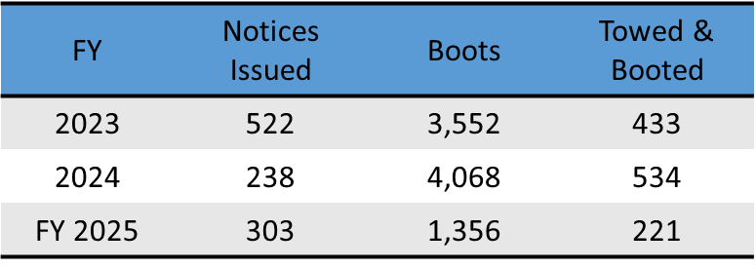
  Question 10.
d. Specify revenues collected for FY2023 to year to date and projected for FY26 per each commission
category and amount outstanding.
e. Specify statistics for FY2023 to year to date for number of parking citations issued/ paid/outstanding as a result of the Auto Vu Mobile License Plate Technology (OVN notices), and the number of vehicles booted and towed.
f. Specify statistics for FY2023 to year to date on number of red-light tickets (video enforcement) issued/paid/outstanding per year and the number of vehicles booted and towed.
Revenue Source | FY2023 | FY2024 | FY2025 YTD | FY2026Projected
False Alarms | $117,185 | $113,959 | $69,993 | $152,087
Parking Citations | $2,974,991 | $2,661,640 | $808,904 | $2,670,287
Red Lights | $4,344,311 | $4,731,004 | $1,259,032 | $4,244,010
Total | $7,436,487 | $7,506,603 | $2,137,928 | $7,066,384
Booting and OVN is determine by the combined total of citations/violations, so the data is currently not available.
As of November 2024, OVN was dissolved.

Slide 31
  Question 10.
g. Specify number of parking citations issued per year by PREO’s for FY23, FY24, and year to date (list amount
paid/outstanding per year).
h. Specify the number of participants per year for the digital parking permit program for the last 2 years.
In FY24 there were 4,500 active permits, FY25 YTD there are 9,476.
i. Specify the number of DMV red-light registrations HOLDs done per year for the last 2 years, and amount
collected/outstanding as result of DMV holds per year for the last 2 years.
FY2023 PREO Issuance | FY2024 PREO Issuance | FY2025 PREO Issuance YTD
50,869 | 45,916 | 29,082
Red Light Registration Holds
 | FY24 | FY25 YTD
Collection | $572,351 | $292,779
Outstanding* | $749,342 | $137,289
*Based on FY issuance

Slide 32
  Question 10.
j. Specify the ROI for the commissions categories.
Law firm assisting with collections: There is a 30% commission associated with the firm as a result of filing of cases in court. Otherwise, the firm is paid on a flat fee for monition and court filings and distribution of collection letters (wage tax).
k. Specify projected impact to this budget if any for the new one-year towing contracts.
The towing contract will be renewed on July 1, 2025 (we provided a three-month extension to the contract to make it co-terminus with the fiscal year and to accommodate any changes in the contract terms due to the settlement). There are no expected changes to the budget for FY 2026 with the new contract. It is anticipated that, as last year, towing companies will charge customers for tows.
l. Specify the number of redlight cameras down during CY2024, and year to date CY2025, and specify any impact to revenue.
CY2024 – 12 camera’s
CY 2025 - 9 camera’s

Slide 33
  Question 11.
Discuss the $525K budgeted for Lockbox Charges ($200K GF, $325K WSF).
a. Justify the rationale for higher cost allocation to the water sewer fund for this charge.
Lockbox charges dropped from a high of $421,000 (FY 2024) to $360,000 in FY 2026 due to drop in mail in payments as customers shift to online payments.
  Question 12.
Discuss the overall growth to the Finance Department’s budget from FY22 to FY26, as to the percentage of growth immensely to the Water Sewer Fund, compared with less growth to the General Fund. Please explain.
The primary drivers of the increases to the Water Sewer Fund from FY 2022 to FY 2026 are:
Standard personnel cost growth of salaries and benefits ($761,755)
Indirect Costs supporting operational services to the Water Sewer Fund ($1,123,151). The indirect cost study was refreshed in FY 2025 from previous estimates in FY 2020. Monthly billing of utilities and all costs associated with the process has increased the budget.
ERP Study Costs ($200,000)
UPAP Program ($250,000)
311 Services ($500,000)
UBCIS and Salesforce Licenses ($400,000)

Slide 34
  Question 13.
Share the methodology that is used to determine how 84 full time positions in the Finance Department could be split funded, 55.15 FTE’S in the General Fund, and 28.85 in the Water Sewer Fund. Please explain.
If a position is directly servicing utility customers or indirectly providing support to direct support personnel, then it is included in either the direct costs or indirect costs.
It is useful to consider the types of customers that the Department of Finance serves. For example, there are approximately 40,000 utility customers who receive monthly bills. This produces over 480,000 bills printed and distributed (Billing Division) and subsequently processed and reconciled when paid (Central Cashiering and Customer Service). In addition, the majority of our collection activity (Account Services and legal partners) encompasses utility delinquencies totaling $19 million.

Slide 35
Question 14.
All Departments
Provide FY2026 proposed organizational chart with the total number of employees (i.e. permanent, temporary, contract, vacancies).
a. If there are multiple divisions, please ensure there are sub-org charts that enumerate all the above.

Slide 36
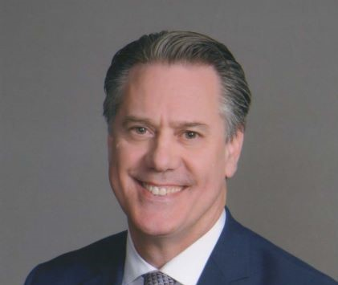

Director of Finance
J. Brett Taylor
Principal Analyst
Procurement Manager
Accounting Manager
Deputy Director
Lois McLaughlin
Customer Service Manager
Senior Financial Officer
Tax
Manager
Procurement
3
Accounting
7
Accounts
Payable
5
Central Cashier
10
Earned Income
Tax
9
Revenue Audit
3
Administrative Assistant
Billing
Manager
Billing
9
Account Services Manager
Account Services
7
Parking Service Manager
Parking Enforcement
14
Meter Readers
2
Database Manager (Proposed)

Slide 37
Accounting | Administration | Billing
Annual Financial Report Accounts Payable Bank Reconciliation Grant Accounting Water Fund Accounting GL Account Analyses | Executive Support Contract Management Personnel Reporting Data Analytics MUNIS Support | Utility Real Estate Tax Meter Reads Police & Fire Extra Duty
Central Cashier | Account Services | Earned Income Tax
Payment Processing Customer Call Center Digital Residential Parking Permits | Sheriff Sales Payment Agreements Collections Task Force | Wage Tax Head Tax Revenue Audit Net Profits Tax Business License

Slide 38
Parking Enforcement | Procurement
Parking Citations Red-light Violation Program Booting Program Digital Residential Parking Permits | Bid Notification Vendor Database Proposal Review Sale of City Surplus Equipment
Staff of 84 Full-time Employees
Temporary Staff of 13
Vacancies 6

Slide 39
Thank You!

