Slide 1


FY 2026 Budget Hearing
INFORMATION TECHNOLOGIES

Slide 2
FY 2026 Budget
General Fund | FY 2023 Actuals | FY 2024 Actuals | FY 2025 Budget | Proposed Budget FY 2026 | $ Change FY'26-25 | % Change FY'26-25
Personal Services | $2,046,316 | $2,283,741 | $2,363,508 | $2,436,048 | $72,540 | 3.1%
Materials, Supplies, and Equipment | 6,324,939 | 6,827,315 | 7,911,580 | 8,239,150 | 327,570 | 4.1%
Internal Services | 25,088 | 43,212 | 17,348 | 17,892 | 544 | 3.1%
Debt Service | 321,161 | 295,713 | 910,948 | 909,809 | (1,139) | -0.1%
Total | $8,717,504 | $9,449,981 | $11,203,384 | $11,602,899 | $399,515 | 3.6%
Staffing Level (FTEs) | 21.00 | 21.00 | 21.00 | 21.00 | 0.00 | 0.0%

Slide 3
FY 2026 Budget – Major Funding Changes
Personal Services: (↑ $72,540)
COLAs and anniversary step increases (↑ $65,605)
Position elimination – Webmaster (↓ $116,471)
Position addition - Application Support Specialist II (↑ $121,391)
Materials, Supplies, and Equipment: (↑ $327,570)
EMS (↑ $166,000):
  Communications equipment (↑ $136,000)
  Tablets / PCs (↑ $30,000)
Consultants (↑ $167,200 net):
  Diamond Technologies (↑ $181,000)
  Website management (↑ $70,000)
  Database Administrator (↓ $60,000), Intern Support (↑ $60,000)
  Network Technician Consultant and Tyler Detect (↓ $161,000)

Slide 4
FY 2026 Budget – Major Funding Changes
Materials, Supplies, and Equipment (Continued)
Other Noncapitalized Equipment (↑ $89,800 net of EMS):
  Field PC replacements (↑ $100,000)
  Land Use and Planning - Laptops and Monitors (↑ $23,800)
  Police workstations (↑ $55,000)
  Elimination of one-time funding for IT requests from the prior year (↓ $89,000)

Slide 5
Department of Information Technologies
IT Divisions
Administration
Telecom
Mapping and Graphics
Network
Applications
Helpdesk

Slide 6
Core Values
Knowledge
Teamwork
Integrity
Communication

Slide 7
FY 2026 Strategic Priorities
Strengthen Cyber Resilience & Operational Continuity Ensure a secure, adaptive, and highly available computing environment that proactively defends against cyber threats, while enabling seamless, resilient operations for City employees.
Elevate Digital Government Services for Citizen Engagement Maintain a user-centric, accessible, and intelligent digital government platform that fosters transparency, efficiency, and direct interaction between citizens and City departments.
Drive Innovation & Smart Government Solutions Implement cutting-edge, data-driven enterprise solutions that enhance government service delivery, improving responsiveness, accessibility, and overall staff and citizen experience.
Foster a Culture of Cyber Security Awareness & Compliance Embed cybersecurity best practices, proactive threat mitigation, and continuous education into the City's workforce, ensuring robust digital protection and informed decision-making.
Harness Emerging Technologies for Strategic Advancement Leverage AI, automation cloud, and other transformative technologies where they provide the best return on investment, driving efficiency and future-proofing City operations.

Slide 8
Question 1. Cyber Security
Considering the cyber security attacks that occurs nationally which can almost freeze any type of business financial activities, please share some assurances of the security and business continuity plans around ransomware that are sufficient and adequately addresses the needs of the City the size of Wilmington.
  Specify if there are adequate funds budgeted.

Slide 9
Question 1 - Answer Cyber Security
  The City of Wilmington IT Department has remained committed to placing Cyber Security as a primary objective since 2015. We leverage resources, including technology, expertise, training, and compliance, to provide a comprehensive protection plan. By continuously evolving our strategies and strengthening our defenses, we ensure the City remains resilient against emerging threats, safeguarding critical systems and protecting the digital integrity of our government and community
  The City of Wilmington currently spends 11% of its annual IT Budget on security initiatives, which places it in the top 70th percentile among municipalities of the same size and scale.

Slide 10
Question 2. Legacy Systems
Share if there are any older, legacy, and manual systems that may impact the operational efficiency of the City and specify the path forward to address these shortcomings.

Slide 11
Question 2- Answer Legacy Systems
  The City of Wilmington is actively addressing legacy systems that impact operational efficiency. We are focused on replacing outdated hardware, including older laptops, PCs, and printers, to enhance performance and reliability.
  Additionally, we are upgrading the remaining Windows 10 operating systems to Windows 11 to improve security and compatibility.
  Our timekeeping system is undergoing a modernization effort, and we have initiated the process to assess and determine the future direction for the City’s ERP software needs, ensuring alignment with evolving operational requirements

Slide 12
Question 3. Artificial Intelligence
Discuss any budgetary fiscal plans to address AI (Artificial intelligence).
  Specify any potential use of City technology services for AI, as well as if any caution against use of AI for certain services.

Slide 13


Question 3 - Answer Artificial Intelligence
  The City is taking a measured and strategic approach to AI adoption, recognizing its potential while ensuring responsible implementation. Over the next 15 months, we will continue exploring AI platforms, defining use cases, strengthening Data Governance, and developing employee training and compliance programs to support a secure and successful integration into City technology services.
  A portion of the 'Cloud Initiatives' budget line has been strategically allocated to support AI research and development, ensuring a forward-thinking approach to emerging technology.

Slide 14
Question 4. Vacant Positions
Discuss any current vacant positions.
  Specify duration of the vacancy.
  Specify timeframe for filling position.
  Specify impact to the department due to the length of the vacancy.
    Any impact to Overtime, Consultants, Temps, etc.

Slide 15
Question 4 - Answer Vacant Positions
Position Title | Vacancy Duration | Status
Sr Desktop Information Engineer | 7 Weeks | Posted, awaiting hire
Information Desktop Engineer | 3 Weeks | Posted, awaiting hire
  Due to the short duration of the vacancies, effective succession planning, and the exceptional performance of our existing staff, the impact on departmental operations has been minimal. Additionally, there has been no significant effect on overtime, consultant usage, or temporary staffing

Slide 16
Question 5. Changes to Positions
Discuss any proposed changes to positions (new positions, deleted positions, upgrade, realignment, transition, downgrade, title change, salary changes, etc.).

Slide 17
Question 5 - Answer Changes to Positions
  The Department has two positional changes. The Webmaster position will be deleted upon the retirement of the incumbent employee before the end of the budget year.
  To align with evolving technological needs, this position will be upgraded to an Application Support Specialist II. This transition will enhance the adoption of emerging technologies such as AI and provide improved support for users' current system requests, ensuring greater efficiency and responsiveness.

Slide 18
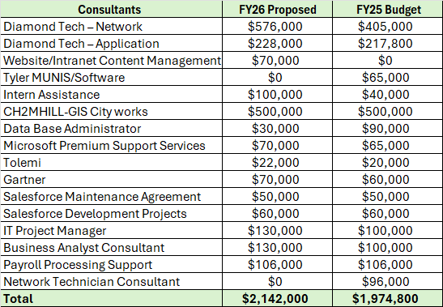
Question 6. Professional Fees
Discuss the planned use of ~$2.3M budgeted for Professional Fees, up $173K over the prior year's budget ($2.14M Consultant, ~$107K Temp Agency, $50K Storage Record Retention).

Slide 19
Question 6. Professional Fees Continued.
With a staff of 21 full-time positions, share how the above Consultant Expertise bolsters your team.
Specify the number of Consultants staffed by Diamond Technology and the functions performed for ~$804K.
Specify the length of all consultant contracts, cost per year, and number of years City has been engaged.
Specify if any vendor are DBE's.
Share how your department is leveraging your Team with the use and growth of Interns.

Slide 20
Question 6 - Answer Professional Fees
The planned ~$2.3M budget allocated for Professional Fees reflects a strategic approach to supporting the organization's IT functions through consultants, contractors and temporary personnel. Small IT departments often face limitations in resources and expertise, making external support essential for maintaining operational efficiency and achieving project goals.
This year’s increase of $173K primarily results from outsourcing the Webmaster position, providing additional funding for project manager and business analyst consultants, and expanding the internship program. These investments ensure access to specialized skills, improve workflow management, and strengthen the department’s ability to meet evolving technological demands.

Slide 21
Question 6 - Answer Professional Fees
There are currently nine consultants working for City IT:
  5 Diamond Technologies Consultants
  3 Brandywine Technologies Consultants
  Remote database management services (DBA) provided by DataStrike
None of the vendors identify as DBE’s

Slide 22

Question 6 - Answer Professional Fees – Consultants
There are currently five consultants staffed by Diamond Technologies:
  1 Chief Information Security Officer (CISO), 1 Network Architect and 1 Network Technician - $576K
  1 Data Scientist- $228K
  1 Helpdesk Support Analyst - $66K

Slide 23

Question 6 - Answer Professional Fees – Consultants
There are currently 3 consultants staffed by Brandywine Technology Services.
  1 IT Project Manager- $130K
  1 Payroll Processing - $100K
  1 Business Analyst - $130K

Slide 24
Question 6 - Answer Professional Fees
Consultant Name | Department | Cost | Duration (Yrs)
Diamond Technologies | IT/CITY-WIDE | $62,000.00 | 19
Jacobs Engineering (Formerly C2HM Hill) | Public Works | $500,000.00 | 19.5
Accellance Consulting | IT/LNI/Finance/PW | $50,000.00 | 2
DataStrike (Remote DBA Access) | IT/CITY-WIDE | $30,000.00 | 1
Brandywine Technology Services | IT/CITY-WIDE | $360,000.00 | 6
Internships and Community initiatives | IT/CITY-WIDE | $100,000.00

Slide 25
Question 6 – Answer Professional Fees - Internships
Our internship program is an asset to the City, as it provides our department with skilled individuals who can supplement our workforce by assisting with projects and ticket requests. In turn, interns gain hands-on experience and develop essential skills that can enhance their career prospects and lead to higher employment opportunities.
Many of our existing technologies, programs and procedures have been vastly improved due to the efforts and ideas of these young recruits!
The Tech Impact program has been our primary partner for technical talent since 2014. We have developed several exceptional full-time employees from previous internship participants.
IT is working to expand our pipeline and develop relationships with additional local programs and institutions.
The City IT department is actively helping to develop Wilmington's future IT workforce by partnering with the Parks Department to fund programs like Kai Coders Summer Camp. This initiative provides young people with access to technology and sparks their interest in the field, equipping them with foundational skills that can inspire future careers in IT.

Slide 26
Question 7. Equipment
Discuss the ~$3M Budgeted in the Equipment account category, up $126K over the prior year's budget.
Specify any new software request for various City initiatives.
Specify length of all contracts, cost per year, and number of years the City has been engaged, and if contract has come before Council.
Specify replacement equipment, etc. For each department.
Specify where the City is in the lifecycle for the replacement schedule pertaining to laptops, etc.

Slide 27
Question 7 - Answer Equipment
The primary increase in this budget line is allocated for the replacement of PC hardware equipment across the City and Public Safety departments, ensuring updated and reliable technology for essential operations. This includes new computers for the Wilmington Police Department and upgraded equipment for Wilmington Fire Department EMS services.
Approximately 57% of City pc systems are at or nearing the end of their lifecycle and are scheduled for replacement to align with the necessary upgrade to Windows 11, ensuring continued performance, security, and compliance.
There are no new software requests included in the FY 2026 budget,
None of the vendors identify as DBEs.

Slide 28
Question 7 - Answer Equipment
Contract Data:
ITEM | Duration (yrs) | Cost | Length (yrs) | Council | DBE
Tyler/MUNIS | 1 | $924,000 | 18 | No | No
SHI/Microsoft | 3 | $350,000 | 18 | Yes | No
SalesForce | 1 | $126,150 | 6 | No | No
OpenGov | 1 | $40,000 | 8 | No | No
Mobile Eyes | 1 | $20,000 | 6 | No | No
UKG/KRONS | 1 | $230,000 | 20 | No | No
Perfect Mind | 1 | $4,000.00 | 6 | No | No
Keystone Digital Imaging | 1 | $110,000 | 5 | No | No
Hosting | 1 | $150,000 | 2 | No | No
DocuSign | 1 | $55,000 | 6 | No | No

Slide 29
Question 8. Communications & Utilities
Discuss the planned use of ~$1.4M budgeted in the Communications and Utilities account groupings.
Specify number of cell phones, tablets, laptops, etc. Per department.
Specify funding allocated for WPD Camera Network and Downtown Visions.

Slide 30
Question 8 - Answer COMMUNICATIONS & UTILITIES
The $1.4M requested will be used as follows:
  $886K is requested for Telephone Direct Charge – including items such as the City's high-speed communication lines, long-distance charges, and drug tip line.
    This request reflects a slight increase from last year’s $77K allocation to support the transition from Comcast to Crowne Castle for the City’s WAN network services, ensuring improved connectivity and operational efficiency."
  $414K is requested for Mobile Airtime – which includes all of the City's wireless connections.
  $100K is allocated for the WPD Camera Network and Downtown Visions.

Slide 31
Question 8 - Answer COMMUNICATIONS & UTILITIES
The number of Cell Phones, Air Cards, Tablets and Laptops are as follows:
Department | Cells | Tablets | Aircards | Laptops
Mayor's Office | 12 |  | 3 | 20
Economic Development | 1 |  |  | 5
IT Department | 11 | 2 | 1 | 21
Cultural Affairs | 2 |  |  | 2
Office of Emergency Mangement | 2 |  |  | 17
Constituent Services | 2 |  |  | 3
City Council | 16 |  | 4 | 23
Finance | 6 |  |  | 39
City Auditor | 1 |  |  | 7
Treasurer | 3 |  |  | 3
Law | 8 |  |  | 19
Human Resources | 8 | 2 |  | 29
Planning / Land Use | 3 | 6 |  | 2
License and Inspection | 2 | 30 |  | 4
Real Estate & Housing | 5 | 1 |  | 8
Public Works | 34 | 26 |  | 28
Parks and Recreation | 7 |  |  | 17
WFD | 25 | 22 | 25 | 18
WPD | 78 | 66 | 75 | 1
Totals | 226 | 155 | 108 | 266

Slide 32
Question 9. Contracted Maintenance
Discuss the ~$718K budgeted for the Contracted Maintenance account grouping.

Slide 33
Question 9 - Answer Contracted Maintenance
The requested amount for this budget line remains the same as the prior year.
This budget typically covers maintenance agreements, software licensing, hardware servicing, and infrastructure upkeep, which are essential for maintaining citywide IT operations.
In the Communications Division, Repairs to Equipment remained $120K.

Slide 34
Question 10. Capital Lease
Discuss the $859K budgeted in the Capital Lease account grouping.
  Specify the frequency for replacement.

Slide 35
Question 10 - Answer Capital Lease
The $859K budgeted for the Capital lease is for the City’s handheld radio replacement.
  A total of 516 radios were purchased.
  Several units have been replaced, the City is still waiting on the State to complete the infrastructure modifications to complete the full deployment. .
The typical replacement cycle for radios depends on factors such as usage intensity, AND technological advancements. Generally:
  Public Safety Radios (Police, Fire, EMS): 6-8 years
  General Municipal Radios: 7-10 years
  Portable Radios: 6 year on average

Slide 36
Question 11.
Provide FY2026 proposed organizational chart with the total number of employees (i.e. permanent, temporary, contract, vacancies).
  If there are multiple divisions, please ensure there are sub-org charts that enumerate all the above.

Slide 37
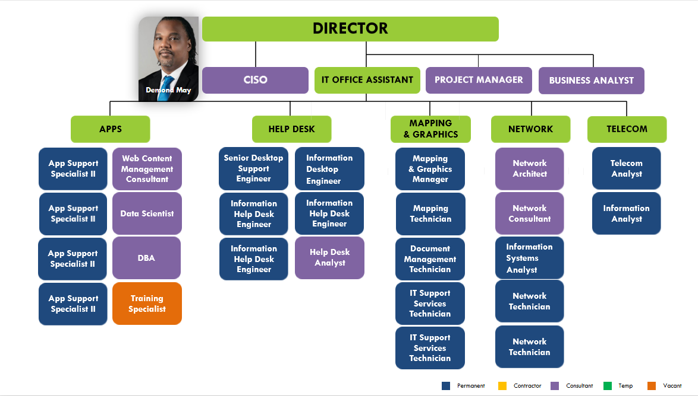
FY 2026 Proposed Organizational Chart

