Slide 1


FY 2026 Budget Hearing
LAND USE & PLANNING

Slide 2
Proposed FY 2026 Budget
General Fund | FY 2023 Actuals | FY 2024 Actuals | FY 2025 Budget | Proposed Budget FY 2026 | $ Change FY'26-25 | % Change FY'26-25
Personal Services | $2,603,878 | $2,832,866 | $3,149,206 | $3,080,131 | (69,075) | -2.2%
Materials, Supplies, and Equipment | 452,783 | 782,673 | 1,048,120 | 1,119,200 | 71,080 | 6.8%
Internal Services | 86,526 | 132,709 | 124,076 | 128,642 | 4,566 | 3.7%
Debt Service | 262,313 | 307,755 | 291,159 | 278,365 | (12,794) | -4.4%
Total | $3,405,500 | $4,056,003 | $4,612,561 | $4,606,338 | (6,223) | -0.1%
Staffing Level (FTEs) | 25.55 | 26.00 | 26.00 | 26.00 | 0.00 | 0.0%

Slide 3
Major Funding Changes (General Fund Proposed Budget)
Personal Services Changes - (↓ $69,075)
Position elimination - Land Use Deputy Director (↓ $145,470)
Position addition - Mechanical Code Enforcement Inspector (↑ $105,966)
Temporary Salaries (↓ $20,000)
Materials, Supplies, and Equipment Changes – (↑ $71,080)
Consultants (↑ net $29,000 )
  Zoning Reform Project – (↑ $125,000)
  ADA Self-Assessment – (↓ $65,000)
  University of Delaware consulting – (↓ $15,000)
  Elimination of one-time NPC consulting – (↓ $10,000)
Demolition costs (↑ $50,000) – Loss of ARPA funding, expanded program.
Engineering services (↑ $20,000) – Professional structural engineering expertise.

Slide 4
Question 1
Considering the reconfiguration of the Land Use & Planning Department, and Licenses & Inspections within the last several years, share any budgetary cost savings, and additional revenues as a result of this change, specifically related to streamlining the permitting process.
Specify number of permits issued the last 3 years, and the amount of fees collected the last 3 years.
Specify number of building inspections the last 3 years.

Slide 5
Answer 1
The purpose of the reorganization was to increase operational efficiency versus budgetary cost savings. Many of these gains in efficiency promote development, growth, and capacity.
Faster permit turnaround and plan review.
Enhanced customer service through a centralized development review.
Stronger alignment with citywide development goals.

Slide 6
Answer 1a
FY | PERMITS | VALUATION | FEES
2021 | 3,624 | $203,808,695.00 | $2,050,017.00
2022 | 4,574 | $275,739,382.00 | $2,946,706.00
2023 | 3,274 | $247,592,681.00 | $2,342,483.00
2024 | 3,735 | $274,037,281.00 | $2,537,565.00
*2025* | 2,594 | $365,577,346.00 | $3,019,838.00

Slide 7
Answer 1b
FY | INSPECTIONS
2021 | 11,075
2022 | 11,729
2023 | 15,057
2024 | ~12,665
*2025* | 10,374

Slide 8
Question 2
With affordable housing being a nationwide issue, share if this budget addresses any creative zoning code developments that could fiscally allow the ability for home ownership, such as the following: tiny homes, pallet homes, ADUs (accessory dwelling units), or other alternative housing.
Specify any potential revenue as a result of: (ex: property taxes, permits, etc.).

Slide 9
Answer 2
Tiny Houses are currently allowed within the current building code.
The department is reviewing the feasibility of implementing ADUs as a matter of right within certain Zoning Districts.

Slide 10
Question 3 & 4
Discuss current vacant positions.
  Specify duration of the vacancy.
  Specify timeframe for filling position.
  Specify any impact to Overtime, Temp Agency, and or Consultants.
  Justify the need for the position.
Discuss any proposed changes to positions (new position, deleted position,
upgrade, realignment, transition, downgrade, title change, salary changes,
etc.).

Slide 11
Answer 3
Position | Vacancy Date | Timeframe for Filing | Impact to Overtime, Etc. | Justification
Deputy Director of Land Use | 08/2024 | TBD | None | The Department is working with HR and the Mayor's Office to improve the Department's organizational structure.
Deputy Director of Planning | 11/2024 | TBD | None | The Department is working with HR and the Mayor's Office to improve the Department's organizational structure.

Slide 12
Question 5
Discuss the planned use for $555K in Consultants, up $29K over the prior year’s budget.
  Specify vendor name, amount of contract, expiration date, length of contract, how long City has been doing business with the vendor, and scope of services.
  Specify if any of the vendors are DBE’s.
  Specify the timeframe for implementing the zoning code reform updates, and costs.
  Specify timeframe for completion of ADA Self-assessment, as similar amount of funding was budget in the last several years.
  Specify the ~$365K that has been expended year to date for Consultants.

Slide 13
Answer 5 (a)
The department utilizes the services of the following consultants:
  CSi – Code Solutions International, LLC
    Contract Amount: $95,000.00
    Expiration Date: Contract runs on fiscal year
    Length of Contract: One year
    How Long Been Doing Business: 5 Years
    Scope of Service: CSi provides plan review services and mechanical inspections.
CSi – Code Solutions International, LLC
Contract Amount: | $95,000.00
Expiration Date: | End of Fiscal Year
Length of Contract: | Fiscal Year
How Long Been Doing Business: | 6 Years
Scope of Service: | CSi provides Plan Review Services & Mechanical Inspections.

Slide 14
Answer 5 (a)
  Larsen and Landis
    Contract Amount: $5,000.00 (as needed)
    Expiration Date: End of Fiscal Year
    Length of Contract: Fiscal Year
    How Long Been Doing Business: 6 Years
    Scope of Service: Structural Engineering Assessments & Reports
Larsen and Landis
Contract Amount: | $10,000.00 (as needed)
Expiration Date: | End of Fiscal Year
Length of Contract: | Fiscal Year
How Long Been Doing Business: | 7 Years
Scope of Service: | Structural Engineering Assessments & Reports

Slide 15
Answer 5(b) DBE Contractors
Dependable Construction (Demolition)
Carolina Construction (Demolition)
SME Construction (Demolition)
R & A Construction (Property Maintenance)
Will's Pest Control (Pest Control)
T & T Embroidery (Uniforms and Accessories)

Slide 16
Answer 5 continued
The Department is reviewing the Zoning Code Reform Analysis recently completed. The final recommendations from the analysis will be incorporated into the proposed scope of work.
The ADA Self-Assessment will be completed in FY 2026. Funds budgeted in FY 2025 have been encumbered and are nearly fully expended. In FY 2026, the right-of-way analysis will be completed, and a final ADA Title II Transition Plan will be produced.
A portion of the Consultant budget was used to support the Gartner Study focused on assessing existing gaps in the City’s Development Process and provided recommendations to further streamline this process.

Slide 17
Question 6
Discuss the $400K budgeted for Demolition, up $50K over the prior year’s budget.
Specify the conditions that necessitate an immediate demolition.
Specify if any funds recouped within the last 2 years and list the amount per year.
Specify number of properties demolished within the last 2 years, and the number of properties in the pipeline.

Slide 18
Answer 6 (a)
All properties with major structural deficiencies posing a potential public safety risk require emergency demolition services.
Neglect and water infiltration are the primary causes of emergency demolitions in Wilmington.

Slide 19
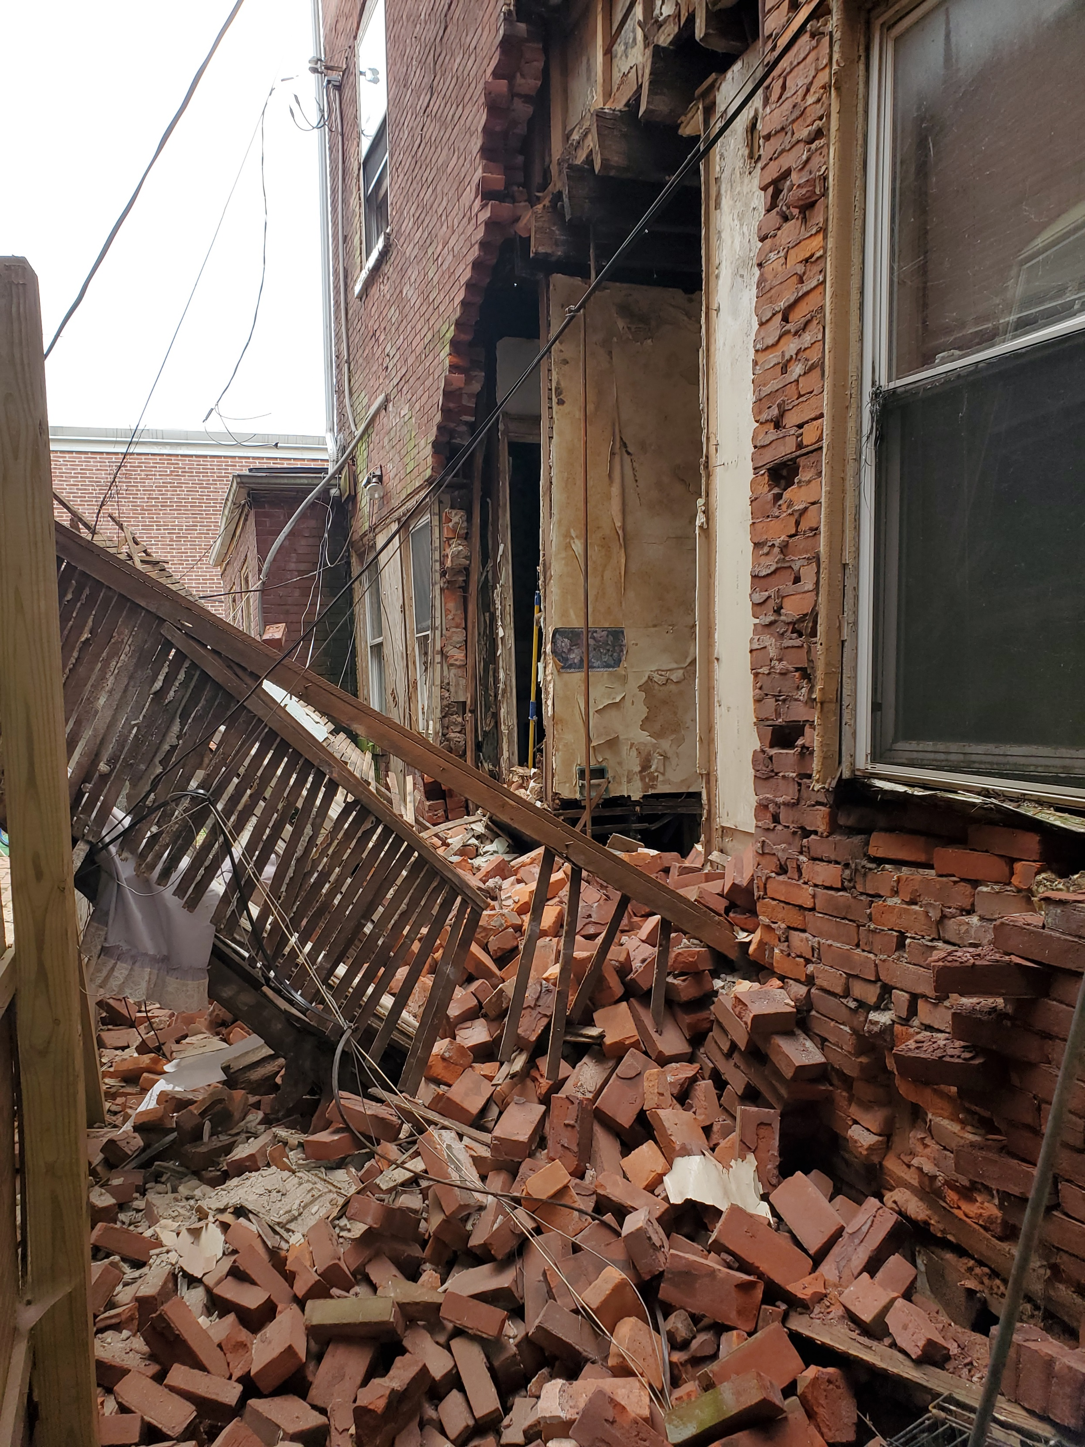
Answer 6 (b)
618 N. BROOM
$160,982.00

Slide 20
Answer 6 (c)
FISCAL YEAR | ADDRESS
2024 | 1210 B STREET
2024 | 2531 WASHINGTON STREET
2024 | 1104 N HEALD STREET (ARPA FUNDS)
2024 | 522 E 4TH STREET
2024 | 17 EAST 22ND STREET
2024 | 15 E 22ND STREET
2024 | 417 W 5TH STREET
2024 | 614 N. HARRISON STREET (ARPA FUNDS)
2024 | 221 W 7TH STREET
2024 | 1108 & 1110 BLOCK OF PULLMAN ST

Slide 21
Answer 6 (c) continued
FISCAL YEAR | ADDRESS
2025 | 2130/2132 N MARKET STREET
2025 | 611 & 613 W 7TH STREET
2025 | 1100-1102 A ST & 402 TOWNSEND ST
2025 | 912 E 17TH STREET

Slide 22
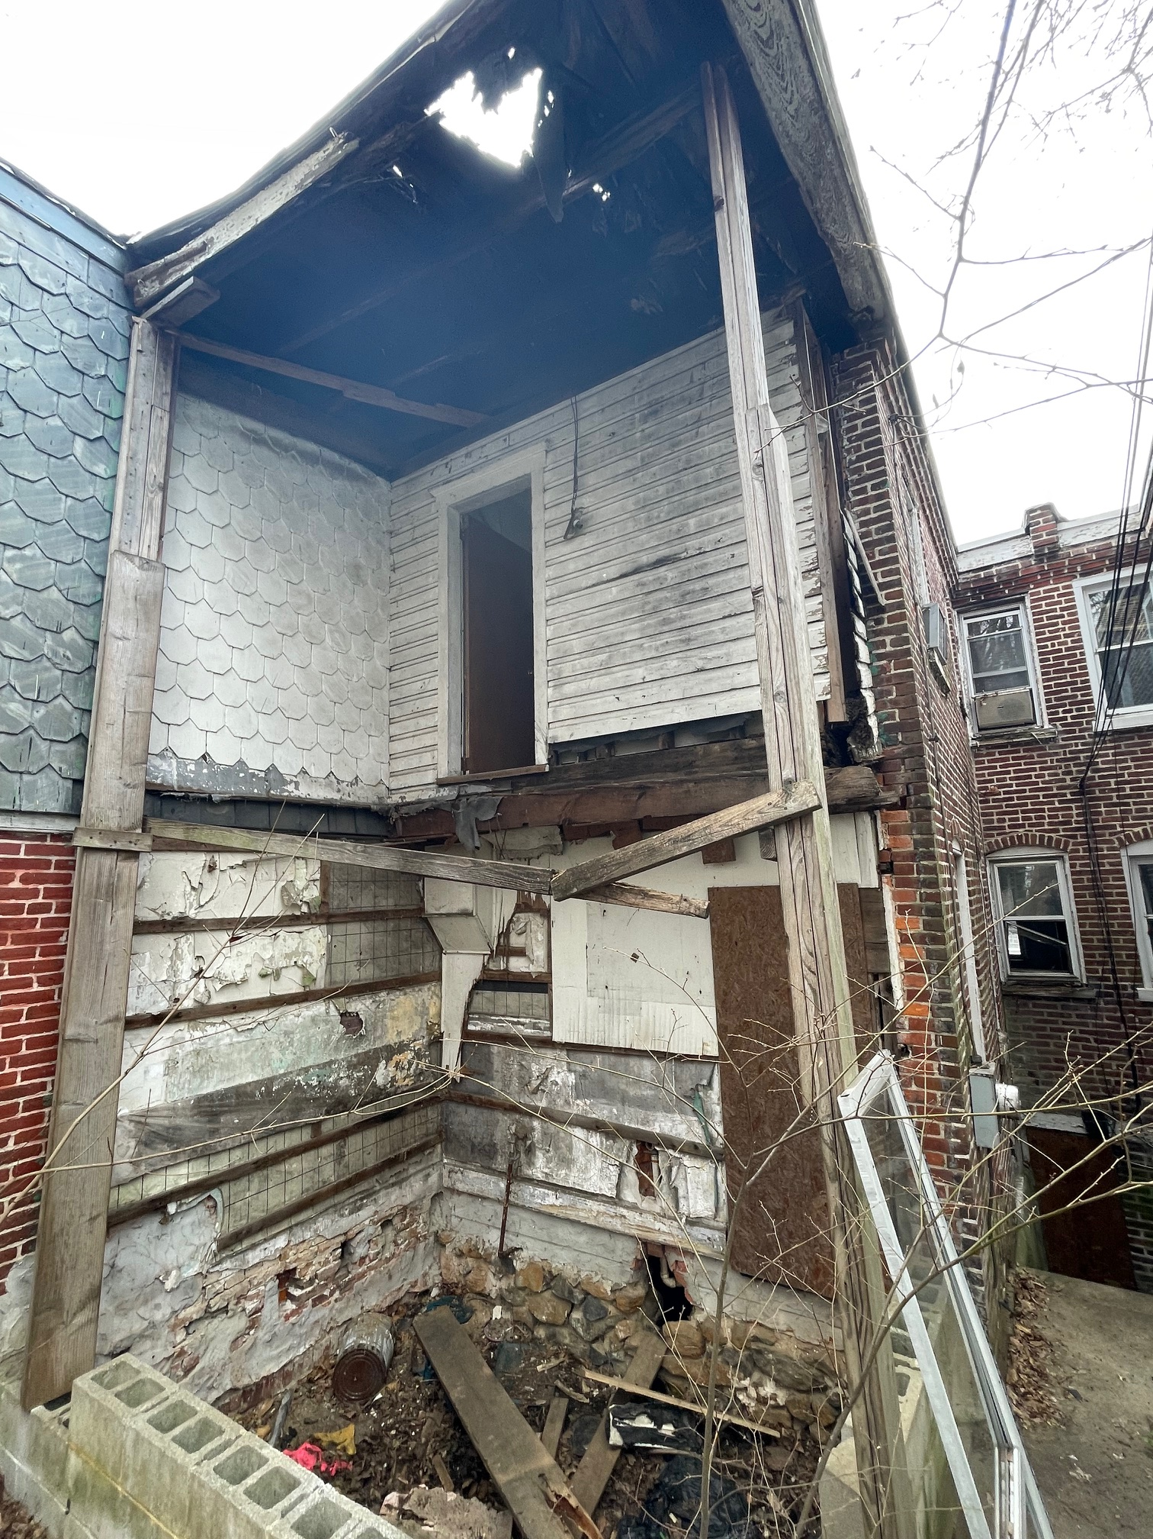
220 N Rodney St
Notes:
220 N Rodney St
13th St
Elm St

Slide 23
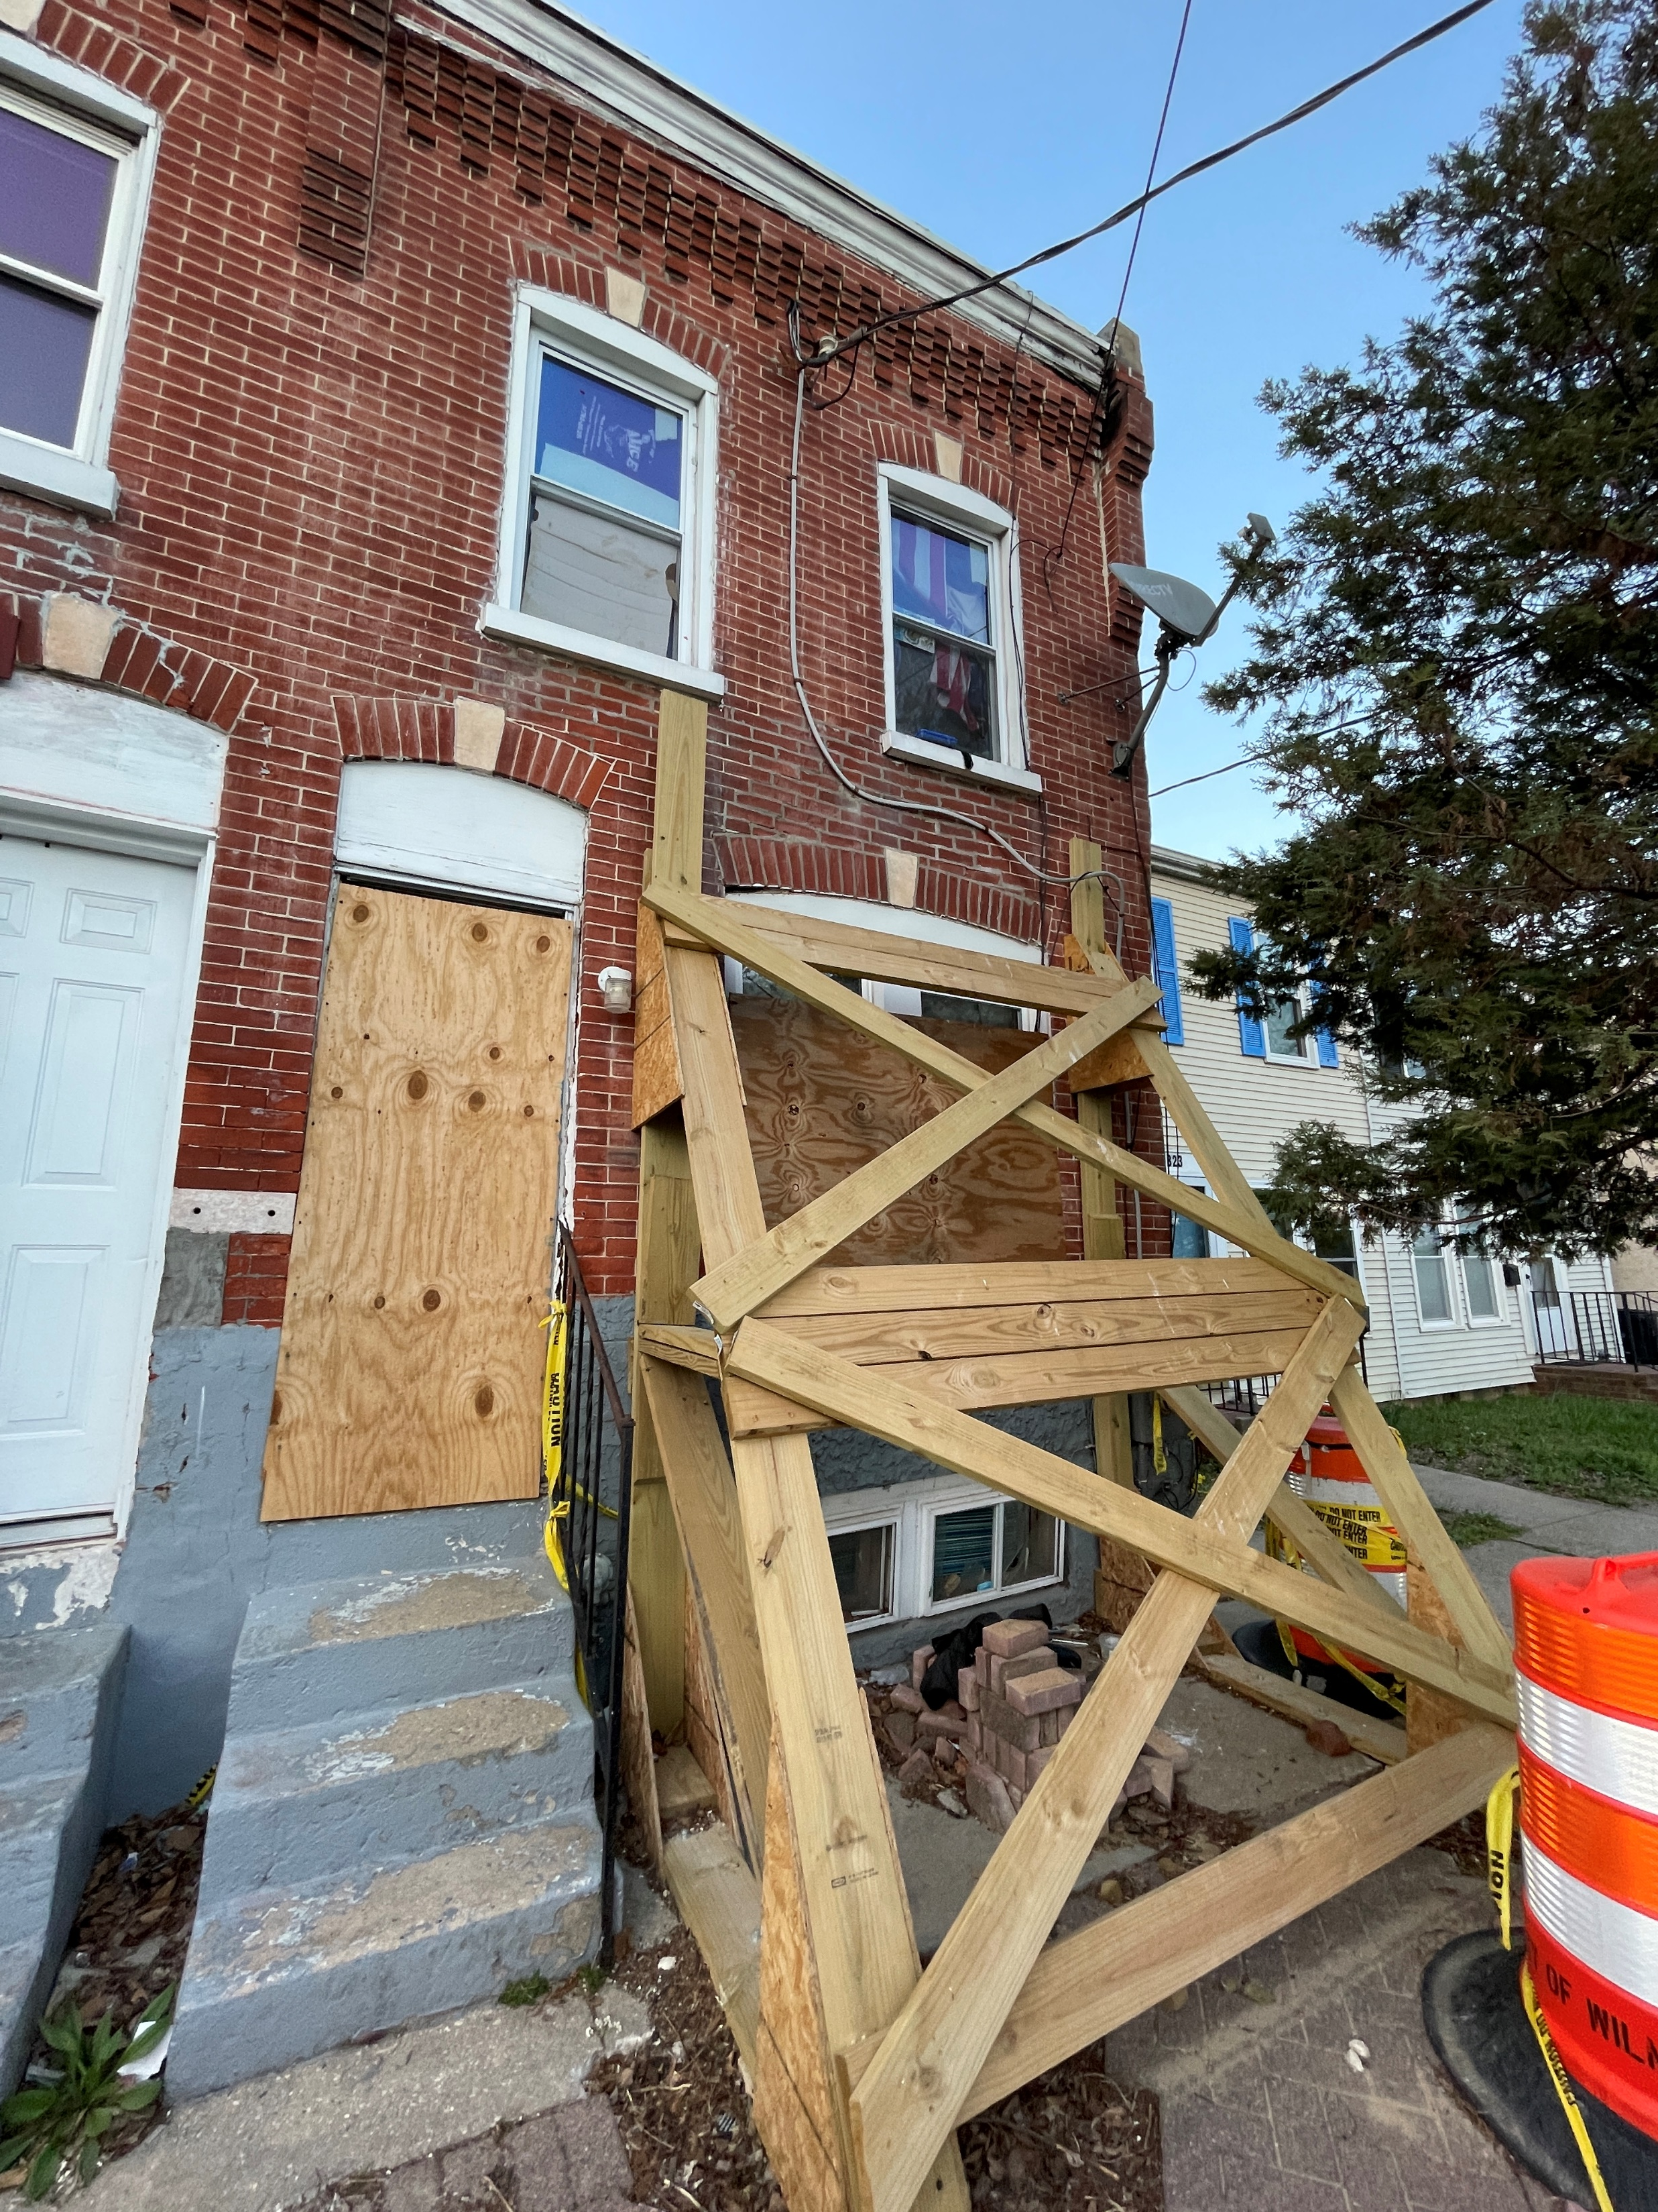
319 E 13th St
Notes:
220 N Rodney St
13th St
Elm St
2nd St with the Tree

Slide 24
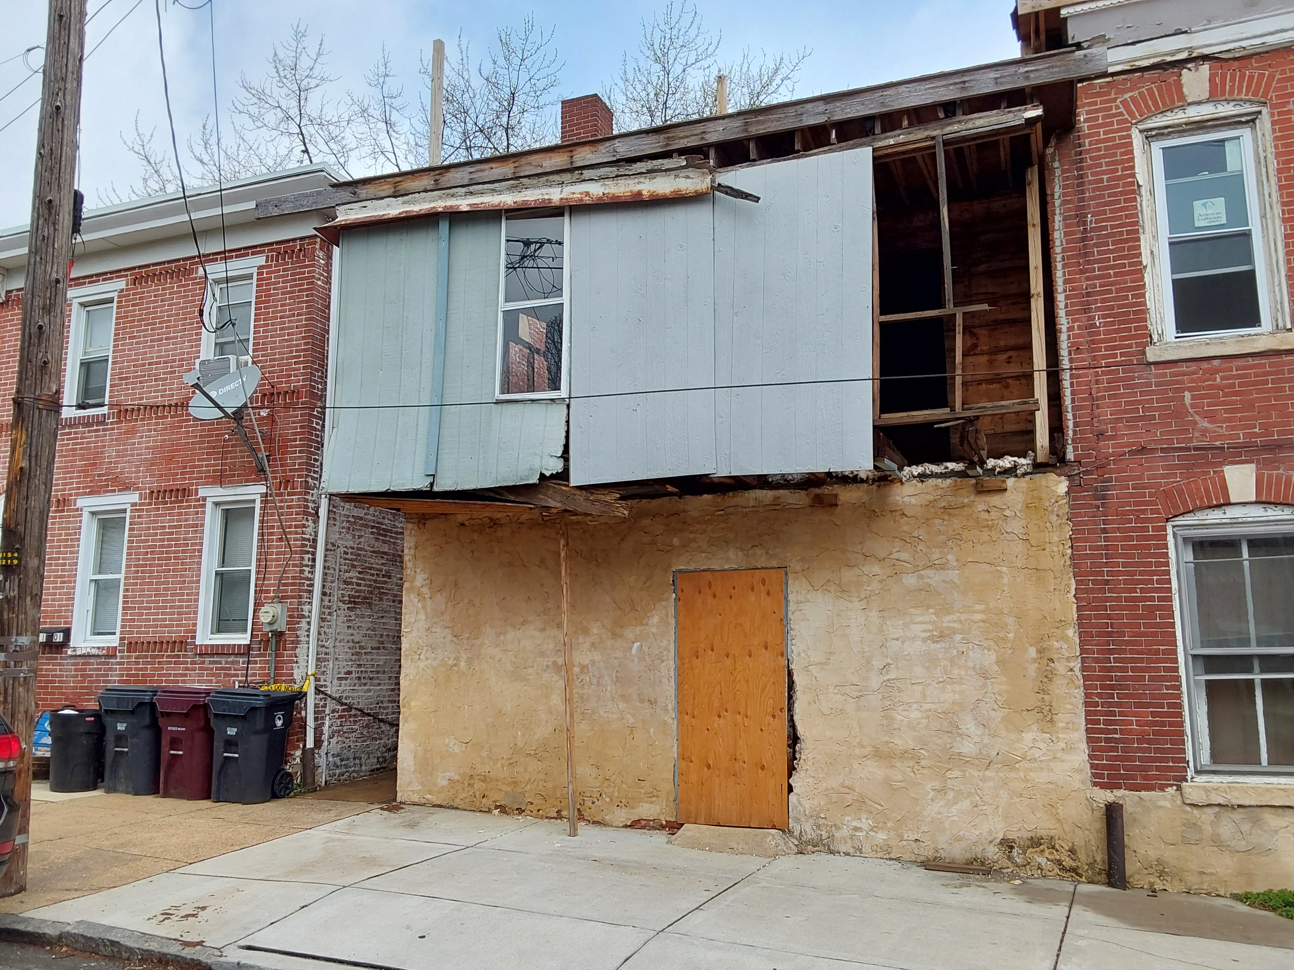
1101 Elm St
Notes:
220 N Rodney St
13th St
Elm St
2nd St with the Tree

Slide 25
Question 7
Discuss the planned use of $96K budgeted in the Temporary Salaries and Engineering account lines.

Slide 26
Answer 7
Land Use
  Historic Preservation Planner is partially funded in this line item in conjunction with the state, per federal requirements.
  The department utilizes professional engineering services for emergency structural assessments.

Slide 27
Question 8
Provide an update on capital funds available for each of the Neighborhood
Planning Councils (per NPC, per capital budget).
  Specify the last time NPCs were allocated any funding.

Slide 28
Answer 8 (a)
District | Amount Allocated | Amount Spent | Amount Remaining for Each District
1 | $ 350,000.00 | $ (317,885.81) | $ 11,550.79
2 | $ 350,000.00 | $ (294,801.80) | $ 55,198.20
3 | $ 350,000.00 | $ (251,870.81) | $ 98,129.19
4 | $ 350,000.00 | $ (218,129.12) | $ 120,160.88
5 | $ 350,000.00 | $ (250,586.63) | $ 99,413.37
6 | $ 350,000.00 | $ (298,280.91) | $ 42,529.09
7 | $ 350,000.00 | $ (248,151.45) | $ 101,848.55
8 | $ 350,000.00 | $ (329,941.79) | $ 58.21
TOTAL | $ 2,800,000.00 | $ (2,228,826.22) | $ 528,888.28
NPC Grant was last funded through the capital budget in 2014.

Slide 29
Question 9
Discuss the 2 additional new vehicles requested for the Land Use &
Planning Department.

Slide 30
Answer 9:
The vehicle requests for FY26 replace the compact Chevy Trax. These are the oldest units within the inspection fleet. The replacements will provide increased safety for the compliance officers in the field.

Slide 31
Question 10
Share any new technology requests submitted.

Slide 32
Answer 10
Monitor Replacement
Laptops equipped to support GIS & Graphics Software
Office Smart Monitor Replacement

Slide 33
Question 11
Considering the number of Inspectors, share within your departmental organization chart if they are aligned by certain quadrants, sectors, and/or districts, and if so, please provide on a chart.
    Provide FY2026 proposed organizational chart with the total number of employees (i.e., permanent, temporary, contract, vacancies)
    If there are multiple divisions, please ensure there are sub-org charts that enumerate all the above.

Slide 34
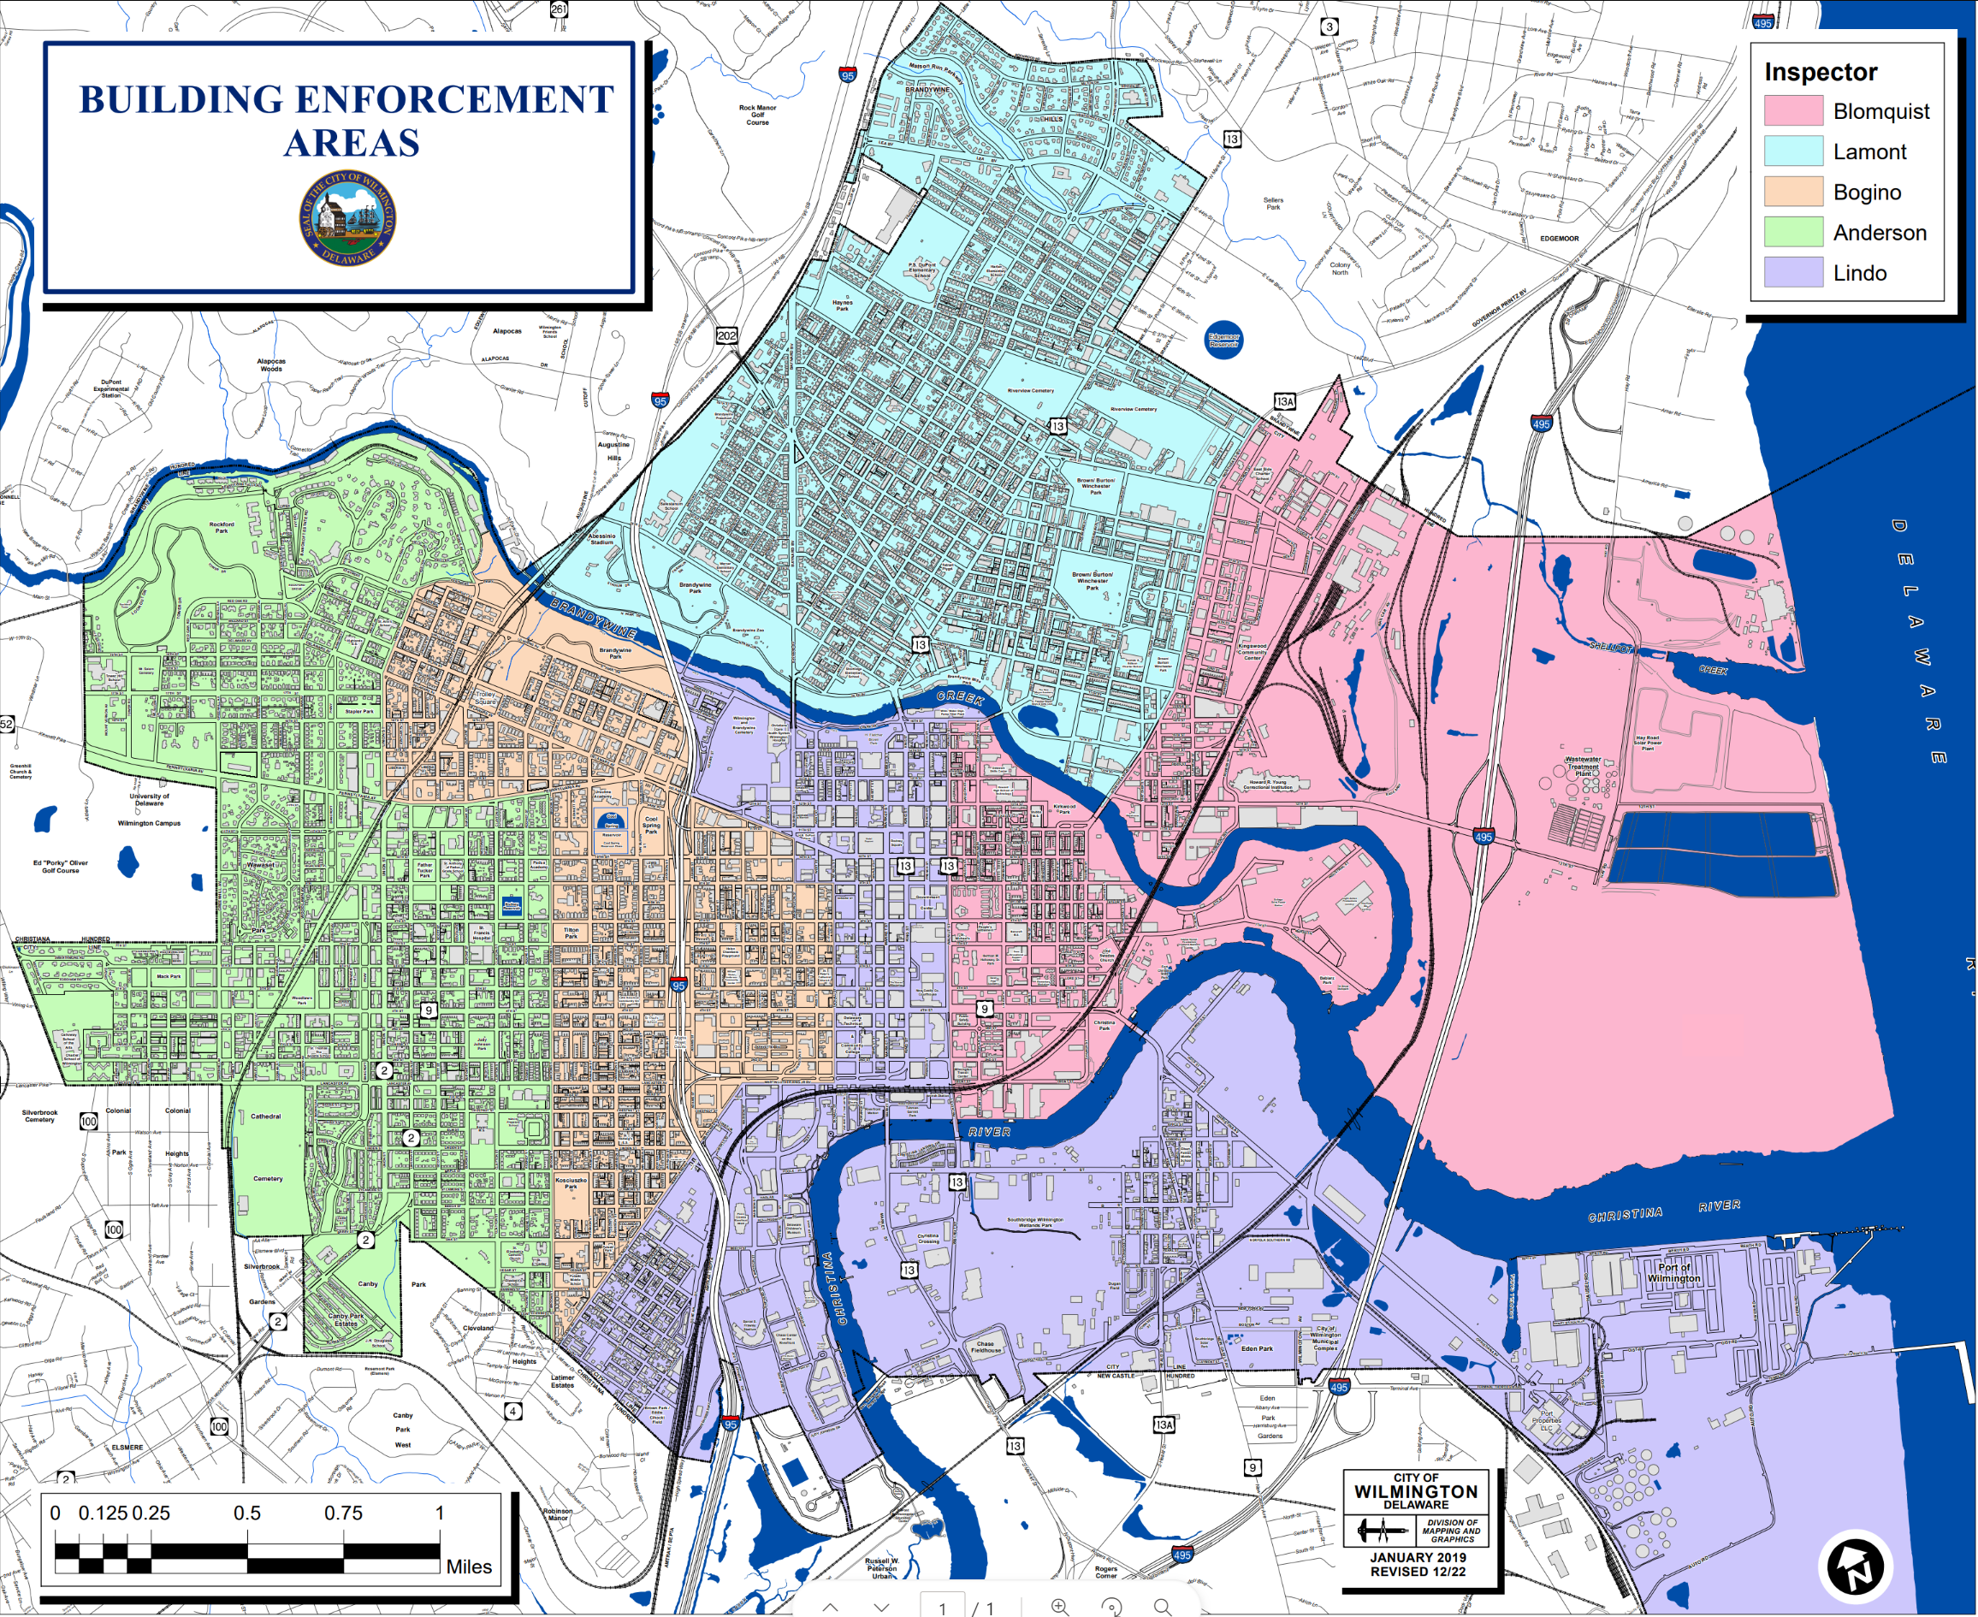
Answer 11

Slide 35
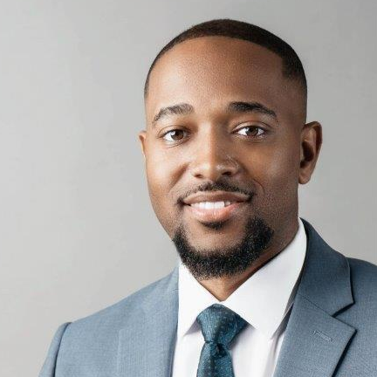
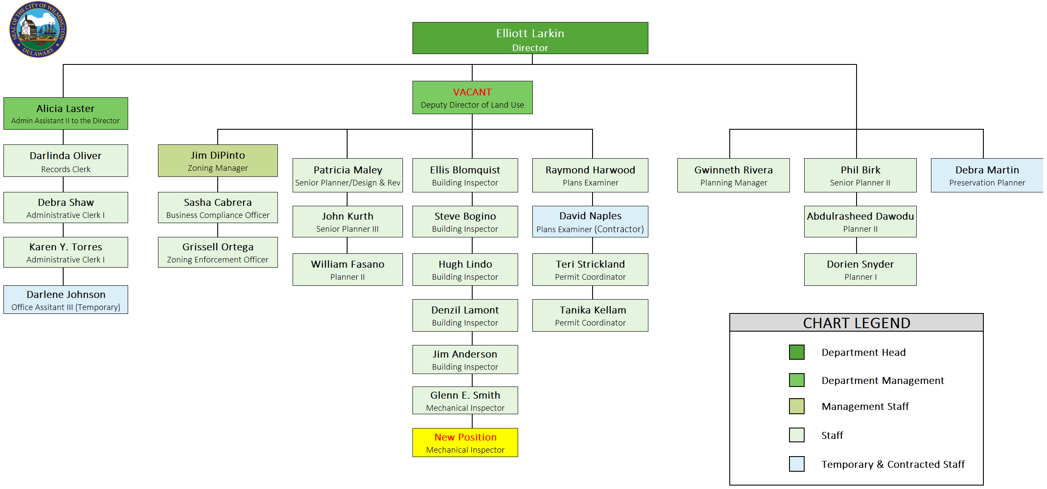
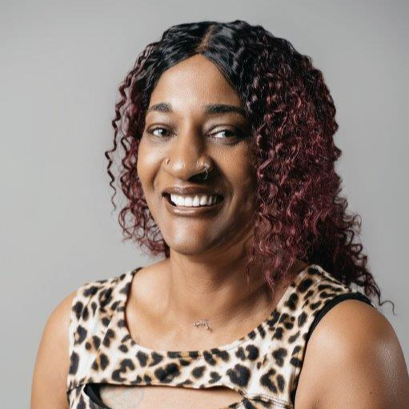
Answer 11 continued
Total Employees: | 26
Temporary: | 2
Contract: | 1

