Slide 1


FY 2026 Budget Hearing
LAW DEPARTMENT

Slide 2
Proposed FY 2026 Budget
Law | FY 2023 Actuals | FY 2024 Actuals | FY 2025 Budget | Proposed Budget FY 2026 | $ Change FY'26-25 | % Change FY'26-25
Personal Services | $2,154,167 | $2,273,932 | $2,421,948 | $2,432,267 | $10,319 | 0.4%
Materials, Supplies, and Equipment | 353,287 | 514,695 | 507,880 | 455,075 | (52,805) | -10.4%
Internal Services | 31,855 | 47,541 | 27,866 | 28,857 | 991 | 3.6%
Total | $2,539,309 | $2,836,168 | $2,957,694 | $2,916,199 | ($41,495) | -1.4%
Staffing Level (FTEs) | 17.00 | 17.00 | 17.00 | 16.00 | -1.00 | -5.9%

Slide 3
Major Funding Changes (Proposed Budget)
Personal Services (↑ $10,319)
  COLAs, Anniversary Steps, Annual Reviews, and Employee Benefits Costs increases
  Position Eliminated (↓ 1.00 FTE) – Legal Assistant I (↓ $97,790)
MS&E (↓ $52,805)
  Legal (↓ $30,000) – Lower anticipated costs for outside counsel
  Temporary Agencies (↓ $20,000) – Law Department fully staffed
  Furniture, Fixtures, and Equipment (↓ $2,800) – Completion of office equip. upgrades

Slide 4
Departmental Vision
An effective, efficient and committed group of legal professionals who have the passion, time and experience to deal with the City’s most important legal issues while at the same time ensuring that the day-to-day legal needs of the City’s government are addressed.

Slide 5
Priorities for Fiscal Year 2026
Continue to provide effective and efficient legal advice to the City
Aggressively defend and prosecute litigation
Provide actionable legal advice on various employment matters
Provide strategic and legal support in the negotiations of collective bargaining agreements
Deliver necessary and appropriate legal support to City Council
Meet budget targets

Slide 6
Top Three Performance Measures
Continue to meet or exceed stakeholder expectations for effectiveness of legal advice and quality of outcomes
Continue to deliver strategic recommendations for comprehensive update to City Code and Charter
Continue to control outside counsel expenses

Slide 7
Question 1. With the evolving changes regarding Federal Grant Funding, while understanding possible legal challenges, share any potential legal plan of action to best protect the city for being on the chopping block for possible federal funding.
The Law Department will continue to monitor executive orders and information coming from Washington, DC, and related decisions issued by the Courts. We have provided and we will continue to provide confidential legal advice to City stakeholders based on this information and provide guidance on how to execute policy decisions as needed.

Slide 8
Question 2. Discuss any proposed changes to positions (new positions, deleted positions, upgraded, realignment, transition, downgrade, title change, salary changes, etc.).
The Law Department eliminated one (1) vacant Legal Assistant I position. This position assisted attorneys, support staff and the Legal Administrator with administrative duties and the Department’s front desk responsibilities. After reviewing the Department’s needs, it was determined that the position could be eliminated with little impact to Departmental services.

Slide 9
Question 2a. Given the reduction of one full-time equivalent position, share how the department is reallocating responsibilities to maintain service levels.
The position’s administrative functions were distributed among existing support staff.
Since the pandemic, the Department has substantially less in-person visitors. We have placed a camera in our lobby and staff are able to monitor the lobby remotely. One staff member’s office is also located in the lobby area. In-coming calls are forwarded to a departmental cell phone which is assigned to staff according to a specific schedule.

Slide 10
Question 2b. Share the retention rate for attorneys in your office.
The Law Department currently has nine (9) staff attorneys. As shown below, over the past several years, the Department experienced an unusually high turn-over in its attorneys and difficulty with hiring.
In the first half of 2017, the Law Department was restructured. As part of the restructuring, two (2) attorney positions were eliminated.
  During restructuring, two (2) attorneys were terminated, one (1) attorney retired, and one (1) attorney resigned. Two (2) new attorneys were hired to fill the vacant positions.

Slide 11
Question 2b. (cont’d) Share the retention rate for attorneys in your office.
2017 – Two (2) resignations – 4 months to fill one position.
2018 – One (1) resignation – 2 months to fill the position.
2019 – Five (5) resignations – an average of 4 months to fill the positions.
2020 – One (1) resignation – 7 months to fill the position.
2021 – One (1) resignation -- 3 months to fill the position.
2023 – Three (3) resignations – an average of 8 months to fill the positions (2 positions remained vacant for 9-10 months).
2024 to present – Zero (0) resignations.

Slide 12
Question 2c. Specify if the recent Charter change “… to provide that, with the exception of the City Solicitor, all persons appointed to serve as attorneys in the law department shall attain tenure upon 3 years of continuous satisfactory full-time service and may not be removed from their positions except for just cause. The Wilmington Charter is also being amended to provide tenure status to attorneys who have already served 3 years of continuous satisfactory full-time service” has benefited the Law Department as far as recruitment and retention; please explain and share any data.
As a public sector employer, the City is primarily competing with the State of Delaware and New Castle County for Delaware-barred attorneys seeking to serve in government.
Since 2016, seven (7) of the thirteen (13) attorneys who resigned took positions with the State of Delaware. We are aware that at least two (2) applicants took positions with New Castle County instead of the City. One (1) attorney took a position with an out-of-state municipality.

Slide 13
Question 2c. (cont’d) Specify if the recent Charter change “… to provide that, with the exception of the City Solicitor, all persons appointed to serve as attorneys in the law department shall attain tenure upon 3 years of continuous satisfactory full-time service and may not be removed from their positions except for just cause. The Wilmington Charter is also being amended to provide tenure status to attorneys who have already served 3 years of continuous satisfactory full-time service” has benefited the Law Department as far as recruitment and retention; please explain and share any data.
One reason cited by some departing attorneys was the Department’s lack of job security. While the City provides outstanding benefits that are comparable with the State’s and County’s benefits, the State and County offer some form of tenure to their attorneys.
The change to the City’s Charter to provide tenure after three (3) years of satisfactory service was done to make the City a more attractive and competitive employer. Although it has only been a year since tenure was implemented, for the first time in six (6) years, the Department has not experienced a vacancy for over a year.

Slide 14
Question 2d. Specify if any challenges with the hiring process due to the Residency requirement.
Over the past several years, the City has had a difficult time recruiting and retaining attorneys. Salary, job security, and the residency requirement are the primary factors influencing the City’s competitiveness.
The residency requirement remains a challenge for the Department. For example, during the hiring process, several attorneys withdrew their application once they became aware of the residency requirement.

Slide 15
Question 3. Share the planned use for $270K budgeted in Legal Fees, and specifically why $30K in Legal Fees was removed pertaining to potential conflicts that may arise pertaining to legal matters that are of difference of legal opinion between the Legislative and Executive branches that will necessitate outside legal expertise.
In the FY25 budget, the Law Department proposed $270,000 in its legal fees line. City Council requested and approved an increase of $30,000 in the line.
The Department proposed the same amount ($270,000) for FY26 for Council’s consideration based upon prior years’ expenditures. However, if Council wishes to increase the Department’s legal fees line again, the Department does not object.
Category | Proposed FY’26 Budget Amount
Labor Negotiations & Associated Litigation | $145,000
Real Estate Transactions, including matters related to economic development. | $25,000
Complex Transactions | $100,000

Slide 16
Question 3a. Specify vendors for FY 2025, agreement expiration date, amount, length of agreement, and if any planned use for FY 2026.
These are at-will retentions, not contracts.
FY2025 Outside Counsel:
  Richards Layton & Finger (since 2020) ($84,855 YTD)
  Young Conaway Stargatt & Taylor LLP (since 2006) ($14,930 YTD)
  The Department may choose to use the same firms to represent the City in FY2026 subject to:
    Ongoing oversight and quality review
    Fee negotiations and cost control willingness
    Competition with other firms

Slide 17
Question 3b. Specify if any vendors that are DBEs.
  The Law Department’s vendors consist of law firms. To the best of our knowledge these law firms are not DBEs as defined by code section 35-132.
  The selection of firms is based on:
  Areas of expertise
  Competitiveness of rates
    Interview firms
    Look for best fit
    Consider lowest rate
    Capacity to litigate complex cases
If a DBE meets the needs of the specific legal matter, we would engage their services.

Slide 18
Question 3c. Share the process for identifying outside law firms that are inclusive of minorities for diversity.
  The Law Department selects firms based upon their competitiveness of rates and expertise in the matter. The selection of firms is based on:
  Areas of expertise
  Competitiveness of rates
    Capacity to litigate complex cases
    Promotion of diversity in hiring and management
  The law firms we use do promote diversity in hiring and management.

Slide 19
Question 3d. Specify if there is a carve out of the $270K in Legal Fees for Council, due to any conflicts that are negated by Charter.
If the Law Department determines that it has a conflict of interest between its representation of the Administration and City Council, legal fees associated with Council’s retention of conflict counsel will be paid from the $270,000 budgeted in the Department’s legal fees line.

Slide 20


Question 3e. Please provide a chart of legal expertise area for in-house attorneys comparable with the use of outside attorneys.
Practice Area | In-House | Outside Counsel
Litigation
Labor and Employment
Complex Transactions
Real Estate
Debt Collection
Legislation
Code Enforcement
Environmental

Slide 21
Question 4. Understanding the Law Department is the official legal representation of the City, share the mitigating fiscal budgetary factors in place that best represent and protect the City from a litany of claims, lawsuits, etc.
The mitigating fiscal budgetary factors in place that protect the city from legal claims are:
Hiring and retaining qualified and hardworking attorneys to work on suitable cases and tasks
Engaging outside counsel at discounted and competitive rates to handle matters more efficiently and more effectively when appropriate
Budgeting funds for professional development and training to enhance the Law Department’s effectiveness in protecting the City from legal claims

Slide 22
Question 4a. Specify if adequate funding budgeted best protects the City regarding any exposure and liability for various claims, etc.
Yes. We believe that in the current fiscal environment, we have budgeted adequately to fund the Law Department’s task of protecting the City from liability.

Slide 23
Question 4b. Citywide there’s ~$1.98M budgeted across all funds for Legal services. Please share your department’s role, if any, with oversight.
With regard to Risk Management’s Insurance Claims/Legal Defense line, the Law Department provides a recommendation to HR regarding estimated outside counsel fees. The proposed budget includes estimates for pending and anticipated litigation related to:
Employment Claims
Federal Constitutional and Statutory Claims
Personal Injury Claims
  The remaining lines have been historically delegated to the individual departments under the Law Department’s oversight. Such oversight includes:
  Selecting and approving outside counsel
  Receiving, reviewing, and approving invoices from firms engaged in litigation matters
  Engaging with the departments to assess the effectiveness of the law firms
  Drafting and reviewing contracts to retain certain firms for specific departments

Slide 24
Question 5. Discuss the planned use budgeted for $75K in the Court Costs and Notary Fees account grouping, considering costs have not exceeded $50K in the last three years, and costs are trending well below budget in the current fiscal year.
$75K is a conservative estimate of costs for research, court filings, monitions, vendexes, etc., related to sheriff sales

Slide 25
Question 6. Now that office equipment upgrades have been completed, and also, there is on-going continued training for all staff, share any operational efficiencies.
The Law Department received a much-needed new front door. The Department has received no other “equipment upgrades” to date.
The new door will eventually enable staff to remotely “buzz” visitors into the office (to date this enhancement has not been completed)
Only attorneys receive on-going training. Attorneys are required to do so to remain in compliance with their membership in the Delaware Bar
Attendance at these courses improves operational efficiencies by keeping attorneys abreast of the most recent legal developments

Slide 26
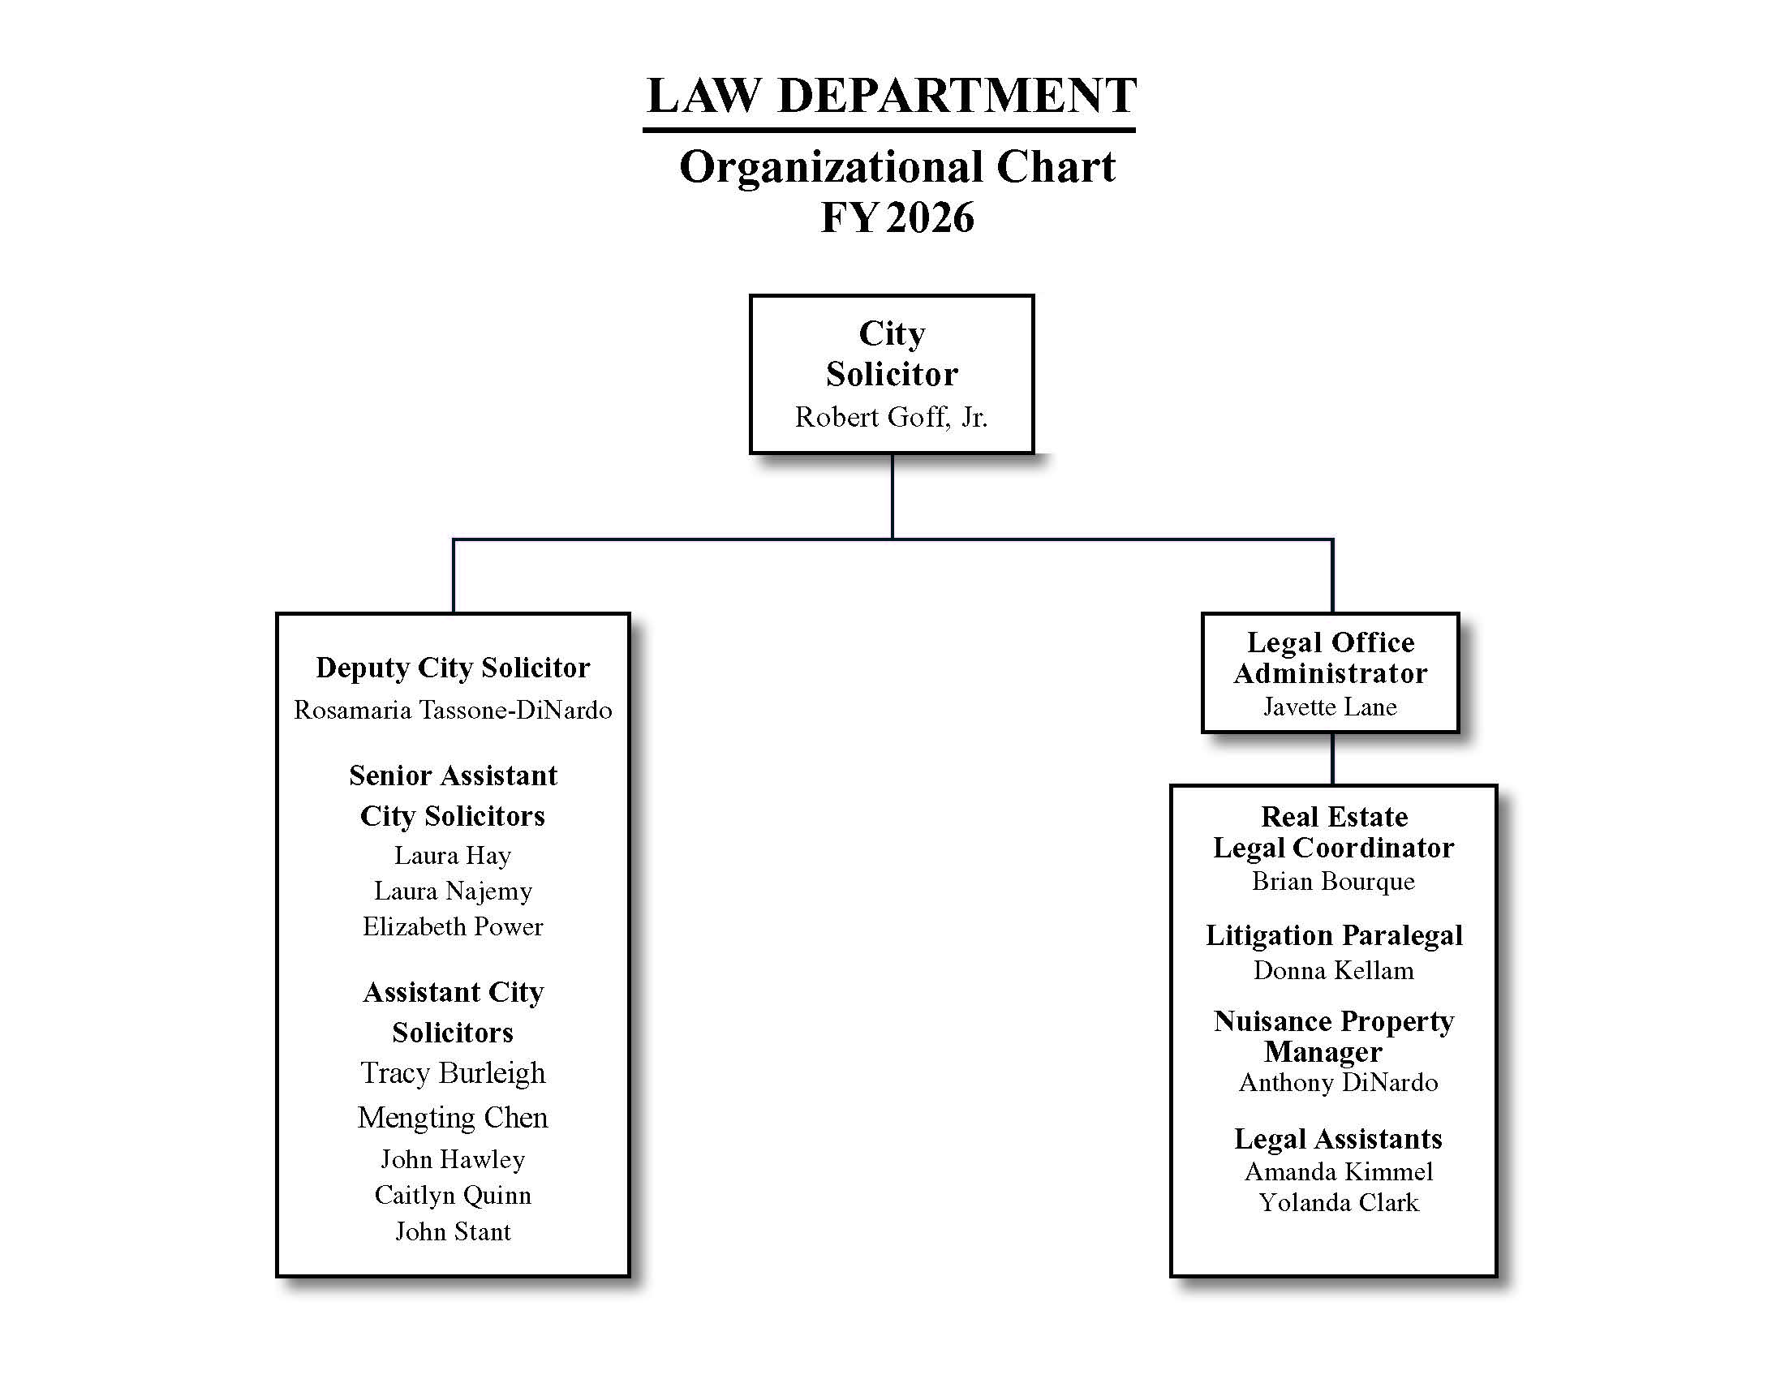

Question 7. Provide FY2026 proposed organizational chart with the total number of employees (i.e., permanent, temporary, contract, vacancies).
16 Permanent Employees

