Slide 1


FY 2026 Budget Hearing
LICENSES & INSPECTIONS

Slide 2
Proposed FY 2026 Budget
Licenses & Inspections | FY 2023 Actuals | FY 2024 Actuals | FY 2025 Budget | Proposed Budget FY 2026 | $ Change FY'26-25 | % Change FY'26-25
Personal Services | $2,508,887 | $2,682,478 | $2,863,182 | $2,899,777 | $36,595 | 1.3%
Materials, Supplies, and Equipment | 177,694 | 212,050 | 297,500 | 309,500 | 12,000 | 4.0%
Internal Services | 202,348 | 248,957 | 261,676 | 271,708 | 10,032 | 3.8%
Special Purpose | 2,791 | 2,243 | 2,245 | 2,187 | (58) | -2.6%
Debt Service | 239,039 | 265,550 | 283,001 | 290,076 | 7,075 | 2.5%
Total | $3,130,759 | $3,411,278 | $3,707,604 | $3,773,248 | $65,644 | 1.8%
Staffing Level (FTEs) | 26.00 | 26.00 | 26.00 | 26.00 | 0.00 | 0.0%

Slide 3
Major Funding Changes (FY 2026 Proposed Budget)
Personal Services expenses: (↑ $36,595)
  Regular Salaries (↑ $67,556) – Salary and anniversary step increases.
  Employee Benefits (↓ $22,251) – Lower pension contribution.
  MS&E : (↑ $12,000)
    Temporary Agencies (↑ $10,000) – Digital scanning of archived records and documents.
  Other Noncapitalized Equipment (↑ $2,000) – Commercial Grade shredder.

Slide 4
VISION STATEMENT
The Department of Licenses and Inspections (L&I) is responsible for promoting the general welfare and protecting the life, health, and safety of all citizens of Wilmington by monitoring the City’s building and housing stock through code enforcement and the abatement of code violations. This is achieved by the implementation of fair and unbiased application of the Wilmington City Codes. Our goal is to facilitate voluntary compliance by working in partnership with our constituents.

Slide 5
DEPARTMENTAL PRIORITIES
Strengthen Code Enforcement & Compliance by:
  Increasing enforcement efforts citywide to address vacant and blighted properties.
  Enhancing code enforcement strategies for vacant properties and structures.
  Identifying non-licensed rental property owners and ensuring compliance with city regulations.
  Monitoring and enforcing civil penalties for rental property violations.
Enhance the Department’s Operational Efficiency by:
  Continuing the implementation and optimization of the Salesforce software for streamlined departmental operations.
  Restructuring the L&I Department to improve vacant property and rental inspection enforcement and processes.

Slide 6
DEPARTMENTAL PRIORITIES (cont)
Increase Community Engagement & Public Awareness by:
  Having more accessibility to the department’s leadership for community groups focused on neighborhood improvements.
  Strengthening communication between L&I and the public through proactive community engagement, participation in neighborhood civic meetings, and collaboration with community and elected officials to address local concerns.

Slide 7
Question 1.
Discuss the amount of funds the City has collected for vacant property registration fees the last 2 years and the amount billed. Please share the amount projected for FY26 budget.
  Share the number of current vacant properties (inclusive of the Land Bank.)

Slide 8
Question 1. Answer
The City of Wilmington does not charge a Registration Fee for vacant properties. Owners are required to register a property as vacant if the property is vacant for more than 6 months. Fees are assessed to vacant properties that have been vacant for more than 1 year, based on the City of Wilmington Vacant Fee Structure.
The billed vacant penalty fees were $2,330,500 in FY 2024, and $2,128,500 in FY 2025. Currently the department is conducting the annual pre-bill vacant property verification check and unable to provide FY 2026 projections until October of 2025.
The city has collected vacant fees in the amounts of $953,267 in FY 2024, $851,242 in FY 2025 (YTD), and FY 2026 projected $920,202.

Slide 9
Question 1. Answer (continued)
As of November 1, 2024, there are 894 vacant properties in the City of Wilmington, including properties owned by the Land Bank, Wilmington Housing Authority, City of Wilmington and 501(c) properties. There are 765 vacant properties owned by private owners.

Slide 10
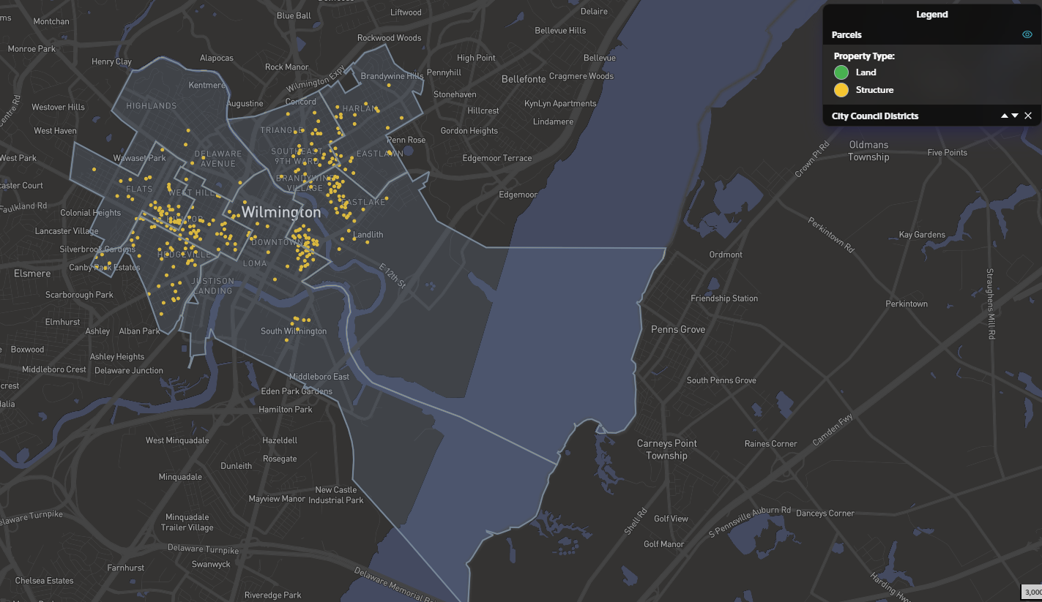
Vacant Properties Map - Tolemi

Slide 11
Question 2.
Discuss the continued funding of $130K budgeted for Property Maintenance pertaining to neglected properties.
  Specify the amount of funds recouped, if any for the last 3 years.
  Specify number of properties assisted the last 3 years.
  Share the process for getting vacant homes boarded.
  Specify number of 311 requests submitted regarding vacant property complaints in the last 2 years.

Slide 12
Question 2. Answer
The City of Wilmington has recouped approximately $300K for property maintenance for the last three (3) years.
There were 889 requests received for property maintenance in FY22 (516 were for public access ways), 610 requests in FY23 (406 were for public access ways), and 498 requests in FY24 (358 were for public access ways)
When a property needs to be secured (boarded up), or trash removed due to illegal dumping, the Inspector documents the current condition and puts in the request to the Contractor for Property Maintenance. Once the issue is addressed by the Contractor, the Inspector verifies that the work has been completed and if the issue was on private property, the property owner is billed, and if the issue is on public property, the Property Maintenance is paid for by the City.

Slide 13
Question 2. Answer (continued)
There were 893 complaints entered into 311 for vacant properties during the last 2 years (456 in 2023, 437 in 2024). Year to date there have been 94 complaints.

Slide 14
QUESTION 3.
Share the amount of funds projected for FY26 pertaining to Nuisance Properties, and the amount of funds collected the last 2 years.
  Specify the number of businesses or properties closed within the last 3 years due to nuisance property. Please list per district and per year.
  Specify number of 311 requests submitted regarding nuisance properties complaints the last 2 years.

Slide 15
Question 3. Answer
The City of Wilmington has worked on approximately 9 nuisance complaints for businesses in the last 3 years. Some may have been closed temporarily but most have come into compliance since being notified of their Nuisance Property status. There have been several residential properties that have been identified as Nuisance Properties and the city has worked with the owners, but none have been “closed”.
There have been a total of 8,465 Property Complaints entered into 311 from January 1, 2023 to December 31, 2024 and a total of 82 complaints entered into 311 for Nuisance Properties (49 in 2023 and 33 in 2024).

Slide 16
QUESTION 4.
Discuss any proposed changes to positions (new positions, deleted positions, upgrade, realignment, transition, downgrade, title change, salary changes, etc.)

Slide 17
Question 4. Answer
There are no position changes in the current budget for the Department of L&I.

Slide 18
QUESTION 5.
Discuss the planned use for ~$50K budgeted between the Overtime and Standby Pay account categories.
  Specify if any funding is allocated for checking permits after hours
  and weekends.

Slide 19
QUESTION 5. Answer
Overtime is paid for after-hours emergency responses. Emergency responses are dispatched 7 days a week, Monday - Friday from 4:30pm to 8:30am and weekends.
Standby Pay is for inspectors to be available for after-hours and emergency calls response.
The standby pay is issued for the week of the On-call Schedule for the inspectors
covering that week: Friday 4:30pm to Friday 8:30am.
The compensation for Overtime and Standby Pay are based on the requirements in the Local 1102 Collective Bargaining Agreement.
L&I has no funds dedicated for after hours permit checks. If requested L&I will respond to complaints of working without a permit during after hours and on weekends.

Slide 20
QUESTION 6.
Discuss the planned use of ~$74K budgeted between the Temp Salary and Consultants account lines.
  Specify vendor name, amount of contract, expiration date, length
  of contract, how long City has been doing business with the vendor,
  and scope of services.
  b. Specify if any DBE’s.

Slide 21
QUESTION 6. Answer
a. Wills Pest Control, 7 years consulting, only for vacant properties, billed
on an as-used basis for small wild animals (racoons, possums, squirrels, etc.)
R. F. Roofing Company, 6 years consulting, billed on an as-used bases,
contractor is called for roof evaluations, emergency repairs on vacant
properties, and for providing certified ladders.
Ron Tree Service, 5 years consulting, billed on an as-used bases,
contractor is called for hazardous trees on vacant properties.
There is $10K in the Temporary Agencies line to hire clerical support for digital scanning for a backlog of documents
b. Wills Pest Control is a minority contractor (DBE).

Slide 22
QUESTION 7.
Discuss the ~ $290K allocated for Animal Control.
Provide the number of animals retrieved for the last two years.
Specify the contract provider and the length of the contract.

Slide 23
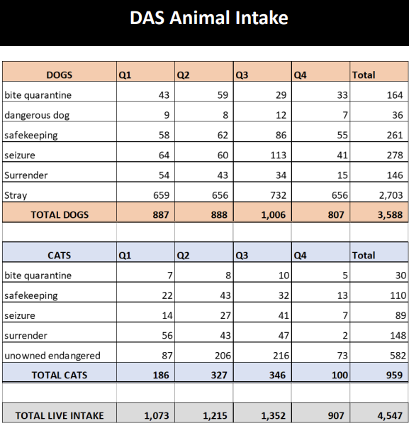
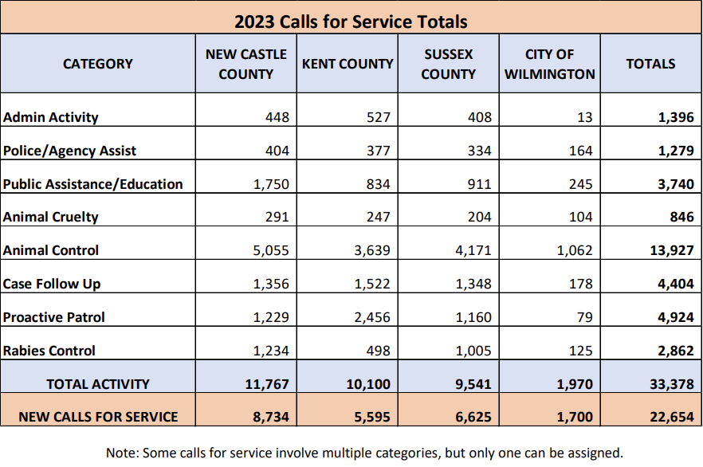
Question 7. Answer

Slide 24
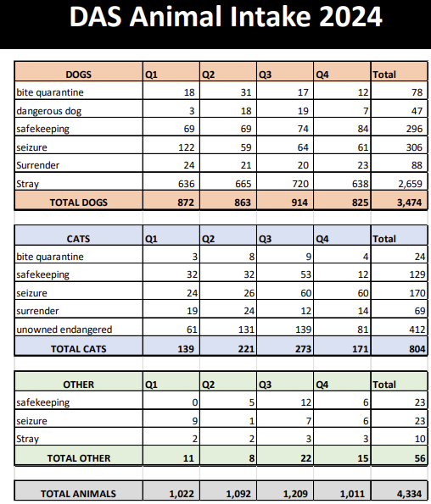
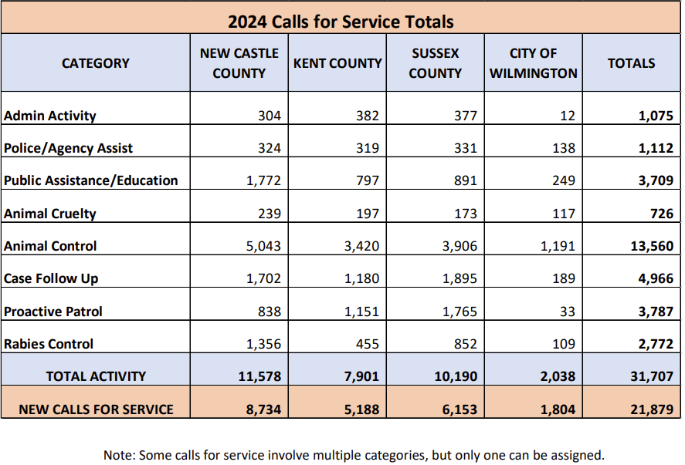
Question 7. Answer

Slide 25
Delaware Animal Services Annual Reports
The Delaware Department of Health & Social Services, Division of Public Health, Office of Animal Welfare is the contract provider, and the length of the contract is for 3 years (ending in June of 2027).
2024 Annual Performance Report
2023 Annual Performance Report
Link: https://animalservices.delaware.gov/detail/12

Slide 26
Question 8.
Considering the number of Inspectors in your department, share within your organizational chart if they are aligned by certain quadrants, sectors, and or districts, and if so, please provide on a chart.
  Provide FY2026 proposed organizational chart with the total of employees (i.e. permanent, temporary, contract, vacancies).
  Share if any staffing resources are allocated for tenants’ rights for health or safety issues.
  Specify is any plans for Inspectors to do any virtual inspections.
  Specify if this organizational chart allows for pre-rental inspections or is it only rental inspections. Please explain.

Slide 27
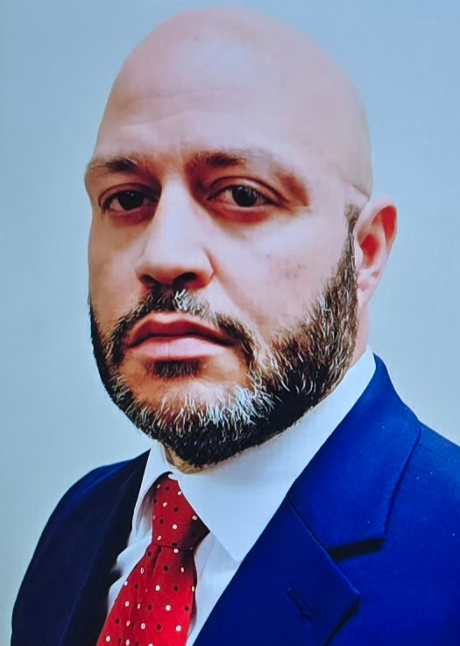
Total Employees: 26 Employees
Commissioner
Code Enforcement Supervisor
(2 Employees)
Administrative Assistant
Code Enforcement Inspector
(18 Employees)
Code Enforcement Administrator
Clerical Supervisor
Administrative Clerks
(3 Employees)
LSE – Office Assistant
(1 Employee)

Slide 28
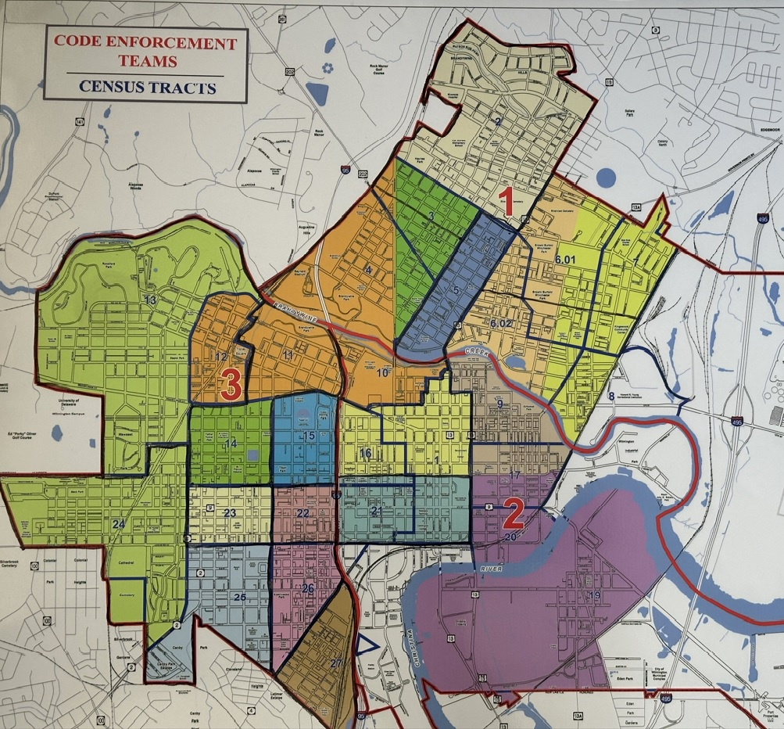
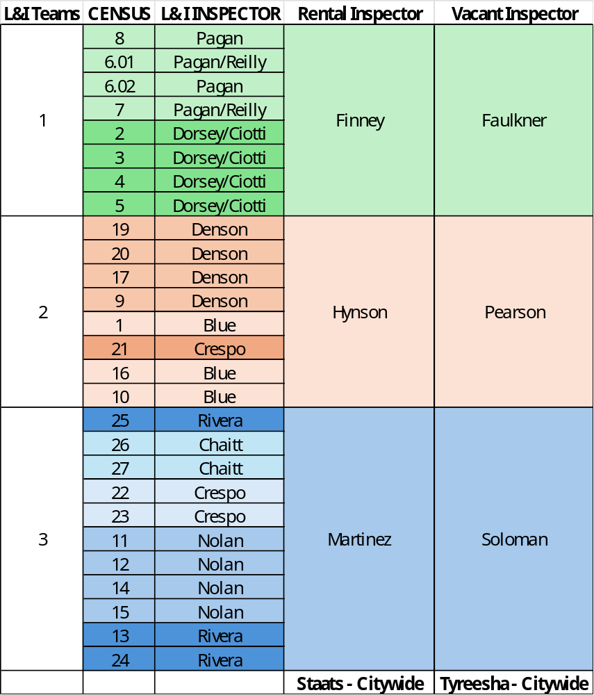
Inspectors are assigned by geographic boundaries by census tracks and area activity.
Question 8. Answer

Slide 29
Question 8. Answer
  Ten (10) inspectors are deployed based on geographical areas, in addition to eight (8) tasked with addressing vacant properties and rental properties. All inspectors address complaints made by tenants related to health or safety issues. Additionally, the State of Delaware Tenant – Landlord code regulates the process for tenant-landlord disputes.
  There is no plan for inspectors to do any virtual inspections.
  The department currently does not perform pre-rental inspections and does not have the workforce to support a pre-rental inspection function.

Slide 30
QUESTION 9.
Share any budgetary request for new vehicles.

Slide 31
Question 9. Answer
Vehicles were upgraded in FY25 from the Trax to Equinox for more compartment space to provide the inspectors more room to do their administrative work in the field on their tablets. The last four (4) replacement vehicles were approved for the FY26 budget.

