Slide 1


FY 2026 Budget Hearing
MAYOR’S OFFICE

Slide 2
FY 2026 Proposed Budget
Summary of All Funds* | FY 2023 Actuals | FY 2024 Actuals | FY 2025 Budget | Proposed Budget FY 2026 | $ Change FY'26-25 | % Change FY'26-25
Personal Services | $2,975,419 | $3,401,647 | $3,361,222 | $3,632,512 | $271,290 | 8.1%
Materials, Supplies, and Equipment | 1,821,759 | 2,093,802 | 2,029,660 | 1,969,970 | (59,690) | -2.9%
Internal Services | 182,882 | 271,290 | 146,218 | 151,184 | 4,966 | 3.4%
Debt Service | 868,189 | 825,663 | 816,136 | 811,679 | (4,457) | -0.5%
Contingent Reserves | 0 | 0 | 672,000 | 672,000 | 0 | 0.0%
EMPG Grant | 171,552 | 190,131 | 85,810 | 149,299 | 63,489 | 74.0%
Total | $6,019,801 | $6,782,533 | $7,111,046 | $7,386,644 | $275,598 | 3.9%
Staffing Level (FTEs) | 25.0 | 26.0 | 25.0 | 26.0 | 1.0 | 4.0%
* Excluding Office of Economic Development

Slide 3
Major Funding Changes (Proposed Budget)
Personal Services (↑ $271,290)
Midyear FY 2025:
  Transition budget amendment, net +2.0 FTE (↑ $284,300)
  Compensation and classification realignment (↑ $21,600)
FY 2026 budget:
  Add Emergency Management Planner position (↑ $125,574, split 50% general / 50% special)
  Delete Executive Assistant to the Mayor, Director of Community Engagement (↓ $278,300)
  Temporary Salaries for Special Assistant for Community Engagement, Admin Assistant (↑ $129,000)
Materials, Supplies, and Equipment (↓ $59,690)
Expanded Cultural Affairs support for community program and events (↑ $225,000)
Eliminate one-time transition costs (↓ $75,000), advertising (↓ $195,000)
HBCU funding moved from Consultants to Grants to Agencies ($200,000, unchanged)

Slide 4
Question 1
Considering the recent court mandated property tax reassessment that has been completed for New Castle County that was done by Tyler Technologies, please share any citywide budgetary or fiscal plans to provide any type of financial assistance if warranted due to various financial circumstances.
Answer:
We are currently working with New Castle County to review the accuracy of the overall assessment and determine if any systemic adjustments can be made.
Our conversations with the County will inform any tax assistance solution we present.

Slide 5
Question 2a and 2b
With the evolving changes regarding Federal Grant Funding, while understanding possible legal challenges, discuss if any potential budgetary or fiscal contingencies for this upcoming budget, considering the large amount of grants, low interest loans, etc. that the city is heavily depended on for the day-to-day operations of the city, as well as capital funds. Please explain why or why not.
Not withstanding the $10M allocated as part of the current FY25 Budget for the Brace Bridge Project, share the impact if any, now that Federal Funding for $5M may be on the chopping block.
Share the impact of the Federal Government changing the tax-exempt status on municipal bonds.

Slide 6
Question 2 Answer
Budgetary Impact: The potential loss of federal funds and the potential impact of taxable municipal bonds may require reallocation of funds from other priority areas within the budget or increased revenue measures to maintain fiscal stability.
Capital Planning: We may need to reassess the scale and timing of capital projects to accommodate higher financing costs.
Advocacy Efforts: We will engage with legislative representatives to advocate for the preservation of our federal funding and the tax-exempt status of municipal bonds, highlighting the financial strain that would result from their removal.
Alternative Financing Strategies: We will explore other financing mechanisms, such as public-private partnerships or grants, that could mitigate the impact of increased borrowing and operational costs. However, we caution that alternative sources of funding may be very limited.

Slide 7
Question 2a Answer
Question: Not withstanding the $10M allocated as part of the current FY25 Budget for the Bridge project, share the impact if any, now that Federal Funding for $5M may be on the chopping block.
We have no knowledge of the loss of $5 million in federal funding impacting the viability of The Bridge project.
However, if the project does not move forward, the City’s $10 million contribution will be returned.

Slide 8
Question 2b Answer
Question: Share the impact of the Federal Government changing the tax-exempt status on municipal bonds.
We analyzed guidance from the Government Finance Officers Association (GFOA) and our own historical experience to determine the potential impact of the federal government removing the tax-exempt status of municipal bonds.
Key Findings:
The difference in interest rates between tax-exempt bonds and taxable bonds is approximately 200 basis points (2.0 percentage points).
The City typically issues $25 million in bonds to finance the biennial General Fund Capital Budget.
If required to issue taxable bonds instead, the annual debt service expense would increase by approximately $350,000.
Over a 20-year repayment period, the City would incur an additional $7 million in total debt service costs.

Slide 9
Question 3
Council shared its FY26 Budget Priorities with the Administration, please elaborate on how the Mayor’s Office proposed budget is aligned with some of the following priorities, and share any sustainability efforts:
Community: Beautification funding set aside in this operating budget for initiatives to address city-wide beautification needs.
Education: Continued HBCU Funding, with a minimum of $100K specifically for Wilmington residents ONLY.
Public Safety: Continued funding for Police Accountability Board (PAB) or Citizen Review (CRB).
Public Safety: Funding set aside for expanding CPSI to other parts of the City.

Slide 10
Question 3a Answer
Question: Community: Beautification funding set aside in this operating budget for initiatives to address city-wide beautification needs.
We plan to work with the NPCs to expend their remaining capital funds to fulfill beautification requests.
For non-capital requests and projects that fall in districts that have already expended NPC funds, we will work with Council to identify existing funding for priority projects.
$2.5 million has been added to Neighborhood Stabilization which will include funds for tree trimming and alleyways.
Clean Team has been increased by $100,000 to a new total of $900,000.

Slide 11
Question 3b Answer
Question: Education: Continued HBCU Funding, with a minimum of $100K specifically for Wilmington residents ONLY.
$200,000 has been included in the operating budget.
We will stipulate that $100,000 is specifically set aside for City youth.

Slide 12
Question 3c Answer
Question: Public Safety: Continued funding for Police Accountability Board (PAB) or Citizen Review (CRB).
$30,000 has been included in the WPD budget for the Community Police Accountability Board.

Slide 13
Question 3d Answer
Question: Public Safety: Funding set aside for expanding CPSI to other parts of the City.
CPSI is currently funded through the end of FY 2026.
We are working to identify non-federal sources of funding that could be used to expand the CPSI, which currently costs over $1 million per year.

Slide 14
Question 4
Discuss any current vacant positions.
  Specify duration of the vacancy.
  Specify timeframe for filling position.
  Specify if position generates revenue, and if so, estimated amount.

Slide 15
Question 4 Answer
There is currently one vacant position, the Director of Communications.
  The position has been vacant since January.
  We are working to fill the position ASAP.
  The position is not revenue generating.

Slide 16
Question 5
Discuss any proposed changes to positions (new position, deleted position, upgrade, realignment, transition, downgrade, title change, salary changes, etc.).
Share any organization staffing changes to build up Constituent Services, and the services for 311.
  Specify the average daily calls to 311, and average response time for completion of the request submitted.
  With the new Emergency Management Planner position, share if this position will interact with the community particularly with flooding issues, climate change, and sea level rise.
  Share about the additional $129K budgeted for Temps.

Slide 17
Question 5 Answer
Question: Discuss any proposed changes to positions (new position, deleted position, upgrade, realignment, transition, downgrade, title change, salary changes, etc.).
There was a net increase of 2 FTEs during the recent mid-year budget amendment.
After acclimating to the office and reviewing the citywide budget, the new administration has decided to eliminate these positions:
  Director of Community Engagement
  Executive Assistant to the Mayor
Eliminating these positions saves $278,300.

Slide 18
Question 5a Answer
Question: Share any organization staffing changes to build up Constituent Services, and the services for 311.
One existing and one new Special Assistant for Community Engagement positions have been added to Constituent Services, as well as one new Constituent Services Officer position, bringing staffing in the Office from 3 FTEs to 6 FTEs.
We have also included $20,000 for a Spanish-speaking temporary employee.
Community Engagement personnel will work to proactively identify issues and communicate with the public, while Constituent Services will work reactively to resolve issues.
We are still mulling changes to the structure of 311. We want to ensure that any changes we make are carefully considered and fully responsive to any problems in the system.

Slide 19
Question 5a-i Answer
Question: Specify the average daily calls to 311, and average response time for completion of the request submitted.
Average Case Age in Days, February 2025
Constituent Services | 4.3
Economic Development | 5.2
Finance | 1.4
L&I | 1.8
Land Use | 5.2
Mayor's Office | 21.0
Parks & Recreation | 41.9
Planning & Development | 0.0
Public Works | 122.3*
Real Estate & Housing | 2.1
*84.6 days with sidewalk cases excluded

Slide 20
Question 5a-ii Answer
Question: With the new Emergency Management Planner position, share if this position will interact with the community particularly with flooding issues, climate change, and sea level rise.
The full-time Emergency Planner position will support the Office of Emergency Management's community outreach and preparedness mission, which includes educating and engaging the community on hazards such as flooding, climate change, and sea level rise.
The current EM Planner is a part-time position, which was filled in November of 2024.
Since that time, the department has organized or attended community outreach events with over 125 residents from various neighborhood groups and civic associations. This significantly outpaces outreach done in previous years.

Slide 21
Question 5a-iii Answer
Question: Share about the additional $129K budgeted for Temps.
One Special Assistant for Community Engagement position will focus on education initiatives ($54,000).
One Administrative Assistant will provide part-time support to the Chief of Staff and the department ($75,000).

Slide 22
Question 6
Discuss the planned use of ~$515K budgeted for Grants to Agencies, up $200K over prior year’s budget (excluding OED).
Specify the reoccurring large grants.
Share the process for how organizations can submit for large grants.

Slide 23
Question 6 Answer
Use of Grants to Agencies | Proposed FY 2026 Budget Amount
Wilmington Hope Commission | $135,000
Wilmington Economic Development Corp. | $50,000
Wilmington Library | $50,000
WECEC | $17,000
Wilmington Jaycees | $10,000
HBCU Week Foundation | $200,000
All grants are allocated to assist with ongoing administrative and operational expenses. The $200,000 increase was due to moving HBCU funding from Consultants to Grants to Agencies.
All are reoccurring.
Grant requests must be submitted in writing to the Mayor’s Office.

Slide 24
Question 7
Discuss the planned use for $475K budgeted in the Miscellaneous Project account line in the Cultural Affairs Division, up $225K.
Specify any fees charged and or revenues collected for annual festivities such as Clifford Brown, July 4th Celebration, Juneteenth, etc.
Specify any sponsorships.

Slide 25
Question 7 Answer
The additional $225,000 in this budget line supports expanded programming, rising artists’ fees and increased production costs related to community and cultural events. Approximately $324,000 of the total is earmarked for:
Expanded Community Programming at the Urban Artist Exchange (UAE) and broader community:
Weekly summer concert series featuring local and regional artists.
Launch of The Mane Gallery, a newly activated art exhibition space.
A multi-day Dance Festival to highlight culturally diverse dance traditions.
Adding community engagement activities/performances to the Wilmington Black Storytelling Residency and the Boysie Lowery Living Jazz Residency.

Slide 26
Question 7 Answer Continued
Increased Production Costs Across All Events:
Union labor costs (stagehands, sound engineers, etc.).
Equipment rental (staging, lighting, audio/visual).
Cost of stage coverings, flooring, soundproofing, and barricades.
Travel and lodging for regional/national performers.
Rising Artist Fees:
Fees have increased 15–30% for high-caliber artists and ensembles.
Community-focused artists and teaching artists are also receiving more competitive compensation.
Future Planning – 2026 Juneteenth Celebration:
Projected increase in costs to enhance programming, cultural authenticity, and audience experience. Includes expanded youth engagement, wellness programming, and higher artist and production costs.

Slide 27
Question 7 Answer Continued
Sponsorships and Vendor Income:
Corporate sponsorships have declined in recent years due to shifting priorities, changes in leadership at key companies (many now based outside Wilmington).
In addition, increased competition from other City departments and initiatives that use Cityfest as a passthrough for grant requests has diluted the organization’s capacity to secure sponsorships solely for its core programming.
Vendor fees and merchandise sales provide a modest but steady revenue stream, though they are not substantial enough to significantly offset program costs.

Slide 28
Question 8
Share the planned use for ~$324K budgeted for Consultants (excluding OED).
Specify vendor name, length of contract, and purpose.
Specify if any DBE’s.

Slide 29
Question 8a Answer – Mayor’s Office Admin
Use of Professional Services Funds | Vendor | Length | Purpose | Proposed FY 2026 Budget Amount
Lobbyist | Maven Strategies LLC | Annual | Represent City’s interests at State Legislature | $46,000
Special Projects Consultant | TBD | TBD, up to 1 year | As needed | $15,000
Contingency consultant services | TBD | TBD, up to 1 year | As needed | $40,000
Total: |  |  |  | $101,000

Slide 30
Question 8a Answer – Cultural Affairs
Disadvantaged Business Enterprises (DBEs):
The Office of Cultural Affairs is committed to supporting minority-owned and operated small businesses. The annual contracts with Flux Creative Consultants, Tierra Spencer, and TAHIRA exemplify this commitment, as all are recognized minority-owned enterprises. For other consulting needs, the office actively seeks to engage DBEs, ensuring that procurement practices promote diversity and inclusion within the cultural programming sector.
Vendor Details:
Flux Creative Consultants - $42,000
Purpose: Provides a range of services including event production, marketing, and community engagement support for various cultural programs.
Length of Contract: Annual contract, subject to renewal based on performance and program needs.
Vendor Status: Minority-owned small business.

Slide 31
Question 8a Answer – Cultural Affairs (continued)
Tierra Spencer - $30,000
Purpose: Serves as the Project Coordinator for the Urban Artist Exchange (UAE) and Director of the Arts Work Youth Apprenticeship Program, overseeing program development, artist coordination, and youth mentorship initiatives.
Length of Contract: Annual contract, with potential for renewal aligned with program cycles.
Vendor Status: Minority-owned small business.
TAHIRA – $5,360
Purpose: Leads the Wilmington Black Storytelling Residency, focusing on preserving and promoting African and African-American storytelling traditions through workshops and performances.
Length of Contract: Agreement structured around the residency schedule, typically annual with specific deliverables.
Vendor Status: Minority-owned small business.

Slide 32
Question 8a Answer – Cultural Affairs (continued)
Additional Consultants
Purpose: Engaged on a case-by-case basis to provide specialized professional services essential for program execution. For example, stage managers are hired for the UAE concert series to ensure seamless event operations.
Length of Contract: Contracts are project-specific, varying in duration based on the scope and timeline of the event or program.
Vendor Status: Efforts are made to include Disadvantaged Business Enterprises (DBEs) where possible, though status may vary depending on the specific consultant engaged.

Slide 33
Question 8a Answer – Cultural Affairs (continued)
In addition to our current consultant engagements, we are actively negotiating with a minority-operated small business to curate and program The Mane Gallery at the Urban Artist Exchange (UAE).
The Mane Gallery will offer local visual artists regular exhibition opportunities and participation in Wilmington’s monthly Art Loop and further the Office of Cultural Affairs’ commitment to supporting diverse, minority-owned businesses within Wilmington’s arts community.
The consultant's budget also covers some of the Clifford Brown Jazz Festival expenses, explicitly funding the travel and accommodations for the artists that travel with encourages.
This allocation ensures that the festival can attract and host high-caliber performers and maintain its reputation as the largest free jazz festival on the East Coast.

Slide 34
Question 9
With the $195K reduction in Advertising for removal of the “It’s Time Campaign”, please share the continued marketing and advertising strategies for promoting the City of Wilmington, and the corelating budgetary costs.

Slide 35
Question 9 Answer
We plan to carefully evaluate long-term marketing strategies before committing to a specific approach or program.
In the meantime, $45,000 has been budgeted to allow for digital, radio, and print advertising.
We will continue to work with WITN and DETV to advertise initiatives throughout the year.

Slide 36
Question 10
Discuss the planned use for $166K budgeted in the Miscellaneous Services account line.
Specify the number of graffiti removals done in the last 2 fiscal years.

Slide 37
Question 10 Answer
$15,000 – Mayor’s Office Admin
  Plant service, sympathy/get well expressions, holiday trees
$114,000 – Office of Emergency Management
  Emergency Operations Center building maintenance contract
$6,000 – Cultural Affairs
  $4,500 - Unanticipated program/event costs (weather, venue change charges)
  $1,500 - Staff Professional Development Workshops/Trainings
$30,000 – Constituent Services
  Citywide graffiti removal

Slide 38
Question 10a Answer
Graffiti removal was low in FY 2024 and FY 2025, as we lacked sufficient staff in Constituent Services to proactively identify graffiti.
With the addition of a Constituent Services Officer and a Community Engagement team, we plan to significantly increase the amount of graffiti removal in FY 2026.
Fiscal Year | # of Sites Cleaned | Area Cleaned (Square Feet) | Amount Spent
2023 | 34 | 2,295 | $9,272
2024 | 20 | 908 | $4,043
2025 YTD | 45 | 2,659 | $13,170

Slide 39
Question 11
For Seniors, please share the budgetary allocations set aside to address some of their needs (ex. fans, thanksgiving ball, etc.).
$34,000 – Thanksgiving Senior Ball
~$2,000 – Senior Fan Drive
$2 million will be allocated to the Neighborhood Stabilization Fund toward:
  Senior Home Repair Lottery
  Alleyway clean-up/repair pilot program
  Assistance with trees on private property

Slide 40
Capital Budget Question 13
While realizing there is a delay when the city goes to the bond market, if you could share some potential planned use or possible projects intended for the “Five Percent for Art Capital Project” for $400,000.

Slide 41
Capital Budget Question 13 Answer
Access to the $400,000 depends on the timing of the City’s bond issuance, and no specific projects have been identified. Potential uses may include:
Public Art at Capital Project Sites – Murals, sculptures, or other artistic features incorporated into public infrastructure, parks, and facilities.
Enhancements at the Urban Artist Exchange – Artistic signage, sculptural seating, or installations that support the site’s ongoing development.
Local Artist Commissions – Projects celebrating Wilmington’s neighborhoods and cultural identity.
Cultural and Historical Works – Art that honors significant people, places, or events in Wilmington’s history.
Maintenance of Existing Public Art – Conservation of city-owned artworks to preserve their quality and visibility.

Slide 42
Capital Budget Question 13 Answer (continued)
The Mayor's Office of Cultural Affairs will create a process to evaluate project ideas. Before this process is implemented, it will be reviewed by city attorneys, the administration team, and other relevant departments.
Once the projects are selected, recommendations will be submitted to the Administration for approval before any committees are formed to carry out the projects.
A similar collaborative approach was used in the development of "Unwavering Courage in the Pursuit of Freedom," the public sculpture honoring Harriet Tubman and Thomas Garrett. This project was guided by an advisory committee that included historians, artists, community leaders, and cultural advocates, ensuring diverse perspectives that focused on historical accuracy, community representation, and artistic integrity.
We plan to model future project teams after this successful example of inclusive, community-centered collaboration.

Slide 43
Mayor’s Office
Organizational Chart

Slide 44
Mayor’s Office Admin (10 FTEs)*
& Constituent Services (6 FTEs)
MAYOR
CHIEF OF STAFF
SPECIAL ASSISTANT TO THE MAYOR
DIRECTOR OF SPECIAL PROJECTS
DEPUTY COS
OPERATIONS
DEPUTY COS
POLICY & COMMUNICATIONS
DIRECTOR OF OPERATIONS
SR CONSTITUENT SERVICES OFFICER
DIRECTOR OF COMMUNICATIONS
MAYOR’S OFFICE RECEPTIONIST
311 ADMINISTRATOR
CONSTITUENT SERVICES OFFICER (2)
DEPT. DIRECTOR OF COMMUNICATIONS
* Includes proposed staffing changes.
SPECIAL ASSISTANT FOR COMMUNITY ENGAGEMENT (2)

Slide 45
Cultural Affairs (3 FTE)
DIRECTOR OF CULTURAL AFFAIRS
ARTS PROGRAM ADMINISTRATOR
EVENTS PERMITTING AND SPECIAL PROJECTS ASSISTANT

Slide 46
Office of Management & Budget (5 FTE)
BUDGET DIRECTOR
ASSISTANT BUDGET DIRECTOR
FISCAL & OPERATIONS
ANALYST (3)

Slide 47
Office of Emergency Management (2 FTE)
EMERGENCY MANAGEMENT DIRECTOR
EMERGENCY MANAGEMENT PLANNER

Slide 48
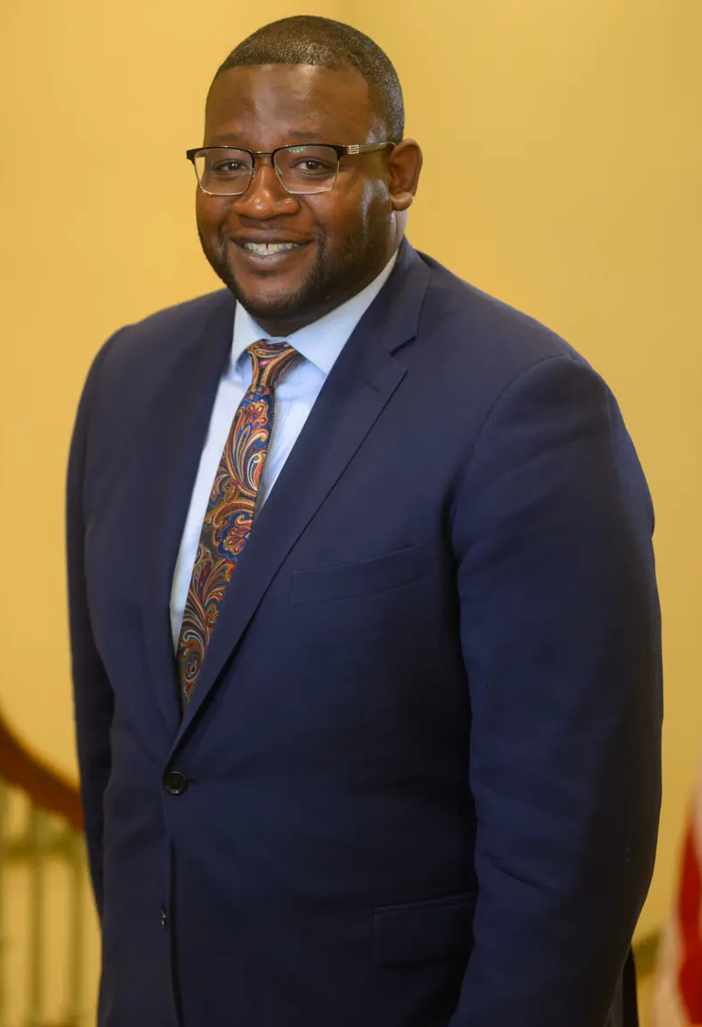
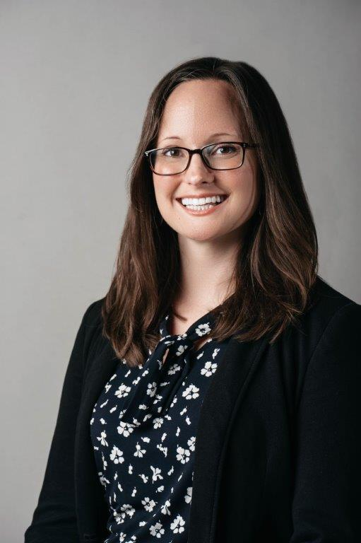
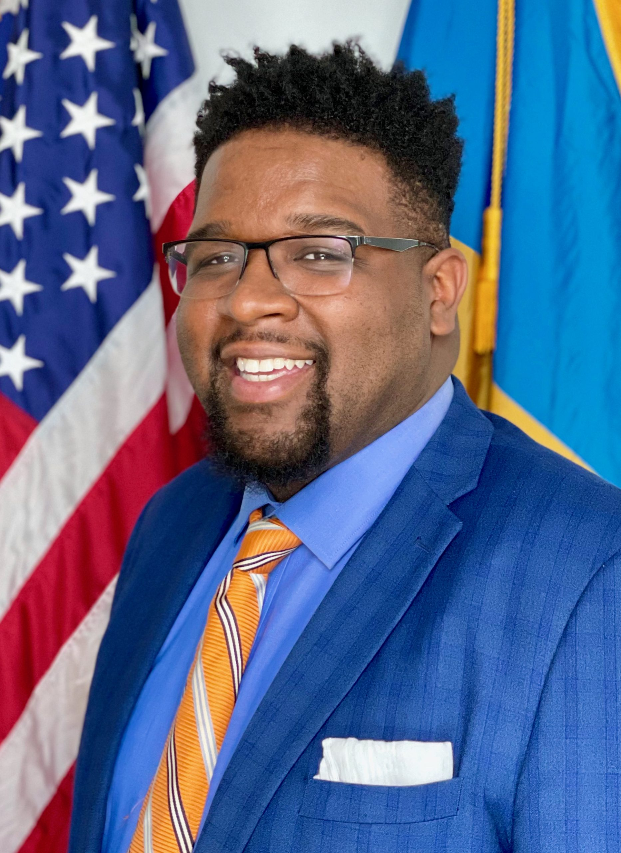
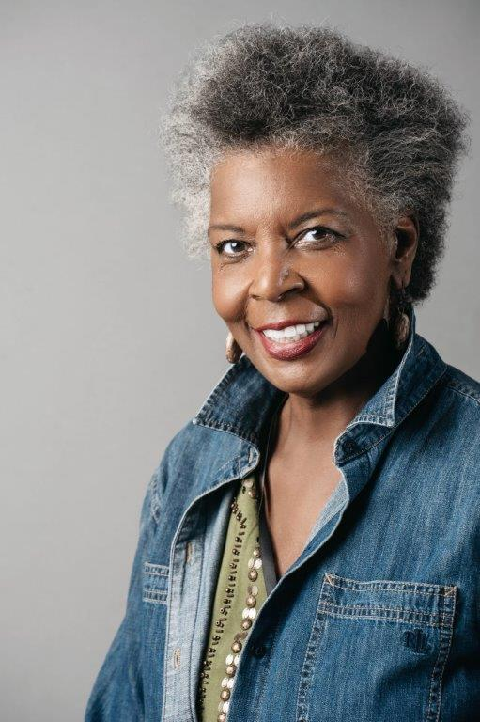
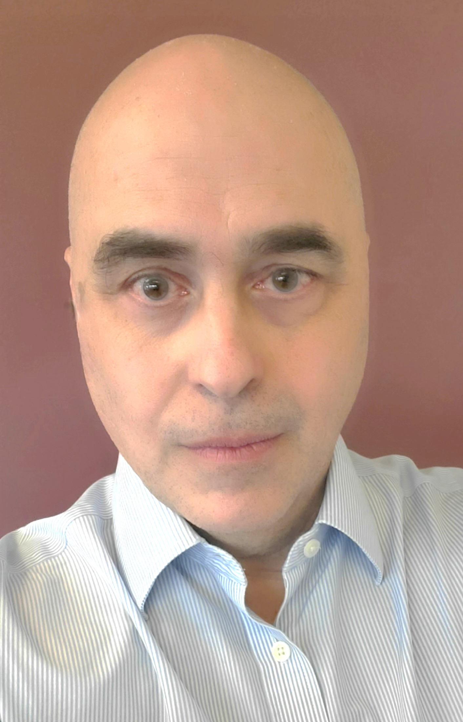
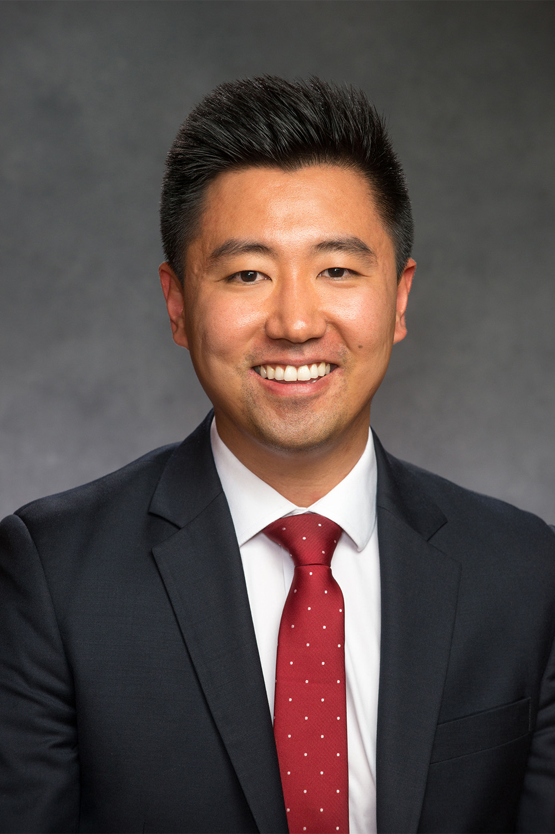
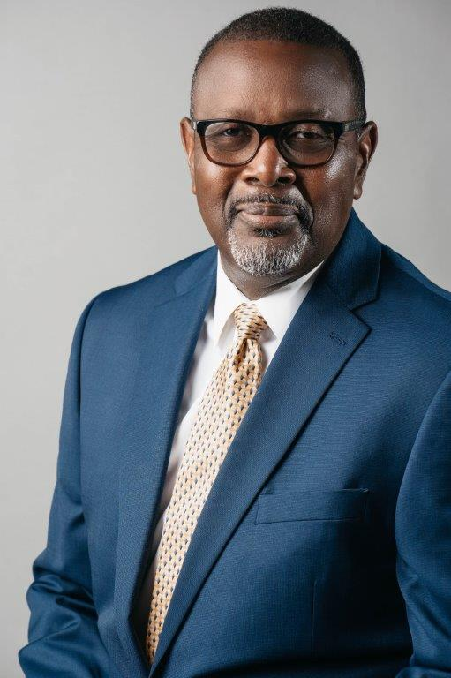
Mayor’s Office Senior Staff
Cerron Cade Washington
Chief of Staff
Stephanie Mergler
Deputy Chief of Staff – Operations
Daniel Walker
Deputy Chief of Staff – Policy and Communications
Tina Betz
Director
Office of Cultural Affairs
Rob Greco
Director
Office of Management and Budget
Sean Park
Director
Office of Economic Development
Willie Patrick
Director
Office of Emergency Management

