Slide 1


FY 2026 Budget Hearing
PUBLIC WORKS
(General & Motor Vehicle Funds)

Slide 2
General Fund – Proposed FY 2026 Budget
Public Works Department General Fund | FY 2023 Actuals | FY 2024 Actuals | FY 2025 Budget | Proposed Budget FY 2026 | $ Change FY'26-25 | % Change FY'26-25
Personal Services | $9,334,720 | $10,029,951 | $10,332,603 | $11,008,398 | $675,795 | 6.5%
Materials, Supplies, and Equipment | 8,112,831 | 9,359,752 | 9,510,791 | 10,057,216 | 546,425 | 5.7%
Internal Services | 3,664,488 | 4,354,169 | 4,121,736 | 4,281,584 | 159,848 | 3.9%
Debt Service | 6,273,219 | 6,181,803 | 5,914,619 | 6,005,668 | 91,049 | 1.5%
Total | $27,385,258 | $29,925,681 | $29,879,749 | $31,352,866 | $1,473,117 | 4.9%
Staffing Level (General Fund FTEs) | 120.05 | 120.05 | 117.55 | 117.55 | 0.0 | 0.0%

Slide 3
Major Funding Changes (General Fund Proposed Budget)
Midyear FY 2025 Departmental Realignment (↑ $37,982)
  Realignment to the Compensation and Classifications Study
  Impacted 8 positions (3 positions split-funded with the Water/Sewer Fund)
Position Changes (↓$30,368)
  4 Positions Downgraded – Street Cleaning Division
    Equipment Operator → General Laborers III
Salary and Wages (↑ $416,478)
Employee Benefits (↑ $297,549)

Slide 4
Major Funding Changes (General Fund Proposed Budget)
Water/Sewer Utility & Stormwater Utility (↑ $160,378)
  FY26 Proposed Rate Increases
    Water/Sewer – 6.5% | Stormwater – 6.0%
Repairs to Buildings and Structures (↑ $145,000)
  Asset Management: property management and repairs services agreement – Municipal Services Complex (Turner Building)

Slide 5
Major Funding Changes (General Fund Proposed Budget)
Greenspace Maintenance (↑ $75,000)
  Additional sidewalk repairs for tree-related sidewalk replacement
Building Maintenance (↑ $69,543)
  Asset Management maintenance costs – City/County Building
Electricity (↓ $51,746)
  Align with prior fiscal year expenditure trends

Slide 6
Major Funding Changes (General Fund Proposed Budget)
Contracted Maintenance Services (↑ $40,400)
  Brine-making maintenance agreement and Engineering/Design contract
Temporary Agencies (↑ $35,000)
  Hiring challenges and unfilled positions of critical personnel
Consultants (↑ $20,950)
  Traffic Studies, Grant Writing, Staff Development and Retention Support

Slide 7
Major Funding Changes (General Fund Proposed Budget)
Xmas Lights & Other Decorations (↑ $19,000)
  Holiday Decorations and Street Tree Lights
Debt Service (↑ $91,049)
  Estimated Payments for the 2025 BAN

Slide 8
Motor Vehicle Fund – Proposed FY 2026 Budget
Public Works Department Motor Vehicle Fund | FY 2023 Actuals | FY 2024 Actuals | FY 2025 Budget | Proposed Budget FY 2026 | $ Change FY'26-25 | % Change FY'26-25
Materials, Supplies, and Equipment | $4,739,780 | $4,792,198 | $5,654,096 | $5,744,491 | $90,395 | 1.6%
Internal Services | 459,639 | 643,491 | 279,562 | 288,025 | 8,463 | 3.0%
Debt Service | 17,531 | 27,478 | 92,155 | 13,523 | (78,632) | -85.3%
Depreciation | 3,272,874 | 3,461,200 | 3,482,705 | 3,461,200 | (21,505) | -0.6%
Total | $8,489,824 | $8,924,368 | $9,508,518 | $9,507,239 | ($1,279) | 0.0%
Staffing Level (Motor Vehicle FTEs) | 0.00 | 0.00 | 0.00 | 0.00 | 0.00 | 0.0%
Notes:
The discrepancy between Powerbi and CK report for FY24 Actuals
FY2024 Actuals
Power Bi:
MS&E: $4,963,088
Total: $9,095,257
CK:
MS&E: $4,792,198
Total: $8,924,368

Slide 9
Major Funding Changes (Motor Vehicle Fund Proposed Budget)
Automotive Equipment (↑ $459,602)
  Fleet Replacement Program – increase in vehicle replacement cost
    Vehicle Requests
      Licenses & Inspections: Upgrade (4) SUVs – Cost: $ 152,800
      Land Use and Planning: Upgrade (2) SUVs – Cost: $ 74,224
      Public Works: (1) Medium Equipment and (1) Trailer – Cost: $74,500
      Parks and Recreation: (2) Medium Equipment and (1) Mower – Cost: $ 33,800
Repairs to Equipment (↑ $79,484)
  Non-target Repairs to Fleet Equipment

Slide 10
DEPARTMENT OF PUBLIC WORKS
The mission of the Department of Public Works is to operate and maintain critical infrastructure and facilities, provide superior services for our customers, and promote resiliency.
The Department of Public Works is complex and provides a wide array of services including: once a week recycling and residential solid waste collection; treatment and distribution of high-quality drinking water; collection and treatment of sewage; storm water management; cleaning and sweeping of City streets; street construction and repairs; maintenance of traffic signs and signals; line striping; storm preparation and snow removal; debris clean-up; and maintenance of the City fleet and City properties; collection and maintenance of GIS data; and much more.

Slide 11
Vision
To provide superior services with respect, with integrity, and with the responsiveness that every customer deserves.
Priorities for FY2026 – General Fund
Beautiful City Initiative – Keep our City clean; reduce trash and increase recycling; stop illegal dumping; improve our sidewalks; repave and repair our streets; plant more trees and maintain gateways; support the community’s efforts to beautify the City.
Infrastructure Improvement Program – Capitalize on funding and partnering opportunities that become available to improve Wilmington’s streets and sidewalks.
Continue street paving and reconstruction and ADA curb ramp installations.

Slide 12
Performance Measures
Public Works collects over 100 data points that are analyzed every 2 weeks. Examples include:
  Street Paving Work by the City, 2-Week periods
  Trash and Recycling Collection Rates Citywide, by route
  Total number of Public Works Service Actions (broken down by group): Public Property, Sanitation, Sewer Maintenance, Street Cleaning, Street Maintenance, Transportation, Trees, Water, Engineering
  City Vehicle Fleet performance, availability of fleet
  Percent of Public Works Service Actions Closed (by groups), median number of days
  Specific Service Tasks totals (broken down by task): special pick-ups, catch basins blocked, dead animal removals, water leaks, sewer back-ups, potholes, trash missed, recycling missed, yard waste requests, illegal dumping, requests for new trash or recycle bins
  Public Works Service requests by Council Districts
  Overtime usage by Division

Slide 13
City Council Questions

Slide 14
Question 1
Discuss the City’s financial condition for Street Paving and whether there is adequate funding and specify any plans for a BAN (Bond Anticipation Note) if warranted.
  Specify the City’s status for ADA curb ramp installations and provide the percentage that is remaining to be completed, and the timeframe for completion.

Slide 15
Question 1 - Response
Remaining BAN Funds for FY’22 and FY’24 CIP Street Paving & Reconstruction - $2.715M
Remaining BAN Funding for ADA Curb Ramp & Sidewalk Compliance - $1.183M
We keep a complete list of all ADA improvements completed under our contracts. However, without performing an ADA assessment of the City's network it would be difficult to provide a percentage to completion of the network. There are other outside entities that have also completed ADA ramp improvements that we don't have locations for making it difficult to give an accurate count.
We have completed roughly 1,027 ADA ramps since 2017.
The ADA Assessment initiated by the Mayors Office will be completed late summer.

Slide 16
Question 2
Considering the current climate regarding the evolving mandates for Electric Vehicles, as well as sufficient on street parking, share if this proposed budget addresses any possible fiscal solutions.
  Specify if any EV charger placements, public EV parking spaces, etc.
  Share any plans for comprehensive study of on-street parking assessment.

Slide 17
Question 2 - Response
The FY’26 budget request does not include any direct funding for electric vehicle charging stations.
Public Works has engaged RK&K to do a comprehensive parking study. This will kick off with a downtown pilot study to address immediate needs of parking and EV concerns.
Public Works will work with the State to explore funding options for EV infrastructure.

Slide 18
Question 3
In view of the Delaware Energy Solutions Act of 2024, and any other legislative mandates for climate control, please share how your budget places environmental sustainability as a fiscal budgetary priority.

Slide 19
Question 3 - Response
Public Works General Fund and Motor Vehicle Fund budget is comprised of funding to carry out City Charter and City Code mandated functions of our department including Salaries, Benefits, MS&E Expenses, Internal Services Charges, and Debt Service.
Delaware Energy Solutions Act of 2024 created a framework for the state to approve offshore wind projects along the coastlines. Since Wilmington is not a coastal city offshore wind projects are not something we have investigated.
Public Works leads Resilient Wilmington and is continues to work towards multiple sustainability goals.
We are purchasing hybrid and EV fleet vehicles as part of our resiliency efforts.
The City has been a member of the Climate Registry since 2012 and has engaged in multiple projects to reduce GHG emissions.

Slide 20
Question 4
Discuss the potential impact to this budget for any changes with the Biden Bipartisan Infrastructure Bill.

Slide 21
Question 4 - Response
The Bipartisan Infrastructure Law (BIL) does not affect our General Fund or Motor Vehicle Fund budget because no funding was received for either fund to date.

Slide 22
Question 1 – General Fund
Discuss current vacant positions.
Specify duration of the vacancy.
Specify impact to the department due to the length of the vacancy.
    Any impact to Overtime, Consultants, Temps, etc.
Justify the need for the position, if any.

Slide 23
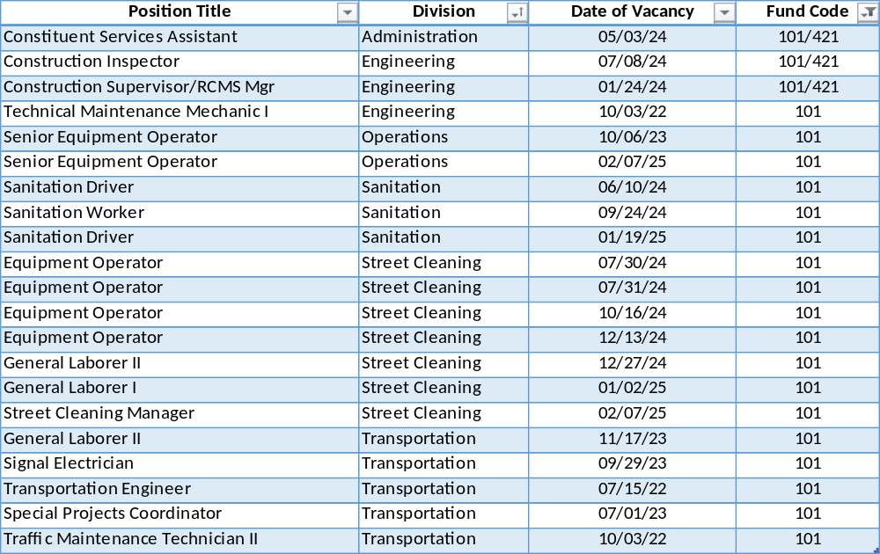
Vacant Positions

Slide 24
Vacant Positions
  We are working closely with Human Resources to fill vacancies as quickly as possible that are approved by the Chief of Staff.
  Street Cleaning is using temp employes for General Laborer positions.
  Operations is using temp employees in Tree Crew Technician positions.
  Transportation has brought in temp employees to assist with the Special Projects Coordinator responsibilities and General Laborer positions.
  There is an operational need for the above listed positions. Further reduction of positions will impact services.
  Public Works averages 30-35 vacancies due to employee turnover and has had trouble in the current labor market attracting and retaining qualified staff due to the available salary ranges and residency requirements.

Slide 25
Question 2 – General Fund
Discuss any proposed changes to positions (new position, deleted position, upgrade, realignment, transition, downgrade, title change, salary change, etc.).

Slide 26
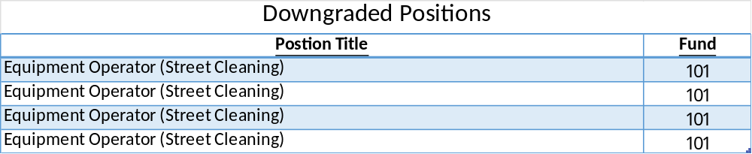
Changes to Positions
  (4) Vacant Equipment Operator positions in Street Cleaning were downgraded to General Laborer III positions due to difficulty in hiring employees with CDL driver’s licenses. The G/L III positions don’t require a CDL license.

Slide 27
Question 3 – General Fund
Considering your proposed budget has ~117.55 full time positions, which ~75% consist of labor positions, and ~25% non-labor, discuss how your budget is augmented with additional staffing support for $1.2M:
Professional Fees | FY’2026 Proposed Budget | FY’2025 Budget | Change
Consultants | $352,104 | $331,154 | $20,950
Engineering | $278,000 | $278,000
Temp Agency | $650,000 | $615,000 | $35,000
Total | $1,280,104 | $1,224,154 | $55,950

Slide 28
Question 3 – General Fund
Specify vendor name, amount of contract, expiration date, length of contract, how long City has been doing business with the vendor, and scope of services.
Specify if any vendors are DBE’s.
Specify any reoccurring contracts.
Specify hourly wages and length of service for all temporary, limited service or contracted employees, and number of limited-service employees.
Realizing vacancies, residency concerns, and specialized expertise, share any consideration for transferring of knowledge and or not so heavily dependent on outside resources.

Slide 29
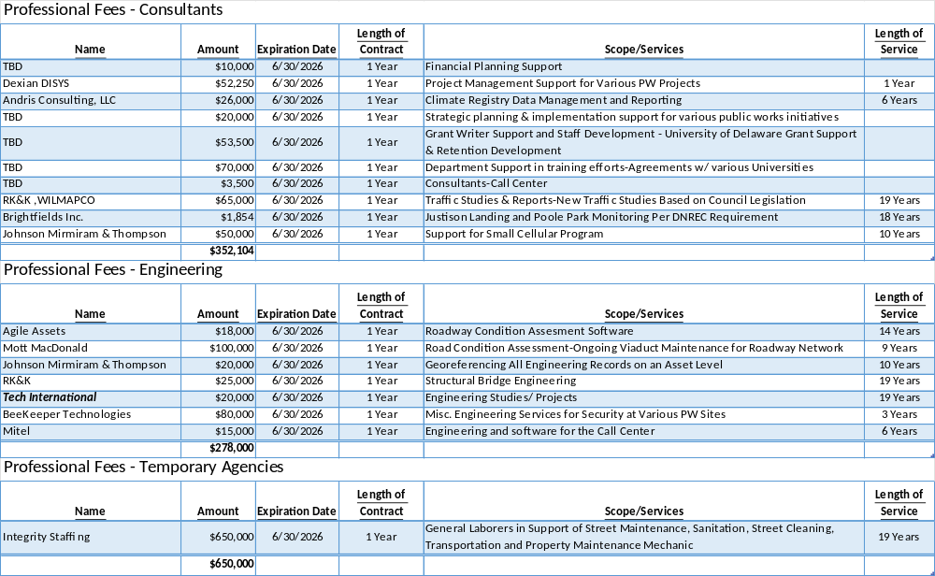

Slide 30
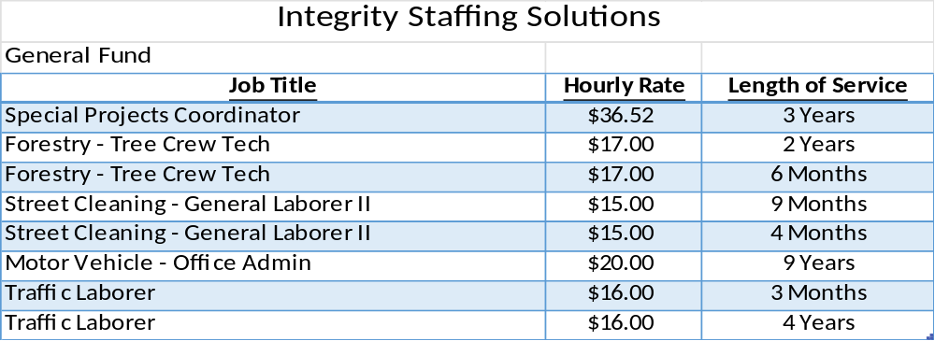
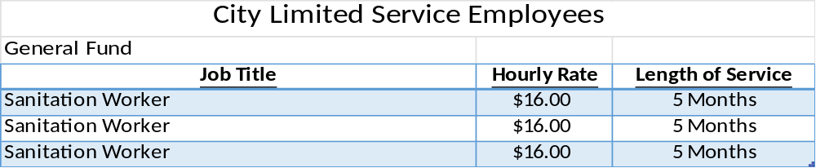
Consultants, Engineering, Temp Agencies

Slide 31
Consultants, Engineering, Temp Agencies
Public Works managers bring in the necessary assistance they need for the project at hand.
Specific expertise is often required for which we don’t have someone on staff that can design or engineer a specific project.
By using outside engineers, the design liability is assumed by the engineer of record not the Public Works manager.
With the large number of projects on-going there are not enough project managers on staff. Our staff manages outside engineers and consultants to assure that tasks and projects are completed successfully.

Slide 32
Question 4 – General Fund
Discuss the planned use of ~$471K budgeted for Overtime, and the mechanisms in place to control overtime.

Slide 33
Overtime – General Fund
Administration - $10k
  Snow Events and Construction Inspectors
Street Maintenance - $3.8k
  Street Repairs and Snow Events
Transportation - $135k
  Emergency Repairs, Knockdowns, Street Light Outages, Crosswalk Painting, Special Projects

Slide 34
Overtime – General Fund
Street Cleaning - $170k
  Snow Events, Leaf Pickups and Cleanup for Special Events
Rubbish Collection - $110k
  Snow Events, Household Hazardous Waste Events and Trash Requests
Property Maintenance - $42k
  Snow Events, Special Events and Emergency Call-In Time
All overtime must be authorized by the division director and approved by the division supervisor and is monitored regularly through the Kronos Timekeeping system by management.

Slide 35
Question 5 – General Fund
Discuss the approximately $2.7M budgeted in the Contracted Maintenance account category, up ~$305K over the prior year’s budget.
 | FY’26 Proposed Budget | FY’25 Budget | Change
Repairs-Miscellaneous | $6,000 | $6,000
Repairs to Equipment | $41,000 | $41,500
Repairs to Buildings and Structures | $644,500 | $499,500 | $145,000
Repairs to Roads & Appurtenances | $65,000 | $50,000 | $15,000
Building Maintenance | $1,566,255 | $1,496,712 | $69,543
Greenspace Maintenance | $385,000 | $310,000 | $75,000
Total | $2,707,755 | $2,403,212 | $304,543

Slide 36
Question 5 – General Fund
Specify vendor name, amount of contract, expiration date, length of contract, how long City has been doing business with the vendor, and scope of services.
Specify if any vendors are DBE’s.
Specify one-year reoccurring contracts.
Specify funds allocated for Building Maintenance Services for this building, and amount of cost that NCC is responsible for sharing.
  Share if adequate funds are budgeted to deal with any mice infestations for this building.
Share the process for publicly requested tree related sidewalk replacement, and the amount of funds available.
Specify cost sharing for Ameresco, and the benefit to the City.

Slide 37
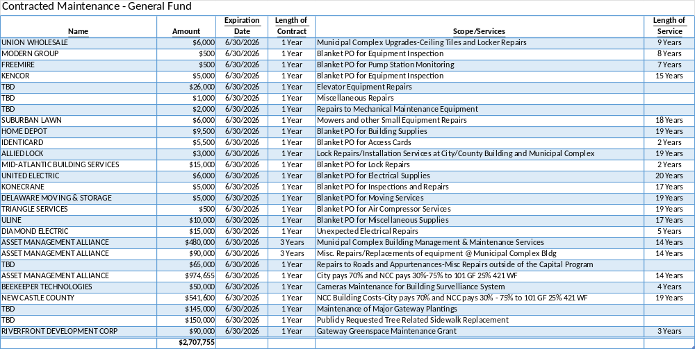
Contracted Maintenance

Slide 38
Contracted Maintenance
Repairs-Misc. - $6k
  Municipal Complex and Mezzanine Repairs
Repairs to Roads and Appurtenances - $65k
  Misc. Street, Curb & Sidewalk, and Brick Crosswalk Repairs
Building Maintenance - $1.566M
  C/C Bldg. Management & Maintenance Costs (Split with NCC 70% / 30%)
  Camera Maintenance for Building Surveillance System
  NCC C/C Bldg. Costs for Electricity and Utilities (Split with NCC 70% / 30%)
Greenspace Maintenance - $385k
  Contracts for Maintenance of Major Gateway Plantings
  Publicly requested Tree Related Sidewalk Replacement
  Riverfront & Christiana River Bridge Approach Gateway

Slide 39
Contracted Maintenance
Repairs to Equipment - $41k
  HVAC/Plumbing/Elevator Repairs at Municipal Complex
  Winch Inspection and Repairs
  Repairs to Pallet Jack, Forklift, and Paint Striping Machine
Repairs to Buildings and Structures - $644.5k
  Asset Management – Municipal Complex Bldg. Management & Maintenance Services

Slide 40
Contracted Maintenance
  The mice problem that occurred last year was attributed to concrete repairs occurring in the parking garage. Now that this project is completed there have not been any reports of mice in the City/County Building.
  Colonial Parking is maintaining rodent traps in the parking garage to minimize mice getting into the upper floors of the buildings.
  The process for publicly requested tree related sidewalk replacement requires that a 311-service request is entered into Cityworks, or an emergency tree removal happens.
  In most cases there is damage to a large portion of the sidewalk when the tree is uprooted. If the stump and roots are large a contractor may be called in to have them removed.
  A concrete contractor is called in to provide a quote to replace the concrete. $15k in additional funding has been requested for Repairs to Roads and Appurtenances for FY’26.
  The Ameresco project was split based on building occupancy 70% City / 30% NCC. Debt Service for this project has been fully paid several years ago.
  The improvements made to the City/County Bldg. as part of the Ameresco project have resulted in lower overall electricity costs and allowed the City to install upgrades to the heating system and lighting throughout the building.

Slide 41
Question 6 – General Fund
Discuss the ~$2.2M budgeted in Other Fees pertaining to Landfill Fees and Recycling.
  Specify the total tonnage for the landfill for the last 2 years, and the correlating fee.
  Share the number of special pick-ups within the last 2 years, and amount of revenue collected.
  Specify the number of households that are due for recycling cans upgrades.

Slide 42
Other Fees – General Fund
Landfill Fees - $1.96M
  Disposal of ~28,000 tons at $70 per/ton
Special Pick-ups
Fiscal Year | Tonnage Collected | Tipping Fee
2023 | 25,518.97 | $71
2024 | 26,007.04 | $72
2025 y-t-d | 19,292.67 | $70
Fiscal Year | Special Pick-ups | Revenue
2023 | 10,295 | $44,100
2024 | 11,093 | $44,400
2025 y-t-d | 7,182 | $30,025

Slide 43
Other Fees – General Fund
Recycle Bank Program - $255k
  This covers cart replacement and inventory of first- and second-generation trash and recycle carts.
  Annually approximately 10 % of first generation recycle carts are replaced. There were a total of 19,200 carts as of July 2021.
  9,983 first generation recycle carts have been replaced to date.
  Proprietary software and equipment upkeep are also included in the requested budget.

Slide 44
Question 7 – General Fund
With Electricity Cost budgeted for ~$2.3M citywide across both General and Water Sewer Funds, discuss if performance guarantees have been met and whether the solar panels that has been used on some City sites has provided any cost savings.
  Specify any additional cost budgeted for electricity, considering the increase anticipated for Delmarva.

Slide 45
Electricity
Costs for electricity have been managed through our procurement process with Enstrat Analytics. We have issued an RFP for Electricity for FY’26 and expect supply costs to be approximately 6.9% higher based on current market conditions.
Solar arrays at the Municipal Complex and Porter Filter Plant have lowered electricity costs by reducing the amount of electricity purchased off the grid.
Post Honeywell there are no guarantees.
FY’26 Budgets for Electricity were set based on anticipated usage based on the past 12 months actual expenses. No additional Delmarva Power anticipated charges were included since these have not been approved by the PSC.

Slide 46
Question 8 – General Fund
Discuss projected funding slated for Municipal Street Aid.
  Share the number of LED street lighting slated to be installed in FY25 and projected in FY26 per district.

Slide 47
Municipal Street Aid
  FY’26 Municipal Street Aid is budgeted at $1,170,154. This funding is used for Electricity Costs for Streetlights & Signals.
  Approximately 1,000 City owned streetlights will continue to be converted to LEDs through FY’25. These are lights where problems were encountered during the initial project phase by Seiberlich Trane and will require additional electrical work to make them operational.
  Privately owned streetlights located within the City’s ROW are being moved to the City’s account and converted to LED’s. This work continued with Seiberlich Trane in FY’25.
  LED conversion has been substantially completed, and we are awaiting final reporting from Seiberlich Trane and Delmarva Power to confirm project completion.

Slide 48
Question 9 – General Fund
Discuss the planned use of ~$790K budgeted between the account categories of Misc. Materials, Supplies & Parts, Construction & Repairs, and the Equipment account groupings.
Specify amount of funds expended for the salt contract the last 2 years, and year to date.
Share the amount of funds budgeted citywide pertaining to Snow Removal (inclusive of salt, grind, equipment rental, etc.).

Slide 49
Construction & Repairs
Traffic Signs and Signals - $180k
  Misc. LED’s Reflective Signs, Signal Heads
  Communication Costs from DelDOT to Host the City’s Traffic Control System
Roadway Markings - $16.5k
  Pavement markings including straight line striping & crosswalks, and stop bars
Material & Supplies-Roads - $262k
  Road Salt
  Sand for Snow Events and Chemical Spills
  Ice Bite Solution to Enhance Brine Effectiveness

Slide 50
Equipment
Furniture, Fixtures, & Office Equipment - $17.8k
  Misc. Office Equipment for all divisions
Other Non-Capitalized Equipment - $74.5k
  Traffic Coordination Equipment
  Backpack Blowers, Weed Wacker’s, Small Mowers, and Poly Brine Tanks
  Small Yard Equipment for Alleyway Maintenance

Slide 51
Equipment
Road Salt Contract
Snow Removal
  Equipment Rental - $150k
  Material And Supplies-Roads - $250k
  Sand - $2.5k
  Ice Bite Solution - $9.5k
  Mayor’s Office Contingency - $172k
Fiscal Year | Amount
2023 | $1,306
2024 | $117,519
2025 y-t-d | $139,438

Slide 52
Question 10 – General Fund
Discuss the planned use of ~$413K budgeted in the Miscellaneous Services account grouping.
Specify vendor name, amount of contract, expiration date, length of contract, how long City has been doing business with the vendor, and scope of services.
Specify if any vendors are DBE’s.
Specify funds allocated for traffic calming devices, and how many has been installed for FY25.
Specify the number of surveillance cameras maintained or budgeted to prevent illegal dumping.

Slide 53
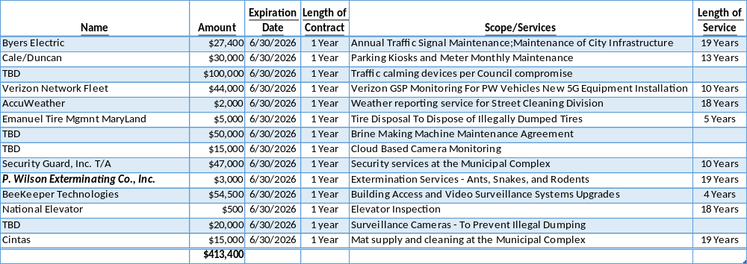
Miscellaneous Services

Slide 54
Miscellaneous Services
Traffic Calming Studies
  $100k was added by Council Request for FY’25 to Contracted Maintenance Services.
  Transportation is awaiting a report from RK&K on traffic calming measures appropriate for a dense urban environment on a case-by-case basis.
  The Mayor’s Office and Public Works have gone on record that speed bumps and similar measures are not appropriate for the City.
Surveillance Cameras
  Public Works does not have any cameras that are on the network utilized by the police department. The police department has provided video from various locations when illegal dumping has occurred. Public works has five trail cameras that can be temporarily placed to attempt to capture illegal dumping. They are currently being used by WPD.

Slide 55
Question 11 – General Fund
Discuss the number Parking Meters slated for replacement with KIOSKS in FY26 if any.
Specify what occurs with removal and/or reuse of single space meter poles and equipment and any impact to budget.

Slide 56
Parking Meters
The Transportation Division is working closely with the Finance Department to purchase new multi-space kiosk pay stations in the Downtown and Riverfront areas. The remaining areas of the City will be regulated by various parking limit signage. These new kiosks were purchased in FY’23 and should be fully operational this fiscal year. The budget estimate to complete the conversion to multi-space kiosks is $400k. This includes the purchase of 40 additional kiosks.
The stockpile of the newest models of single space meters will be retained and used as spares to replace meters that fail on individual ADA parking spaces. The remaining meters will be scraped.

Slide 57
Question 12 – Motor Vehicle
Discuss the ~$6.6M budgeted for motor vehicle fleet replacement plan.
Provide any new additions, deletions, or modifications to the City’s motor vehicle fleet per department, specify cost.
Specify if any of the additional vehicles are hybrid and or electric vehicles.

Slide 58
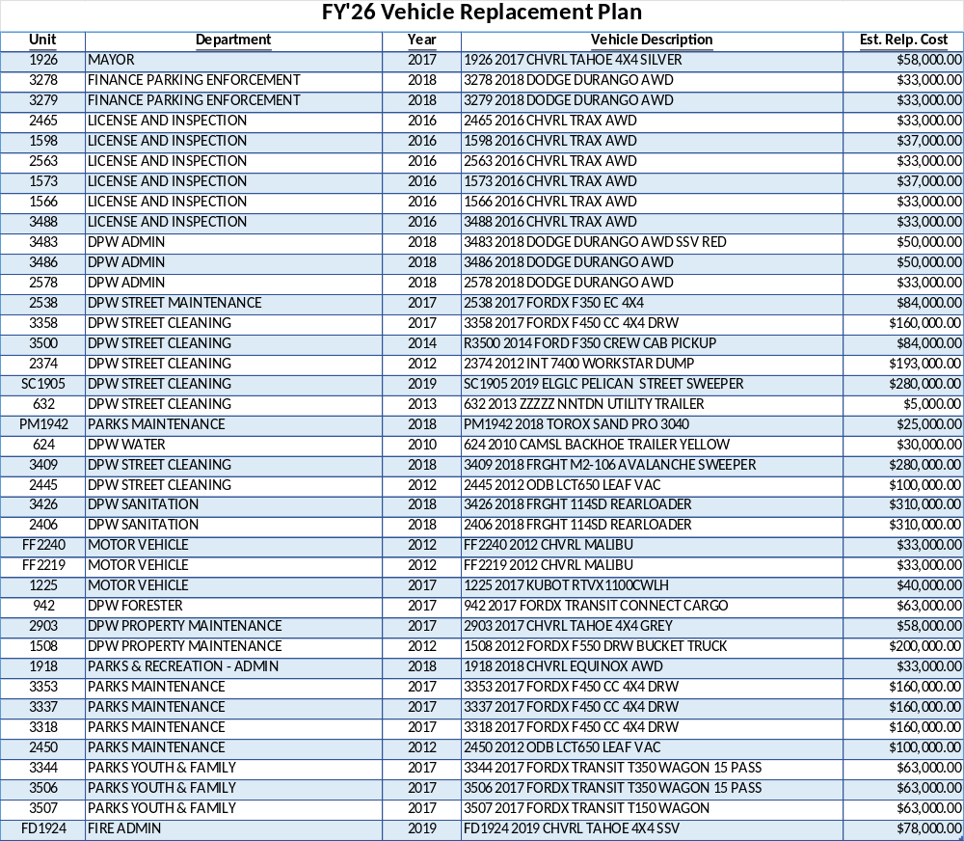

Slide 59
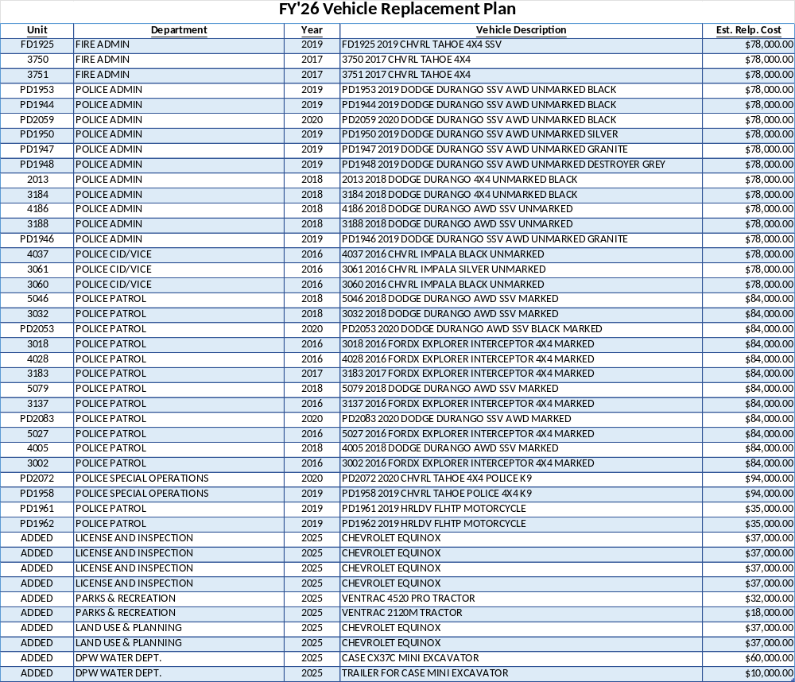

Slide 60
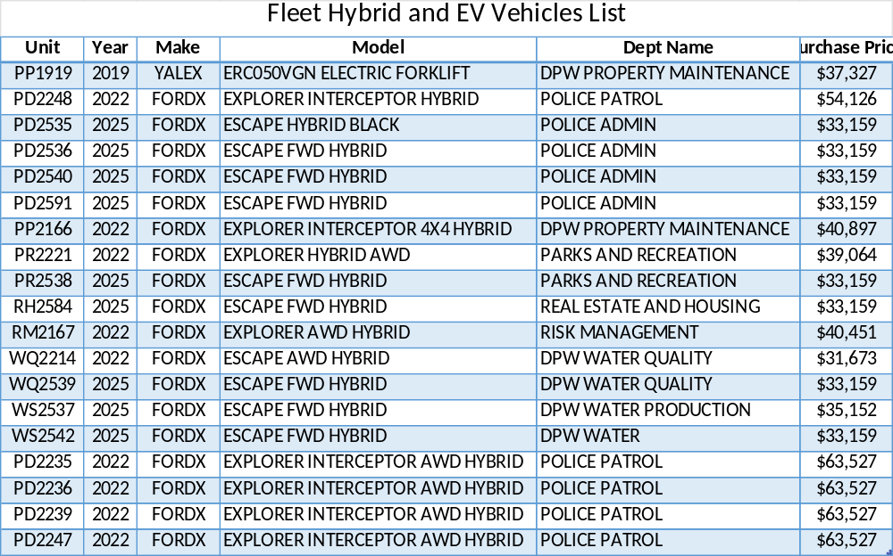
Fleet Replacement Plan
  Based on their availability on the State Contract some replacements may be ordered as Hybrid or EV.
  The additional vehicle prices were determined based on normal aspirated engines. Hybrid pricing will be approximately $6,000 more per vehicle.

Slide 61
Question 13 – Motor Vehicle
Discuss the ~$2.5M in Miscellaneous Services account grouping regarding expenses pertaining to the motor vehicle fleet maintenance contract.
Provide vendor name, amount of contract, expiration date, length of contract, and scope of services.

Slide 62
Fleet Maintenance
The Fleet Maintenance and Repair Services Contract was awarded to First Vehicle Services (now Transdev Fleet Services) effective October 1, 2017. The amended agreement is 5 years with (3) one-year extension options.
  $2.329M Annual Targeted Expenses
  Contract expires June 30, 2033, including the options
Services provided include maintaining fleet inventory, preventive maintenance, emergency repairs, vehicle and equipment repair, vehicle safety and emissions inspections, snow operations, new vehicle inspections and other fleet related activities.
AIM Fuelmaster Annual Maintenance Agreement
  $35k
AIM Fuelmaster Titanium Plan - Cloud Based Data Management System
  $7.5k
Syn-Tech Service for Reading Fuel Modules
  $23k

Slide 63
Question 14 – Motor Vehicle
Discuss the ~$1.7M budgeted for Motor Fuels & Lubricants.
Share mechanisms in place to best protect City’s fuels from abuse.
Specify cost per gallon based on type of gasoline.

Slide 64
Motor Vehicle Fuels and Lubricants
Unleaded Gasoline - $1.173M
  335,000 gallons based on actual 12-month usage.
Diesel Fuel - $502k
  150,000 gallons based on actual 12-month usage.
Contracts for Gasoline & Diesel Fuel only lock in delivery charges, the price of the products fluctuate based on market conditions.
The costs paid by the City are roughly $0.42 per gallon less than retail because of the City’s tax-exempt status.
AIM Fuelmaster System is utilized on City vehicles and requires a City ID Badge to dispense fuel and the vehicle VDM must be in the database of vehicles that can receive fuel. If both verifications are not met fuel cannot be dispensed.

Slide 65
Motor Vehicle Fuels and Lubricants
Fuel Type | Avg. Price Per Gallon
Diesel – Small Tank | $2.8644
Diesel – Large Tank | $2.6881
Gasoline – Large Tank | $2.4110

Slide 66
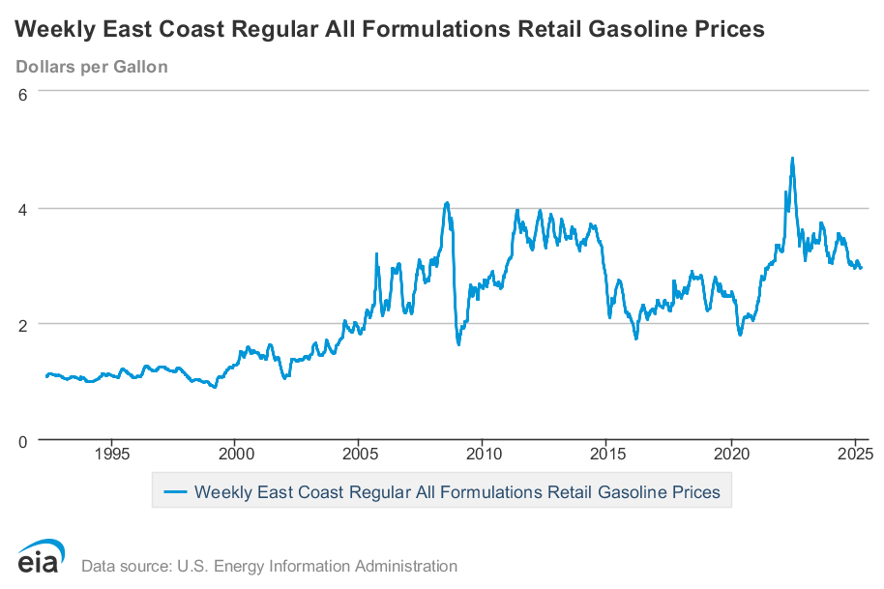
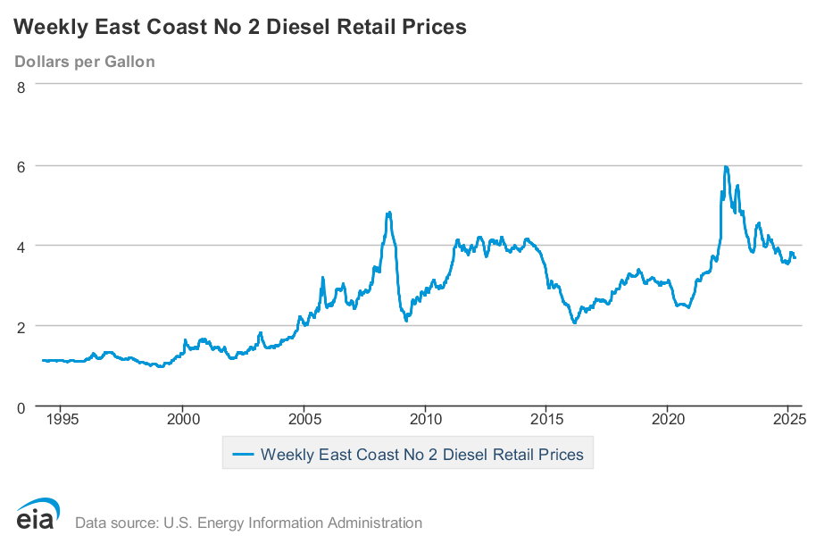
Motor Vehicle Fuels and Lubricants

Slide 67
Question 15 – Motor Vehicle
Discuss the planned use for ~$1.4M in the Repairs to Equipment account line.
  Share amount of targeted repairs for the last 2 years per department.

Slide 68
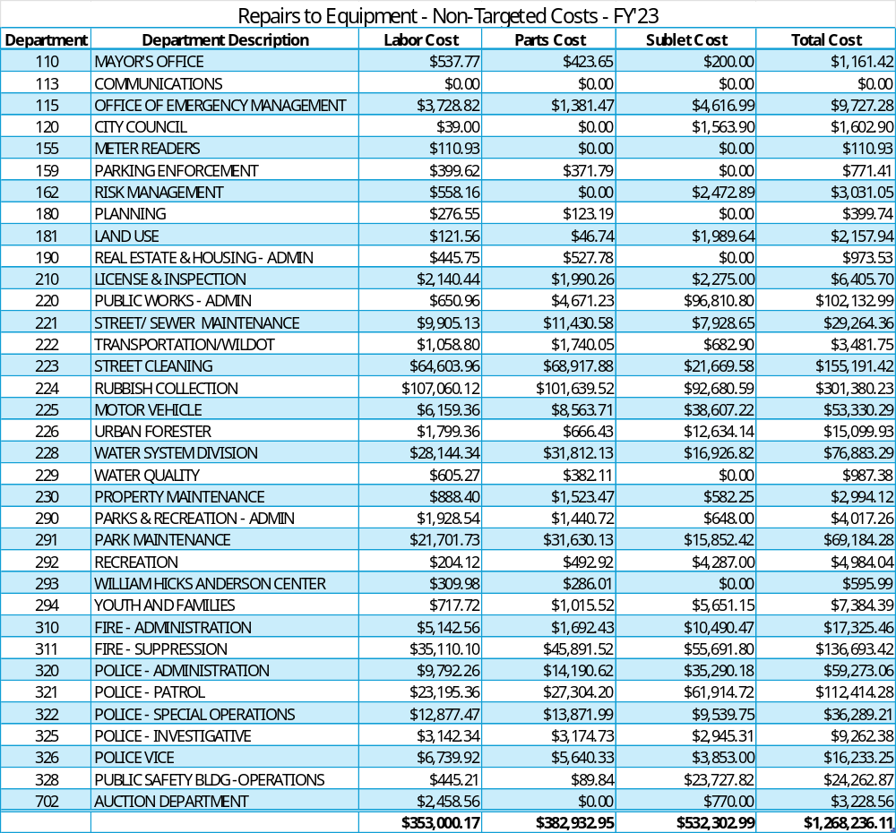
Repairs to Equipment

Slide 69
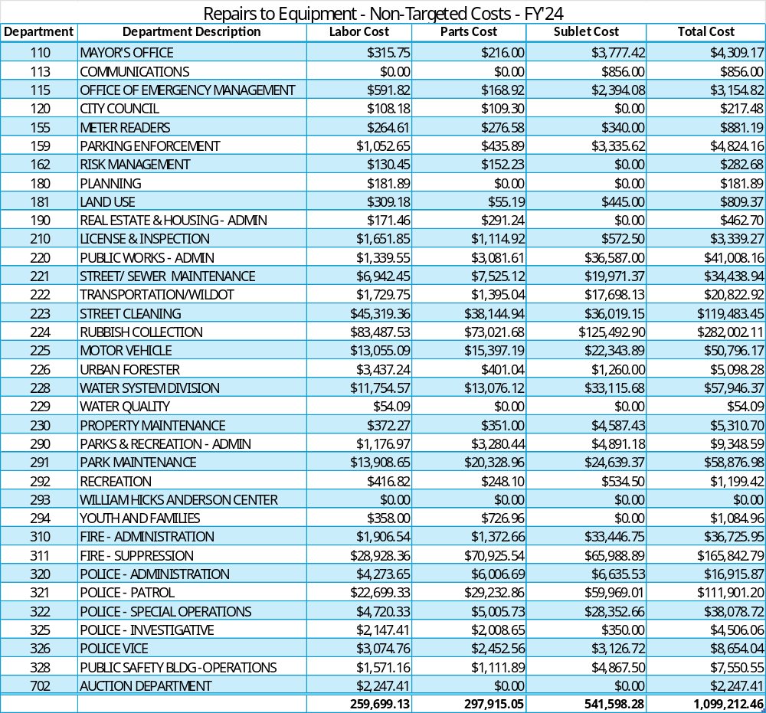
Repairs to Equipment

Slide 70
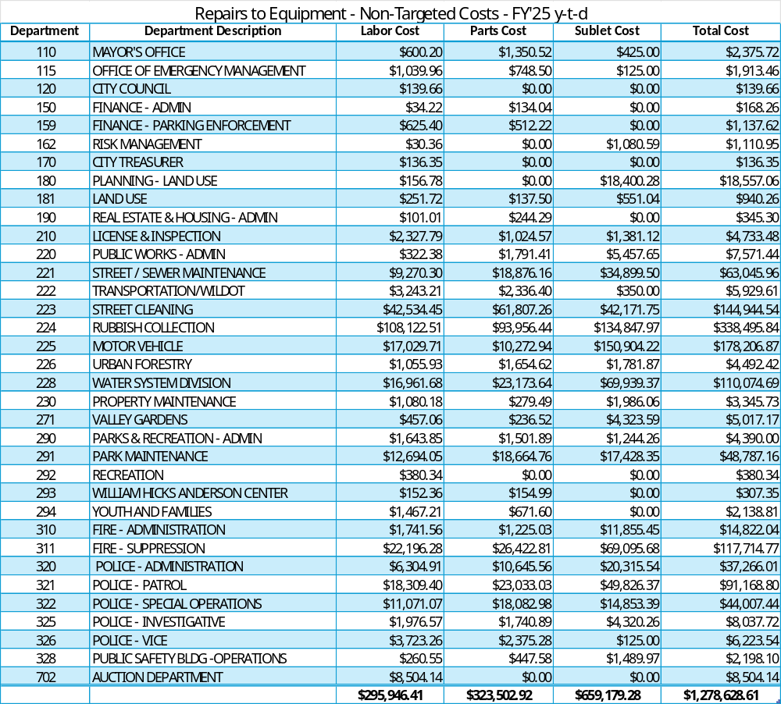
Repairs to Equipment

Slide 71
Question 16 – All Departments
Provide FY2026 proposed organizational chart with the total number of employees (i.e., permanent, temporary, contract, vacancies).
  If there are multiple divisions, please ensure there are sub-org charts that enumerate all the above.

Slide 72
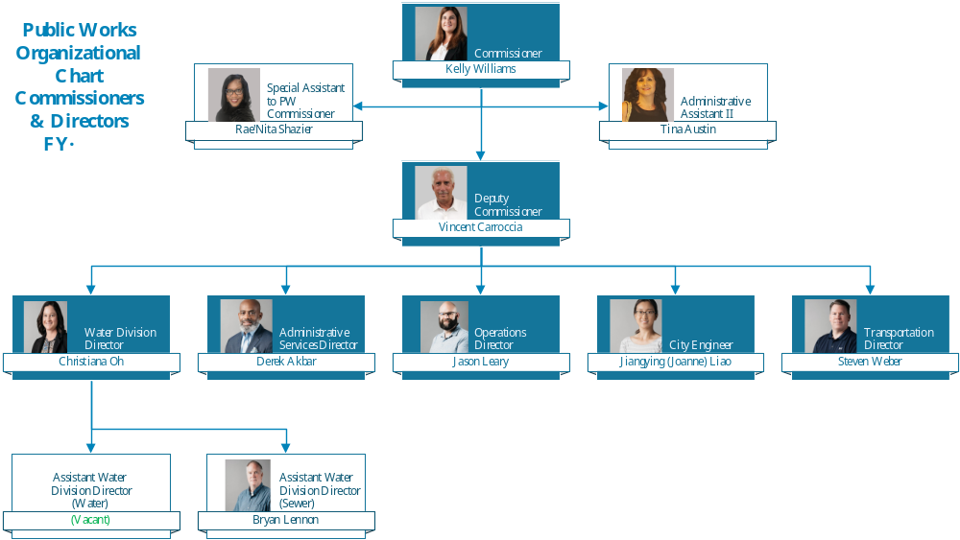

Slide 73
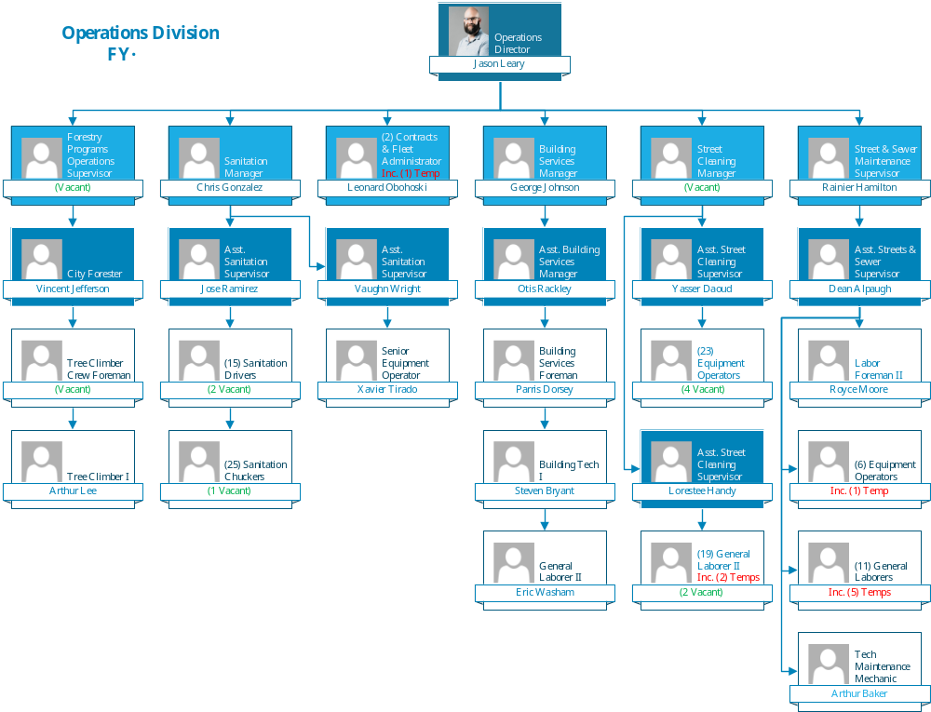

Slide 74
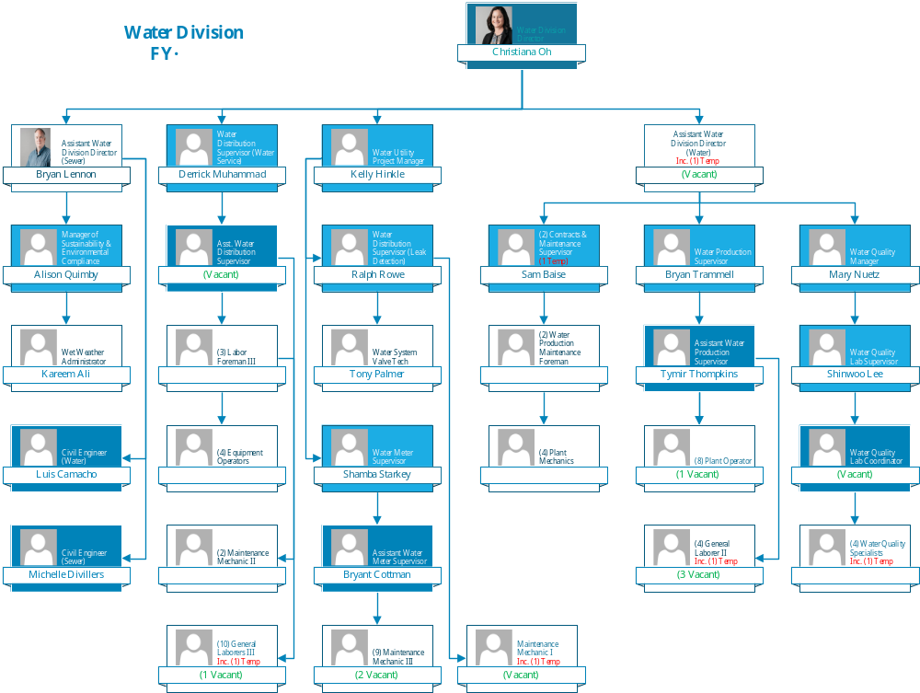

Slide 75
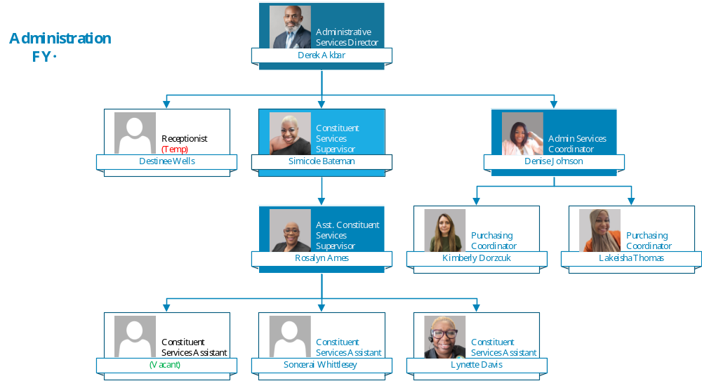

Slide 76
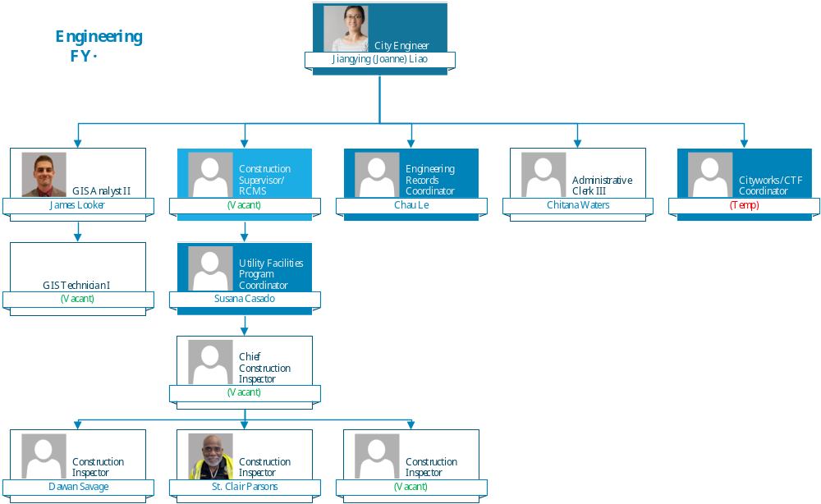

Slide 77
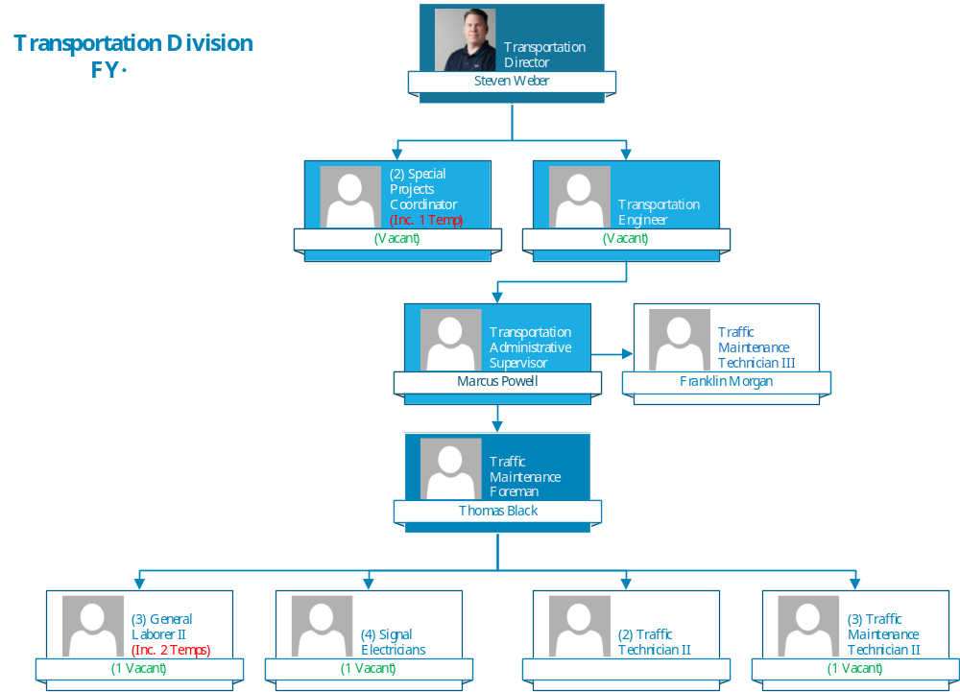

Slide 78
Question 17 – Capital Budget
Discuss the FY26 Proposed Capital Budget requests.
  Street Paving $7M
  Emergency Sidewalk Repairs $1M
    Specify how community can access these funds.
  Wilmington Transportation Initiatives $2M
  ADA Curb Ramp & Sidewalk Compliance $2M

Slide 79
Capital Budget
Street Paving - $7M
  Funds budgeted for the FY’26 Capital Improvement Program for Street Paving and Rehabilitation are based on pavement condition assessment ratings and represent a portion of what is needed to maintain the City road network.
Emergency Sidewalk Repairs - $1M
  Funds budgeted for FY’26 Capital Improvement Program for Emergency Sidewalk Repairs represent a small portion of the overall need to address the volume of sidewalk complaints we receive. Sidewalk complaints can be submitted to 311 or the Public Works Call Center. All Service Requests are inspected and prioritized for repair based on available funding.
Wilmington Transportation Initiatives - $2M
  Provide local matching funds for City/DelDOT/Wilmapco enhancement & other such projects as they are approved through the pipeline process.
ADA Curb Ramp & Sidewalk Compliance - $2M
  Installation of ADA compliant curb ramps and sidewalk repairs to facilitate compliance with federal requirements.
FY’26 Capital Improvement Plan funds will only become available after the City secures funding.

Slide 80
Thank You!

