Slide 1


FY 2026 Budget Hearing
PUBLIC WORKS
(Water / Sewer / Stormwater Fund)

Slide 2
Proposed FY2026 Water/Sewer Fund Budget
Public Works Department Water / Sewer Fund | FY 2023 Actuals | FY 2024 Actuals | FY 2025 Budget | Proposed Budget FY 2026 | $ Change FY'26-25 | % Change FY'26-25
Personal Services | $8,938,484 | $9,621,389 | $10,292,487 | $11,085,120 | $792,633 | 7.7%
Materials, Supplies, and Equipment | 43,887,435 | 52,024,942 | 54,526,754 | 57,365,604 | 2,838,850 | 5.2%
Internal Services | 1,851,239 | 2,862,457 | 1,857,453 | 1,924,823 | 67,370 | 3.6%
Debt Service | 4,903,865 | 5,402,484 | 4,228,305 | 4,075,821 | (152,484) | -3.6%
Depreciation | 10,916,346 | 11,204,573 | 10,916,346 | 11,204,573 | 288,227 | 2.6%
Total | $70,497,369 | $81,115,845 | $81,821,345 | $85,655,941 | $3,834,596 | 4.7%
Staffing Level (Water/Sewer Fund FTEs) | 103.95 | 103.95 | 104.45 | 104.45 | 0.00 | 0.0%

Slide 3
Major Funding Changes (Water/Sewer Fund Proposed Budget)
Midyear FY 2025 Department Realignment (↑ $135,327)
  Realignment to the Compensation and Classification study
  Impacted 16 Positions (3 positions split-funded with the General Fund)
Personal Services (↑ $792,633)
  Salaries and Wages (↑ $407,478)
    COLAs, Anniversary Steps, & Annual Review increases
  Employee Benefits (↑ $385,234)
    Increased Hospitalization Costs

Slide 4
Major Funding Changes (Water/Sewer Fund Proposed Budget)
Indirect Costs (↓ $1,473,931) – New Indirect Cost Model (Black & Veatch)
Contracted Maintenance Services (↑ $1,231,694)
  Jacobs Contract – Operate and maintain the City’s Sewage Treatment Plant and Renewable Energy Bio-Solids Facility
Repairs to Equipment (↑ $817,584)
  SCADA system maintenance and upgrades at the water plants
  Brandywine Pumping Station – pump replacements

Slide 5
Major Funding Changes (Water/Sewer Fund Proposed Budget)
Repairs to Water Lines and Sewer Line - combined (↑ $787,000)
  Main breaks, valve replacement, aging infrastructures, and winter-related emergency repairs
Engineering (↑ $470,000)
  GIS inventory management for lead mitigation & underground utility identification
Consultants (↑ $218,000)
  EPA’s lead and copper rule and PFAS chemicals removal

Slide 6
Major Funding Changes (Water/Sewer Fund Proposed Budget)
Agricultural and Landscaping (↑ $177,500)
  Street tree emergency and hazard mitigation program
Condition Assessment (↑ $150,000)
  New asset management program for inspecting and cleaning of sewer interceptors and inlets
Temporary Agencies (↑ $105,000)
  Address several vacancies in the Water Department

Slide 7
Major Funding Changes (Water/Sewer Fund Proposed Budget)
Water Meter Shop Supplies (↑ $85,000)
  Rising cost of water meters, fire meters, and ERTS
Debt Service (↓ $152,484)
  Based on the existing debt service schedule

Slide 8
DEPARTMENT OF PUBLIC WORKS
The mission of the Department of Public Works is to operate and maintain critical infrastructure and facilities, provide superior services for our customers, and promote resiliency.
In addition to providing services vital to City constituents such as waste collection, street cleaning, snow removal, street paving, sidewalk replacement, traffic controls, constituent call center and much more, the Department also operates an entire Water, Wastewater and Stormwater utility.
The Utility consists of:
  Approximately 108,000 customers inside and outside of the City
  2 Water treatment plants that produce an average of 16 million gallons per day of drinking water
  420 miles of water transmission and distribution mains
  370 miles of sewer and stormwater mains
  Regional wastewater treatment plant servicing residents and business north of the C&D canal and part of SE Pennsylvania, approximately 600,000 customers
  Stormwater management program that captures more than 80% of stormwater run-off within the City

Slide 9
Vision
To manage our utility and resources to meet evolving regulatory requirements, water supply needs and customer expectations in the future.
Priorities for FY 2026 – Water/Sewer Fund
  Provide customers with safe, reliable water, wastewater and stormwater mitigation services, and continue 100% compliance with regulatory requirements.
  Implement stormwater mitigation projects, focusing on areas with reoccurring flooding issues.
  Proactive identification and replacement of potential lead service lines.
  Comply with forthcoming regulations from the EPA and Delaware Office of Drinking Water which include:
    Prepare for compliance with EPA PFAS regulations
    Create a service line inventory and replacement plan under the Lead and Copper Revised Rule
  Maintaining a standard of exceptional integrity, honor, and respect through open communication and accessibility.

Slide 10
Performance Measures
  The 3 major performance measures for the utility include:
    Number of non-compliance events that must be reported to a state or federal agency, such as: CSO overflows, NPDES violations, Boil Water Advisories, Safe Drinking Water Act violations
    Length of time a customer is without water, measured in hours
    Number of water quality complaints

Slide 11
City Council Questions

Slide 12
Question 1 – Water/Sewer Fund
Understanding the City has the responsibility to ensure that Indirect Cost adequately reflects the best usage for services that are aligned with the Water Sewer Fund, please justify the ~$8.5M (WSF) budgeted citywide for Indirect Cost; yet while realizing the FY26 proposed Water and Sewer Rate Increase of 6.5% and Stormwater for 6%. Please explain.
  Specify the frequency for how often the indirect cost study is done.
  Specify the direct correlation to the impact of Water, Sewer, and Stormwater Rates, considering a rate increase has been done each year for the last 5 years.
  Specify if the indirect cost allocation is a standard governmental best practice for cities of a similar size to Wilmington with a water utility.

Slide 13
Indirect Costs
  Comprehensive indirect cost allocation studies are commonly performed once every five years or so and/or whenever there are any material departmental changes within a municipal government’s organizational structure. The comprehensive study helps define an allocation plan which is then used by municipalities to update and allocate indirect cost budgets to the enterprise fund departments.
  OMB uses its Indirect Cost Allocation Plan to first determine the O&M indirect cost budget allocation for each direct division of the 421 Water/Sewer Fund. Then, the water, sewer, stormwater O&M costs inclusive of the indirect costs along with all other revenue requirements (such as capital costs and reserves) determine the level of annual rate increases that are needed. Therefore, while the O&M indirect costs allocated each year to the water, sewer, and stormwater utilities are an integral part of the total water/sewer fund cost increases, the magnitude of the allocated indirect cost increase could be higher or lower than the annual water/sewer and stormwater rate increases.
  The indirect cost allocation (referred also as pricing of internal services) is a governmental best practice that is adopted widely in the public sector, where an Internal Service Fund and/or General Fund provides services to an Enterprise Fund. Therefore, the operating budgets of water/sewer utilities include indirect costs. Attached are a couple of resources that provide an overview of governmental best practices for determining and allocating indirect costs to enterprise fund departments.
  Pricing Internal Services [gfoa.org] (GFOA website)
Highly Recommended: Sound Practices for Calculating Enterprise Fund Indirect Costs | Mass.gov [mass.gov] (Commonwealth of Massachusetts)

Slide 14
Question 2 – Water/Sewer Fund
Discuss any grant funds and rate stabilization funds utilized to mitigate the proposed 6.5% water/sewer and 6% stormwater rate increase.

Slide 15
Grant Funds/Principal Forgiveness
  $52,316,436 – SRF Funds with Principal forgiveness loans (this includes $14.116M in lead and PFAS to close in FY’26) - active projects
  $13,060,000 EPA Community Grants - active projects
  $9,144,072 Grants - various sources - active projects

Slide 16
Grant Funds/CDS
  South Wilmington Sewer Infrastructure Expansion - $4.8M
  Prices Run Interceptor Rehabilitation & CSO 4A - $3.06M - Completed
  South Wilmington Sewer Separation B Street - $4M - In-progress
  South Wilmington Sewer Separation C Street - $6M - In -Progress

Slide 17
Question 3 – Water/Sewer Fund
With the evolving changes regarding Federal Funding, while understanding possible legal challenges, share if any potential budgetary or fiscal contingencies for this upcoming budget and or any potential operational changes, considering the Federal Funds that the City receives for the day-to-day operations of the city, that may possibly result in being on the chopping block.

Slide 18
Federal Funding
Public Works has not added any contingency funds to the FY’26 Operating Budget.
SRF funding with Principal Forgiveness has not been affected to date. SRF comes through the State.
Congressionally Directed Spending (CDS) is contingent upon Congress Passing a bill with appropriations for this funding. The funding award for $8M in FY’25 for CSO-30 Stormwater Improvements was not approved by Congress and has been resubmitted for FY’26.
Large Federal Grants, to minimize risk to the City:
  Funds are drawn down as soon as invoices are approved by the project manager; reimbursed funds should be received by the City within days.
  Construction progress is evaluated to determine optimal stop work points in the event the funding is retracted.
Smaller Federal Grants would either be covered by the existing budget or scope would be reduced.

Slide 19
Question 4 – Water/Sewer Fund
Considering that the Federal Government and the EPA (Environmental Protection Agency) is regulating PFAS, which is inclusive of setting drinking water standards, please share if any federal funding and or budgetary funding set-aside to assist with any of these mandates.
  Specify plans for the pending EPA and PFAS regulations for the water treatment plants and WWTP.

Slide 20
PFAS - Funding
  $13,287,405 in SRF Loans dedicated to PFAs
    $10,403,414 of which is principal forgiveness
  $2,473,134 in Grants

Slide 21
PFAS
  While the new standards do not take effect for another four years, the City of Wilmington is taking the following proactive actions:
    We are voluntarily testing our water (monthly) to gather the best data possible to guide future decision-making and keep our customers informed. We will also participate in all required Federal and State testing.
    We will continue to coordinate and collaborate with State and Federal regulatory agencies regarding ongoing research and rule-making developments.
    We have chosen to take part in legal action that seeks to compensate Wilmington for our PFAS-related efforts.
    We will continue openly communicating about PFAS, and we encourage our customers to contact us with any questions.
    We are examining strategies to effectively address PFAS compounds through our water treatment process. We are focusing on the two options that our engineers believe are best suited to their findings: ion exchange and granular activated carbon (GAC). We have completed one round of seasonal testing to evaluate various media and are conducting an evaluation of the ability for an advanced treatment option to be constructed at the plant. Wilmington (and many other utilities) not only need to evaluate the best treatment options for MCL compliance but also determine how that treatment process can be constructed at the plant.

Slide 22
Question 5 – Water/Sewer Fund
Discuss any budgetary funding set-aside in this budget for adopting any water conservation measures and other strategies to reduce climate change.

Slide 23
Conservation Measures/Climate Change
Water Conservation Rates
  The City of Wilmington approved Water Conservation Rates for residential water customers in fiscal year 2006. These rates took effect July 1, 2005. The purpose of the rate structure is to promote water conservation among City of Wilmington water customers.
  The residential rates are Inclining Block Rates. Effective July 1, 2018, the City switched from quarterly to monthly billing. Monthly billing makes it easier to manage payments and household budgets, avoid delinquency, track water usage, and avoid huge bill spikes by identifying leaks faster.
The FY’26 Operating Budget funds our annual contribution to the Water Resources Agency (WRA).
Funds are included for the Annual Water Protection Subsidy for source water protection activities within the watershed.
Public Works leads Resilient Wilmington and continues to work towards multiple sustainability goals.
We are purchasing hybrid and EV fleet vehicles as part of our resiliency efforts.
The City has been a member of the Climate Registry since 2012 and has engaged in multiple projects to reduce Green House Gas emissions.

Slide 24
Question 6 – Water/Sewer Fund
Discuss any proposed changes to positions (new position, deleted position, upgrade, downgrade, realignment, title change, salary adjustment, etc.).
  Share any vacant positions.
    Specify duration of the vacancy.
    Specify timeframe for filling position.
    Specify any impact on Overtime, Temp Agency, and or Consultants.
    Specify any impact with the Residency requirement for filling any vacant positions.
    Share about the department retention and resource program.
  Share the number of positions that are split funded between the Water Sewer and the General Fund.

Slide 25
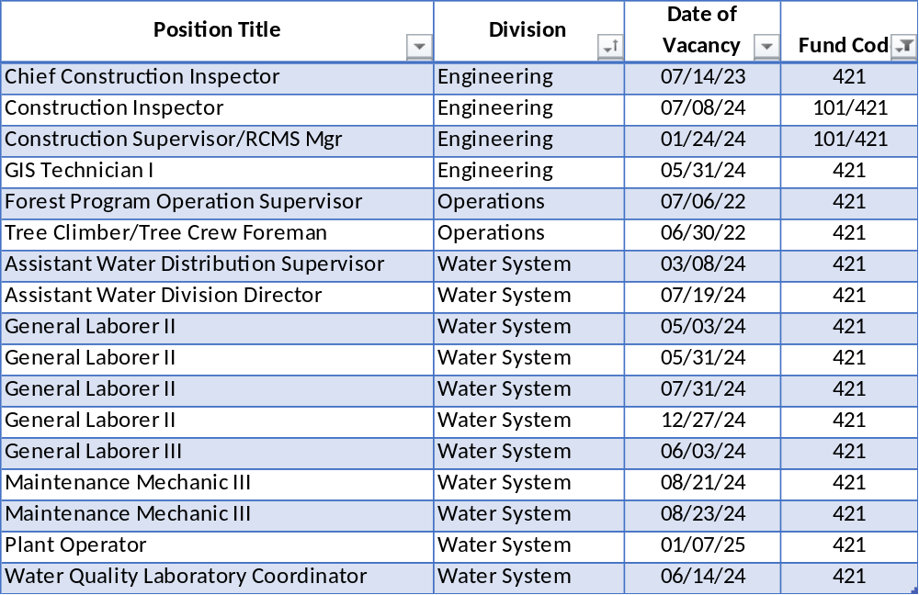
Changes / Vacant Positions – Water/Sewer Fund
  No Changes to Positions in Water/Sewer Fund

Slide 26
Vacant Positions – Water/Sewer Fund
  We are working closely with Human Resources to fill vacancies as quickly as possible that are approved by the Chief of Staff.
  Public Works averages 30-35 vacancies due to employee turnover and has experienced difficulty in the current labor market attracting and retaining qualified staff due to the available salary ranges and residency requirements. One applicant for Forest Program Operation Supervisor turned down the position due to the City’s Residency Requirement. It’s worth noting that she applied because of the Administration’s notice that there was no longer a residency requirement at the time.
  Temp Employees are being used to perform some of the job functions of vacant positions where possible.
  There are (24) General Fund Positions that are split funded in the Water/Sewer Fund.
    These are mainly administrative staff that work between both funds.

Slide 27
Question 7 – Water/Sewer Fund
Understanding that the Wastewater Treatment Plant is the City’s largest asset and the largest expenditure, discuss the approximately $26M budgeted in the Contracted Maintenance account line, up $1.2M over the prior year’s budget.
  Specify vendor name, length of contract.
  Specify community investment.
  Specify funding allocated for sewer maintenance pest control.

Slide 28
Contracted Maintenance Services - WWTP – Water/Sewer Fund
Contracted Maintenance Services - $24.699M
  WWTP Operations and Maintenance agreement for 20 years with Operations Management International (OMI).
  Local Community Investment
    School Supplies for the Back-To-School Drive - August
    Food Drive for the Sunday Breakfast Mission - November
    Collected Toys for the Mayor's Toy Drive - December
    Assembled 250 Snack Bags for The WRK Group at The Warehouse - January
    Park Cleanup and Beautification of Brandywine Playground - April
    Earth and Arbor Day Event - April
    Summer Internship - Delaware Resident
    On-Site Tours for The Tatnall School – February
  Sewer Maintenance has budgeted $15k for Pest Control for FY’26.

Slide 29
Question 8 – Water/Sewer Fund
Justify the $5.7M budgeted in Professional Fees, up ~$800K over the prior year’s budget (Consultants $2.1M, Engineering $2.8M, Legal $103K, and Temp Agency $555K), considering the 104.45 full time employees, while realizing some outside expertise is required.
  Specify vendor name, amount of contract, expiration date, length of contract, how long City has been doing business with the vendor, and purpose.
  Specify if there are any DBE’s.
  Specify any re-occurring one-year agreements.

Slide 30
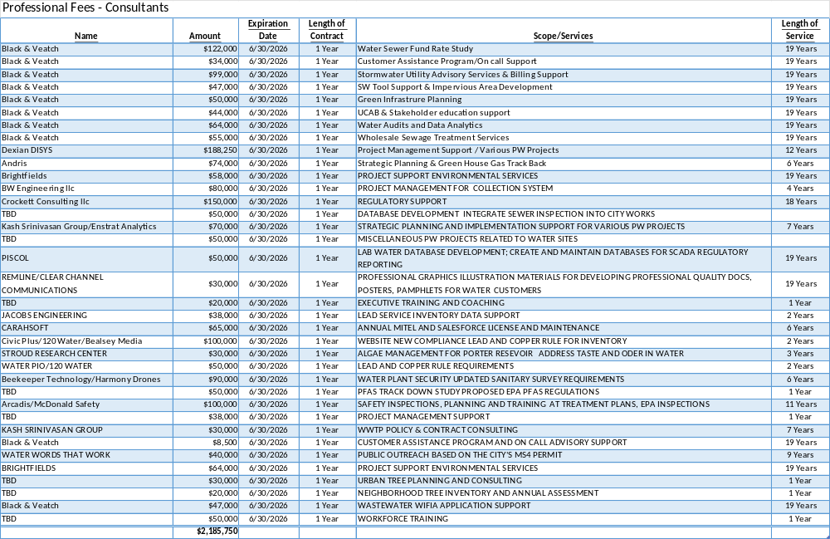

Slide 31
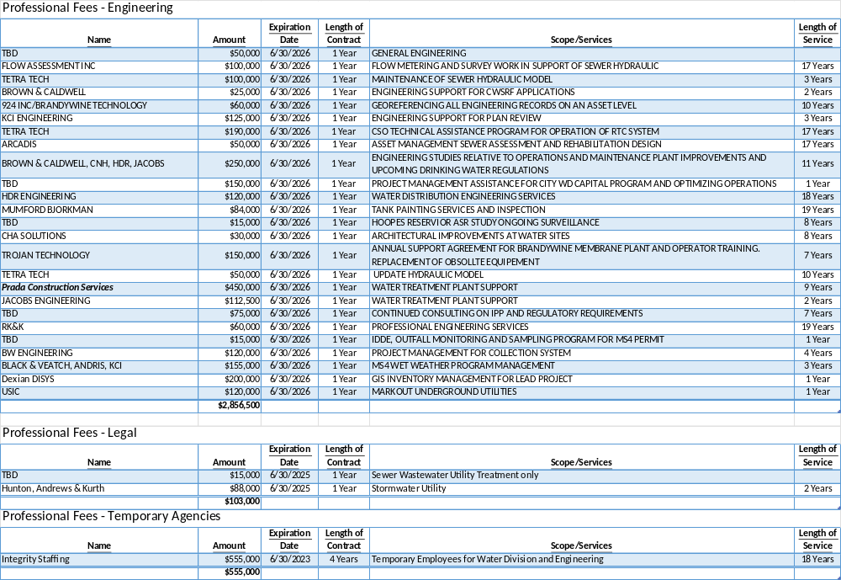

Slide 32
Question 9 – Water/Sewer Fund
Discuss the ~$13M budgeted in the Contract Maintenance account grouping, up $1.8M over the prior year’s budget.
Account | FY’2026 Proposed Budget | FY’2025 Budget
Repairs to Equipment | $4,554,383 | $3,736,799
Repairs to Building & Structures | $1,770,000 | $1,710,000
Repairs to Sewer Lines | $1,600,000 | $1,400,000
Repairs to Water Lines | $3,617,000 | $3,000,000
Building Maintenance | $554,382 | $531,204
Condition Assessment | $850,000 | $700,000
Feasibility Studies & Testing | $35,000 | $35,000
Total | $12,980,765 | $11,143,003

Slide 33
Question 9 – Water/Sewer Fund
Specify if there are any DBE’s.
Specify the number of large meters scheduled for replacement and testing.
Specify number of main break and valve replacements that are scheduled.

Slide 34
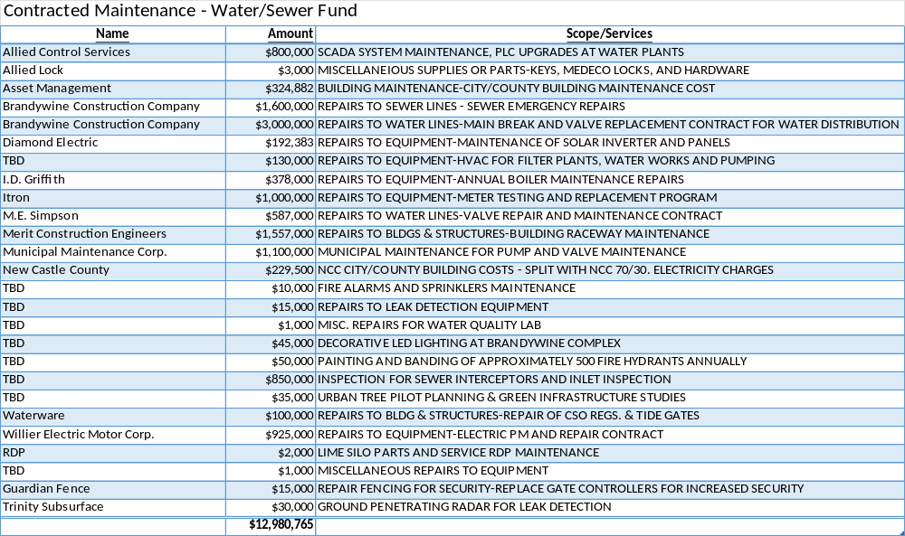

Slide 35
Contracted Maintenance – Water/Sewer Fund
Tribus / Wilmington | FY 2026
Water Meter Testing
5/8" - 1" | TBD
2" (tested every five years) | 75
3" (tested every 3 years) | 15
4" (tested every 2 years) | 15
6" and larger (tested every year) | 55
  Water main breaks and valve replacement are emergency work and therefore are not scheduled. This contract is used for emergency response to breaks and leaks.

Slide 36
Question 10 – Water/Sewer Fund
Discuss the planned use of approximately $1.9M budgeted in Petroleum and Chemicals account line pertaining to the water treatment at both Porter and Brandywine Filter Plants.

Slide 37
Petroleum and Chemicals – Water/Sewer Fund
Motor Fuels & Lubricants - $16k
  Propane Gas Cylinders – Keen
  Lubrication for Pumps and Motors – Reit Energy Co.
Bulk Chemicals - $1.8M
  Chemicals for Water Treatment
Laboratory Supplies - $143.2k
  Misc. Lab Supplies & Parts – Fisher Scientific & Hach
  Supplies for Bacteria Analysis - Idexx
  Nitrogen for TOC Analyzer - Keen Gas
  Bottleware – Scientific Specialties
  Parts for TOC Analyzer - Teledyne

Slide 38
Bulk Chemicals – Water/Sewer Fund
  Chemical usage is based on average production of 20 MGD. Chemical usage is being continually optimized and is based on production demand. Main breaks and leaks result in higher water production and therefore require additional water treatment chemicals.
  Usage of water from Hoopes Reservoir requires much higher levels liquid Ferric Chloride to coagulate. This also requires higher dosing of Lime to balance ph. Heavy rain events; pollution discharge; or drought conditions can require the switch to Hoopes water. Hoopes Reservoir is the City’s backup source to ensure continuous clean water.
  Bulk chemical usage is not linear. Water production is higher during spring and summer periods and requires greater chemical usage during warm months.
  Our two most frequently used chemicals are Ferric Chloride and Sodium Hypochlorite. These have both increased in price by 93% and 44% respectively since 2022.

Slide 39
Question 11 – Water/Sewer Fund
Discuss the ~$1.4M budgeted in the Miscellaneous, Materials, Supplies, and Parts account grouping, up $184K over the prior year’s budget.
  Specify if any of the vendors are DBE’s.
  Specify the number of fire hydrants slated for replacement.

Slide 40
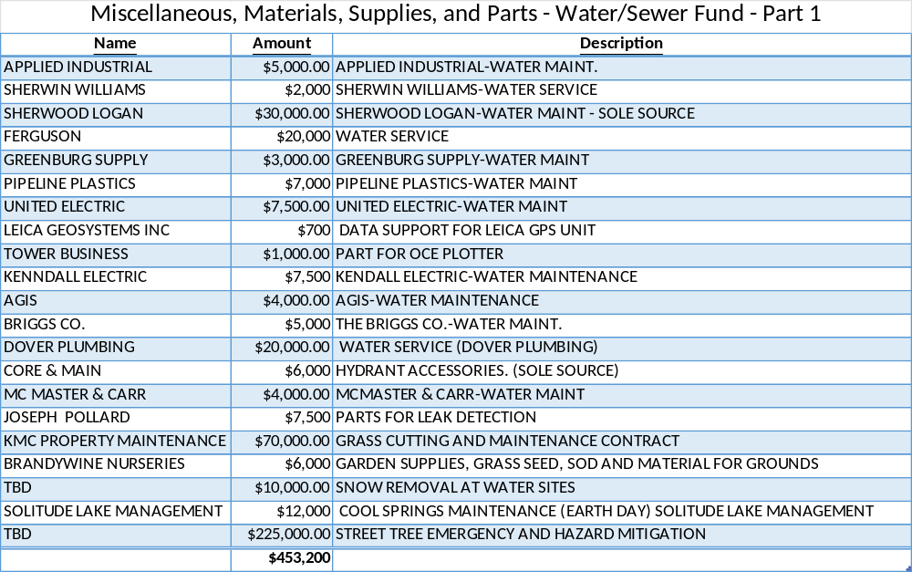

Slide 41
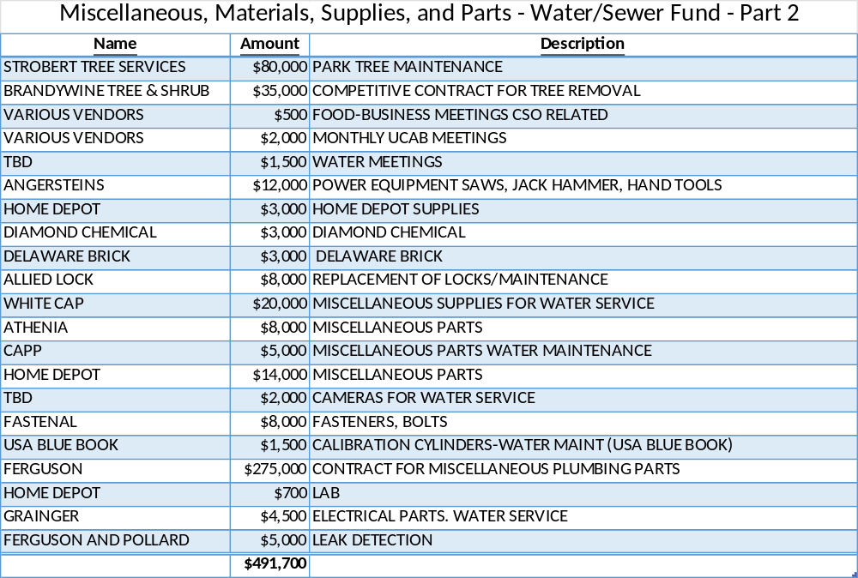

Slide 42
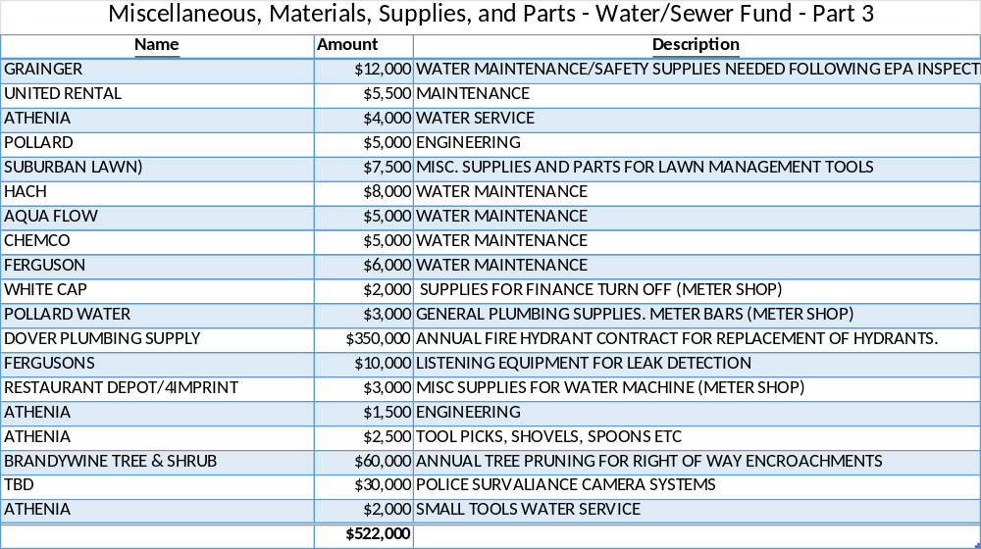
Fire Hydrant Replacement - 80

Slide 43
Question 12 – Water/Sewer Fund
Discuss the ~$1.4M budgeted between the Equipment and Construction & Repairs account groupings.

Slide 44
Equipment – Water/Sewer Fund
Furniture, Fixtures & Office Equipment - $13k
  Office Equipment for Staff
  File Cabinets, Tables, Chairs
Other Non-Capitalized Equipment - $142.5k
  Barrels/Cones in Sewer Maintenance
  Walk Behind Saw Blades
  Hand-Held Gas-Powered Chop Saw Blades
  Water Service Crew Supplies - Pollard
  Hydrant Wrenches, Service Box Cleaners, Curb Keys, Saw Blades, Gauges, and Probes for Water Service
  Ground Mic, Correlator and Data Logger Equipment
  Dell Servers for SCADA

Slide 45
Equipment – Water/Sewer Fund
Computer Software - Non-Capital - $429k
  ESRI – Site License for GIS used by Public Works, Mapping and Graphics, Planning, Economic Development, and Public Safety
  InfoWater Hydraulic Modeling Software Annual License Fee
  Cityworks Server Site License for Unlimited Users
  Digsmart – Miss Utility GIS Software Maintenance Agreement
  GPS Licensing for Smart Connect and Field Software
  C-Soft Annual License Fee to TetraTech-CSO

Slide 46
Construction and Repairs – Water/Sewer Fund
Building Supplies - $1k
  Blanket PO for Home Depot
Materials & Supplies-Roads - $498k
  Concrete
  Black Top Hot Mix
  Cold Patch
  Mineral Aggregates
  Catch Basins
  Manhole Covers, Catch Basins, Monument Boxes
Water Meter Shop Supplies - $335k
  Water Meters
  Fire Meters
  Itron ERT’s

Slide 47
Question 13 – Water/Sewer Fund
Discuss the planned use for $220K in the Community Activities account grouping.

Slide 48
Community Activities – Water/Sewer Fund
Homeowner Connection Subsidy - $60k
Water Protection Subsidy - $60k
Easement – Cemetery - $100k

Slide 49
Question 14 – Water/Sewer Fund
Share a high-level overview of the FY2026 Capital Projects for $126M.

Slide 50
Capital Projects – Water/Sewer Fund
  11th Street Sewage Pumping Station Upgrade - $10M
  Annual Minor Sewer Improvements - $2.5M
  Major Sewer Improvements - $6M
  Annual Water Improvements - $20M
  Porter Filter Plant Improvements - $20M
  Emerging Contaminants - $50M
  Transmission Main Improvements - $4M
  Pressure Zone Reliability Improvements - $2M
  Brandywine Filter Plant Improvements - $3M
  Raw Water System Improvements - $3M
  Architectural Improvements - $1.5M
  Pumping Station Improvements - $500k
  Automated Metering Infrastructure (AMI) - $5M
  WWTP Infrastructure System Improvements - $25M
  Stormwater Drainage Management Program - $2M
  Stormwater Mitigation (Green Infrastructure) - $1.5M
  Urban Forest Management Program - $500k

Slide 51
Question 15 – All Departments
Provide FY2026 proposed organizational chart with the total number of employees (i.e., permanent, temporary, contract, vacancies).
  If there are multiple divisions, please ensure there are sub-org charts that enumerate all the above.

Slide 52
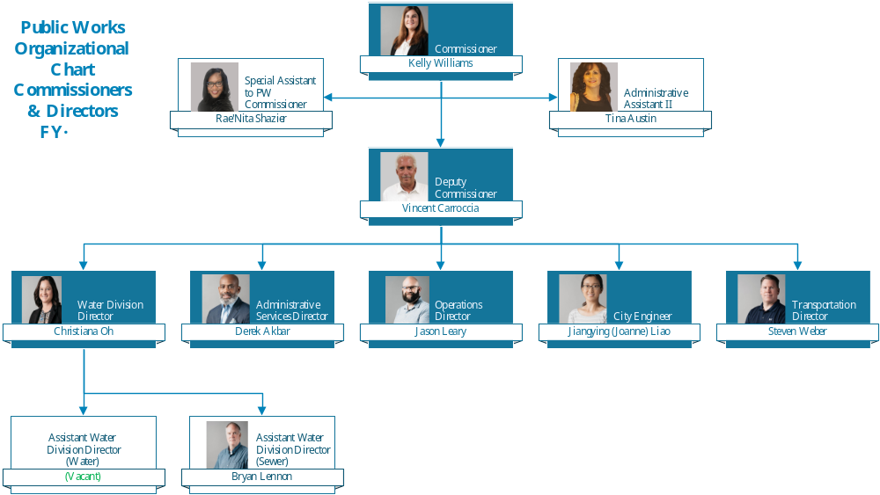

Slide 53
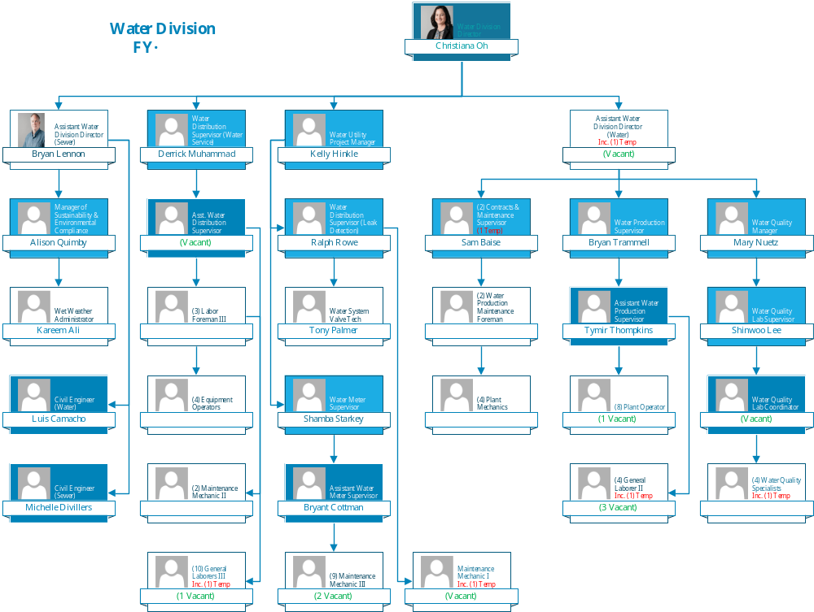

Slide 54
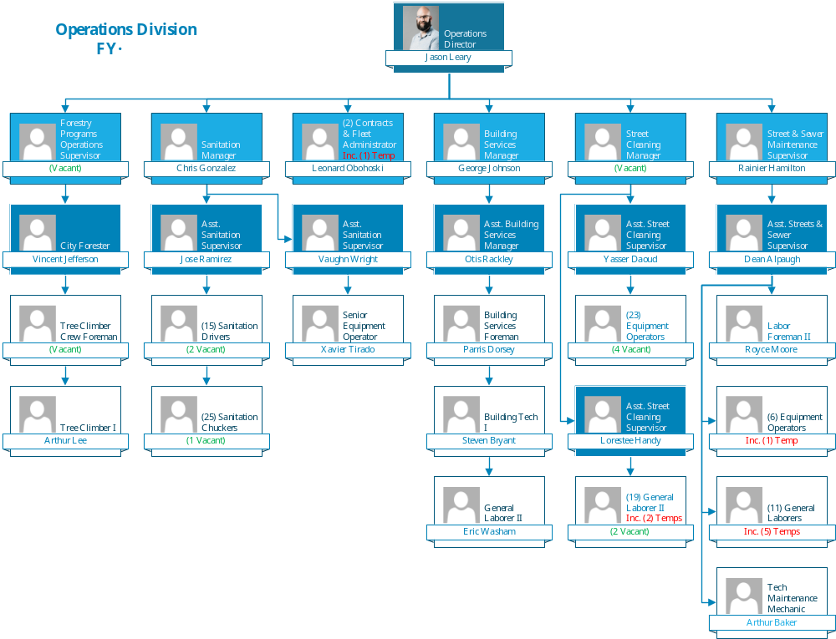

Slide 55
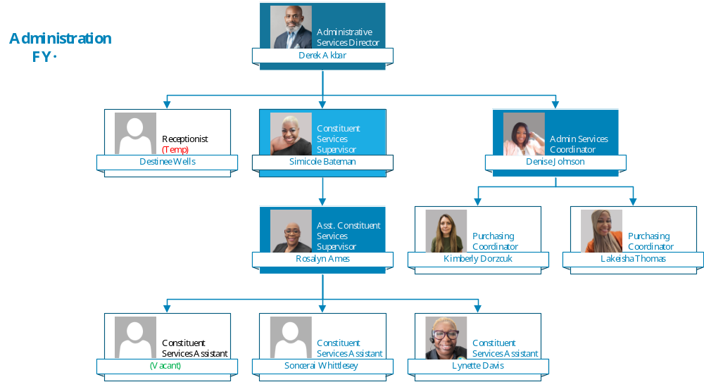

Slide 56
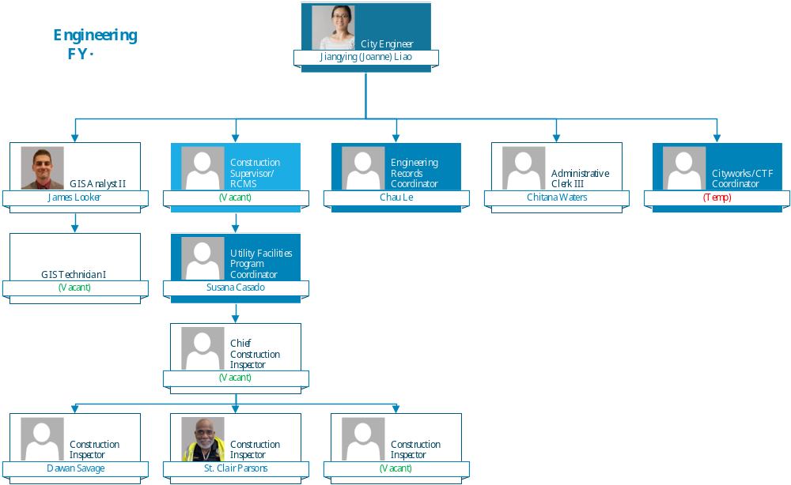

Slide 57
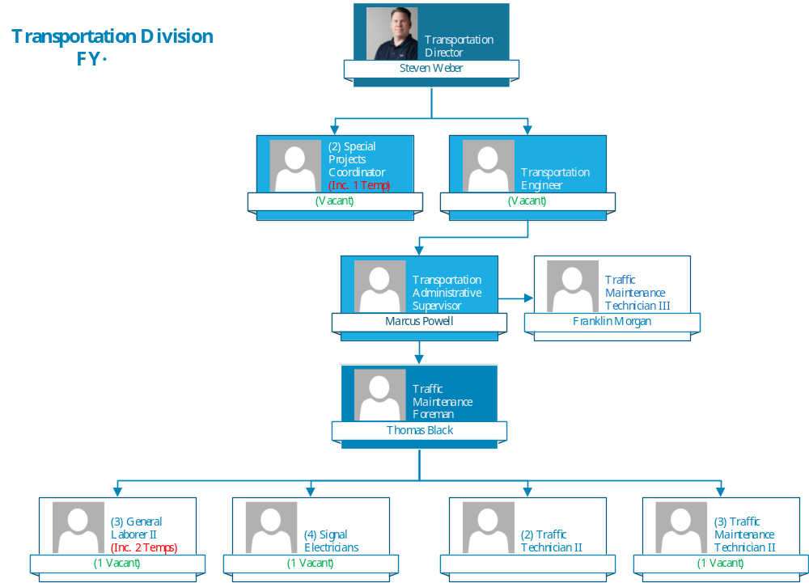

Slide 58
Thank You!

