Slide 1

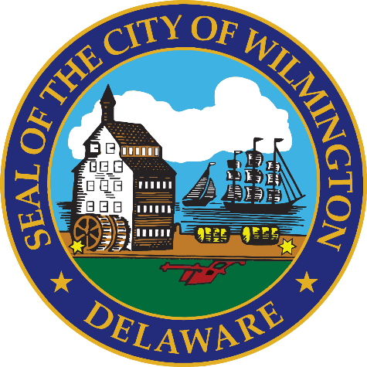
FY 2026 Budget Hearing
REAL ESTATE & HOUSING

Slide 2
FY 2026 General Fund Budget
General Fund | FY 2023 Actuals | FY 2024 Actuals | FY 2025 Budget | Proposed Budget FY 2026 | $ Change FY'26-25 | % Change FY'26-25
Personal Services | $294,485 | $314,633 | $281,360 | $305,151 | $23,791 | 8.5%
Materials, Supplies, and Equipment | 1,833,821 | 1,306,443 | 1,524,475 | 1,622,600 | 98,125 | 6.4%
Internal Services | 34,832 | 33,469 | 60,730 | 63,141 | 2,411 | 4.0%
Debt Service | 2,087,210 | 730,971 | 708,748 | 685,945 | (22,803) | -3.2%
Total | $4,250,348 | $2,385,516 | $2,575,313 | $2,676,837 | $101,524 | 3.9%
Staffing Level (FTEs) | 2.38 | 2.15 | 2.20 | 2.00 | (0.20) | -9.1%

Slide 3
Major Funding Changes, General Fund – Proposed FY 2026 Budget
Personal Services Changes
  Total positions down net 0.20 FTE
  Senior Rehabilitation Specialist II (10% General Fund and 90% Special Funds) eliminated (↓$9,780)
  Senior Program Director (10% General Fund and 90% Special Funds) eliminated (↓$11,183)
  Temporary Salaries (↑ $35,000)
Materials, Supplies, and Equipment Changes
  Clean Team program (↑ $100,000)
Debt Service (↓ $22,800)

Slide 4
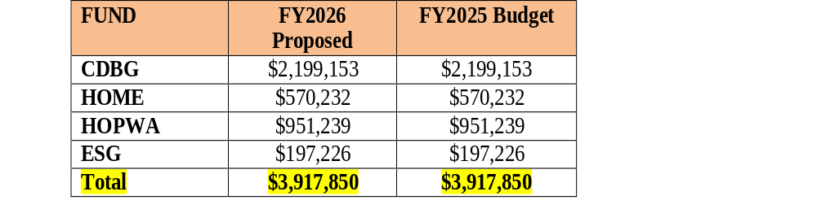
Major Funding Changes, HUD Grant Funds
FY 2026 are estimates. REH is anticipating the release of the Federal Allocation in mid-May. Based on the Federal Continuing Resolution we are estimating a flat budget

Slide 5
Departmental Vision
The vision of the Department of Real Estate and Housing is to improve the quality of life for the residents in the City of Wilmington by increasing the supply of affordable housing, improving housing markets and the existing housing stock, promoting self-sufficiency and engaging in activities to stabilize and revitalize neighborhoods.
The Department plans, allocates, and administers Federal, State, and local resources for the benefit of persons of low- and moderate-income and the neighborhoods in which they live, involving residents to the greatest extent feasible in decisions that affect their lives. In carrying out this mission, the Department partners with other City departments, government agencies, the private sector, and other organizations that share its goals.

Slide 6
Top Three Priorities
Increase the supply of affordable housing that is decent, safe and sanitary.
Engage in activities geared toward stabilization and revitalization of neighborhoods.
Increase homeownership opportunities through City-sponsored initiatives and collaborative efforts with non-profit and for-profit developers.

Slide 7
Top Three Performance Measures
Support organizations that provide services to Wilmington’s most needy residents.
Administer and/or fund programs to create affordable housing, preserve existing housing and help stabilize neighborhoods.
Increase the accessibility to affordable homeownership units.

Slide 8
Question 1: Considering that Council shared its FY2026 Budget Priorities with the Mayor, which some priorities are Neighborhood Stabilization and Affordable Housing/Revitalization, that are in alignment with the Administration, please share how your budget supports these priorities.
Specify any budgetary programming for programs and projects that provide essential public services to low- and moderate-income families and neighborhoods, and homelessness prevention.
Specify any programming in the pipeline for programs that were previously supported by the Housing Opportunity Fund.
The bulk of this presentation will outline the alignment of the Council and Mayor’s priorities with City funds.

Slide 9
Question 2: With the challenges of the evolving changes with Federal Funds, please specify if there is any consideration within this budget for a public private partnership that will enable the City to have the ability to collaborate with private entities for funding and sponsorships to help augment City funds to assist with affordable housing. Please explain why or why not, particularly knowing the limitations of federal funds, as well as the continued scale back of federal funds, and the rising costs for housing.
REH is continually looking for collaborations that will advance the City’s affordable housing agenda.
Specify if any collaboration efforts for Enterprise Zones
Enterprise Zones are designated areas where state and local governments offer incentives, like tax credits and regulatory relief, to encourage businesses to invest and create jobs, aiming to stimulate economic growth and revitalize communities and Purpose-Built Communities. REH supporting thru the federal budget – HOME & CDBG, participating in the CNI implementation.

Slide 10
Question 3: Notwithstanding jurisdictions that choose to be a Sanctuary City; however, considering the evolving Federal Mandates, specify impact to your budget if Wilmington was a Welcoming City or Safe Haven for immigrants.
Federal policy would dictate awards of federal entitlement funds.

Slide 11
Question 4: Share the planned use for $2.5M allocated to the Neighborhood Stabilization Fund from the Tax Stabilization Reserve.
$500K allocated for the Wilmington Neighborhood Conservancy Land Bank (WNCLB) - operating budget and $2M for Homeowner Repair, Alley Clearance and Problem Tree Removal Initiative.
Funding that City has allocated to WNCLB per year since inception.
Fiscal Year | Source | Amount
2025 | Neighborhood Stabilization Fund | 1,000,000.00
2025 | State Bond Bill | 1,500,000.00
2024 | Neighborhood Stabilization Fund | 2,400,000.00
2024 | ARPA | 1,860,000.00
2023 | ARPA | 749,441.51
2023 | General Fund Operating Budget | 500,000.00
2022 | ARPA | 4,149,410.46
2022 | General Fund Operating Budget | 511,752.32
2022 | General Fund Capital Budget | 275,632.00
2021 | General Fund Operating Budget | 1,000,000.00
2017 | Housing Strategic Fund | 1,449,000.00
 | Total: | 15,395,236.29

Slide 12
b. Specify amount of funds allocated for the Home Repair Lottery Program for the last 2 years and amount expended year to date.
Homeowner Repair Lottery | # Homeowners Assisted | Total Spent | Average Spent per Homeowner
Safe, Warm and Dry #1 | 73 | $831,017 | $11,384
Safe, Warm and Dry #2 | 74 | $690,128 | $9,326
Safe, Warm and Dry #3 (65 years and older) | 65 addresses drawn (waiting on bids) | TBD | TBD

Slide 13
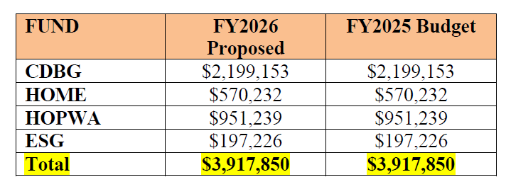
Question 5: While realizing Federal Funding is evolving on a daily basis with many legal challenges, share the planned use of the approximately ~$4M budgeted across Community Development Block Grant Fund (CDBG), Home Investment Partnership Program Fund (HOME), Housing Opportunities for Persons with Aids (HOPWA), and Emergency Solutions Grant (ESG), which these funds has remained the same as the previous budget.
REH is expecting an award commitment in MAY. This is based on the CR. REH is working under the assumption the award will be similar to last year.
Specify if there are any contingency plans for the federal funds
Reduced activity; reduced workforce.

Slide 14
Question 5 Continued
Specify criteria and selection process for grant awards.
The COW / REH accepted proposals from organizations between 1/6/25 – 2/7/25. The application review committee met on 3/13/25 and scored the applications. RE&H makes the final recommendations for funding to Council.
Specify any new recipients projected to receive funds.
No new applicants are being recommended at this time.
Specify the total dollar amount of requests submitted, and the total amount awarded.
HUD Program | Requested | Allocated
CDBG public service | ~$800,000 | ~$350,000
CDBG public facility | ~$2,100,000 | ~$1,500,000
HOME requests | ~$1,600,000 | ~$600,000
ESG | ~$360,000 | ~$193,000
HOPWA | ~$1,000,000 | ~$950,000

Slide 15
Question 5 Continued
Specify all the major budget uses for the CDBG funds and specify if any is for youth purposes.
The major CDBG budget uses are administration, public services, housing rehabilitation, and public infrastructure improvements. Several youth programs will likely be selected to receive funding for public services.

Slide 16
Question 6: Discuss the planned use for ~$1.55M budgeted in Community Activities, up $100K over the prior year’s budget:
Increased funding for Clean Team is to accommodate minimum wage increase.
Specify the names of the entities for the Neighborhood Clean Team, and amount per entity.
Program | FY25 BUDGET | FY26 PROPOSED
Non-Federal Activities | $300,000 | $300,000
Neighborhood Clean Team Initiative | $800,000 | $900,000
Live Near Your Work | $150,000 | $150,000
Down Payment Assistance Program | $200,000 | $200,000
TOTAL | $1,450,000 | $1,550,000
Entity | Neighborhood | FY 2025 Actual YTD
Temple United Learning Center, Inc | West Center City, Hilltop & Little Italy | $321,000
Community Empowerment Project, Inc | Eastside & 9th Ward Area | $219,076
Wilmington Hope Commission | Northeast | $107,838
Rainbow of Grace Community Services, Inc. | Browntown, Hedgeville & Bayard Square | $157,933
Lawrence Consultant Group, LLC |  | $39,600
TOTAL |  | $845,447

Slide 17
Question 6 Continued
Specify the number of people who have participated in the Live Near Your Work program and the number of City employees that have used this program within the last 2 years.
174 employees since Program inception with 6 settlements in 24/25
Specify the number of people that participated in the Down Payment Assistance Program, and average amount of funds allocated per person, and specify number of City employees that have participated if any.
75 closings to date, with the average assistance of $12,600 with 2 City employees in the program
Specify how non-federal activities funds are administered.
The miscellaneous project line is used for various real estate activities including but not limited to, grass cutting, debris and snow removal, title searches, appraisals, testing and abatement of environmental contaminates, General Fund overages, tree surgery and removal, property acquisitions, outside counsel legal services, down payment and settlement assistance.

Slide 18
Question 7: Discuss current vacant positions.
Specify duration of the vacancy.
Specify timeframe for filling position.
Specify any impact to Overtime, Temp Agency, and or Consultants.
Justify the need for the position.
REH is currently at full staffing to meet its operational needs.

Slide 19
Question 8. Discuss any proposed changes to positions (new position, deleted position, upgrade, realignment, transition, downgrade, title change, salary changes, etc.).
Eliminated:
Senior Rehabilitation Specialist II (10% General Fund and 90% Special Funds) ($97,795 )
Senior Program Director (10% General Fund and 90% Special Funds) ($111,834 )
Specify mechanisms in place to ensure that Administrative Cost overruns from the CDBG Administrative Caps as it pertains to staffing will not create cost overruns to be charged to the General Fund.
One Roof monthly reconciliations

Slide 20
Question 9. Discuss the planned use of $165K budgeted for consultants ($65K GF, $100K CDBG).
Specify vendor names.
Specify if any DBE’s.
Jeter & Company, LLC (DBE)
M&L Associates

Slide 21
Question 10. Share ongoing plans for the Neighborly Community Development Program software.
Specify cost, and purpose.
The Neighborly software is designed to increase efficiency and accountability to the enrollment, administration, and reporting of government funded programs. REH currently have 5 licenses with a yearly cost $13,500.

Slide 22
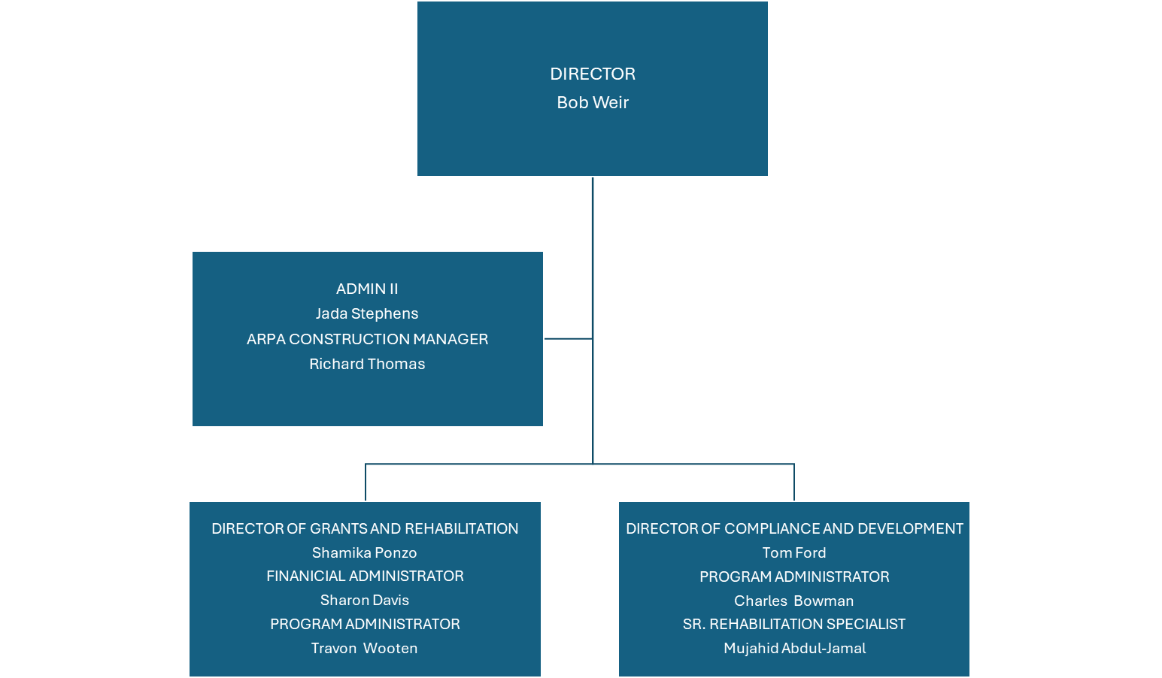

Question 9 Organizational Chart

