Slide 1


FY 2026 Budget Hearings
Revenue Projections

Slide 2
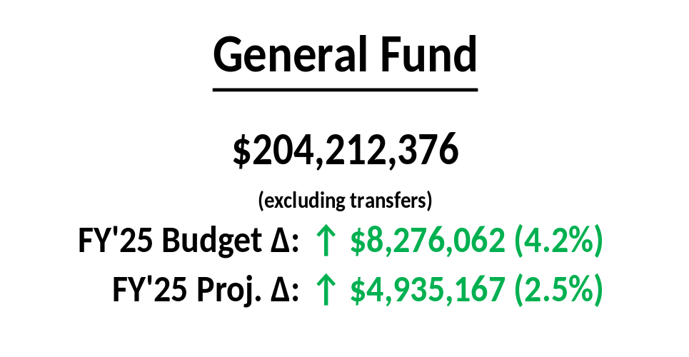
Revenue budget approved by Wilmington Economic and Financial Advisory Council (WEFAC) on March 27, 2025
No use of Tax Stabilization Reserve to balance budget
Projection does not include recession in FY 2026

Slide 4
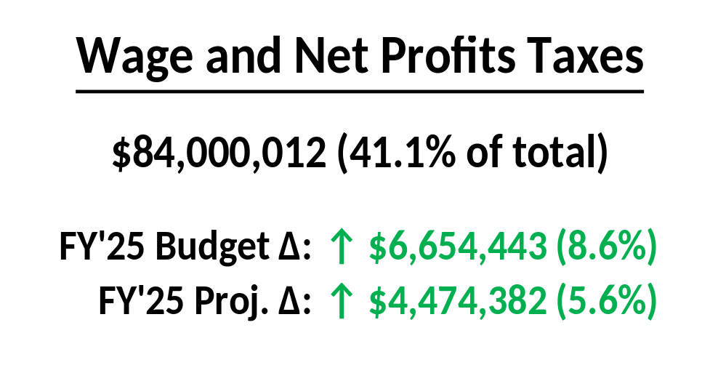
Wage Tax: $75.3 million (↑ $7.0 million)
  Lower refund losses as employees return to office (↑ $1.9 million)
  4.5% growth in taxable wages (↑ $3.2 million)
Net Profits: $8.7 million; consistent with FY’24/FY’25 (↓ $337,000)

Slide 5
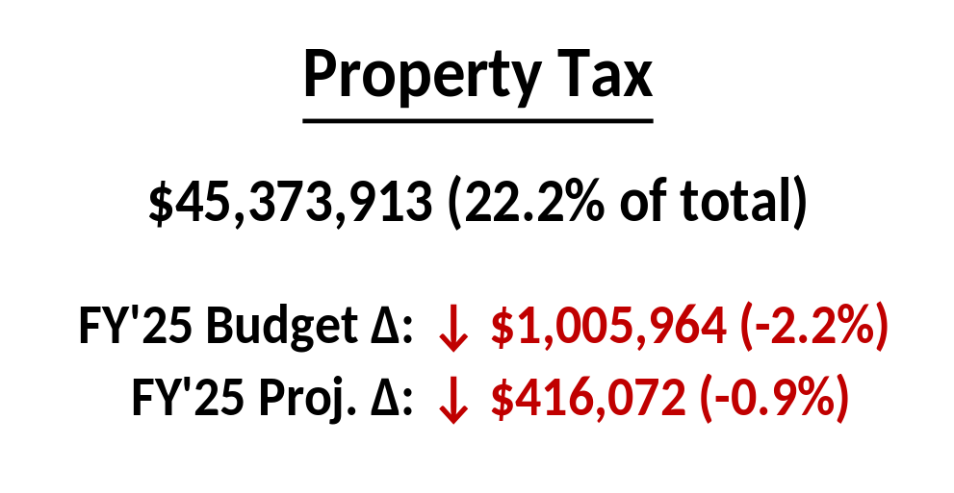
First New Castle County total reassessment since 1983
City is keeping overall tax billings level, though individual bills may change
  New rate is 4.5577 mills (or $4.5577 per every $1,000 of assessed value)
Residential properties make up a larger portion of total base
  Commercial (↑3.2x): 29% of total tax base, down from 42%
  Residential (↑5.7x): 57% of total tax base, up from 47%
Median homeowner ($210,300 assessed value): $216 annual increase

Slide 6
Base billings of $45.3 million, the same billed in FY’25
Base lower than FY’25 budget due to exemptions (↓ $697,000)
Penalty and Interest: $1.3 million; consistent with trending (↓ $198,000)

Slide 7
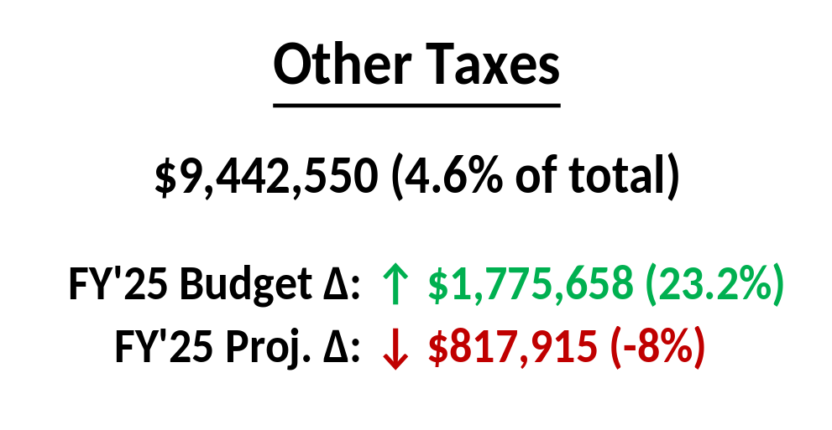
Head Tax: major employer resumes payment, net of ongoing declines (↑ $397,000)
Continued growth in Residential Transfers (↑ $745,000) and Commercial Transfers (↑ $634,000)
Delmarva electricity Franchise Fee unchanged

Slide 8
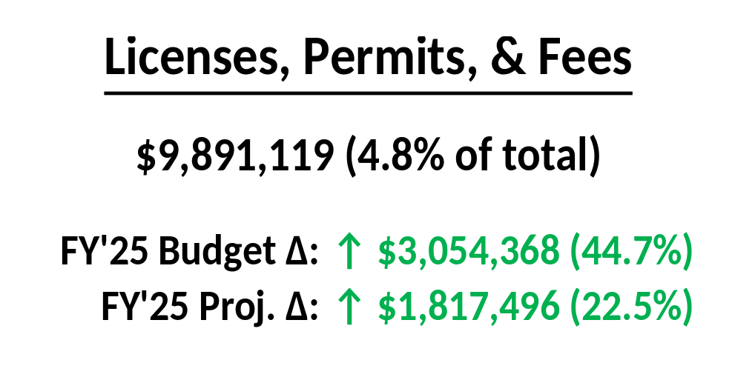
Permits up due to strong building and demolition permits (↑ $465,000)
Business License flat
Fees up due to property maintenance, fire inspection, cut fees (↑ $78,000)
New EMS medical insurance fees (↑ $2.5 million)
  Based on Trinity Health, could reach annual fees of $3.0 million to $4.0 million
  Budget is conservative, includes billing delays for Medicare / Medicaid / private insurers

Slide 9
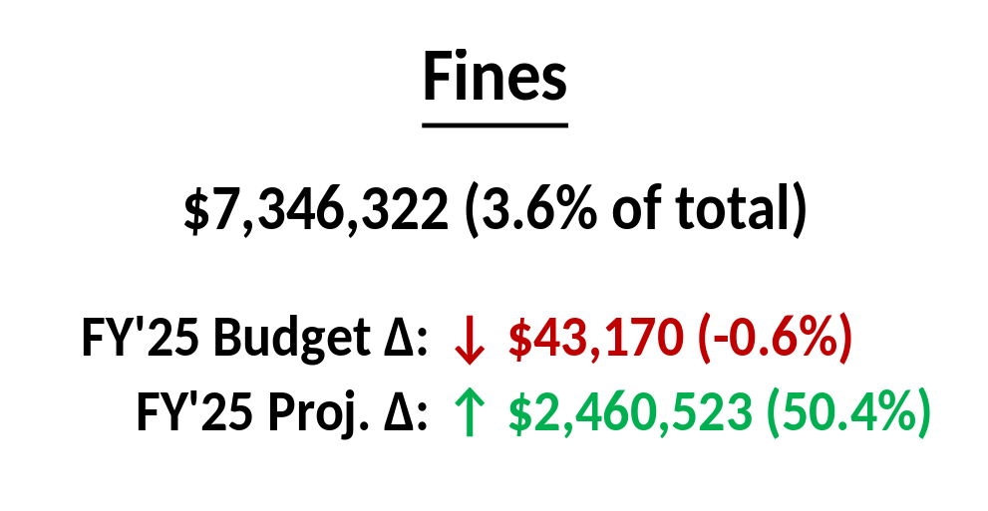
Redlights down due to FY’25 camera outages, lost collections (↓ $325,000)
Parking trending better than expected (↑ $261,000)
Small changes to Criminal Fines / Instant Tickets (↑ $21,000)

Slide 10
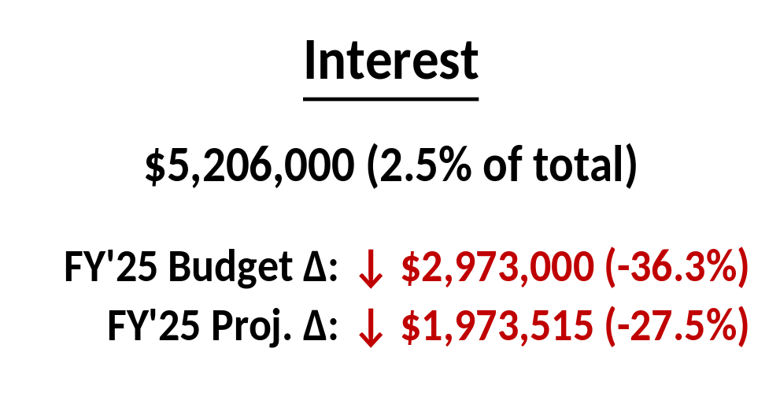
FY 2025:
  Rate reductions matched budgeted average of 4.3%
  Revenue drop largely driven by fall in cash balances due to capital outlays and incentives (Q1: $181M → Q3: $153M)
FY 2026:
  Projected rate of 3.3%
  Rates based on data from Treasurer and Federal Reserve

Slide 11
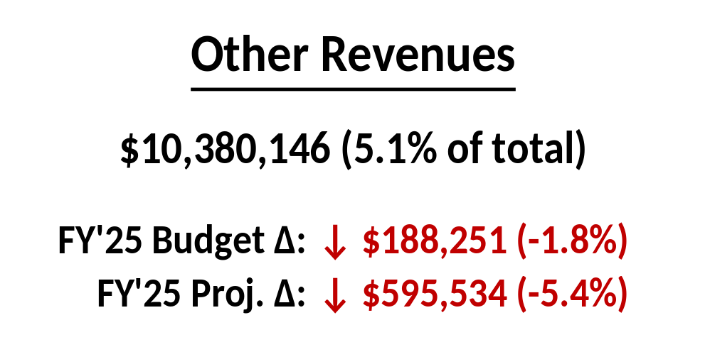
General Government Charges: vacant property registrations (↑ $407,000)
Indirect Costs: new Black & Veatch cost allocation study (↓ $596,000)

Slide 12
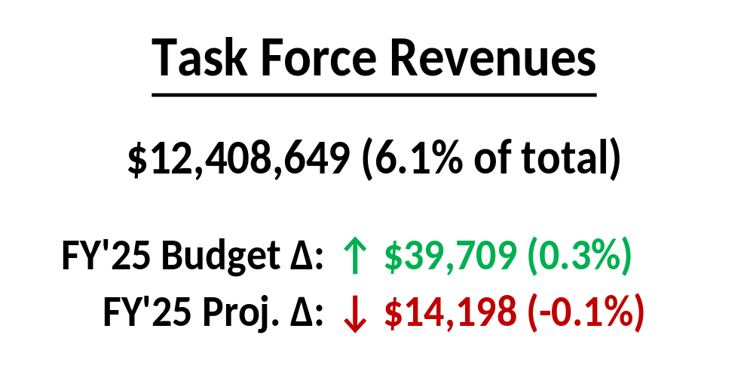
Largest revenues are Corporate Filing Tax (↑$51,000), LCC Filing Tax (↑$135,000)
Lodging Tax up slightly (↑$47,000)
Natural Gas Tax consistent with FY 2024 / 2025 (↓ $192,000)

Slide 13
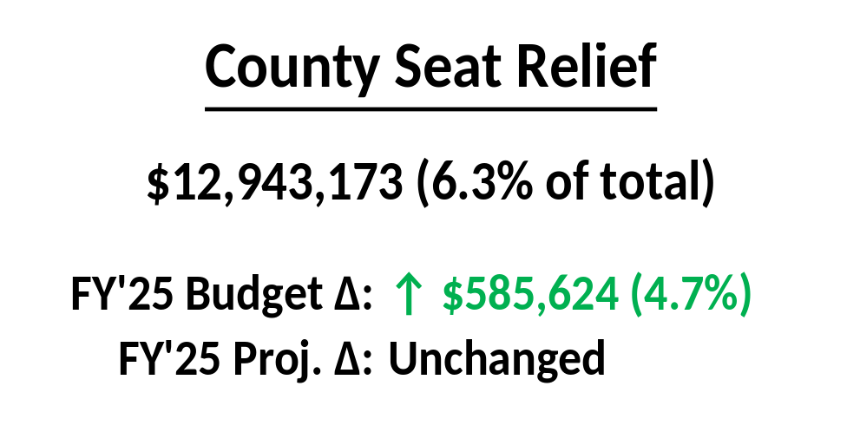
NCC Corporate Filing Fees (↑$151,000) and UCC Filing Fees (↑$451,000) consistent with WEFAC, DEFAC projections
PILOT: down slightly, matches to FY’25 actual (↓ $16,000)
Statutory Trust: capped at $1.0M

Slide 14
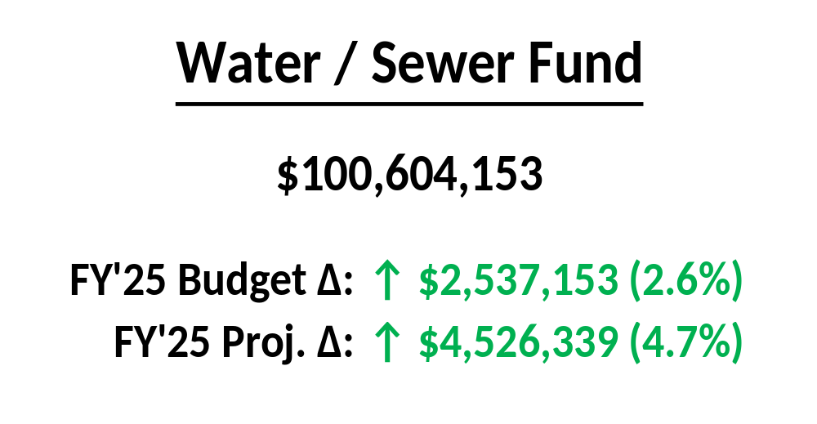
Revenue budget approved by WEFAC
Water / Sewer revenues derived from charges to customers, not taxes

Slide 16
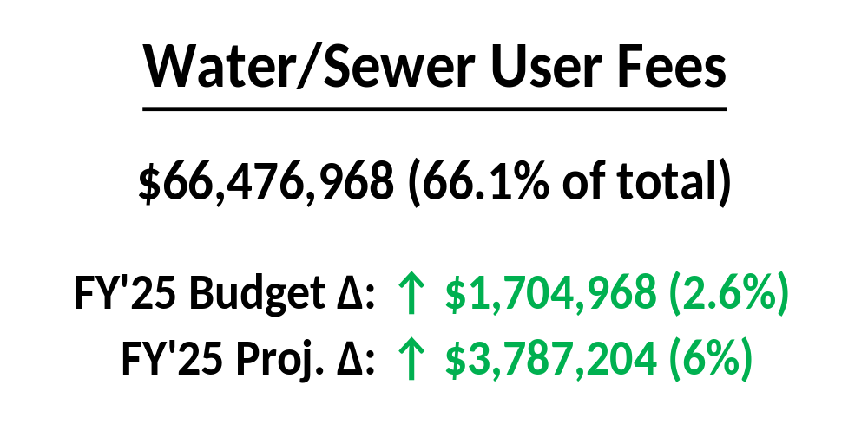
Decrease to base due to consumption, expected collections (↓ $332,000)
6.5% rate increase for all users
  Additional revenue is ↑ $3.8 million
  $4.33/month increase for typical inside City residential customer

Slide 17
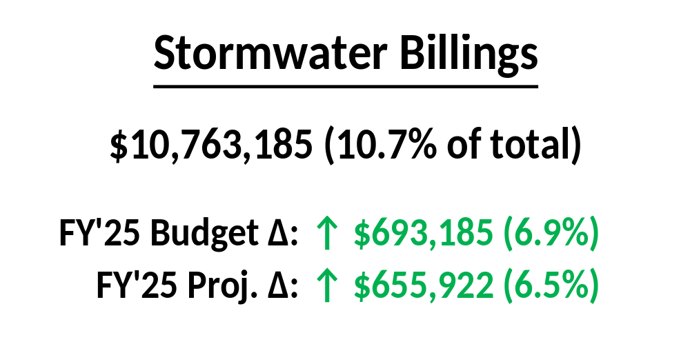
Not based on consumption, but on size and characteristics of property
6.0% rate increase
  Additional revenue is ↑ $543,000
  $0.33/month increase for typical inside City residential customer

Slide 18
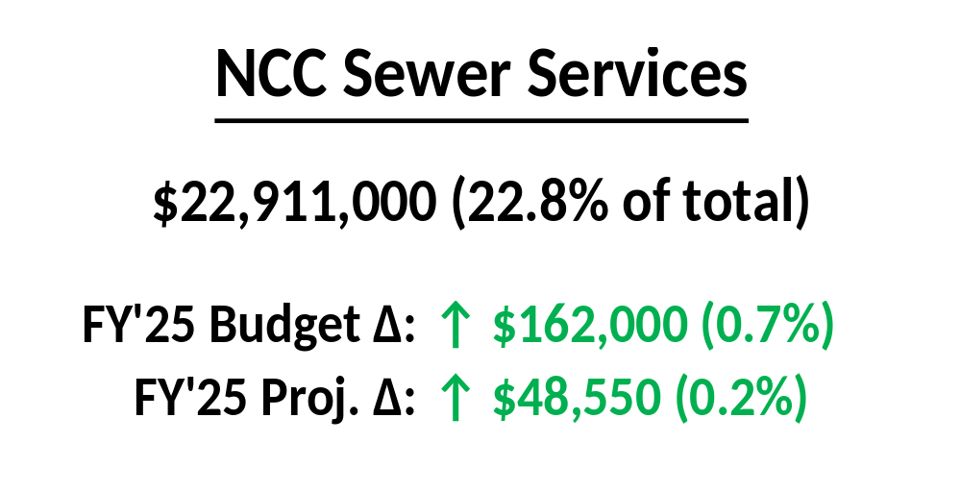
Revenue associated with City’s treatment of NCC sewage
Estimate is from Black & Veatch analysis of contract with County

Slide 19
FY 2026 Budget Hearings
Revenue Projections

