Slide 1


FY 2026 Budget Hearing
POLICE DEPARTMENT

Slide 2
FY 2026 Proposed Budget
General Fund | FY 2023 Actuals | FY 2024 Actuals | FY 2025 Budget | Proposed Budget FY 2026 | $ Change FY'26-25 | % Change FY'26-25
Personal Services | $54,206,408 | $52,417,048 | $58,501,033 | $58,185,668 | ($315,365) | -0.5%
Materials, Supplies, and Equipment | 3,563,202 | 3,951,765 | 4,098,637 | 4,888,126 | 789,489 | 19.3%
Internal Services | 5,691,550 | 8,178,444 | 6,095,004 | 6,330,861 | 235,857 | 3.9%
Debt Service | 290,472 | 291,945 | 145,871 | 136,515 | (9,356) | -6.4%
Total | $63,751,632 | $64,839,202 | $68,840,545 | $69,541,170 | $700,625 | 1.0%
Staffing Level (General Fund FTEs) | 365.0 | 366.0 | 358.0 | 361.0 | 3.0 | 0.8%
Staffing Level (All Funds FTEs) | 373.0 | 374.0 | 366.0 | 367.0 | 1.0 | 0.3%
Sworn Officers (All Funds FTEs) | 312.0 | 312.0 | 305.0 | 305.0 | 0.0 | 0.0%

Slide 3
Major Funding Changes (Proposed Budget)
Personal Services (↓ $315,365)
Position changes (↑ 3.0 FTE in General Fund):
  Midyear FY 2025: compensation and classification revisions (↑ $1,300)
  FY 2026 budget: Crime Analyst - Guns (↑ $112,400)
  FY 2026 budget: Bethel Villa no longer contracting for two Patrol Officers (↑ $217,300)
Net regular salary reductions (↓ $542,900)
  Elimination of FY’25 one-time $7,500 retention bonus (↓ $2.2 million)
  COLA and steps per contract (↑ $1.5 million)
Reductions to Overtime (↓ $81,500), special events overtime (↓ $38,400)
Net increase to Benefits: hospitalization (↑ $902,300), state pension (↑ $274,200), City pension (↓ $970,800)
Temporary Salaries reduced due to crossing guard vacancies (↓ $47,000)

Slide 4
Major Funding Changes (Proposed Budget)
Materials, Supplies, and Equipment (↑ $789,489)
Consultants ↑ $444,900:
  Biennial promotional process (↑ $275,000)
  Telestaff scheduling software (↑ $150,000)
Contracted Maintenance Services ↑ $162,800:
  License late recognition (LPR) software (↑ $114,800)
  ShotSpotter contract (↑ $17,000)
  Other Real-Time Crime Center contracts (↑ $20,400)
Electricity, based on actuals (↑ $35,000)

Slide 5
Question 1.
Council Shared its FY26 Budget Priorities with the Administration, please explain if the Police Department’s budget is aligned with the following priorities:
Public Safety: Continued funding for Police Accountability Board (PAB) or Citizen Review (CRB).
Public Safety: Funding set aside for expanding CPSI to other parts of the City.
Public Safety: Continued funding for Partners in Care Program.

Slide 6
Question 1. Answer
$30,000.00 is included in the proposed budget to support Police Accountability Board or Citizen Review.
Funding for the Community Public Safety Initiative is provided through the Mayor’s Office. WPD supports CPSI and Dr. Mason on a daily basis to help them succeed in their mission.
We are requesting $125,000.00 to cover 50% of the program cost for FY26. (The Department utilized grant funding for the first half of the fiscal year)
  Once grant funds are exhausted, we will request the full cost of the program, $250,000.00 in FY27 budget

Slide 7
Question 2.
With the evolving changes regarding Federal Grant Funding, while understanding possible legal challenges, share if any potential budgetary or fiscal contingencies for this upcoming budget and or any potential operational changes, considering the Federal Grant funds that the City receives for the day-to-day operations of the city, that may possibly result in being on the chopping blocks.
HB 58: “a law-enforcement officer of this State is not allowed to do any of the following: (1) Stop, question, arrest, search, or detain any individual based on actual or suspected citizenship or immigration status, or actual or suspected violations of federal civil immigration law. (2) Inquire about an individual’s immigration status, citizenship, place of birth, or eligibility for a social security number. (3) Make an arrest, detain, or prolong the detention of an individual based on civil immigration warrants or immigration detainers”
HB 96: “Act requires the Division of Civil Rights and Public Trust of the Department of Justice to submit a quarterly report to the General Assembly, Governor, and Office of Legislative Services detailing any request form a federal agency or entity for assistance from any State law enforcement agency regarding undocumented residents.
Potential or possible Sanctuary City classification for Wilmington being a “Welcoming City or Safe Haven for immigrants.”

Slide 8
Question 2. Answer
  Our primary mission is to support residents and visitors to Wilmington. We do not intend to participate in any federal immigration enforcement.

Slide 9
Question 3.
Understanding the national issue with recruitment and retention for Police Officer positions, and considering the latest Collective Bargaining Agreement (CBA) for FOP Lodge #1, share if this proposed budget allocates the necessary resources to keep WPD competitive with NCC, State of DE, etc.
Specify if the PERB (Public Employee Relations Board) ruling form last year, which basically removed the 5-year residency requirement, if that has made a difference with filling vacant positions.
Specify any consideration for take-home vehicles, pertaining to Res# 25-020, “A Resolution Requesting a Cost-Benefit Analysis on the Viability of a Take-Home Vehicle Program for the Wilmington Police Department.”
Specify if WPD has a dedicated position for Recruitment and Retention.
Specify the number of vacant positions, and length of the vacancy.

Slide 10
Question 3. Answer
The department has seen the recruitment-related benefits of the PERB ruling. In the past, one of the main impediments to recruiting police officers – particularly those who may already be well into their careers and who have established residences with their families elsewhere, has been the residency requirement. We have seen increased applications following this ruling.
A preliminary analysis of the costs associated with the take-home vehicle program revealed:
    Approximate $12 million up-front cost to purchase the estimated 125 additional vehicles necessary to up-size our fleet
    Approximate $2 million additional annual costs (does not include cost for gas, insurance, or expansion of our fleet vehicles services contract to expand capacity of the motor vehicle shop to service these additional vehicles).
Our Human Resource Division oversees recruitment, and that division includes a Captain, Lieutenant, as well as two Sergeants who manage recruitment and our police academy. We also have a recruitment team that consists of additional officers from various divisions and units who volunteer to be a part of this team to attend hiring events and conduct outreach with prospective applicants.
The Department currently has 22 vacant sworn positions, with an active Academy holding 10 recruits.

Slide 11
Question 4.
Specify funding within this budget that is directly allocated for violence prevention and intervention (please specify amounts per category).
With the City of Wilmington’s Police force having the most Officers per capital, share if any consideration for establishing an Office of Violence Prevention that is separate from the Police Department.

Slide 12
Question 4. Answer
The vast majority of our budgeted funds are intended to support violence prevention efforts. In addition, we apply for federal and state grant funding each year to support overtime assignments to allow for extra patrols and police presence following acts of violence as well as to conduct drug investigations and other special operations to address crimes and violence.
    The Community Engagement Unit & Partners in Care Unit
    WPD works closely with the city’s Community Public Safety Initiative Program.
    Support the work with Dr. Debra Mason and her colleagues and partners.
    We collaborate with the Group Violence Intervention Program, which works to help identify those with highest propensity for violence and offer them resources and opportunities to steer them away from crime.

Slide 13
Question 5.
Discuss any proposed changes to positions (new position, deleted position, upgrade, realignment, transition, downgrade, title change, salary changes, etc.)

Slide 14
Question 5. Answer
The department will add a new position for a Crime Analyst within the Crime Gun Intelligence Center. This position will significantly enhance the investigative capability for the entire organization in the department’s campaign against crimes involving illegal firearms and gun violence in the city.

Slide 15
Question 6.
Discuss the Department’s Authorized Strength proposed at 305 Officers.
FY26 Proposed authorized strength
FY25 Budgeted authorized strength vs actual (military leave, vacancies, etc.-list # of Officers per division).
Specify number of School Resource Officers (list site, contract term & amount).
  Specify if SRO contracts are funded at 100% of cost.
Share the diversity for the Authorized Strength. Specify if SRO contracts are funded at 100% of cost.

Slide 16
Question 6. Answer
  The FY26 authorized strength is 305 Sworn Officers, which decreased from 312 in FY24.
  The current actual strength is 273 (currently 22 Sworn Personnel vacancies)
    There is currently an active academy with 10 recruits set to graduate July 2025.
  The current operational strength is 261
    2 - Military Deployment
    10 - Modified duty personnel (injured/FMLA/Administrative Duty)

Slide 17
Question 6. Answer (Continued)
  There are currently 6 School Resource Officers:
    Howard High School – 10-Month Contract
    P.S. DuPont Middle School – 12-Month Contract
    Douglas School – 10-Month Contract
    Community Education Building (CEB) – 12-Month Contract
    Maurice Pritchett Sr. Academy – 12-Month Contract
    Bayard Middle School – 12-Month Contract
    Contracts follow the fiscal year (July 1 through June 30) at the rate of $91,544 for a 12-month program and $76,287 for a 10-month program. The contract cost is calculated based upon an average Patrol Officer’s salary with family benefits

Slide 18
Question 6. Answer (Continued)
WILMINGTON DEPARTMENT OF POLICE
Authorized Strength Demographics
Authorized Strength: 305
Current Strength: 273
 | MALES |  |  |  |  |  |  |  | FEMALES
SWORN PERSONNEL | White |  | Black |  | Hispanic |  | Other |  | White |  | Black |  | Hispanic |  | Other |  | Totals
CHIEF | 0 | 0.00% | 0 | 0.00% | 1 | 0.35% | 0 | 0.00% | 0 | 0.00% | 0 | 0.00% | 0 | 0.00% | 0 | 0.00% | 1
MAJOR | 0 | 0.00% | 1 | 0.35% | 0 | 0.00% | 0 | 0.00% | 1 | 0.00% | 0 | 0.00% | 0 | 0.00% | 0 | 0.00% | 2
CAPTAIN | 5 | 1.40% | 2 | 0.70% | 0 | 0.00% | 0 | 0.00% | 0 | 0.35% | 0 | 0.00% | 0 | 0.00% | 0 | 0.00% | 7
LIEUTENANT | 9 | 3.15% | 0 | 0.35% | 0 | 0.00% | 0 | 0.00% | 1 | 0.35% | 0 | 0.00% | 0 | 0.00% | 0 | 0.00% | 11
SERGEANT | 26 | 9.09% | 2 | 0.70% | 0 | 0.00% | 1 | 0.35% | 1 | 0.70% | 1 | 0.35% | 1 | 0.35% | 0 | 0.00% | 32
MASTER CORPORAL | 43 | 18.18% | 17 | 6.29% | 7 | 3.15% | 1 | 0.35% | 5 | 1.40% | 3 | 0.70% | 2 | 0.00% | 0 | 0.00% | 79
SENIOR CORPORAL | 24 | 8.39% | 6 | 2.10% | 3 | 1.05% | 0 | 0.00% | 3 | 1.05% | 1 | 0.35% | 3 | 1.75% | 1 | 0.00% | 39
CORPORAL | 17 | 7.34% | 4 | 1.75% | 5 | 1.75% | 1 | 0.35% | 1 | 0.70% | 3 | 1.40% | 1 | 0.35% | 0 | 0.35% | 33
PATROL OFFICER | 23 | 8.04% | 23 | 6.29% | 7 | 2.10% | 0 | 0.00% | 4 | 1.40% | 9 | 3.50% | 3 | 1.05% | 0 | 0.00% | 69
TOTAL | 147 | 53.85% | 56 | 20.51% | 22 | 8.42% | 3 | 1.10% | 16 | 5.86% | 17 | 6.23% | 10 | 3.66% | 1 | 0.37% | 273

Slide 19
Question 7.
Discuss any plans for a Police Academy in FY2026 and the budgetary costs per account category.

Slide 20
Question 7. Answer
  20 to 25 recruits are anticipated; the final number will be based upon the attrition rate at the time the academy begins
  The timeline for the total process includes:
      Application process and selection process
      Academy (approximately 24 weeks)
      Following graduation, officers are assigned to Field Training in the Uniformed Services Division
      The approximate timeline is 1 year from start to finish

Slide 21
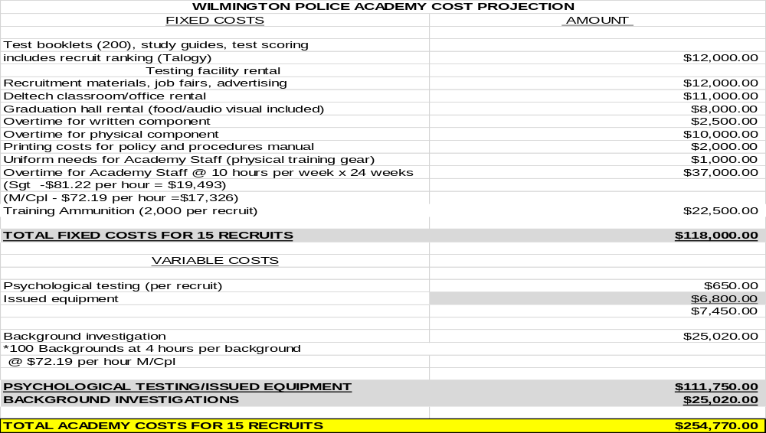
Question 7. Answer (Continued)

Slide 22
Question 8.
Discuss any budgetary funding set-aside for the Civilian/Youth Public Safety Academy, and the Police Cadet Program.
Specify the number of participants for the last 2 years, and if any City residents.

Slide 23
Question 8. Answer
The department has set-aside budgetary funding for the Civilian / Youth Public Safety Academy and Police Cadet Program.
        Within the last 2 years the department has had 5 participants in the Cadet Program, which 3 of those participants reside within the City of Wilmington. The department is anticipating 3 to 5 cadets in the program for FY26
        Within the last 2 years, the department had 50 participants in the youth academy, which 38 of those participants reside within the City of Wilmington. The department is anticipating 20 to 30 participants for the youth academy for FY26.

Slide 24
Question 9.
Discuss the $425K budgeted for part-time Crossing Guards.
  Specify the reduction in the number of crossing guards, considering budget was reduced $50K in FY25, and $22K in FY26. Please share the site locations, as well as the sites that will no longer have coverage.

Slide 25
Question 9. Answer
There has been a lack of applicants to fill the vacant Crossing Guard positions, the reduction in temporary salaries will not interfere with current staffing.
The city currently has 35 locations for Crossing Guards, which 21 of those locations are filled however 14 locations remain open.

Slide 26
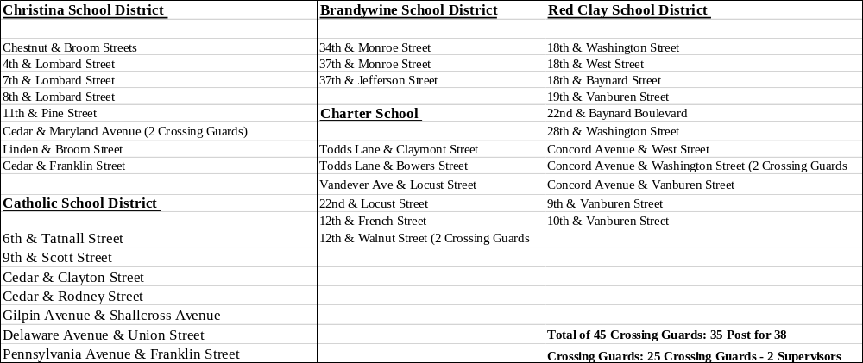
Question 9. Answer (Continued)

Slide 27
Question 10.
Discuss the planned use $3.54M budgeted in the overtime account categories.
  Share mechanisms in place to control overtime.
  Share any budgetary cost for Mayor’s security detail.

Slide 28
Question 10. Answer
POLICE DEPARTMENT OVERTIME - $3.54M
Divisional overtime including Patrol and Detective Divisions
Crisis Management Tactical Team
Vice operations
Canine overtime
City Sponsored Special Events
The Chief’s Office and our Fiscal Unit regularly monitor overtime expenditures and available funding in various account lines. Additionally, commanding officers in each division are responsible for monitoring and justifying overtime use. This includes monitoring use of anti-violence overtime funding, and an evaluation of the effectiveness of these assignments as they relate to the current crime trends.
Any budgetary costs for the Mayors Executive Detail has been budgeted under the Special Operations Division, Special Events Overtime.

Slide 29
Question 11.
Discuss the planned use of $1.8M budgeted in the Real-time Crime Center Division in the Consultant and Contracted Maintenance account groupings.
Specify total number of neighborhood cameras (per district).
Specify the number of camera operators assigned to each shift and hours that cameras are monitored.
Specify funds allocated for ShotSpotter, and the effectiveness.
Specify adequate funding for the body cameras for all officers.
Specify the effectiveness for the Licenses Plate Recognition software, and cost.

Slide 30
Question 11. Answer
  Currently, there are 111 cameras city wide
            Sector 1 – 20 Cameras
            Sector 2 – 57 Cameras
            Sector 3 – 24 Cameras
  Currently, there are a total of 9 employees (covering a 16-hour shift) monitoring cameras with 7-day coverage:
      Monday-Friday 0800-1600 (2 operators) 1000-1800 (1 operator) 1600-2400 (2 operators)
      Saturday/Sunday 0800-1600 (2 operators) 1600-2400 (2 operators)
  The budget includes $356,431 allocated for ShotSpotter for yearly contract.
  The budget includes $353,112 for the Body-Worn Camera program.
  The License Plate Recognition (LPR) is used as an investigative tool. Wanted motor vehicles are updated several times daily. The LPRs are reviewed after crimes to identify vehicles used in crimes, all of which led to arrest. The budgeted cost for FY26 $114,770.

Slide 31
Question 12.
Discuss the planned use of $735K budgeted in Consultants across the Admin and Public Safety Director Divisions.
Specify the vendor selection process for the promotional process?
Explain the promotional process for inclusivity regarding diversity such as race, gender, etc.
Please share if funds for the Police Accountability Board is inclusive of board training, as well as administrative resources.
Specify the number of clients for Partners in Care Unit, per district, since inception.
Share if any consideration for expanding the hours for the Partners in Care Unit.
Specify the number of cases or clients that the Clinical Services for Youth & Families has handled within the last 2 years.

Slide 32
Question 12. Answer
2026-2028 Promotional Process (Sergeant/Lieutenant) – $275K
    Vendor for Promotional Process is Talogy previously PSI Service
We continue to work with an outside vendor with a proven track record to facilitating impartial, independent promotional process in departments across the country. We offer each of our candidates with support and guidance to help them to prepare for this process, and independent review boards conduct each phase of testing. With this process the department has seen increased diversity among our supervisors as a result.
$30,000.00 is included in the proposed budget to support Police Accountability Board or Citizen Review.
Partners in Care clients are not tracked by council districts (and many are transient or unhoused, which makes it difficult to identify the geographically), but we continue to see steady growth in clients served.
    2024 – Q1 & Q2: 92 clients
    2024 – Q3: 115 clients
    2024 – Q4: 108 clients
    2025 – Q1: 115 clients
At this time, the hours of coverage do appear to align with the greatest needs. For hours when the teams are not working, officers can also make referrals to the team for follow-up.
In the last 2 years the Clinical Services for Youth & Families has handled:
    2023 - 274 families
    2024 – 178 families

Slide 33
Question 13.
Discuss the $220K allocated for the Axon Taser Contract.
Specify the life expectancy.

Slide 34
Question 13. Answer
The budget includes $220,110, for year 5 payment, for the AXON Taser 7 Equipment which was purchased in 2019 to be compatible with the current Body Worn Camera equipment.
The life expectancy for Conductive energy weapons have a five year useful life expectancy.
Any Technological product, such as high-tech electronic devices, a conductive energy weapon’s high voltage and other electronic components wear out over time and may not operate as expected, increasing the risk of a TASER / CEW failing in the field.

Slide 35
Question 14.
Provide an update on all authorized and received grant funds for FY24 and FY25 year-to-date.
Specify available grant funds.

Slide 36
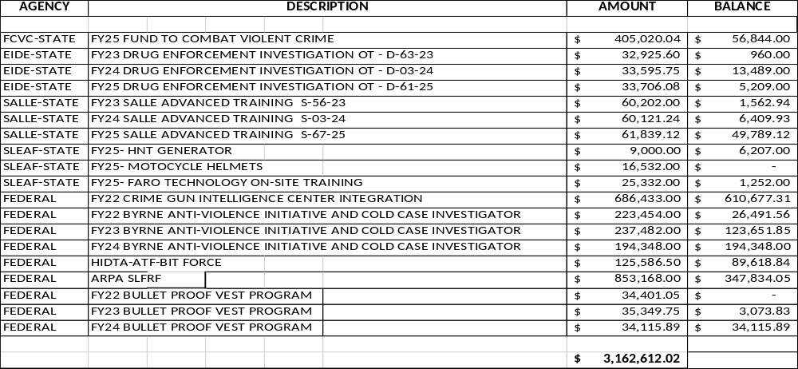
Question 14. Answer

Slide 37
Question 15.
Discuss the $447K budgeted for part-time Crossing Guards.
Specify if any reduction in the number of crossing guards, considering budget was reduced $50K, and share the site locations, as well as the sites that will no longer have coverage.
  RESPONSE IN QUESTION 9.

Slide 38
Question 16.
Discuss any new vehicle requests.

Slide 39
Question 16. Answer
There were no vehicle requests for FY2026.

Slide 40
Question 17.
Capital – Please discuss capital requests:
$460K - Public Safety Building Elevators
$130K - HVAC (911) Center

Slide 41
Question 17. Answer
$460K Public Safety Building Elevators: To replace 3 elevators, the equipment is failing and parts are no longer manufactured to repair.
$130K HVAC (911) Center: Replace equipment that is over 20 years old that is failing and parts are no longer manufactured to repair.

Slide 42
Question 18.
Provide FY2026 proposed organizational chart with the total number of employees (i.e. permanent, temporary, contract, vacancies).
Outline specific duties of each employee.
If there are multiple divisions, please ensure there are sub-org charts that enumerate all the above.

Slide 43

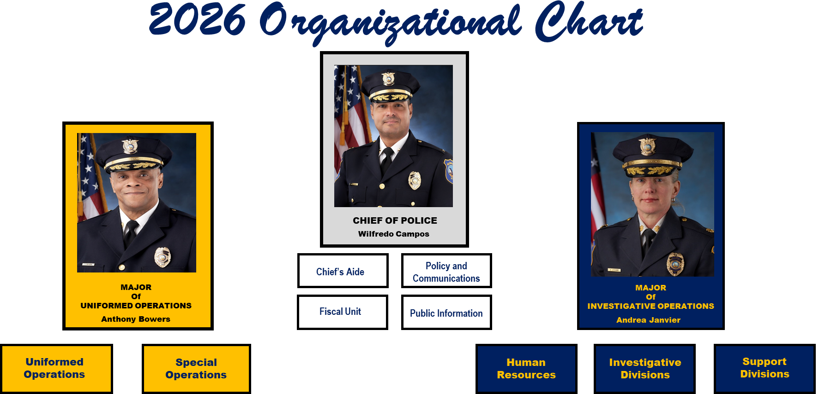
WILMINGTON DEPARTMENT OF POLICE

Slide 44
AUTHORIZED STRENGTH: 305
CURRENT STRENGTH: 273
 |  |  |  |  |  |  |  |  |  |  | Chief | Major | Captain | Lieutenant | Sergeant | Officer | Total
 |  |  |  |  |  |  |  | AUTHORIZED STRENGTH |  |  | 1 | 2 | 7 | 10 | 39 | 246 | 305
Administration |  |  |  |  |  |  |  |  |  |  | 1 | 2 |  |  |  | 2 | 5
Human Resources Division |  |  |  |  |  |  |  |  |  |  |  |  | 1 | 1 | 2 | 3 | 7
Office of Professional Standards |  |  |  |  |  |  |  |  |  |  |  |  | 1 |  | 5 | 1 | 7
Criminal Investigations Division |  |  |  |  |  |  |  |  |  |  |  |  | 1 | 1 | 6 | 20 | 30
Forensic Service Unit |  |  |  |  |  |  |  |  |  |  |  |  |  |  | 1 | 10 | 11
Drugs, Organized Crime & Vice |  |  |  |  |  |  |  |  |  |  |  |  | 1 | 1 | 1 | 15 | 18
RTCC, CGIC & Tech Resource Unit |  |  |  |  |  |  |  |  |  |  |  |  |  | 1 | 2 | 12 | 15
Support Services & Communications |  |  |  |  |  |  |  |  |  |  |  |  |  |  | 1 | 2 | 3
Special Operations -(Traffic - K9 - SRO - Pal - Hicks – CEU - PIC ) |  |  |  |  |  |  |  |  |  |  |  |  |  | 1 | 3 | 31 | 37
Uniformed Services Division (Administration) |  |  |  |  |  |  |  |  |  |  |  |  | 3 | 1 |  |  | 4
A Platoon |  |  |  |  |  |  |  |  |  |  |  |  |  | 1 | 4 | 27 | 34
B Platoon |  |  |  |  |  |  |  |  |  |  |  |  |  | 1 | 4 | 25 | 34
C Platoon |  |  |  |  |  |  |  |  |  |  |  |  |  | 1 | 4 | 28 | 36
D Platoon |  |  |  |  |  |  |  |  |  |  |  |  |  | 1 | 4 | 25 | 31
Downtown - Riverfront |  |  |  |  |  |  |  |  |  |  |  |  |  |  | 2 | 13 | 15
 |  |  |  |  |  |  |  | ACTUAL STRENGTH |  |  | 1 | 2 | 7 | 10 | 39 | 214 | 273

Slide 45
CIVILIAN PERSONNEL
Administration |  |  |  |  | 1
Human Resource Division |  |  |  |  | 3
Uniform Services Division (Patrol) |  |  |  |  | 1
Special Operations (Crossing Guards) |  |  |  |  | 27 | 18-Vacant
Support Services |  |  |  |  | 8 | 1-Vacant
Criminal Investigations Division |  |  |  |  | 2
Victim Services |  |  |  |  | 5
Communications |  |  |  |  | 35 | 3-Vacant
RTCC |  |  |  |  | 2
 |  |  |  |  | 84

