Slide 1


FY 2027 Budget Hearing
AUDIT DEPARTMENT

Slide 2
All Funds – FY 2027 Budget
Audit Department Total All Funds | FY 2024 Actuals | FY 2025 Actuals | FY 2026 Budget | Proposed Budget | $ Change FY'27-26 | % Change FY'27-26
 |  |  |  | FY 2027
Personal Services | $744,756 | $778,482 | $932,387 | $982,583 | $50,196 | 5.4%
Materials, Supplies, and Equipment | 295,255 | 272,125 | 409,299 | 408,182 | (1,117) | -0.3%
Internal Services | 6,967 | 9,233 | 4,123 | 4,281 | 158 | 3.8%
Total | 1,046,978 | 1,059,840 | 1,345,809 | 1,395,046 | 49,237 | 3.7%
Staffing Level (FTEs) | 5.00 | 5.00 | 6.00 | 6.00 | 0.00 | 0.0%

Slide 3
General Fund – FY 2027 Budget
Audit Department General Fund | FY 2024 Actuals | FY 2025 Actuals | FY 2026 Budget | Proposed Budget | $ Change FY'27-26 | % Change FY'27-26
 |  |  |  | FY 2027
Personal Services | $744,756 | $778,482 | $932,387 | $982,583 | $50,196 | 5.4%
Materials, Supplies, and Equipment | 210,947 | 187,076 | 270,069 | 268,740 | (1,329) | -0.5%
Internal Services | 6,967 | 9,233 | 4,123 | 4,281 | 158 | 3.8%
Total | 962,670 | 974,791 | 1,206,579 | 1,255,604 | 49,025 | 4.1%
Staffing Level (FTEs) | 5.00 | 5.00 | 6.00 | 6.00 | 0.00 | 0.0%

Slide 4
Water/Sewer Fund – FY 2027 Budget
Audit Department Water/Sewer Fund | FY 2024 Actuals | FY 2025 Actuals | FY 2026 Budget | Proposed Budget | $ Change FY'27-26 | % Change FY'27-26
 |  |  |  | FY 2027
Personal Services | $0 | $0 | $0 | $0 | $0 | 0.0%
Materials, Supplies, and Equipment | 84,308 | 85,049 | 139,230 | 139,442 | 212 | 0.2%
Internal Services | 0 | 0 | 0 | 0 | 0 | 0.0%
Total | 84,308 | 85,049 | 139,230 | 139,442 | 212 | 0.2%
Staffing Level (FTEs) | 0.00 | 0.00 | 0.00 | 0.00 | 0.00 | 0.0%

Slide 5
Major Funding Changes
Personal Services (General Fund)
Steps and COLAs, filled vacancies (↑ $50,196)
Materials, Supplies, and Equipment (General Fund)
Accounting: external audit assistance (↓ $6,000)
Subscriptions/Books: Gartner audit research and guidance (↑ $6,259)
Furniture, Fixtures, and Office Equipment (↓ $1,500)

Slide 6
Audit Department Vision
Maintain an efficient approach to the overall audit process.
To provide an independent and objective perspective to an accountable government.
Provide efficient and effective audits and look for ways to help improve controls and processes at the City.

Slide 7
Top Three Priorities
To conduct quality audits.
Provide timely and consistent audit follow-ups with Management.
To promote awareness of the Fraud Hotline.

Slide 8
Top Three Performance Measures
Completed Audits
Reporting the Status of Management Action Plans
  Implemented
  Open
  Past due, action taken
  Past due, no action taken
Fraud Calls Investigated

Slide 9
1. Understanding the 5-year revenue and expenditure projections show expenditures far outpacing revenues for FY27 to FY30, and that FY27 General Fund Proposed Budget uses $25.7M of the Tax Stabilization Reserve Fund, please share how this budget aligns with closing any potential budget gaps.
  Based on the regulatory requirements the auditing department must adhere to regarding the City Code and Generally Accepted Government Auditing Standards, we really do not have the bandwidth to make any decreases to the budget without becoming noncompliant with the requirements or creating significant risk to the city.
a) Specify any cost savings or reductions, and if this budget provides adequate resources to meet the departmental needs.
  As a result of my budget being very lean, at various times I may need to request additional funds to ensure we have the appropriate coverage and skillsets needed during emergencies or special projects when they arise.
b) Specify any high-level major additions.
  Not applicable

Slide 10
2. Considering the $1.680M budgeted for Stormwater Utility and the Water Sewer Utility charges across both the General and Water Sewer Funds, please share if there are any plans to conduct a review to ensure that these charges are adequate.
The funds mentioned above are covered in the city’s annual external audit performed by Belfint, Lyons and Shuman (BLS). Based on this information, I don’t think it’s necessary for another audit to be performed because it’ll be a duplication of efforts and a waste of taxpayers' money.
  Specify if there is any financial impact on the city with this cost.
    No, I don’t think this is applicable based on my previous response.

Slide 11
3. With Black & Vetch presenting the 6-year financial rate plan for the water sewer fund, please share if there are any plans to conduct any audits to ensure that the financial rate plans presented to Council is sustainable.
Yes, this area is covered during the city’s external audit each year by BLS when they audit the water sewer fund. In addition, Black & Veatch are subject matter experts in this area and with BLS auditing this fund annually, I think it’s reasonable to assume the financial rate plans presented to Council are sustainable.
a) Specify if there has been any review by the City’s Outside Auditor (please explain why or why not).
    As mentioned above, the city’s water sewer fund is audited by BLS during the city’s annual external audit.

Slide 12
4. Now that the court mandated Property Tax Reassessment for New Castle County was done by Tyler Technologies, which the methodology used is based on market rate value, please share any budgetary or fiscal plans to audit the data file. Please explain why or why not.
Specify if there are any collaborations with NCC Auditor, and the State Auditor.
  The auditing department is in the process of conducting the city’s Annual Risk Assessment within the next few weeks. This is what determines which audits will be selected for the Audit Plan the next fiscal year. Regarding the Property Tax Reassessment, I’ve had correspondence with Robert Wasserbach, County Auditor and as of now, I think it makes more sense for him to conduct this audit because it’s New Castle County’s data that was used by Tyler Technologies for the assessment.

Slide 13
5. Discuss the mechanisms in place to ensure that both internal and external clients are abreast of the City’s fraud hotline.
a) Share the amount of funds budgeted. Answer: $1,000
b) Specify the number of calls for FY24, FY25, and year to date.
  FY24 - 4 calls
  FY25 - 4 calls
  FY26 – 6 calls
c) Specify if any calls led to fraud investigation, per year, for the last 3 years.
  FY24 - 1 fraud investigation
  FY25 - 2 Fraud investigations
  FY26 - 1 Fraud investigations
d) Share the number of Risk Assessments submitted FY24, FY25, and FY26.
  FY24 - 20 Respondents
  FY25 - 15 Respondents
  FY26 - 18 Respondents

Slide 14
6. Discuss the planned use of $242K budgeted in the Consultants account line (across both the General and Water Sewer Funds).
$198K is budgeted to cover the cost of the city’s external audit fees.
$35k is being budgeted for Annual Financial Reporting assistance to the finance department.
$9K is budgeted to fund additional auditing services provided by consultants, as needed.
Specify vendor name, duration of the contract, and how long the City has been doing business with this vendor.
    Vendor name: Belfint, Lyons and Schuman
    Contract amount: $198,000
    Contract duration: Three-year contract with two possible one-year extensions.
    Length of contract & relationship: BLS is the firm we currently use for the city’s external audit. We have been doing business with them for nine years.
Specify if the vendor has affiliation with inclusion of DBE’s:
  No formal subcontractor relationships with DBEs (or non-DBEs).

Slide 15
7. Discuss the number of planned audits proposed for FY27, and the number of planned audits versus completed audits for FY25 and FY26.
We are still in the process of gathering responses to formulate the audit plan for FY27.
In FY26, we planned to conduct 16 audits. We have completed three audits to date, and five audits are currently a work in progress.
For FY25, we planned 15 audits*, completed six and seven were carried forward to FY26.
  a) Specify the number of audits that will be carried over to FY27:
    At this time, we anticipate 4 audits being carried over.
  b) Specify the number of audits that have been done externally per year, the last 3 years.
    Belfint, Lyons and Shuman conducted the City’s ACFR, Single Audit, as well as the Police and Fire Pension Audits over the last 3 years.
    Avenu Insights and Analytics conducted the City’s Comcast Franchise Audit in FY24.
    Victor Prospero conducted the City’s ARPA Funding Audit in FY24 and completed the Wilmington Neighborhood Conservancy Land Bank Audit in FY25.
* Staffing turnover directly impacts our ability to complete the total number of planned audits.

Slide 16
8. Discuss the impact on your operations as a result of the new integrated audit management platform (Optro OpsAudit) that was recently implemented.
As of April 1, 2026, we have launched the use of Optro (formerly known as AuditBoard) to conduct our audits. Utilizing Optro allows us to conduct previously stand-alone functions within the audit management system, such as
Request audit documents electronically
Conduct City Risk Assessment
Conduct Quarterly Status updates.
Specify if adequate funding is allocated.
  Funding has been requested in the FY 2027 budget for the annual support services regarding Optro.

Slide 17
9. Please share the latest updates from the recent Peer Review of the Audit Department, and if this budget provides the necessary funding and resources.
The most recent peer review was completed on November 05, 2025. The review covered the period of July 1, 2022, to June 30, 2025. The Department received a pass rating which means it is the peer review team’s opinion that the City of Wilmington Audit Department's internal quality control system was adequately designed and operating effectively to provide reasonable assurance of compliance with Government Auditing Standards and applicable legal and regulatory requirements for engagements during the period June 1, 2022, to June 30, 2025.
a)Specify your plans to maintain and build upon the areas where your department excelled.
Peer reviewers noted the following areas where the City of Wilmington’s Audit department excels:
  The use of flowcharts within the audit documentation was particularly effective in illustrating key processes and controls.
  Audit Department is committed to providing ongoing training to ensure staff are well­ versed in applicable professional standards.
  Our department remains committed to leveraging technological advancements to enhance the efficiency, effectiveness, and quality of its audit processes.
The Department plans to maximize available technology, such as ThirdLine and Optro to increase the use data analytics in audits. In addition, we’re continuing what we have been doing in terms of obtaining quality and relevant CPE training.

Slide 18
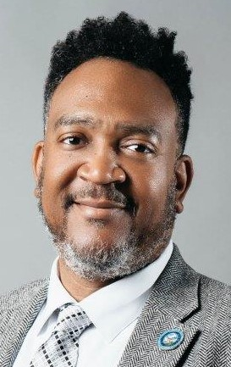
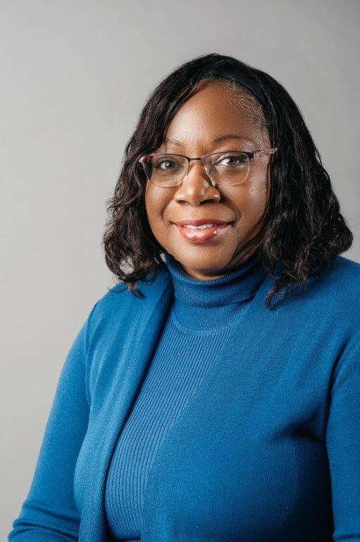
10. Provide FY26 proposed organizational chart with the total number of employees (i.e. permanent, temporary, contract, vacancies).
Audit Organizational Chart
Senior Auditor
Michael J. Maldonado
Office Assistance
Part-time
Rebecca Cruz
CITY AUDITOR
Terence J. Williams
Senior Auditor
Victoria Fuentes-Cox
Audit Manager
Tamara Thompson
Senior Auditor
Ariana M. Fleming
Senior IT Auditor
Shiv D. Patel

Slide 19
Outline specific duties of each employee.
City Auditor-
  As the Chief Audit Executive, responsibilities include overseeing the department’s financial and operational activities and monitoring compliance of the established policies and procedures of the City. This is accomplished by conducting an annual risk assessment and presenting the annual audit plan to the Audit Review Committee. In addition, reporting results of completed audits and the status of risks being mitigated by City Management on a quarterly basis.
Audit Manager-
  Handles the day-to-day operations of the department. The Manager assists the City Auditor with planning the audit schedule, managing projects to ensure engagements are properly planned, staffed, and completed in accordance with Generally Accepted Government Auditing Standards. In addition, the Audit Manager ensures the staff are properly trained in the evolving needs of the audit profession and maintaining their continuing professional education requirements.
Office Assistant-
  Handles administrative, organizational and clerical support tasks.
Senior Auditor (3)-
  They are responsible for completing audit objectives by gaining an understanding of functional areas being audited. This is accomplished by interviewing process owners, documenting their understanding of the processes, identifying gaps / control weaknesses in processes and performing detailed testing. In addition, they are responsible for assisting Audit Management with developing audit reports and quarterly status updates for the Audit Review Committee.
Senior IT Auditor (1)-
  IT Auditor is responsible for completing IT audit objectives by gaining an understanding of IT areas being audited and developing and maintaining a city-wide IT risk assessment . This is accomplished by interviewing process owners, documenting their understanding of the processes, identifying gaps / control weaknesses in processes and performing detailed testing. In addition, they are responsible for assisting Audit Management with developing audit reports and quarterly status updates for the Audit Review Committee.

