Slide 1


C CITY COUNCIL FY 2027 Budget Hearing
www.wilmdebudget.org

Slide 2
Mission of City Council
Provide visionary leadership in policymaking on quality-of-life matters.
Develop well-researched legislation that will enable Wilmington government to provide its residents, visitors and businesses with the highest quality of public services in a fiscally responsible manner through cooperative decision-making, strong ethical leadership, open communications and transparency with its public.
Fulfill the critical responsibility of providing a check on the executive branch of City government both through individual City Council Committees, and legislative measures to enhance transparency, accountability and adherence to stated and collectively agreed upon goals for City operations.
Connect with constituents to identify needs in the community and to devise strategies to address those needs, both through legislation and through collaboration with the executive branch of City government.

Slide 3
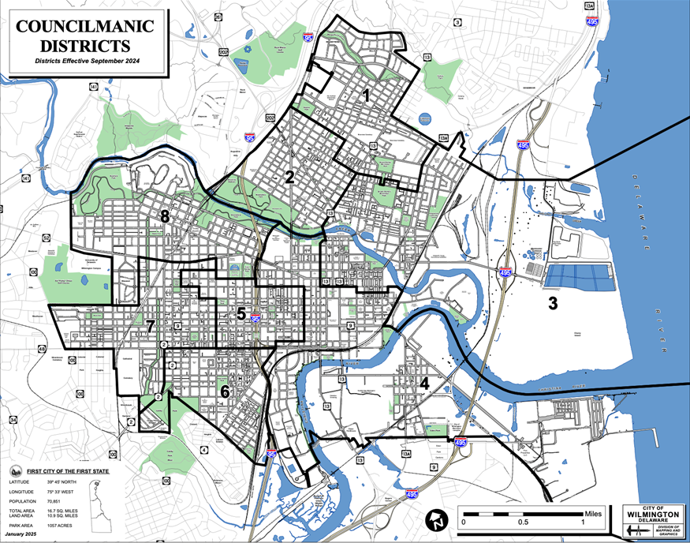
City Council/Purview
City Council is the Legislative Branch of Government
  13 Elected Officials (part-time)
  Represents 8 Districts Across the City
  Governed by City Code and State Charter
Primary Responsibilities
  Enacting Laws (Ordinances)
    Annual Operating Budget
  Drafting Resolutions
  Provide Checks & Balances
  Provide Constituent Services for City Residents
  Redistricting

Slide 4
Standing Committees of City Council
Community Development & Urban Planning
  Chair: Maria D. Cabrera
Education, Youth & Family Services
  Chair: Latisha Bracy
Finance & Economic Development
  Chair: Michelle Harlee
Health, Environmental, Aging & Disabilities
  Chair: Coby J. Owens
Intergovernmental
  Chair: Shané N. Darby
Public Safety
  Chair: Yolanda M. McCoy
Public Works & Transportation
  Chair: Zanthia Oliver

Slide 5
City Council Office Operations
Legislative/Financial/Admin Support Div.
Provide Support to Council Members
Process Scholarships, Fund Requests, Payments
WITN/Social Media
City Clerk
Communications
Government Programs that Promote the City of Wilmington; Social Media promoting City; Council & WITN Website
Official Custodian of City Records/Council Meetings
Media, New Releases, Public Relations, Event Coordination
Scripts/PSA’s
Grant and Contract Management/Oversight
Legislative Ordinances, Council Agenda
Council website/Council Social Media
FOIA
Attest Mayor and President
Collaborate with PEG/Comcast Franchise Agreement, Assist TPO
NCC County – airing and recording NCC committee and Council meetings
Research/Policy
News/Programs – focus on City of Wilmington
Research, Policy, Draft Non- Legislative Resolutions
Strategic Plan
Special Projects -Disparity Study, Police Accountability Review Board, Violence Reduction
Office of Educational Advocacy
Advocate for the educational needs and rights of the youth of the City of Wilmington
Develop and Support Evidence-based solutions to address educational needs and rights
Mobilization efforts with local communities
Tracking Key Educational Performance Indicators via Data, surveying, etc.

Slide 6
All Funds (General & CATV) – FY 2027 Budget
City Council Total All Funds | FY 2024 Actuals | FY 2025 Actuals | FY 2026 Budget | Proposed Budget FY 2027 | $ Change FY’27-26 | % Change FY’27-26
Personal Services | $2,337,401 | $2758,967 | $2,988,985 | $3,129,308 | $140,323 | 4.7%
Materials, Supplies, and Equipment | 894,390 | 959,964 | 1,248,203 | 1,155,889 | -92,314 | -7.40%
Internal Services | 50,934 | 66,010 | 20,642 | 21,091 | 449 | 2.1%
Debt Service | 22,771 | 22,805 | 22,631 | 46,905 | 24,274 | 107.3%
Other/Special Purpose | 13,169 | 13,365 | 16,500 | 20,500 | 4,000 | 24.2%
Total | $3,318,664 | $3,821,111 | $4,296,961 | $4,373,693 | $76,732 | 1.8%
Staffing Level (All Funds FTEs) | 27.00 | 27.00 | 29.00 | 28.00 | -1.00

Slide 7
General Fund – FY 2027 Budget
City Council General Fund | FY 2024 Actuals | FY 2025 Actuals | FY 2026 Budget | Proposed Budget FY 2027 | $ Change FY’27-26 | % Change FY’27-26
Personal Services | $1,624,602 | $1,935,572 | $2,142,075 | $2,229,516 | $87,441 | 4.1%
Materials, Supplies, and Equipment | 765,824 | 867,009 | 1,080,684 | 1,024,735 | -55,949 | -5.2%
Internal Services | 50,934 | 66,010 | 20,642 | 21,091 | 449 | 2.2%
Other Special purpose | 13,169 | 13,365 | 16,500 | 20,500 | 4,000 | 24.2%
Total | $2,454,529 | $2,881,956 | $3,259,901 | $3,295,842 | $35,941 | 1.1%
Staffing Level (All Funds FTEs) | 19.65 | 19.65 | 21.90 | 21.90

Slide 8
CATV Fund – FY 2027 Budget
City Council CATV Fund | FY 2024 Actuals | FY 2025 Actuals | FY 2026 Budget | Proposed Budget FY 2027 | $ Change FY’27-26 | % Change FY’27-26
Personal Services | $712,799 | $736,291 | $846,910 | $899,792 | $63,749 | 7.6%
Materials, Supplies, and Equipment | 128,565 | 92,955 | 167,519 | 131,154 | (36,365) | -21.7%
Debt Service | 22,771 | 22,805 | 22,631 | 46,905 | 24,274 | 107.3%
Total | $864,135 | $939,155 | $1,037,060 | $1,077,851` | 51,658 | -5.0%
Staffing Level (All Funds FTEs) | 7.35 | 7.35 | 7.10 | 6.10 | (1.0)

Slide 10
General Fund Major Changes
General Fund total $3.2M, up $35.9K
  Personal Services total $2.2M, up $87K:
    $63K Increase : Healthcare Cost
    $35K Added : Front Desk Office Recep./Admin Assistant-OEA (offset by $50K reduction in Consultants)
    -$40K Decrease : Salary placeholder for vacant Dir. OEA ,changed from $150K to $110K,
    New Council salaries effective for 109th session, CY2026
    Professional Development Council Staff –performance, COLA’s
    Internship Program : Continued funding for 4 interns @ $5K each
    Comms Assistant

Slide 11
General Fund Major Funding Changes – MSE
MSE total $1.024M, decrease -$56K
  Community Activities total $622K, decrease -$2.5K
Purpose: | FY2027-PROPOSED Budget | FY2026 BUDGET
Council Scholarship Funds ($5,000 per Council person) | $65,000 | $52,000
Council Discretionary/Community Support Funds ($28,076 per Council person) | $364,988 | $377,988
Community Paid Activities (Festivals/Parades) | $10,000 | $10,000
Community Services (Ads, Sponsorships, Tickets, Comm Support) | $47,000 | $47,000
Beautification Funds (or Discretionary/Scholarships) ($5,769 per council person)- | $75,000 | $75,000
Misc. Projects (Large Grants)
CCAC | $0 | $20,000
Thanksgiving Turkey Drive | $25,000 | $0
HBCU Foundation | $10,000 | $10,000
Rysheema Dixon Foundation or Play Streets | $10,000 | $10,000
WECEC | $15,000 | $15,000
Grand Total | $621,985 | $624,488

Slide 12
General Fund Major Funding Changes – MSE (continued)
  Consultants total $264K, decrease -$47.5K
 | FY2027-PROPOSED | FY2026- BUDGET
Project Manager | $20,000 | $17,500 | $2.5K
Annual Black Restaurant Week | $50,000 | $50,000 | $0
Mayor Baker Agreement | $15,000 | $15,000 | $0
AI Translation(Spanish) | $15,000 | 15,000 | $0
Policy Fellows | $64,000 | $64,000 | $0
Outside Attorney Expertise, Financial, Marketing, Etc. | $75,000 | $75,000 | $0
Office of Educational Adv/Technical Data Firm, Other Expertise | $0 | $50,000 | -$50,000
Advocate/Lobbyist | $25,000 | $25,000 | $0
TOTAL: | $264,000 | $311,500 | -$47,500

Slide 13
General Fund – MSE (Continued)
Professional Development: $54K
  Conferences, Travel
Printing & Advertising:$27.5K, up $5.5K
  Public Hearing Notices, MUNI Code and Supplement services, Digital Ads,
Food $10.6K, up $1.5K
  Council meetings, budget hearings, youth council, etc.
Misc. Charges NOC: Increased $15K, funds for paying Youth Council
Special Purpose: Increased $4K, annual holiday gathering
Parking for Council, $4.1K, decrease -$16.2K

Slide 15
CATV Fund Major Funding Changes – MSE
CVT Fund total $1.077M, up $51K
  Personal Services total $899K
    Healthcare cost : Increased $32K
    Continued funding Professional Growth Development/COLA’s
    Deleted 1 Vacant Defunded Producer position
  Debt Service total $47K, up $24K
  MSE Total:$131K, decrease -$36K

Slide 16
CATV Fund Major Funding Changes – MSE
  Continued Funding
    $25K : Legal Expertise/Franchise Agreement Negotiations -Verizon
    $41K : Subscription services: Killer Tracks, Adobe, Zoom, Comcast, Mailchimp, Wotchit, Canva
    $15K : Lerro Contract, repairs to equipment, Tightrope Cable System
    $20K : Equipment needs
    $11K: Parking
    $13K: Professional Development

Slide 17
Comcast Franchise Fees (Fiscal Year) blue shade = actual

Slide 18

FUNDING GAP/ FRANCHISE FEES TO WITN BUDGET
WITN FY2026 PROPOSED BUDGET:
$1,077,851
COMCAST FRANCHISE FEES
FY2027 PROJECTED :
$786,980
NCC Funds FY26 Projected:
$34,000
CVT FUND BALANCE AS OF 6/30/25:
$1.936M
COMCAST BASIC WILM CITY CABLE USERS | YEAR
17,650 | 2017
17,154 | 2018
16,272 | 2019
15,235 | 2020
13,552 | 2021
11,772 | 2022
9,940 | 2023
8,435 | 2024
7,653 | 2025
Funding Gap : $256K

Slide 19
POSITIONS
Total Positions:
  WITN : 5
  Council Staff: 10
  Council Members: 13
Vacancies:
  Dir. of Education Advocacy – vacant since 3/8/26
  Part-Time Communications Assistant – vacant since 10/23/2025

Slide 20
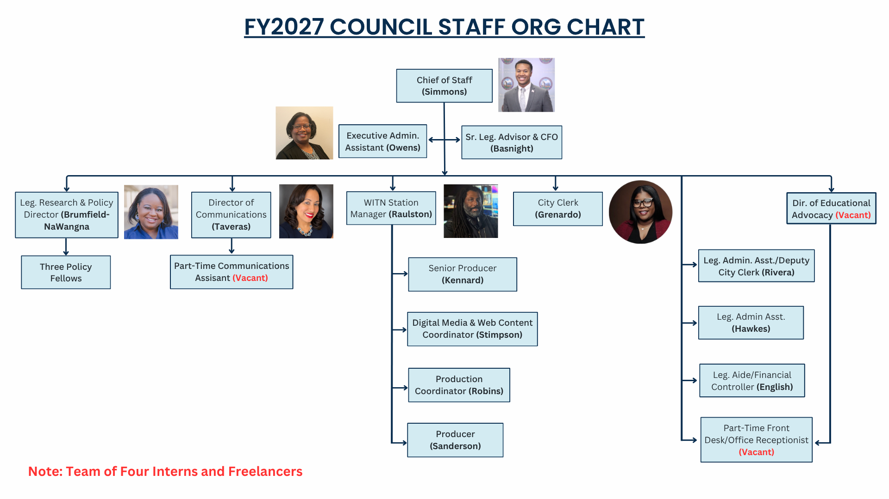

Slide 21
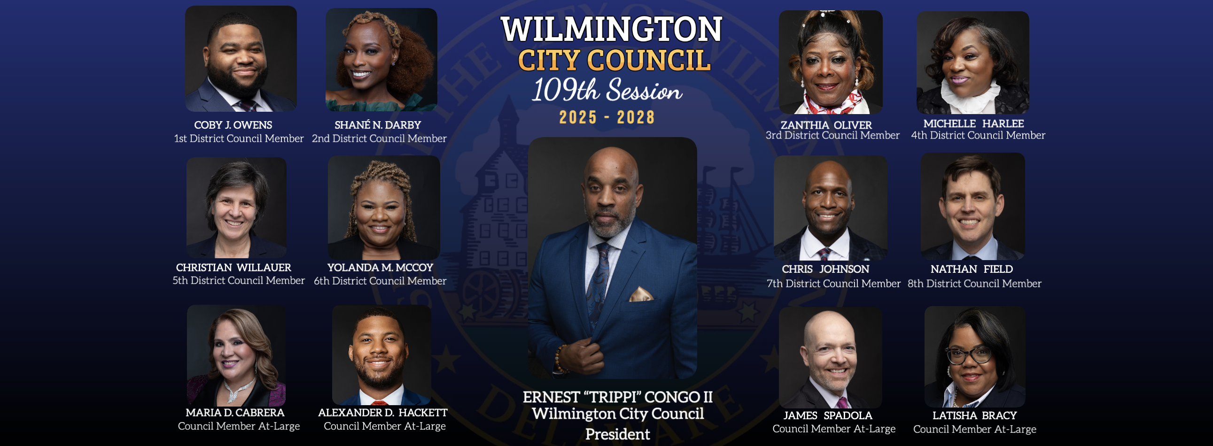
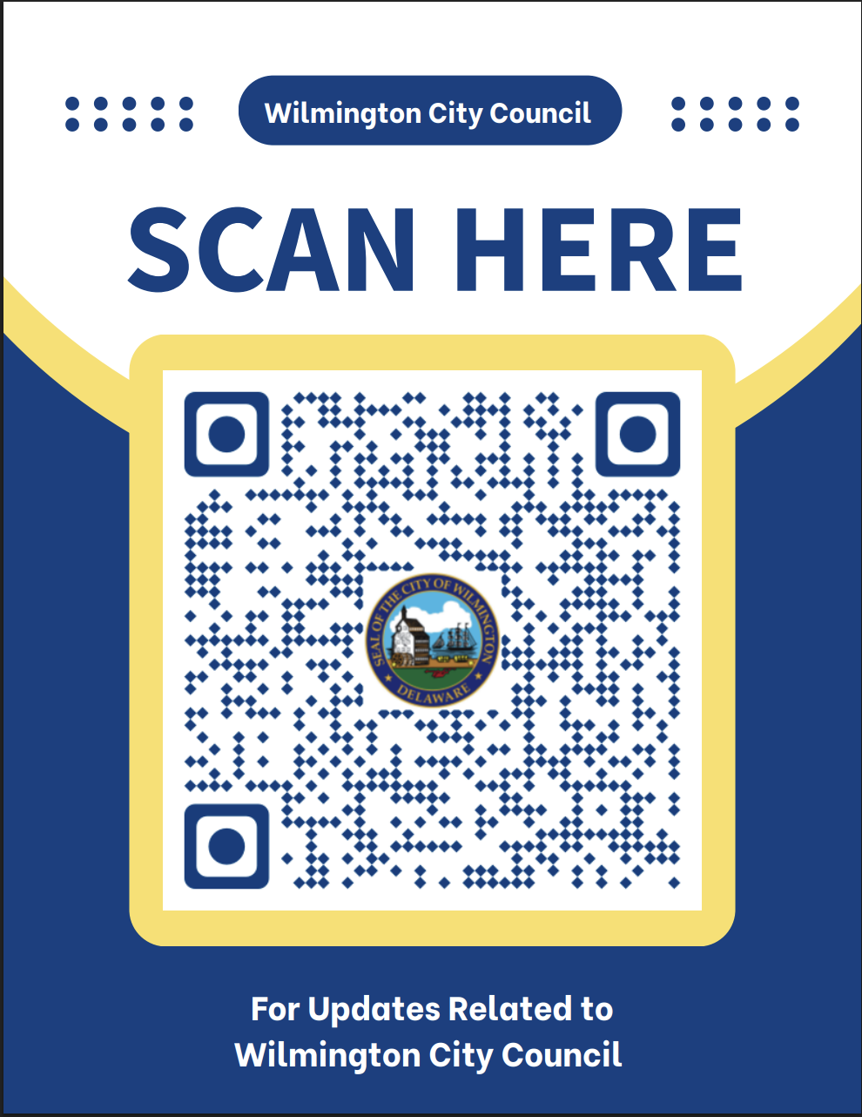
CONTACT- WWW.WILMINGTONCITYCOUNCIL.COM
  Louis L. Redding City/County Building • 800 N. French Street, 9th Floor • Wilmington, DE 19801
  Phone: (302) 576-2140 • Fax: (302) 571-4071 • Hours: Monday-Friday 8:30 a.m. - 4:30 p.m.

