Slide 1

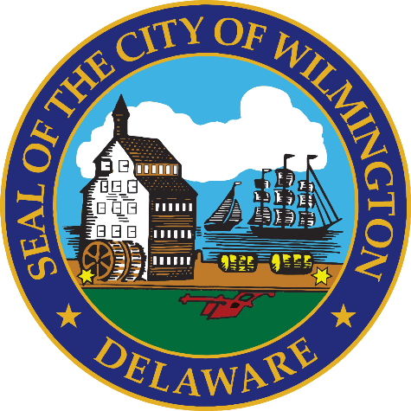
FY 2027 Budget Hearing
ECONOMIC DEVELOPMENT

Slide 2
FY 2027 Proposed Budget
General Fund | FY 2024 Actuals | FY 2025 Actuals | FY 2026 Budget | Proposed Budget FY 2027 | $ Change FY’27-26 | % Change FY’27-26
Personal Services | $417,973 | $476,246 | $578,087 | $620,951 | $42,864 | 7.4%
Materials, Supplies, and Equipment | 109,435 | 155,333 | 161,930 | 161,930 | 0 | 0.0%
Internal Services | 3,193 | 5,690 | 4,807 | 4,978 | 171 | 3.6%
Debt Service | 361,847 | 381,730 | 377,992 | 356,671 | (21,321) | -5.6%
SMBEO | 12,608 | 22,600 | 22,600 | 22,600 | 0 | 0.0%
Total | $905,056 | $1,041,599 | $1,145,416 | $1,167,130 | $21,714 | 1.9%
Staffing Level (FTEs) | 5.00 | 4.00 | 5.00 | 5.00 | 0.00 | 0.0%

Slide 3
Major Funding Changes (Proposed Budget)
Salaries and benefits increases for steps, COLAs, hospitalization (↑ $37,797)
Total MS&E unchanged
  Advertising: City-oriented ads in local/regional publications and online (↑ $10,000)
  Grants to Agencies: no longer providing grant to True Access Capital (↓ $10,000)
Debt Service: existing debt schedule, new FY’26 borrowing (↑ $335,479)
SMBEO unchanged

Slide 4
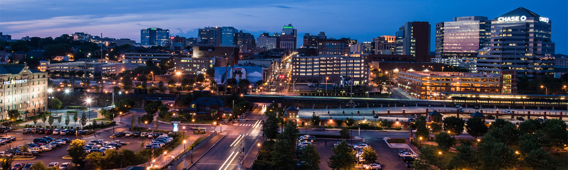
Departmental Overview
Identify Departmental Vision
  The Office of Economic Development (OED) is committed to ensuring a diversified local economy for the City by promoting and developing all varieties of industry and by initiating programs to increase job opportunities for residents of the City of Wilmington.

Slide 5
Departmental Overview
Top Priorities
  Complete DBE program updates
  Create and retain permanent private-sector jobs
  Stimulate private sector investment
  Increase productivity
  Increase the quality of life
  Grow the tax base

Slide 6
Understanding the 5-year revenue and expenditure projections show expenditures far outpacing revenues for FY27 to FY30, and FY27 General Fund Proposed Budget uses $25.7M of the Tax Stabilization Fund, please share how this budget aligns with closing any potential budget gaps.
Specify any cost savings or reductions, and if this budget provides adequate resources to meet the departmental needs.
Specify any high-level major additions.

Slide 7
Question 1. Answer
OED’s goal is to increase wage tax revenue and property tax revenue:
  Increase wage tax through business attraction, retention and expansion.
    Wage Tax revenue has increased 16.6% since FY22 from $63,467,109 to $73,997,327 projected in FY26.
  Increase property tax revenue by activating underutilized parcels, investing in infrastructure improvements, and attracting private investment.
No increases in OED MS&E expenditures
  High-level addition: $4M in Strategic Funds to aid in business attraction, retention and expansion efforts.
  Transferring $10,000 from Grants to Agencies to Advertising
  OED has reduced staffing from 9 employees in FY15 to 5 employees in FY25

Slide 8
Question 2.
In FY2025, Council approved $10M for the relocation of the Delaware Law School and DSU Nursing Program to the Bracebride II Building, share the return on investment including tangibles and intangibles.
As a result of the recent changes with Incyte, specify the ROI to the City, and share how the $5M will be allocated to the city.

Slide 9
Question 2. Answer
Bracebridge II
  Direct Benefits: The Bridge is estimated to be a $60M development with $39M in construction costs resulting to one-time City revenue of $780K through construction payroll tax and permit fees. Ongoing City revenue projection of $264K per year from 316 projected employees subject to the wage and head tax.
  Indirect Benefits: 2350 students projected to utilize the Bridge are projected to spend $10,194,817 per year in ancillary spending (off-campus food, entertainment, transportation, and personal supplies) within the City of Wilmington, assuming each student is projected to spend roughly $4,338 per year in Wilmington based on University of Delaware data.
Incyte
  Employment agreement with Incyte is being negotiated. Incyte signed a 10-year lease for 80,000 sq. ft. offices in Bracebridge with 200 jobs projected. Based on average salary figures, annual wage and head tax revenue is projected to be $462,169 from 200 jobs.
  $3.5M State bond bill funds returned to the City, $1.5M returned to UDAG.

Slide 10
Question 3.
Considering the $4M transfer from the Tax Stabilization Reserve Fund to the Economic Development Strategic Fund, which $1M is allocated for the Small Minority Business Development Program, while Council has provided $1.675M to the Small Minority Business Development Program since inception, please share the planned use for these funds with the anticipated return on investment, and the projected timeframe for use.
With the recent closing of the two Starbuck’s site locations and Specs for Less, please share if this budget provide adequate funding and resources for consideration to help keep businesses in Wilmington as reasonably as possible.
Please share any plans to notify small businesses of these new funds who may be in need of some type of assistance.
Specify the ROI for the Economic Development Strategic Fund for the last 5 years, per fiscal year, beginning FY2021(specify any cash infusions, specify amount of revenues as a result of these funds, # of additional jobs, city district, and # of new businesses (please list the business)).
Specify the ROI for the Small Minority Business Development Program for the last 5 years, per fiscal year, beginning FY2021(specify any cash infusions, specify amount of revenues as a result of these funds, # of additional jobs, city district, and # of new businesses (please list the business)).
Share a summary of the incentives the city uses to attract, and sustain businesses, and if this budget provides the adequate resources and funding.
Specify if the incentives are comparable to other cities of similar size, and the last time the city code has been updated to reflect any new changes.
Specify the number of small businesses that directly benefited from Wilmington UDAG Corp Multi-Party Loan and Participation Agreement (MPLPA) the last 2 fiscal years (Grow Wilmington Fund).

Slide 11
Question 3a,b,&e. Answer
OED notifies small businesses of Strategic Fund opportunities through the following methods:
  Community partners: Northeast CDC, Cornerstone West CDC, Downtown Visions, NCC Chamber of Commerce, DE Black Chamber of Commerce
  CDFI Partners: WEDCO, DCDC, True Access Capital, Grow Wilmington Fund
  Website: choosewilmingtonde.org
  Council and interdepartmental referrals
Summary of the incentives the city uses to attract, and sustain businesses:
Strategic Fund
Small Business Development & Set-Aside
Attraction
Retention
Property Investment
Architecture and Engineering Study
Façade Improvements
Operating Budget
Consulting Budget
Advertising
State Incentives
Downtown Development District
City Component Units
Community Development Financial Institutions (CDFI)
Delaware Community Development Corporation
Grow America Fund
Wilmington UDAG Corporation
Christina Gateway Corporation
Expansion
Capital Budget
Site Acquisition
Site Improvements
Delaware Prosperity Partnership
Division of Small Business
Business Needs Assessments
Wilmington Economic Development Corporation
True Access Capital
Grow Wilmington Fund
Employment
Strategic Plan with New Castle County
Black Restaurant Week
Publications directed at site selectors
Destination Marketing Organization ads

Slide 12
Question 3c&d. Answer
Strategic Fund Infusions Since FY21
FY21 | $1,000,000
FY21 SMBEO | $250,000
FY22 | $1,000,000
FY22 SMBEO | $250,000
FY24 | $700,000
FY24 SMBEO | $300,000
FY25 SMBEO | $350,000
FY26 SMBEO | $350,000
FY21-FY26 Total | $1,700,000
FY21-FY26 SMBEO Total | $1,500,000
FY27 Proposed | $3,000,000
FY27 SMBEO Proposed | $1,000,000
Strategic Fund Expenditures Since FY21
Fiscal Year | Strat Fund | SMBE | Total
FY21 | $15,000 | $226,370 | $226,370
FY22 | $538,745 | $70,000 | $608,745
FY23 | $367,350 | $154,588 | $521,938
FY24 | $68,750 | $398,773 | $467,523
FY25 | $327,025 | $522,888 | $849,913
FY26 | $246,230 | $172,395 | $418,625
Total | $1,548,100 | $1,545,014 | $2,866,744
Strategic Fund Expenditures Since FY21 By District
District | 1 | 2 | 3 | 4 | 5 | 6 | 7 | 8
Count | 2 | 4 | 8 | 46 | 4 | 4 | 5 | 1
Total | 74

Slide 13
Question 3c. Answer
Economic Development Strategic Fund ROI since 2022
Wage Taxes Collected from Strategic Fund Businesses
Calendar Year 2025 | $10,096,648.04
Calendar Year 2024 | $10,959,257.63
Calendar Year 2023 | $10,454,103.40
Calendar Year 2022 | $10,117,042.23
Total (2002-present) | $168,900,819.72
  Small Business ROI Examples:
    Precious Little Hands: $20k SF grant in CY 2021 / >$200k investment, has since opened their 2nd city location, $25K wage taxes paid since.
    The Warner: $200K SF grant in 2020, A&E, SB Signage: $157k DDD / >$2M investment. Currently working on rehabilitating Eden Hall.
    Make and Mellow: $34k total grant / >$300k investment. Pursuing additional investments in Downtown.

Slide 14
Question 3d. Answer – New small minority owned businesses
Midnight Flavor (Downtown)
Serena’s Soul Food (LOMA)
Spirit of the East (Westside)
Lavish De 302 (Trolley Sq)
Tacos El Carnalito (Downtown)
Scratch's (Trolley Sq)
Oath '84 (Downtown)
Make and Mellow
Chiles Loco (Downtown)
Villa Italiana (LOMA)
Juxtamod (Downtown)
Smokin Ace’s (NE Wilm)
Nanu's Hot Chicken (Westside)
Urban Fork Restaurant & Bar (LOMA)
Plate and Social (Greenhill)
GNP Hot Chicken

Slide 15
Question 3f. Answer
e) Specify if the incentives are comparable to other cities of similar size, and the last time the city code has been updated to reflect any new changes.
Trenton, NJ
Offer of a reduced sales tax rate, obtain tax-free purchases on capital equipment, and receive tax credits for hiring for businesses located in UEZ
Loans of up to $250,000 at a low interest rate to boost hiring, with potential loan forgiveness for employing city residents.
Lancaster, PA
Enables specific tax revenues to be used to pay debt service on improvements within designated zones.
New Haven, CT
Reimburses up to 50% of total pre-tax construction costs for façade improvements on commercial/mixed-use properties.
Property Tax Assessment Deferral Program that freeze the property tax assessments on certain eligible properties at pre-construction or pre-rehabilitation values.
Frederick, MD
75% reimbursement up to ($5,000) for building exterior improvements in the special improvement district.
Micro grants intended to encourage and financially-support physical improvements by targeted businesses to commercial buildings.
Provides gap financing in targeted communities for redevelopment in older neighborhoods.
Grants up to 50% in matching funds for facade improvements
Offers existing businesses free marketing and a boost in search engine optimization.
Provides tax exemptions on improvements to industrial and commercial properties.
Provides financing options for business growth, with a focus on retaining and creating local jobs.
Provide property tax exemptions and corporation business tax credits for the expansion, renovation, construction, or acquisition of facilities in distressed areas.

Slide 16
Question 3g. Answer
Wilmington UDAG Corp entered into an agreement with Grow America Fund and Discover Bank in October 2014 to establish the Grow Wilmington Fund to make loans to small businesses in the City of Wilmington
  Total Loans Made: $4,997,000
  Number of Loans: 9
  Total Jobs Retained/Created: 83
  Average Loan Size: $555,222
  $812,984 in funds available to invest
In FY25, Farmer & The Cow was approved for a $710,000 loan for the relocation on Market Street (5 jobs projected)
Grow New Castle County Fund announced in April 2023

Slide 17
Question 4.
Discuss the growth rate for new business and new jobs within the city over the last 3 years, and whether this budget provides adequate funding and resources.

Slide 18
Question 4. Answer
Wilmington Employment and Wages by Industry 2022-2024 (Source: Department of Labor)
 | 2022 |  | 2023 |  | 2024
Industry | Employment | Payroll | Employment | Payroll | Employment | Payroll
All Industries | 47,305 | $1,162,403,913 | 48,359 | $1,200,224,486 | 50,423 | $1,342,599,580
Construction | 1,193 | $26,348,165 | 1,268 | $29,776,293 | 1,196 | $31,287,773
Manufacturing | 839 | $14,804,258 | 838 | $16,013,270 | 835 | $17,585,893
Wholesale Trade | 351 | $9,823,897 | 367 | $10,532,840 | 680 | $15,596,755
Retail Trade | 1,948 | $24,542,187 | 1,966 | $25,249,720 | 1,957 | $26,367,512
Transportation and Warehousing | 1,148 | $19,178,862 | 1,149 | $20,038,475 | 1,191 | $22,848,067
Information | 73 | $1,982,032 | 247 | $6,664,457 | 76 | $2,596,376
Finance and Insurance | 11,622 | $379,361,040 | 11,511 | $403,596,037 | 10,971 | $414,134,447
Real Estate and Rental and Leasing | 960 | $19,356,609 | 803 | $14,530,432 | 1,313 | $30,544,520
Professional and Technical Services | 5,127 | $301,837,465 | 5,061 | $285,383,109 | 5,237 | $344,160,523
Management of Companies and Enterprises | 1,209 | $41,912,747 | 1,166 | $39,673,101 | 1,083 | $37,753,639
Administrative and Waste Services | 2,203 | $40,231,475 | 2,396 | $39,005,526 | 2,580 | $45,900,575
Educational Services | 776 | $8,725,826 | 709 | $8,099,120 | 807 | $10,427,850
Health Care and Social Assistance | 6,323 | $81,147,852 | 6,862 | $94,451,869 | 7,836 | $110,338,715
Arts, Entertainment, and Recreation | 544 | $4,736,453 | 725 | $5,513,956 | 700 | $6,032,650
Accommodation and Food Services | 2,230 | $16,164,129 | 2,197 | $17,079,742 | 2,473 | $19,942,258
Other Services, Except Public Administration | 1,174 | $13,569,839 | 1,320 | $17,192,021 | 1,347 | $25,895,945
Total Government | 8,754 | $137,358,793 | 9,108 | $147,499,936 | 9,215 | $154,127,387

Slide 19
Question 4. Answer
Across all industries, employment in the City of Wilmington increased by 3,118 and payroll increased by $180M from 2022 to 2024
Top Industries by employment are Finance and Insurance, Professional and Technical Services, Government, and Health Care and Social Assistance
  33,259 out of 50,423 jobs in Wilmington (66%)
Industries with the largest employment percentage gains since 2022 include:
  Wholesale Trade (93% employment increase, 58% payroll increase)
  Real Estate and Rental and Leasing (37% employment increase, 57% payroll increase)
  Arts, Entertainment, and Recreation (29% employment increase, 27% payroll increase)
  Health Care and Social Assistance (24% employment increase, 36% payroll increase)
The proposed budget provides adequate funding for consulting and advertising in the operating budget and Strategic Funds for business attraction, retention and expansion.

Slide 20
Question 5.
With the passage of SB#33, which basically authorizes large municipalities to designate Downtown Development Corridors, please share if this budget provides the necessary funding and resources for any incentives.
Please share how the Corridor program will differ from existing DDD eligibility requirements and incentives.
List all local incentives offered for eligible DDD project investments.
Please share how DDD is marketed.
Share any plans for nominating opportunity zones and how it can benefit Wilmington.

Slide 21
Question 5. Answer
SB#33 was signed by the Governor on 9/2/25, but the Office of State Planning Coordination have not produced guidelines for municipalities
  The DDD incentive offers up to a 20% rebate on construction costs after the project is completed.
  According to SB#33, one Corridor may be designated for each municipality as determined by the “Corridor plan”.
  “Downtown” means that portion of a city, town, or unincorporated area that traditionally comprises its central business district(s).
Incentives offered for eligible DDD projects: Strategic Fund, A&E Feasibility, Infrastructure & Site Improvement, Property Tax Abatement, WEDCO, UDAG.
DDD is marketed with mailers to eligible permit applicants meeting the minimum investment threshold of $25,000 in investment.
17 Wilmington census tracts are eligible to apply. Applications from municipalities are due to the State on May 15th and will be subsequently nominated by the Governor.
  Opportunity Zones can spur additional private investment by allowing investors to defer, reduce, and potentially eliminate federal taxes on capital gains by reinvesting them into Qualified Opportunity Funds (QOFs) that invest in designated low-income communities.

Slide 22
Question 6.
Considering that OED’s Fiscal Year 2027 Budget total ~$1.5M, please share if this budget provides the necessary funding and resources to address some of Council’s budget priorities:
Disparity Report.
DBE Program (excluding Public Works contracts).
  Share any participation goals for the DBE
Promote and market various programs in the city of Wilmington to connect city residents, businesses, and protentional investors with opportunities (specifically direct support, no pass-through).
Share any outcomes from collaborations with NCC and State of Delaware’s Office of Economic Development.
Workforce Development. (budget lines to address this priority)

Slide 23
Question 6 a
Disparity Report.
  Changes being pursued this year:
    Legislative
      Increase procurement thresholds to mirror recently amended New Castle County thresholds
      Amend codified language to shift from historic unemployment justification to confirmed disparities
      Establish periodic (every 5 or 10 years) updates to DBE availability metrics
      Update contract review board language in DBE code to reflect the current active steering committee comprised of department heads and council staff
    Policy Procedures
      Establish procurement policy that OED be notified of under bid threshold projects for DBE "First Look"
      Market DBE fund through partner CDFI's to counter payment float barriers
      Expedite payments to prime contractors using DBE subs to reduce payment time
      Explore DBE Direct payments for DBE Subs

Slide 24
Question 6 b.
DBE Program (excluding Public Works contracts).
  Share any participation goals for the DBE program.
    Pivoting towards creating specific opportunities where there are ready, willing, and able firms owned by disparity confirmed groups to compete for under-bid-threshold contracts. Additionally, OED has created a series of DBE Day events to market DBE businesses directly to City Departments.
    Partnerships with local organizations to build DBE capacity and increase the number of ready, willing, and able firms to compete for City procurement opportunities.

Slide 25
Question 6 d.
OED is collaborating with New Castle County on a City and County Economic Development Strategic Plan. The Strategic Plan will update the City’s Plan from 2014 with a focus on attracting investment into commercial corridors, placemaking, and targeting businesses that have opportunity for growth in Wilmington.
OED meets monthly with Delaware Prosperity Partnership to discuss business attraction pipelines and coordinate on State/City incentives if needed. Recently, we have worked closely together to keep Corteva and Incyte in the State of Delaware and bring new business to the City of Wilmington rather than competing out-of-state offices.

Slide 26
Question 6c&e.
Advertising budget line
  Promote various City-wide events including Black Restaurant Week, Lady Bug Festival, and Brandywine Festival of the Arts.
  Destination Marketing ads highlighting amenities in Wilmington
  Site Selection focused online and print advertisements highlighting investment and business opportunities
Consultant budget line can be used to address workforce development through studies highlighting industry specific workforce needs and potentially partnerships with industry-led workforce programs such as ZipCode Delaware or BioConnect DE.

Slide 27
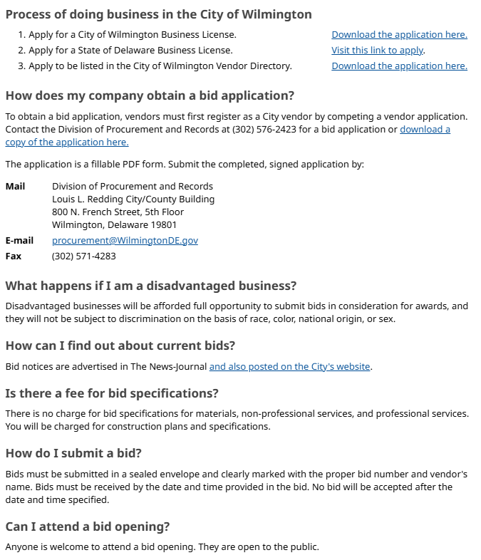
Question 6 c(ii) – Procurement Process.
www.wilmingtonde.gov/business/bid-notices-and-rfps/vendor-guide-to-procurement

Slide 28
Question 7.
Please share if $25.7K budgeted for Advertising provides the necessary funding and adequate resources to promote and market the city of Wilmington.
Specify the amount small business development program.

Slide 29
Question 9. Answer
FY27 Advertising Proposed
Advertising Proposed Use | Amount
City-oriented advertising, website, & promotional content in local & regional publications | $23,700
Advertisement and promotion of City small & minority business initiatives classes and related outreach (in SMBEO) | $2,000
Total | $25,700

Slide 30
Question 8.
Discuss the planned use for $110K budgeted for Consultants.

Slide 31
Question 8. Answer
FY27 Consultants Proposed
Consultants Proposed Use | Amount
Consulting Support for Development & Infrastructure Projects | $95,000
Consultant services for SMBEO programing | $15,000
Total | $110,000

Slide 32
Question 8. Answer
Proposed Examples in FY27:
The Savoury Group (DBE): Business needs assessments
Aliya Hammond Consulting (DBE): Social Media Marketing Strategy development
Erin Hutt Consulting (DBE): Program application support
Resonance Consulting: Economic Strategic Plan with NCC
Golden Shovel: Economic Development website hosting and copywriting
Costar Realty Information: Real Estate software subscription

Slide 33
Question 9.
Provide FY27 proposed organizational chart with the total number of employees (i.e. permanent, temporary, contract, vacancies).
Please include in the Org chart a photo of all Directors, Managers, Divisions Heads, and Supervisors.

Slide 34
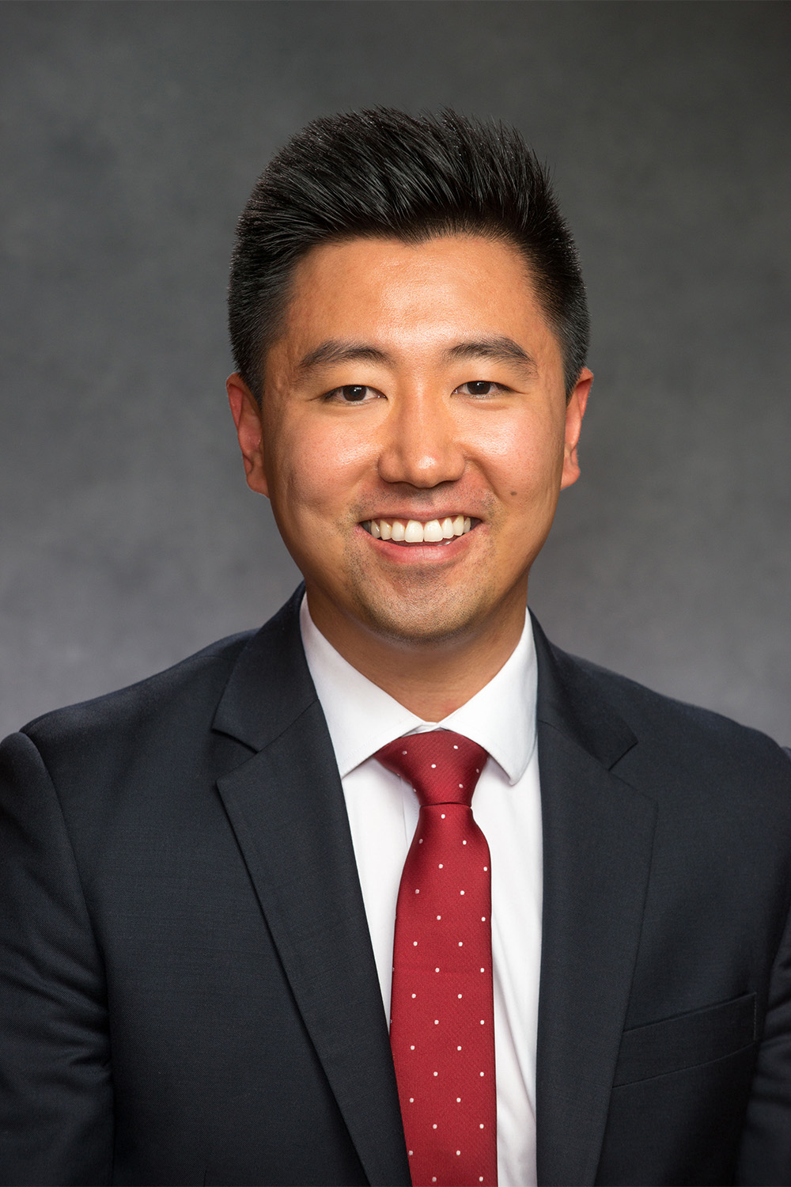
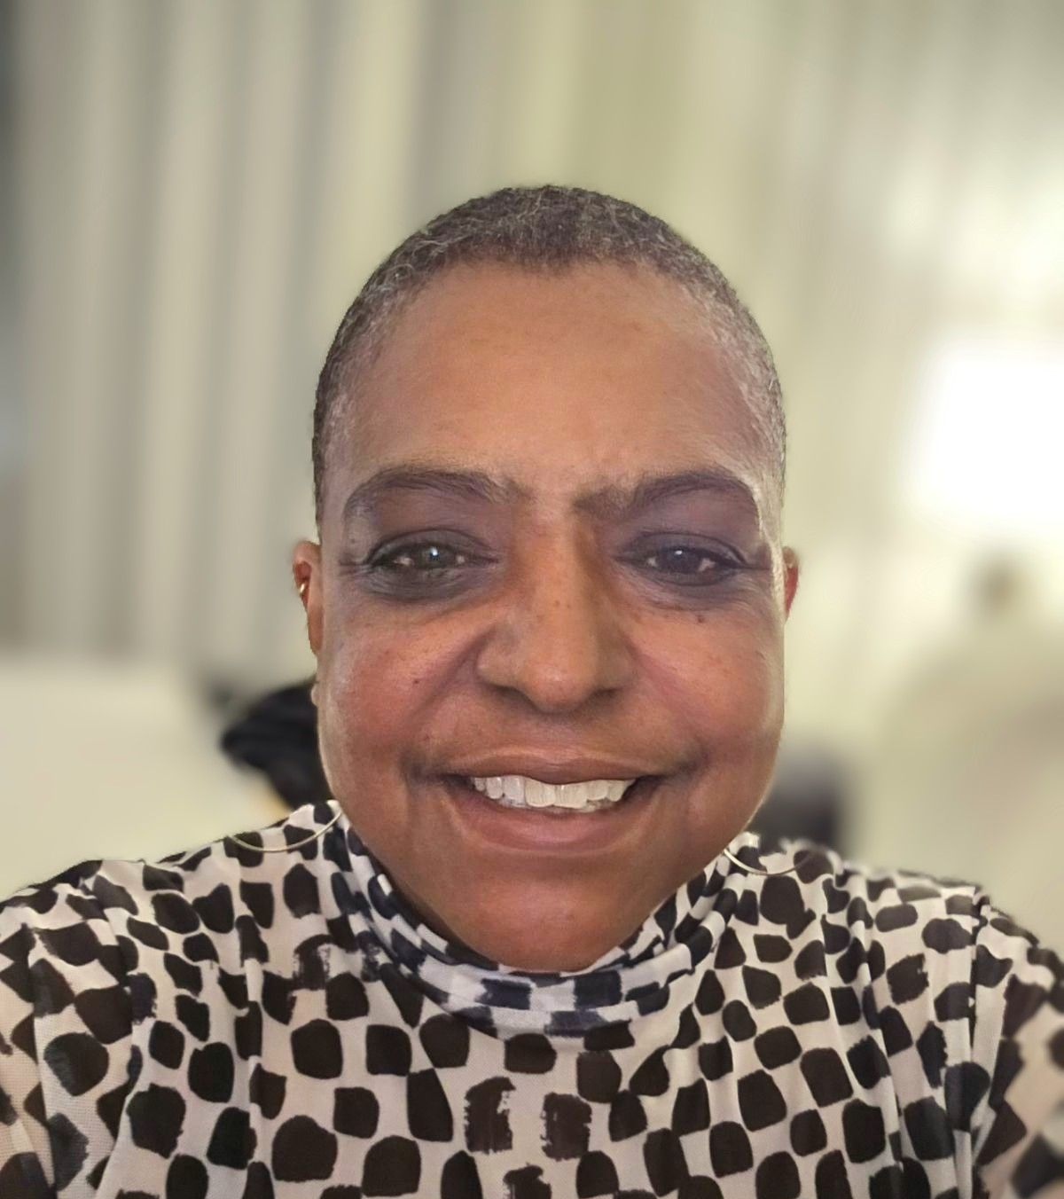
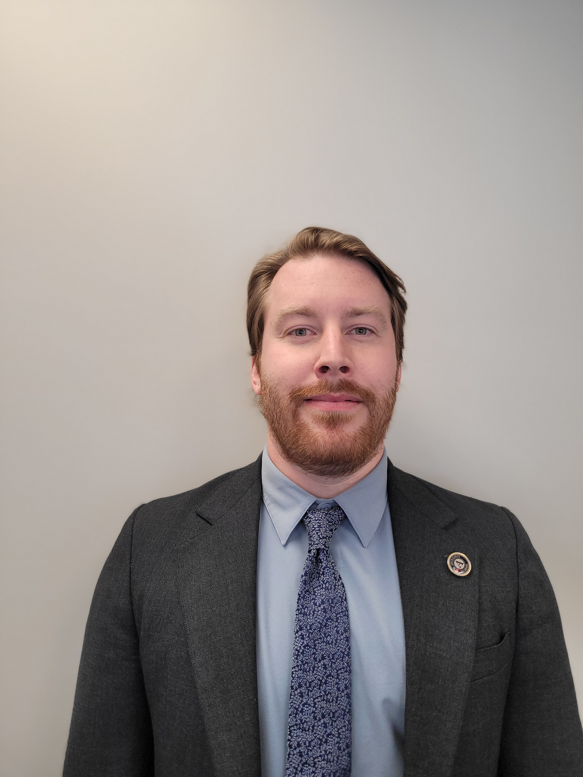
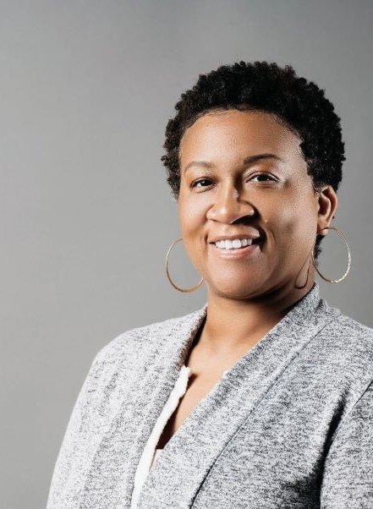
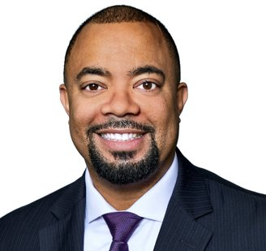
The Office of Economic Development Current Staff
Sean Park
Director*
5 Total Employees:
3 Appointed*
2 Merit
Marcie Moss
Administrative Assistant II*
Peter Weir
Economic Development Project Manager I*
James Williams
Small & Minority Business Development Manager
Shawnte Manning Disadvantaged Business Enterprise Analyst

