Slide 1


FY 2027 Budget Hearing
FINANCE DEPARTMENT

Slide 2
Combined Funds – Proposed FY 2027 Budget
Combined Funds | FY 2024 Actuals | FY 2025 Actuals | FY 2026 Budget | Proposed Budget FY 2027 | $ Change FY’27-26 | % Change FY’27-26
Personal Services | $7,994,934 | $8,416,496 | $9,044,308 | $9,482,411 | $438,103 | 4.8%
Materials, Supplies, and Equipment | 8,549,202 | 8,683,920 | 11,022,832 | 12,214,846 | 1,192,014 | 10.8%
Internal Services | 514,052 | 622,015 | 396,830 | 411,391 | 14,561 | 3.7%
Debt Service | 79,055 | 153,491 | 197,160 | 758,722 | 561,562 | 284.8%
Total | $17,137,243 | $17,875,922 | $20,661,130 | $22,867,370 | $2,206,240 | 10.7%
Staffing Level (Combined Funds FTE) | 84.00 | 83.00 | 84.00 | 83.00 | -1.00 | -1.2%

Slide 3
General Fund – Proposed FY 2027 Budget
General Fund | FY 2024 Actuals | FY 2025 Actuals | FY 2026 Budget | Proposed Budget FY 2027 | $ Change FY’27-26 | % Change FY’27-26
Personal Services | $5,361,817 | $5,588,779 | $5,784,322 | $6,146,282 | $361,960 | 6.3%
Materials, Supplies, and Equipment | 4,239,049 | 4,189,788 | 5,095,302 | 5,528,994 | 433,692 | 8.5%
Internal Services | 342,868 | 418,069 | 221,565 | 229,460 | 7,895 | 3.6%
Debt Service | 44,130 | 119,923 | 164,663 | 380,870 | 216,207 | 131.3%
Total | $9,987,864 | $10,316,559 | $11,265,852 | $12,285,606 | $1,019,754 | 9.1%
Staffing Level (General Fund FTE) | 56.60 | 54.80 | 55.15 | 55.15 | 0.0 | 0.0%

Slide 4
Major Funding Changes (General Fund Proposed Budget)
Personal Services Changes (↑ $361,960)
Regular Salaries: increase mainly COLAs and steps (↑ $174,892)
Upgrades:
  Billing Clerk (1102 Grade 5-3 to 6-4, 20% GF / 80% WSF) (↑ $878)
  Billing Manager (NUC to E&M merit, 20% GF / 80% WSF) (↑ $1,375)
Salary Adjustments:
  Deputy Director (60% GF / 40% WSF) (↑ $408)
  Senior Financial Officer (50% GF / 50% WSF) (↑ $2,565)

Slide 5
Major Funding Changes (General Fund Proposed Budget)
Materials, Supplies, and Equipment Changes (↑ $433,692)
Workshops/Seminars/Training (↑ $56,000)
Temporary Agencies (↓ $130,000)
Collection Expense - Legal, Sheriff Sale, & Other (↑ $60,000)
Collection Expense - Parking Citation Commissions (↑ $114,750)
Collection Expense - Red Light Camera Commissions (↑ $142,042)
License Plate Recognition program (↑ $150,000)
Debt Service (↑ $216,200)

Slide 6
Water/Sewer Fund – Proposed FY 2027 Budget
Water/Sewer Fund | FY 2024 Actuals | FY 2025 Actuals | FY 2026 Budget | Proposed Budget FY 2027 | $ Change FY’27-26 | % Change FY’27-26
Personal Services | $2,633,120 | $2,827,713 | $3,259,986 | $3,336,129 | $76,143 | 2.3%
Materials, Supplies, and Equipment | 4,310,156 | 4,494,131 | 5,927,530 | 6,685,852 | 758,322 | 12.8%
Internal Services | 171,186 | 203,943 | 175,265 | 181,931 | 6,666 | 3.8%
Debt Service | 34,924 | 33,567 | 32,497 | 377,852 | 345,355 | 1062.7%
Total | $7,149,386 | $7,559,354 | $9,395,278 | $10,581,764 | $1,186,486 | 12.6%
Staffing Level (Water/Sewer Fund FTE) | 27.40 | 28.20 | 28.85 | 27.85 | -1.00 | - 3.5%

Slide 7
Major Funding Changes (Water/Sewer Fund Proposed Budget)
Personal Services Changes (↑ $76,143)
Total positions down net 1.00 FTE
  Billing Analyst position (100% Water/Sewer Fund ) deleted (↓ $116,195)
Regular Salaries: increase mainly COLAs and steps (↑ $31,112)
Upgrades:
  Billing Clerk (1102 Grade 5-3 to 6-4, 80% WSF / 20% GF) (↑ $3,511)
  Billing Manager (NUC to E&M merit, 80% WSF / 20% GF) (↑ $5,502)
Salary Adjustments:
  Deputy Director (40% WSF / 60% GF) (↑ $272)
  Senior Financial Officer (50% WSF /50% GF) (↑ $2,565)

Slide 8
Major Funding Changes (Water/Sewer Fund Proposed Budget)
Materials, Supplies, and Equipment Changes (↑$758,322)
Workshops/Seminars/Training (↑ $51,000)
Printing (↓ $30,000 )
Miscellaneous Charges – N.O.C. (↑ $290,000)
Contracted Maintenance Services (↑ $149,192)
Indirect Costs Charges (↑ $265,838)

Slide 9
Finance Department
Mission Statement
“Excellence in Financial Management”
The Finance Department safeguards the City of Wilmington's financial integrity by delivering exceptional accounting services, responsive customer service, and sound financial stewardship.

Slide 10
Vision Statement
Transform community engagement and customer service to empower residents in accessing City of Wilmington resources.
Ensure robust accounting practices with strong quality control for financial integrity.
Direct collection processes to maximize revenue generation.
Implement best practices to revolutionize business processes and enhance data management with technology.

Slide 11
DEPARTMENT KEY PERFORMANCE METRICS
ANNUAL SUMMARY REPORT
💵
BILLING & PAYMENTS
Bills Issued
480,000
Delinquent Accounts
755
UB Payments Processed
629,696
Net Profits Processed
214
Total Payments Processed
759,608
Settlements Processed
2,752
🎧
CUSTOMER ENGAGEMENT
COW Calls
14,378
Salesforce Tickets
1,083
Move Ins Processed
3,264
🚔
ENFORCEMENT & CITATIONS
Parking Tickets
48,648
Vehicles Booted
1,677
Redlight Tickets Issued
30,388
Vehicles Towed
3,069
🤝
VENDOR & CONTRACT MGMT
Vendors Served
1,642
AP Invoices
18,367
Contracts Bid
46
Accounting Transactions
3,300
🏠
LICENSING & TAX
Business Licenses (New)
2,058
Wage Tax Filers
7,120
Delinquency Collections
1,053
Wage Tax Delinquency
343
Finance & Revenue Department • Annual Performance Overview

Slide 12
  Q & A

Slide 13
Question 1.
Understanding the 5-year revenue and expenditure projections show expenditures far outpacing revenues for FY27 to FY30, and FY27 General Fund Proposed Budget uses $25.7M of the Tax Stabilization Fund, please share suggestions for 1% reduction to your budget (excluding debt service, internal services, pension, hospitalization,).

Slide 14
Question 1.
The Administration has reviewed and developed the budget as presented. During the course of the budget preparation, reductions were incorporated. Any further reductions would have detrimental effects on services to customers and the recouping of revenue to support the budget.

Slide 15
Question 2.
While understanding the City previously referred to the fund balance as the unassigned fund balance, and now per Ord# 18-045, the Tax Stabilization Reserve Fund was created to establish future tax stabilization for the General Fund, and Ord# 22-038 established the parameters such as: appropriations may be made from the tax stabilization reserve as necessary in order to pay city obligations and limit the need to increase taxes when authorized by city council by ordinance, with exception of pension, debt service, and the true-up agreement with NCC for the waste water treatment plant; please share if there is a city policy for replenishing if the reserve was to get below a certain amount.
There is no official policy for the replenishment of the fund balance or tax stabilization reserve. However, we follow guidelines established by bond rating agencies to maintain at least a 25% total fund balance (very strong/ Moodys) relative to revenue in order to meet unanticipated reductions in revenue during the year.

Slide 16
Question 2.
Specify the last time city withdrew $20M or more from the Tax Stabilization Fund and share the
purpose.
This is the first time since the establishment of the Tax Stabilization Reserve in 2018 we have had a sufficient fund balance to allocate $20 million or more for budget purposes and still maintain well over 25% in total fund balance.
Share the last time the city did a Property Tax Rate increase, and if any type of reserve funds were
used to ease any of the tax burden (please explain why or why not).
The last time we had a property increase was 2023 of 6%. While we have used TSR to balance the proposed budget (spending authority), we have not had to use the reserve to meet actual spending.

Slide 17
Question 2.
Share within the last 6 years, if the city has deficit budgetary spending, meaning expenditures far
out pace actual revenues (excluding transfers in).
The table below shows that, over the past six years, revenue has consistently outpaced expenditure, resulting in no deficit.
Fiscal Year | GF Revenue | GF Expenditure | Income/(Loss)
2025 | 203,427,012 | 195,603,322 | 7,823,690
2024 | 203,993,911 | 183,701,579 | 20,292,332
2023 | 199,489,413 | 174,897,705 | 24,591,708
2022 | 181,918,584 | 171,502,042 | 10,416,542
2021 | 175,171,282 | 159,776,923 | 15,394,359
2020 | 167,198,744 | 163,786,254 | 3,412,490

Slide 18
d. Share if any best GFOA practices have been established for the Tax Stabilization Reserve Fund.
GFOA recommends policy guidelines for reserves but does not prescribe specific percentages of reserve. Instead, it cautions to have reserves available to meet 2-3 months of operating cost requirements as a floor. (For the General Fund this equals between $33.6 and $50.4 m; for the Water Sewer Fund, it equals between $15.9 and $23.8 m). Further, it recommends sufficient funds to meet policy demands and cash liquidity issues and to meet fluctuating revenues, both short-term (revenue collection interruptions) and long-term (extended recession, etc.)
e. Specify the Economic Development Fund Balance changing from $1.8M in FY24 to $11.6M in FY25, and if that is inclusive of the $10M for Brace Bridge Project, considering it has since been shared the number has changed to $5M.
Yes, it includes the $10 million for the Bridge Project, which came directly from the General Fund Balance. The $5 million reference was for the $10 million for the Incyte Project, which we understand will be returning the $5 million to the City.
f. Specify the amount of funds set aside in the Water Sewer Operations & Maintenance Reserve and share if it is at the 17% mandated threshold as per Ord# 22-038.
Yes, the FY 2025 O&M reserve is $16,182,376, based on the FY 2026 (following year) water sewer operating budget of $95,190,449.
Question 2.

Slide 19
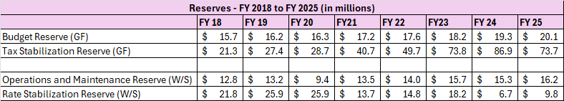
g. Specify the amount of funds in the Water Sewer Rate Stabilization Fund, and if it is sufficient for easing burdens with any proposed water sewer rate increases.
The Rate Stabilization Reserve at the end of FY 2025 stood at $9,758,412. However, there was only $18,200,108 in cash and cash equivalents in the Fund, sufficient to meet the O&M reserve of $16,182,376. The majority of the Rate Stabilization reserve is based on accounts receivable, which are not liquid. Balancing the budget on non-liquid assets is not advised. In addition, it is estimated that the Rate Stabilization reserve will be depleted in FY 2026. It is critically important that a rate increase be approved to support sufficient reserves.
Question 2.

Slide 20
Question 3.
Share how this budget addresses helping the community for items such as water utility assistance program, payment arrangements, senior property tax assistance program, low-income, long-term home-owner property tax abatement, etc.
Among our programs to assist various populations:
Utility Payment Assistance Program (UPAP) provides up to $1,500 to customers in helping meet water bill payments. Up to $350,000 is authorized each year for this program and is included in this budget.
The Department of Finance provides payment arrangements for customers in need of paying down past due bills. We offer generous terms including up to 4 years to pay and waiving a percentage of penalties and interest based on promise to pay and length of time to pay.
Property Tax exemption programs for seniors, persons with disabilities, and tax abatements for long-term owners of properties meeting certain income thresholds.
A reduction of 31% ($18.76 of $27.29) in the water facilities charge for seniors enrolled in the property tax exemption program.

Slide 21
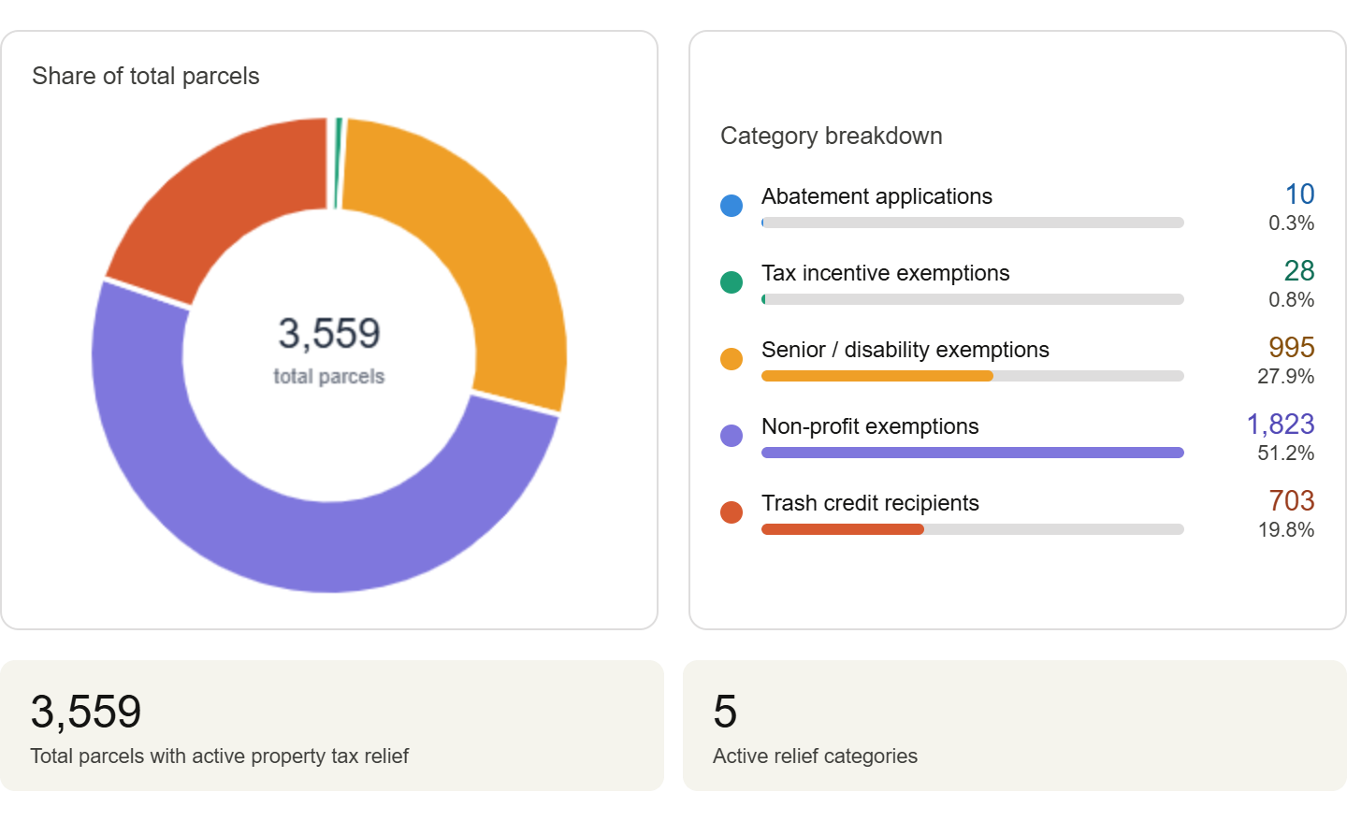

Delinquent Collections — Payment Assistance Programs
City of Wilmington | Finance Department
Community relief programs tracking payment assistance and delinquent account resolution
Since 2021
Since 2024
Since 2024
Since 2024
Utility Payment
Assistance Program
Parking
Payment Plans
Red Light
Payment Plans
Delinquency
Payment Plans
$1,655,699.45
$249,169.58
$64,740.00
$4,275,089.00
1,231 participants
1,122 participants
498 participants
1,254 participants
Total Collections:
$6,244,698.03
Total Participants:
4,105
Property Tax Relief Programs
Parcel-level assistance across all active property tax relief categories
City of Wilmington | Finance Department | Delinquent Collections

Slide 22
  Question 4.
The city has invested $2.9M in the new ERP System, please share if this new system is yet operational, and the projected timeframe for completion.
No, the ERP is not operational. We are in the process of evaluating new systems. We anticipate development beginning in FY 2027.
For the new Enquesta Utility Billing Information System, please share if issues have been resolved.
  For the most part Enquesta has been operating to specification. Bills are being sent out monthly. We are still verifying addresses by comparing the addresses from New Castle County and working on data clean up. This is critical to ensuring that we have the proper property tax valuations for the next property tax billing in July 2026. We are still linking properties and addressing individual customer requests for water utility bills as they appear.
Discuss the $322K budgeted regarding UBCIS, up $149K.
  This amount is dedicated to the annual cost of maintenance and development of the Enquesta system. This will be ongoing for the next 5 years.
Justify the $300K expended year to date in the Contracted Maintenance account line that was unbudgeted.
  The additional $200,000 reflects the true contracted maintenance cost of the Enquesta system, which was underestimated in the original FY2026 budget request.

Slide 23
  Question 5.
Discuss current vacant positions.
Specify duration of the vacancy.
Specify timeframe for filling position.
Specify if position generates revenue, and if so, estimated amount.
Specify any impact on Overtime, Temp Agency, and or Consultants.
Justify the need for the position.
Current Vacant Positions | Date of Vacancy | Justification | Impact | To be filled
Billing Consultant | 11/27/2025 | Employee retired. Expertise needed to assist in monthly billing, reviewing and adjustments of water utility. Revenue generating | Overtime & additional operational strain on existing staff | 04/30/2026
Delinquent Account Agent | 03/27/2026 | Employee retired. Expertise needed to provide options for constituents due to delinquency. Revenue generating | Overtime & additional operational strain on existing staff | 04/30/2026
Billing Analyst | 2/19/2026 | Employee retired. | Overtime & additional operational strain on existing staff | 06/30/2026

Slide 24
  Question 6.
Discuss any proposed changes to positions (new position, deleted position, upgrade, realignment, transition, downgrade, title change, salary changes, etc.).
Specify if there are any revenue generating positions
Proposed | Position | Total
Deletion | Billing Analyst | (73,243)
Upgrade | Billing Clerk | 3,719

Slide 25
  Question 7.
Please share if the ~$1.235M budgeted in Professional Services (Temp Agencies and Consultants), $615K General Fund, $620K Water Sewer Fund, if it provides the necessary funding and resources to address the needs of your department. Please explain why or why not.
Specify vendor name, length of contract, amount, and purpose for all Consultants.
Specify if any vendors are DBE’s. Not at this time.
Specify any recurring one-year agreements.
Specify if any of the positions are revenue generating, and if so, please share the return on investment.
Vendor | Length of Contract | Amount of Contract |  | Purpose
 |  | General Fund | Water Fund
Integrity Staffing | Managed by HR Departement | $ 210,000.00 | $ 170,000.00 | Temporary (full & part time) staff supporting 5 divisions, performing various duties to provide departmental support.
RobertHalf | 4/21/2025 - 4/20/2026 | $ 50,000.00 | $ 50,000.00
Consultants | TBD | $ 355,000.00 | $ 400,000.00 | Finance initiatives to include but not limite to revenue and expense related projects as well as supplemental assistance
TOTAL |  | $ 615,000.00 | $ 620,000.00

Slide 26
  Question 8.
Considering the liabilities that the city has on the books, please share the return on investment for the $965K budgeted in the General Fund and $620K in the Water Sewer Fund for Collection Expenses, up $75K.
Please share any plans for more aggressive collection efforts.
Specify the uncollectable amount for collections.
Specify vendor name, length of contract, amount, and purpose.
Specify if there are any DBEs.
Specify any recurring one-year agreements.

Slide 27
  Question 8. Considering the liabilities that the city has on the books, please share the return on investment for the $965K budgeted in the General Fund and $620K in the Water Sewer Fund for Collection Expenses, up $75K. Please share any plans for more aggressive collection efforts.
Specify the uncollectable amount for collections.
The Department's primary and legally enforceable collection techniques are sheriff sales and water disconnections. The Department has recently added automated collection notifications to our Enquesta system to normalize communication to property owners. This has yielded a significant increase to our collection efforts. Water disconnection requests are now integrated into the Enquesta system.
Breakdown of Delinquencies by Class
Class | Amount | No. Accts
Residential
Water | $ 9,880,540 | 35,297
Sewer | $ 2,682,299 | 22,610
Stormwater | $ 1,422,344 | 25,518
Total | $ 13,985,183
Commercial
Water | $ 6,143,008 | 3,819
Sewer | $ 1,424,689 | 2,746
Stormwater | $ 1,110,493 | 3,350
Total | $ 8,678,190
Grand Total | $ 22,663,373
All utility and property tax debt is considered collectible due to the placement of liens on property, which stay with the property until satisfied through sale or redemption. For accounting purposes, we designate 10% of the delinquency as uncollectible for each year the debt goes unpaid.
The majority of debts are satisfied prior to a disconnection or a sale.

Slide 28
  Question 8.
Please share any plans for more aggressive collection efforts.
 | General Fund | Water Fund
Collection Expense Legal Sheriff Sale | $ 360,000 | $ 420,000
Collection Expense Wage & Head Audit | $ 465,000 | $ -
Collection Expense Credit Card Fees | $ 125,000 | $ 180,000
Collection Expense Court Cost | $ 15,000 | $ 20,000
TOTAL | $ 965,000 | $ 620,000
Vendor Name | Length of Contract |  | Amount of Contract |  | Purpose
No DBE’s at this time | Start | End | General Fund | Water Fund
Avenu Insights | 7/1/2025 | 6/30/2026 | $ 200,000.00 | $ - | Collections through audits and discovery of wages, heads, net profits, lodging taxes, and business licenses.
Manning, Gross + Massenburg, LLP | 7/1/2025 | 6/30/2026 | $ 60,000.00 | $ 300,000.00 | To take necessary and reasonable actions to collect outstanding receivables owed to the City of Wilmington.
Paymentus | 7/1/2025 | 7/1/2026 | $ 125,000.00 | $ 180,000.00 | To Provides credit card processing services and facilitating secure electronic payments .
Giordano, DelCollo, Werb & Gagne, LLC | 7/1/2025 | 6/30/2026 | $ 485,000.00 | $ 140,000.00 | Court cost associated with collections and sheriff sales
Audit Collection support – CPA firm | TBD |  | $ 95,000.00 | $ - | Collection support for Accounting.

Slide 29
  Question 9.
Discuss the $1.1M budgeted in Miscellaneous NOC account line (across both General Fund and Water Sewer Fund, up $300K over the prior year’s budget.
Justify why additional funding allocation for the 311-call center is now charged to the Water Sewer Fund that was previously General Fund.
Before FY 2026, costs for the 311 Call Center was 100% Water Sewer funded. As noted in the Mayor’s Office budget hearing the total for the 311 effort should be $200K and $250 allocation split between the General and Water fund respectively. The majority of calls coming into 311 are utility related given the number of monthly bills that are issued.
Calls Received by Blindsight for Finance by Type
Calendar Year 2025 | Number | Pct
Customer Service Linked Accounts | 541 | 1.90%
Account Services (Collections) | 1,094 | 3.83%
Utility Billing | 11,541 | 40.45%
Customer Service | 8,234 | 28.86%
Earned Income Tax | 704 | 2.47%
Parking Enforcement | 3,709 | 13.00%
Property Tax | 2,712 | 9.50%
Total | 28,535 | 100.00%
Water Sewer Fund Statistics
FY 2025 | Count
Total Bills Issued | 480,000
UB Bills Processed | 432,000
Total Payments processed | 759,608
UB Payment processed | 629,696
COW Calls | 14,378
Pct of Utility Billing Calls
Payment Agreements | 2,355
UPAP offered | $ 429,066
Defaulted payment agreement | 62%

Slide 30
  Question 10.
Please share how the city administers the budgeted funding allocations for Commissions totaling $3.1M,
up $247K over the prior year’s budget.
  a. Specify vendor name, length of contract, amount, scope and purpose.
  b. Specify if any vendors are DBE’s.
  c. Specify statistics for FY2025 to date on number of red-light tickets (video enforcement)
  issued/paid/outstanding per year and the number of vehicles booted and towed.
  d. Specify the number of redlight cameras down during CY2025, and year to date CY2026, and specify any
  impact on revenue.
  e. Specify the ROI for the commissions categories.
The Department contracts with third party firms to assist in the collection of delinquent revenues. There is a direct relationship between the investment in these contracts and the amount of revenue recovered. Please keep in mind that the cost of the service must be budgeted independently of the revenues recovered (in other words, the cost of service is not netted out of the revenues before we receive them).
We offer a table below to describe these relationships.

Slide 31
  Question 10.
ACCOUNT LINE | FY2026 BUDGET | FY2027 PROPOSED | Change
Parking Citations Commissions | $ 990,000.00 | $ 1,104,750.00 | $ 114,750.00
Red Light Commissions | $ 1,853,702.00 | $ 1,995,744.00 | $ 142,042.00
 | $ 2,843,702.00 | $ 3,100,494.00 | $ 256,792.00
Revenue Source | Vendor Name | Length of Contract | Amount of Contract | Scope | Purpose
Parking Citations | Passport | 9/1/2024 – 3-year agreement with possible two, one(1) year extension | $1,014,750 | Parking citation database management and collection service system and support on a real-time basis. To include online appeals, customer services, collections with payment arrangements | Parking violation services , Digital Residential Parking Permits System , Call Center and Collections Services.
Parking Citations | State of Delaware | Memorandum of Understanding | $60,000 | State of Delaware provides collection assistance to the City for severely delinquent drivers, for traffic violations only. | DMV registration hold
Parking Citations | PayLock/IPT, LLC’S | 07/01/2025 - 06/30/2026 | $90,000 | Provide booting software and equipment along with 24hrs/7days a week customer service for release and payment collections. | Booting services
Red lights | Modaxo (Formely Conduent) | 04/01/2025 - 03/31/2026 | $1,935,744 | Traffic signal violation photo monitoring and enforcement. | Traffic signal violation monitoring system

Slide 32
  Question 10.
c. Specify statistics for FY2025 to date on number of red-light tickets (video enforcement)
issued/paid/outstanding per year and the number of vehicles booted and towed.
Red Light tickets – FY 2025
FY | Issued | Paid | Outsatndings | Towed & Booted
2025 | 30,388 | 29,372 | 1,016 | 248
2026 YTD | 28,193 | 18,104 | 10,089 | 79
d. Specify the number of redlight cameras down during CY2025, and year to date CY2026,and specify any impact on revenue.
Red Light Ticket Collections - Calendar Year 2025
Average Hours Enforced | Average Days Enforced | Average Citations Per Day | Total Days Offline | Pct Offline | Revenue Loss
6,771 | 282.12 | 1.11 | 82.88 | 23% | $ 390,718.55
Note: Calendar Year 2026 data is unavailable
ROI - FY2025
 | REVENUE COLLECTED | EXPENSE | TOTAL | RETURN ON INVESTMENT
Parking Citations | $ 925,690.43 | $ 358,307.54 | $ 567,382.89 | 158%
Red Lights | $ 2,104,821.20 | $ 1,409,431.79 | $ 695,389.41 | 49%

Slide 33
  Question 11.
Share the amount of funding allocated for training, and professional growth and development for your staff, and if this is adequate funding to address the training needs for your team.
The Department intends to broaden its training on Enquesta in FY 2027. The budget is adequate for the cost of this training.
  Question 12.
Share the determinant that was utilized by Black & Veatch that led to $266K increase in Indirect Cost to the Water Sewer Fund.
This is best discussed during the City Council hearing on the Water Sewer Fund rate setting and budget.

Slide 34
  Question 13.
Does this budget provide the necessary resources to address any new GASB Pronouncements, and findings as a result of the FY2025 audit of financial statements?
Yes, most of the GASB pronouncements are geared to accounting and internal controls. Some of the GASB requirements have increased the cost of external auditor activity on the annual financial statements. Lastly, some additional programming in Enquesta and MUNIS may be required.
Overall, Finance can absorb these costs as needed.

Slide 35
Question 14.
All Departments
Provide FY2027 proposed organizational chart with the total number of employees (i.e. permanent, temporary, contract, vacancies).
If there are multiple divisions, please ensure there are sub-org charts that enumerate all the above.
Please include in the Org chart a photo of all Directors, Managers, Divisions Heads, and Supervisors.

Slide 36
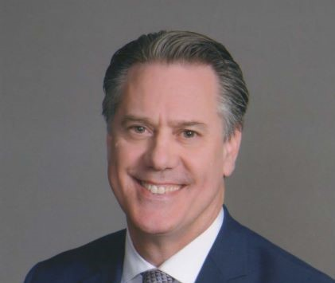
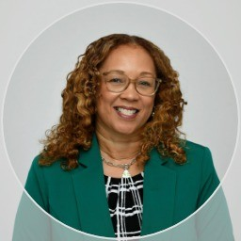
FY 2026 Budget Hearings | Finance Department — Organization Chart
Director of Finance
J. Brett Taylor
Administrative
Assistant
Deputy Director
Lois McLaughlin
Principal Analyst
Senior Financial
Officer
Database Manager
Procurement
Manager
Accounting
Manager
Billing
Manager
Customer Service
Manager
Tax
Manager
Account Services
Manager
Parking Service
Manager
Procurement
3
Accounting
8
Billing
10
Central Cashier
10
Earned Income Tax
9
Account Services
7
Parking Enforcement
14
Accounts Payable
5
Meter Readers
2
Revenue Audit
3
Senior Leadership
Division Managers
Staff / Units (number = headcount)

Slide 37
Finance Department — Functions & Responsibilities
City of Wilmington | Finance Department
Accounting
Administration
Billing
Parking Enforcement
Annual Financial Report
Executive Support
Utility
Parking Citations
Accounts Payable
Contract Management
Real Estate Tax
Red-light Violation Program
Bank Reconciliation
Personnel Reporting
Meter Reads
Booting Program
Grant Accounting
Data Analytics
Police & Fire Extra Duty
Digital Residential Parking Permits
Water Fund Accounting
MUNIS Support
GL Account Analyses
Central Cashier
Account Services
Earned Income Tax
Procurement
Payment Processing
Sheriff Sales
Wage Tax
Bid Notification
Customer Call Center
Payment Agreements
Head Tax
Vendor Database
Digital Residential Parking Permits
Collections Task Force
Revenue Audit
Proposal Review
Net Profits Tax
Sale of City Surplus Equipment
Business License
City of Wilmington | Finance Department | FY 2026

Slide 38
Thank You!

