Slide 1


FY 2027 Budget Hearing
FIRE DEPARTMENT

Slide 2
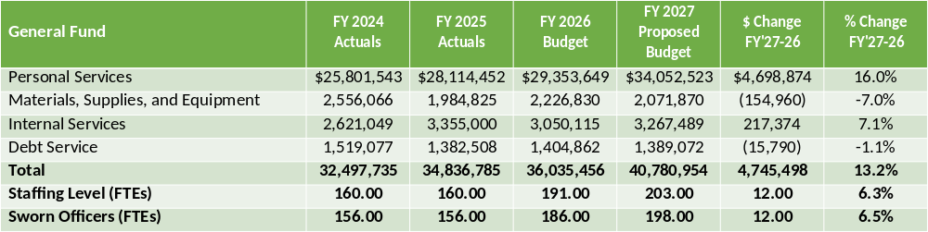
FY 2027 Proposed Budget

Slide 3
Major Funding Changes
Staffing levels post EMS implementation
  Insufficient staffing due to in-house EMS, schedule change, minimum manning requirements
  Unsustainable hours worked by existing employees
  FY 2026 overtime currently trending to $2.8 million ($1.3 million over budget)
FY 2027: Addition of 12 Firefighter / EMTs
  Base salaries and benefits, net of attrition (↑ $970,359)
  MS&E for hiring, training, and protective equipment (↑ $204,054)
  Increased Workers’ Compensation costs (↑ $92,060)
  Avoidance of nearly $1.1 million in additional overtime

Slide 4
Major Funding Changes
Personal Services (excluding new positions)
  Regular Salaries increase for steps, COLAs (↑ $827,387)
  Overtime of nearly $2.1 million (↑ $568,367)
  Employee benefits:
    State Fire Pension (↑ $455,634)
    Healthcare savings for recent hires (↓ $90,490)
  State Pension Contribution passthrough (↑ $1.5 million)

Slide 5
Major Funding Changes
Materials, Supplies, and Equipment (excluding new positions)
Wearing Apparel and Safety Supplies (↓ $391,029)
  One-time FY’26 purchases of turnout gear (↓ $342,000)
  EMS start-up PPE (↓ $140,000, with $125,000 moved to Medical Supplies)
  Additional recruit protective equipment (↑ $50,000), replacement SCBA bottles (↑ $40,000)
Consultants: off-year for biennial promotional process (↓ $164,750), firefighter health program (↑ $20,000)
Collection Expenses – EMS Fees: Speclin increases, third-party compliance assistance (↑ $81,000)
Medical Supplies (↑$174,500):
  EMS PPE moved from Wearing Apparel and Safety Supplies (↑ $125,000)
  Addition EMS supplies (↑ $25,000), stretcher and stairchair maintenance (↑ $23,000)

Slide 6
Vision
The Wilmington Fire Department's vision is to continue providing the citizens of the City of Wilmington with the highest level of life-safety emergency services and property preservation. This will be accomplished through intense training, public education, prompt responses, and compassionate emergency care.

Slide 7
Performance Measures
Quality assurance of all fire reports and inspections for accuracy, content completion, and submission in a timely manner
Officer Development program:
Continue Fire Officer Certifications
Continuous Proficiency training
Provide an EMS service that meets and exceeds both State and National Standards.
Contained fire to room of origin 90%
Risk reduction for the citizens of Wilmington by continuing various public education programs, fire drills, installation of free smoke and carbon monoxide detectors, and completing building inspections and preplans

Slide 8
Identify Top Priorities
Secure funding to continue the renovations to all city fire stations.
Replace fire apparatus according to recommended replacement cycle.
Continue free smoke and carbon monoxide alarm programs for all citizens.
Increase public education programs to include community events that target children and senior citizens.
Maintain authorized strength of 198 uniform positions.

Slide 9
Question 1.
Understanding the 5-year revenue and expenditure projections shows expenditures far outpacing revenues for FY27 to FY30, and FY27 General Fund Proposed Budget uses $25.7M of the Tax Stabilization Fund. Please share how this budget aligns with closing any potential budget gaps.
a) Specify any cost savings or reductions, and if this budget provides adequate resources to meet the departmental needs.
b) Specify any high-level major additions .

Slide 10
Question 1. Answer
The increase of authorized strength by 12 firefighters will offset the use of overtime by increasing daily shift strength, which is expected to reduce mandatory overtime by approximately $1.1 million.

Slide 11
Question 2.
Now that WFD has taken full responsibility for EMS since July, please share how the Department is moving from short-term urgency to developing a sustainable, long-term plan for operations, staffing, etc.
Specify impact of FY26 mid-year budget amendment, resulting in 12 new positions.
Specify 12 new positions added for FY27.
Specify impact to revenue collections for EMS services.
Specify impact for EMS Collection Fees budgeted for $371K, up $88K.
Share the number of new EMS personnel recruited since the start of FY2026?
Share if the city has adequate vehicles, equipment, and the necessary resources to manage the demand for EMS services.
Share if any need for new technology to accommodate these new responsibilities.

Slide 12
Question 2. Answer
No positions were added as part of the mid-year FY’26 budget amendment, which incorporated changes from the recent CBA.
The increase of authorized strength by 12 firefighters will offset the use of overtime by increasing daily shift strength, which is expected to reduce mandatory overtime by approximately $1.1 million.
Revenue collections for EMS services are on target to be a sustainable source for long-term operation.
EMS Collection Fees Based are a percentage of revenue generated.
The Department hired an additional 30 firefighters in FY26.
Yes. We are adding new equipment for the new positions and one replacement ambulance.
We are currently adding additional computers and radios. The Department has also implemented a medical supply inventory system.

Slide 13
Question 3.
Considering WFD’s recent union agreement, please share the impact to this budget as a result of the work schedule change for firefighters/EMTs from 24 hours on 48 hours off, to 24 hours on and 72 hours off, and if this budget provides the necessary funding and resources.
a) Specify any impact on ~$2M budgeted in Overtime, up~ $568K.
b) Specify any impact on Sick Leave.
c) Discuss mechanisms in place to control overtime and sick leave abuse.
d) Discuss mechanisms in place for meeting the minimum manning requirements for all fire apparatus.

Slide 14
Question 3. Answer
The increase is related to the additional daily personnel required to staff ambulances and suppression apparatuses.
We anticipate a further reduction in unplanned sick leave with the 24/72 Shift.
We can reduce Overtime by maintaining authorized strength. Sick Leave policy is mandated through the collective bargaining agreement.
The mechanisms in place are maintaining authorized strength and implementing Impact Days to offset overtime.

Slide 15
Question 4.
Discuss budgetary plans for addressing the condition assessment of the Fire Stations, and for protective gear.
a) Specify the last time condition assessments were done.
b) Specify if adequate and reasonable accommodation is at all site locations for all staff (ex.: disability, gender, etc.).
c) Specify the lifetime expectancy for all protective equipment, and if there are adequate funds budgeted to cover this cost.

Slide 16
Question 4. Answer
The Department conducts annual station inspections for condition assessments.
During building renovations, we incorporate required and reasonable accommodations for all personnel.
The NFPA mandates that protective equipment has a life span of 10 years max. We include funds in the budget
The Department has requested Capital Improvement Funding for the renovations for 2 Stations.

Slide 17
Question 5.
Discuss whether the proposed budget adequately provides the necessary funding or resources to address the following:
a) Diversity
b) Recruitment
c) Retention
d) Training
e) Accreditation

Slide 18
Question 5. Answer
The proposed budget adequately funds our ability to address Diversity, Recruitment, Retention, and Training.
The proposed budget does not include funds for accreditation.

Slide 19
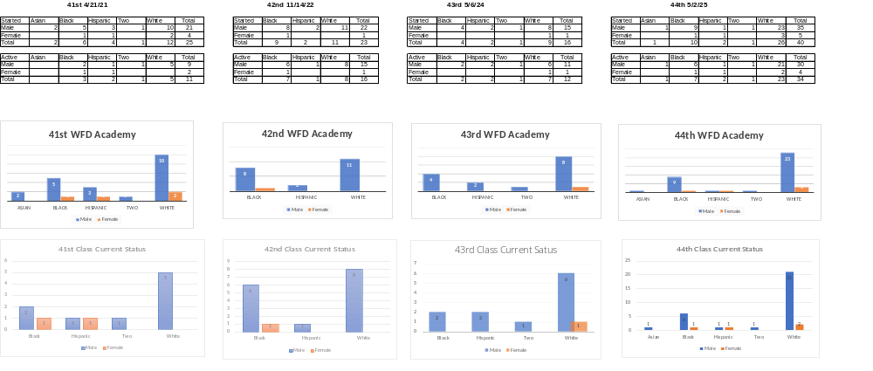

Slide 20
Question 6.
Discuss any plans for a Fire Academy and share the budgeted costs. a) Specify proposed timeframe for an anticipated WFD academy.

Slide 21
Question 6. Answer
In FY 27 we plan on hiring 12 new positions in the beginning of July
We anticipate a class in the spring for 15 positions (which includes attrition)
WILMINGTON FIRE DEPARTMENT
2027 Recruit Costs (27 Recruits)
Grand Totals
 | Per Recruit | Total
Protective Equipment | $11,445.00 | $309,015.00
Station Wear | $2,018.85 | $54,508.95
Training | $3,199.00 | $86,373.00
Hiring Process | - | $4,100.00
Grand Total | $16,662.85 | $453,996.95

Slide 22
Question 7.
Discuss the impact to your budget for House Bill # 171- AN ACT TO AMEND TITLE 14 OF THE DELAWARE CODE RELATING TO ELECTIVE CREDIT FOR VOLUNTEERING WITH LOCAL FIRE DEPARTMENTS, which permits high school students to receive elective credit for completing community service in a local fire department.
a) Share if any local students contacted WFD about this opportunity.
b) Are there any plans to promote this opportunity?
c) Specify funding allocated for the Fire Explorers Program, and share the number of people that has participated in the program and became a city Firefighter.

Slide 23
Question 7. Answer
HB 171 was intended to attract firefighters to volunteer companies. The Wilmington fire department does not have any volunteer positions. The Department is unaware of any students who have contacted the Department regarding volunteer programs.
The Department has allocated $10K to the Explorers program in the budget. We have approximately 10 former explorers who became firefighters.

Slide 24
Question 8.
Discuss the planned use for ~$189K budgeted in the Consultants account category.

Slide 25
Question 8 Answer
$53,750 for Cardio Kinetics (added in recruit class + additional firefighters)
$15,000 for Fire Engineering, Continuing Education for EMT Certifications.
$120,000 requested for Plans Examiner

Slide 26
Question 9.
Discuss any current vacant positions.
a) Specify duration of the vacancy.
b) Specify timeframe for filling position.

Slide 27
Question 9 Answer
Currently we have 11 vacancies that will be filled on April 27th

Slide 28
Question 10.
Discuss the Department’s Authorized Strength.
a) Specify FY27 Proposed Authorized Strength.
b) Specify FY26 Actual Authorized Strength (vacancies, military leave, etc.).
c) How many personnel will be eligible for retirement in FY 2027
d) Share the demographics for the authorized strength (race, gender, and age)

Slide 29
Question 10. Answer
FY27 authorized strength: 198
FY26 current strength: 175 (186 authorized)
33 firefighters are eligible for retirement.

Slide 30
Question 10. Answer
Gender Breakdown
Gender | Count
Male | 169
Female | 9

Slide 31
Question 10. Answer
Race Breakdown
Race | Count
White | 121
Black or African American | 37
Hispanic | 15
Two or More | 3
Asian | 1
Unspecified | 1

Slide 32
Question 10. Answer
Age Group Breakdown
Age_Group | Count
<25 | 25
25-34 | 51
35-44 | 51
45-54 | 35
55-64 | 16
65+ | 0

Slide 33
Question 11.
Discuss the available amount of State Grant in Aid Funds remaining and amount of funding anticipated for FY2027.
a) Specify the planned use of remaining funds,

Slide 34
Question 11. Answer
The amount of funds remaining in Grant in Aid is $1.1M. We do not currently know how much Grant in Aid will be in FY’27.
The funds will be used for:
  Expansion of our training facility on Hay Rd. ($500K)
  Dedicated funds EMS Supplies ($50K)
  Offset for Engine ($350K)
  Station exhaust removal system repairs ($100K)
  Dedicated funds for Marine Unit ($26K)

Slide 35
Question 12.
Discuss the planned use for ~$141K budgeted in the Registration account line.

Slide 36
Question 12. Answer
The Registration account is used for all new recruit training, schooling, EMT renewals, and tuition reimbursement.

Slide 37
Question 13.
Please share how this proposed budget provides the necessary funds and resources for the Fire Marshal’s Office.
a) Carbon Monoxide Detectors
b) Fire Alarms
c) Fees for services (specify the last time increases were made, considering the recent HB 124 allowed the State Fire Marshal to increase fees).

Slide 38
Question 13. Answer
Both Smoke Detectors and Carbon Monoxide Detectors are provided to the Department by the American Red Cross and WPVI 6ABC Save a Life Program
Fees were increased in FY24 with no plans to increase in FY27.

Slide 39
EMS Question 1.
What is the total annual cost of EMS operations within the Fire Department, and what percentage of those costs are currently covered by EMS billing revenue?

Slide 40
EMS Question 1. Answer
Inclusive of 12 new firefighter/EMTs, FY’27 costs are expected to be approximately $5.4 million
Per Speclin, EMS revenues are projected to be $5.3 million

Slide 41
EMS Question 2.
What is the City’s current collection rate on EMS billing, and how does that compare to industry benchmarks?

Slide 42
EMS Question 2. Answer
The City averages $350 per transport.
  Minquadale: $340
  New Castle City: $311
  Five Points: $315
The City averages 2,000 runs per month.
  Average of 1,400 runs is billable per month.
  We collect approx. 90.7% of billable runs.
  The Industry Standard is 90%

Slide 43
EMS Question 3.
What steps are being taken to ensure full reimbursement from Medicaid, Medicare, and private insurers?

Slide 44
EMS Question 3. Answer
The Department conducts Quality Assurance on EMS reports to ensure we maximize our collection of fees.
Outside auditor ensures compliance with insurance, Medicaid, and Medicare.
Patient Care Reports are completed within 24 hours.

Slide 45
EMS Question 4.
Are there any barriers—administrative, regulatory, or operational—that are limiting our ability to maximize EMS revenue?

Slide 46
EMS Question 4. Answer
Currently, EMS is only reimbursed when a patient is transported, even if that transport is not medically necessary.
Federal legislation is proposed (H.R. 2538 and S. 3145 – the CARE Act of 2025) which would allow Medicare to reimburse EMS agencies for treatment-in-place (TIP), meaning we can treat patients on scene when appropriate, without being forced to transport to the emergency department just to receive reimbursement.
We cannot bill for calls for service that do not require medical transport.

Slide 47
EMS Question 5.
Has the City explored or applied for any state or federal funding opportunities to support EMS as essential public safety infrastructure?

Slide 48
EMS Question 5. Answer
The Department is actively researching avenues for additional funding.
We received a one-time payment of $50K in the State Grant and Aid bill this year for EMS.

Slide 49
EMS Question 6.
What investments are needed (staffing, equipment, technology) to ensure EMS services are both effective and financially sustainable long-term?

Slide 50
EMS Question 6. Answer
Additional 12 firefighters for staffing
Additional Radios.
Additional equipment.
Additional computers.

Slide 51
EMS Question 7.
How does the administration plan address any gap between EMS revenue and actual operational costs?

Slide 52
EMS Question 7. Answer
Any gap between EMS revenues and expenditures will be covered using other General Fund revenues.

Slide 53
Question 14.
Provide FY2027 proposed organizational chart with the total number of employees (i.e. permanent, temporary, contract, vacancies).
a) If there are multiple divisions, please ensure there are sub-org charts that enumerate all the above.
b) Please include in the Org chart a photo of all Directors, Managers, Divisions Heads, and Supervisors.

Slide 54
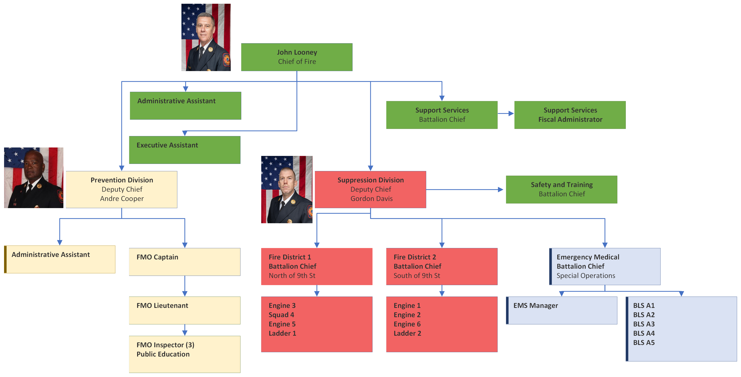
Organizational Chart

