Slide 1


FY 2027 Budget Hearing
LAND USE & PLANNING

Slide 2
Proposed FY 2027 Budget
General Fund | FY 2024 Actuals | FY 2025 Actuals | FY 2026 Budget | Proposed Budget FY 2027 | $ Change FY’27-26 | % Change FY’27-26
Personal Services | $2,832,865 | $2,931,753 | $3,314,633 | $3,584,761 | $270,128 | 8.1%
Materials, Supplies, and Equipment | 782,672 | 1,004,371 | 1,119,200 | 1,042,200 | (77,000) | -6.9%
Internal Services | 132,709 | 184,316 | 128,642 | 133,476 | 4,834 | 3.8%
Debt Service | 307,755 | 291,160 | 278,365 | 27,707 | (250,658) | -90.0%
Total | $4,056,000 | $4,411,597 | $4,840,840 | $4,788,144 | (52,696) | -1.1%
Staffing Level (FTEs) | 26.00 | 26.00 | 28.00 | 29.00 | 1.00 | 3.6%

Slide 3
Major Funding Changes (General Fund Proposed Budget)
Personal Services Changes - (↑ $270,128)
Salaries and Wages (↑ $126,529)
Employee Benefits (↑ $145,337)
Position addition - Historic Preservation Planner (↑ $106,318)
  Temporary Salaries (↓ $62,923)

Slide 4
Major Funding Changes (General Fund Proposed Budget)
Materials, Supplies, and Equipment Changes – (↓ $77,000)
Consultants (↓ net $116,500 )
  Zoning Reform Project – (↓ $275,000)
  ADA Self-Assessment – (↓ $135,000)
  ICC Code Review Update – (↑ $150,000)
  Wilmington 2038 Comprehensive Development Plan Update – (↑ $137,500)
Travel and Subsistence (↑ $13,500)
Memberships and Registrations (↑ $24,500)
Debt Service (↓ $250,658 )

Slide 5
Question 1:
Understanding the 5-year revenue and expenditure projections show expenditures far outpacing revenues for FY27 to FY30, and FY27 General Fund Proposed Budget uses $25.7M of the Tax Stabilization Fund, please share how this budget aligns with closing any potential budget gaps.
  Specify any cost savings or reductions, and if this budget provides adequate resources to meet the departmental needs.
  Specify any high-level major additions.

Slide 6
Answer 1a
New positions identified during the requested re-structuring during the preparation of the FY2026 Budget have been excluded from this year's budget.
Training has been limited to a portion of the department’s staff.
The Forerunner software implementation eliminates the need for a dedicated Floodplain Management position.

Slide 7
Answer 1b
The Historic Preservation Planner is converted from a Limited Service Employee (LSE) into a full-time role.
International Code Council (ICC) Code Review Update to prepare for 2024 Code adoption.
Wilmington 2038 Comprehensive Development Plan Update.
Increase in funding to support training.
*The department has implemented all prudent reductions in coordination with OMB. Any further reductions would result in a direct reduction in service capacity.

Slide 8
Question 2
With the recent passage of legislation for a moratorium on all smoke shops, please share how this budget addresses any funding or resources for the mandated equity impact assessment.
a. Specify the projected timeframe for completion.

Slide 9
Answer 2
Given the recent passage and signing of the ordinance, the department’s FY2027 budget does not include funding or resources needed to complete the equity impact assessment.
Proposed Timeline:
Phase 1: Identify Immediate Action (Q2–Q4 FY2026)
Phase 2: Preliminary Analysis (FY2027)
Phase 3: Full Equity Impact Assessment (FY2028 – Pending Funding)
Phase 4: Policy Implementation (Post-EIA)

Slide 10
Question 3
Notwithstanding the massive and outdated zoning laws, share if your budget
addresses any funding or resources to best mitigate reforming the city’s
zoning laws.
  Specify any funding.
  Specify projected timeframe for completion.
  Specify if any EV Charger Inspections/Installations, etc.

Slide 11
Answer 3
Funding was allocated towards the Zoning Modernization Project during the current fiscal year. The Request for Proposal for this project has been advertised and is currently open for bid. Additional funding has not been allocated for FY 2027.
Projected Timeline:
  Project Kickoff: June 2026
  Draft Zoning Ordinance & Map: October 2026
  Adoption & Certification: February 2027
Since the formation of the EV Installation Manual, we have received 2 requests for electric vehicle charging installations that encroach upon the public right-of-way.
Notes:
Notwithstanding the massive and outdated zoning laws, share if your budget
addresses any funding or resources to best mitigate reforming the city’s
zoning laws.
a. Specify any funding. Funding was allocated this fiscal year for the Zoning Reform Project.
b. Specify projected timeframe for completion.

Slide 12
Question 4
Considering the number of nuisance properties, please share if this budget provides adequate funding or resources to address.
Specify the number of business closures within the last 3 years because of a nuisance property.

Slide 13
Answer 4
The Nuisance Property Program is coordinated by the Law Department. LU&P is a partner providing oversight of land use and business license compliance, enforcement, and inspections.

Slide 14
Question 5
Discuss the additional $156K budgeted for Consultants in the Planning Division.
  Specify the projected timeframe for ICC Code Review update.
  Specify the projected timeframe for the Wilmington 2038 Comprehensive Development Plan Update.
  Are there resources budgeted to implement SB# 237, that requires community resiliency and addressing the impacts of climate change?
  Specify if the ADA Self- Assessment is fully completed.

Slide 15
Answer 5(a)
  The additional funding supports the completion of the ICC Code review and recommended amendments.
  Completion is targeted for Q4 FY2027, with the adoption process proceeding thereafter.

Slide 16
Answer 5(b)
  The funding allocated towards the Wilmington 2038 Comprehensive Development Plan represents the beginning of a multi-year process. FY2027 funding represents 50% of the estimated total engagement cost, with the remainder to be budgeted in FY 2028.

Slide 17
Answer 5(c)
No funding is currently allocated to directly support the SB 237; however, resiliency is currently a part of the Comprehensive Plan.
The Resilient Wilmington Plan is a product of the current Comprehensive Plan and will continue to be a priority moving forward.

Slide 18
Answer 5(d)
  The ADA Self- Assessment is nearly complete. No additional funds have been allocated for FY 2027.

Slide 19
Question 6
Share the amount of funding allocated for training, and professional growth and development for your staff.

Slide 20
Answer 6
Funding | Division | FY2027 | FY2026 | Change
Travel & Subsistence | Land Use (181) | $9,000 | $3,000 | +$6,000
Travel & Subsistence | Planning (182) | $6,000 | $6,000 | $0
Travel & Subsistence | Admin (180) | $10,000 | $2,500 | +$7,500
Workshops/Seminars–Training | Land Use (181) | $20,000 | $14,500 | +$5,500
Registration Fees | Land Use (181) | $3,000 | $1,500 | +$1,500
Registration Fees | Planning (182) | $2,500 | $2,000 | +$500
Memberships | Land Use (181) | $15,000 | $2,500 | +$12,500
Memberships | Planning (182) | $2,500 | $2,000 | +$500
Subscriptions/Books | Land Use (181) | $7,000 | $3,500 | +$3,500
Subscriptions/Books | Planning (182) | $1,500 | $1,000 | +$500
TOTAL | All Divisions | ~$76,500 | ~$38,500 | +$38,000

Slide 21
Question 7
With the streamlining of services for the permitting process, please share if this budget provides the necessary funding and resources to maintain that service.
  Specify number of permits issued over the last 2 years, and the amount of fees collected in the last 2 years.
  Specify number of building and zoning inspections over the last 2 years.

Slide 22
Answer 7(a)
FY | PERMITS | VALUATION | FEES COLLECTED
2024 | 3,710 | $270,621,015.00 | $2,494,797.00
2025 | 3217 | $467,601,482.00 | $4,145,262.00
*2026 | 2343 | 192,844,985.00 | $1,519,914.00

Slide 23
Answer 7(b)
FY | BUILDING INSPECTIONS | ZONING & BUSINESS INSPECTIONS
2024 | 11,295 | 1,577
2025 | 11,315 | 1,890
*2026 | 5,969 | 1,897

Slide 24
Question 8
Discuss current vacant positions.
  Specify duration of the vacancy.
  Specify timeframe for filling position.
  Specify any impact on Overtime, Temp Agency, and or Consultants.
  Specify if the position is revenue generating.

Slide 25
Answer 8(a)(b)
Position | Vacancy Date | Status
Plans Examiner | 05/2025 | Interviews Pending Start Date June 2026
Office Manager | 07/2025 | Job Post Pending Start Date June 2026

Slide 26
Answer 8(c)
  Greater reliance on consultants, with additional loss of inspection capacity.

Slide 27
Answer 8(d)
Yes, the department is responsible for land and construction-related development. Both the Plans Examiner and Office Manager are integral to the development and permitting process.

Slide 28
Question 9
Discuss any proposed changes to positions (new position, deleted position, upgrade, realignment, transition, downgrade, title change, salary changes, etc.).
    Specify if the position is revenue generating.

Slide 29
Answer 9
Position | Change type | Division | Revenue generating?
Historic Preservation Planner | New Permanent Position | Planning (182) | Yes — regulatory

Slide 30
Question 10
Discuss the $400K budgeted for Demolition.
  Specify the conditions that necessitate an immediate demolition.
  Specify if any funds have been recouped within the last 2 years (list the amount per year).
  Specify number of properties demolished within the last 2 years, and the number of properties in the pipeline

Slide 31
Answer 10(a)
The funding is used to address properties that require demolition, primarily those that have experienced structural failure.

Slide 32
Answer 10(b)
  No funds have been recouped.

Slide 33
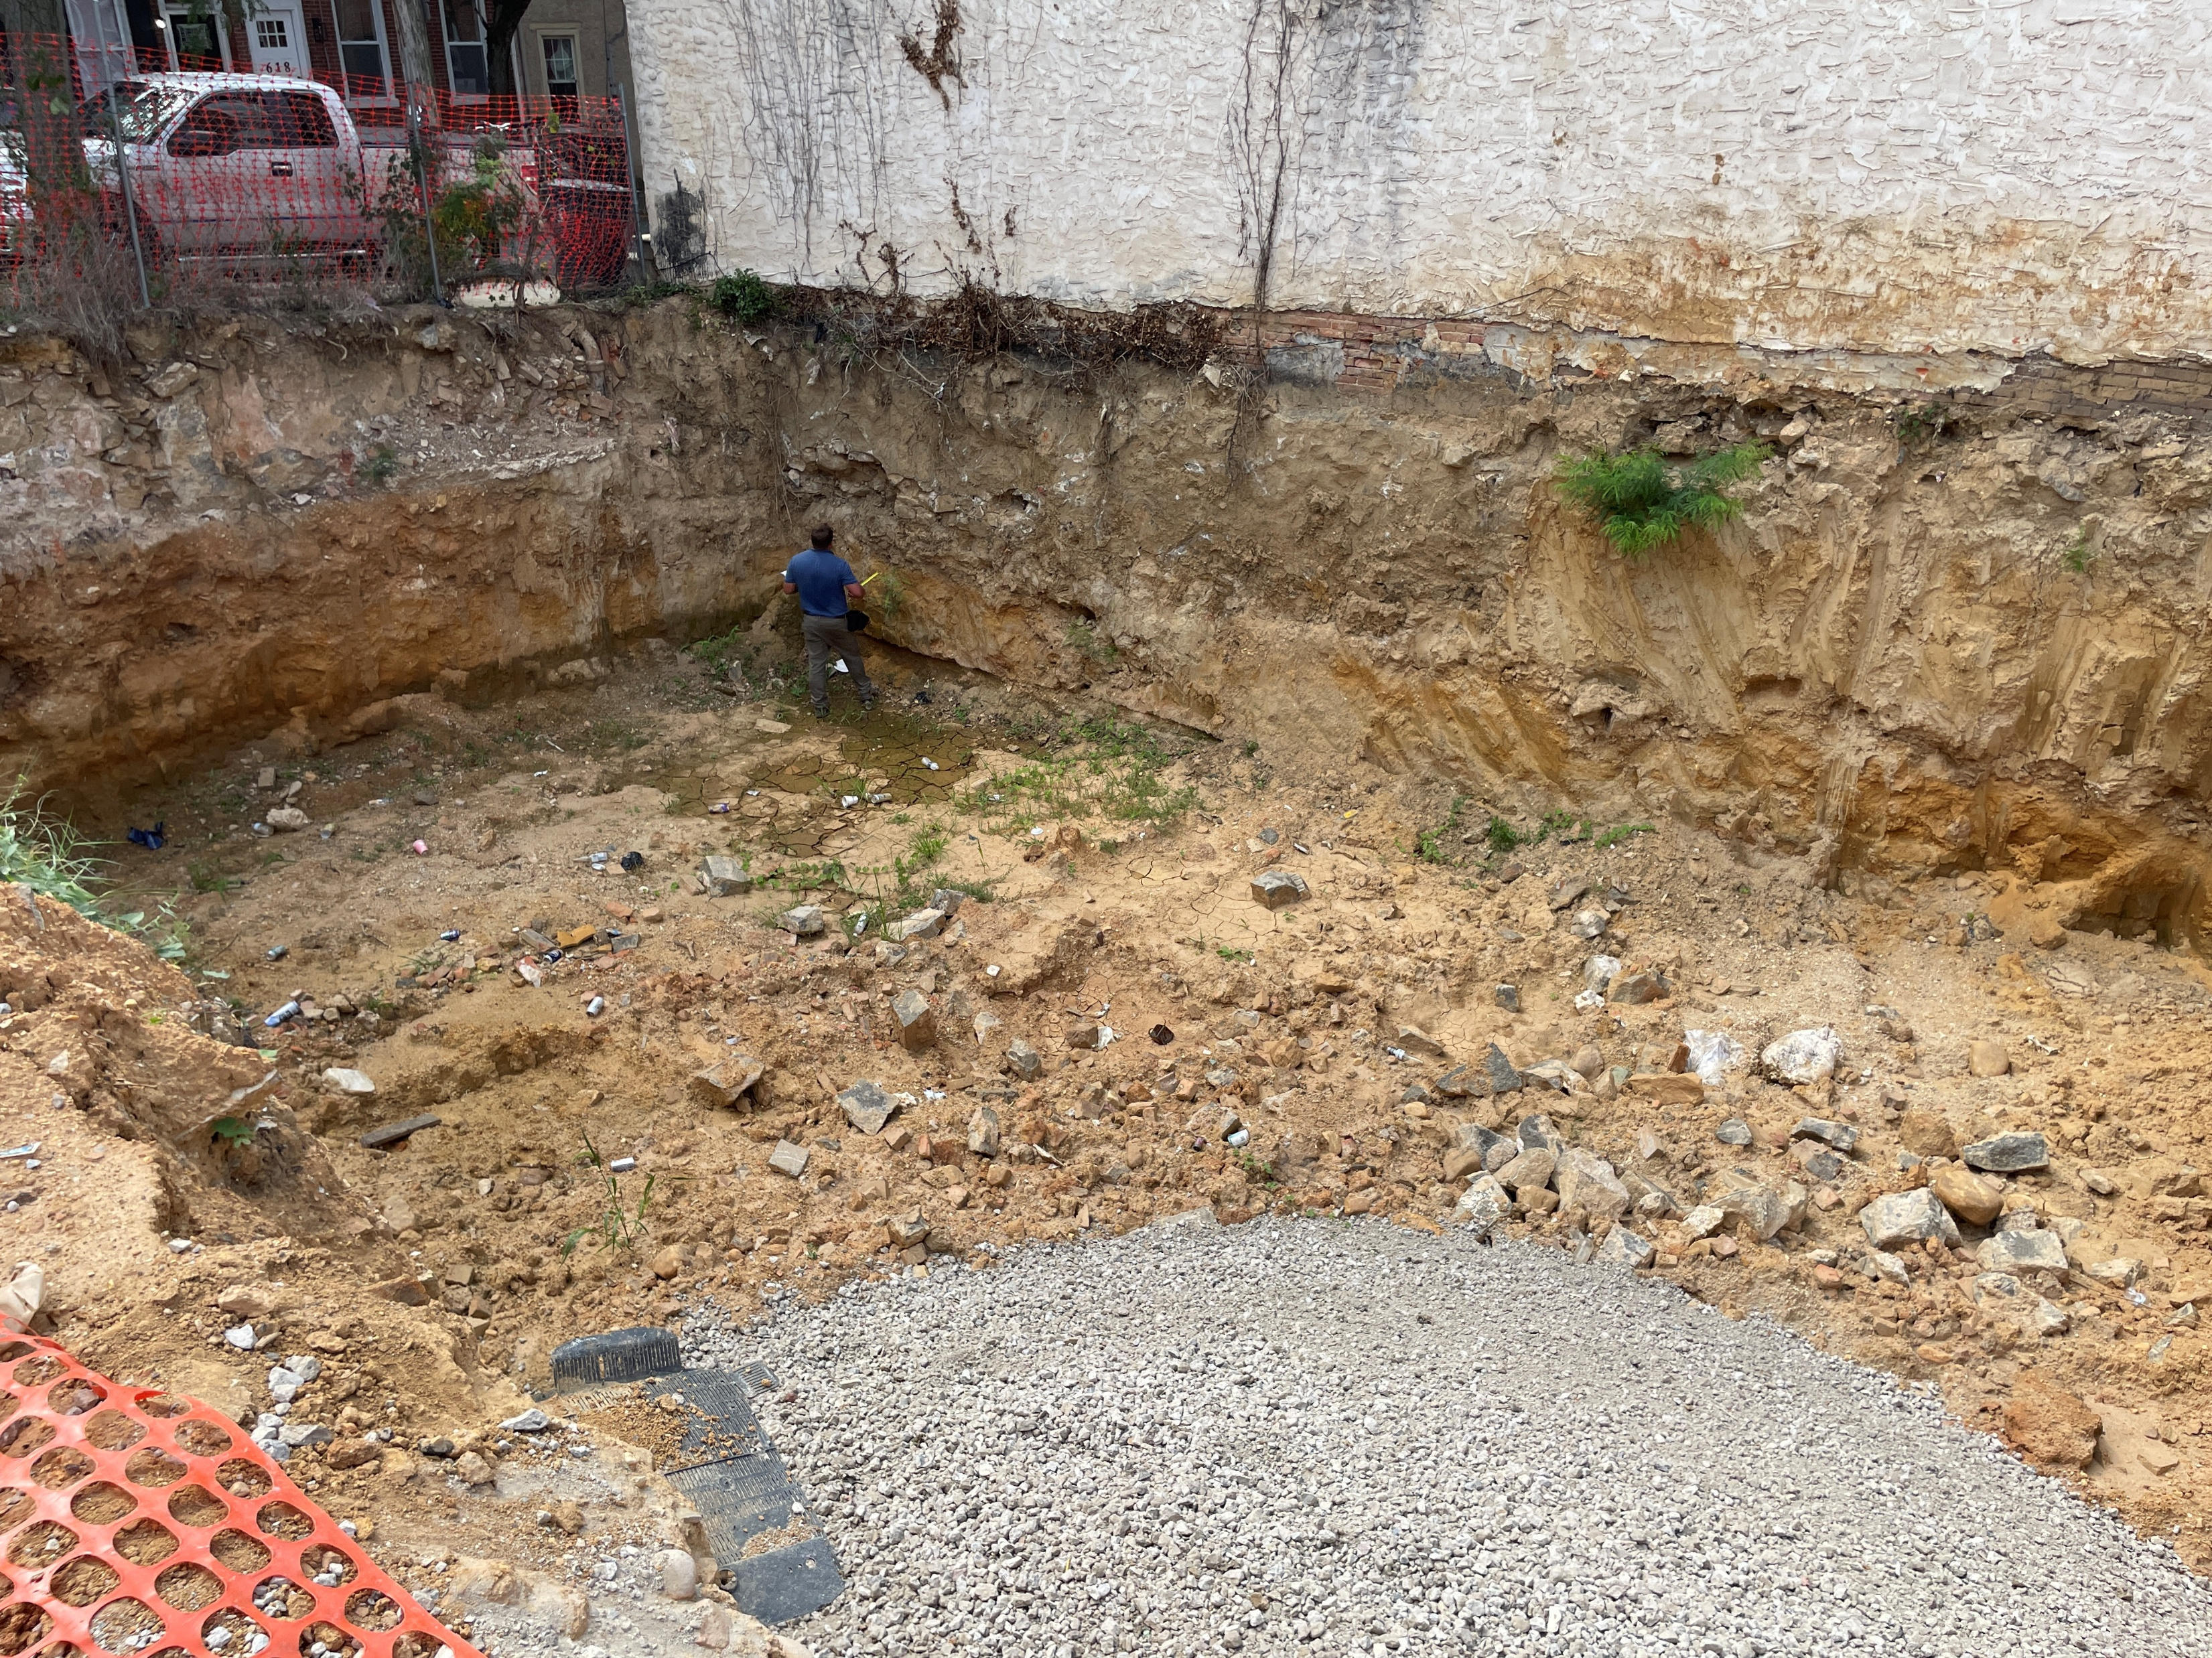
611 & 613 W 7TH STREET
Notes:
TOTAL
$245,410.00
???

Slide 34
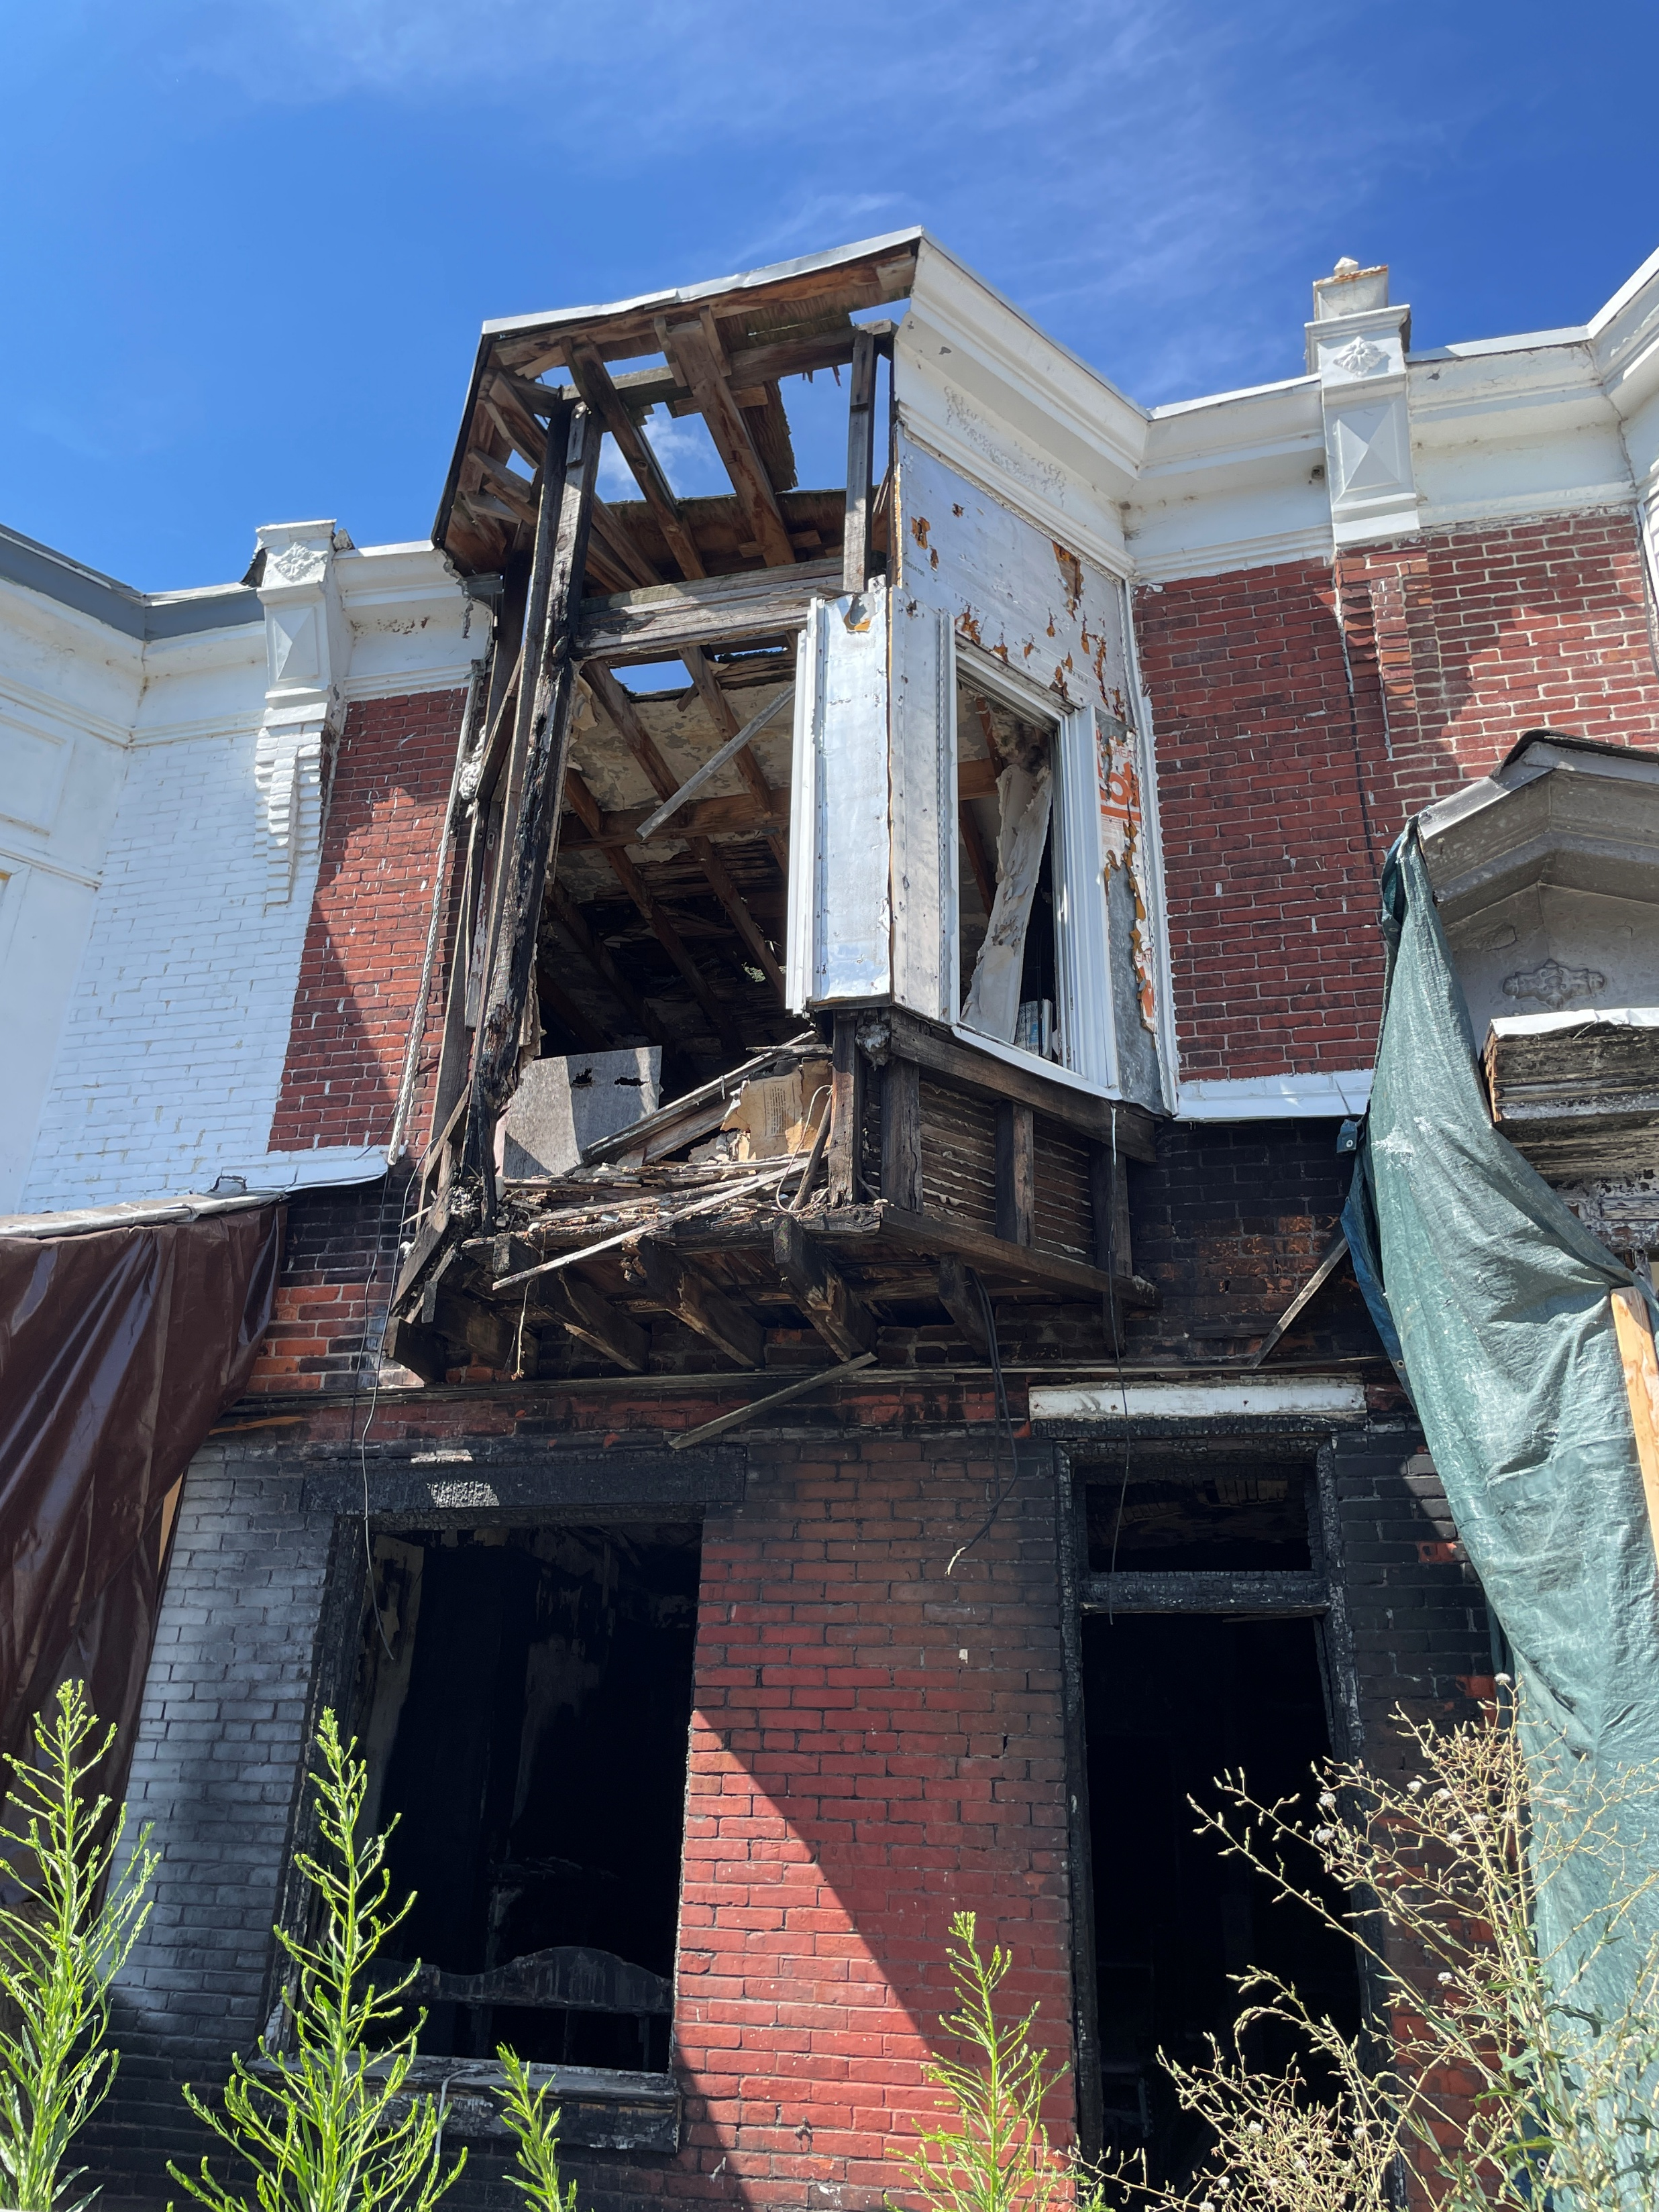
912 E 17TH STREET
Notes:
TOTAL
$245,410.00
???

Slide 35
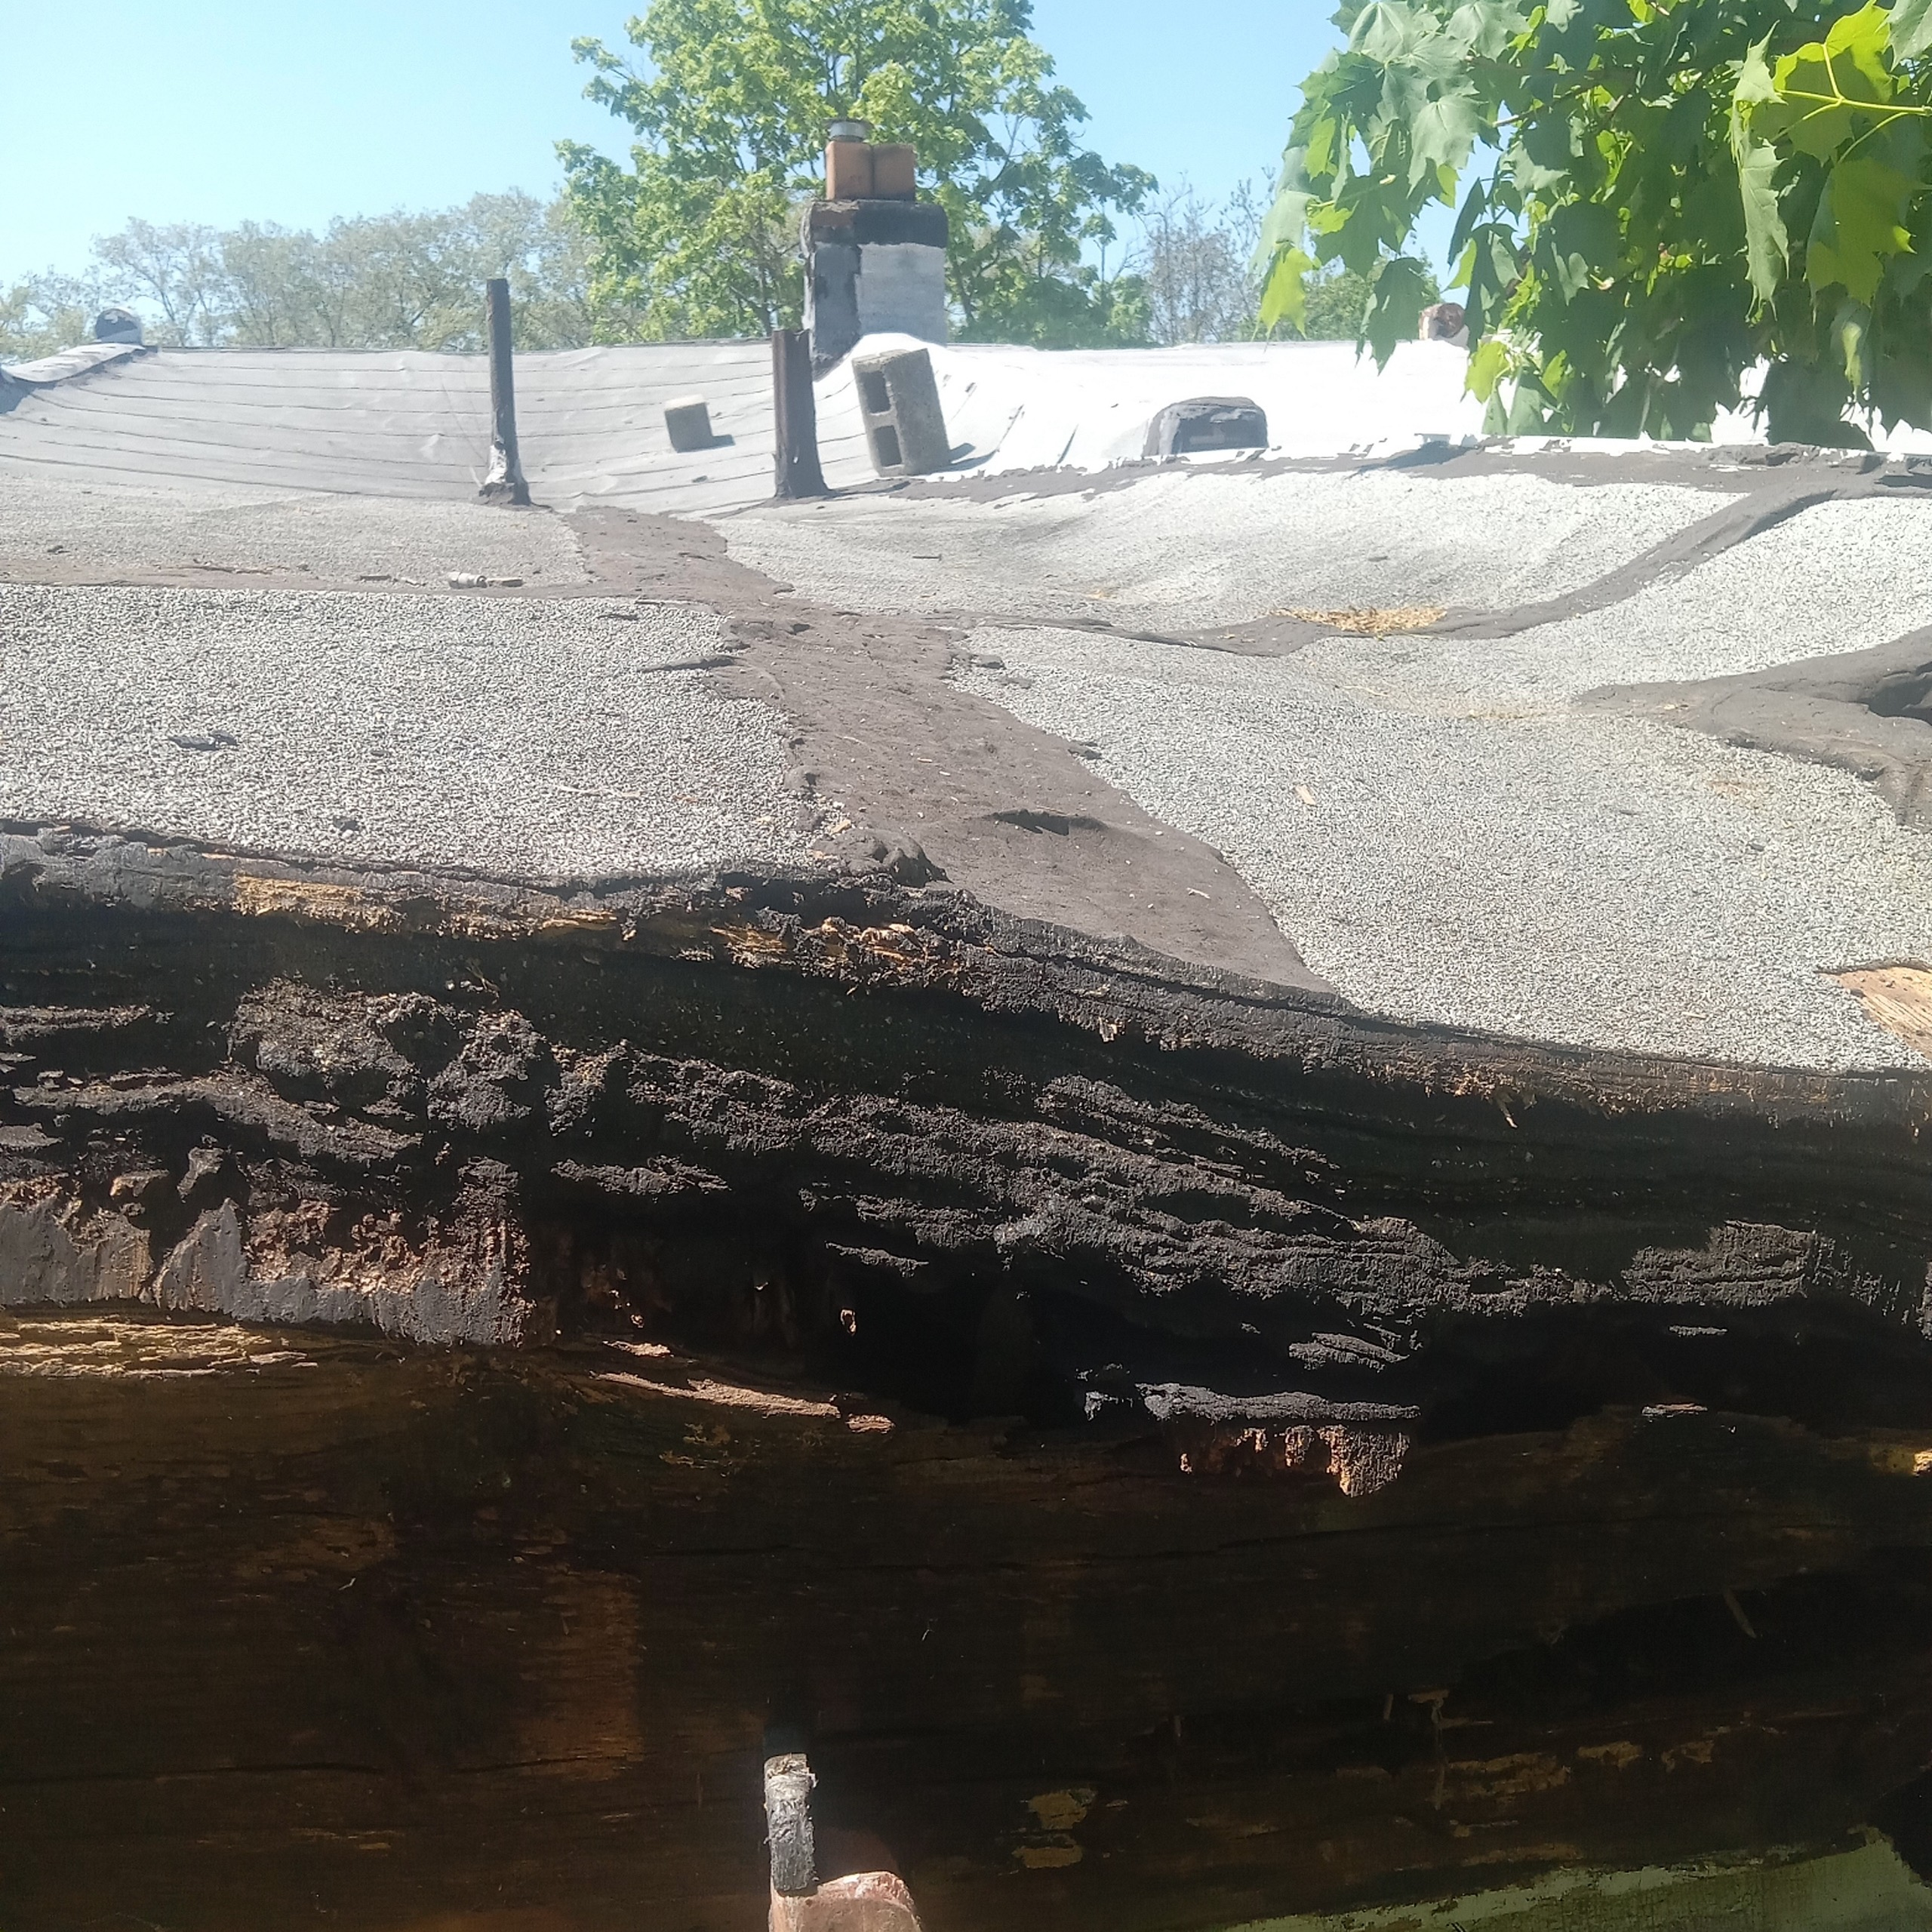
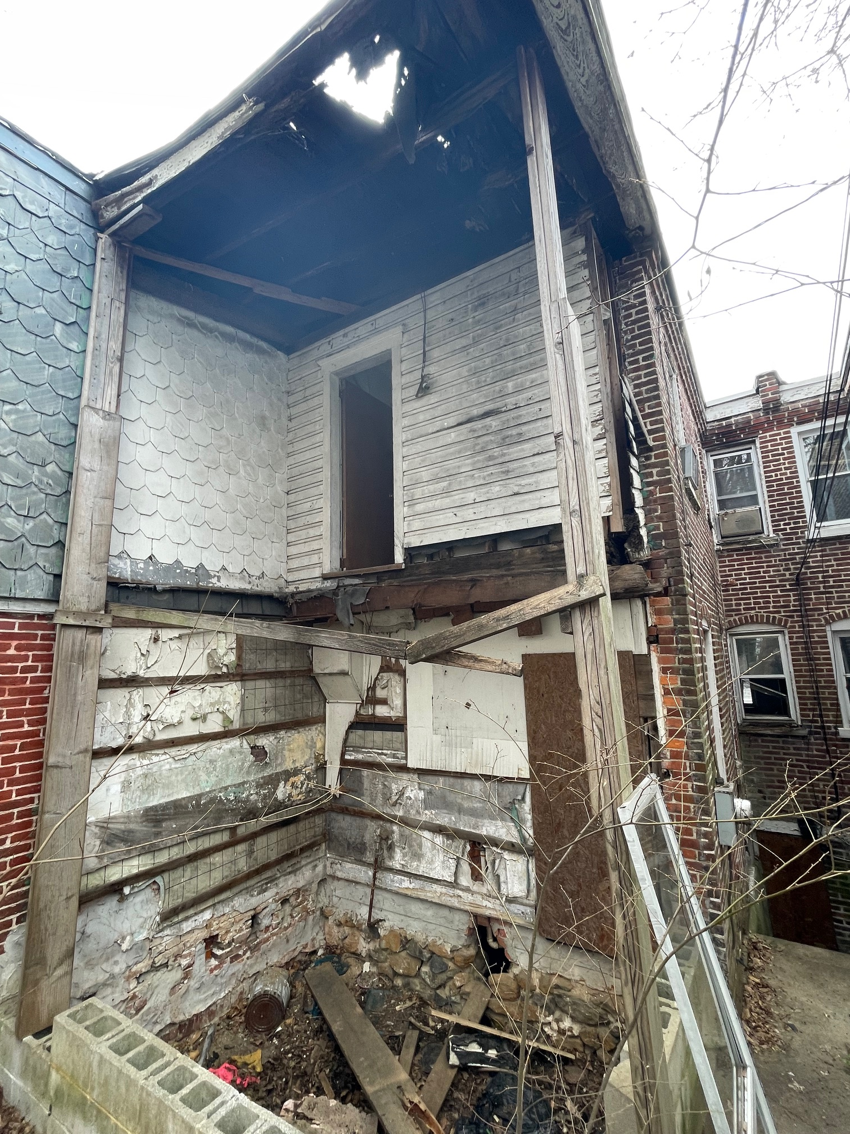
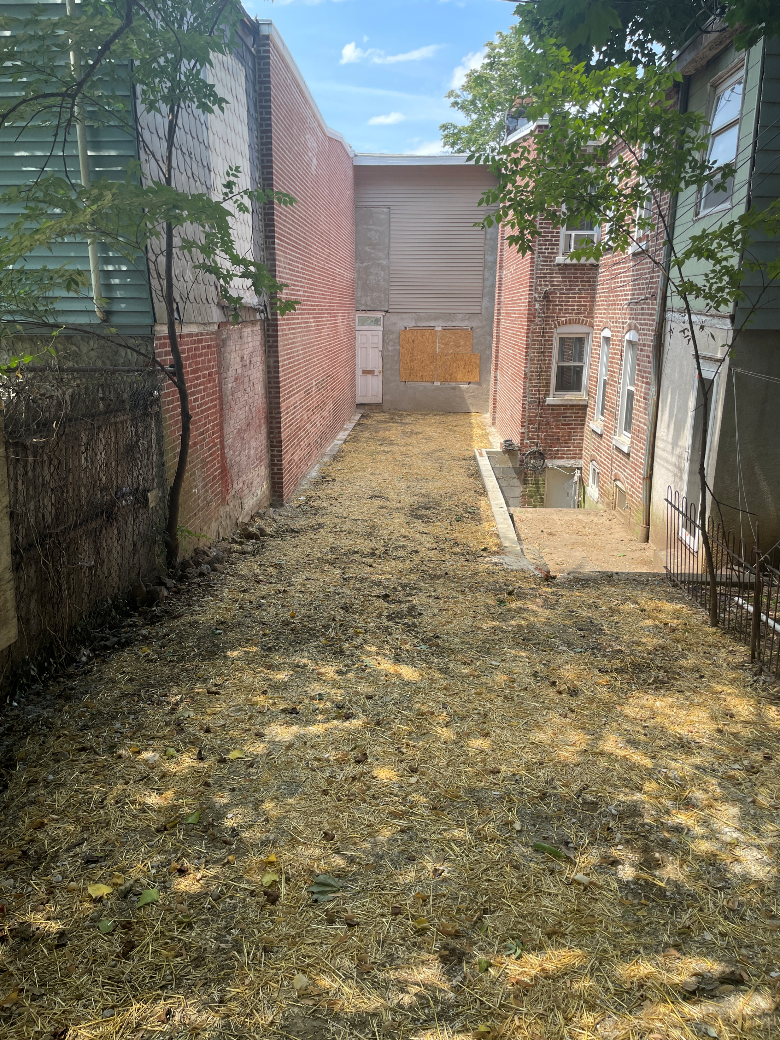
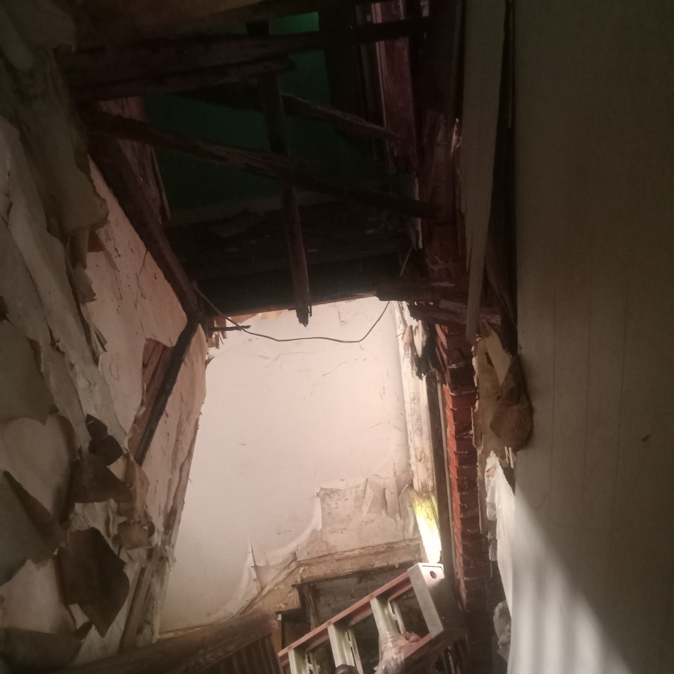
220 N RODNEY STREET
Notes:
TOTAL
$245,410.00
???

Slide 36
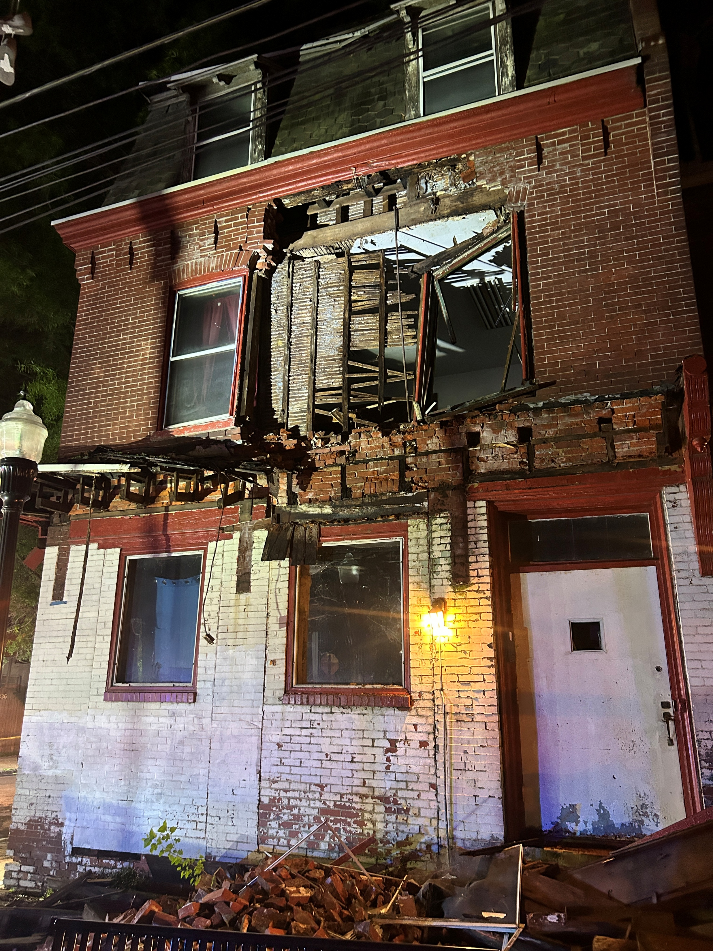
800 W 9TH STREET
Notes:
TOTAL
$245,410.00
???

Slide 37
Answer 10 (c) continued
FISCAL YEAR | ADDRESS
2025 | 2130/2132 N MARKET STREET
 | 611 & 613 W 7TH STREET
 | 1100-1102 A ST & 402 TOWNSEND ST
 | 912 E 17TH STREET
 | 220 N RODNEY STREET
 | 800 W 9TH STREET
Notes:
TOTAL
$245,410.00
???

Slide 38
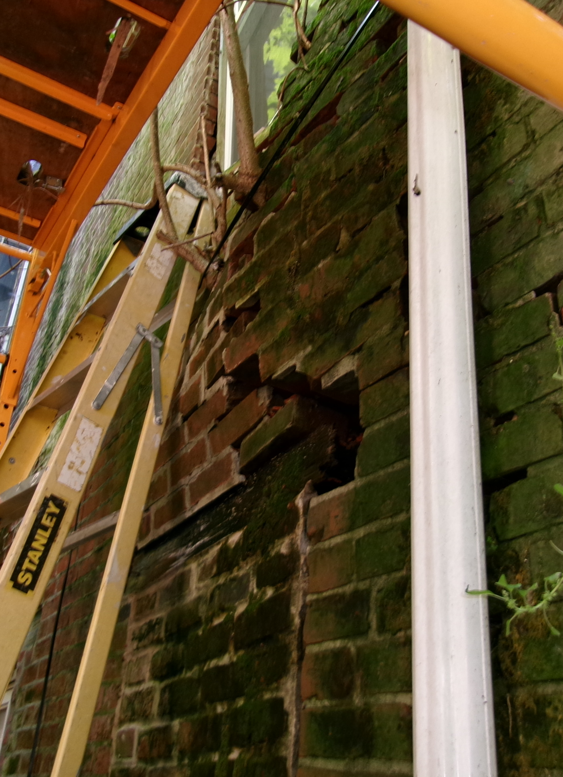
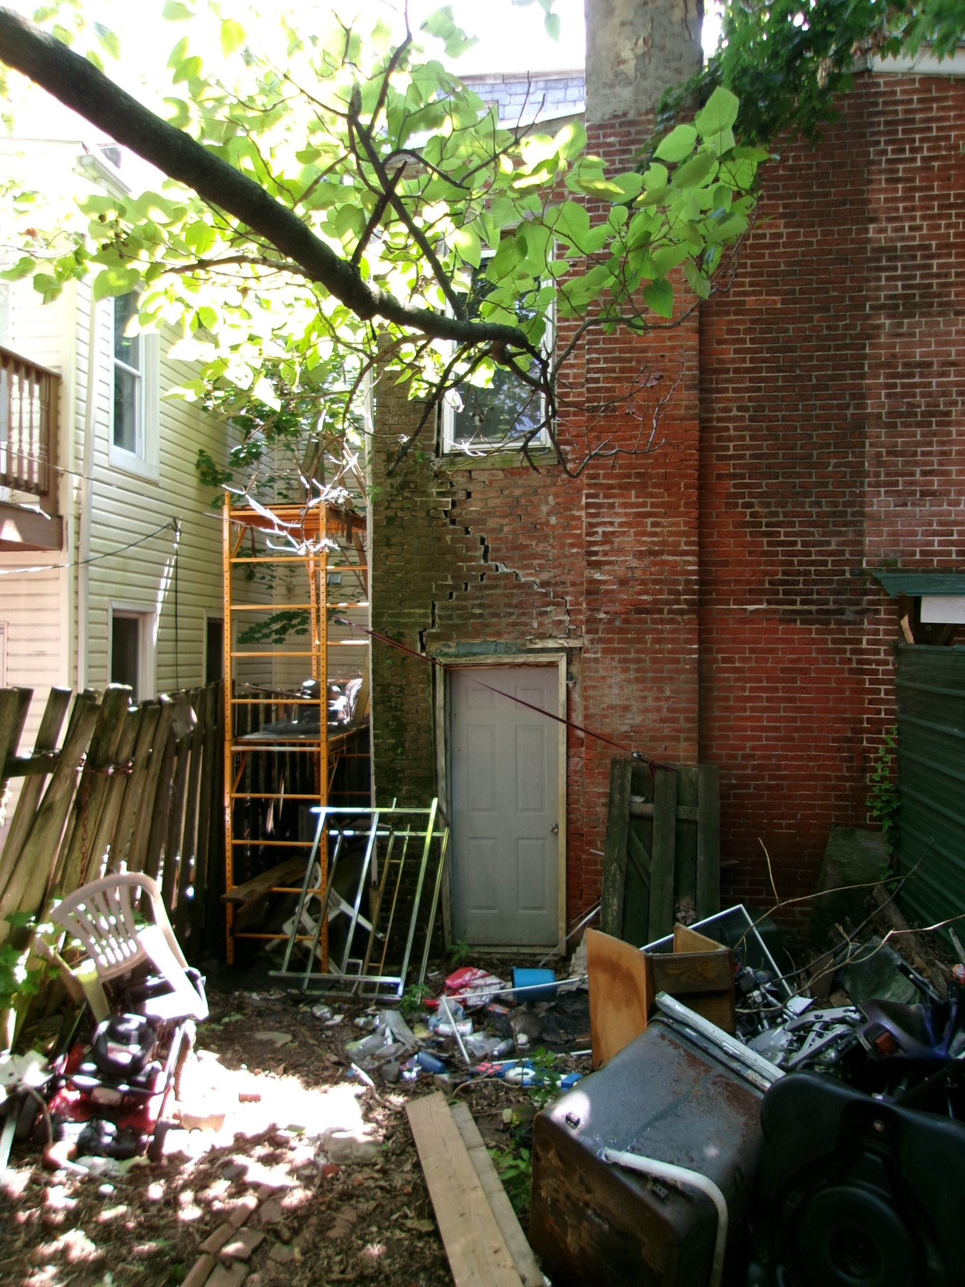
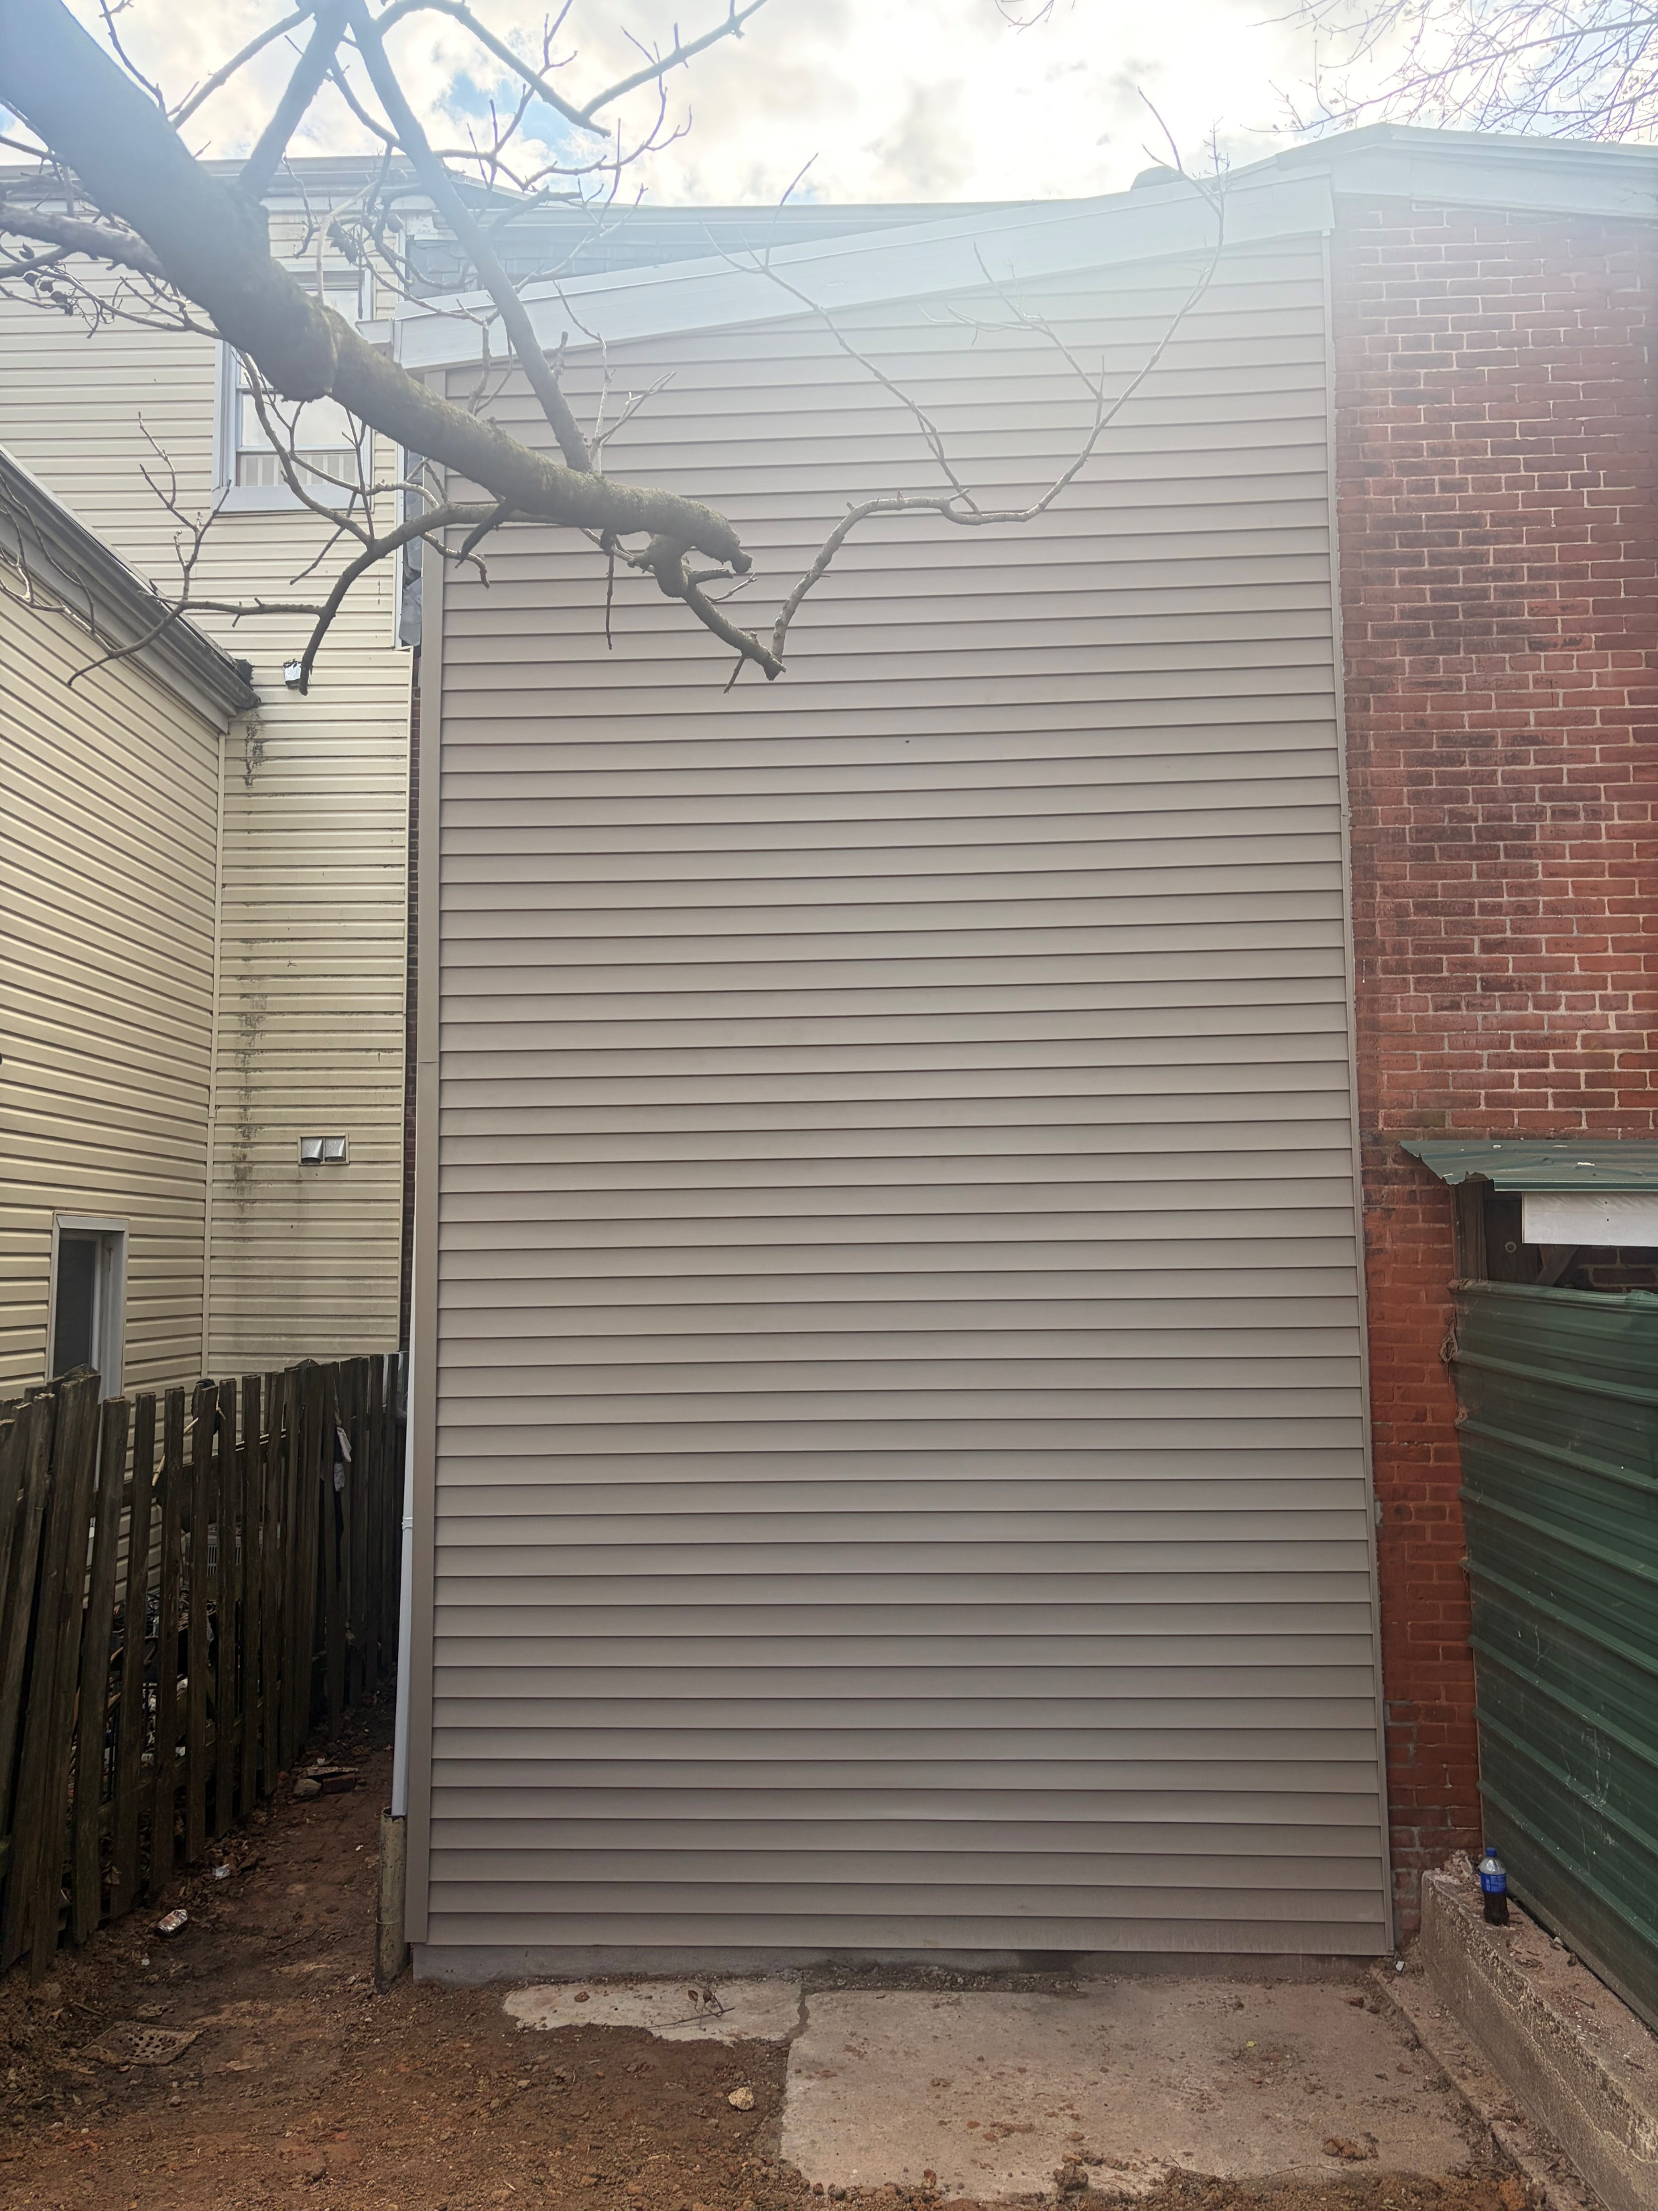
615 W 9th STREET

Slide 39
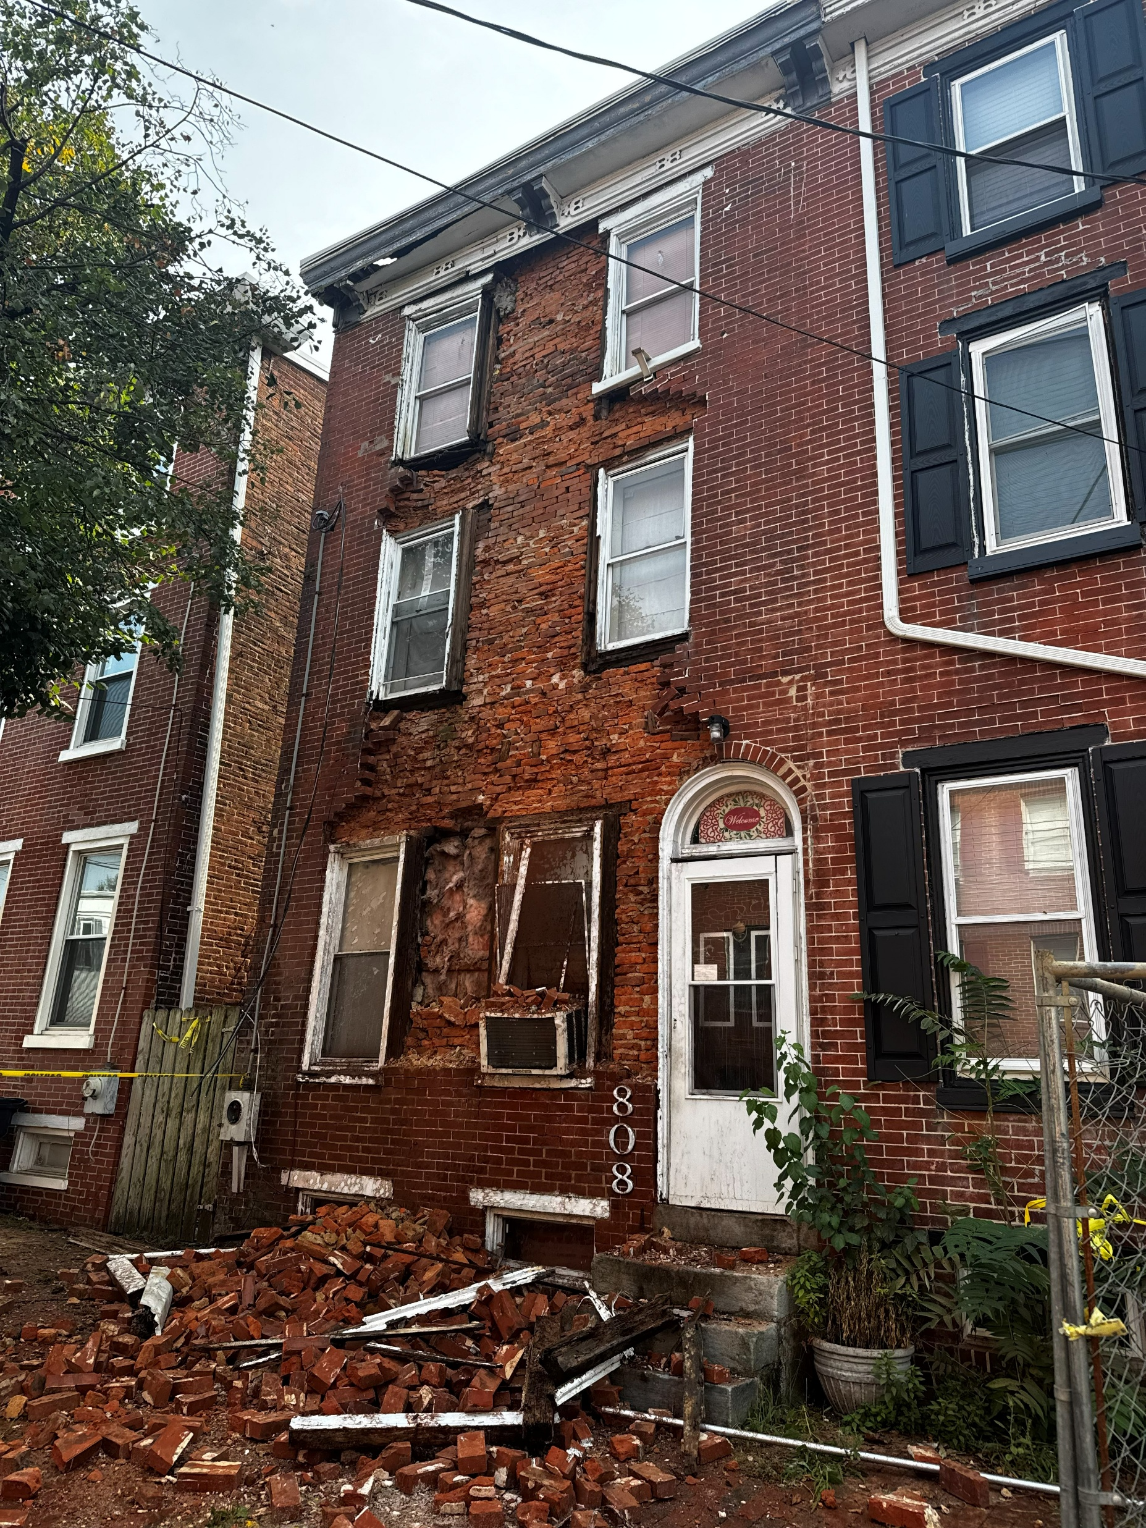
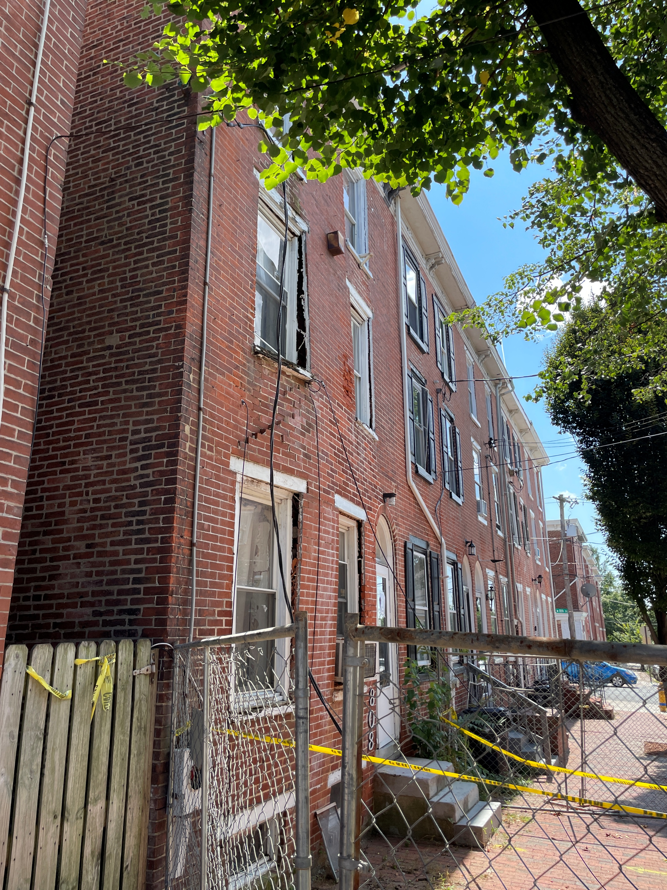
808 N MADISON STREET
Notes:
TOTAL
$245,410.00
???

Slide 40
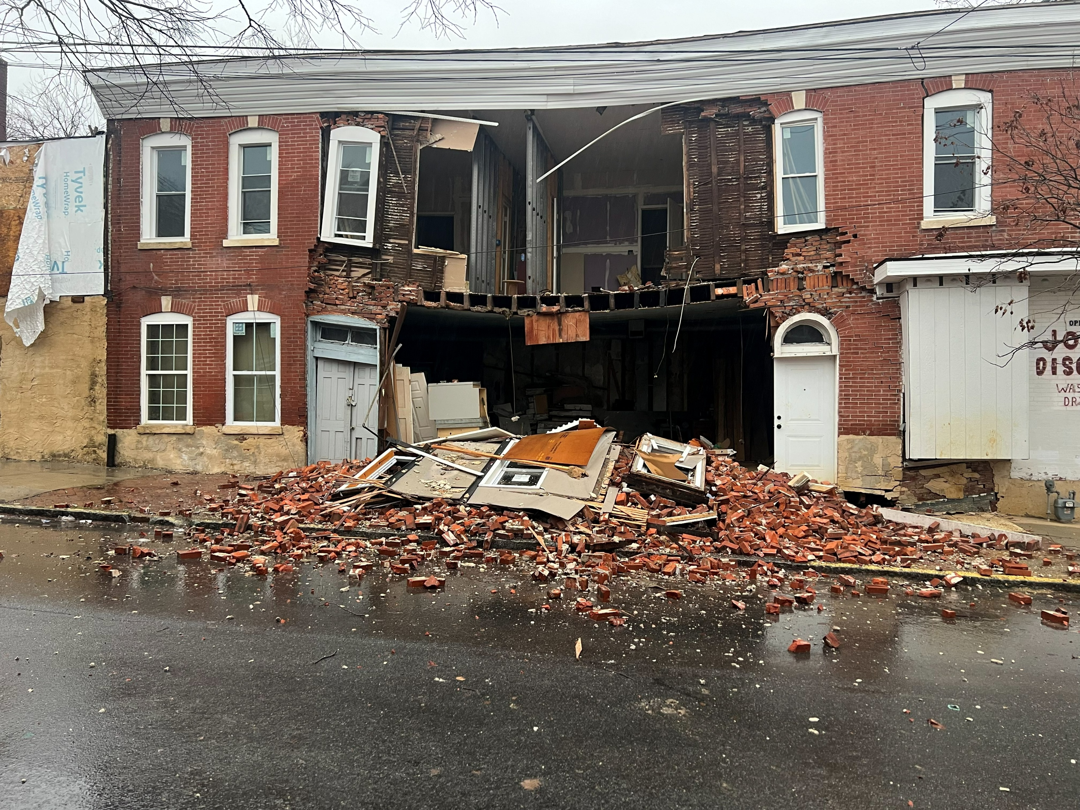
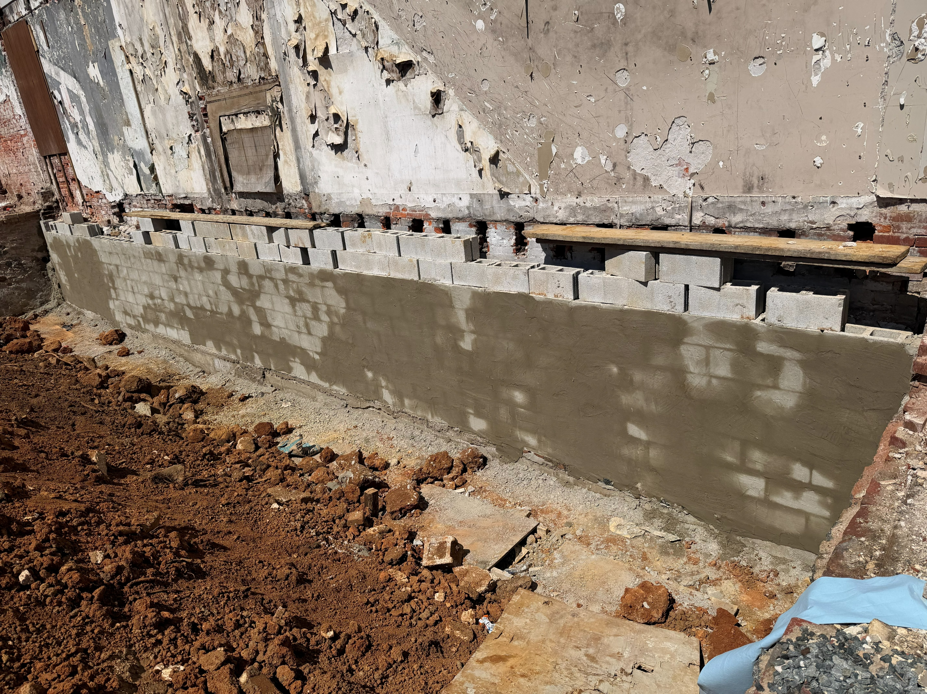
223 S VAN BUREN STREET
Notes:
TOTAL
$245,410.00
???

Slide 41
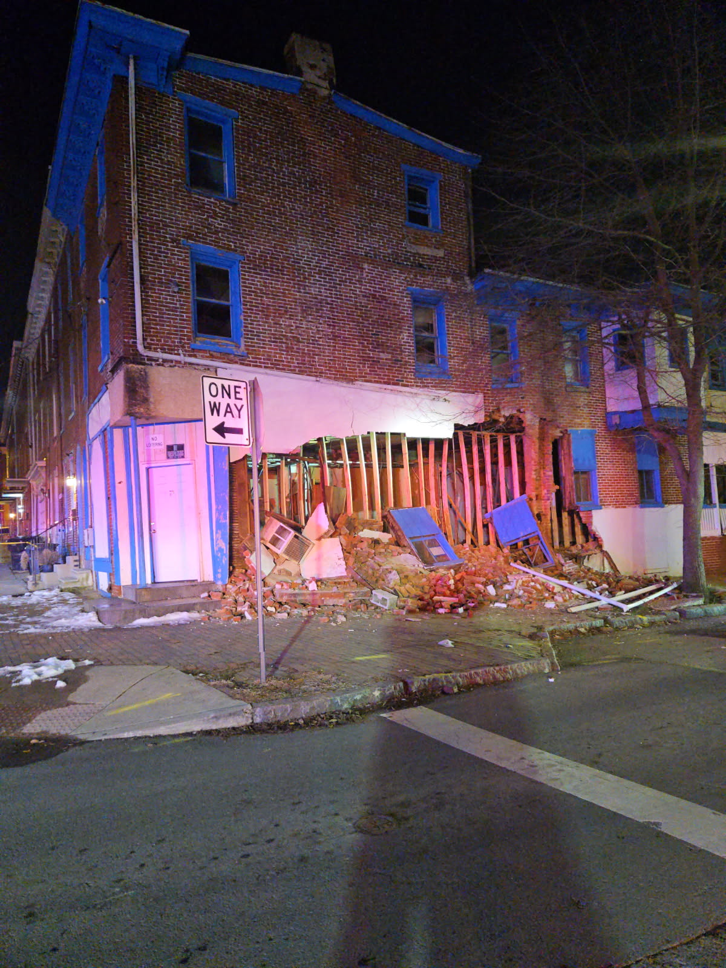
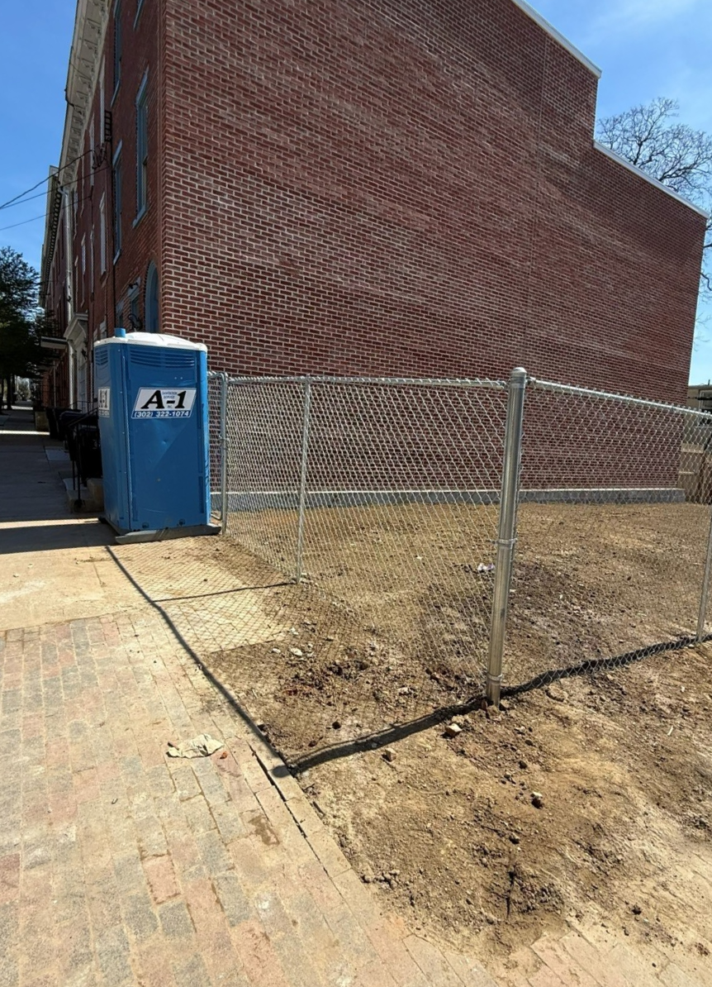
630 W 9TH STREET
Notes:
TOTAL
$245,410.00
???

Slide 42
Answer 10 (c) continued
FISCAL YEAR | ADDRESS
*2026 | 412 W 26TH STREET
 | 808 N MADISON STREET
 | 615 W 9TH STREET
 | 504 W 4TH STREET
 | 223 S VAN BUREN STREET
 | 630 W 9TH STREET
 | 1229 LANCASTER AVE
Notes:
TOTAL
$219,975.00

Slide 43
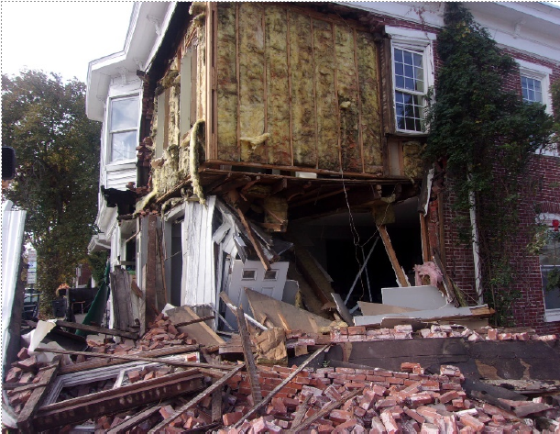
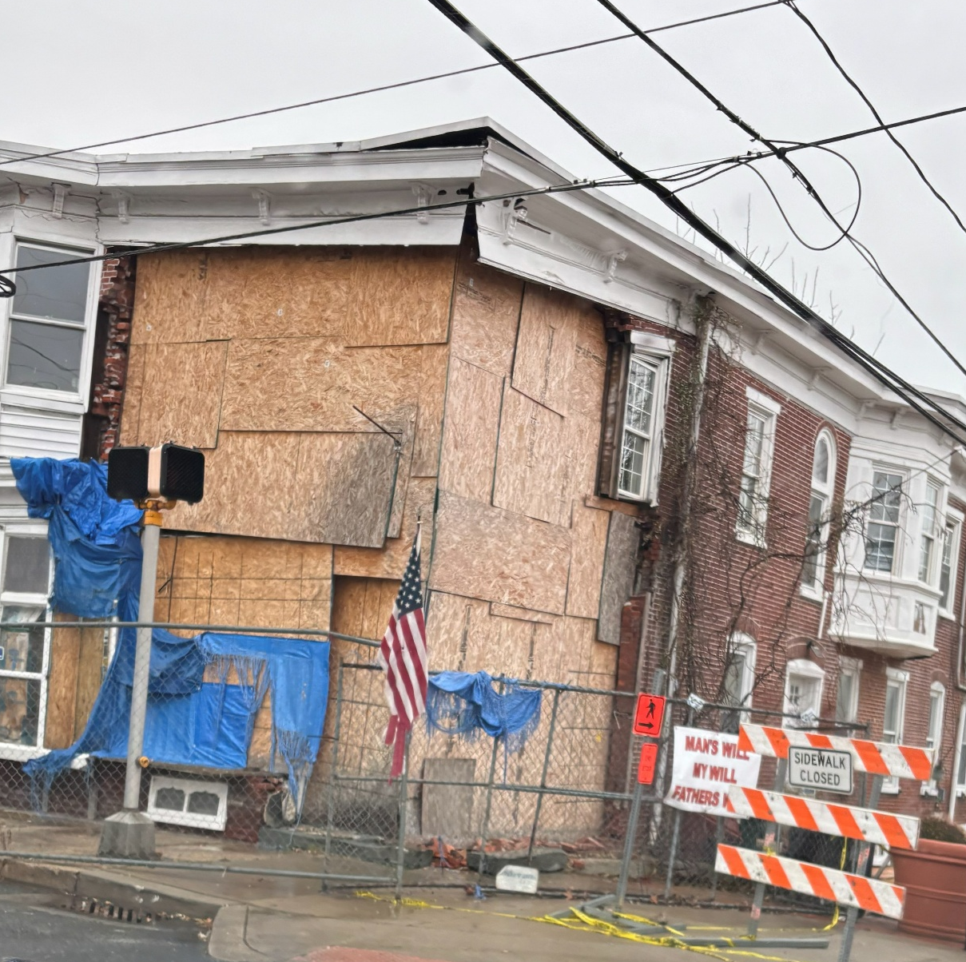
401 S HEALD STREET
*POTENTIAL DEMOLITION

Slide 44
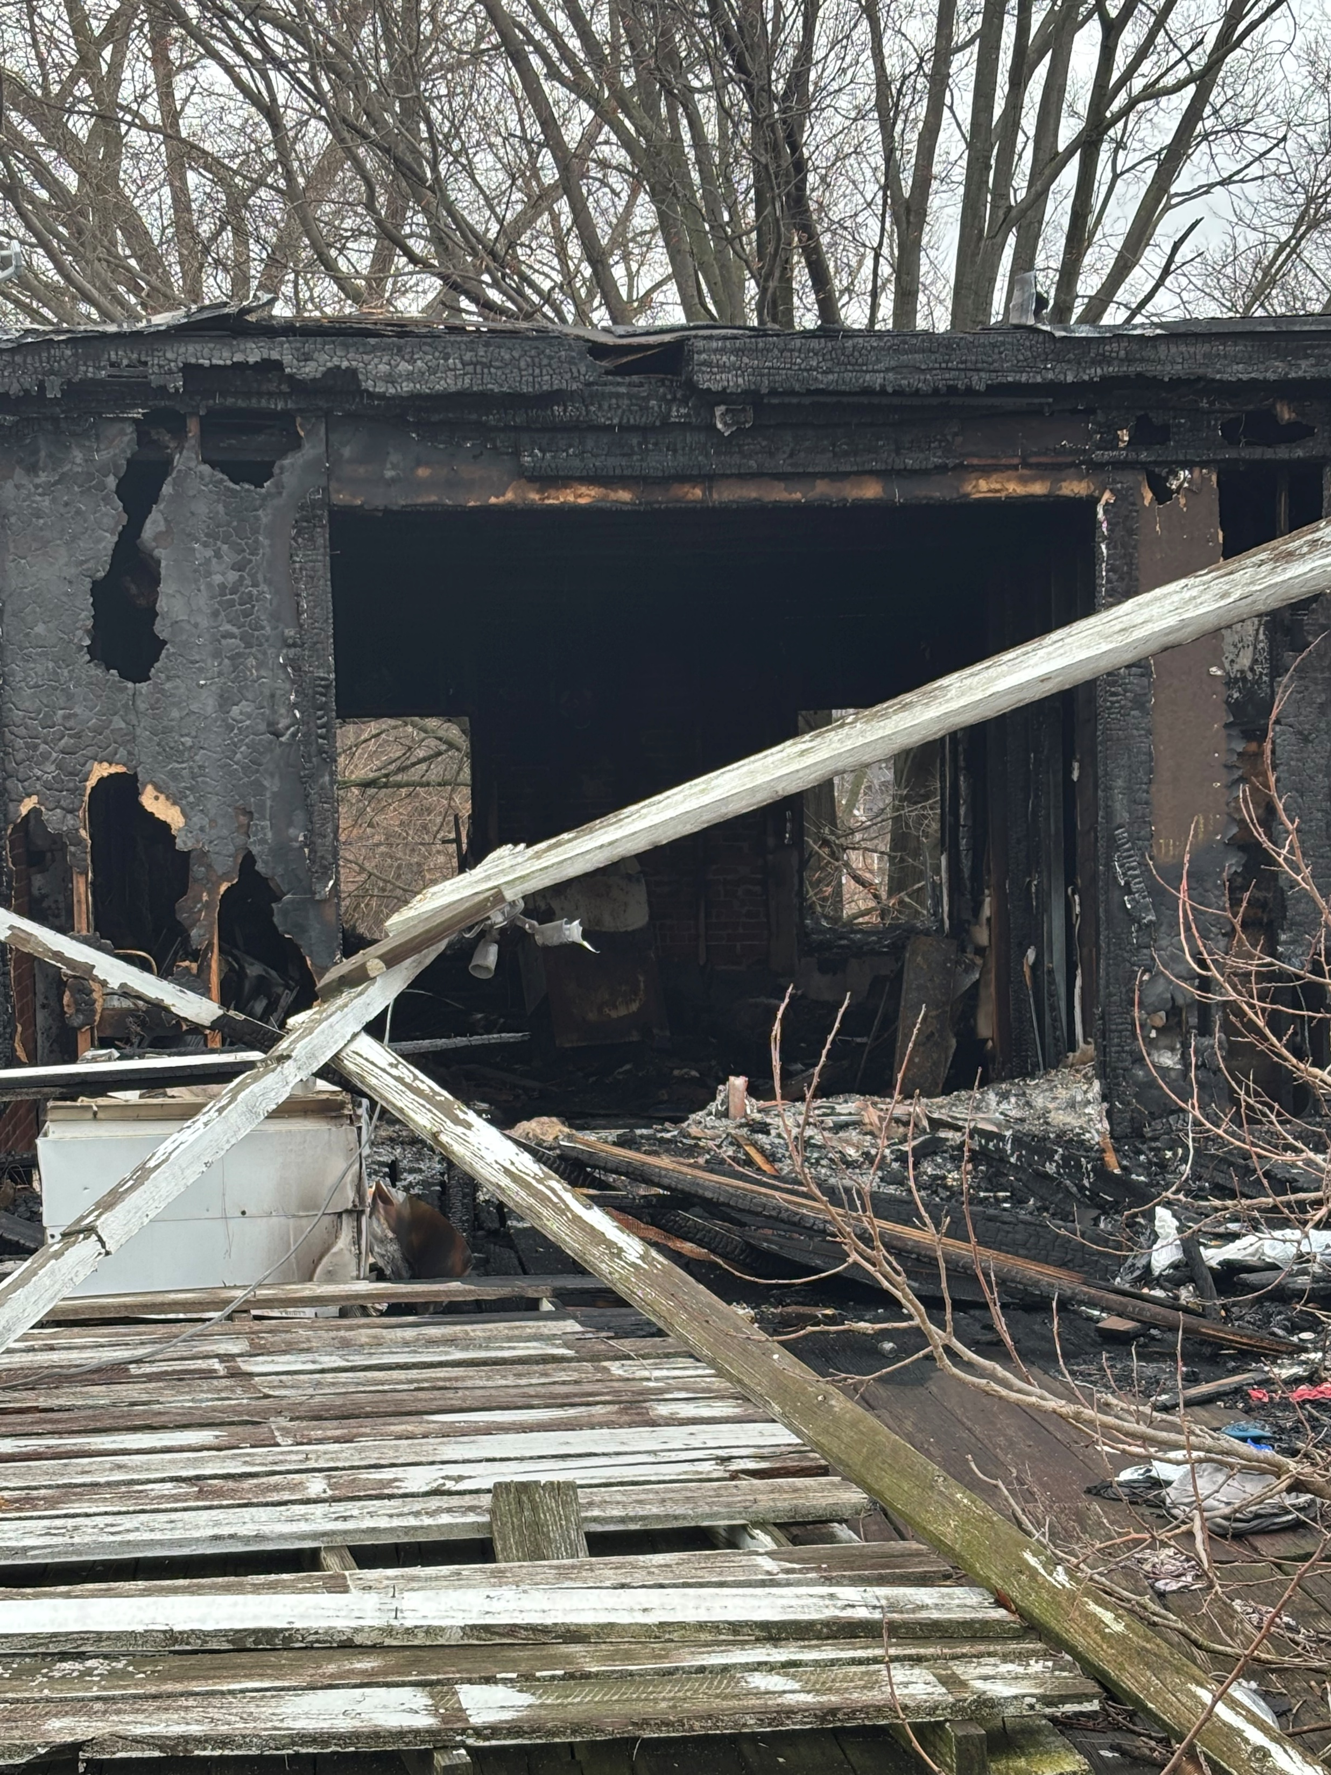
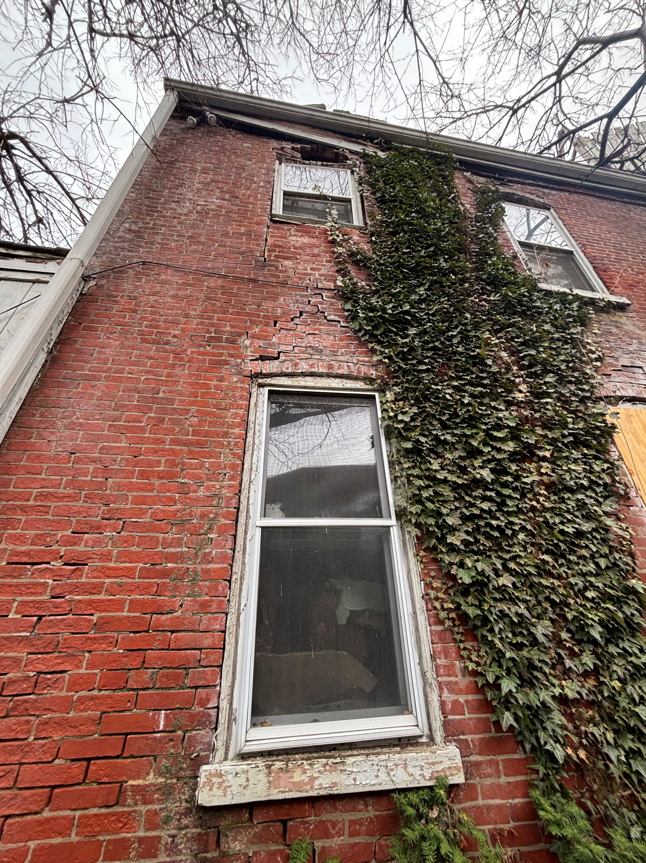
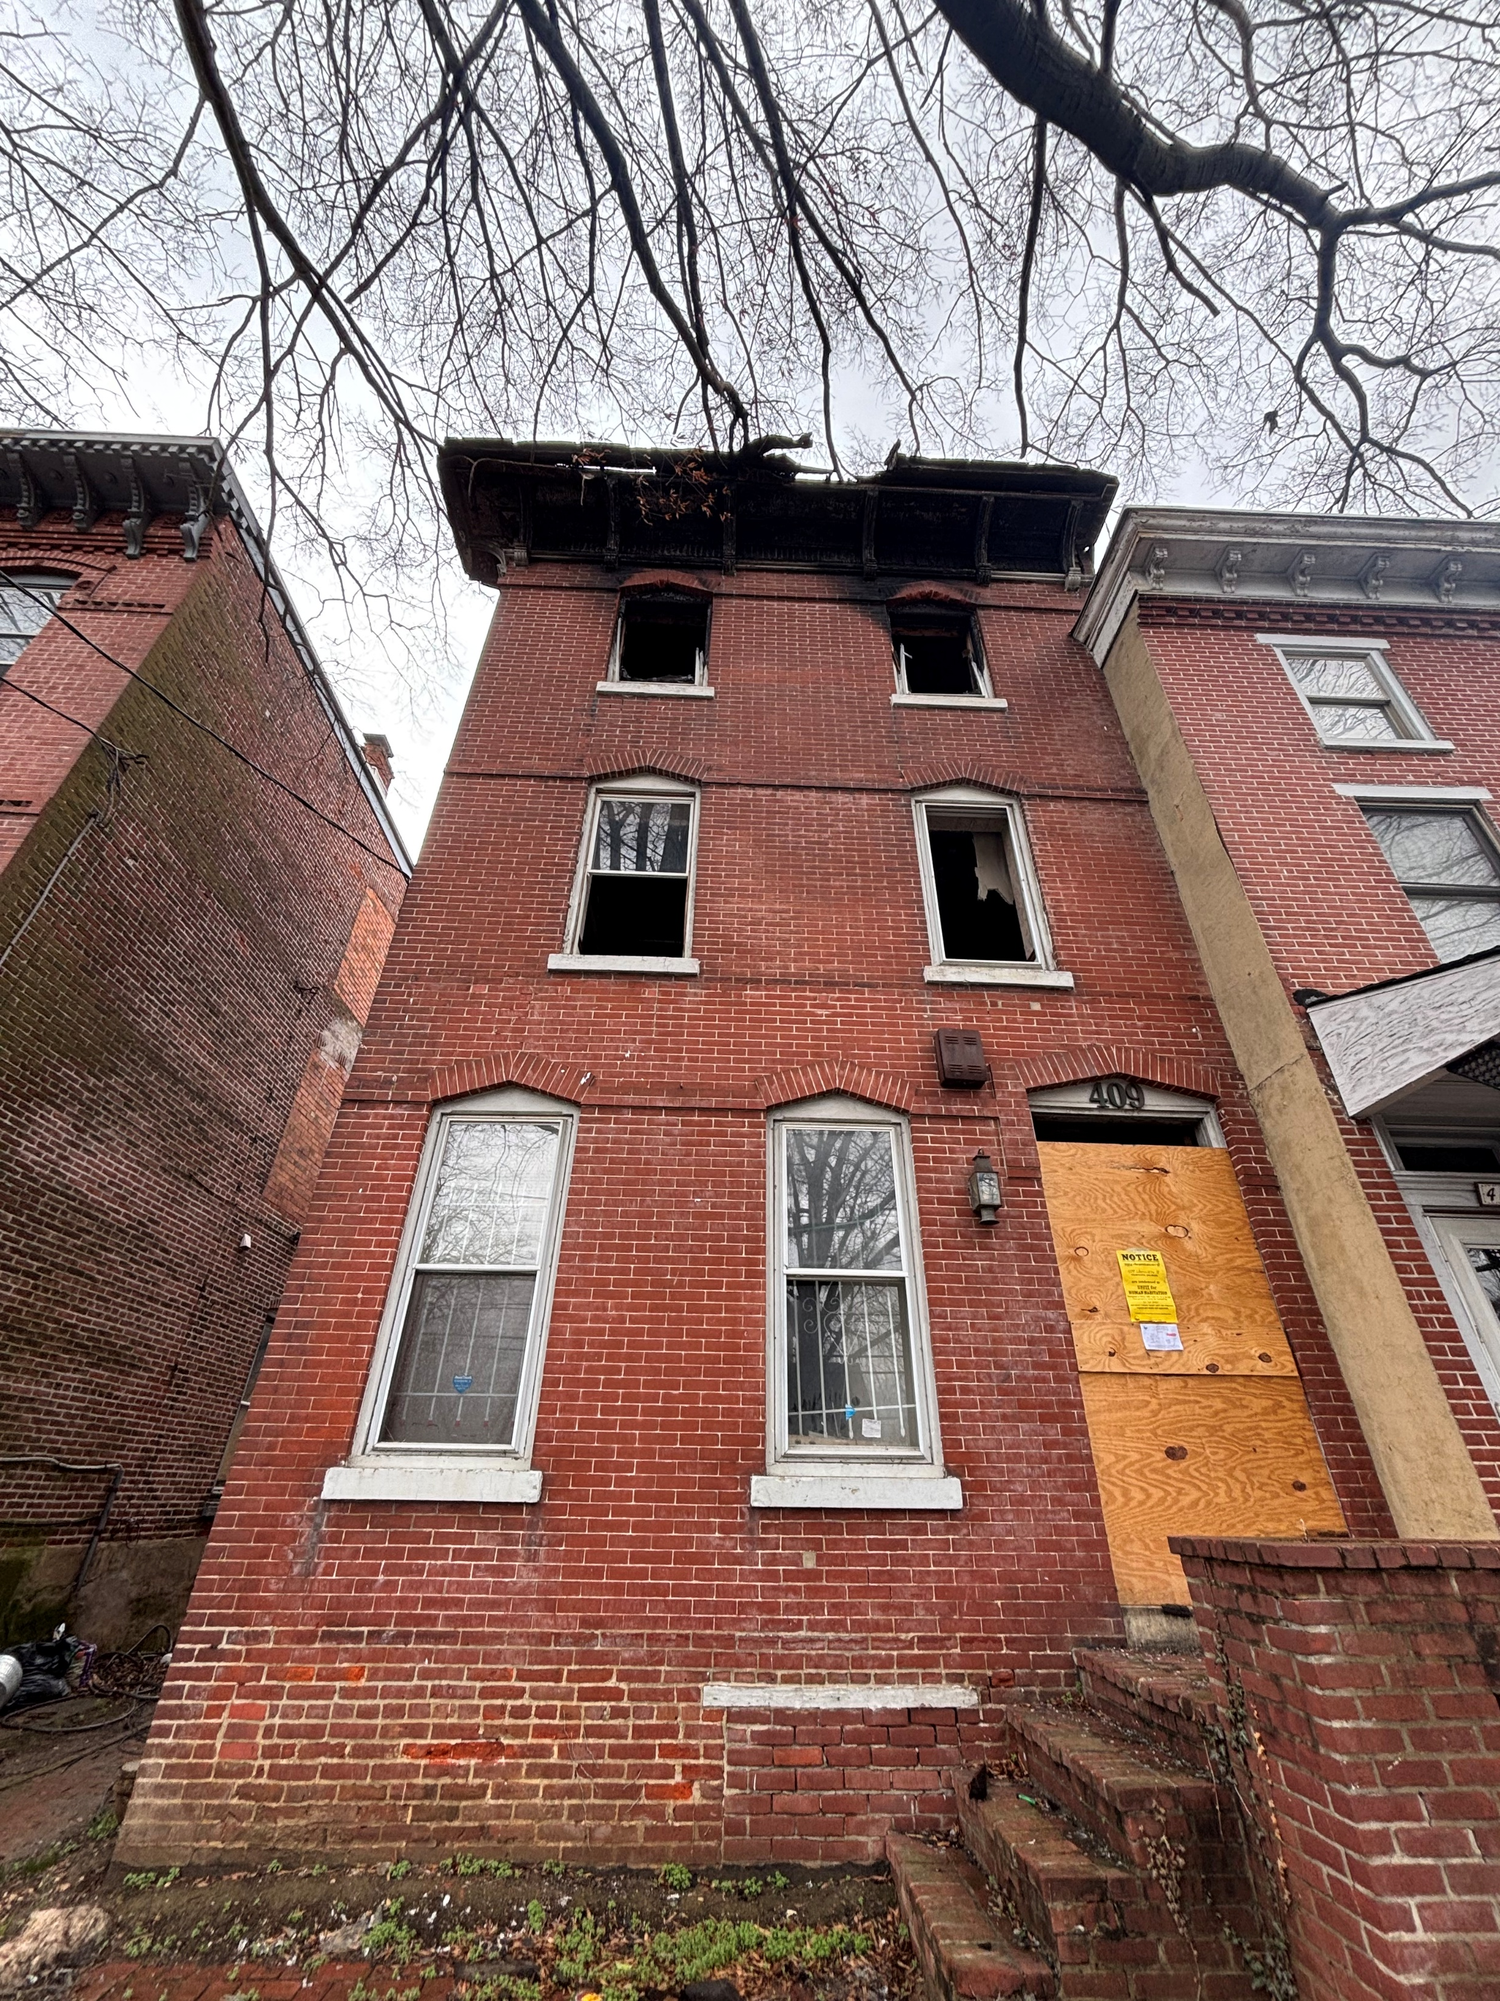
409 WASHINGTON STREET
*POTENTIAL DEMOLITION

Slide 45
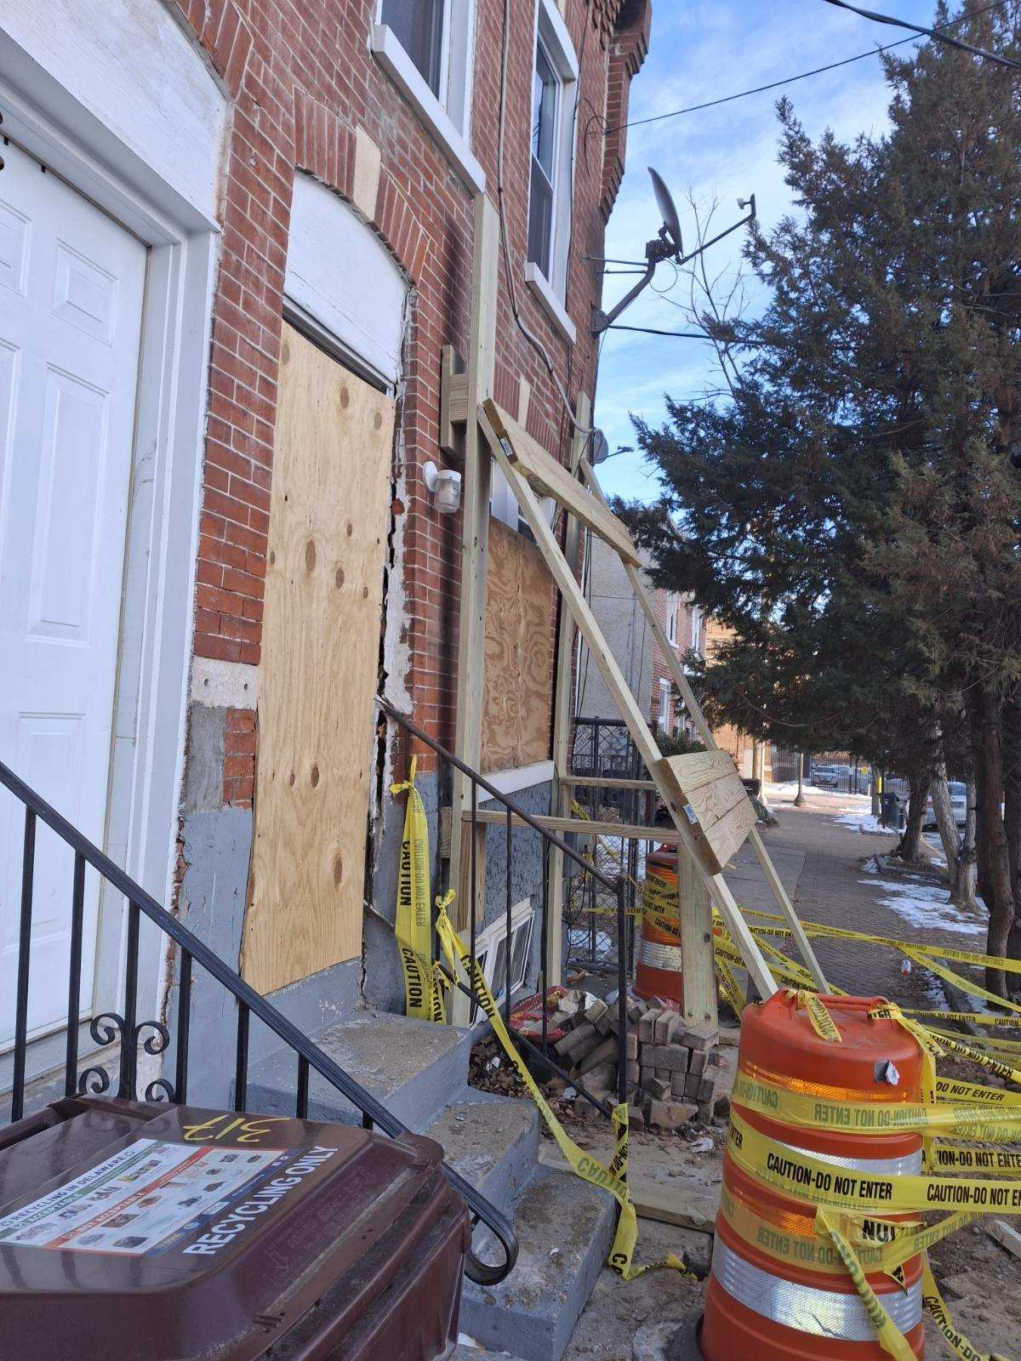
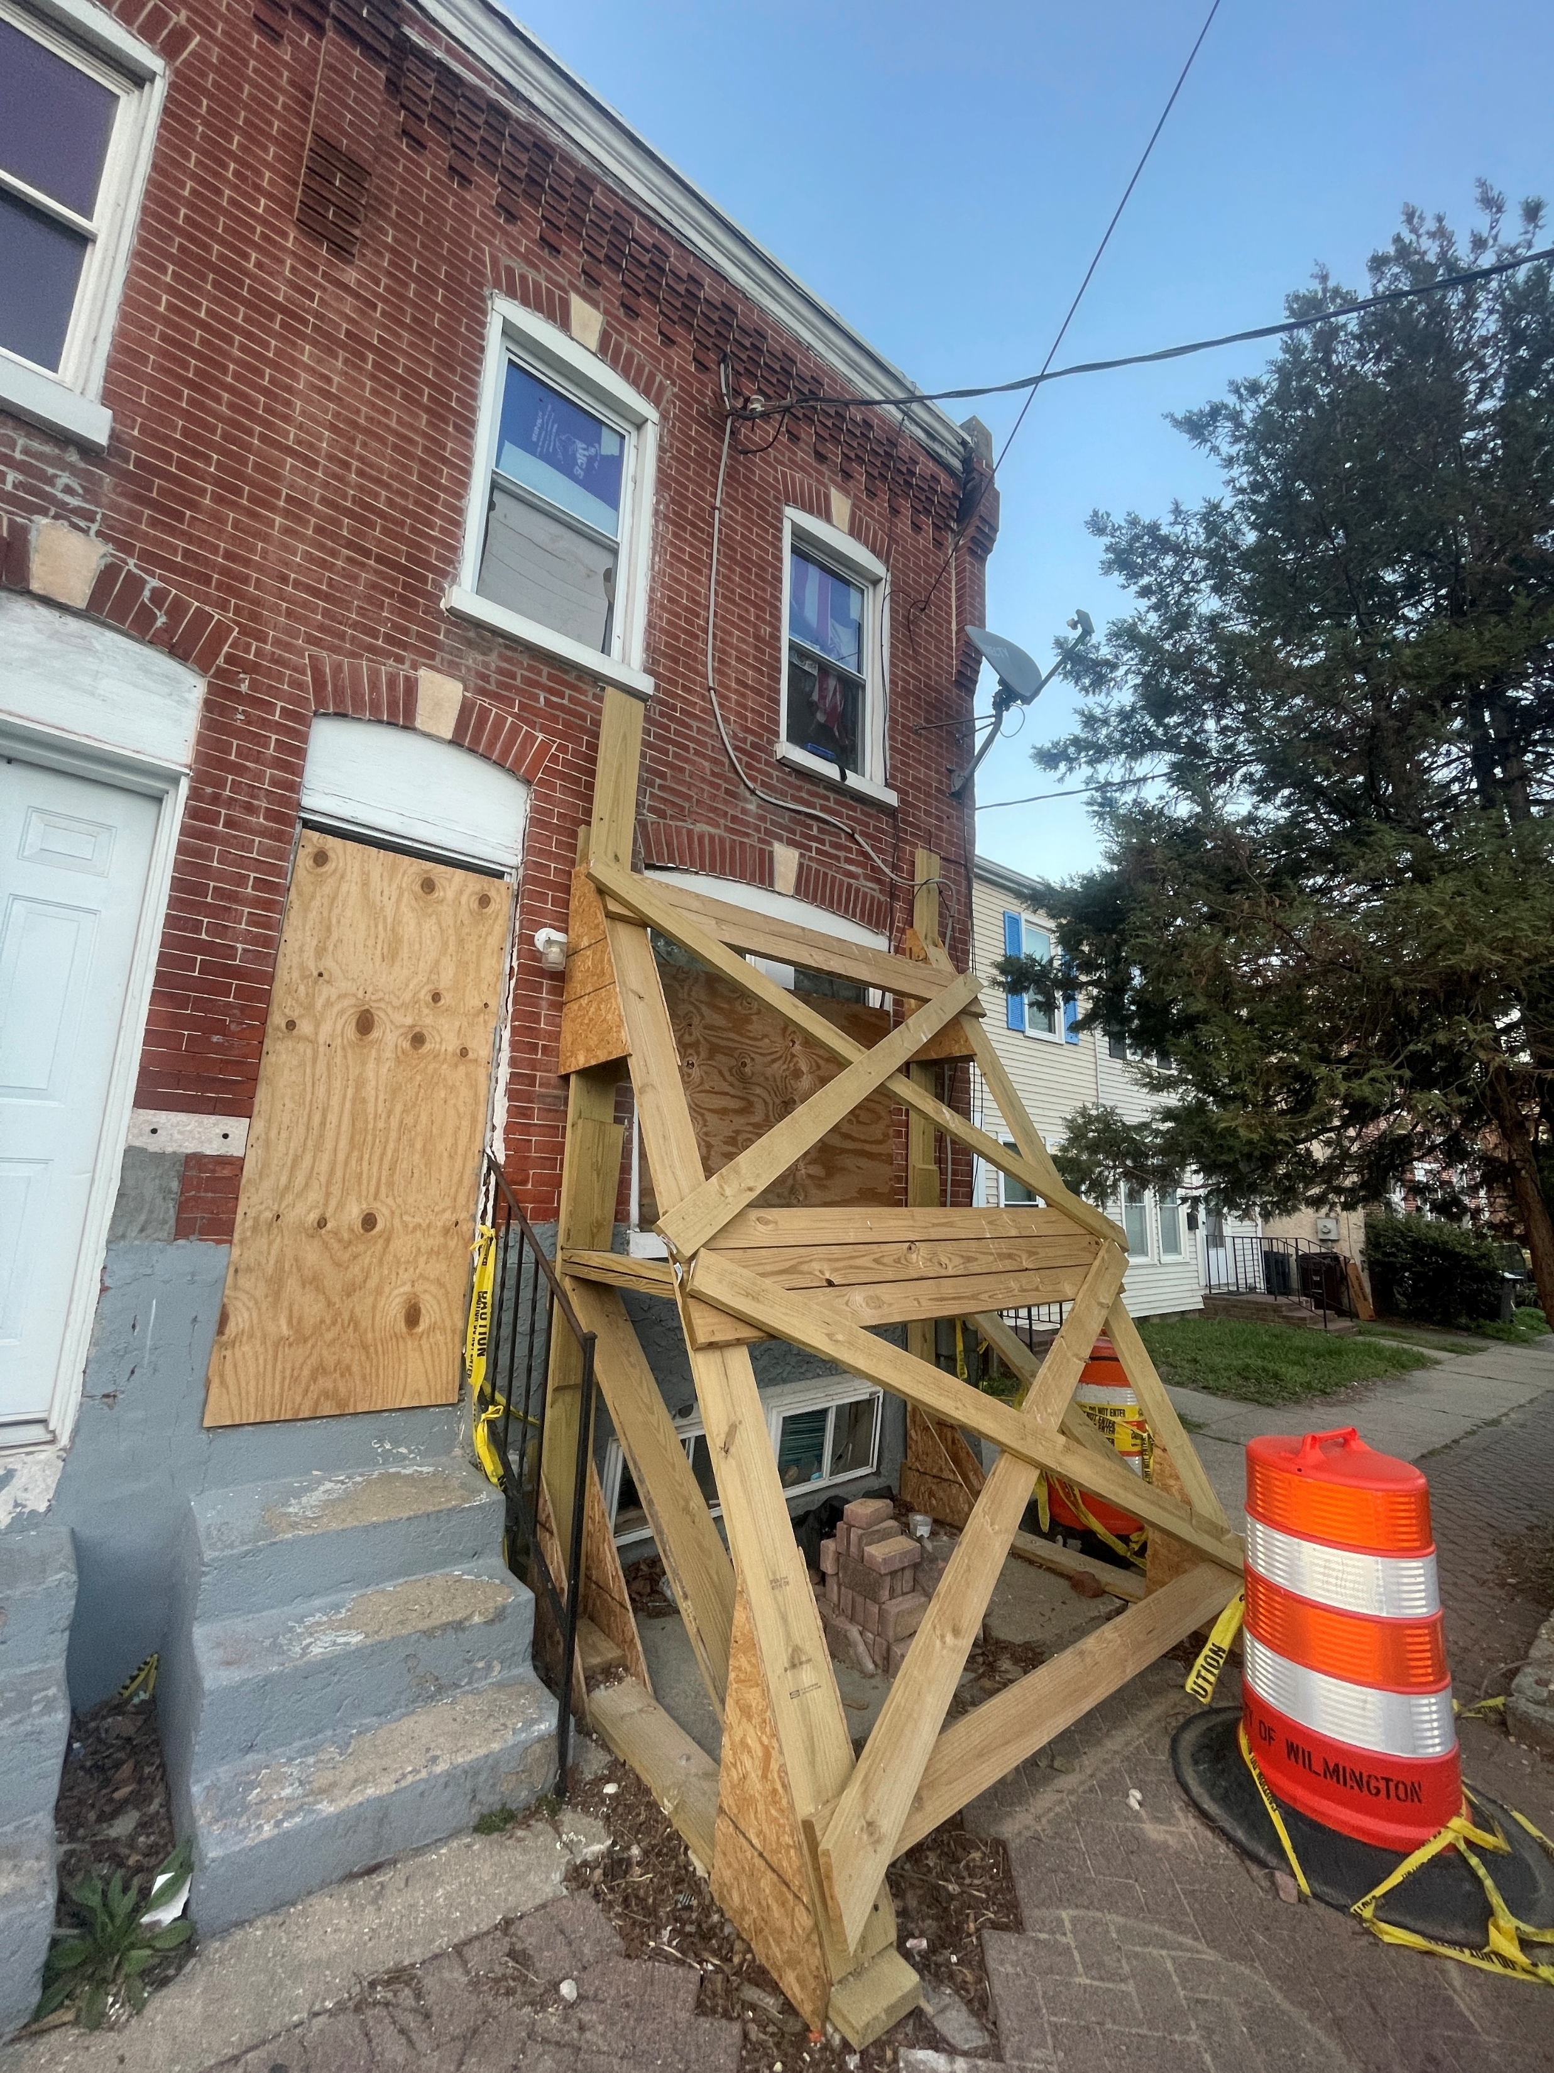
319 E THIRTEENTH STREET
*POTENTIAL DEMOLITION

Slide 46
Question 11
Please share the planned use for $124K for Technology Request.
  Salesforce Software, Forerunner Software.
  Share if there are adequate funding and resources for training, inclusive of GIS certification, etc.

Slide 47
Answer 11(a)
Salesforce - $100,000
Establishes a functional inspection and enforcement platform to manage daily operations.
Enables real-time tracking of inspections, violations, and permit status
Supports integration with Munis, improving efficiency and reducing manual processes
Creates the foundation to transition to a comprehensive permitting and inspection system
Notes:
Salesforce - $100,000
Inspection Tool Completion
Forerunner - $24,000
Floodplain Management Tool

Slide 48
Answer 11(a) continued
Forerunner - $24,000
Ensures compliance with FEMA and CRS (Community Rating System) requirements
Protects the City's existing flood insurance discounts for residents
Positions the City to gain approx. 900 additional CRS credit points, increasing savings for City residents

Slide 49
Answer 11(b)
Additional Training and Certifications are not specifically included. However, department staff have working knowledge of GIS platforms. Cross-training opportunities are utilized to grow the department’s ability to support in-house analysis.

Slide 50
Question 12
Provide an update on capital funds available for each of the Neighborhood Planning Councils (per NPC, per capital budget).
  Specify the last time NPCs were allocated any funding.
  Specify if the City has reallocated any funding from any of the NPC’s due to non-use, etc.

Slide 51
Answer 12 (a) - Update
District | Amount Allocated | Amount Spent as of June 2025 | Total FY2026 Approved Projects | Amount Remaining for Each District
1 | $350,000.00 | $(338,449.21) | $8,538.80 | $3,011.99
2 | $350,000.00 | $(294,801.80) | $0.00 | $55,198.20
3 | $350,000.00 | $(250,870.81) | $27,780.00 | $71,349.19
4 | $350,000.00 | $(237,514.12) | $7,675.00 | $112,485.88
5 | $350,000.00 | $(250,586.63) | $37,650.00 | $61,763.37
6 | $350,000.00 | $(307,470.91) | $20,450.00 | $22,079.09
7 | $350,000.00 | $(248,151.45) | $54,851.00 | $46,997.55
8 | $350,000.00 | $(329,941.79) | $0.00 | $58.21
TOTAL | $2,800,000.00 | $ (2,207,426.72) | $156,944.80
 | Amount Remaining as of 4/2026 | Amount Remaining in MUNIS as of 4/13/2023 |  | $385,270.93
*NPC Grant was last funded through the capital budget in 2014.

Slide 52
Answer 12 (b)
No additional funding has been allocated to the Grant for FY2027.

Slide 53
Question 13
Provide the FY2027 proposed organizational chart with the total number of employees (i.e., permanent, temporary, contract, vacancies). If there are multiple divisions, please ensure there are sub-org charts that enumerate all the above.
  a. Please include in the Org chart a photo of all Directors, Managers, Division Heads, and Supervisors.

Slide 54
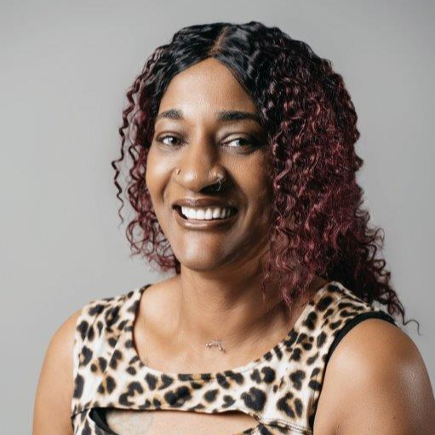
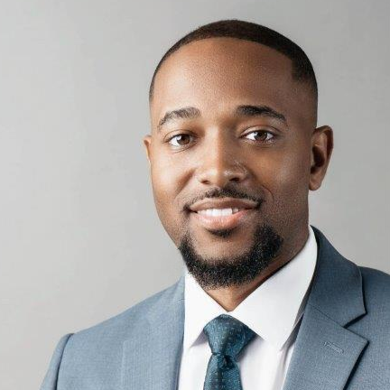
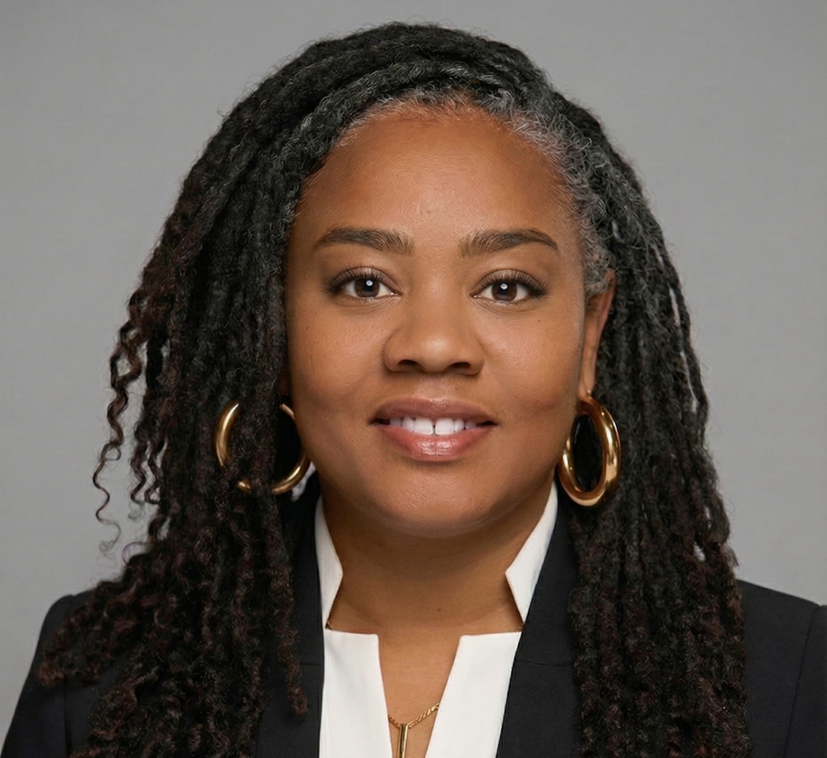
Alicia Laster
Admin Assistant II to the Director
Elliott Larkin
Director
Answer 13
Yvonne Flagg
Deputy Director
VACANT
Office Manager
Jim DiPinto
Zoning Manager
Gwinneth Kaminsky
Planning Manager
Karen Y. Torres
Administrative Clerk I
Grissell Ortega
Zoning Compliance Officer
Patricia Maley
Senior Planner/Design & Review
Ellis Blomquist
Building Inspector
VACANT
Plans Examiner
Phil Birk
Senior Planner II
Debra Shaw
Administrative Clerk I
John Kurth
Senior Planner III
Steve Bogino
Building Inspector
Dave Naples
Plans Examiner (Contractor)
Abdulrasheed Dawodu
Senior Planner II
Sasha Cabrera
Business Compliance Officer
Teri Strickland
Permit Coordinator
William Fasano
Planner II
Hugh Lindo
Building Inspector
Landon Jones
Planner II
Tanika Kellam
Permit Coordinator
Denzil Lamont
Building Inspector
Total Employees: |  | 31
 | Temporary: | 2
 | Contract: | 1
 | Vacancies: | 2
 | Out of Class | 3
Dorien Snyder
Planner I
Darlinda Oliver
Records Clerk
Jim Anderson
Building Inspector
Debra Martin
Preservation Planner
Darlene Johnson
Office Assistant III (Temporary)
Glenn E. Smith
Mechanical Inspector
Warrick Galbert Jr.
Mechanical Inspector

