Slide 1


FY 2027 Budget Hearing
MAYOR’S OFFICE

Slide 2
FY 2027 Proposed Budget
Summary of All Funds* | FY 2024 Actuals | FY 2025 Actuals | FY 2026 Budget | Proposed Budget FY 2027 | $ Change FY’27-26 | % Change FY’27-26
Personal Services | $3,401,647 | $3,742,894 | $3,632,512 | $3,865,137 | $232,625 | 6.40%
Materials, Supplies, and Equipment | 2,093,802 | 2,170,226 | 1,969,970 | 1,994,160 | 24,190 | 1.20%
Internal Services | 271,290 | 327,521 | 151,184 | 156,414 | 5,230 | 3.50%
Debt Service | 825,663 | 816,136 | 811,679 | 931,533 | 119,854 | 14.80%
Contingent Reserves | 0 | 0 | 672,000 | 672,000 | 0 | 0.00%
EMPG Grant | 194,797 | 213,486 | 149,299 | 88,325 | (60,974) | -40.84%
Total | $6,787,199 | $7,270,263 | $7,386,644 | $7,707,569 | $320,925 | 4.34%
Staffing Level (FTEs) | 26.0 | 25.0 | 26.0 | 27.0 | 1.0 | 3.85%
* Excluding Office of Economic Development

Slide 3
Major Funding Changes (Proposed Budget)
Personal Services (↑ $232,625)
Midyear FY 2026:
  Director of Community Safety (↑ $141,186)
FY 2027 budget:
  Temporary Salaries: Reduced admin support (↓ $24,000), Spanish-speaking temp in Constituent Services (↑ $35,000), coverage of vacant Emergency Management Planner in OEM (↑ $20,000)
  Vacant Emergency Management Planner adjustment (↓ $66,012 in both General and Special Funds)
Materials, Supplies, and Equipment (↑ $24,190)
Office of Community Safety: Consultants (↑ $60,000), Stationery And Supplies (↑ $3,000)
Other reductions: Contracted Maintenance (↓ $10,000), OEM electricity (↓ $10,000)

Slide 4
Question 1a
While understanding the implications of the property tax reassessment administered by Tyler Technologies to residential, small business, and commercial entities, please share if the proposed citywide budget addresses any funding or resources to aid with appeals and if this budget provides the necessary adequate measures to assist with any unwarranted financial implications.
Answer: Understanding the impact of the reassessment on our taxpayers, this budget contains no property tax increase. Instead, we have opted to balance the budget by using the Tax Stabilization Reserve. We are also processing abatements through the Senior and Disabled Tax Exemption program and Councilmember Harlee’s Property Tax Abatement for Low-to-Moderate Income Long-Term Homeowners. We will also continue to offer grants to assist residents in filing appeals with the New Castle County Board of Assessment Review through the existing program.

Slide 5
Question 1a
Specify the impact for the Property Tax Abatement Program (Low-to-Moderate Income, Long-Term Homeowners) and share the number of applicants submitted thus far.
Answer: 10 applications have been submitted so far. The applications are still being processed, but we should be able to share the impact next week.

Slide 6
Question 1b
Specify the number of applicants that submitted for grant assistance for appeals and share the amount of funds available from the $75K allocation.
Answer: We are still in the process of securing a contract with a third-party organization to administer this program. We expect to be underway before the next appeal cycle.

Slide 7
Question 1c
Since there were not any bids submitted for the RFP regarding interior assessments, please share if this budget addresses any funding set-asides, and if NCC is supportive for interior assessments.
Answer: As we did not receive any responses to the RFP, we have begun reaching out directly to firms that might be interested in performing the work. New Castle County has indicated that they will work with us to adjust the assessment if we are able to hire an expert to conduct the validation.

Slide 8
Question 1d
Specify the potential impacts of recent state legislation on the 2025-2026 property tax valuations and billing, such as SB 228 AN ACT TO AMEND TITLES 9 AND 14 OF THE DELAWARE CODE RELATING TO COUNTY ASSESSMENTS AND TAX COLLECTION, which would give the county the authority to conduct quality control reviews after a general assessment.
Answer: SB 228 enabled New Castle County to make revisions and corrections to the tax roll. This will allow NCC to work with our expert to improve the overall assessment.
Explain how this proposed budget accounts for contingencies in the 2025-2026 property tax revenues and going forward.
Answer: We anticipate an overall reduction to our property tax base due to property tax appeals. The revenue projections reflect that reduction.

Slide 9
Question 2a
Considering the city has ~$74M in the Tax Stabilization Reserve Fund (per FY25 ACFR), and notwithstanding that its good financial prudence or the “rule of thumb” to have a minimum of 25% of the budget in the Tax Stabilization reserve, please share the rationale for the unprecedented draw down of $24M.
Answer: The 25% rule of thumb applies to total fund balance. The mid-year total fund balance was about $99 million, so we will still be left with a healthy 35% balance in total reserves after this infusion.
This draw-down represents a necessary investment in affordable housing and economic development. These are one-time funds that we believe will have significant return on investment for the quality of life of our constituents.

Slide 10
Question 2b
Specify the return on investment of $16.8M for the Affordable Housing Subsidy, and projected timeframe for ROI.
Answer: We anticipate the creation of close to 200 new units at various levels of subsidy over the next 10 years. These units will be both homeownership and rental.
Specify the return on investment of $2M for Vacant Lots, and projected timeframe for ROI.
Answer: The Land Bank has over 150 vacant lots in their portfolio. Our goal is to leverage innovative design and zoning techniques to develop these lots into additional housing. The total number of units created is subject to availability of vacant lots. This will include subsidy for water/sewer connections.

Slide 11
Question 2c
With 5-year projections showing expenditures far outpacing revenues each year, share the rationale for the draw down, and or is it the opinion that it’s prudent to draw down due to the amount in the Tax Stabilization Reserve Fund far exceeds the 25% “rule of thumb”.
Answer: As stated above, there will still be $75 million in total fund balance following this draw-down, which is 35%. We believe this is sufficient and that the return on investment outlined in the previous slide is worth the investment.

Slide 12
Question 3
Discuss any current vacant positions.
Answer:
Director of Community Safety; vacant since 3/5/26, ASAP
Constituent Services Officer; vacant since 12/22/25; ASAP
Emergency Management Planner; vacant since 7/1/25; being offset by attrition due to uncertainty of federal EMPG funding.
Specify if position generates revenue, and if so, estimated amount.
Answer: None of the above positions are revenue generating.

Slide 13
Question 4
Discuss any proposed changes to positions (new position, deleted position, upgrade, realignment, transition, downgrade, title change, salary changes, etc.).
Answer: N/A

Slide 14
Question 5
Discuss how this budget meets the priorities of having an inclusive community. Specify how it supports the needs of vulnerable populations, including seniors, those with disabilities, and the immigrant populations, etc.
Answer:
The budget is grounded in and reflects the diversity of our city and the priorities we hear from across Wilmington. It is focused on balancing current budget realties with long-term investments to maintain the City’s vitality. Because of that focus, this budget does not include a property tax increase. This is because we know many residents were hit with natural increases following reassessment and, because of that, we responsibly accessed our large budget reserve to balance the budget. This helps ensure our vulnerable populations are not paying more property taxes within our control. We funded our home repair lottery, the senior tax abatement, and the tax abatement program sponsored by Councilperson Harlee in this budget.
We also included additional funding to extend the hours worked by our Spanish-speaking Constituent Services temporary employee. In addition, we are working to update our website to improve usability and accuracy. As part of that effort, we will be converting our PDF forms to meet accessibility standards and translating our forms into Spanish.

Slide 15
Question 6
Discuss whether this budget provides the necessary funding, resources, and training for 311 to ensure that all staff are adequately trained in how to best assist with calls for service, etc.
Answer: Yes – Project Cornerstone, the City’s new employee training, evaluation, and professional development platform, is scheduled to go live in July. We will now be able to better manage and schedule 311 trainings and track our employees’ progress. Metrics related to customer service and 311 response time will also be integrated into our employee evaluations.
We are also working to update our Knowledge Base (KB), the document our call takers use to answer questions and route cases to City staff. We are looking at ways of integrating AI to make the KB more user friendly and easier to search.
We will also be making improvements to the City’s website to improve usability and accuracy. This should allow us to make future improvements, such as integrating a chatbot.

Slide 16
Question 6
Specify the average daily calls to 311, and average response time for completion of the request submitted.
Average Case Age in Days, February 2026
Constituent Services | 0.3
Economic Development | 6.7
Finance | 7.3
L&I | 2.4
Land Use | 22.5
Parks & Recreation | 6.1
Planning & Development | 19.4
Public Works | 192.0
Real Estate & Housing | 1.3
Cultural Affairs | 42.0

Slide 17
Question 6
b. Any plans for technology that can best assist constituents or improve operational efficiency such as an app.
Answer: Yes, we have $125k set aside in the IT budget for 311 technology improvements. This will be enough to make the improvements requested in CM Spadola’s resolution, along with exploring a citywide app.
c. Specify funding allocated for 311 services.
Answer:
Salesforce Licenses: $259,000
Call Center: $500,000
Development: $125,000

Slide 18
Question 7
Please share if this budget provides adequate funding or resources to promote, advertise, and market all areas of Wilmington as a place for people and business to come visit, work, or live.
Specify if any budgeted funding or resources allocated.
Answer: The 250th celebration will be the perfect opportunity to showcase everything Wilmington has to offer. $800k was set aside in the recent budget amendment for this purpose.

Slide 19
Question 8
Discuss the planned use of ~$515K budgeted for Grants to Agencies in the Admin. Division.
Specify if any reoccurring grants.
Share the process for how organizations can submit for grant funding.

Slide 20
Question 8 Answer
Use of Grants to Agencies | Proposed FY 2026 Budget Amount
Wilmington Hope Commission | $135,000
Wilmington Economic Development Corp. | $50,000
Wilmington Library | $50,000
WECEC | $17,000
Wilmington Jaycees | $10,000
HBCU Week Foundation | $200,000
Parades & Festivals | $25,000
Annual Small Grants | $20,000
Tickets & Sponsorships | $8,000
All large grants are reoccurring.
Grant requests must be submitted in writing to the Mayor’s Office.

Slide 21
Question 9
Discuss the planned use for $475K budgeted in the Miscellaneous Project account line in the Cultural Affairs Division, and please share if this budget provides adequate funding and resources for the various cultural festivities throughout the city such as but not limited to: Clifford Brown Jazz Festival, July 4th Celebration, Juneteenth, 250th Celebration, etc.
Specify funding budgeted.
Specify any fees charged and revenues collected for annual festivities.
Share if any collaborations or sponsors.

Slide 22
Question 9 Answer
Use of Funds:
Supports major City events, including the Clifford Brown Jazz Festival, July 4th, Juneteenth, and 250th initiatives
Supports expanded programming at the Urban Artist Exchange, including concerts, the MANE Gallery, and dance programming featuring nationally recognized companies such as Urban Bush Women, a groundbreaking ensemble rooted in Black women’s stories and movement traditions, and Step Afrika!, the acclaimed company that celebrates the African American tradition of stepping
Covers production costs such as labor, staging, audio/video, security, and sanitation
Supports increased artist fees and hospitality costs
Juneteenth: supports planning and partnerships with existing organizations
250th: supports activities beyond signature events, including Arts Work youth projects and field trips

Slide 23
Question 9 Answer
Funding Adequacy:
Supports continued delivery and modest growth
Rising costs for labor, equipment, and artists continue to outpace base funding
External support remains important

Slide 24
Question 9 Answer
Fees and Revenues:
All major events remain free to the public
Clifford Brown Jazz Festival: limited vendor and merchandise revenue
July 4th Celebration: vendor fee revenue
Juneteenth: no City revenue is generated; vendor and related revenue, if any, supports partner organizations
UAE programming: primarily free, with occasional nominal fees

Slide 25
Question 9 Answer
Collaborations and Sponsorships:
Partnerships with community and cultural organizations support programming
Foundation, grant, and in-kind support contribute to selected initiatives
Clifford Brown Jazz Festival sponsorship is pursued annually, but is not guaranteed and has become less dependable
City funding remains essential to sustain free and accessible public events

Slide 26
Question 10
Share the planned use for ~$387K budgeted for Consultants (excluding OED), up $63.5K.
Specify vendor name, length of contract, and purpose.
Specify if there are any DBE’s.

Slide 27
Question 10a Answer – Mayor’s Office Admin
Use of Professional Services Funds | Vendor | Length | Purpose | Proposed FY 2026 Budget Amount
Lobbyist | Maven Strategies LLC | Annual | Represent City’s interests at State Legislature | $46,000
Miscellaneous Consulting Services | TBD | TBD, up to 1 year | As needed | $50,000
Total: |  |  |  | $96,000

Slide 28
Question 10 – Cultural Affairs
Use of Funds:
Proposed budget: $221,000 (up $3,500)
Supports specialized services needed for program delivery and production
Supports artistic, technical, and program expertise

Slide 29
Question 10 – Cultural Affairs
Key Consultants
Flux Creative Consulting: annual contract; creative, production, and program support
TAHIRA: program-based agreement; Wilmington Black Storytelling Residency
MANE Gallery consultant, currently in negotiation: curatorial and programming services
Additional consultants, as needed: stage managers, production specialists, and teaching artists
Includes Clifford Brown Jazz Festival artist travel entourage support

Slide 30
Question 10 – Cultural Affairs
DBE Participation
Primary consultants are minority-owned or minority-operated small businesses
Continued commitment to DBE and local vendor engagement

Slide 31
Question 11
Please share the amount of funds expended year to date from the $500K Contingent Reserves account line.
Beginning FY 2026 Contingency Fund Balance |  |  | $500,000
Date | Item | Fund and Dept Transferred To | Amount
7/30/2025 | Temporary EMT Field Training Officers | Fire - Suppression | (38,754)
9/23/2025 | Biohazard waste removal and pressure washing of the Front & Poplar Street bridge area | Mayor's Office - Admin | (30,000)
9/23/2025 | Contract with Event Allies to plan the 250th Celebration | Mayor's Office - Admin | (25,000)
9/24/2025 | Non-School-Based Educational Program Landscape Analysis | Mayor's Office - Admin | (50,000)
12/11/2025 | Biohazard clean-up at Christina Park | Mayor's Office - Admin | (60,000)
2/18/2026 | 250th Celebration funding for City Council | City Council | (15,000)
3/6/2026 | Temporary fencing at Eastlawn Park | Parks - Maintenance | (58,100)
3/17/2026 | Additional gardening plots at Rodney Reservoir Park | Parks - Maintenance | (13,200)
TOTAL |  |  | ($290,054)
Current Contingency Fund Balance |  |  | $209,946

Slide 32
Question 12 (Office of Community Safety)
Considering that City Council launched the Community Policing Safety Initiative (CPSI) in FY2023, and now this newly created office is seeking to establish something similar, please share if this proposed budget provides adequate funding for Network Connect and the Center for Structured Equity for the time period of January 1, 2027 to June 30, 2027 (please explain why or why not).
Answer: The CPSI is currently funded by ARPA, which expires on December 31, 2026. Unfortunately, the CPSI is too expensive to include in the City’s operating budget. The current annual cost is $1 million, which would be equivalent to a 2.5% tax increase.
Using the MS&E budget of the new department, we are engaging a grant writer who will be tasked with finding alternative revenue sources for this important program.

Slide 33
Question 13 (Office of Community Safety)
Please share if there are any mini-grants or other resources allocated in this budget for support of the community violence prevention and intervention activities (please explain why or why not).
Answer: Not at this time. This office will be applying for grants to support these activities.

Slide 34
Question 14 (Office of Community Safety)
Discuss if this budget addresses plans for consideration of expanding CPSI to other parts of the City related to hotspots (please explain why or why not).
Answer: Yes, the Director of Community Safety will be tasked with developing a strategy to expand the CPSI citywide to address hotspots.

Slide 35
Question 15 (Office of Community Safety)
Executive Order 2026-05 states that the Office of Community Safety will enhance coordination between City departments and strengthen governmental and community partnerships. Discuss any budgetary implications for planned coordination and partnerships.
Answer: These activities will require hard work, dedication, and diplomacy by the new Director, but not funding beyond what we’ve included in the MS&E budget.
Specify if there is any potential consideration for partnership with GVI.
Answer: Absolutely. This Office will be partnering with GVI on a strategic (but not monetary) level.
b. Specify if budget allocates necessary resources to assist with the Incident Response Team.
Answer: This budget includes funds for a Director and limited MS&E for a grant writer and other coordination activities. All other support will be nonmonetary.

Slide 36
Question 16 (Office of Community Safety)
Discuss the plans for this Office to collaborate with WPD regarding matters such as oversight of the Wilmington Community Police Accountability Board.
Specify any funding allocated while understanding $30K is in WPD’s budget for the WCPAB.
Answer: Funding for the WCPAB will remain at the same level as FY 26. The Director of Community Safety will provide all necessary administrative support for the Board.

Slide 37
Question 17
Provide FY2027 proposed organizational chart with the total number of employees (i.e. permanent, temporary, contract, vacancies).
Provide FY2027 proposed organizational chart with the total number of employees (i.e. permanent, temporary, contract, vacancies.
If there are multiple divisions, please ensure there are sub-org charts that enumerate all the above.

Slide 38
Mayor’s Office
Organizational Chart

Slide 39
Mayor’s Office Admin (10 FTEs)
& Constituent Services (6 FTEs)
MAYOR
CHIEF OF STAFF
SPECIAL ASSISTANT TO THE MAYOR
DIRECTOR OF SPECIAL PROJECTS
DEPUTY COS
OPERATIONS
DEPUTY COS
POLICY & COMMUNICATIONS
DIRECTOR OF OPERATIONS
SR CONSTITUENT SERVICES OFFICER
DIRECTOR OF COMMUNICATIONS
MAYOR’S OFFICE RECEPTIONIST
311 ADMINISTRATOR
CONSTITUENT SERVICES OFFICER (2)
DEPT. DIRECTOR OF COMMUNICATIONS
SPECIAL ASSISTANT FOR COMMUNITY ENGAGEMENT (2)

Slide 40
Cultural Affairs (3 FTE)
DIRECTOR OF CULTURAL AFFAIRS
ARTS PROGRAM ADMINISTRATOR
EVENTS PERMITTING AND SPECIAL PROJECTS ASSISTANT

Slide 41
Office of Management & Budget (5 FTE)
BUDGET DIRECTOR
ASSISTANT BUDGET DIRECTOR
FISCAL & OPERATIONS
ANALYST (3)

Slide 42
Office of Emergency Management (2 FTE)
EMERGENCY MANAGEMENT DIRECTOR
EMERGENCY MANAGEMENT PLANNER

Slide 43
Office of Community Safety (1 FTE)
Director of Community Safety

Slide 44
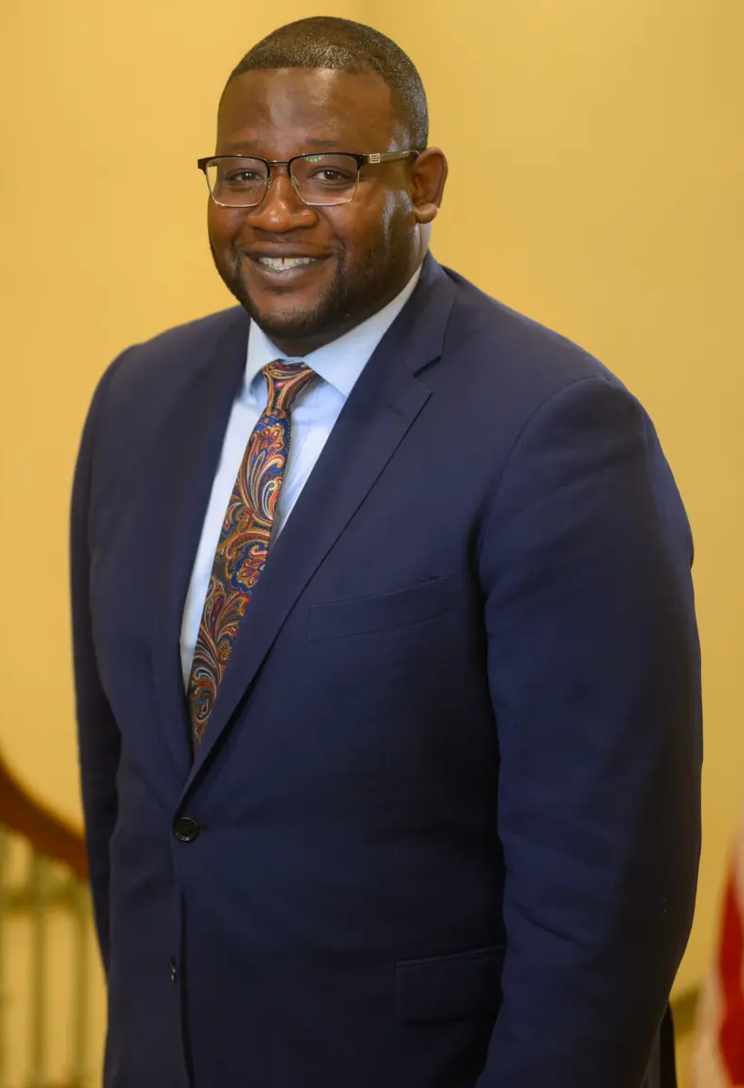
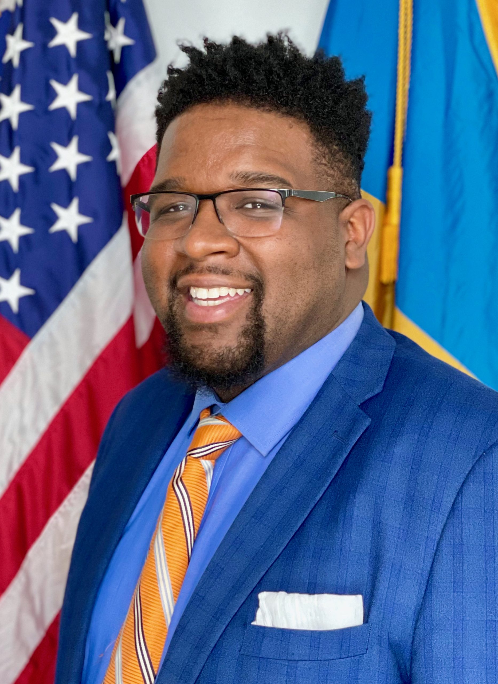
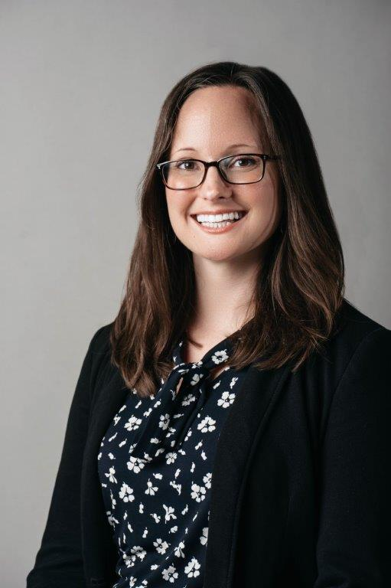
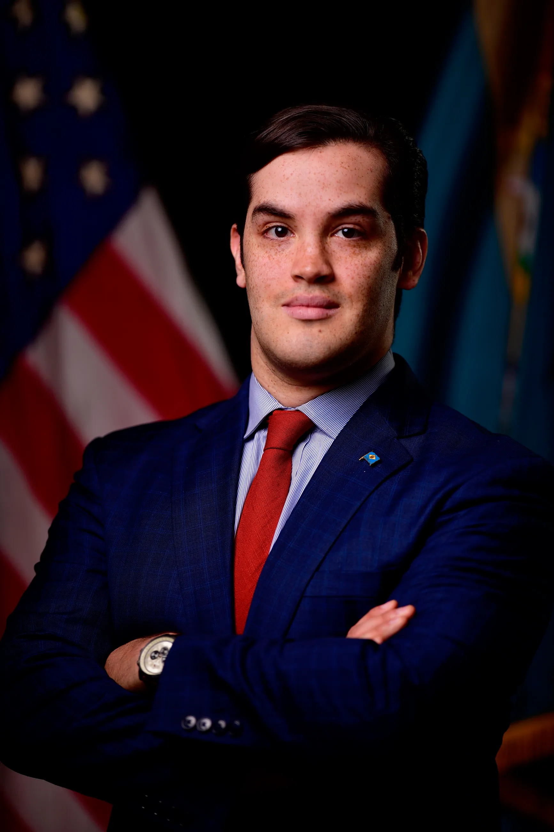
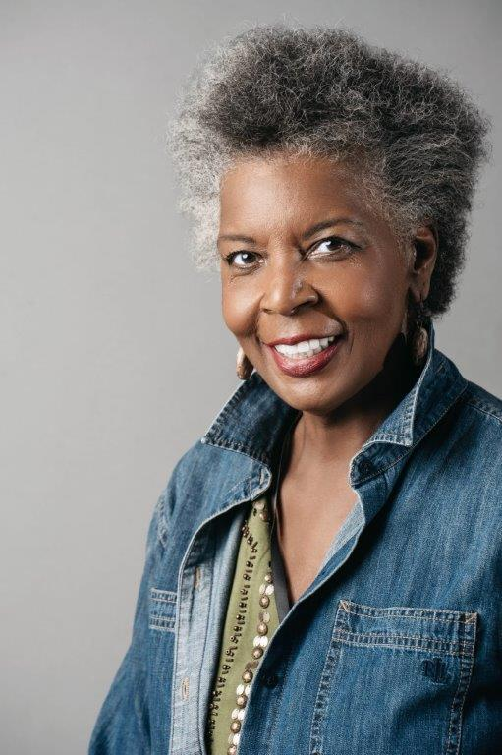
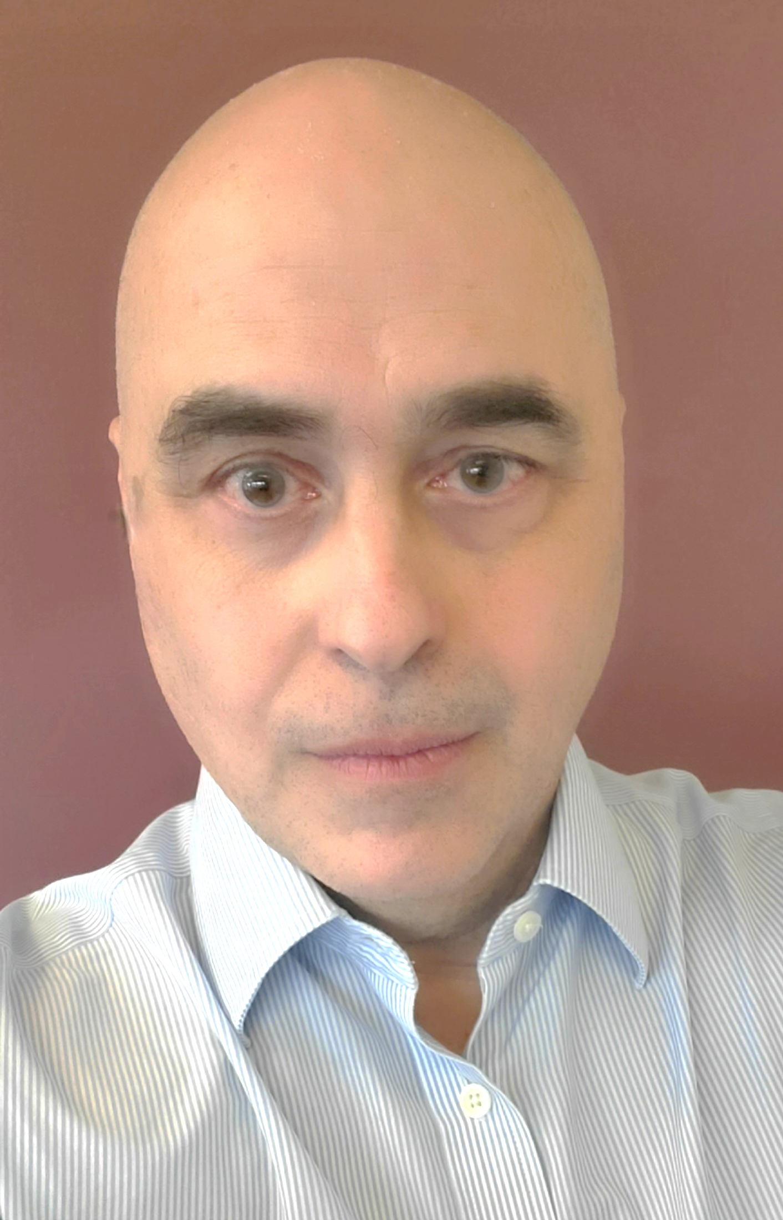
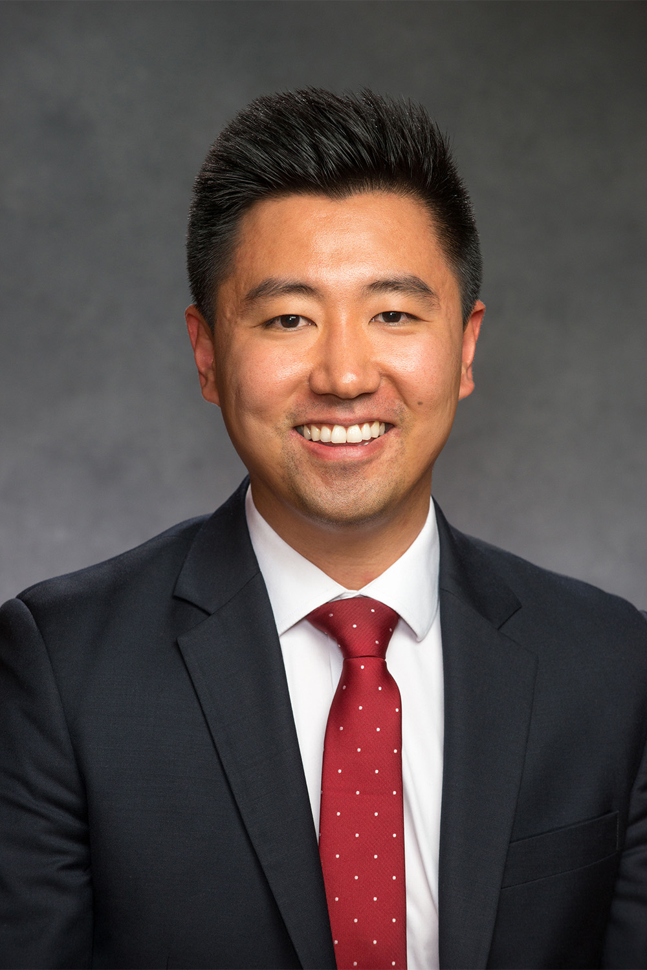
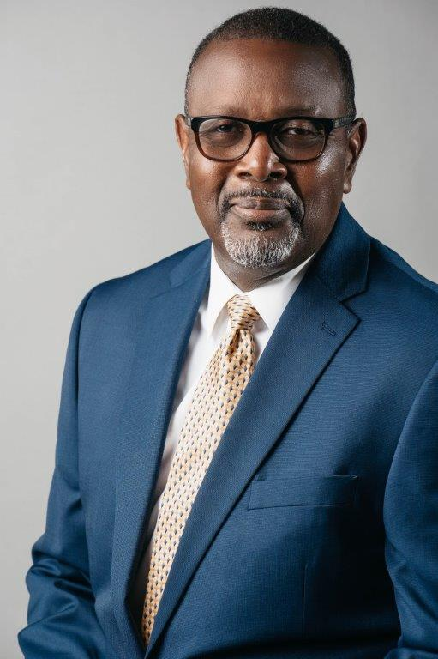
Mayor’s Office Senior Staff
Cerron Cade
Chief of Staff
Daniel Walker
Deputy Chief of Staff – Policy and Communications
Stephanie Mergler
Deputy Chief of Staff – Operations
Javier Horstmann
Director of Special Projects
Tina Betz
Director
Office of Cultural Affairs
Rob Greco
Director
Office of Management and Budget
Sean Park
Director
Office of Economic Development
Willie Patrick
Director
Office of Emergency Management

