Slide 1


FY 2027 Budget Hearing
PARKS & RECREATION

Slide 2
All Funds (General and Special Funds) – FY 2027 Proposed Budget
Parks & Recreation Department | FY 2024 Actuals | FY 2025 Actuals | FY 2026 Budget | Proposed Budget FY 2027 | $ Change FY’27-26 | % Change FY’27-26
Personal Services | $4,977,721 | $5,709,199 | $7,032,649 | $7,413,916 | $381,267 | 5.4%
Materials, Supplies, and Equipment | 2,733,419 | 2,745,669 | 2,635,645 | 2,497,371 | (138,274) | -5.2%
Internal Services | 1,524,727 | 1,818,486 | 1,341,467 | 1,394,040 | 52,573 | 3.9%
Debt Service | 2,969,211 | 2,875,996 | 2,937,209 | 2,356,946 | (580,263) | -19.8%
Total | $12,205,078 | $13,149,350 | $13,946,970 | $13,662,273 | (284,697) | -2.0%
Staffing Level (General Fund FTEs) | 40.60 | 39.60 | 38.60 | 42.60 | 4.00 | 10.4%
Staffing Level (Special Funds FTEs) | 0.40 | 0.40 | 1.40 | 1.40 | 0.00 | 0.0%
Staffing Level (All Funds FTEs) | 41.00 | 41.00 | 40.00 | 44.00 | 4.00 | 10.0%

Slide 3
General Fund – FY 2027 Proposed Budget
Parks & Recreation Department | FY 2024 Actuals | FY 2025 Actuals | FY 2026 Budget | Proposed Budget FY 2027 | $ Change FY’27-26 | % Change FY’27-26
Personal Services | $4,150,175 | $4,881,649 | $5,654,184 | $6,035,451 | $381,267 | 6.7%
Materials, Supplies, and Equipment | 1,545,151 | 1,557,404 | 1,740,273 | 1,601,999 | (138,274) | -7.9%
Internal Services | 1,522,272 | 1,816,031 | 1,338,951 | 1,391,524 | 52,573 | 3.9%
Debt Service | 2,969,210 | 2,875,996 | 2,937,209 | 2,356,946 | (580,263) | -19.8%
Total | $10,186,806 | $11,131,078 | $11,670,617 | $11,385,920 | (284,697) | -2.4%
Staffing Level (General Fund FTEs) | 40.60 | 39.60 | 38.60 | 42.60 | 4.00 | 10.4%

Slide 4
Major Funding Changes (General Fund Proposed Budget)
Personal Services expenses: (↑ $381,267)
  Positions Changes:
    Added: (2) General Laborer I (↑ $147,476 total)
    Added: General Laborer III (↑ $80,562)
    Added: Small Engine Mechanic (↑ $97,707)
    Added: Pool & Maintenance Mechanic (↑ $92,907)
    Added: Equipment Operator (↑ $88,467)
    Eliminated: (2) Labor Foreman I (↓ 153,099 total)
  Temporary Salaries (↓ $164,863)

Slide 5
Major Funding Changes (General Fund Proposed Budget)
  MS&E : (↓ $138,274 )
    Temporary Agencies (↓ $68,500)
    Consultants (↑ $23,000)
    Miscellaneous Charges – N.O.C. (↑ $13,300)
    Contracted Repairs – Miscellaneous (↓ $32,993)
    Maintenance Services (↓ $25,000)
    Recreational Equipment (↓ $14,000)
Debt Service (↓ $580,263 )

Slide 6
Department Mission and Vision
The mission of the Department of Parks & Recreation is to preserve and enhance urban parklands through environmentally safe practices. This includes maintaining clean, safe, trash free and sustainable parks that encourage residents to engage with the beauty of nature. The department is committed to providing comprehensive programming that supports the overall wellness of city residents. Additionally, the Parks & Recreation Department aims to offer a variety of recreational, social, cultural, employment, and educational opportunities to all city residents.
Our vision is to create an inclusive and vibrant community where every resident can thrive, regardless of age or physical limitations in safe and clean parks that are environmentally sustainable. We aspire to be a beacon of holistic wellness, offering diverse recreational, social, cultural, employment, and educational opportunities that enrich the lives of all city residents.

Slide 7
Question 1
Understanding the 5-year revenue and expenditure projections show expenditures far outpacing revenues for FY27 to FY30, and FY27 General Fund Proposed Budget uses $25.7M of the Tax Stabilization Fund, please share how this budget aligns with closing any potential budget gaps.
In developing the FY 2027 budget, we were intentional about aligning with the Mayor’s budget guidance while also being mindful of the long-term structural outlook, particularly as expenditures are projected to outpace revenues in the coming years. To help close the budget gap, the Department implemented targeted cost-saving measures across multiple areas. We reduced temporary salaries by approximately $164,000 by transitioning the nutrition program back to grant funding, which lowered the burden on the General Fund. We also reduced MS&E by over $168,000 across professional services, contracted maintenance, equipment, rentals, and other operational lines. These actions allowed us to right-size our budget and establish a more sustainable baseline moving forward.
At the same time, we were very deliberate about protecting core services, particularly those serving children and young adults. Our approach reflects a balance between immediate fiscal responsibility and maintaining essential services that directly impact clean and sustainable parks, youth engagement, safety, and development of recreational, educational and cultural programs

Slide 8
Question 1a, 1b, and 1c
Specify any cost savings or reductions, and if this budget provides adequate resources to meet the departmental needs.
The department has implemented significant cost-saving measures across multiple areas of the budget.
  Reduced temporary salaries by $164K, with total savings of ~$176K including taxes
  Decreased MS&E by over $168K across multiple operational areas
  Strategic reductions made without compromising core services
  Overtime increased to support expanded programming and park maintenance
  Budget sustains current operations, but future growth will require additional investment
b. Specify any high-level major additions.
  The Parks Department is seeking to realign two maintenance positions to modernize outdated titles and better align with operational needs. We are also requesting two new laborer positions, a pool maintenance mechanic, and an additional LSE position to strengthen capacity within the Youth and Families Division.
c. Justify the new passenger van vehicle
  Transportation is currently the biggest barrier to program access
  Enables consistent participation in workforce, educational, and enrichment programs
  Strengthens citywide programming, not just one center
  Maximizes existing investments in youth services by ensuring access
  Positions the City to meet increasing demand without turning youth away

Slide 9
Question 2a and 2b
Specify plans for the unhoused for use of this park (cost, projected timeframe for use of the park).
The City of Wilmington has contracted with the Friendship House to manage the Christina Park temporary initiative. The current contract runs from January 5, 2026 to June 30, 2026. The current contract is for $218,400. There have been additional costs:
  Portable toilet rental and cleaning (5): $3,030 per week
  Emergency purchase of tarps (45): $3,757
  Additional tarps (75): $933
  Original Tents (105): $4,095
  Improved Tents (49): $6,932
  Custom-built platforms from Challenge Program: $54,373 ($20,700 labor, $33,673)
  Biohazard waste removal (Lewis Environmental): $12,573 ($47,427 remaining encumbered)
  Permanent bathroom: $59,750. Delivery and installation expected in August.
Specify any plans for locating the unhoused to different site location.
Christina Park was already used as the unofficial designated site when the decision was made following the taskforce’s recommendation. There are no other plans for a tent site once the temporary timeframe of the Christina Park initiative is met.

Slide 10
Question 2c
c. Share all vendors and any partnerships for services that the city is using or in the pipeline for the unhoused in Christina Park. Any plans for Springboard Delaware, etc.
The only official city vendor is the Friendship House. However, they have created a service calendar for non-profits to provide services at Christina Park.
  The Bridge Clinic
  Brandywine Counseling
  1 and 7B Foundation
  Community Partner Support Unit
  St. Francis Mobile Health
  Gibney Mobile Health
  Network Connect
  Wilmington Housing Authority (housing navigators)
We also have the Wilmington Police Department's Partners in Care which focuses on case management from a clinical perspective.

Slide 11
Question 2d, 2e, and 2f
Share the plans for $50K budgeted in Community Services account line regarding the unhoused and the displaced foster care for youth.
The Street Ministries Food Program provides a hot breakfast, mental health and substance abuse referral services to displaced adults every Saturday morning from 7am-10am. This program is a pillar to individuals in need of a meal and sense of community. While the program doesn’t have a set number of measurable outcomes, the program garners about 60-70 participants weekly.
One Step at a Time Foundation provides educational and cultural programming for youth in the foster care system, many of whom have experienced displacement. The program includes educational enrichment such as tutoring, reading, and STEM activities, along with arts and crafts and cultural field trips. The organization is responsible for submitting monthly reports on demographics and attendance, as well as quarterly progress reports that track educational outcomes and growth. Parks and OSAAT are currently exploring options to restructure funding, including a potential RFP process and/or supporting OSAAT in delivering after-school programming at an alternate site in Wilmington. As a result, the $40,000 included in this budget request may not be allocated entirely to OSAAT.
e. Share any plans for a new site location for the unhoused (site location, cost, projected timeframe, etc.)
We are currently in conversations with Springboard Delaware about building a pallet village similar to the one currently operating in Georgetown. Those conversations are ongoing.
f. Share the plans and funding commitment for the Friendship House.
Please reference response to Question 2a

Slide 12
Question 3a and 3b
Considering that William Hicks Anderson Community Center (W.H.A.C.C.) is the city’s only Community Center and is classified as an Emergency Shelter Site, please share if this budget provides the necessary resources and funding to best address the needs of the community.
Specify if any Public/Private Partnerships for programming and share if any current partnerships with existing youth centers.
  The city currently has partnerships with the following community centers
  PAL-Wilmington
  MSK Community Center
  The Community Education Building & The New Community Education Youth Development Center
  The department has several program partnerships with organizations like Wow Science, Kai Coders, Code Differently, Natural Glow Self Love Club and a host of employer partners for the Youth Career Development (YCD) program
Specify if the site location is a safe haven site, and if so, please share the operational hours, and programs.
  Yes, WHACC is a Safe Haven Site
  Save Haven runs from July-September yearly, through a grant provided by the Division of Services for Children, Youth & Their Families (DSCYF)
  Safe Haven Schedule
    Tuesday: 6:00 p.m. – 11:00 p.m.
    Wednesday, Thursday, Friday: 6:00 p.m. – 10:00 p.m.
    Saturday: 2:00 p.m. – 5:00 p.m.

Slide 13
Question 3c
Specify if budget provides the necessary resources for equipment, computer lab, gym, pool, boxing facility, etc. at this site
The current budget adequately supports day-to-day operations across the equipment, computer lab, gym, pool, and boxing facility. However, to fully maximize the site’s impact and modernize the space, additional funding for a comprehensive renovation of WHACC would be beneficial.
The current budget allows us to operate. A renovation would allow us to elevate.

Slide 14
Question 4a and 4b
  Understanding the limitations of Federal Grant Funding, please share if this budget realigns any services and fills grant funding shortfalls to best ensure that city youth and seniors are not impacted as reasonably as possible.
Specify number of participants for the summer/evening feeding program for the last 2 years.
2024-2025 - SFSP – 94,501
2025-2026 – SFSP – 110,000
2024-2025- CACFP -131,629
2025-2026- CACFP – 61,917
  Share the success for the feeding program.
Through our expanded partnership with the Community Education Building, the City of Wilmington Nutrition Program continues to grow its reach and impact. We anticipate approximately 60 partner sites, including camps, daycares, community centers, and parks, participating in the Summer Food Service Program, with over 110,000 meals served, including breakfast, lunch, and supper at select locations. This partnership has allowed us to provide fresh, hot, and more nutritious meals, including daily fresh fruit, which has resulted in strong satisfaction across sites. Additionally, we have expanded access by increasing participation at community and afterschool sites through both the Summer Food Service Program and the Child and Adult Care Food Program.

Slide 15
Question 4c
  Share if any impact with the Nutrition Program, which is now proposed to be funded with Project Funds.
Over the past two years, the nutrition program was temporarily moved to the General Fund due to increased vendor costs following the transition to a new provider. Since that time, we have successfully renegotiated pricing with the vendor and leveraged remaining COVID-era funds, allowing us to transition the program back to grant funding through the Department of Education at least for the next three (3) years. This shift reduces pressure on the General Fund while ensuring continued delivery of nutrition services to our youth. Please keep in mind that the nutrition program allows for reimbursement that covers only the food expense of the program with little excess to cover additional expenses for staff running the program, which can affect future general fund requests.

Slide 16
Question 4d
  Provide an update on available balances for all grant funding received to date
  Current yearly staffing expense proposed: $177,030 yearly (with no wage increases)
Youth & Families – Nutrition Program SFSP/CACFP Funding Available to date:
PROJECT 24P20 (SFSP) | $193,432
PROJECT 25P22 (CACFP) | $455,937

Slide 17
Question 5a
  Some of Council’s priorities for Education/Parks is Youth Master Plan, Workforce Development, Youth Leadership Council, Maintenance & Upkeep of city parks to name a few, please share how this budget provides the necessary resources and funding that are aligned with these priorities.
  Share the budgetary plans for Playstreets/Dixon Foundation, inclusive of annual sponsorship provided by City Council.
Playstreets Project 22008
Summer 2025 starting budget | $ 15,535.57
Donations (City Council) | $ 12,000.00
2025 New Balance | $ 27,535.57
Summer 2025 Expenses | $ (15,261.39)
Current Remaining Balance | $ 12,274.18

Slide 18
Question 5b
  Provide a summary report per district, update status for each park (example – status of any park renovations, playground equipment, etc.)
  Please reference the chart provided for Question 13

Slide 19
Question 6a
  Specify the programs, participation, if any costs that’s required by the participant, share how the programs are marketed, share how is it determined what programming the youth may be interested in, and share how the programs are tracked for success.
The Department of Parks and Recreation offers a wide range of recreational, educational, and workforce development programs across the Recreation and Youth & Families Divisions. These include athletics such as basketball, flag football, track and field, boxing, and swimming, as well as enrichment programs like STEM, literacy, arts, and youth leadership development. Participation across programs remains strong, with thousands of youth and residents engaged annually, including over 80,000 pool visits and more than 100,000 meals served through our nutrition programs.
Programs offered at low or no cost to ensure accessibility
Marketed through schools, community outreach, and social media
Program design driven by community feedback and participation trends
Success tracked through attendance, retention, and outcome-based measures

Slide 20
Question 6a continued
  Specify the programs, participation, if any costs that’s required by the participant, share how the programs are marketed, share how is it determined what programming the youth may be interested in, and share how the programs are tracked for success.
Programs | Participation | Cost | Cost to Participant
Camp Barnes, Summer 2027 | Anticipate between 55-60 | $11K Estimated | $6,000
Camp Barnes, Summer 2026 | 52 | $10,858.88 | 0
Camp Barnes, Summer 2025 | 57 | $9,920 | 0
SAT PREP | 20 | $3,000.00 | 0
Youth in City Government | 150 | $5,629.89 | 0
Spring College Tour 2025 | 40 | $24,146.00 | $16,825
Spring College Tour 2026 | 31 | $23,467.97 | $12,305

Slide 21
Question 6b and 6c
  Share any plans for addressing curfew and truancy.
  Share any plans for after schooling programs, literacy, reading assist program and tutoring
  Parks plays a proactive role in addressing curfew and truancy by offering structured, supervised programming Monday through Saturday, with extended Safe Haven hours from September through July at WHACC. In partnership with MSK Community Center and Wilmington PAL, we ensure youth have access to safe spaces during high-risk after-school and summer periods. Our programming includes reading and tutoring support, arts programs, martial arts, boxing, STEM activities, and a variety of physical enrichment opportunities designed to keep youth engaged. Additionally, the Wilmington Youth Leadership Incubator provides targeted intervention focused on youth gun violence prevention, helping young people make informed decisions and avoid negative behaviors. These services are extended beyond WHACC through our partnerships with MSK Community Center and Wilmington PAL, allowing us to expand our reach and impact across the city.

Slide 22
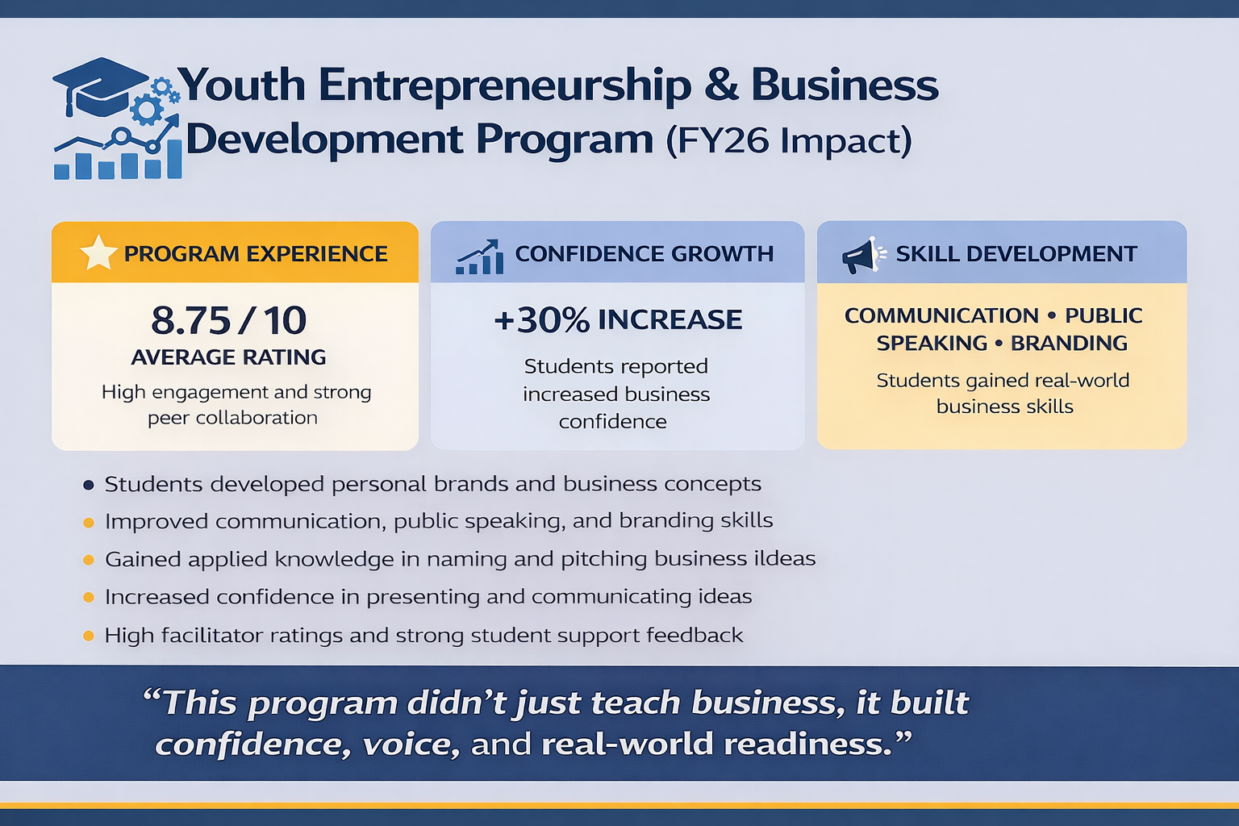
Question 6d and 6e
  Provide update on the following programs implemented from FY26 budget.
    Youth Entrepreneurship & Business Development Program

Slide 23
Question 6d and 6e
  Provide update on the following programs implemented from FY26 budget.
    Film, Media, & Content Creation Lab I
    Mobile Recreation Unit
While both the Film, Media, and Content Creation Lab and the Mobile Recreation Unit remain priorities, implementation was delayed due to current fiscal constraints and a strategic pivot to align with the Mayor’s educational priorities. For the Film, Media, and Content Creation Lab, we actively pursued implementation through partnerships with Future First Gaming and the Eastside Charter STEM Hub. However, limited funding prevented full execution, and the expiration of Future First Gaming’s lease impacted our ability to move the project forward as planned.
Similarly, we made efforts to launch the Mobile Recreation Unit, including attempting to recruit staff to support the initiative. While those positions were not successfully filled, we still ensured service delivery by providing physical and educational enrichment to youth throughout the summer, particularly those not enrolled in structured camp programs, through our collaboration with the nutrition program.
Both initiatives remain part of our future planning and will move forward as resources, staffing, and partnerships are solidified.
e. Specify the anticipated site locations for the Arts in the Park program
Arts in the Park moves across the entire city. Some parks included in the rotation are Haynes Park, Barbara Hicks Park, Father Tucker Park, Brown Burton Winchester, Park and a few others. Stapler Park has also been added as a brand-new Park site for this year.

Slide 24
Question 7a
Discuss all budgetary programs for the Recreation and Youth & Families Divisions.
List all Programs (share cost for the program, share if any fees charged, share amount of funds collected the last 2 years per program, and number of attendees per program the last 2 years
(for example: Camp Barnes, College Tour, Ben Jones, Crozier Summer League, Wednesday Night Track, flag football, tennis program, SAT, College Tours, training, movie nights, skate events, etc. just to name a few)

Slide 25
Question 7a
Programs | FY26 Program Cost | FY26 # of Attendees | FY25 Program Cost | FY25 # of Attendees
Let’s Play S.T.E.M. Program | $4,000 | 50 | $4,000 | 50
Delaware Nature Society | $2,500 | 50 | $2,500 | 50
Natural Glow Self Love Club Girls Program | $3950 | 28 | $4000 | -
Mariposa Arts – Art of the Well Being | $6,000 | 35 | $2,000 | 35
WHACC Aquatic Program | $15,050 | 4,140 | $15,000 | 3,899
Wilmington Friend School (WSF) Swim Team | $8,000 | 3,725 | $7,000 | 3,525
Tower Hill School Swim Team | - | - | $7,000 (New) This is revenue | 3,667
Swim Lessons | $850 (new) | 113 | - | -
Book Nook – Reading Literacy Program (Summer/Academic Year) | $0 | 85 | - | -
Kai Coders Program | - | - | $7,250 | 50 (new)
One Step At A Time Program | $40,000 | 15 | $40,000 | 25
Youth Mentorship Program | $2,250 | 20 (new) | - | -
Community Garden / Lassiter Foundation | $15,000 | 50 | $21,813 | 40
Notes:
*No cost for college day tours

Slide 26
Question 7a Continued
Programs | Participation FY 2026 | FY 2026 Cost | Participation FY 2025 | FY 2025 Cost
Boxing | 250 | $16,974 | 225 | $11,429
Aquatic Program | 27,310 | $30,000 (est.) | 81,625 pool visits | $19,951
Summer Cinema | 165 (estimated) | $2,725 | 165 (estimated) | $2,725
Tennis in the Streets | May 8, 2026 (Projected 500) | $4,000 (est) | 742 | $8,430
Playstreets | 1500 (across 8 city districts) – summer program | $15,261.39 (funded by city council and Mayor’s office) | 625 | $2,000
Summer Camp | 50 | $18,674.37.00 | 50 | $7,622
Street Ministries | 720 yearly | $5,000 | 720 yearly | $5,500
Charity Crossings | 720 yearly | - | 530 | -
Spelling Bee | 450 | $2,799 | 420 | $5,000
90 Day Fitness Camp/Fitness Center/Weight Room | 75 Quarterly | $2,500 | 72 | $2,500
Field Trips – Community/Hicks | 52 | $650 | 74 | $1650
Aqua Zumba/Zumba | 75 (new program) | $1960 | - | -

Slide 27
Question 7a Continued
Programs | Participation FY 2026 | FY 2026 Cost | Participation FY 2025 | FY 2025 Cost
Men’s Softball | 266 | $2,670 | 190 | $3,750
Women’s Softball | 134 | $852 | 75 | $2,775
Youth Basketball | 500 | $18,168 | 660 | $22,000
Flag Football | 135 | $4,416 | 120 | $5,500
Wednesday Track and Field | 400 | $3,500 | 1,200 | $5,000
Child Adult Care Food Program (CACFP meals served) | 61,917 | Grant Funded | 131,629 | Grant funded
Summer Food Service Program (SFSP meals served) | 110,000 | Grant Funded | 94,501 | Grant funded
Youth Career Development (YCD Summer) | 105-WF 40-NL 60-INTERN | General Funding BOA- Anticipating $100,000 | 162-WF 23-NL 61-INTERN | $265,000 Grant funded (DOL $190,000)
Youth Career Development (YCD Academic) | 100 Anticipating | $250,000 Anticipating DOL | 65 | $75,000
SAT Classes | 20 | $3,000 | 20 | $3,000
Youth Leadership Training (YCD) | 305 | $20,000 Anticipated | 307 | $18,850
Youth In City Government (May) | 150 | $5,630 | 150 | $5,000
College Tour* | 31 | $23,468 | 40 | $24,146
Camp Barnes | 52 | $10,858.88 | 57 | $9,920
Notes:
*No cost for college day tours

Slide 28
Question 7a Continued
Programs | Participation FY 2026 | FY 2026 Cost | Participation FY 2025 | FY 2025 Cost
Youth In City Government (May) | 150 | $5,630 | 150 | $5,000
College Tour* | 31 | $23,468 | 40 | $24,146
Camp Barnes | 52 | $10,859 | 57 | $9,920
Drive-In Movie Nights (Summer) | 75 (new) | $2,200 | - | -
Skating in the Parks Initiative | 50 | $2,000 | - | -
Bowling Club | 21 | $550 quarterly | 15 | $550
Senior Program (i.e. National Health & Fitness/Senior Luncheon) | May 27, 2026 (projected 350) | $2,500 | 324 | $30,000 (grant funded)
Field Hockey (Leagues/Clinics/Clubs) | 108 (new program) | $8,000 (partially grant funded) | - | -
Girls Flag Football | 120 (new program) | $1,000 | - | -
Notes:
*No cost for college day tours

Slide 29
Question 7a Continued
Programs | Participation FY 2026 | FY 2026 Cost | Participation FY 2025 | FY 2025 Cost
Fitness in the Parks | - | - | 75 (summer) | $225
Martial Arts (Youth) | 25 | $1,500 | 25 | $1,300
Martial Arts (Adult) | 10 | N/A | 10 | N/A
T-Ball – Judy Johnson | 93 | $2,000 | 68 | $550
Expand Your Mind – Afterschool Program | 60 | $10,000 | 60 | $10,000
Double Dutch | 250 | $3,800 | 182 | $2,500
WHACC Fatherhood Group | 15 (new program) | External Funding Source | - | -

Slide 30
Question 7a Continued
Programs | Participation FY 2026 | FY 2026 Cost
Kickball Leagues/Clinics (Youth/Adult) | 183 (new program) | $300
Youth Yoga Program | 30 (new program) | $250
Youth Dodgeball League – (Co-Ed) | 40 (new program) | $300
Notes:
*No cost for college day tours

Slide 31
Question 8
Discuss current vacant positions.
  Discuss any current vacant positions.
  Specify duration of the vacancy.
  Specify timeframe for filling position.
  Specify impact to the department due to the length of the vacancy.
    i. Any impact to Overtime, Consultants, Temps, etc.
  Specify if Residency has any impact with filling the vacancies

Slide 32
Question 8a-8e
Position | Vacancy Date | Expected Fill Date | Impact | Impact
Superintendent of Park Maintenance | 2/28/26 | Interviews are scheduled for April 22nd | Administrative & Operational Strain | There were only 3 applicants for this position. Residency could have impacted the candidate pool
Senior Equipment Operator | 9/10/25 | Position is currently posted until April 27th. Tentative interview date is May 11th | Operational Strain | CDL A requirement
General Laborer I | 1/2/2026 | Interviews are scheduled for April 20th | Operational Strain | N/A
Labor Foreman I (Rubbish) | 8/22/2025 | A request has been submitted to delete this position and create a new position with a new title. Summer, 2027 (after new position is created) | Severe Operational Strain | N/A
Labor Foreman I (Ballfields) | 6/2/2025 | A request has been submitted to delete this position and create a new position with a new title. Summer, 2027 (after new position is created) | Severe Operational Strain | N/A

Slide 33
Question 9
Discuss any proposed changes to positions (new position, deleted position, upgrade, realignment, transition, downgrade, title change, salary changes, etc.)
Title | Division | Position Type
General Laborer I (2) | Maintenance | Added
General Laborer III | Maintenance | Added
Small Engine Mechanic | Maintenance | Added
Pool & Maintenance Mechanic | Maintenance | Added
Equipment Operator | Maintenance | Added
Labor Foreman (2) | Maintenance | Eliminated

Slide 34
Question 9a and 9b
  Specify if any new positions are revenue generating.
  N/A
  b) Share the impact for the department reorganization, inclusive if any impact for Overtime budgeted for $220K, which year to date is over budget, and has exceeded budget the last 3 years, and for Consultants budgeted for $79K
  The Park maintenance division has experienced extreme staff shortages during FY26, and as a result of staff shortages, and the number of citywide events the maintenance division supports, overtime could not be avoided. Additionally, overtime increased during FY26 due to increased cleaning of parks on weekends. With the requested increased maintenance division positions, including adding an additional pool maintenance mechanic, the department anticipates remaining at budget for FY27.
    Any funding allocated for cleaning parks on the weekend.
    Yes, funding is including in the Park Maintenance Division overtime line for one Saturday per month during the peak season of April-November
    With the reorganization, any changes with W.H.A.C.C.
    There are no changes to WHACC.

Slide 35
Question 9b
Overtime budgeted for ~$220K
Overtime Budget | FY27 PROPOSED | PURPOSE | Changes
MAINTENANCE | $184,356 | Sponsored events: Cultural Affairs, Mayor’s Office, Dept. mowing/leaf removal, Extended pool and spray shower hours | $9,000
RECREATION | $30,000 | OT expense for Full-time and Limited-Service Employees | $4,000 Transfer from Repairs-Misc
YOUTH & FAMILIES | $5,000 | YCD and Nutrition coverage for time worked over scheduled hours | $5,000
TOTAL | $219,356

Slide 36
Question 9b
Discuss the planned use of ~$79K budgeted for Consultants.
PROFESSIONAL FEES 52701- Consultants | FY27 PROPOSED | PURPOSE | Changes
ADMIN | $2,000 | Consultants as needed to create Community Based Programming | ($2,000) Transfer to Temp Salary line
REC /WHACC | $58,500 | Safe Haven - $22,500 / Professional Contracts - $12,500 / Aquatics Training/Cert - $12,000 / Registration & Monitoring Software - $9,000 / Track & Field Timer - $2500 | $12,500 increase with Transfer from MISC CHGS line
Y&F | $18,500 | Entrepreneurship Program - $12,500 / YCD Training Presenter Fees - $6,000 | $12,500 increase with Transfer from Rec Div - Rec Equip line
TOTAL | $79,000

Slide 37
Question 10
Please share the budgetary costs for City pools per site (Eden, Brown, Prices, W.H.A.C.C. and P.S.)
FY2026 Operational and Repair Expenses as of April 20, 2026
 | Dr. Foster M. Brown Swimming Pool | Eden Park Swimming Pool | Biden Aquatic Center Swimming Pool (a.k.a Prices Pool) | William Hicks Anderson Community Center Swimming Pool | P. S. duPont Swimming Pool |  | Total
Operational Costs | $12,809 | $14,209 | $16,829 | $1,477 |  |  | $45,324
Repairs | $6,688 | $49,459 | $21,475 | $66,138 |  |  | $143,760
Rental |  |  |  |  | $10,457 |  | $10,457
Total | $19,497 | $63,668 | $38,304 | $67,615 | $10,457 |  | $199,541

Slide 38
Question 10a
  Provide site locations for City spray parks and the operational hours.
  Spray Parks operate from dawn till dusk
Father Tucker Park | Helen Chambers | Brown Park | Woodlawn Park | Rodney Square | Mack Park
9th & Lincoln St. | 7th & Madison St. | 8th Avenue & Duncan St. | 4th & Ferris St. | 10th & Market St. | Ford Ave.
Notes:
*No cost for college day tours

Slide 39
Question 10b
  Provide tentative hours of operations for summer pools.
  City pools will run from June 22nd to August 21st – P.S. Dupont Pool will run from (7/6 – 8/14) - All City Pools are closed on 4th of July
Pool | Address | Telephone | Hours of Operation | Sunday | Monday | Tuesday | Wednesday | Thursday | Friday | Saturday
Eden | New Castle Avenue & City Ave | 302-573-5560 | 3PM - 7PM | 1PM - 7PM | CLOSED | 3PM - 7PM | 3PM - 7PM | 3PM - 7PM | CLOSED | 1PM -7PM
Joseph R. Biden Aquatic Center (Prices) | 26th St. & Speakman | 302-571-4248 | 1PM - 7PM | 1PM - 7PM | CLOSED | 1PM - 7PM | 1PM - 7PM | CLOSED | 1PM - 7PM | 1PM -7PM
Brown | 7th & Lombard | 302-571-4265 | 1PM - 7PM | 1PM - 7PM | CLOSED | 1PM - 7PM | CLOSED | 1PM - 7PM | 1PM - 7PM | 1PM -7PM
WHACC | 501 North Madison | 302-571-4266 | 1PM - 7PM | CLOSED | 9AM - 11AM ADULT SWIM ______________11AM – 1PM SUMMER CAMPS 1PM - 7PM OPEN SWIM | 9AM - 11AM ADULT SWIM _______________11AM – 1PM SUMMER CAMPS 1PM - 7PM OPEN SWIM | 9AM - 11AM ADULT SWIM ______________11AM – 1PM SUMMER CAMPS 1PM - 7PM OPEN SWIM | 9AM - 11AM ADULT SWIM ______________11AM – 1PM SUMMER CAMPS 1PM - 7PM OPEN SWIM | 9AM - 11AM ADULT SWIM _______________11AM – 1PM SUMMER CAMPS 1PM - 7PM OPEN SWIM | CLOSED
P.S. Dupont | 701 W. 34th | 302-762-7146 | 3PM – 6PM | CLOSED | 3PM – 6PM | CLOSED | 3PM – 6PM | CLOSED | 3PM - 6PM | CLOSED
Notes:
*No cost for college day tours

Slide 40
Question 10c and 10d
  c) Specify the date when the city pools will open and the end date.
  JUNE 22, 2026 – AUGUST 21, 2026
  d) Specify any revenues collected for other entities using the City pools.
WHACC POOL USAGE/RENTAL REVENUE FY26
Greater Philadelphia Underwater Hockey League | $ 1,530.00
Wilmington Friends School | $ 8,000.00

Slide 41
Question 11a, 11b, and 11c
Discuss the planned use of ~$1.6M budgeted between Temporary Salaries and Temp Agencies account groupings and share if this provides adequate resources and funding to address the department’s needs for the city youth.
  Share the plans for the co-op program for Howard High School.
The goal is to create a hands-on co-op experience for Howard High School students studying diesel engine repair, giving them exposure to small engine systems and shop operations within the Park Maintenance division. Students will not only build technical skills, but also develop discipline, work ethic, and professional habits. They will have the opportunity to earn income while learning, and for those who excel, this program can serve as a direct pathway to future employment.

Slide 42
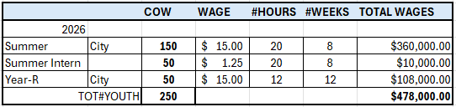
Question 11b and 11c
Discuss the planned use of ~$1.6M budgeted for Temporary Salaries.
  b) Specify the anticipated number of summer youth career development jobs and correlating funds budgeted in the General Fund.
FY 2027 – 165 workers ($396,000)
FY 2026 – 150 workers ($336,000)
  Specify the amount of grant dollars anticipated for summer youth for FY2027, amount received in FY2026, and anticipated number of summer youth jobs for City residents and for non-City residents.
  FY2027
Department of Labor (59 City Youth & 15 Non-City Youth) Total = ($190,000)
Bank of America (Anticipated 35 Youth Workers) Total = ($100,000 Requested)
General Fund (150 City Youth & 15 Non-City Youth) Total = ($396,000)
FY 2026
Department of Labor (59 City Youth & 15 Non-City Youth) = ($190,000)
Bank of America (23 Youth Workers) Total = ($75,000)
General Fund (150 City Youth & 12 Non-City Youth) ($388,800)

Slide 43
Question 11d & 11e
Discuss the planned use of ~$1.2M budgeted for Temporary Salaries.
  d) Specify number of youth career pathway jobs and correlating cost.
      2025-2026 YCD Career Pathways: 2 ( Entrepreneurship & Academic Career Pathway Youth)
      Total Jobs: approximately 40 youth jobs
      Total costs: approximately $232,128.00 (Anticipated $100,000 Bank of America grant, balance from general fund)
  e) Share If there are any planned sponsorships
  FY 2026
        Bank of America = Anticipated $100,000
  FY 2025
        Bank of America= $75,000
  FY2024
  Bank of America = $100,000

Slide 44
Question 12
Discuss the planned use for ~439K budgeted in Miscellaneous Services.
MISCELLANEOUS SERVICES | FY26 | FY27 | +/(-) | PURPOSE
53107 - EXTERMINATION SERVICES | $13,200 | $13,200 | $0 | No Change
53108 - MISC CHARGES - NOC | $87,313 | $100,613 | $13,300 | Maint – Decrease by $2000 transfer to Temp Agency Recreation – Decrease by $12,500 transfer to Consultant & $2200 xfer to Advertising Recreation – Increase by $30,000 xfer from Mayor’s Office for Reading Assist Program
53109 - CONTRACTED MAINT SVCS | $314,205 | $289,205 | ($25,000) | Maint – Decrease by $5000 to transfer to Temp Agency OMB – Decrease by $20,000 to align with prior year actuals
53123 - RECREATIONAL ACTIVITIES | $30,500 | $35,500 | $5,000 | Recreation – Increase Boxing Program by $4000 transfer from REC Equip & $1000 transfer from REC MISC Supplies
TOTAL | $445,218 | $438,518 | ($6,700)

Slide 45
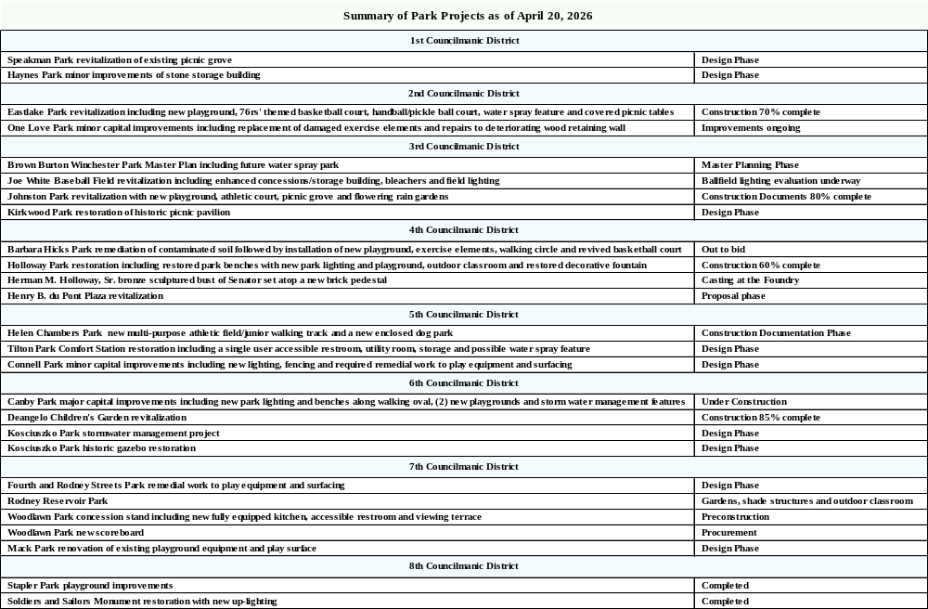
Question 13
Provide a summary report per district, update status for each park (example – status of any park renovations, playground equipment, etc.).

Slide 46
Question 14
Share the amount of funding allocated for training, and professional growth and development for your staff.
TRAINING/PROFESSIONAL DEV | TRAVEL&SUB | REGISTRATION | TOTAL BUDGETED
ADMIN | $5000 | $1,500 | $6,500
MAINTENANCE | $8000 | $8,000 | $16,000
RECEATION | $12,000 | $5,000 | $17,000
YOUTH & FAMILIES | $14,000 | $3,500 | $17,500
TOTAL | $39,000 | $18,000 | $57,000

Slide 47
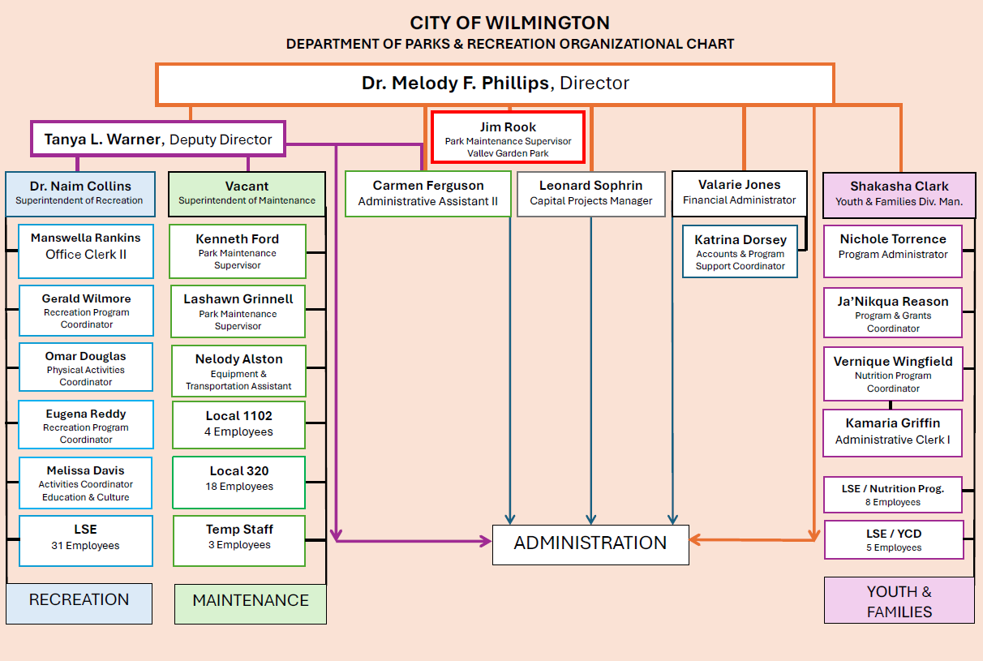
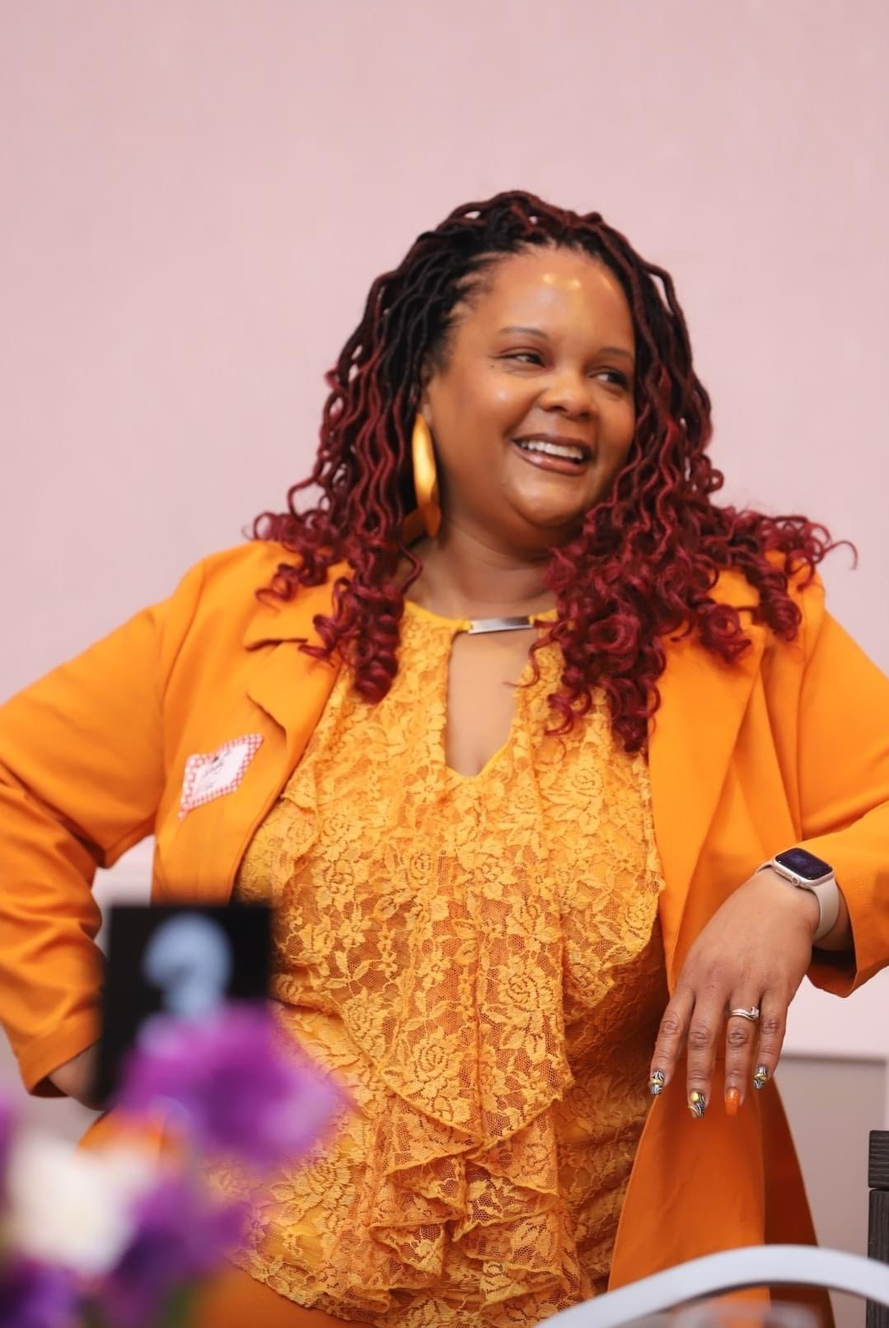
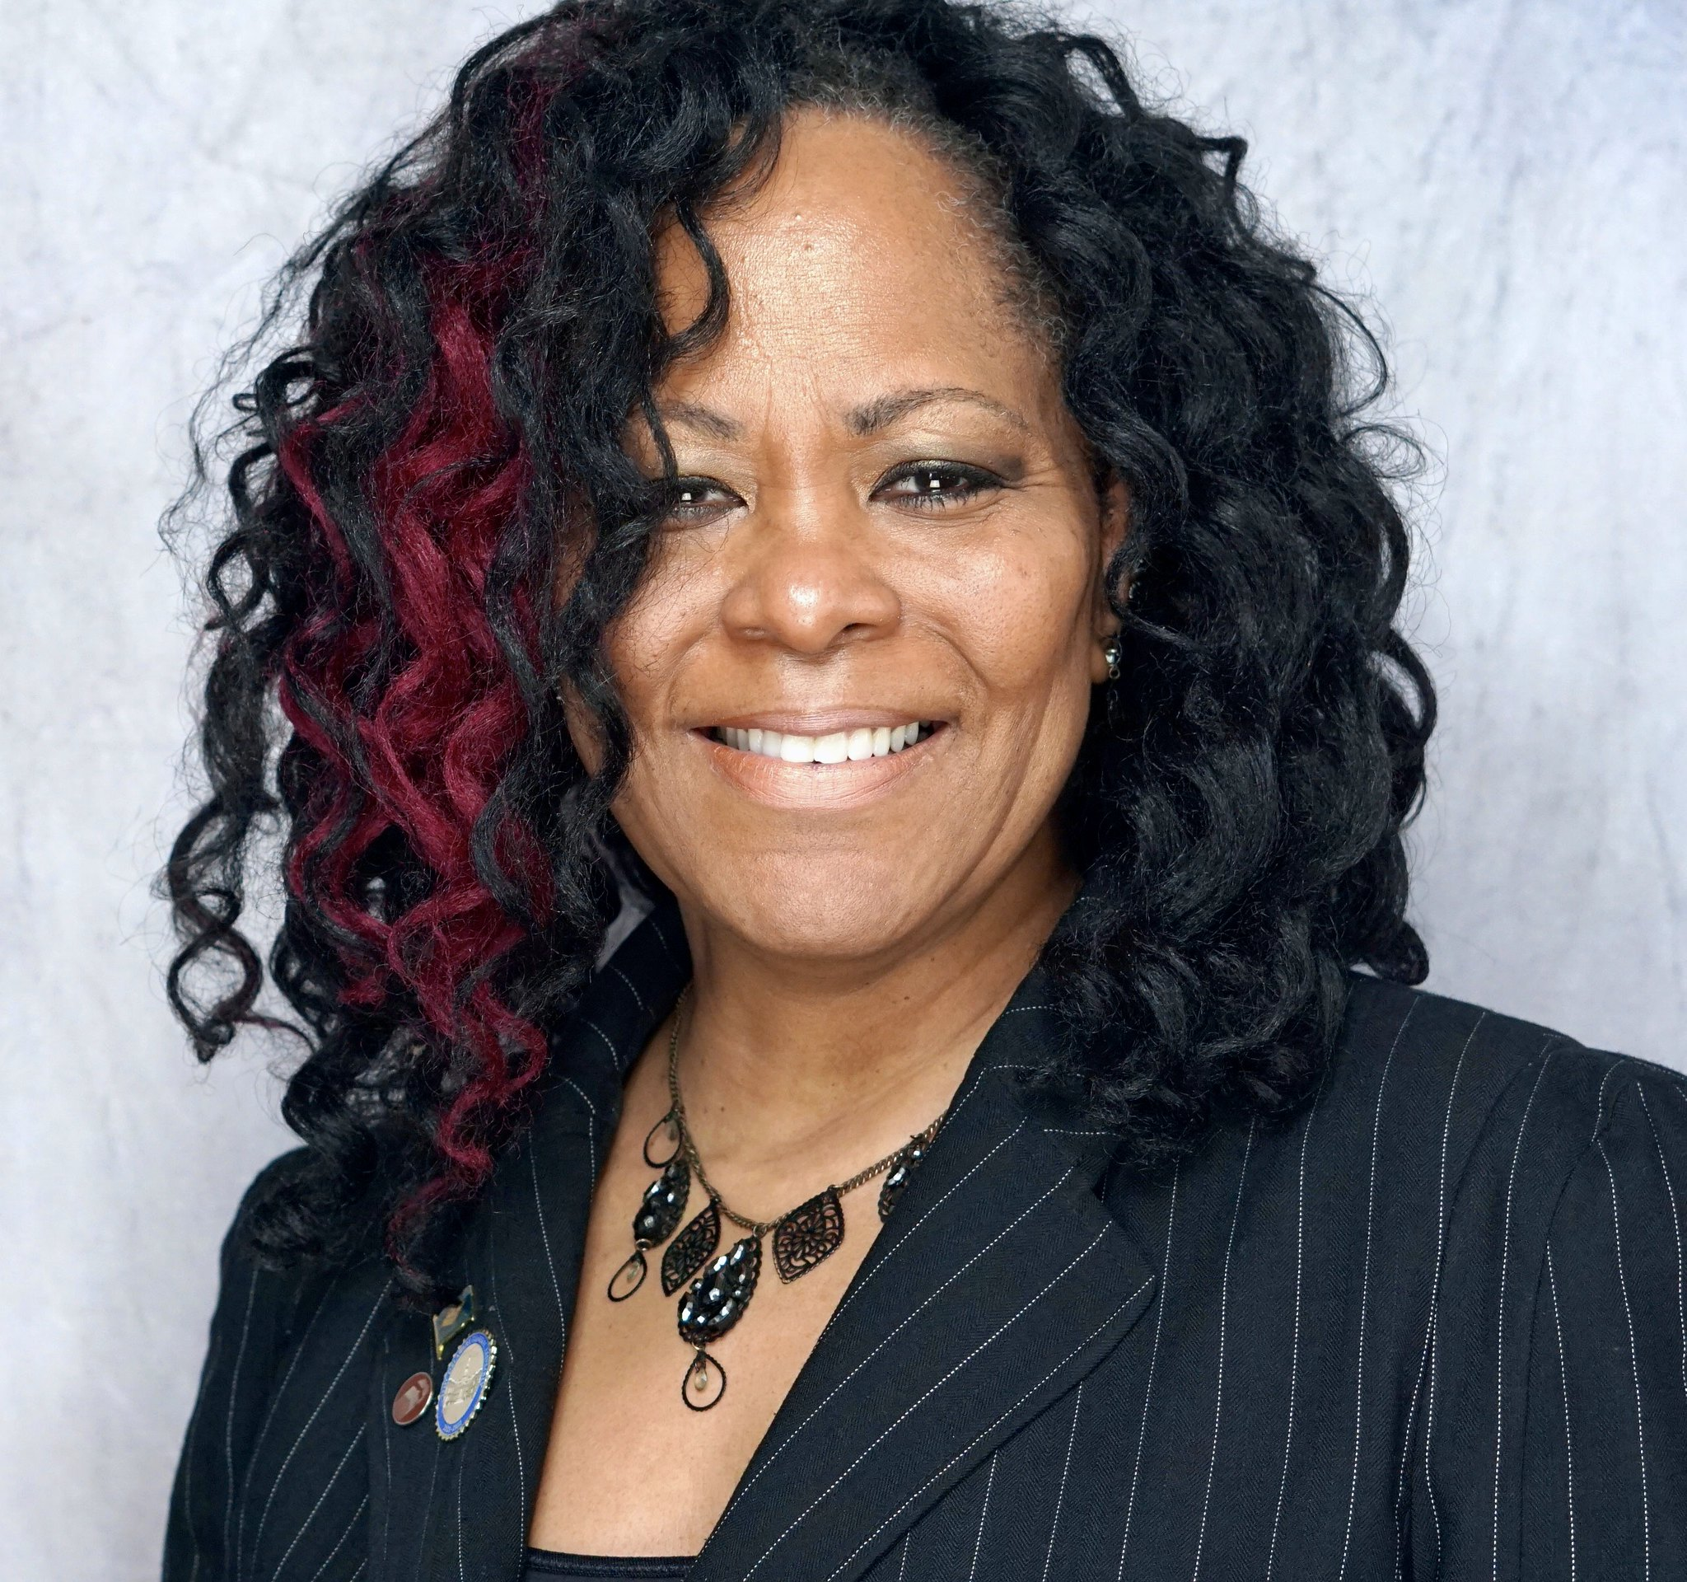

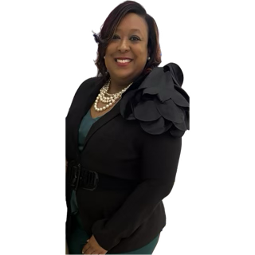
Question 15
Provide FY2025 proposed organizational chart with the total number of employees (i.e., permanent, temporary, contract, vacancies).

