Slide 1


FY 2027 Budget Hearing
PUBLIC WORKS
(General & Motor Vehicle Funds)

Slide 2
General Fund – Proposed FY 2027 Budget
Public Works Department General Fund | FY 2024 Actuals | FY 2025 Actuals | FY 2026 Budget | Proposed Budget FY 2027 | $ Change FY’27-26 | % Change FY’27-26
Personal Services | $10,029,953 | $9,980,328 | $10,713,165 | $11,154,880 | $441,715 | 4.1%
Materials, Supplies, and Equipment | 9,359,754 | 8,996,659 | 10,117,947 | 10,745,699 | 627,752 | 6.2%
Internal Services | 4,354,171 | 4,951,235 | 4,281,584 | 4,449,164 | 167,580 | 3.9%
Debt Service | 6,181,803 | 5,914,619 | 6,005,668 | 6,482,559 | 476,891 | 7.9%
Total | $29,925,681 | $29,842,841 | $31,118,364 | $32,832,302 | $1,713,938 | 5.5%
Staffing Level (General Fund FTEs) | 120.05 | 117.55 | 114.55 | 115.05 | 0.50 | 0.4%

Slide 3
Major Funding Changes (General Fund Proposed Budget)
Position Change (↑ $42,567) (↑ 0.50 FTE)
  Add: Inventory Distribution Specialist (50% General | 50% Water/Sewer)
Salary and Wages (↑ $160,855)
  Anniversary Steps and Annual Reviews for E&M staff
Employee Benefits (↑ $310,028)
  Increased Health Care Cost - Hospitalization

Slide 4
Major Funding Changes (General Fund Proposed Budget)
Repairs to Buildings and Structures (↑ $547,000)
  Asset Management: Property Management and Repairs Services Agreement
    19-Year-Old Municipal Services Complex (Turner Building)
      Preventive Maintenance & Repairs
      Capital Improvements
      Security Guard Contract
      Critical Air Intake Unit Repairs

Slide 5
Major Funding Changes (General Fund Proposed Budget)
Communications and Utilities (↑ $105,361)
  Water/Sewer & Stormwater Utility (↑ $95,361)
  Electricity (↑ $10,000)
    Based on FY25 Actuals | Burn-Rate (Cash Outflow)

Slide 6
Major Funding Changes (General Fund Proposed Budget)
Greenspace Maintenance (↑ $30,000)
  Additional maintenance and landscaping
    Riverfront Development Corporation (RDC) Gateway
Building Maintenance (↑ $19,941)
  City/County Building & Asset Management costs
    City (70%) | County (30%)

Slide 7
Major Funding Changes (General Fund Proposed Budget)
Parking Fees (↓ $17,000)
  Cost-Saving Measures in Fleet Management
    Revised Eligibility for Vehicle Assignments
    Reduction of Parking Garage Access Cards
Debt Service (↑ $476,891)
  New Debt Service Schedule – December 2025 Bond Issuance

Slide 8
Motor Vehicle Fund – Proposed FY 2027 Budget
Public Works Department Motor Vehicle Fund | FY 2024 Actuals | FY 2025 Actuals | FY 2026 Budget | Proposed Budget FY 2027 | $ Change FY’27-26 | % Change FY’27-26
Materials, Supplies, and Equipment | $4,792,198 | $5,291,467 | $5,744,601 | $6,013,508 | $268,907 | 4.7%
Internal Services | 643,492 | 780,072 | 288,025 | 296,759 | 8,734 | 3.0%
Debt Service | 27,478 | 15,449 | 13,523 | 10,815 | (2,708) | -20.0%
Depreciation | 3,461,200 | 4,008,605 | 3,461,200 | 4,008,605 | 547,405 | 15.8%
Total | $8,924,368 | $10,095,593 | $9,507,349 | $10,329,687 | $822,338 | 8.6%
Staffing Level (Motor Vehicle FTEs) | 0.00 | 0.00 | 0.00 | 0.00 | 0.00 | 0.0%
Notes:
The discrepancy between Powerbi and CK report for FY24 Actuals
FY2024 Actuals
Power Bi:
MS&E: $4,963,088
Total: $9,095,257
CK:
MS&E: $4,792,198
Total: $8,924,368

Slide 9
Major Funding Changes (Motor Vehicle Fund Proposed Budget)
Automotive Equipment (↑ $104,866)
  Fleet Replacement Program – increase in vehicle replacement cost
    Vehicle Requests (3 Vehicles) – Cost: $329,900
      Parks & Recreation: (1) 15-Person Passenger Van – Cost: $76,200
      Public Works: (1) Heavy-Duty Truck w/ Dump – Cost: $169,500
      Treasurer’s Office: (1) SUV – Cost: $84,200

Slide 10
Major Funding Changes (Motor Vehicle Fund Proposed Budget)
Contracted Maintenance Services (↑ $198,887)
  TransDev – Fleet Management and Maintenance
Repairs to Equipment (↑ $54,550)
  Non-target Repairs to Fleet Equipment

Slide 11
DEPARTMENT OF PUBLIC WORKS
The mission of the Department of Public Works is to operate and maintain critical infrastructure and facilities, provide superior services for our customers, and promote resiliency.
The Department of Public Works is complex and provides a wide array of services including: once a week recycling and residential solid waste collection; treatment and distribution of high-quality drinking water; collection and treatment of sewage; storm water management; cleaning and sweeping of City streets; street construction and repairs; maintenance of traffic signs and signals; line striping; storm preparation and snow removal; debris clean-up; and maintenance of the City fleet and City properties; collection and maintenance of GIS data; and much more.

Slide 12
Vision
To provide superior services with respect, with integrity, and with the responsiveness that every customer deserves.
Priorities for FY2027 – General Fund
Beautiful City Initiative – Keep our City clean; reduce trash and increase recycling; stop illegal dumping; improve our sidewalks; repave and repair our streets; plant more trees and maintain gateways; support the community’s efforts to beautify the City.
Infrastructure Improvement Program – Capitalize on funding and partnering opportunities that become available to improve Wilmington’s streets and sidewalks.
Continue street paving and reconstruction and ADA curb ramp installations.

Slide 13
Performance Measures
Public Works collects over 100 data points that are analyzed every 2 weeks. Examples include:
  Street Paving Work by the City, 2-Week periods
  Trash and Recycling Collection Rates Citywide, by route
  Total number of Public Works Service Actions (broken down by group): Public Property, Sanitation, Sewer Maintenance, Street Cleaning, Street Maintenance, Transportation, Trees, Water, Engineering
  City Vehicle Fleet performance, availability of fleet
  Percent of Public Works Service Actions Closed (by groups), median number of days
  Specific Service Tasks totals (broken down by task): special pick-ups, catch basins blocked, dead animal removals, water leaks, sewer back-ups, potholes, trash missed, recycling missed, yard waste requests, illegal dumping, requests for new trash or recycle bins
  Public Works Service requests by Council Districts
  Overtime usage by Division

Slide 14
City Council Questions

Slide 15
Question 1
Understanding the 5-year revenue and expenditure projections show expenditures far outpacing revenues for FY27 to FY30, and FY27 General Fund Proposed Budget uses $25.7M of the Tax Stabilization Fund, please share how this budget aligns with closing any potential budget gaps.
Specify any cost savings or reductions, and if this budget provides adequate resources to meet the departmental needs.
Specify any high-level major additions.

Slide 16
Question 1 - Response
Reducing the General Fund operating budget would require a reduction in services. Costs for Electricity, Materials, Supplies, and Services continue to rise. Public Works has tried to minimize increases while still being able to perform department functions as required by the City Charter and Code.
High level budget additions/increases are addressed in the OMB slides previously reviewed.

Slide 17
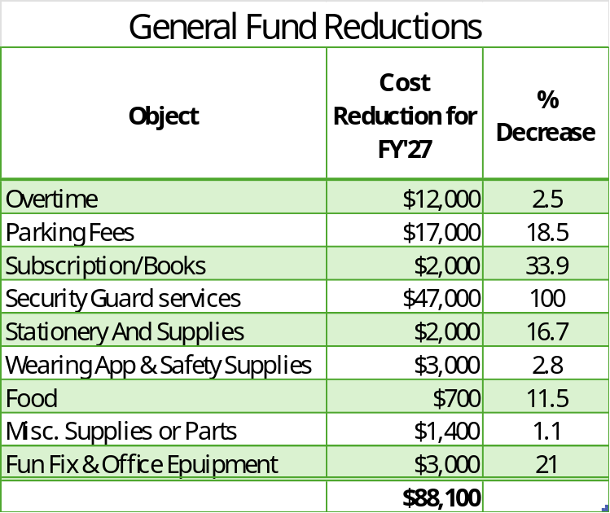
Question 1 - Response
Budget lines below were cut after meetings with OMB and the Mayor’s Office

Slide 18
Question 2
With the Biden Bipartisan Infrastructure Bill that ends September 30, 2026, please share any impact to this budget.
Specify any impact with roads, clean energy, resilient and environmental remediation.
Specify any cost savings for any resiliency measures.

Slide 19
Question 2 - Response
The Bipartisan Infrastructure Law (BIL) does not affect our General Fund or Motor Vehicle Fund budget because no funding was received for either fund to date.

Slide 20
Question 3
Considering Winter Storm Fern that poured an average of 6.5 inches of precipitation, and 8 to 9.5 inches of snow, as well as ice, which was the worst snow event that the city experienced in 10 years, please share if this budget provides the necessary resources and funding if such an event would occur in FY2027.
Please share how the city is managing the various potholes, etc. as a result of any major snow event.
Share if any new equipment, etc. is being requested.
Share if adequate funding budgeted for street paving or if any necessary bond anticipation notes are required.

Slide 21
Question 3 - Response
Public Works budgets based on our normal winter storm response for Overtime, Road Salt, Brine, and Equipment Rental. In the event of another snow event like Winter Storm Fern, we would exhaust our Equipment Rental budget and require a budget amendment.
Potholes
  All Public Works divisions have been instructed to keep lists of potholes wherever they are encountered throughout the city and report this information to the Operations Director daily. Street Maintenance has been filling 40-60 potholes per day since hot mix asphalt became available.
Equipment
  No additional snow removal equipment has been requested in FY’27. We are looking at replacement of our brine system at the Municipal Complex.
Street Paving
  Capital funding for Street Paving and Reconstruction was received in the most recent bond offering and should be adequate for the upcoming paving season.

Slide 22
Question 4
Discuss any planned operational efficiencies to help modernize the city to become more of a “SMART city” and share if this budget provides the necessary funding and resources.
Any plans for more utilization of solar panels.
Any impact with $2.4M budgeted for Electricity across both General and Water Sewer Funds.
Any plans with public EV parking spaces.

Slide 23
Question 4 - Response
Solar Panels
  The City has installed solar panels at the Municipal Complex and Porter Filter Plant. There are no plans to add additional solar installations currently.
Electricity
  The City is in the process of going out for Electricity procurement for 1 to 5 years. Based on data from our consultant, Enstrat Analytics, we are expecting a 3% or greater increase in supply costs in addition to the recent increase in DPL distribution costs.
EV Parking
  The FY’27 budget request does not include any direct funding for public electric vehicle charging stations.
  Public Works has engaged RK&K to do a comprehensive parking study. This will kick off with a downtown pilot study to address immediate needs of parking and EV concerns.
  Public Works will continue working with the State to implement EV infrastructure.

Slide 24
Question 5
Please share if this budget provides the necessary funding and resources for environmental sustainability and beautiful city initiatives for all corridors in the city.
Specify any updates with tree canopy.

Slide 25
Question 5 - Response
Greenspace Maintenance
  Major Gateway Plantings -$175k
  Publicly Requested Tree Related Sidewalk Replacement -$150k
  RDC Gateway Grant -$90k
Tree Canopy
  Funding for the Urban Forest Management Program was just received in the 2025 G/O Bond issuance. Projects are planned with DCH and Parks & Rec to plant trees on the streets and inside of multiple parks this summer and fall that will add to the tree canopy.

Slide 26
Question 1 – General Fund
Discuss current vacant positions.
Specify duration of the vacancy.
Specify impact to the department due to the length of the vacancy.
    Any impact to Overtime, Consultants, Temps, etc.
Justify the need for the position, if any.
Specify if any challenges with the hiring process due to the Residency requirement.

Slide 27
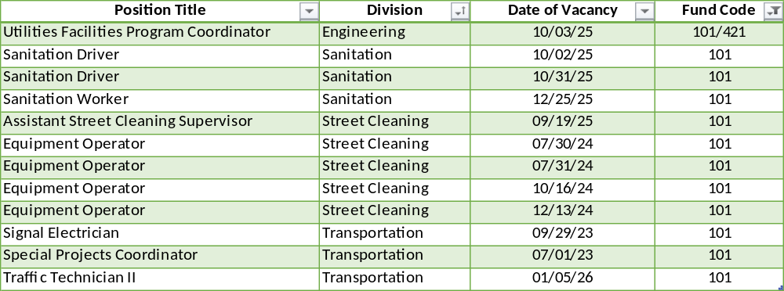
Vacant Positions

Slide 28
Vacant Positions
  We are working closely with Human Resources to fill vacancies as quickly as possible that are approved by the Chief of Staff and have made continued progress and reducing the number of vacant positions in the department.
  Sanitation is using temp employes for General Laborer positions to distribute Trash Carts.
  Street & Sewer Maintenance is using temp employees for General Laborer positions.
  Operations is using temp employees in Tree Crew Technician positions.
  Transportation has brought in temp employees to assist with the Special Projects Coordinator responsibilities and General Laborer positions.
  There is an operational need for the above listed positions. Further reduction of positions will impact services.
  Public Works averages 18-25 vacancies due to employee turnover and has had trouble in the current labor market attracting and retaining qualified staff due to the available salary ranges and residency requirements.

Slide 29
Question 2 – General Fund
Discuss any proposed changes to positions (new position, deleted position, upgrade, realignment, transition, downgrade, title change, salary change, etc.).

Slide 30
Position Changes
Inventory Distribution Specialist (New Position)
  This split funded position in the Operations Division will allow the department to centralize inventory, manage the flow of goods, track goods, and ensure accurate stock levels.

Slide 31
Question 3 – General Fund
Discuss the $1.3M budgeted for Professional Fees ($352K Consultants, $278K Engineers, $711K Temp Agency).
Specify vendor name, amount of contract, expiration date, length of contract, how long City has been doing business with the vendor, and scope of services.
Specify if any vendors are DBE’s.
Specify any reoccurring contracts.
Specify the cost benefit analysis for Outside expertise versus doing internally.

Slide 32
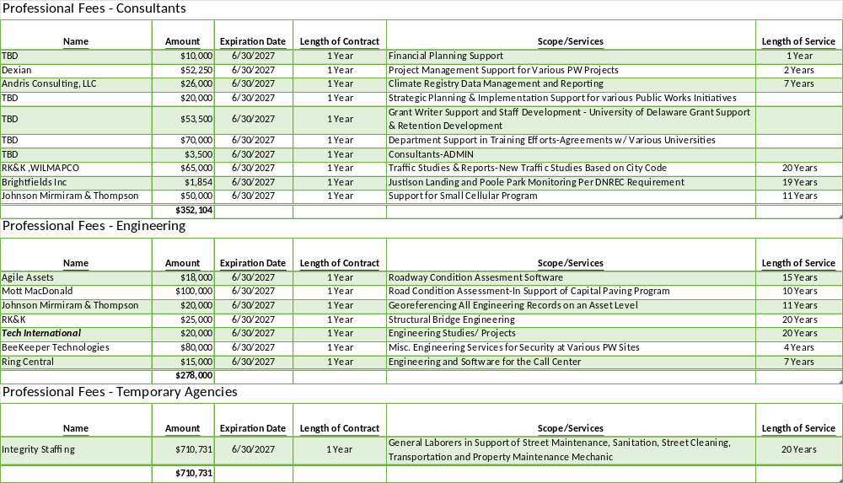

Slide 33
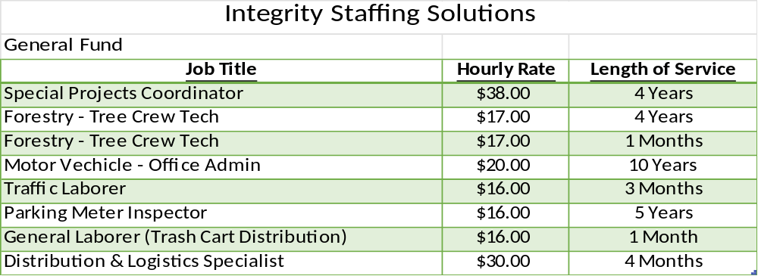
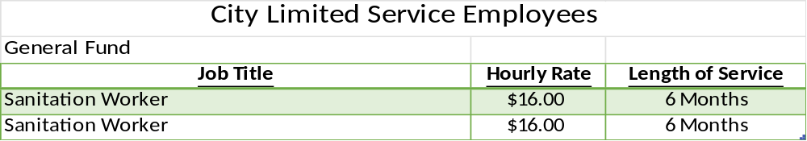
Consultants, Engineering, Temp Agencies

Slide 34
Consultants, Engineering, Temp Agencies
Public Works managers bring in the necessary assistance they need for the project at hand.
Specific expertise is often required for which we don’t have someone on staff that can design or engineer a specific project.
By using outside engineers, the design liability is assumed by the engineer of record not the Public Works manager.
With the large number of projects on-going there are not enough project managers on staff. Our staff manages outside engineers and consultants to assure that tasks and projects are completed successfully.

Slide 35
Question 4 – General Fund
Share if this budget has the adequate funding and resources to address the following needs of the city:
Transportation
Street Cleaning
Rubbish Collection
Property Maintenance
Specify impact of the above for $460K budgeted in Overtime.

Slide 36
Overtime – General Fund
Funding for General Fund Personal Services, and Materials, Supplies, and Equipment has been budgeted according to projected needs for FY’27 and is reflected in the proposed budget.
Administration - $10k
  Snow Events and Construction Inspectors
Street Maintenance - $3.8k
  Street Repairs and Snow Events
Transportation - $135k
  Emergency Repairs, Knockdowns, Street Light Outages, Crosswalk Painting, Special Projects

Slide 37
Overtime – General Fund
Street Cleaning - $170k
  Snow Events, Leaf Pickups and Cleanup for Special Events
Rubbish Collection - $110k
  Snow Events, Household Hazardous Waste Events and Trash Requests
Property Maintenance - $30k
  Snow Events, Special Events and Emergency Call-In Time
All overtime must be authorized by the division director and approved by the division supervisor and is monitored regularly through the Kronos Timekeeping system by management.

Slide 38
Question 5 – General Fund
Discuss the approximately $3.3M budgeted in the Contracted Maintenance account category, up to $547K over the prior year’s budget.
Specify vendor name, amount of contract, expiration date, length of contract, how long City has been doing business with the vendor, and scope of services.
Specify if any vendors are DBE’s.
Specify one-year reoccurring contracts.
Share the process for publicly requesting tree related sidewalk replacement, and the amount of allocated funding available.
Specify if any funding expended year to date for Traffic Calming Devices.

Slide 39
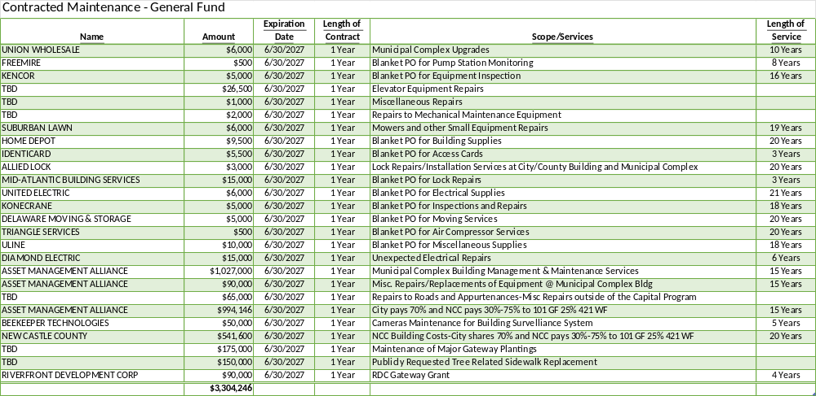
Contracted Maintenance

Slide 40
Contracted Maintenance
Repairs-Misc. - $6k
  Municipal Complex and Mezzanine Repairs
Repairs to Roads and Appurtenances - $65k
  Misc. Street, Curb & Sidewalk, and Brick Crosswalk Repairs
Building Maintenance - $1.585M
  C/C Bldg. Management & Maintenance Costs (Split with NCC 70% / 30%)
  Camera Maintenance for Building Surveillance System
  NCC C/C Bldg. Costs for Electricity and Utilities (Split with NCC 70% / 30%)
Greenspace Maintenance - $415k
  Contracts for Maintenance of Major Gateway Plantings
  Publicly requested Tree Related Sidewalk Replacement
  Riverfront & Christiana River Bridge Approach Gateway

Slide 41
Contracted Maintenance
Repairs to Equipment - $41k
  HVAC/Plumbing/Elevator Repairs at Municipal Complex
  Winch Inspection and Repairs
  Repairs to Pallet Jack, Forklift, and Paint Striping Machine
Repairs to Buildings and Structures - $1.191M
  Asset Management – Municipal Complex Bldg. Management & Maintenance Services

Slide 42
Contracted Maintenance
  The process for publicly requested tree related sidewalk replacement requires that a 311-service request is entered into Cityworks, or an emergency tree removal happens.
  In most cases there is damage to a large portion of the sidewalk when the tree is uprooted. If the stump and roots are large a contractor may be called in to have them removed.
  Traffic Calming Devices – Total amount of funds utilized for Traffic Calming Review and Reports from FY’26 is $79,856.

Slide 43
Contracted Maintenance
Traffic Calming Location and activities during this fiscal year:
  Lancaster Ave. & N. Broom St. – Lancaster Ave corridor and accident history review
  All Way Stop Control (AWSC) Reports
    N. Jefferson St. & W. 19th St.
    N. Madison St. & W. 21st st.
    N. Monroe St. & W. 23rd St.
    N. West St & W. 41st St.
    Concord Ave. & N. Monroe St.
  S. Walnut St. & A St. – Intersection Review & Recommendations
  MLK Blvd./N. Market St./E. Front St - Intersection Review & Recommendations
  E. 16th St. & Clifford Brown Walk – Intersection and drainage review
  12th St. Road Diet review
  Baynard Blvd & Washington St. corridor review
  Citywide Traffic Calming Manual
  Citywide AWSC Guidelines

Slide 44
Question 6 – General Fund
Considering the rapid growth of waste tonnage at the Cherry Island Landfill, please share if this budget allocates the necessary funding and resources for diversion pertaining to recycling and refuse.
Specify the total tonnage for the landfill for the last 2 years, and the correlating fee.
Share the number of special pick-ups within the last 2 years, and amount of revenue collected.
Specify if there is any consideration for revenue sharing pertaining to landfill gas (lfg).

Slide 45
Other Fees – General Fund
Landfill Fees - $1.96M
  Disposal of ~28,000 tons at $70 per/ton
Special Pick-ups
Fiscal Year | Tonnage Collected | Tipping Fee
2024 | 26,007 | $72
2025 | 26,343 | $70
2026 y-t-d | 16,589 | $70
Fiscal Year | Special Pick-ups | Revenue
2024 | 11,093 | $44,400
2025 | 10,083 | $40,325
2026 y-t-d | 8,489 | $29,575

Slide 46
Other Fees – General Fund
Recycle Bank Program - $255k
  This covers cart replacement and inventory of first and second-generation trash and recycle carts.
  Approximately 60% of first generation recycle carts have been replaced. There were a total of 19,200 carts as of July 2021.
  Proprietary software and equipment upkeep are also included in the requested budget.
Landfill Gas
  The City doesn’t own or operate the Landfill. This is operated by DSWA and Archaea Energy. The City uses Landfill Gas at the REBF for electricity generation and sludge drying at the plant. The City pays Archaea Energy, the supplier of the gas.

Slide 47
Question 7 – General Fund
Discuss projected funding slated for Municipal Street Aid.
Share the number of LED street lighting slated to be installed in FY26 and projected in FY27 per district.

Slide 48
Municipal Street Aid
FY’26 Municipal Street Aid is budgeted at $1,157,802. This funding is used for Electricity costs for Streetlights & Signals.
Approximately 1,000 City owned streetlights have been converted to LEDs through FY’26.
Privately owned streetlights located within the City’s ROW are being moved to the City’s account and converted to LEDs. This work continued with Seiberlich Trane in FY’26.
LED conversion has been substantially completed, and we are awaiting final reporting from Seiberlich Trane and Delmarva Power to confirm project completion. Any lights encountered that are not LED are replaced by City crews for city-owned lights or reported to Delmarva to schedule replacement by others.

Slide 49
Question 8 – General Fund
Please share if this budget provides adequate resources and funding for parking signage and a parking locator mobile app.

Slide 50
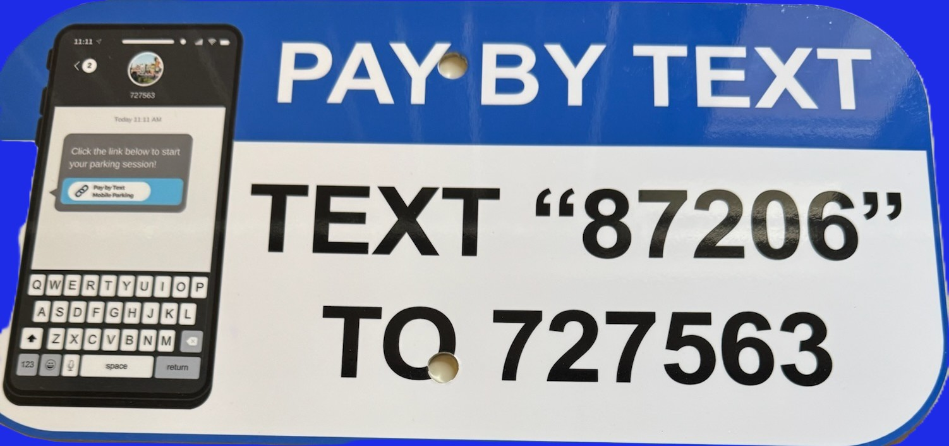
Parking Signage & Mobile App
  The Traffic Shop makes up and installs parking signs as needed.
  Additional Parking Kiosks are being purchased and installed through capital funding.
  Our parking vendor has a mobile app (Park Mobile) available for use at parking kiosks.
  Finance has a Text to Park number available on each kiosk.

Slide 51
Question 9 – General Fund
Discuss the $1.4M budgeted for Water/Sewer Utility and Storm Water Utility.
Please share if this charge is adequate or something that may need to be revisited legislatively.

Slide 52
Water/Sewer & Stormwater Charges
  Funding for Water/Sewer Charges and Stormwater Charges is allocated in our Property Maintenance budget for all General Fund city-owned properties.
  The operating budget is adjusted based on increases to the Water/Sewer Charges and Stormwater Charges as they are proposed.
  Water/Sewer and Stormwater Charges are increased to provide adequate reserves, financial stability, and assure that the utility is self-sufficient. The utility is fully supported by User Fees.

Slide 53
Question 10 – Motor Vehicle
Discuss the ~$6.7M budgeted for motor vehicle fleet replacement plan.
Provide any new additions, deletions, or modifications to the City’s motor vehicle fleet per department, specify costs, and justify the need for new vehicles.
Specify if any of the additional vehicles are hybrid or electric vehicles.
Share if any new changes with the $2.6M budgeted for the fleet services contract.
  Provide vendor name, amount of contract, expiration date, length of contract, and scope of services

Slide 54
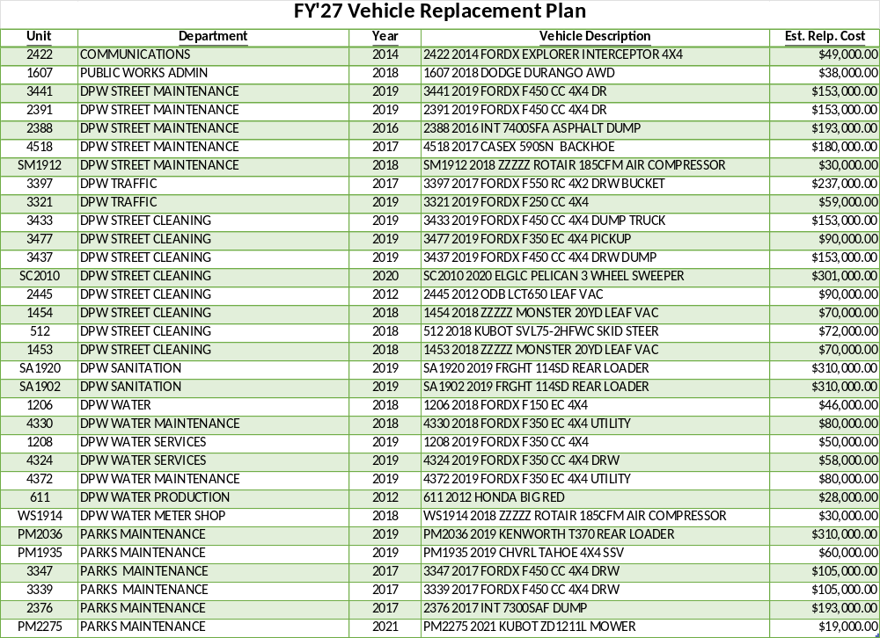

Slide 55
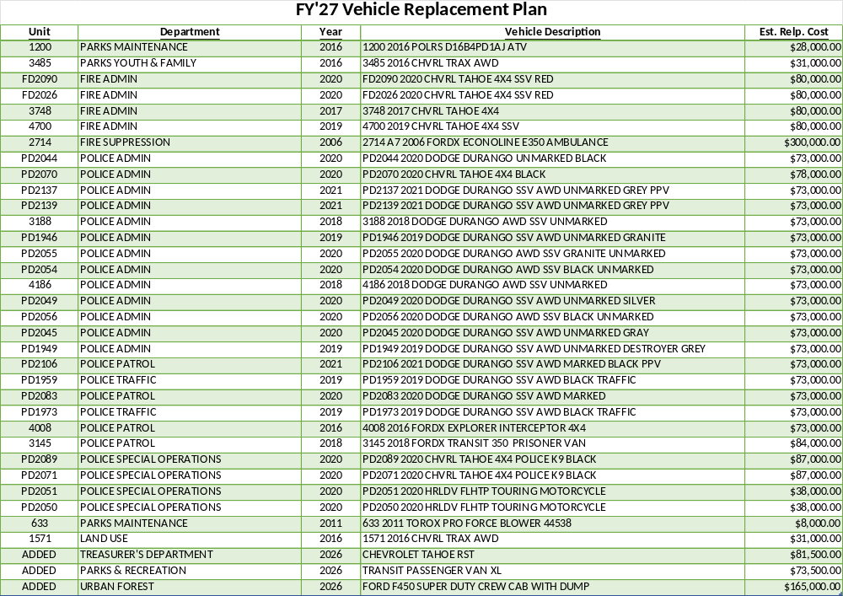

Slide 56
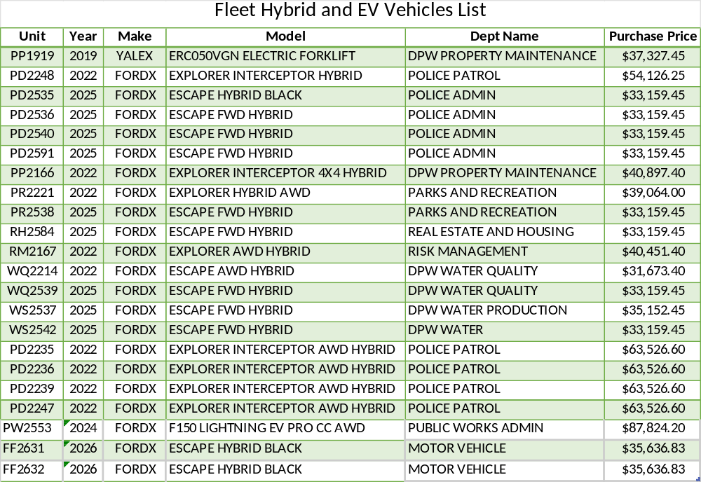
Fleet Replacement Plan
  Based on their availability on the State Contract some replacements may be ordered as Hybrid or EV.
  Fleet vehicles need to be replaced according to the Fleet Maintenance Contract life cycle based on vehicle type or use, or additional non-targeted costs will be incurred.

Slide 57
Fleet Maintenance
The Fleet Maintenance and Repair Services Contract was awarded to First Vehicle Services (now Transdev Fleet Services) effective October 1, 2017. The amended agreement is 5 years with (3) one-year extension options.
  $2.548M Annual Targeted Expenses
  Contract expires June 30, 2033, including the options
Services provided include maintaining fleet inventory, preventive maintenance, emergency repairs, vehicle and equipment repair, vehicle safety and emissions inspections, snow operations, new vehicle inspections and other fleet related activities.
AIM Fuelmaster Annual Maintenance Agreement
  $35k
AIM Fuelmaster Titanium Plan - Cloud Based Data Management System
  $7.5k
Syn-Tech Service for Reading Fuel Modules
  $23k

Slide 58
Question 11 – Motor Vehicle
Considering the escalating cost for Motor Fuels & Lubricants, please share if this budget provides any necessary alternative measures to help mitigate.
Specify if any biofuels as an option, please explain why or why not.

Slide 59
Motor Vehicle Fuels and Lubricants
Unleaded Gasoline - $1.173M
  335,000 gallons based on actual 12-month usage.
Diesel Fuel - $502k
  150,000 gallons based on actual 12-month usage.
Contracts for Gasoline & Diesel Fuel only lock in delivery charges, the price of the products fluctuate based on market conditions.
The costs paid by the City are roughly $0.42 per gallon less than retail because of the City’s tax-exempt status.
AIM Fuelmaster System is utilized on City vehicles and requires a City ID Badge to dispense fuel and the vehicle VDM must be in the database of vehicles that can receive fuel. If both verifications are not met fuel cannot be dispensed.
Biofuels have been used in the past but the cost per gallon was higher than regular gasoline or diesel fuel. E-85 caused maintenance issues with fleet vehicles due to separation during storage.

Slide 60
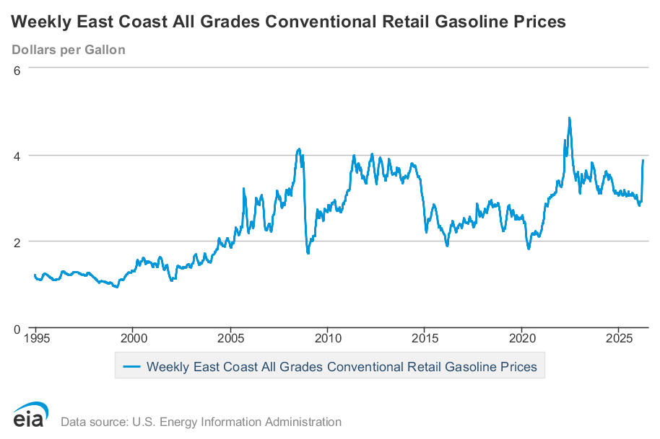
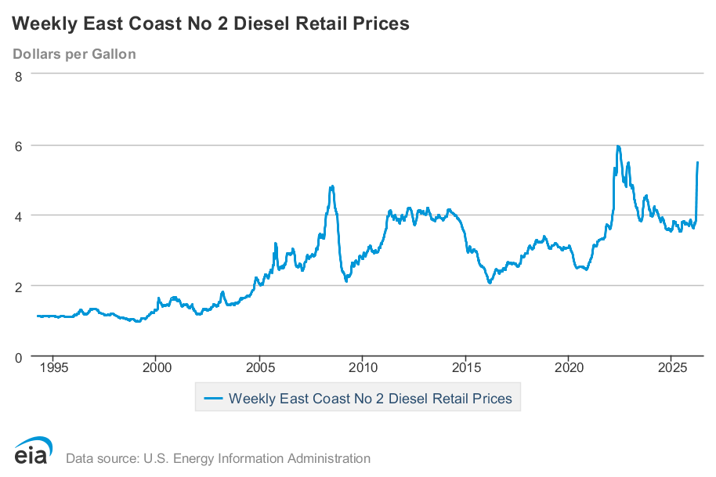
Motor Vehicle Fuels and Lubricants

Slide 61
Question 12 – All Departments
Provide FY2027 proposed organizational chart with the total number of employees (i.e., permanent, temporary, contract, vacancies).
  If there are multiple divisions, please ensure there are sub-org charts that enumerate all the above.
  Please include in the Org chart a photo of all Directors, Managers, Divisions Heads, and Supervisors.

Slide 62
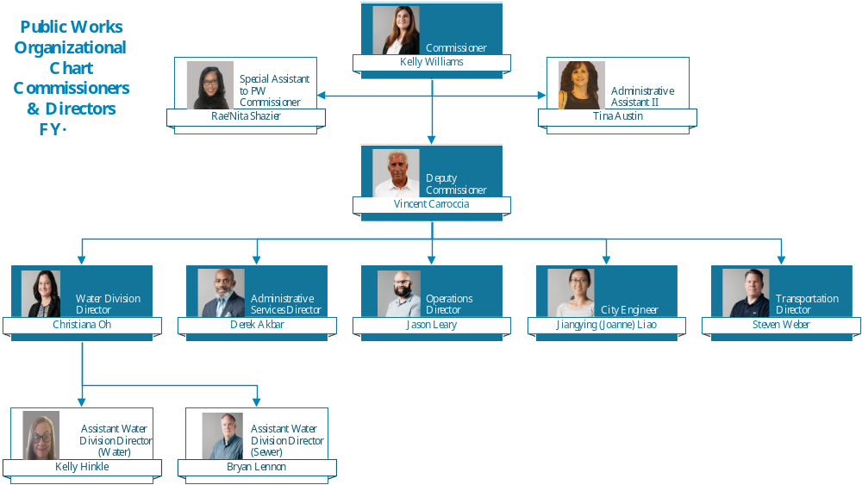

Slide 63
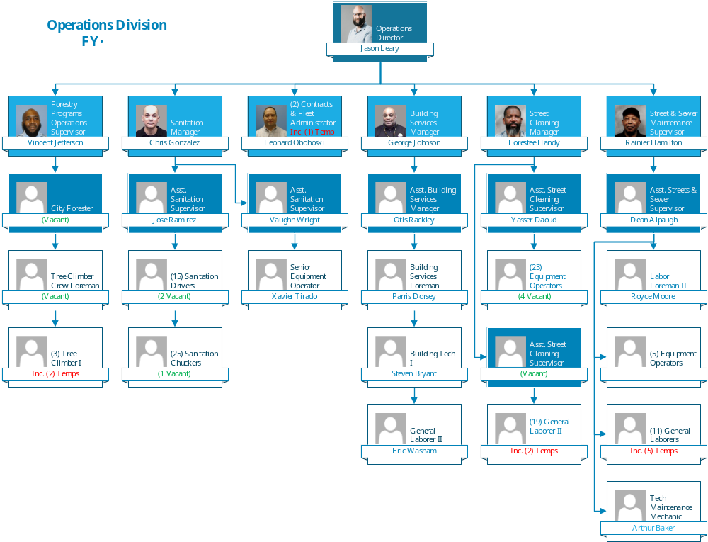

Slide 64
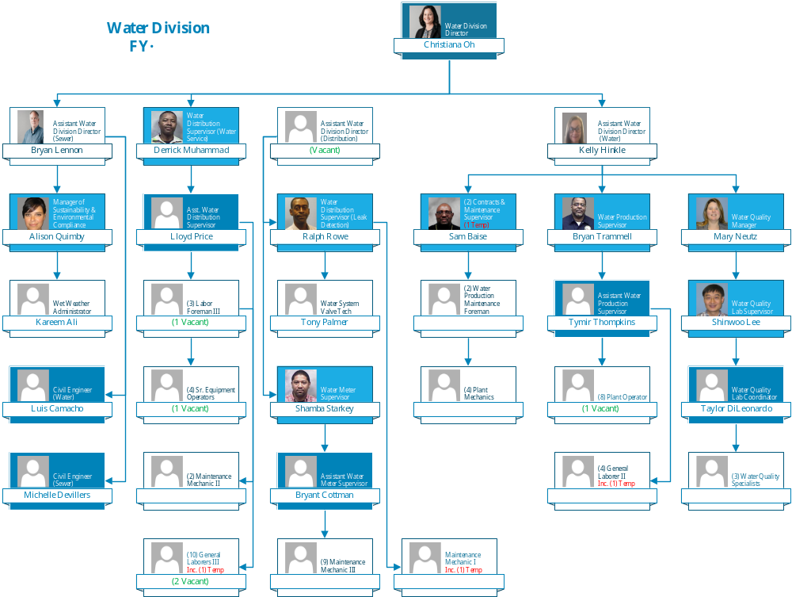

Slide 65
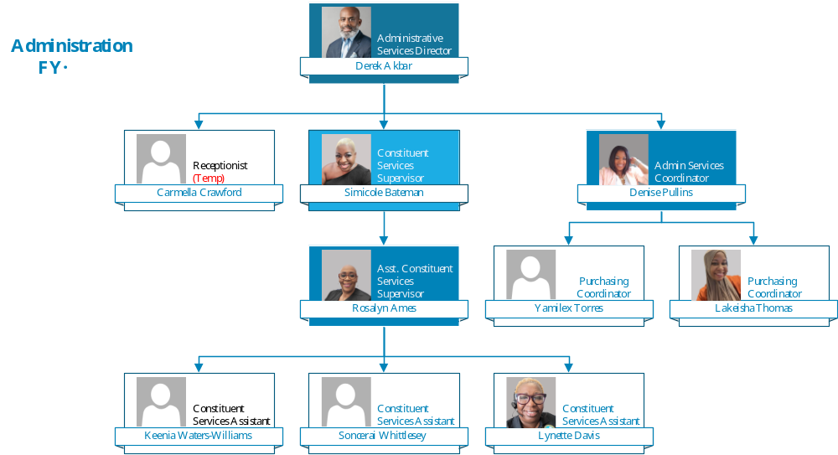

Slide 66
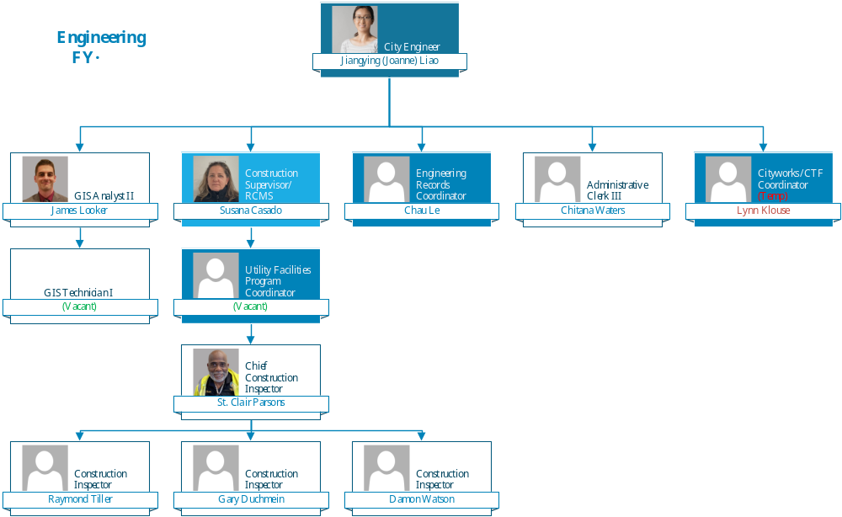

Slide 67
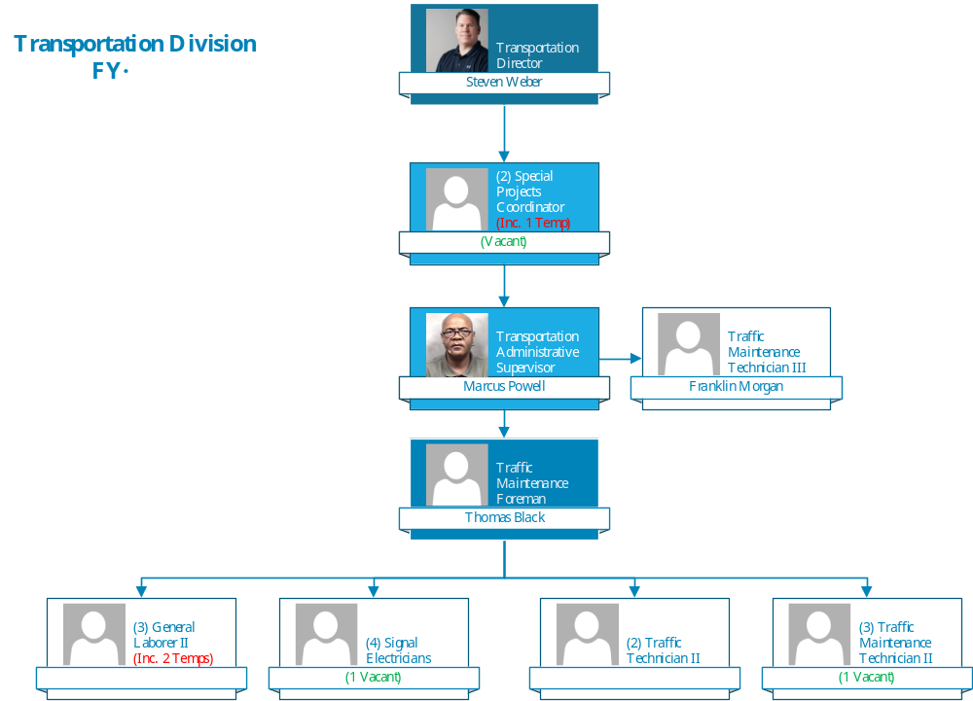

Slide 68
Thank You!

