Slide 1

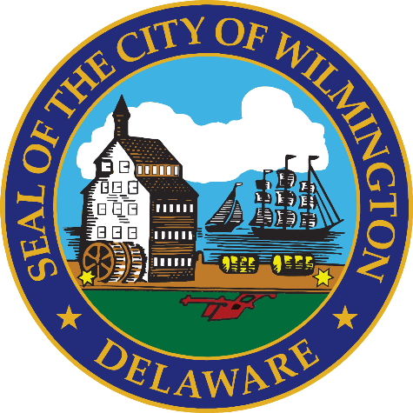
FY 2027 Budget Hearing
PUBLIC WORKS
(Water / Sewer / Stormwater Fund)

Slide 2
Proposed FY 2027 Water/Sewer Fund Budget
Public Works Department Water / Sewer Fund | FY 2024 Actuals | FY 2025 Actuals | FY 2026 Budget | Proposed Budget FY 2027 | $ Change FY’27-26 | % Change FY’27-26
Personal Services | $9,621,389 | $9,975,497 | $11,085,120 | $11,641,647 | $556,527 | 5.0%
Materials, Supplies, and Equipment | 52,024,942 | 53,706,182 | 57,365,604 | 59,120,638 | 1,755,034 | 3.1%
Internal Services | 2,862,457 | 3,411,506 | 1,924,823 | 1,997,406 | 72,583 | 3.8%
Debt Service | 5,402,484 | 4,463,392 | 4,075,821 | 4,700,971 | 625,150 | 15.3%
Depreciation | 11,204,573 | 12,112,801 | 11,204,573 | 12,112,801 | 908,228 | 8.1%
Total | $81,115,845 | $83,669,378 | $85,655,941 | $89,573,463 | $3,917,522 | 4.6%
Staffing Level (Water/Sewer Fund FTEs) | 104.45 | 104.45 | 104.45 | 104.95 | 0.50 | 0.5%

Slide 3
Major Funding Changes (Water/Sewer Fund Proposed Budget)
Position Changes (↑ $65,330) (↑ 0.50 FTE)
  Delete: Utility Project Manager (100% Water/Sewer)
  Add: Assistant Water Division Director – Distribution (100% Water/Sewer)
  Add: Inventory Distribution Specialist (50% Water/Sewer | 50% General)
Personal Services (↑ $556,527) (↑ 5.0%)
  Salaries and Wages (↑ $264,293) – COLAs, Anniversary Steps, and Annual Reviews
  Employee Benefits (↑ $291,729) – Increased Hospitalization Costs

Slide 4
Major Funding Changes (Water/Sewer Fund Proposed Budget)
Contracted Maintenance Services (↑ $918,356)
  Jacobs – Operate and maintain the City’s Sewage Treatment Plant and “REBF”
  Hydrant testing and maintenance
Indirect Costs (↑ $282,933) – Indirect Cost Model (Black & Veatch)
Bulk Chemicals (↑ $180,000)
  Address drinking water taste and odor concerns
  Porter and Brandywine Filter Plants
Notes:
REFB – renewable energy biosolids facility

Slide 5
Major Funding Changes (Water/Sewer Fund Proposed Budget)
Repairs to Water Lines and Sewer Lines - Combined (↑ $147,600)
  Main breaks, valve replacements, aging infrastructures, and winter-related emergency repairs
Building Maintenance (↑ $115,600)
  City/County Building & Asset Management costs
    City (70%) | County (30%)
Repairs to Equipment (↓ $258,000) – offset Building Maintenance increase

Slide 6
Major Funding Changes (Water/Sewer Fund Proposed Budget)
Other Fees (↑ $107,000)
  Stream Guage Monitoring – Elimination of State Funding (DNREC)
  Meter Reading and Billing
    Quality Assurance, Quality Control, and Management Oversight
Consultants (↑ $102,550)
  Miscellaneous Fee Study (B&V) – Utility Fee Schedule and Structure

Slide 7
Major Funding Changes (Water/Sewer Fund Proposed Budget)
Miscellaneous Charges N.O.C (↑ $61,500)
  Backflow Solutions Maintenance agreement (HydroCorp)
    Companion Ordinance: $150.00 Fee for Customer (Backflow Preventer)
        Ord. 26-001-0164
Debt Service (↑ $625,150)
  New Debt Service Schedule – December 2025 Bond Issuance

Slide 8
DEPARTMENT OF PUBLIC WORKS
The mission of the Department of Public Works is to operate, maintain and improve City infrastructure with a commitment to excellence, ensuring superior service to our customers while advancing environmental sustainability for a resilient future for Wilmington.
The Water/Sewer/Stormwater Utility consists of:
  Approximately 108,000 customers inside and outside of the City
  Porter & Brandywine Water Treatment Plants that produce an average of 16 million gallons per day of drinking water
  420+ miles of water transmission and distribution mains
  370+ miles of sewer and stormwater mains
  Regional wastewater treatment plant servicing residents and business north of the C&D canal and part of SE Pennsylvania, approximately 600,000 customers
  Combined Sewer Management Program that captures more than 80% of stormwater run-off within the City

Slide 9
Vision
To manage our utility and resources to meet evolving regulatory requirements, water supply needs and customer expectations in the future.
Priorities for FY 2026 – Water/Sewer Fund
  Provide customers with safe, reliable water, wastewater and stormwater mitigation services, and continue 100% compliance with regulatory requirements.
  Comply with forthcoming regulations from the EPA and Delaware Office of Drinking Water which include:
    Prepare for compliance with EPA PFAS regulations
    Complete a service line inventory and replacement plan under the Lead and Copper Revised Rule
  Maintaining a standard of exceptional integrity, honor, and respect through open communication and accessibility.

Slide 10
Performance Measures
  The 3 major performance measures for the utility include:
    Number of non-compliance events that must be reported to a state or federal agency, such as: CSO overflows, NPDES violations, Boil Water Advisories, Safe Drinking Water Act violations
    Length of time a customer is without water, measured in hours
    Number of water quality complaints

Slide 11
City Council Questions

Slide 12
Question 1 – Water/Sewer Fund
Council has a fiduciary duty to ensure the water sewer fund is solvent and has the necessary funding and adequate resources to support the city’s largest asset. Please discuss the following:
Explain the correlation of $9M for Indirect Cost, up $550K, to the proposed 9.95% increase for water, sewer, and stormwater rates.

Slide 13
Indirect Costs
  Comprehensive indirect cost allocation studies are commonly performed once every five years or so and/or whenever there are any material departmental changes within a municipal government’s organizational structure. The comprehensive study helps define an allocation plan which is then used by municipalities to update and allocate indirect cost budgets to the enterprise fund departments.
  OMB uses its Indirect Cost Allocation Plan to first determine the O&M indirect cost budget allocation for each direct division of the 421 Water/Sewer Fund. Then, the water, sewer, stormwater O&M costs inclusive of the indirect costs along with all other revenue requirements (such as capital costs and reserves) determine the level of annual rate increases that are needed. Therefore, while the O&M indirect costs allocated each year to the water, sewer, and stormwater utilities are an integral part of the total water/sewer fund cost increases, the magnitude of the allocated indirect cost increase could be higher or lower than the annual water/sewer and stormwater rate increases.
  The indirect cost allocation (referred also as pricing of internal services) is a governmental best practice that is adopted widely in the public sector, where an Internal Service Fund and/or General Fund provides services to an Enterprise Fund. Therefore, the operating budgets of water/sewer utilities include indirect costs. Attached are a couple of resources that provide an overview of governmental best practices for determining and allocating indirect costs to enterprise fund departments.
  Pricing Internal Services [gfoa.org] (GFOA website)
Highly Recommended: Sound Practices for Calculating Enterprise Fund Indirect Costs | Mass.gov [mass.gov] (Commonwealth of Massachusetts)

Slide 14
Question 2 – Water/Sewer Fund
The Resilient Wilmington Report was done July 2025, please share if this budget provides funding and resources to address the following:
Greenhouse Gas Reduction Initiative
Flood & Heat Resilience Infrastructure Improvements
Community Outreach & Capacity Building

Slide 15
Resilient Wilmington
  Greenhouse Gas Reduction Initiative
    The budget for Resilient Wilmington covers the generation of, and updates to, the Resilient Wilmington Report. It also covers coordination activities with the Interdepartmental Resilient Wilmington Working group. Resiliency related projects have different budget line items in the Department and Divisions which initiate the project work.
  Flood & Heat Resilience Infrastructure Improvements
    Flood and Heat Resiliency projects are funded in the Department and Divisions which initiate the project work.
    DPW is pursuing grant funding (FEMA and/or USACE) for Flood Resilience Improvements for Northeast Wilmington based upon the recommendations of the Lower Brandywine Flood Study. The Final Study report is in draft form and will be released in the next 4-8 weeks.
  Community Outreach & Capacity Building
    Community Outreach & Capacity Building is primarily accomplished with internal staffing and is supplemented with Resilient Wilmington funding and collaboration with the Partnership for the Delaware Estuary.

Slide 16
Question 3 – Water/Sewer Fund
Discuss the vitality of the City’s drinking water for both lead and copper, and if this budget provides adequate funding and resources to meet all EPA regulations.
Specify if the City test drinking water for PFAS, also known as “forever chemicals” which are manmade chemicals that are linked to major health issues.

Slide 17
Lead & Copper Rule / PFAS
The City of Wilmington’s drinking water system is in compliance with EPA Lead and Copper Rule requirements. Corrosion control treatment is in place, and lead is not present in treated water leaving the plant; risk is limited to older service lines and plumbing. The City maintains a service line inventory and is advancing replacement efforts, indicating that current funding supports regulatory compliance, though continued investment will be needed for future requirements.
Wilmington tests for PFAS (“forever chemicals”), including PFOA and PFOS. Current results show PFOA meets standards, while PFOS is slightly above proposed limits. The EPA’s final PFAS drinking water regulations were issued in 2024, with compliance required by 2031. Wilmington is actively monitoring, planning treatment improvements, and has already secured some funding although there is still a very large funding gap. The City on track to meet the required compliance timeline for PFAS. Additional information, including steps residents can take to minimize potential exposure, is available online and in our annual Consumer Confidence Report.
Customers can check their service line information on our interactive map at https://www.wilmingtondewater.gov/245/Service-Line-Inventory-Map.

Slide 18
Question 4 – Water/Sewer Fund
Share the total amount of funding received from the Bipartisan Infrastructure Funds since inception and specify how this funding has helped defray costs to your budget.

Slide 19
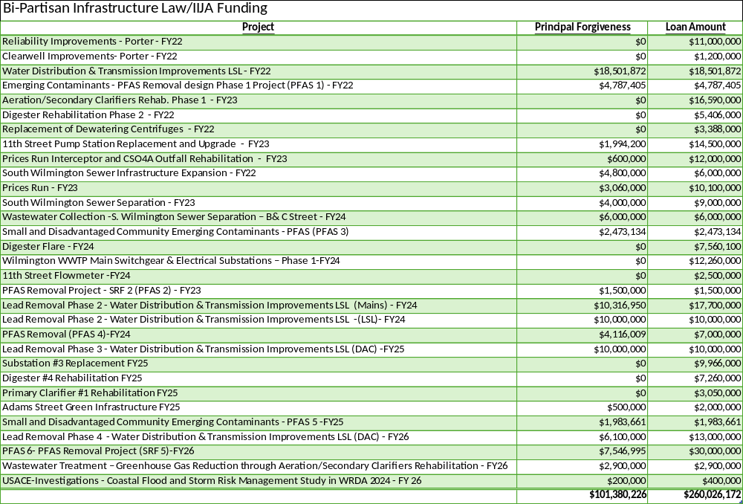
Bipartisan Infrastructure Funds

Slide 20
Water System Budget
Funding received through the Bi-partisan Infrastructure Law (BIL) has mainly come to the City in the form of principal forgiveness in State Revolving Fund (SRF) loans for drinking water and clean water.
Principal forgiveness means the repayment of these funds at the completion of the project is waived.
This lowers the Water/Sewer/Stormwater capital improvements rate impact because of a reduction in debt service that would otherwise be required to pay down the loans.

Slide 21
Question 5 – Water/Sewer Fund
With the mounting costs to maintain the water sewer system for budget of $90M, please share how this budget is aligned with the following priorities and provides the necessary funding and resources:
Water Quality Protection
Water Main Replacements
PFAS Treatment Pilot Study
Delaware River Nutrient Compliance
Drinking Water Treatment Plant Optimization
Hydrant and Valve Rehabilitation Program

Slide 22
Water System Budget
Water Quality Protection
  Drinking water treatment plants operate 24/7/365
  Thousands of water quality tests performed annually across the system
  Ongoing corrosion control treatment to meet Lead and Copper Rule requirements
  Ongoing PFAS treatment upgrades and sampling
  Customer Impact: Continuous delivery of safe and reliable drinking water that meets all EPA standards
Water Main Replacements
  System includes ~420 miles of water mains
  City experiences ~100-150 water main breaks per year, driving replacement priorities
  Annual capital program replaces aging, high-risk mains
  Customer Impact: Fewer breaks, improved reliability, and reduced service interruptions over time

Slide 23
Water System Budget
PFAS Treatment Pilot Study
  PFAS detected at low levels; PFOS slightly above proposed limits
  ~$2 million in grant funding secured for PFAS response efforts
  Pilot studies underway to evaluate treatment technologies ahead of 2031 compliance deadline
  Customer Impact: Proactive reduction of “forever chemicals” and long-term regulatory compliance
Delaware River Nutrient Compliance
  Wastewater treatment plant treats ~70 million gallons per day (MGD)
  Ongoing investments to meet Delaware River Basin Commission nutrient limits
  Customer Impact: Protects regional waterways and avoids costly regulatory penalties that could impact rates

Slide 24
Water System Budget
Drinking Water Treatment Plant Optimization
  System produces ~16-20 million gallons per day (MGD) of drinking water
  Continuous process improvements and chemical optimization to reduce chemical costs in an unstable market
  Customer Impact: Consistent water quality, continuous service, fire storage, and minimize chemical costs that could impact rates
Hydrant and Valve Rehabilitation Program
  System includes thousands of hydrants and valves requiring routine maintenance
  Annual inspection and exercising program to maintain operability and improve infrastructure
  Customer Impact: Improved fire protection, faster isolation during breaks, and shorter outages

Slide 25
Question 6 – Water/Sewer Fund
Now that Jacob’s is in the 7th year of the 20-year agreement for management of the Wastewater Treatment Plant for $27M (~$500M over 20 years) that accounts for 30% of this budget, please share the mechanisms in place to ensure quality control compliance and management oversight.
Please share any community investment.

Slide 26
WWTP Contract Operations
This budget accounts for the cost of the operations contract for the Wastewater Treatment Plant (WWTP) with Jacobs (OMI). The City receives revenue from New Castle County in the form of wholesale billing to account for the County's wastewater discharges to the plant. Approximately 80.58% of the costs to operate the Wastewater Treatment Plant are allocated to New Castle County.
Monthly Operations and Maintenance meetings are held between City Staff and Jacobs.
Wastewater Treatment Committee Meetings are held every 2 months between the City, New Castle County and Jacobs.
Quarterly Business Meetings between the City and Jacobs are held to review key performance indicators of the wastewater treatment plant and discuss operational and capital projects. These are attended by Public Works staff including the Commissioner and Deputy Commissioner
Jacobs provides monthly discharge monitoring reports to DNREC (with copies to the City) of tabular data and information including water quality sampling and testing. These reports demonstrate compliance with the requirements of the NPDES Permit for the WWTP.
The City and Jacobs are co-listed on the NPDES permit for the WWTP so that both parties have a vested interest in compliance.
The annual true-up of the Wastewater Contract fees with Jacobs and the annual true up of New Castle County's allocation of WWTP costs are reviewed by the Water Division's financial consultant.

Slide 27
WWTP Contract Operations
Community Investment
    School Supplies for the Back-To-School Drive - August
    Food Drive for the Sunday Breakfast Mission - November
    On-Site Tours for Delaware Technical Community College – November
    Collected Toys for the Mayor's Toy Drive - December
    Assembled 500 Snack Bags for The WRK Group at The Warehouse - January
    On-Site Tours for The Tatnall School – February
    Earth and Arbor Day Event - April
    Year-Round Internship - Delaware Resident

Slide 28
Question 7 – Water/Sewer Fund
In addition to staffing salaries and benefits for $11.6M, justify the planned use for $5.8M in Professional Fees (Consultants $2.2M, Engineering $2.8M, Legal $103K, and Temp Agency $565K).
Specify vendor name, amount of contract, expiration date, length of contract, how long City has been doing business with the vendor, ROI, and purpose.
Specify if there are any DBE’s.
Specify if it is more cost-effective to continue some services contracted out versus in-house.
Explain why $0 has been expended from Legal Fees for last 3 years.

Slide 29
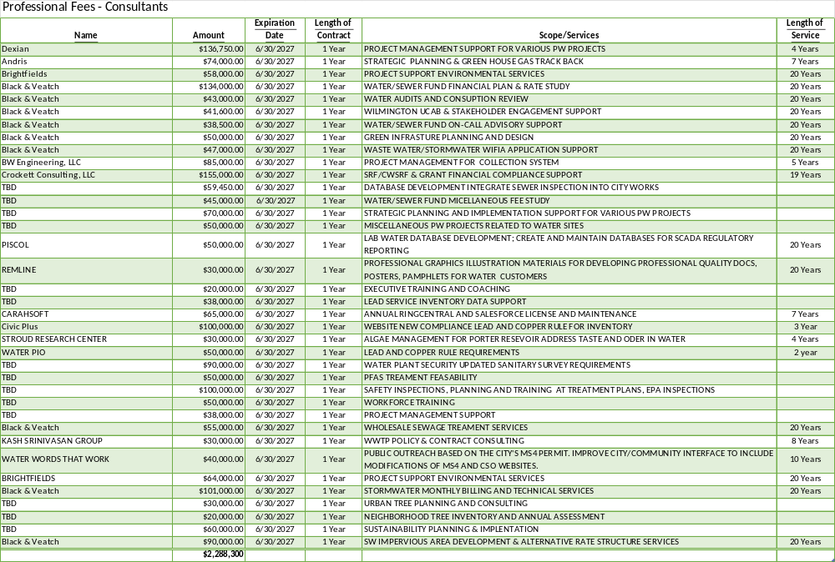

Slide 30
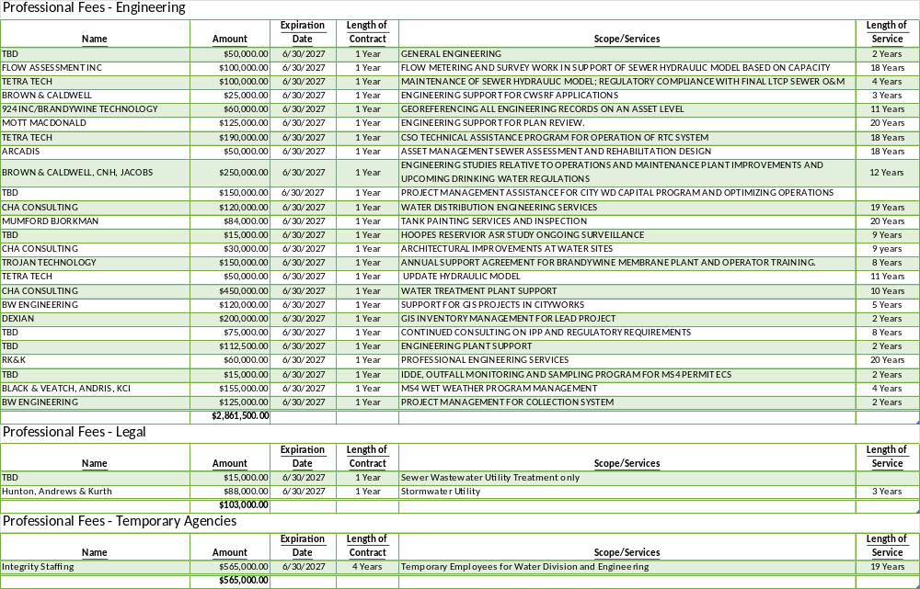

Slide 31
Professional Fees Water/Sewer Fund
  Public Works managers bring in the necessary assistance they need for the project at hand.
  Specific expertise is often required for which we don’t have someone on staff that can design or engineer a specific project.
  By using outside engineers, the design liability is assumed by the engineer of record not the Public Works manager.
  With the large number of projects on-going there are not enough project managers on staff. Our staff manages outside engineers and consultants to assure that tasks and projects are completed successfully.
  Legal Fees – There has been no active litigation involving the utility over the past 3 years requiring the expenditure of funds budgeted. This can rapidly change.

Slide 32
Question 8 – Water/Sewer Fund
Discuss the planned use for ~$13M budgeted in the Contract Maintenance account grouping and share if this provides the necessary funds to address any major repairs to water and sewer lines.
Specify if there are any DBE’s.
Specify the number of large meters scheduled for replacement and testing.
Specify number of main break and valve replacements that are scheduled.

Slide 33
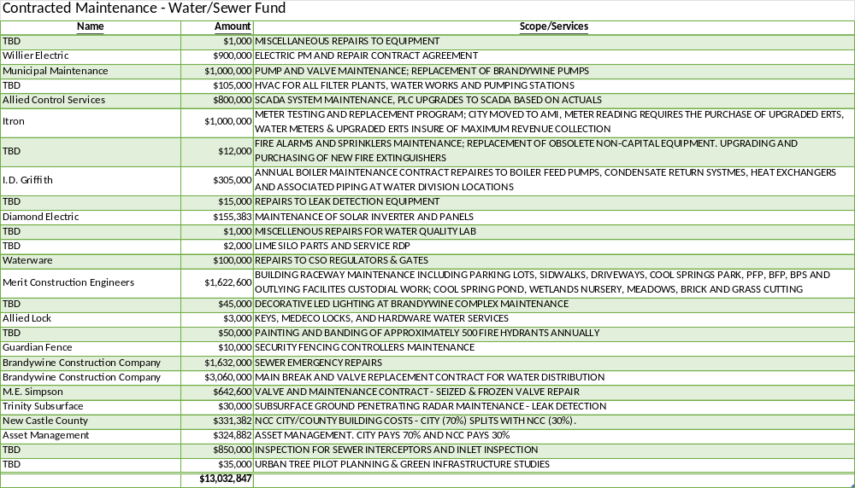

Slide 34
Contracted Maintenance – Water/Sewer Fund
Tribus / Wilmington | FY’27 Estimated Quantities
5/8” – 1” Meter Replacement | 700
1 ½” – 2” Meter Replacement | 30
3" | 15
4” | 15
6” | 5

Slide 35
Contracted Maintenance – Water/Sewer Fund
Tribus / Wilmington | FY’27 Estimated Tests
1 ½” (tested every five years) | 5
2" (tested every five years) | 20
3" (tested every 3 years) | 150
4" (tested every 2 years) | 120
6" and 8” (tested every year) | 55

Slide 36
Contracted Maintenance – Water/Sewer Fund
Fiscal Year | # Main Breaks
FY’24 | 80
FY’25 | 129
FY’26 y-t-d | 78
  Water main breaks and valve replacement are emergency work and therefore are not scheduled. This contract is used for emergency response to breaks and leaks.
  Valves Replaced FY’26 y-t-d - 12

Slide 37
Question 9 – Water/Sewer Fund
Discuss the impact to the department regarding vacant positions.
Specify duration of the vacancy.
Specify timeframe for filling position.
Specify any impact to $526K budgeted in Overtime, Temp Agency $565K, and Consultants $2.2M.
Specify any impact with the Residency requirement for filling vacant positions.

Slide 38
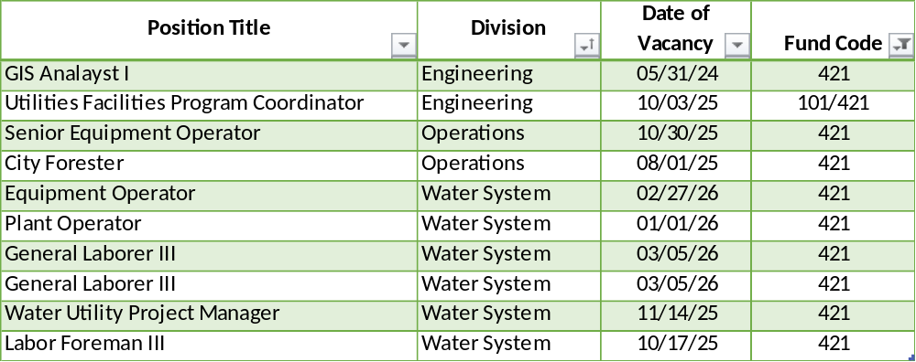
Changes / Vacant Positions – Water/Sewer Fund

Slide 39
Vacant Positions – Water/Sewer Fund
  We are working closely with Human Resources to fill vacancies as quickly as possible that are approved by the Chief of Staff.
  Public Works averages 18-25 vacancies due to employee turnover and has experienced difficulty in the current labor market attracting and retaining qualified staff due to the available salary ranges and residency requirements.
  One applicant for Forest Program Operation Supervisor turned down the position due to the City’s Residency Requirement.
  Temp Employees are being used to perform some of the job functions of vacant positions where possible.

Slide 40
Question 10 – Water/Sewer Fund
Discuss the planned use of approximately $2.1M budgeted in Petroleum and Chemicals account line pertaining to the water treatment at both Porter and Brandywine Filter Plants.
Specify if concerns with taste and odor has been addressed.

Slide 41
Petroleum and Chemicals – Water/Sewer Fund
Motor Fuels & Lubricants - $16k
  Propane Gas Cylinders – Keen
  Lubrication for Pumps and Motors – Reit Energy Co.
Bulk Chemicals - $1.98M
  Chemicals for Water Treatment
Laboratory Supplies - $143.2k
  Misc. Lab Supplies & Parts – Fisher Scientific & Hach
  Supplies for Bacteria Analysis - Idexx
  Nitrogen for TOC Analyzer - Keen Gas
  Bottleware – Scientific Specialties
  Parts for TOC Analyzer - Teledyne

Slide 42
Bulk Chemicals – Water/Sewer Fund
  Chemical usage is based on average production of 20 MGD. Chemical usage is being continually optimized and is based on production demand. Main breaks and leaks result in higher water production and therefore require additional water treatment chemicals.
  Usage of water from Hoopes Reservoir requires much higher levels liquid Ferric Chloride to coagulate. This also requires higher dosing of Lime to balance ph. Heavy rain events; pollution discharge; or drought conditions can require the switch to Hoopes water. Hoopes Reservoir is the City’s backup source to ensure continuous clean water.
  Bulk chemical usage is not linear. Water production is higher during spring and summer periods and requires greater chemical usage during warm months.
  Our two most frequently used chemicals are Ferric Chloride and Sodium Hypochlorite. These have both increased in price by 93% and 44% respectively since 2022.

Slide 43
Taste & Odor – Water/Sewer Fund
  Wilmington's drinking water occasionally experiences temporary taste and odor issues, often due to seasonal algal growth in the source water. While these issues can cause an earthy taste or smell, the water remains safe to drink, as the City's treatment processes effectively removes the algae. Wilmington Water is continually working on long-term solutions to proactively minimize these aesthetic concerns.
  Taste and odor are aesthetic (not health) concerns, caused by naturally occurring compounds from seasonal algae that can give water an earthy or musty taste or smell. Seasonal algae blooms are becoming more frequent and intense due to climate change, as warmer temperatures and increased nutrient runoff create ideal conditions for growth. The water remains safe to drink and meets all standards.
  Wilmington actively manages these conditions by adjusting treatment, including dosing powdered activated carbon (PAC) as needed to remove taste and odor causing compounds. The City has also implemented an LG Sonic buoy system to control algae at the source and will continue improving this system this summer to further reduce occurrences.

Slide 44
Question 11 – Water/Sewer Fund
Discuss the ~$809K budgeted in the Miscellaneous, Materials, Supplies, or Parts account line.
Specify if any of the vendors are DBE’s.
Specify the number of fire hydrants slated for replacement.

Slide 45
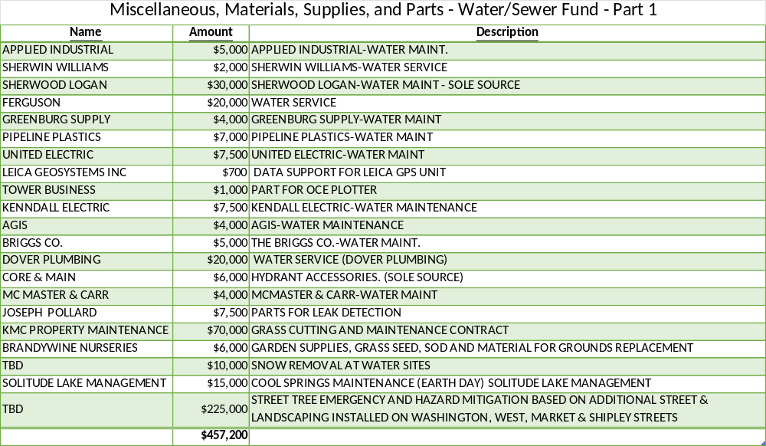

Slide 46
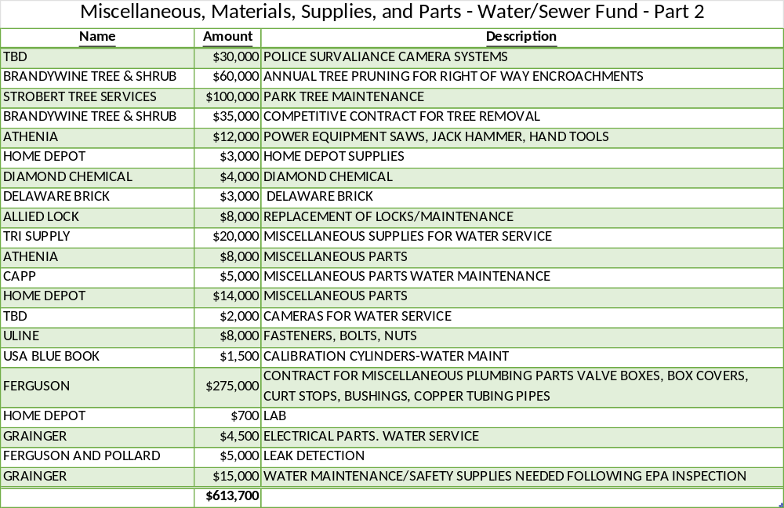

Slide 47
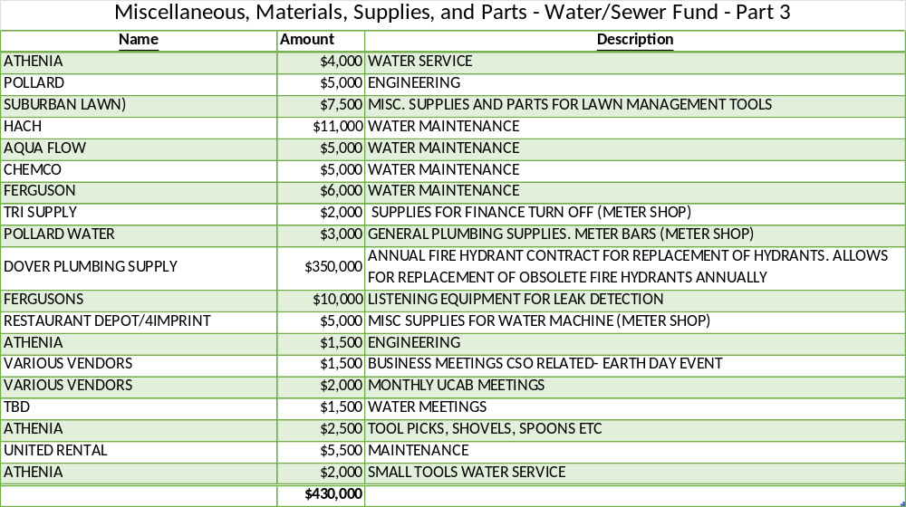
Fire Hydrant Replacement - 75

Slide 48
Question 12 – Water/Sewer Fund
Justify the $795K budgeted in Construction & Repairs account line, considering year to date is well below budget, and the last 3 years has trended well below budget.

Slide 49
Construction and Repairs – Water/Sewer Fund
Building Supplies - $1.5k
  Blanket PO for Home Depot
Materials & Supplies-Roads - $458k
  Concrete
  Black Top Hot Mix
  Cold Patch
  Mineral Aggregates
  Catch Basins
  Manhole Covers, Catch Basins, Monument Boxes
Water Meter Shop Supplies - $335k
  Water Meters – Over the past 3 years there have been supply chain issues with deliveries in excess of a year.
  Fire Meters
  Itron ERT’s – Over the past 3 years there have been supply chain issues with deliveries in excess of a year

Slide 50
Question 13 – Water/Sewer Fund
Share the plans for informing the public regarding homeowner connection and the water protection subsidy.
Specify number of participants over the last 2 years.

Slide 51
Community Activities – Water/Sewer Fund
Homeowner Connection Subsidy - $60k
  Customers are notified whenever Water Service responds to a leak on property or when they contact Engineering Division for assistance. This is also advertised on the Wilmington Water website at https://www.wilmingtondewater.gov/209/Lead-Service-Line-Replacement.
Water Protection Subsidy - $60k
  These funds are used for grants to agencies upstream on the Brandywine Creek to prevent contaminants from entering the surface water supply to decrease downstream treatment costs.
Fiscal Year | Expenditures ($1,000 each)
FY’24 | $9,000
FY’25 | $13,000
FY’26 y-t-d | $17,000

Slide 52
Question 14 – Water/Sewer Fund
Discuss whether this budget provides adequate funding for training and professional development for staff.

Slide 53
Training & Professional Development – Water/Sewer Fund
Funds are budgeted for staff to attend conferences and seminars; Water Quality Training, GIS conferences, Delaware Rural Water Association Training, Damage Prevention Conferences, Construction Training, Customer Service Training, SCBA Certification, Water Operators License Fees, Water Quality Training, etc.

Slide 54
Question 12 – All Departments
Provide FY2027 proposed organizational chart with the total number of employees (i.e., permanent, temporary, contract, vacancies).
  If there are multiple divisions, please ensure there are sub-org charts that enumerate all the above.
  Please include in the Org chart a photo of all Directors, Managers, Divisions Heads, and Supervisors.

Slide 55
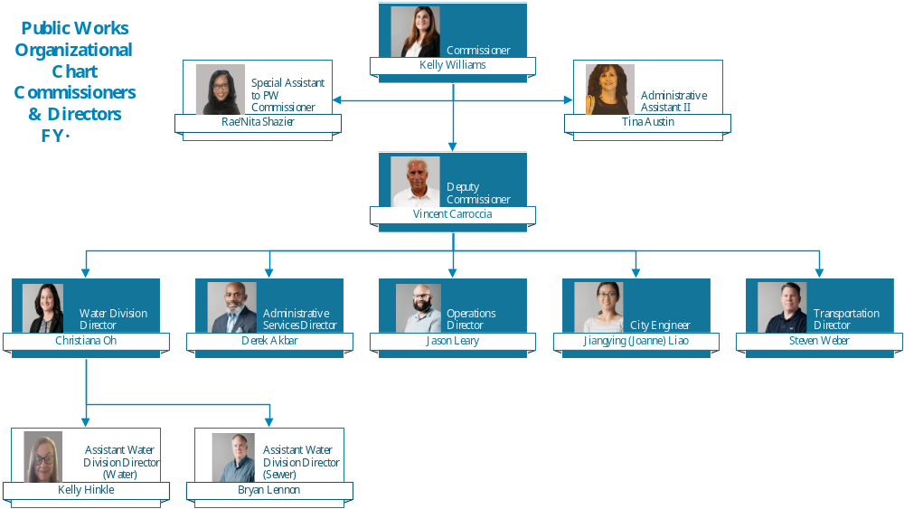

Slide 56
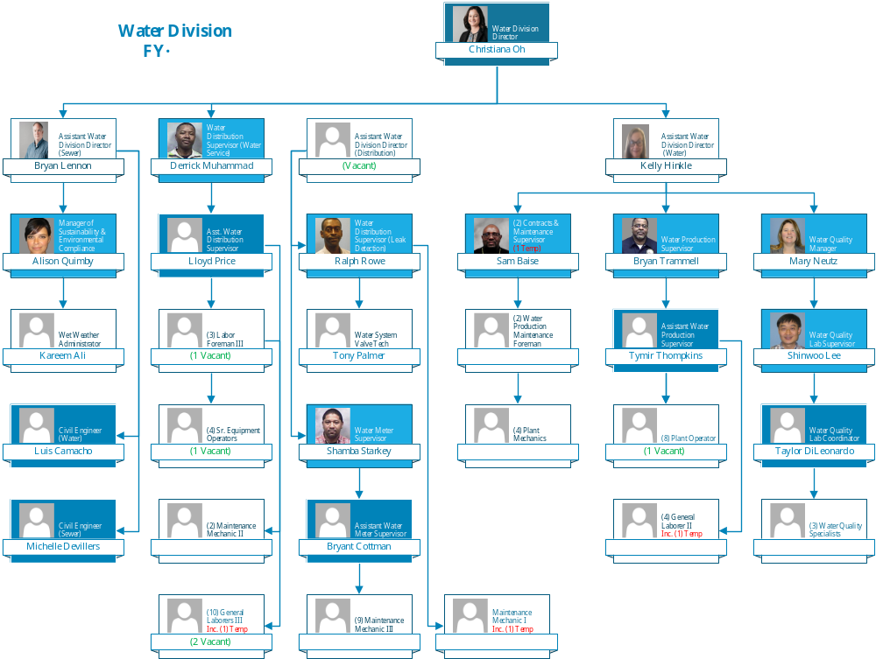

Slide 57
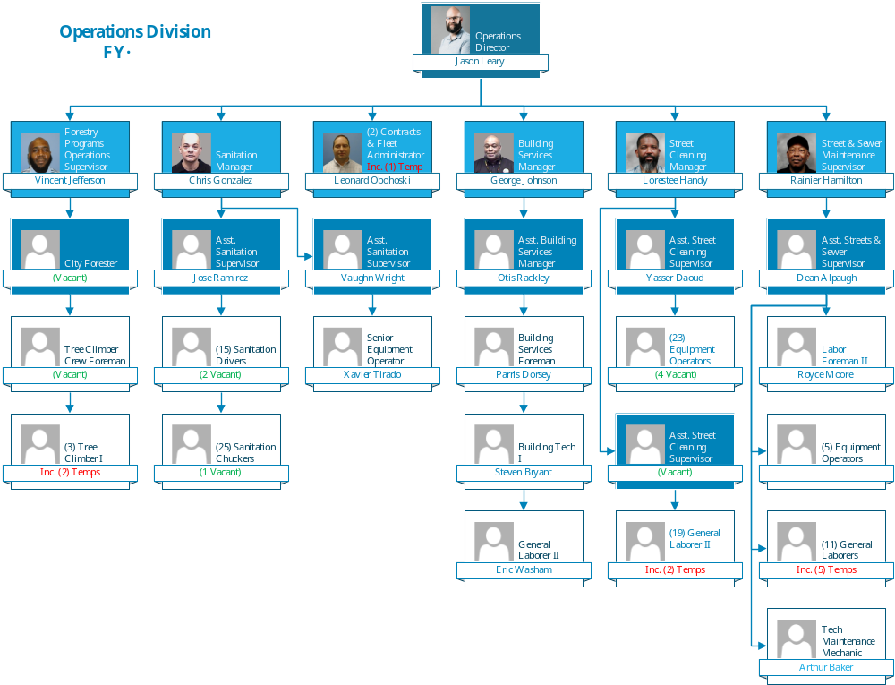

Slide 58
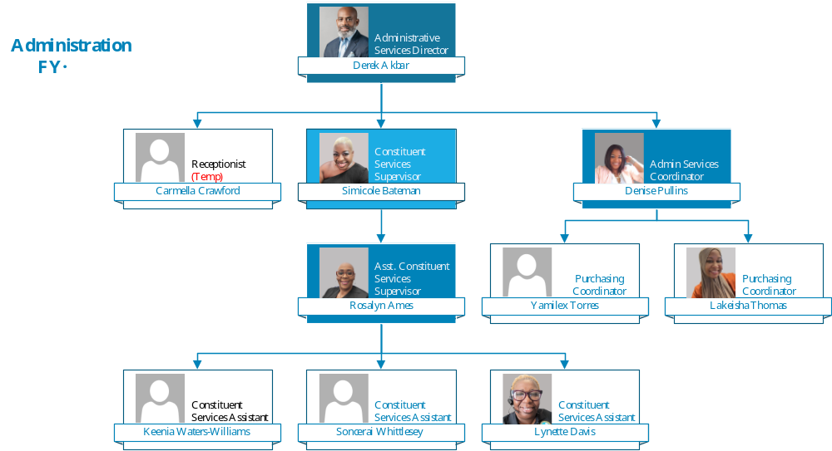

Slide 59
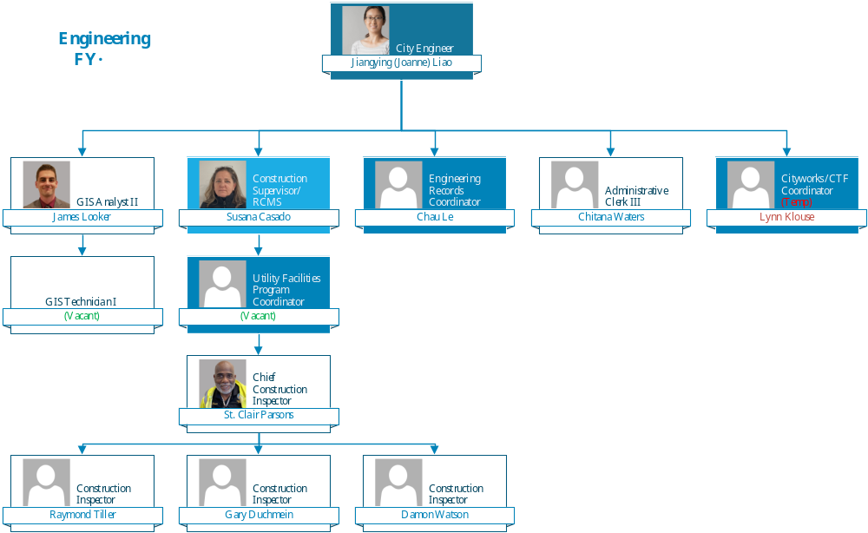

Slide 60
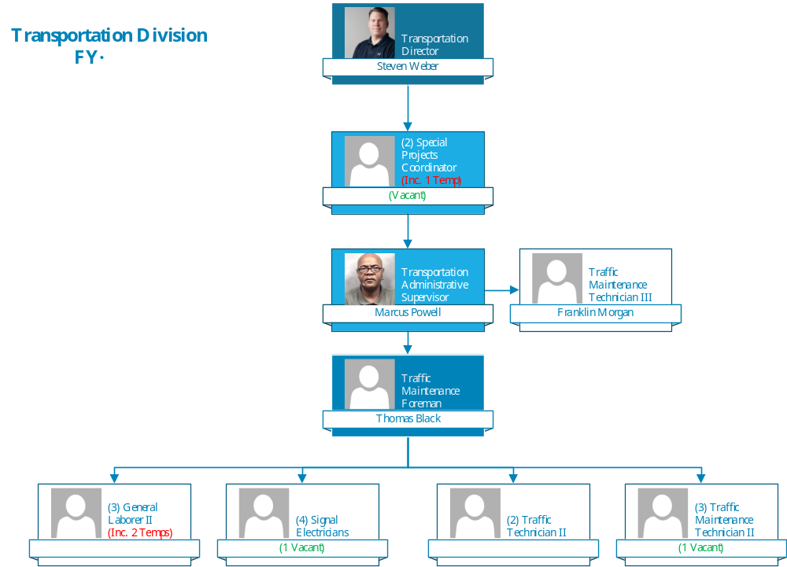

Slide 61
Thank You!

