Slide 1

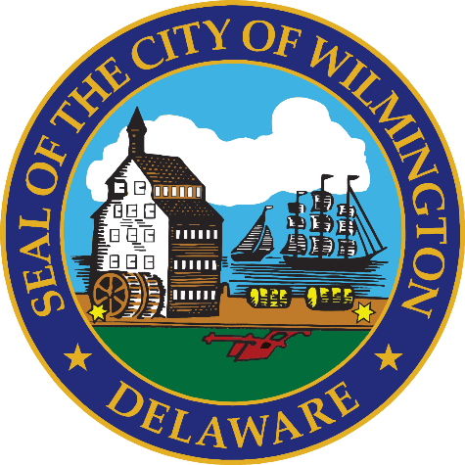
FY 2027 Budget Hearing
REAL ESTATE & HOUSING

Slide 2
FY 2027 General Fund Budget
General Fund | FY 2024 Actuals | FY 2025 Actuals | FY 2026 Budget | Proposed Budget FY 2027 | $ Change FY’27-26 | % Change FY’27-26
Personal Services | $314,633 | $309,681 | $306,625 | $312,640 | $6,015 | 2.0%
Materials, Supplies, and Equipment | 1,306,443 | 1,510,051 | 1,622,600 | 1,622,100 | (500) | 0.0%
Internal Services | 34,469 | 32,716 | 63,141 | 65,655 | 2,517 | 4.0%
Debt Service | 730,971 | 708,748 | 685,945 | 791,710 | 105,765 | 15.4%
Total | $2,385,516 | $2,561,196 | $2,678,311 | $2,792,105 | $113,794 | 4.2%
Staffing Level (FTEs) | 2.15 | 2.20 | 2.00 | 2.00 | 0 | 0.0%

Slide 3
Major Funding Changes, General Fund – Proposed FY 2027 Budget
Personal Services Changes
  Regular Salaries (↑$4,461) – COLAs and Anniversary Step Increases.
Materials, Supplies, and Equipment Changes
  Consultants (↑$5,000) - Ensure compliance with federal reporting requirements
  Miscellaneous Charges-N.O.C (↓$5,000) - Eliminated
Debt Service (↑$105,765) – December 2025 Bond Issuance

Slide 4
Major Funding Changes, HUD Grant Funds
FUND | FY 2026 Award | FY 2027 Award | $ Change FY’26-’27
CDBG | $2,261,378 | $2,224,294 | <$37,084>
HOME | $477,885 | $464,610 | <$13,275>
HOPWA | $944, 530 | $1,053,630 | $109,100
ESG | $197,824 | $198,751 | $927
Total | $3,881,617 | $3,941,285 | $59,668

Slide 5
Departmental Vision
The vision of the Department of Real Estate and Housing is to improve the quality of life for the residents in the City of Wilmington by increasing the supply of affordable housing, improving housing markets and the existing housing stock, promoting self-sufficiency and engaging in activities to stabilize and revitalize neighborhoods.
The Department plans, allocates, and administers Federal, State, and local resources for the benefit of persons of low- and moderate-income and the neighborhoods in which they live, involving residents to the greatest extent feasible in decisions that affect their lives. In carrying out this mission, the Department partners with other City departments, government agencies, the private sector, and other organizations that share its goals.

Slide 6
Top Three Priorities
Increase the supply of affordable housing that is decent, safe and sanitary.
Engage in activities geared toward stabilization and revitalization of neighborhoods.
Increase homeownership opportunities through City-sponsored initiatives and collaborative efforts with non-profit and for-profit developers.

Slide 7
Top Three Performance Measures
Support organizations that provide services to Wilmington’s most needy residents in compliance with the funding sources.
Administer and/or fund programs to create affordable housing, preserve existing housing and help stabilize neighborhoods.
Increase the accessibility to affordable homeownership units.

Slide 8
Question 1 - The Delaware General Assembly recently introduced SB# 23, to require counties and municipalities to include an affordable housing plan in comprehensive plans. If passed, it would require municipalities to develop an affordable housing plan that includes an inventory of existing affordable housing, an analysis of existing and projected housing needs for all income levels along with an assessment of barriers to meeting those needs, reporting on the percentage of permits issued for affordable housing, percentage of all housing units in the City that meet the definition of "affordable," and an objective of reaching a minimum of 20% affordability for all housing inventory. Is this budget sufficient to support compliance with the objectives and reporting standards of the affordable housing plan component of the comprehensive plan, if enacted?
The proposed legislation requires Affordable Housing Plans for counties and municipalities with populations over 2,000. REH already completes a 5-year Comprehensive Plan that includes affordable housing. A multi department response is expected to meet compliance of SB#23 including Land Use, OED and Mayor’s Office.

Slide 9
Question 2 - Understanding the 5-year revenue and expenditure projections show expenditures far outpacing revenues for FY27 to FY30, and FY27 General Fund Proposed Budget uses$25.7M of the Tax Stabilization Reserve Fund, please share how this budget aligns with closing any potential budget gaps.
Specify any cost savings or reductions, and if this budget provides adequate resources to meet the departmental needs.
Specify any high-level major additions.
REH’s Administration, Program and Project funding is primarily federally funded. Additional nonfederal programs and projects would require additional staffing or consultancy based on volume and detail of the project and programs.

Slide 10
Question 3 - Discuss the planned use for $20M drawdown from the Tax Stabilization Reserve Fund to the Neighborhood Stabilization Fund for special projects: $16.8M Affordable Housing, $2M Vacant Lots, $500K Home Repair Lottery, $500K Landbank, $200K Architectural and Engineering Services for Predevelopment Work and Planning).
a. Specify the ROI for the $20M and the projected timeframe. For the $16.8M / 200+ affordable units under 10 years
b. Specify if any planned allocations for certain percentage of funds for large developers and small developers. No current allocations
c. Specify if any requirements for affordability targets are based on rental versus home ownership. Incomes of 30% and up to 80% of the area median income (30% - $25,100 / 80% - $66,850)
d. Specify plans for any Large Development Subsidy Program (# of units, income, levels of subsidy, affordability period, and eligibility requirements). e. Specify plans for any Small Development Subsidy Program (# of units, grant ranges, milestone specifications, cap for developer fee, and eligibility requirements). Planning for Large Development Subsidy Program includes non-profit developers with 100% or less of affordable units and for-profit developers building income diversity within their developments, Small Development Subsidy Program for infill and under 10 units
f. Specify plans and eligibility requirements for the Get-A-Lot Program. (# of vacant lots in the City) REH primary focus is on the 150 lots controlled by WNCLB. City –wide potential of infill of the 2200 vacant lots city-wide).
g. Specify amount of funds allocated, expended, encumbered, and available balance for the Homeowner Lottery Repair Program (in presentation)
  i. Share any initiatives beyond the home repair lottery program to assist with home repairs such as educational awareness, etc. Partnerships and funding for non-profit partners i.e. Ingleside Senior Center, Habitat for Humanity
h. Has the city fulfilled its funding commitment to the Landbank since inception. Yes, details in the presentation
  i. Specify if the Landbank has fully exhausted $3.1M in City ARPA Funds (Demolition and Repair). Yes, as per their latest audit

Slide 11
3a What is the plan for the $16.8 million in funding?
The City will support a mix of large (10+ units) and small projects focused on increasing the supply of affordable housing. This includes but not limited to land currently under control, partnering with developers, and applying flexible affordability standards to meet community needs. The City will not construct homes itself. Instead, it will support qualified developers through land access, incentives, and funding tools.
Subsidy amounts will vary by project (subject to income limits on end users) and demonstrated need. All participating developers will be subject to caps on allowable fees. Locations will depend on: existing controlled infill lots, opportunities on vacant or mixed‑use sites along with the ability to leverage private and public investment
Minority‑owned and small local contractors will be included through active recruitment, predevelopment grants (e.g., architectural and engineering support), infrastructure assistance and sliding‑scale development grants with the goal to expand participation and build long‑term capacity.
Existing projects can request affordable housing funding. Requests will go through a need-based review process. Developer fee caps will apply to ensure responsible use of funds. Funding will be distributed through an application submission, review and scoring, award decisions with payments for completed work or reimbursement for eligible expenses

Slide 12
3a continued
$2M Vacant Lots – The infill development of vacant lots owned by the COW and the WNCLB. REH has completed predevelopment analysis and believes 60+ affordable units can be in place with 36 months with Infrastructure grants and architectural and engineering services for predevelopment work (projected subsidy of $35K per unit plus land; leveraging more than $11M)
$500K Home Repair Lottery – Budget projects moving from a lottery program to a by application homeowner repair program managed thru partners (projected grant of up to $25K per household)
$500K Landbank – Administrative grant to allow WNCLB to operate and use other capital funding made available thru other sources

Slide 13
3G i) Specify amount of funds allocated for the Home Repair Lottery Program for the last 2 years and amount expended year to date.
Homeowner Repair Lottery | # Homeowners Assisted | Total Spent | Average Spent per Homeowner
Safe, Warm and Dry #1 | 73 | $831,017 | $11,384
Safe, Warm and Dry #2 | 74 | $690,128 | $9,326
Safe, Warm and Dry #3 (65 years and older) | 65 | $618,930 | $9,522
Safe, Warm and Dry #4 | 74 | Under construction or bid

Slide 14
Wilmington Neighborhood Conservancy Land
3H i) Funding that City has allocated to WNCLB per year since inception.
Fiscal Year | Source | Amount
2026 | Neighborhood Stabilization Fund (proposed) | 500,000.00
2025 | Neighborhood Stabilization Fund | 1,000,000.00
2025 | State Bond Bill | 1,500,000.00
2024 | Neighborhood Stabilization Fund | 2,400,000.00
2024 | ARPA | 1,860,000.00
2023 | ARPA | 749,441.51
2023 | General Fund Operating Budget | 500,000.00
2022 | ARPA | 4,149,410.46
2022 | General Fund Operating Budget | 511,752.32
2022 | General Fund Capital Budget | 275,632.00
2021 | General Fund Operating Budget | 1,000,000.00
2017 | Housing Strategic Fund | 1,449,000.00
 | Total: | 15,895,236.29
Dispositions to date: 183 / affordable homeownership, 38 / affordable rental, 121 / non-profit joint projects and side lots, parcels for garden leases and green space.
Inventory: 150 vacant lots, 36 structures of which 11 under construction; 3 reserved for non-profits; Elbert Palmer site & Gibraltar; 3 Jumpstart; 1 demo; 2 disposition in process; 3 listed; 1 garage; 3 hold for future projects;7 will advertise to sell.

Slide 15
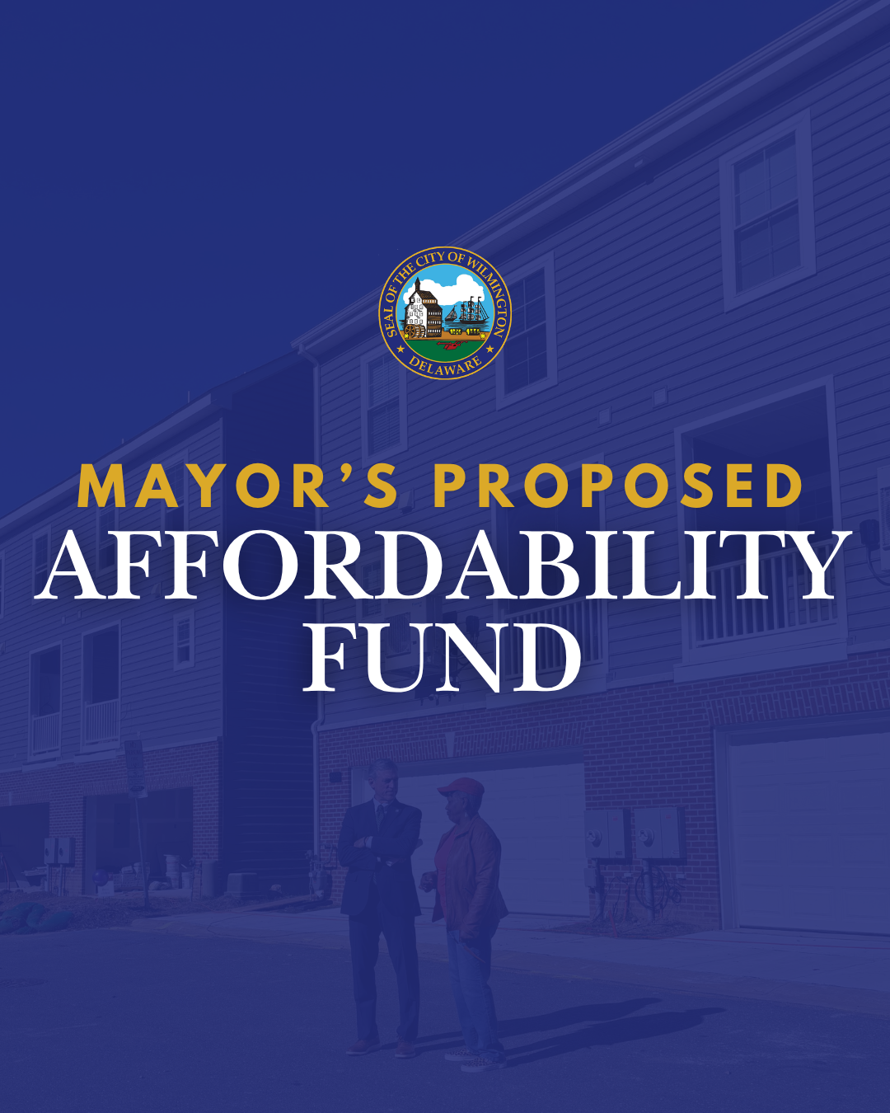

Slide 16
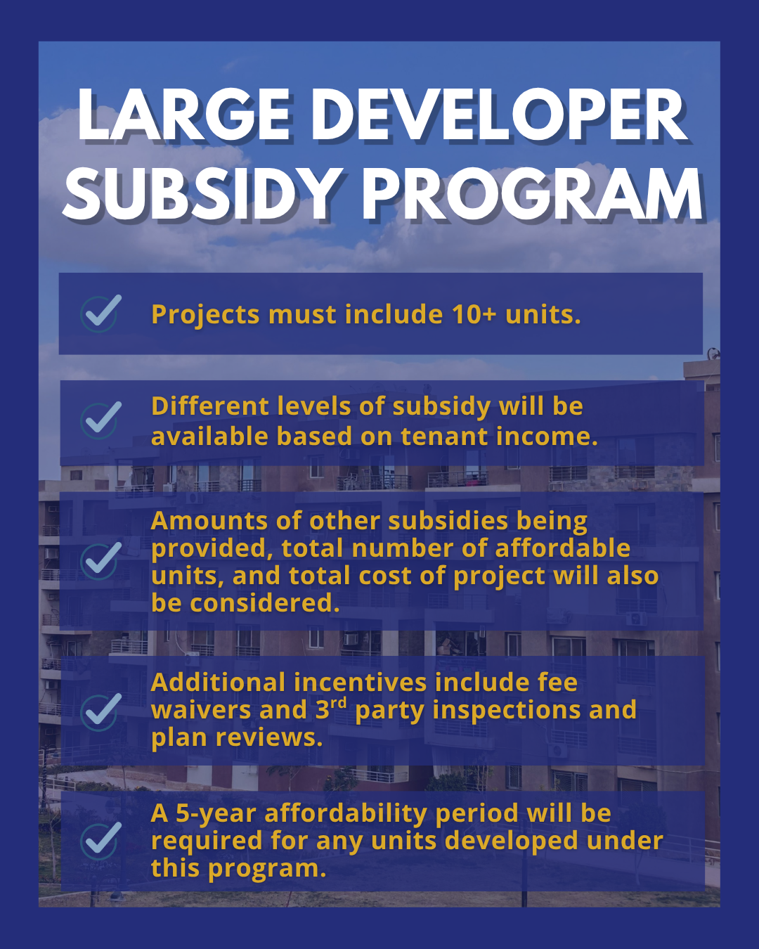

Slide 17
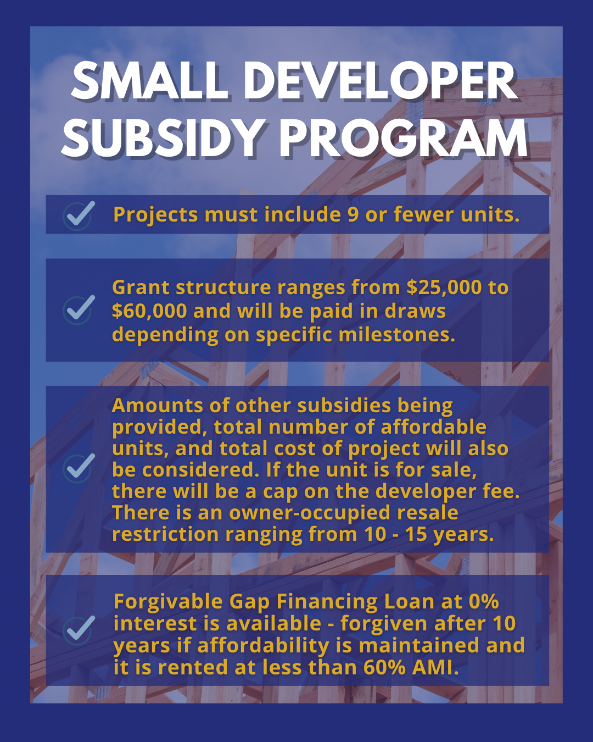

Slide 18
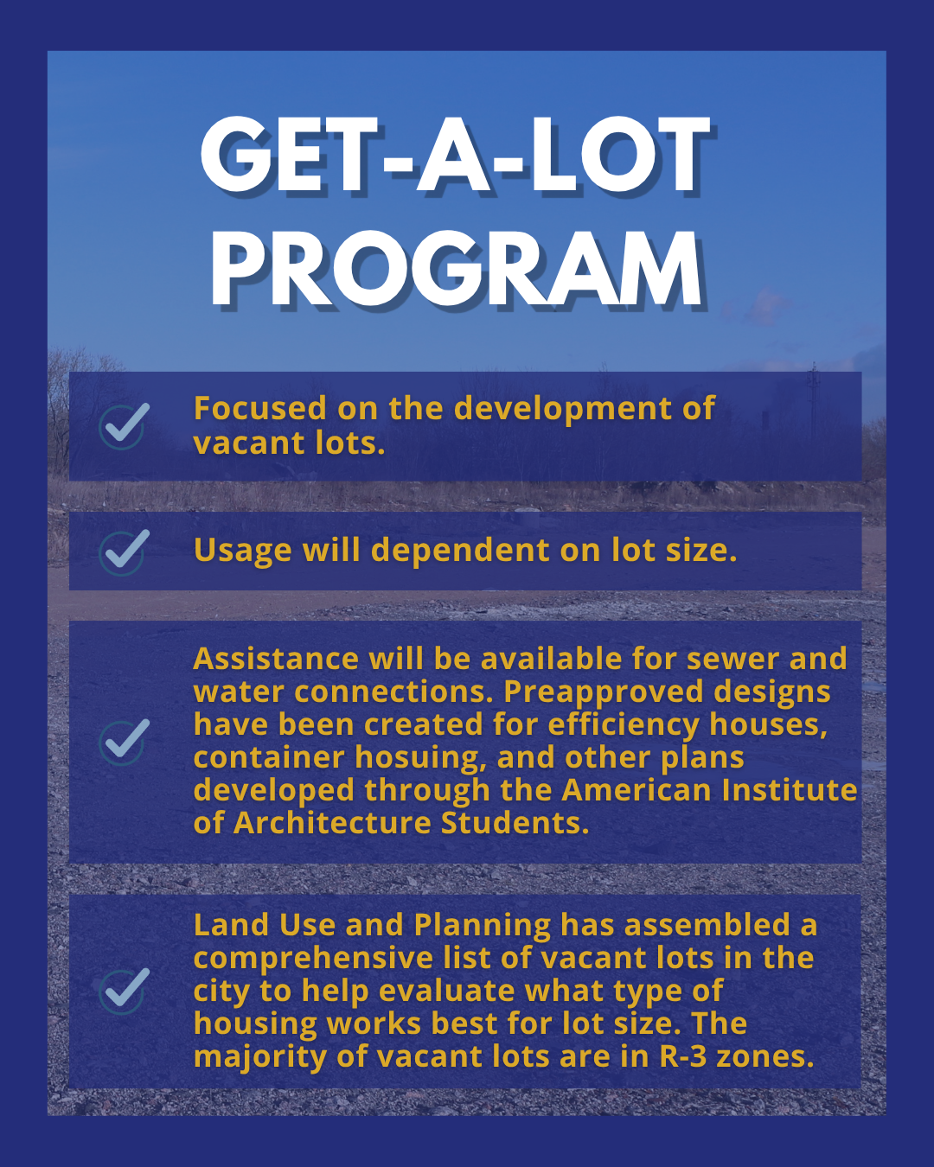

Slide 19
Question 4 - Discuss if this budget provides adequate funding and resources for projects that provide essential public services to low- and moderate-income families and neighborhoods, and homelessness prevention.
Specify any budgetary initiatives and collaborations to support home ownership.
REH participates regularly in homeownership fairs and events and presents the Live Near Your Work program at every new employee orientation.

Slide 20
Question 5
Given that the State of Delaware is taking more action regarding lead-based paint, please share if this budget provides adequate funding and resources to best address, or if any leveraging with other non-profits.
REH currently partners with the NCC Lead Hazard Control and Healthy Homes Program for lead hazard reduction and rehabilitation in Wilmington. REH currently is replacing lead drinking water lines in the eastside as part of the redevelopment there.
a) Specify if any plans to assist with lead safe or lead-free certifications (such as HB#70).
REH sponsors Lead-Based Paint Safe Worker Certification classes thru CDBG funding.

Slide 21
Question 6 - Understanding the legal challenges with evolving Federal Mandates pertaining to “sanctuary cities”, specify if any potential impact to your budget if Wilmington was a Welcoming City or Safe Haven for immigrants.
Federal policy, executive orders, legislative efforts and court rulings would dictate awards of federal entitlement funds.

Slide 22
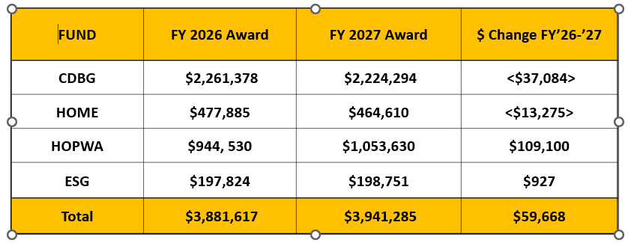
Question 7 - With the recent criteria changes pertaining to the Community Development Block Grant Fund (CDBG), and other Federal Funds, please share the impact for the ~$4M budgeted across Community Development Block Grant Fund (CDBG), Home Investment Partnership Program Fund (HOME), Housing Opportunities for Persons with Aids(HOPWA), and Emergency Solutions Grant (ESG).
Specify if any concerns with compliance of Federal Executive Orders regarding Diversity, Equity, Inclusion, and if any impact to funding - Not at this time
Specify if there are any contingency plans for federal funding – less funding less programing; reduced workforce

Slide 23
Question 7 (continued) Specify criteria and selection process for grant awards.
The COW / REH accepted proposals from organizations between 12.29.25 – 02.13.26. The application review committee met on 03.05.26 and scored the applications. RE&H makes the final recommendations for funding to Council.
Specify any new recipients projected to receive funds.
No new applicants are being recommended at this time.
Specify the total dollar amount of requests submitted, and the total amount to be awarded.
HUD Program | Requested | To Be Allocated
CDBG public service | $1,262,972.45 | $341,999
CDBG public facility | $1,376,767.50 | $781,000
HOME requests | $2,345,357.56 | $348,451.72
ESG | $339,716 | $183,845
HOPWA | $1,100,660 | $1,022,022
TOTALS | $6,425,473.51 | $2,677,317.72

Slide 24
Question 8
Discuss the planned use for ~$1.55M budgeted in Community Activities.
a. Specify the names of the entities for the Neighborhood Clean Team and amount per entity. In presentation
b. Specify if any consideration for expanding some version of the Clean Team program for the winter months. No due to extreme weather
c. Specify the number of people who have participated in the Live Near Your Work program and the number of City employees that have used this program within the last 2 years. 181 employees since Program inception with 11 settlements in 25/26. 2 additional employees anticipate to go to settlement before July 1
d. Specify the number of people that participated in the Down Payment Assistance Program, and average amount of funds allocated per person, and specify number of City employees that have participated if any. 183 closings to date, with the average assistance of $12,389 with 7 City employees in the program
e. Specify how non-federal activities funds are administered. In presentation

Slide 25
Question 8 - Discuss the planned use for ~$1.55M budgeted in Community Activities:
Specify the names of the entities for the Neighborhood Clean Team and amount per entity.
Program | FY26 BUDGET | FY27 PROPOSED
Non-Federal Activities | $200,000 | $200,000
Neighborhood Clean Team Initiative | $900,000 | $900,000
Live Near Your Work | $150,000 | $150,000
Down Payment Assistance Program | $300,000 | $300,000
TOTAL | $1,550,000 | $1,550,000
Entity | Neighborhood | FY 2026 Actual YTD
Temple United Learning Center, Inc | West Center City, Hilltop & Little Italy | $321,000
Community Empowerment Project, Inc | Eastside & 9th Ward Area | $219,070
Wilmington Hope Commission | Northeast | $107,830
Rainbow of Grace Community Services, Inc. | Browntown, Hedgeville & Bayard Square | $157,610
Lawrence Consultant Group, LLC |  | $41,184
Administrative Fees (Payroll & Tax Filing) | Jeter & Company, LLC for 4 organizations | $13,970
TOTAL |  | $860,664

Slide 26
Question 8
e) Specify how non-federal activities funds are administered.
The miscellaneous project line is used for various real estate activities including but not limited to, grass cutting, debris and snow removal, title searches, appraisals, testing and abatement of environmental contaminates, tree surgery and removal, property acquisitions, outside counsel legal services, down payment and settlement assistance.

Slide 27
Question 9 - Discuss mechanisms in place to ensure that Administrative Cost overruns from the CDBG Administrative Caps as it pertains to staffing will not create cost overruns to be charged to the General Fund.
One Roof monthly reconciliation
a) Specify reallocation for Home Partnership Program that exceeded the budget $623K in FY25, and if any impact to FY26, and FY27 Proposed Budget.
REH does not believe the budget was exceeded; the report includes $623K budgeted of which $61, 708 has been expended.

Slide 28
Question 10 - Discuss the planned use of $160K budgeted for consultants ($70K GF, $85K CDBG, $5K HOME).
Specify vendor names.
Specify if any DBE’s.
a & b) Jeter & Company, LLC (DBE) & M&L Associates.

Slide 29
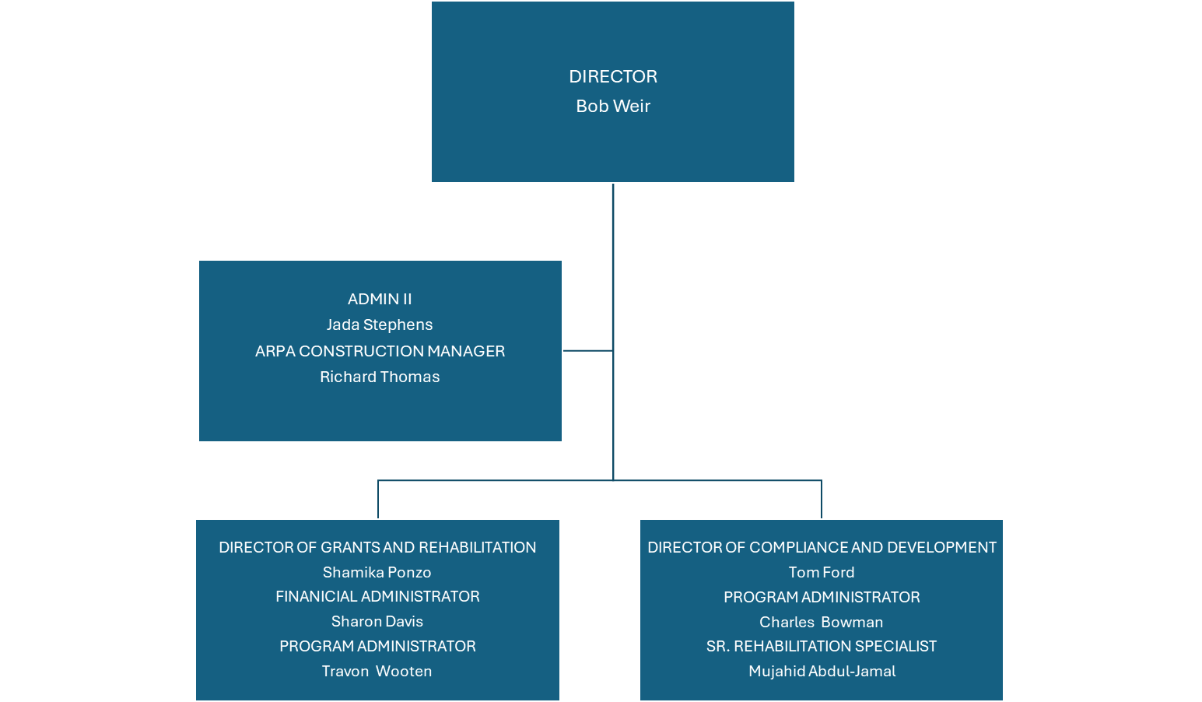
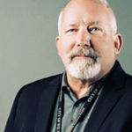
REH Organizational Chart

