Slide 1


FY 2027 Budget Hearing
OFFICE OF THE CITY TREASURER

Slide 2
Total All Funds (General & Pension Funds) – FY 2027 Budget
Treasurer’s Office Total All Funds | FY 2024 Actuals | FY 2025 Actuals | FY 2026 Budget | Proposed Budget FY 2027 | $ Change FY’27-26 | % Change FY’27-26
Personal Services | $733,743 | $1,038,578 | $970,359 | $1,155,917 | $185,558 | 19.1%
Materials, Supplies, and Equipment | 794,812 | 730,888 | 1,096,921 | 1,318,650 | 221,729 | 20.2%
Internal Services | 19,934 | 23,518 | 22,984 | 23,918 | 934 | 4.1%
Other / Special Purpose | 4,750,000 | 5,000,000 | 5,250,000 | 5,500,000 | 250,000 | 4.8%
Total | $6,298,489 | $6,792,984 | $7,340,264 | $7,998,485 | $658,221 | 9.0%
Staffing Level (All Funds FTEs) | 7.00 | 7.00 | 7.00 | 8.00 | 1.00 | 14.3%

Slide 3
General Fund – FY 2027 Budget
Treasurer’s Office General Funds | FY 2024 Actuals | FY 2025 Actuals | FY 2026 Budget | Proposed Budget FY 2027 | $ Change FY’27-26 | % Change FY’27-26
Personal Services | $366,396 | $418,073 | $406,496 | $506,352 | $99,856 | 24.6%
Materials, Supplies, and Equipment | 50,072 | 68,115 | 95,700 | 284,200 | 188,500 | 197.0%
Internal Services | 18,568 | 22,079 | 21,492 | 22,366 | 874 | 4.1%
Total | $435,036 | $508,267 | $523,688 | $812,918 | $289,230 | 55.2%
Staffing Level (All Funds FTEs) | 3.00 | 3.00 | 3.00 | 3.50 | 0.50 | 16.7%

Slide 4
Major Funding Changes (General Fund Proposed Budget)
Position Change (↑ $87,669) (↑ 0.50 FTE)
  FY 2026 Mid-Year Add: Manager of Communications, Programs, and Strategic Partnerships
    50% General Fund / 50% Pension Fund
Workshops/Seminars – Training (↑ $160,000)
  Financial Empowerment and Wellness Programming (Employees, Retirees, and Residents)
    Wealth-Building Bootcamps
    Homebuyer Education
    Treasury Talks

Slide 5
Major Funding Changes (General Fund Proposed Budget)
Trustee Fees (↑ $15,000)
  Consultants (↓ $15,000) – reallocated to Trustee Fees
  Administrative costs for Bond and Escrow accounts – 2025 Bond Issuance
Community Services (↑ $15,000) - Outreach, Sponsorships, and Community Partnerships
Travel and Subsistence (↑ $10,000) - Trainings, Conferences, and Professional Development
Vehicle Request: (1) SUV ($ 84,900)
  Commute to professional meetings, trainings, and events

Slide 6
Pension Funds – FY 2027 Budget
Treasurer’s Office Pension Funds | FY 2024 Actuals | FY 2025 Actuals | FY 2026 Budget | Proposed Budget FY 2027 | $ Change FY’27-26 | % Change FY’27-26
Personal Services | $367,347 | $620,505 | $563,863 | $649,565 | $85,702 | 15.2%
Materials, Supplies, and Equipment | 744,740 | 662,773 | 1,001,221 | 1,034,450 | 33,229 | 3.3%
Internal Services | 1,366 | 1,439 | 1,492 | 1,552 | 60 | 4.0%
Other / Special Purpose | 4,750,000 | 5,000,000 | 5,250,000 | 5,500,000 | 250,000 | 4.8%
Total | $5,863,453 | $6,284,717 | $6,816,576 | $7,185,567 | $368,991 | 5.4%
Staffing Level (All Funds FTEs) | 4.00 | 4.00 | 4.00 | 4.50 | 0.50 | 12.5%

Slide 7
Major Funding Changes (Pension Funds Proposed Budget)
Position Change (↑ $87,669) (↑ 0.50 FTE)
  FY 2026 Mid-Year Add: Manager of Communications, Programs, and Strategic Partnerships
    50% Pension Fund / 50% General Fund
Consultants (↑ $32,886)
  Advisory and Actuarial Service Fees
Medical Costs (↑ $250,000)
  Self-Insurance Actuarial Target funding for Retiree Healthcare increased from $5.25 million to $5.50 million.

Slide 8
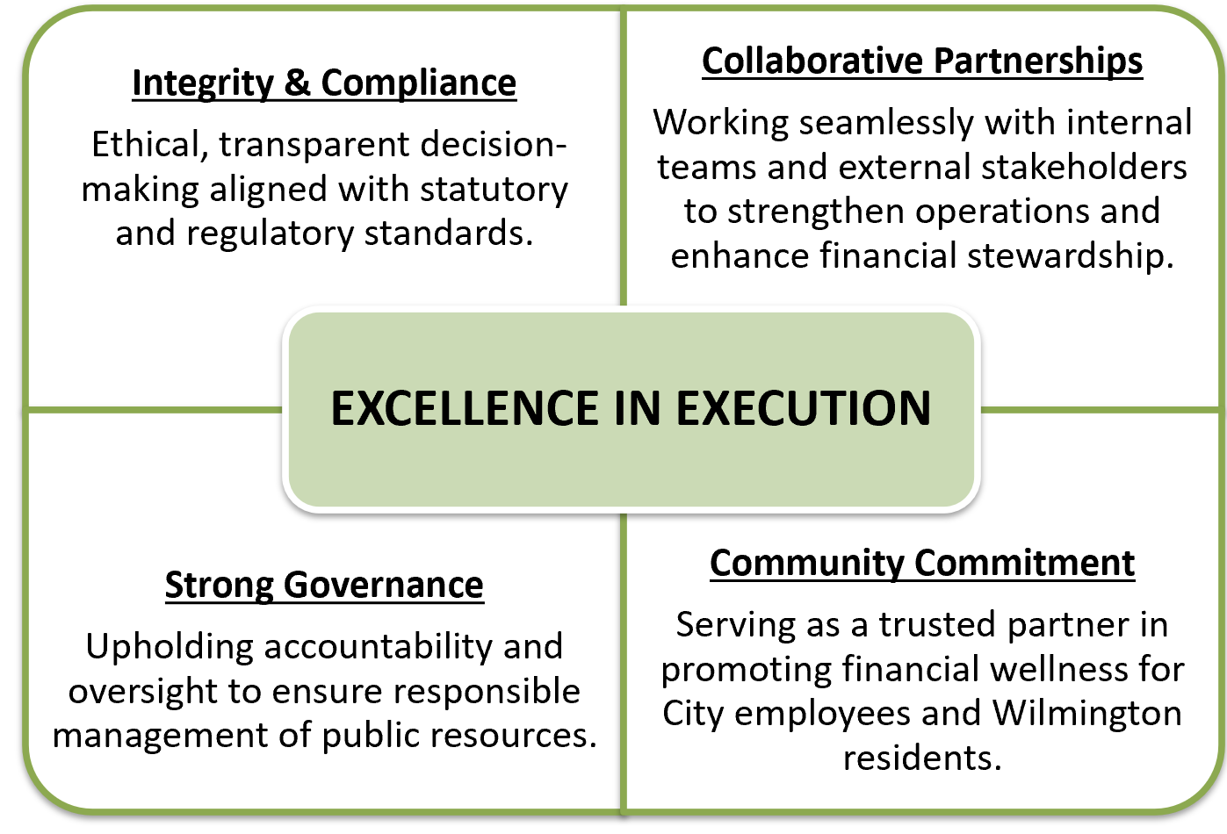
OUR
VISION

Slide 9
OUR PRIORITIES
Governance
A strong culture of integrity, compliance, and financial stewardship.
Modernization
Enhancing facilities, updating internal policies, and refining investment strategies.
Efficiency
Continuous evaluation and optimization of processes, procedures, and resource alignment.
Outreach
Expand social, cultural, and financial empowerment initiatives for employees, retirees, and the Wilmington community.

Slide 10
OUR PERFORMANCE MEASURMENT RESULTS
Reduce Fee Expense Ratios
Increase Return/ Reduce Risk
  Negotiated .29% reduction in investor fees
  Targeted annualized fee savings of $604K (24.5% Inc over LY)
  Maintained certain cash deposit levels allowing minimum fees
  Over $111M growth in Pension Funds since 2021
  Continued 3(38) fiduciary relationship with advisors
  $221.3M in plan assets managed by MWBEs( $28.6M |14.9% Increase LY)
  Current level $78M in unreserved cash position
  Weekly rebalancing has resulted in over $14.9M in reduced risk to Pension Fund
  FY26 budgeted $5.2M of Interest Income. Project to be over $1m for a total of $6.21M
Commitment to Diversity/Equity
  67.9% of pension plan assets managed by MWBE (4.7% Inc LY)
  61.5 % of Professional Services vendors are MWBEs

Slide 11
Question 1. Understanding the 5-year revenue and expenditure projections show expenditures far outpacing revenues for FY27 to FY30, and FY27 General Fund Proposed Budget uses $25.7M of the Tax Stabilization Fund, please share how this budget aligns with closing any potential budget gaps.
a. Specify any cost savings or reductions, and if this budget provides adequate resources to meet the departmental needs.
b. Specify any high-level major additions.
c. Justify the new SUV vehicle requested.
d. Justify the $160K in the Workshops/Seminars account line.
Please see next slide as well as expanded details in following questions.

Slide 12
Question 1a-d (continued).
This operational budget reflects the next phase of a multi-year strategic plan that executes on departmental priorities and obligations citywide.
High-level additions: A new position to establish a programs & communications, restructuring and realignment of appointed staff, training and development for upskilling of staff, technology upgrades & office equipment including the assigned vehicle, and funding for financial empowerment and wellness programs launched in FY26.
These initiatives are appropriately budgeted within the General Fund—primarily Workshops/Seminars & Professional Fees—with the Pension Fund utilized only when programmatically appropriate.
The Treasury’s General Fund administrative budget request represents
less than one-half of one percent (.38%) of the City’s $213M proposed operating budget.

Slide 13
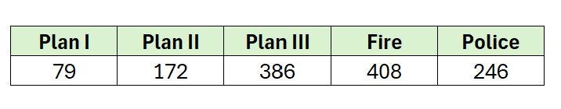
Question 2. Considering the Pension Commission recently provided a recommendation to the Mayor and Council for a one-time payment of $1,000 for Pensioners as of Dec.31, 2019, please share any potential plans for addressing a Cost-of-Living Adjustments (COLA), considering these Pensioners have not received COLA since 2006, in over 20 years.
There is no budgetary mechanism to ENSURE that a cost-of-living increase is received.
The Pension Commission is the statutory mechanism to CONSIDER the FINANCIAL VIABILITY of a cost-of-living increase on an annual basis.
This charge is articulated in Section 39-6 of City Code. See code except on the following slide.
2a. Specify # of Pensioners in each Pension Plan.

Slide 14
Question 2 (continued).
Section 39-6 of City Code:
  39-6 (a) Establishment. There is hereby established a city pension commission for the primary purpose of conducting annual reviews of the overall financial condition of the city and determining whether cost of living increases should be recommended for all city retirees
  39-6 (c) Pension commission duties and responsibilities. The pension commission, beginning in January of each year, shall review the city's overall financial condition and formulate recommendations regarding cost-of-living increases, if any, for all city retirees during the calendar year. The pension commission's recommendation...shall be forwarded to city council and to the mayor not later than April 15 of the calendar year in which the recommendation is made. In any instance in which the recommendation is more than the amount of zero dollars, the pension commission shall hold another meeting between 20 and 30 business days later to affirm, rescind or lessen the amount of the recommendation after review of the financial impact. This shall be the only agenda item, and the only action taken, shall be as set forth herein. The administration shall prepare, or cause to be prepared, an ordinance to implement the pension commission's recommendation. Such ordinance shall be presented to the full city council and shall be voted upon not later than June 30 of that same calendar year.
  39-6 (d) Review of fiscal condition. In reviewing the overall fiscal condition of the city, the commission shall review and consider the most recent reports issued by the Wilmington Financial and economic Advisory Committee (WEFAC) and the City's expenditure review board

Slide 15
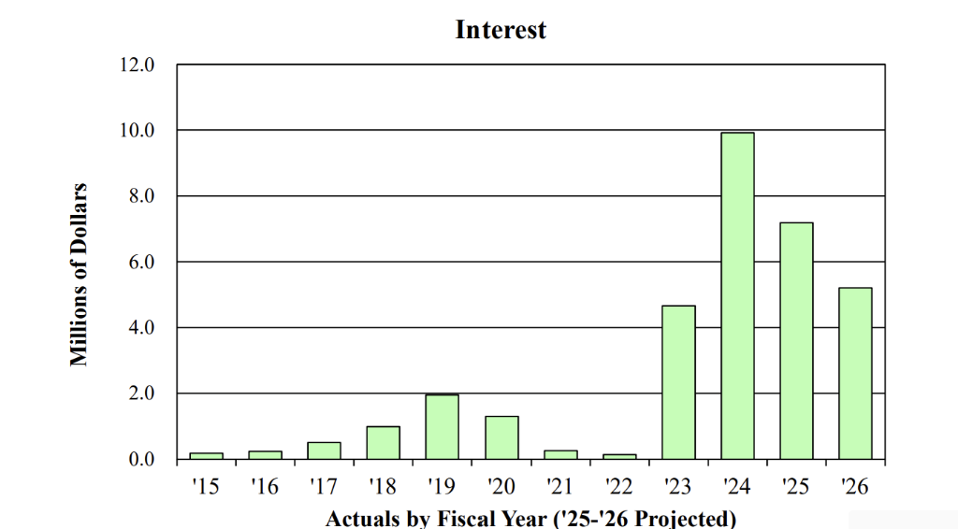
Question 3. Understanding the city has a healthy fund balance, please share the impact with actual cash, and the growth with investment income.
Healthy Fund Impact
Interest Earnings projected $1,003,040 over FY26 Budget. (19% overage)
Increases due to Federal Reserve raises rates to curtail inflation; consistent monitoring required as rates currently trending down.
Increased City’s unrestricted cash position to over $70mm.

Slide 16
Question 3a (Continued). Understanding the city has a healthy fund balance, please share the impact with actual cash, and the growth with investment income.
a. Share best cash management practices and policies for tax stabilization reserve funds.
Cash Management Strategies & Best Practices
Conservative Risk Profile: Limitations of investment vehicles and ensure minimum collateralization on all deposits.
Diversification Strategy: Our portfolio diversification strategy is designed to capture maximum upside benefit while minimizing downside risk.
Active Cash Management: Limit excess cash in operating accounts; Actively invest in appropriate vehicles
Cash Planning: Deep understanding of needs with reporting, monitoring and forecasting
Interest Rate Monitoring: Understanding direction and forces impacting rate changes
Competitive Bidding Process: Ensure best interest rates and diverse banking relationships. Yielded an expansion of banking products; 5 vs 2 Banks | 4 vs 2 Products

Slide 17
Question 4. Discuss the overall health of the city’s pension funds.
89% of goal to a fully funded Pension as of FYE 2025. (Based on MVA - Market Value of Assets)
FY25 13.5% rate of return achieved vs 7.2% discount rate.
Estimating Plan will be fully funded by FYE 2030.
The City has met or exceeded the ADC over the past 3 fiscal years.
Below is a summary from the Required Supplementary Information contained in our GASB 67/68 reports:
    FY 2025: ADC = $13.1mm, Contribution = $16.1mm
    FY 2024: ADC = $13.2mm, Contribution = $15.0mm
    FY 2023: ADC = $17.2mm, Contribution = $19.2mm

Slide 18
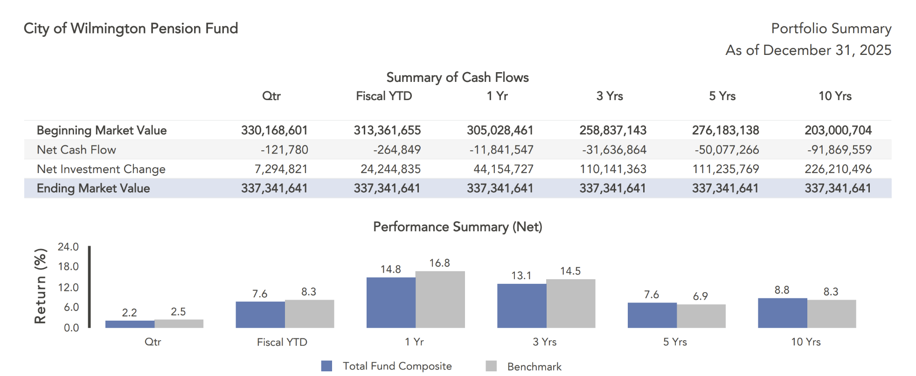
Question 4 (cont’d). Discuss the overall health of the city’s pension funds.

Slide 19
Question 5. Discuss the $5.5M Budgeted for Pension Healthcare (Medical Cost).
a. Specify the total number of participants.
Funds ($250K) allocated each year is provided through the OPEB valuation process.
411 participants enrolled.
Retirees | Plan | Headcount
Under 65 | Highmark | 87
Over 65 | Highmark | 3
Over 65 | Aetna | 321
Total |  | 411

Slide 20
Question 6. Discuss any proposed changes to positions (new position, deleted position, upgrade, realignment, transition, downgrade, title change, salary changes, etc.).
a. Mid-year budget amendment.
b. Share any vacant positions.
    A new position was added (split-funded across funds.)
    A multi-year strategic realignment and restructuring of appointed positions.
      Revised position titles and expanded job descriptions
      Compensation analysis across the City; realigned all appointed salaries accordingly
Manager| Communications, Programs & Strategic Partnerships:
  Anticipate onboarding of new hire in early May 2026.
  New position added in the FY26 Budget (Amendment #2.)
  Appointee brings a wealth of experience in program development, communications and engagement strategies.

Slide 21
Question 7. Discuss the planned use of ~$1.1M budgeted for Professional Services across both the General and Pension Funds, considering actuals has not exceeded $840K in the last 2 years.
All professional fees are used for the operation and stewardship of the Treasury. Specifically, it is used for consultants and advisors pertaining to pension management, accounting, trustee fees, and programming.
  Savings since 2022 are a result of OCIO strategy.
  New efficiencies allow for repurposing of funds for Pension specific financial education programming and projects.
    FY2027 is a Pension Fund actuarial valuation year.
    Contingency dollars budgeted for special projects (e.g. Pension Commission Impact Study)
Starting in FY2026, the Office launched a series of financial empowerment and wellness program serving the needs of city employees and retirees on their road to retirement.
For pension fund professional fees: Consultant fees are tied to the market valuation of the pension fund, and investment manager fees are tied to the dollar value of funds under management, which vary with market performance.
Further there are variable expenses (i.e. legal fees and special projects) that arise annually.

Slide 22
Question 7 (continued). Discuss the planned use of ~$1.1M budgeted for Professional Services across both the General and Pension Funds, considering actuals has not exceeded $840K in the last 2 years.
List vendors and specify if any of the vendors are DBEs.
  See following slides for list of vendors.
  61.5% (8 of 13) vendors are DBEs.
  67.9% of Pension Investment Managers are MWBEs.
  Sample financial literacy & empowerment programs
b. Specify one-year reoccurring agreements.
All professional services agreements are evaluated annually.

Slide 23
Question 7a(Continued).
List vendors and specify if any of the vendors are DBEs.
VENDOR | PURPOSE | DBE
CHEIRON | Pension Plan Actuarial Services
It’s Benni Black, LLC | Graphic Design & Branding | x
DB Smith Consulting, LLC | Communication & Programs consulting | x
Fifth Media | Photography & Video | x
Jeter & Co | Financial Recordkeeping & Reports RMGCC | x
Kairos Class, LLC | Financial Education Membership-based Program | x
Make & Mellow | Venue & Professional Services | x
VENDOR | PURPOSE | DBE
Marquette Associates | Pension Plan Advisors | *
My Stewardship Journey | Financial Leadership Training | x
Oath 84 | Venue & Catering Services | x
Ballard Spahr | Debt Counsel
Retirement Plan Advisors | Defined Contribution Consultants
PFM Consulting, LLC | Debt Advisors

Slide 24

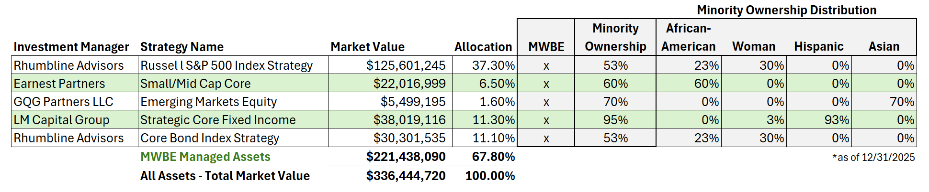
Question 7a (continued). List vendors and specify if any of the vendors are DBEs.
Investment Policy Statement (IPS) updated to include Minority Women Business Enterprise (MWBE) investment managers.
MWBE Investment Manager Participation:
  Over $221,439,000 ($28.6M |14.9% Increase LY)
  67.9% of plan assets managed (4.7% Increase LY)
  38.5% Plan Asset Managers (5 vs 13 total)
​

Slide 25
Question 7 (continued). Discuss the planned use of ~$1.1M budgeted for Professional Services across both the General and Pension Funds.
Financial Wellness & Empowerment Programs
What Are the Treasury Talks?
Testimonials
Program Results – Launched October 2025
Planned Use – FY2027
Our Partners

Slide 26


“What our employees
are saying…”
“It’s reassuring to have this information ahead of time because planning matters.
I truly appreciate the work the entire team put into this. We thank you.”
– Active Employee/ FOP Retiree, 42 Yrs service
It’s more than a tagline— it’s a commitment to sparking dialogue, activating change and the acknowledging the power of starting where you are.
“I really need this. What you’re doing is so necessary,
and people are going to be lined up out the door.”
– Active Employee, 19 Yrs service
“The discussion around money should be as common as our discussion around professional sports.
Treasury Talks promotes these important conversations.
– Active Employee, 9 yrs of service

Slide 27
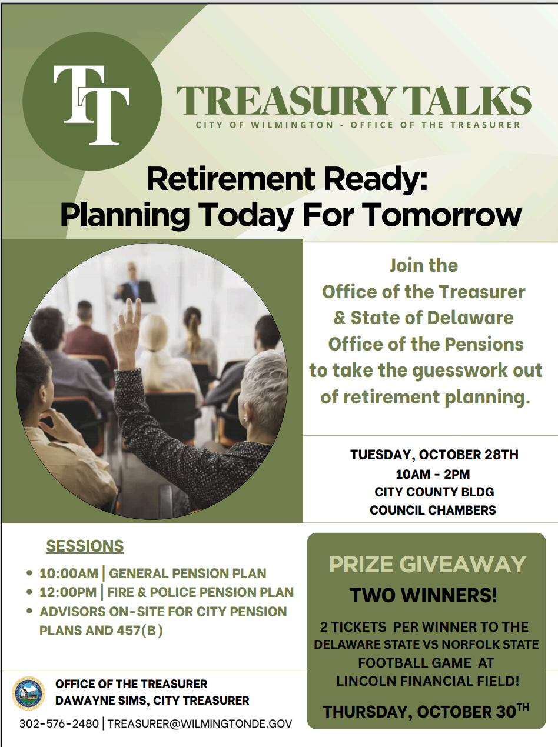

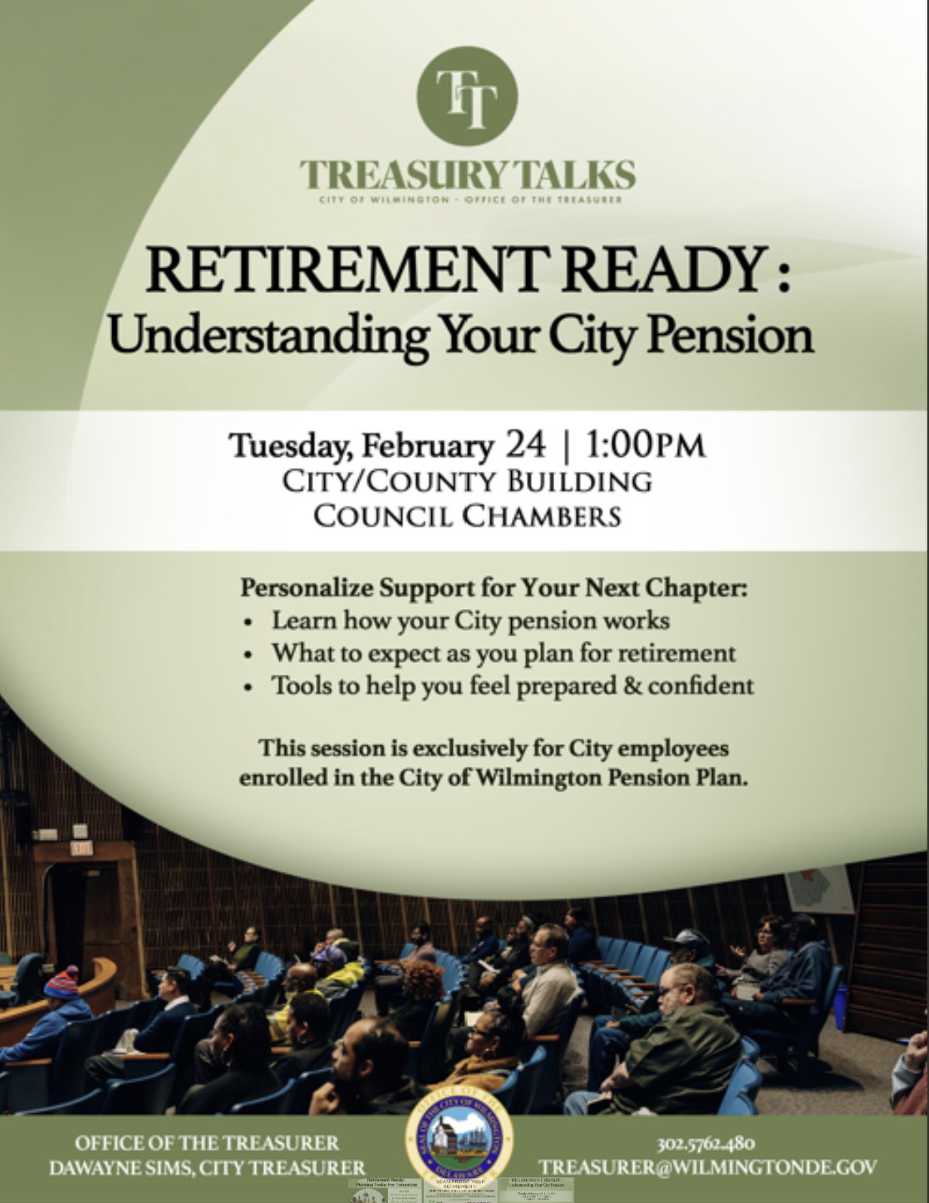
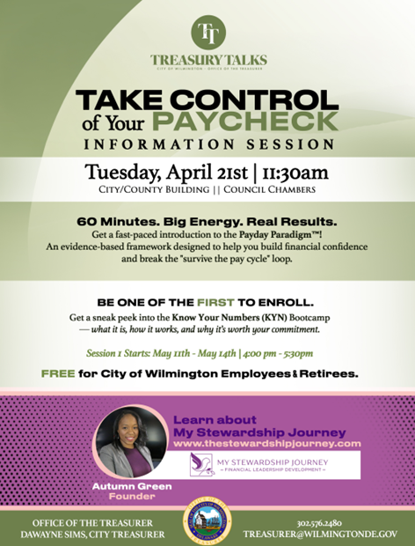
THE CONVERSATION
9 Events
260 Participants
499 Impressions

Slide 28

Treasury Talks – Calendar of Events
April
Take Control of Your Paycheck – Bootcamp Information Session
May
Know Your Numbers Bootcamp (Phase 1 – Payday Paradigm)
June
* Strategic Partners Fundraising Event
* Higher Education Partnership
* DE250 Financial Freedom Series
July
Wealth-Building Bootcamp (Cohort 1)
Aug
Know Your Numbers Bootcamp (Cohort 2)
Sept
Homebuyer Education Series (Tentative)
Oct
Treasury Talks LIVE – Financial Empowerment Summit
Dec
Strategic Partners Fundraising Event #2
Jan
Vision Board Your Financial Future

Slide 29

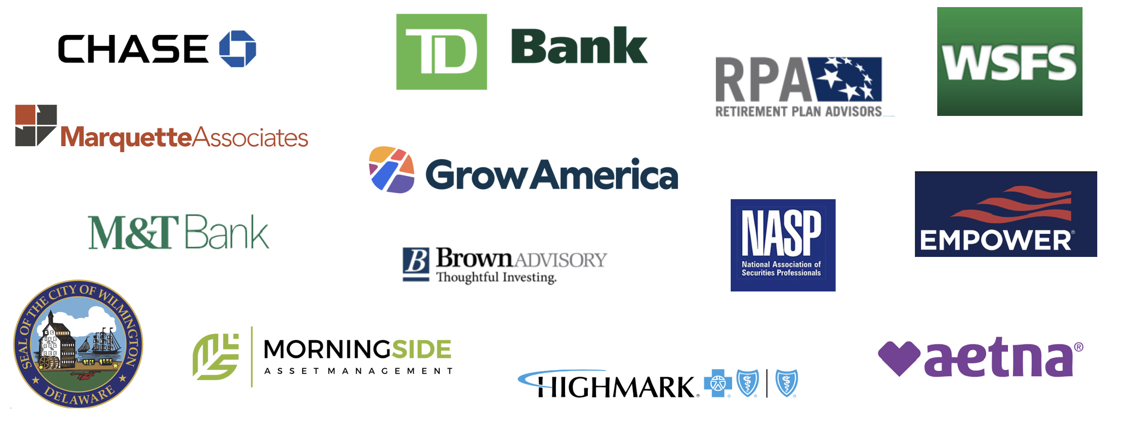
OUR PARTNERS

Slide 30
Question 8. Share the planned use for $40K budgeted for Community Services.
Specify if any reports have been submitted to Council, as per City Code.
b. Specify the ROI
Execute on departmental priority of Community Outreach by supporting strategic partnerships that expand educational, social, and cultural enrichment initiatives.
City’s Treasurer Office is not a grant-making agency. Any funds spent on community activities are in the form of programming sponsorships.
The Office provides sponsorship at the institutional level on an ad hoc basis to impact youth & family outcomes, enhance community vitality, and increase public engagement.
Community Partners
Christina Cultural Arts Center
Cultural Restoration Project
Delaware State University
HBCU Week Foundation, Inc
The Grand Opera House
True Access Capital
Wilmington Public Library

Slide 31
Question 9. Provide FY2027 proposed organizational chart with the total number of employees (i.e. permanent, temporary, contract, vacancies).
  Outline specific duties of each employee.
  b. Please include in the Org chart a photo of all Directors, Managers, Divisions Heads, and Supervisors.

Slide 32
DaWayne Sims
City Treasurer
Dany Bourjolly Smith
Manager| Communication, Programs, & Strategic Partnerships
Victoria Roth
Retirement Benefits &
Pension Manager
Alfred Lance
Deputy City Treasurer
Kwartemaa Asante-Yeboah
Cash & Investment Portfolio Manager
Kylenae Stribling
Treasury Analyst II
Pension Division
Styna LeCompte
Treasury Analyst II
Administrative Division
Marilyn Amaro-Valentin
Administrative Assistant
Marilyn Amaro-Valentin Administrative Assistant

Slide 33
Question 9(a).
City Treasurer – Executive leader of the Office with primary responsibilities that include, but are not limited to, the global strategic direction and management of all Assets Under Management and all Executive level Office affairs such as the management of internal/external banking and vendor relationships; including the administration of Treasury’s policy, legal and regulatory matters.
Administrative Assistant to City Treasurer – direct report to the City Treasurer with primary responsibilities that include, but are not limited to, managing the schedule of the Treasurer; including all high-level administrative needs of the Office and Staff.
Deputy City Treasurer – direct report to the City Treasurer with primary responsibilities that include, but are not limited to, serving as the primary manager and point of contact for all Treasury Operations and direct management of Treasury Staff.
Treasury Analyst II – Pension – direct report to Deputy City Treasurer with primary responsibilities that include, but are not limited to, managing the daily administrative operations of the City’s Pension portfolio; such as the administration of Pension Payroll, direct Pensioner service inquiries and Pension calculations.
Treasury Analyst II – Admin – direct report to Deputy City Treasurer with primary responsibilities that include, but are not limited to, managing the daily administrative operations of the City’s Payroll, administration of the City’s 457(b) Deferred Compensation Plan and other related direct service inquiries.
Cash & Investment Portfolio Manager - direct report to Deputy City Treasurer with primary responsibilities that include, but are not limited to, tracking and managing of the City’s Primary Government and Pension Cash positions; including all Unrestricted and Restricted Cash, the daily operations engagement with external banking partners and interdepartmental colleagues.
Retirement Benefits & Pension Manager – direct report to City Treasurer with primary responsibilities that include managing high level Pension benefit projects and engagement with interdepartmental colleagues, external, and other Agencies as well as developing systems & documentation for improved efficacy and automation of all processes pertaining to the Treasury & Pension.
Manager, Communications, Programs & Strategic Partnerships – direct report to City Treasurer with primary responsibilities that include building new financial literacy programs for city employees, retirees, and the community, developing strategic partnerships, and communications.

