Slide 1


FY 2027 Budget Hearing
Revenue Projections

Slide 2
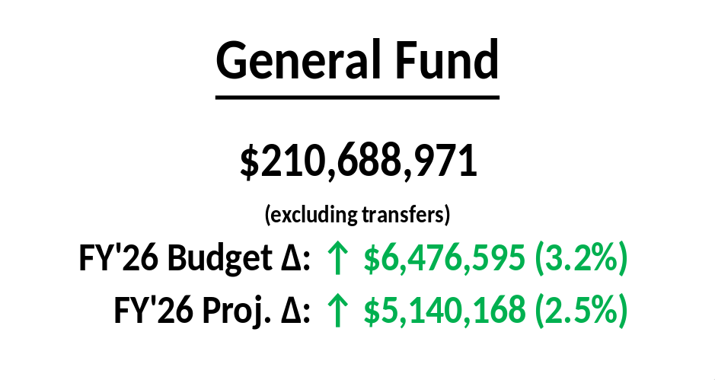
Revenue budget approved by WEFAC
Projected revenues (plus WPA transfer) of $210.9 million not sufficient to cover budgeted expenditures of $212.6 million
Nearly $1.7 million use of Tax Stabilization Reserve to balance budget
  Tax stabilization balance as of YE FY’25: $73.7 million
No assumption that the economy goes into recession in FY 2027

Slide 4
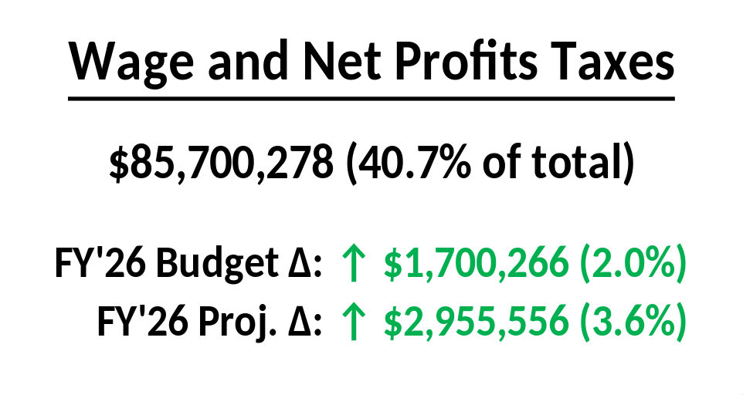
Wage Tax: $76.8 million (↑ $1.6 million)
  4.0% growth in taxable wages (↑ $2.9 million)
  March DEFAC projection for FY 2027: 4.3% growth
  Known employment growth (↑ $438,000)
Net Profits: $8.9 million; consistent with adjusted FY’25 (↑ $121,000)

Slide 5
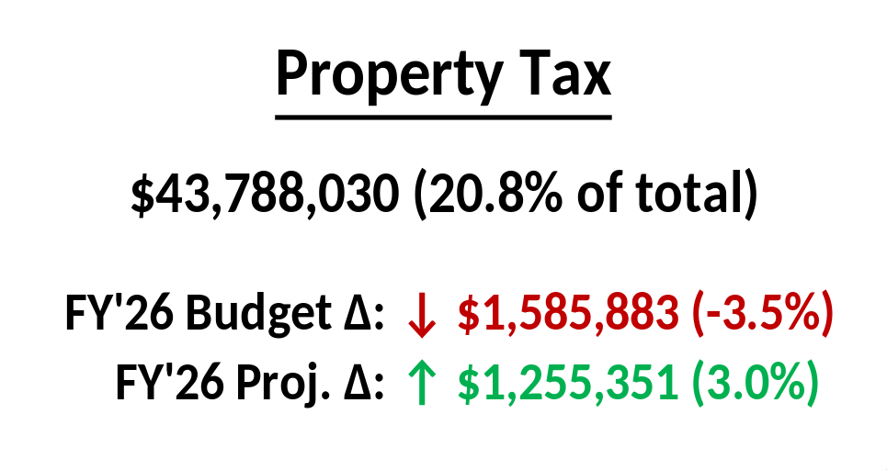
City is maintaining bifurcated rates, unchanged from FY 2026
Loss due to lower assessments post-appeal (↓ $770,000)
  FY 2026 net taxable assessed value: $9.92 billion
  FY 2027 net taxable assessed value: $9.60 billion
Estimated losses due to outstanding appeals (↓ $957,000)
Appeals losses equivalent to a 4.0% rate increase
Penalty and Interest: restored after being waived (↑ $1.5 million vs. Q2 FY 2026)

Slide 6
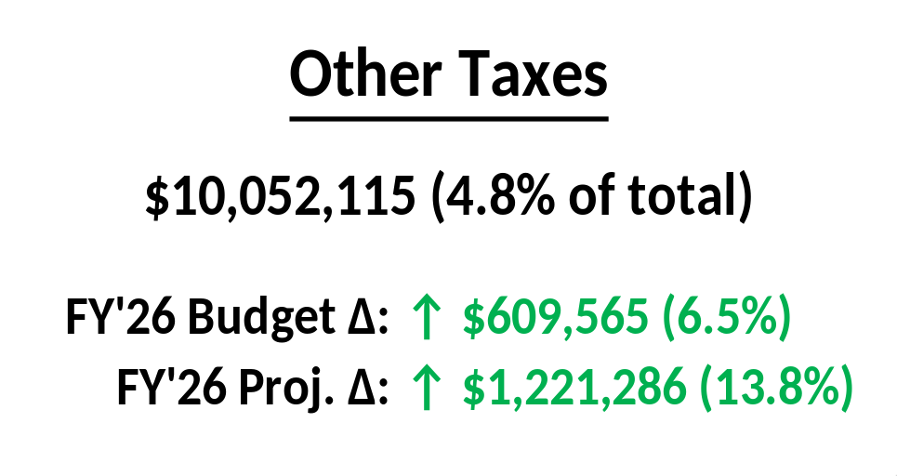
Head Tax: same as FY 2026 WEFAC projection (↑ $192,000)
Strong Residential Transfers continue in FY’27 (↑ $405,000)
Commercial Transfers down in FY’26; FY’27 budgeted at historical average
Delmarva electricity Franchise Fee flat

Slide 7
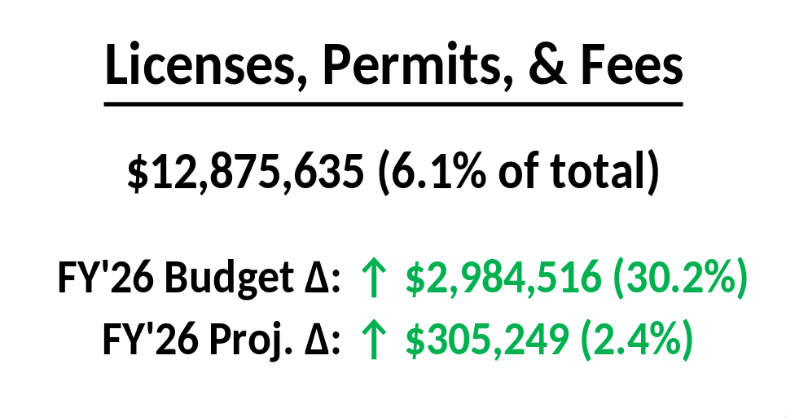
EMS medical insurance fees (↑ $2.8 million)
  FY’26 was conservatively based on Trinity Health; now projected to be ↑ $2.3 million vs budget
  FY’27 growth now that City is fully certified (↑ $437,000)
  EMS revenues do not fully cover costs
Business License up due to improved L&I enforcement (↑ $278,000)
Permits return to historically average levels (↓ $136,000)
Fees up due to parking meters, property maintenance (↑ $82,000)

Slide 8
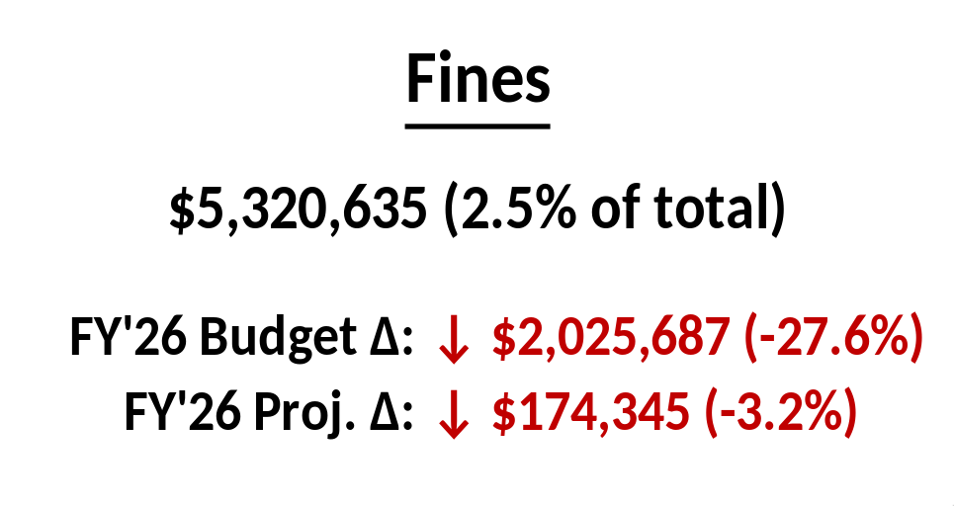
Redlight losses seen in FY’25, FY’26 continue (↓ $2.2 million)
  Prior to FY’25: average of $4.4 million; post-FY’25: average of $2.3 million
  Losses due to cameras being offline, no expected fix in FY’27
  Additional collection losses of $313,000
Parking matches Q2 WEFAC (↓ $19,000)
Criminal Fines matches Q2 WEFAC (↓ $18,000)
Instant Tickets: historically average tickets plus L&I civil penalties (↑ $213,000)

Slide 9
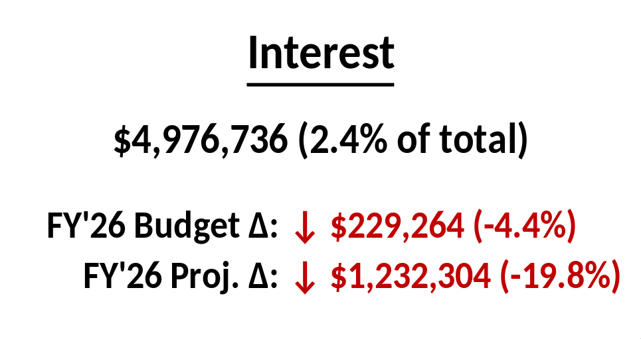
FY 2026:
  Projected interest rate of 3.3%
  Real rate as of Q2 better than budgeted at 3.8%
FY 2027:
  Projected interest rate of 3.16%
  Rates based on data from Treasurer and Federal Reserve
  Reductions due to spending of capital funds

Slide 10
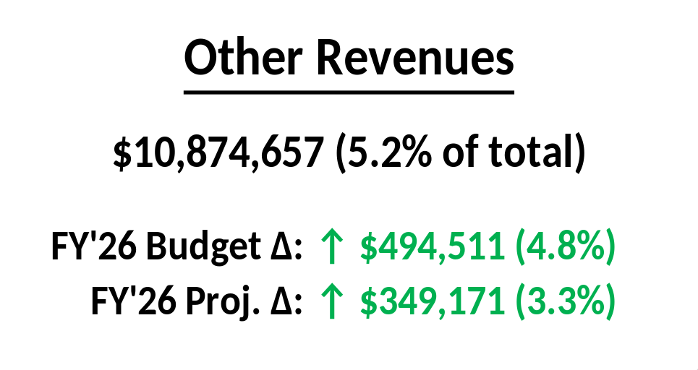
Rentals and Concessions flat
General Government Charges (↓ $54,000)
Indirect Costs: Updated Black & Veatch cost allocation study (↑ $549,000)

Slide 11
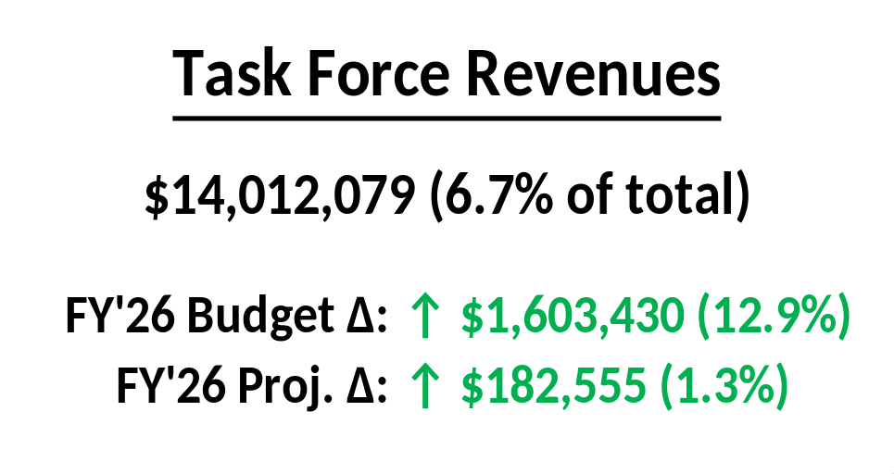
Corporate Filing Tax (↑$516,000), LLC Filing Tax (↑$804,000) consistent with FY’26 WEFAC, FY’27 DEFAC projections
Lodging Tax (↑$207,000), Natural Gas Tax (↑$76,000) based on historical trends

Slide 12
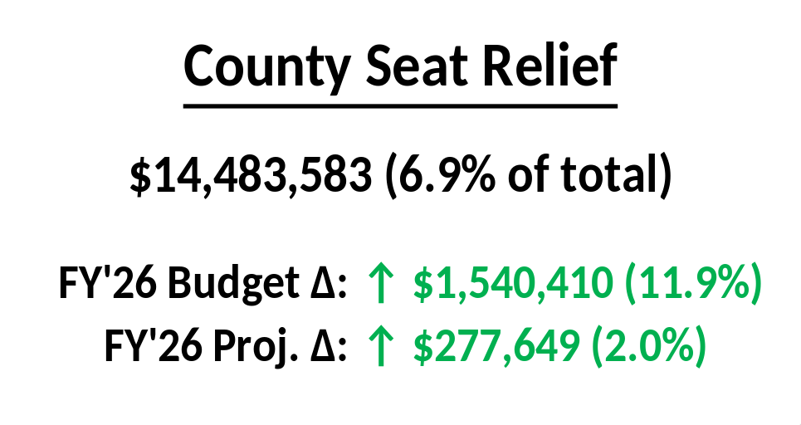
NCC Corporate Filing Fees (↑$310,000) and UCC Filing Fees (↑$976,000) consistent with FY’26 WEFAC, FY’27 DEFAC projections
PILOT matches to FY’26 actual (↑$255,000)
Statutory Trust: capped at $1.0 million

Slide 13
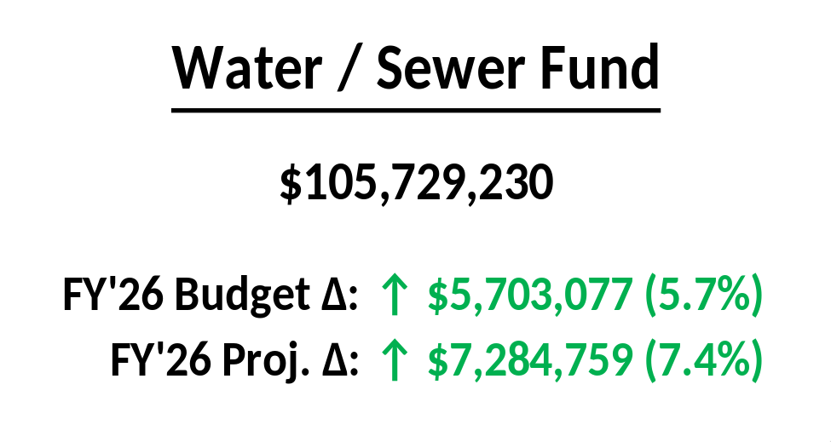
In depth presentation by Black & Veatch on April 29
Revenue budget approved by WEFAC
Budgeted revenues are on an accrual basis; B&V revenues are cash
Water / Sewer revenues derived from charges to customers, not taxes

Slide 15
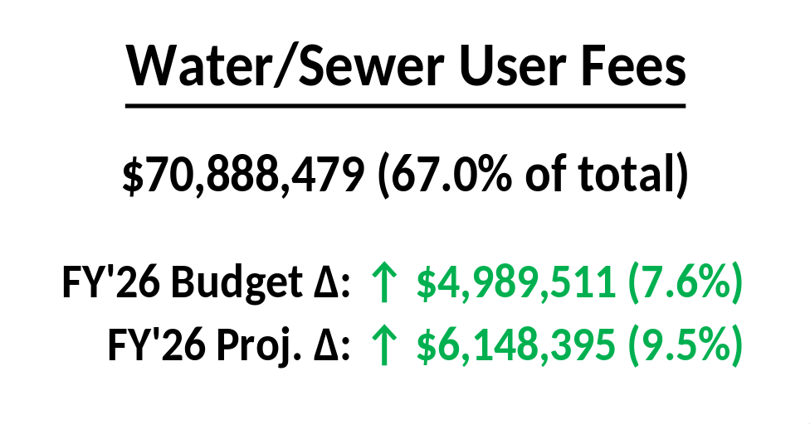
Increase in base revenues (↑$270,000)
Change to sewer factor (↑$160,000)
  $0.35/month for typical inside city residential customer
9.95% rate increase for all users (↑ $6.0 million)
  $7.36/month increase for typical inside city residential customer
Change in bad debt from 3% to 5% (↓ $1.6 million)

Slide 16
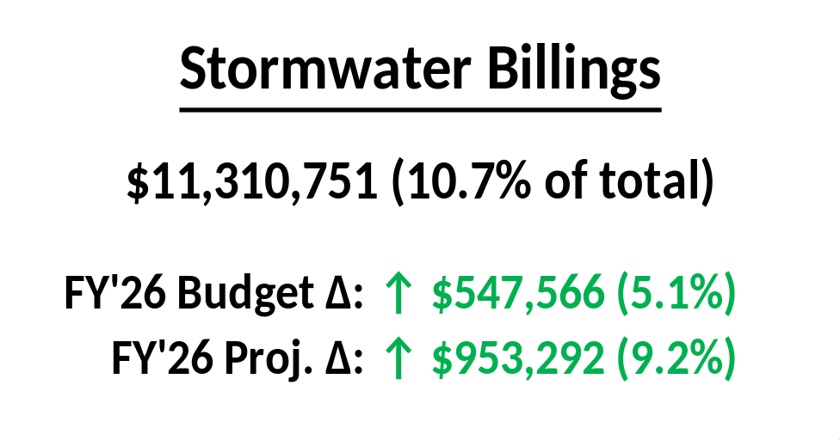
Not based on consumption, but on size and characteristics of property
9.95% rate increase (↑ $956,000)
  $0.59/month increase for typical inside City residential customer
No change to bad debt

Slide 17
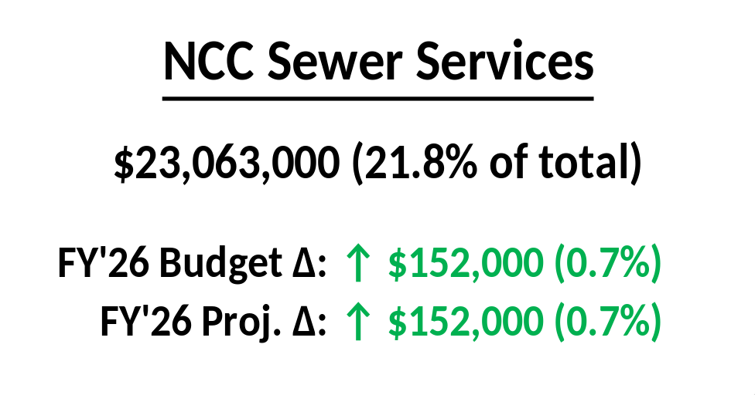
Revenue associated with City’s treatment of NCC sewage
Estimate is from Black & Veatch analysis of contract with County

Slide 18
FY 2027 Budget Hearing
Revenue Projections

