Slide 1


FY 2027 Budget Hearing
POLICE DEPARTMENT

Slide 2
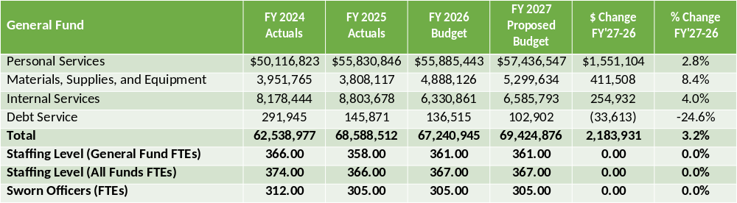
FY 2027 Proposed Budget

Slide 3
Major Funding Changes (Proposed Budget)
Personal Services (↑ $1,551,104)
Position changes:
  Midyear FY 2026: Addition of Victim Services Specialist (↑ $112,179), Communications and Marketing Coordinator (↑ $151,109)
  Midyear FY 2026: Deletion of Criminal Records Coordinator (↓ $87,866), Administrative Clerk II (↓ $86,282)
  Midyear FY 2026 : Police Policy and Communication Director retitled to Police Department Chief Administrative Officer (no salary change)
Regular salary increases due to steps, COLAs (↑ $474,857)
Benefits (↑ $1.7 million): hospitalization (↑ $1.0 million), state pension (↑ $721,276)
State Pension Contribution (↓ $150,148)
Attrition (↑ $798,495): better reflects actual civilian and sworn vacancies

Slide 4
Major Funding Changes (Proposed Budget)
Materials, Supplies, and Equipment (↑ $411,508)
Axon body camera and taser contract, up 86.1% (↑ $1.1 million)
  Combined contract in Contracted Maintenance Services (↑ $1.3 million)
  Tasers previously budgeted in Uniforms and Related Equipment (↓ $200,000)
  FY 2027: year two of five-year contract, $1.6 million per year
Consultants (↓ $686,605)
  Real-Time Crime Center camera operations brought in-house (↓ $412,000)
  Off-year for biennial promotional process (↓ $275,000)
  Telestaff scheduling software replaced by existing UKG (↓ $150,000)
  Partners in Care, previously partially grant funded (↑ $150,000)
Other changes: Rental of office and training space (↓ $49,000), street mapping software (↑ $27,725), Public Safety Building contract with Asset Management (↑ $23,699)
Contracted Maintenance Services Biennial promotional process (↑ $1.3 million) Telestaff scheduling software (↓ $474,857)
Contracted Maintenance Services Biennial promotional process (↑ $1.3 million) Telestaff scheduling software (↓ $474,857)
  License late recognition (LPR) software (↑ $114,800)
  ShotSpotter contract (↑ $17,000)
  Other Real-Time Crime Center contracts (↑ $20,400)
Electricity, based on actuals (↑ $35,000)

Slide 5
Question 1.
Understanding the 5-year revenue and expenditure projections show expenditures far outpacing revenues for FY27 to FY30, and FY27 General Funds Proposed Budget uses $25.7 of the Tax Stabilization Fund, please share how this budget aligns with closing any potential budget gaps.
Specify any cost savings or reductions, and if this budget provides adequate resources to meet the departmental needs.
Specify any high-level major additions.

Slide 6
Question 1. Answer
Our department is consistently working to balance operational expenses and investments in technology and equipment, with the need to be fiscally prudent. We rely heavily on grant funding to support major initiatives, and have taken steps to reduce budget increases by leveraging grant funding or making adjustments to various programs to save on costs.
One example is eliminating a contract with a company for camera monitoring, and instead utilizing our personnel to monitor cameras to save on costs, for a savings of $412,000
There are no major high-level additions in this year’s budget. However, the existing Axon taser and body camera contract increased by $1.1 million (86%). We are mandated to use this contract by the State and do not have room to negotiate on pricing.

Slide 7
Question 2.
The Delaware Prescription Opioid Settlement Distribution Commission has opened the 2026 grant cycle, please share if any plans to leverage programs such as Partners in Care, Community Engagement Unit, Community Policing, etc.
Specify funding that was allocated in CY2025 and projected for CY2026.

Slide 8
Question 2. Answer
  This initiative is being spearheaded by the Mayor’s Office, and the City is exploring options to leverage these funds to support adding a second case manager to the WPD Partner In Care Program.

Slide 9
Question 3.
Considering that City Council initiated the Community Public Safety Initiative (CPSI) in Fiscal Year 2023, please share any funding allocated within your proposed budget to support partnerships or resources that can advance public safety so that officers are efficiently utilized.
    Specify if any impact to overtime or any other resources.

Slide 10
Question 3. Answer
This program is administered and funded through the Mayor’s Office budget. WPD has collaborated with CPSI program leadership since the establishment of the program.
  Similar to how CPSI deploys its resources, WPD continues to rely on data and our CompStat methodology to help deploy officers to the areas most in need of police presence, and where crimes or violence have taken place.

Slide 11
Question 4.
With a budget of ~$72M, which ~$60M pertains to staffing, healthcare, and pension cost please share if this is adequate funding for resources to address some budget priorities that are aligned with Council such as the following (please explain why or why not):
  Violence Prevention and Intervention
  Expanding hours for the Partners in Care Program
  Youth – Safe Haven/Truancy Resources
  Community Engagement Unit

Slide 12
Question 4. Answer
We continue to leverage City budget funding and grant funding to support overtime for investigations as well as increasing police presence in areas affected by crime and violence.
At this time, we believe our program covers the days and times with the highest needs. For hours when the team is not working, we have Crisis Intervention Team-Trained officers on every patrol platoon, and a referral process for Partners in Care in place.
We continue to assign a police officer to the Hicks Anderson Community Center and the Police Athletic League of Wilmington, in addition to School Resource Officers in many of our schools. We also support Parks and Recreation and their efforts to provide resources and safe space for youth.
At all times we maintain a fully-staffed Community Engagement Unit, with a police officer assigned to each patrol district in the city. This team continues to provide exceptional service and outreach to each of our neighborhoods.

Slide 13
Question 5.
Considering HB#67 that passed in June 2025 regarding the removal of motor vehicles from private or public property by private tow companies, share from an enforcement perspective if any impact with your budgeted resources, while realizing the Finance Department manages the towing agreement.

Slide 14
Question 5. Answer
Delaware House Bill 67 does not impact the Department or its budgeted resources. The Department utilizes an approved towing company, which is managed through the City of Wilmington Finance Department.

Slide 15
Question 6.
Discuss the plan to change for the Real Time Crime Center for the camera operations to now be done in-house versus contracting the service out.
  Share a summary of the cost benefit analysis, and if any savings.
  Specify total number of neighborhood cameras (per district).
  Specify the number of camera operators assigned to each shift and hours that cameras are monitored.
  Specify how a community can request to have a neighborhood camera linked with this system.

Slide 16
Question 6. Answer
  The department evaluated the operational, financial, and organizational impacts of continuing the outsourced camera-monitoring contract with OPS Security Group versus transitioning monitoring responsibilities to internal personnel, including light-duty officers and Real Time Crime Center (RTCC) personnel.
        FY-26 Contract cost $412,105
        FY-27 Projected cost $425,000
      Previously, contractor had 3% - 5% cost increase each year, which represents a significant recurring expenditure with limited measurable return
      Computer aided dispatch (CAD) review shows only 25 documented complaints since 2021
      Cost per reported incident approximately $70,000
      Output is far below what is expected from a citywide camera monitoring operation.
      Utilizing existing personnel who are familiar with departmental policies, radio procedures and response expectations, eliminates the annual cost of $425,000

Slide 17
Question 6. Answer (Continued)
There are currently 100 operational cameras city wide:
            Downtown – 28 Cameras
            Sector 1 – 17 Cameras
            Sector 2 – 27 Cameras
            Sector 3 – 28 Cameras
The camera‑monitoring operation will be staffed using a blended model that incorporates RTCC analysts, light‑duty officers, and available patrol personnel to ensure consistent and informed coverage. Two operators will be assigned to each shift, providing daily monitoring from 0800 to 0000 hours.
Requests to add cameras to the City’s system are handled by the Camera Working Group. Requests can be submitted to the Mayor’s Office.
  Privately owned cameras cannot be directly linked to this secure system, but residents and businesses owners are welcomed to share footage with police to support investigations and members of our Technical Resource Unit manages this process.

Slide 18
Question 7.
Please list an vacant positions (please share the length of the vacancy, justify if there is a need for the vacancy).
  Specify any new recruitment and retention strategies WPD has implemented or has plans to implement in FY2027.
  Discuss any funding that has been allotted for supporting a departmental culture that promotes officer retention and diversity.
  Share plans for recruitment strategies for Crossing Guards.

Slide 19
Question 7. Answer
Currently there are 20 vacant civilian positions.
    Communications Supervisor (1 position)
    Emergency Communication Specialist (3 positions)
    Emergency Call Operator (1 position)
    Tele-Serve (1 position)
    Bilingual Victim Services Specialist (1 position)
    Crossing Guards (13 positions)

Slide 20
Question 7. Answer (Continued)
WPD continues to utilize traditional recruitment methods, including attendance at career fairs, community resource events, and other venues that provide opportunities for recruitment outreach. The Department also leverages billboard advertising, social media, and online platforms, in addition to utilizing personal and professional networks to support recruitment efforts. We will continue to explore every angle, elicit every networking opportunity, and continue the department’s push to return to full authorized strength with the resources available.
While the department has successfully graduated six (6) academy classes in just under five years, demonstrating the strong commitment of recruitment and academy staff—the most recent class further reflects the Department’s commitment to diversity, with 12 of the 19 recruits identifying as minority. WPD continues to promote a culture of pride and professionalism that supports officer retention and morale, while maintaining an accelerated pace of recruitment and training to achieve authorized staffing levels.
The Department’s recruitment strategy for the Crossing Guards focuses on increasing community awareness and engagement through the use of social media platforms to distribute recruitment materials. These efforts support both broad outreach and direct interaction with prospective candidates, helping to attract individuals interested in serving in a community-based role.

Slide 21
Question 8.
Discuss any proposed changes to positions (new positions, deleted positions, upgrade, realignment, transition, downgrade, title changes, salary changes, etc.)
  Specify any mid-year FY26 budget amendment new positions.
  Share the rationale for the increase in Attrition, and if this is aligned with the trend of officers that retire or leave city for various reasons as well as civilian staff, and specify the trigger that warranted the increase in comparison to previous years.

Slide 22
Question 8. Answer
Fiscal Year 2026 budget was amended to eliminate two (2) vacant positions to improve organizational and budgetary efficiency, with funding reallocated to support two (2) new positions and a title change.
      Positions Eliminated:
        Criminal Records Coordinator (Criminal Investigative Division)
        Administrative Clerk II (Human Resource Division)
  FY26 Budget Amendment: New Positions and Title Change.
        New Positions:
        Victim Services Specialist (Criminal Investigative Division)
        Communications & Marketing Coordinator (Chief’s Office)
        Title Change:
        Police Policy & Communication Director to Chief Administrative Officer
  The projected increase in attrition for FY2027, estimated at approximately 17 FTEs, is not attributed to a specific trigger but is intended to better align with historical vacancy trends. No operational impact is expected, as the budget maintains adequate funding to support the anticipated academy class.

Slide 23
Question 9.
Discuss the Department’s Authorized Strength proposed at 305 Officers.
FY27 Proposed authorized strength.
FY27 Budgeted authorized strength vs actual (military leave, vacancies, etc.-list # of officers per division).
Specify number of School Resource Officers (list site, contract term & amount).
    Specify if SRO contracts are funded at 100% of cost.
Share the diversity for the Authorized Strength. Specify if SRO contracts are funded at 100% of cost.
How many officers will be eligible for retirement in FY 2027?
Share if any resources and or funding allocated within this budget to support the city’s homeless initiatives.

Slide 24
Question 9. Answer
  The FY27 authorized strength is 305 Sworn Officers.
  The current actual strength is 281 (currently 24 Sworn Personnel vacancies)
  The current operational strength is 263
    3 - Military Deployment
    15 - Modified Duty Personnel (Injured/FMLA/Administrative Duty)

Slide 25
Question 9. Answer (Continued)
  c. There are currently 6 School Resource Officers:
    Howard High School – 10-Month Contract
    P.S. DuPont Middle School – 10-Month Contract
    Douglas School – 10-Month Contract
    Community Education Building (CEB) – 12-Month Contract
    Maurice Pritchett Sr. Academy – 12-Month Contract
    Bayard Middle School – 12-Month Contract
    Contracts follow the fiscal year (July 1 through June 30) at the rate of $120,771.00 for a 12-month program and $100,643.00 for a 10-month program. The contract cost is calculated based upon an average Patrol Officer’s salary with family benefits

Slide 26
Question 9. Answer (Continued)
WILMINGTON DEPARTMENT OF POLICE
Authorized Strength Demographics
Authorized Strength: 305
Current Strength: 281
As of 4/13/2026
 | MALES |  |  |  |  |  |  |  | FEMALES
SWORN PERSONNEL | White |  | Black |  | Hispanic |  | Other |  | White |  | Black |  | Hispanic |  | Other |  | Totals
CHIEF | 0 | 0.00% | 0 | 0.00% | 1 | 0.36% | 0 | 0.00% | 0 | 0.00% | 0 | 0.00% | 0 | 0.00% | 0 | 0.00% | 1
MAJOR | 0 | 0.00% | 1 | 0.36% | 0 | 0.00% | 0 | 0.00% | 1 | 0.36% | 0 | 0.00% | 0 | 0.00% | 0 | 0.00% | 2
CAPTAIN | 5 | 1.78% | 2 | 0.71% | 0 | 0.00% | 0 | 0.00% | 0 | 0.00% | 0 | 0.00% | 0 | 0.00% | 0 | 0.00% | 7
LIEUTENANT | 9 | 3.20% | 1 | 0.36% | 0 | 0.00% | 0 | 0.00% | 1 | 0.36% | 0 | 0.00% | 0 | 0.00% | 0 | 0.00% | 11
MASTER SERGEANT | 4 | 1.42% | 0 | 0.00% | 0 | 0.00% | 1 | 0.36% | 0 | 0.00% | 0 | 0.00% | 0 | 0.00% | 0 | 0.00% | 5
SERGEANT | 16 | 5.69% | 3 | 1.07% | 0 | 0.00% | 0 | 0.00% | 1 | 0.36% | 2 | 0.71% | 1 | 0.36% | 0 | 0.00% | 23
MASTER CORPORAL | 38 | 13.52% | 16 | 5.69% | 5 | 1.78% | 1 | 0.36% | 5 | 1.78% | 2 | 0.71% | 2 | 0.71% | 0 | 0.00% | 69
SENIOR CORPORAL | 20 | 7.12% | 6 | 2.14% | 3 | 1.07% | 0 | 0.00% | 3 | 1.07% | 1 | 0.36% | 3 | 1.07% | 0 | 0.00% | 36
CORPORAL | 14 | 4.98% | 4 | 1.42% | 5 | 1.78% | 1 | 0.36% | 1 | 0.36% | 3 | 1.07% | 1 | 0.36% | 1 | 0.36% | 30
PATROL OFFICER | 30 | 10.68% | 32 | 11.39% | 11 | 3.91% | 2 | 0.71% | 3 | 1.07% | 13 | 4.63% | 6 | 2.14% | 0 | 0.00% | 97
TOTAL | 136 | 48.40% | 65 | 23.13% | 24 | 8.90% | 5 | 1.78% | 15 | 5.34% | 21 | 7.47% | 13 | 4.63% | 1 | 0.36% | 281

Slide 27
Question 9. (Continued)
There will be 88 sworn officers eligible for retirement in FY2027.
Any resources and/or funding related to the City’s homelessness initiatives are led and coordinated by the Mayor’s Office. The Partners in Care and Community Engagement Units regularly visit Christina Park to engage with individuals, offer resources, and provide services.

Slide 28
Question 10.
Discuss any plans for a Police Academy in FY2027 and the budgetary costs per account category.

Slide 29
Question 10. Answer
The Department is currently in the hiring process for the 106th Academy, which is scheduled to begin in July 2026.
The total budgeted cost for an academy with expenses detailed by individual categories in the chart on next slide.

Slide 30
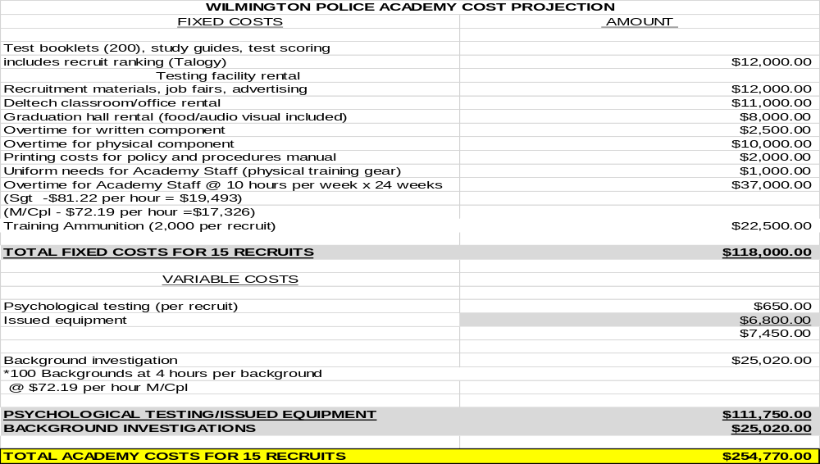
Question 10. Answer (Continued)

Slide 31
Question 11.
Discuss the planned use of ~$3.40M budgeted in the overtime account categories.
  Share mechanism in place to control overtime.

Slide 32
Question 11. Answer
POLICE DEPARTMENT OVERTIME - $3.40M
Divisional overtime including Patrol and Detective Divisions
Crisis Management Tactical Team
Vice operations
Canine overtime
City Sponsored Special Events
The Chief’s Office and our Fiscal Unit regularly monitor overtime expenditures and available funding in various account lines. Additionally, commanding officers in each division are responsible for monitoring and justifying overtime use. This includes monitoring use of anti-violence overtime funding, and an evaluation of the effectiveness of these assignments as they relate to the current crime trends.
  During June through August, officers and Supervisors in specialized Divisions are scheduled to work Summer Deployment to help offset overtime costs.

Slide 33
Question 12.
Please share if this budget provides adequate funding and resources for training, professional growth, and development for your team.
Specify if any funding for trauma-informed policing training.

Slide 34
Question 12. Answer
The department provides adequate funding to support all of our training and professional development programming. This includes training around trauma-informed approaches to policing, cultural diversity, implicit bias, law enforcement legitimacy, de-escalation and more. We continue to far exceed training that is required under state regulations as well as through our accreditation standards.

Slide 35
Question 13.
Discuss the planned use of ~$2.67M budgeted in the Real-Time Crime Center Division in contracted maintenance service, up $1.3M over the prior year’s budget.
What is the return on investment for Shot Spotter? (What percentage of shooting incidents has it benefited?)
Share if adequate funding and resources for all officers to be equipped with body cameras.

Slide 36
Question 13. Answer
The Real-Time Crime Center budget reflects the 3%-5% increase in contracted maintenance services, consistent with contractual obligations.
ShotSpotter is an invaluable tool that supports every investigations into shots fired incidents and shooting incidents. This tool alerts police to the precise location of gunfire before 9-1-1 calls are received, enables officers to respond quickly to gather critical evidence, and in some cases, apprehend suspects before they can leave the scene.
Every Sworn Police Officer is issued a Body-Worn Camera.

Slide 37
Question 14.
Discuss the planned use of $366K budgeted in Consultants in the Public Safety Director Division, up $150K.
Share if any consideration for expanding the hours for Partners in Care Unit.
Specify the number of case or clients that the Clinical Services for Youth & Families has handled within the last two (2) years.

Slide 38
Question 14. Answer
The FY2027 budget reflects a 5% contractual increase with Christiana Care to support the Partners In Care Unit partnership, which is no longer supported by grant funding.
The program is structured to cover the days and times with the highest need. For any incidents that occur outside of those hours, we have Crisis Intervention Team-trained officers on every patrol platoon, as well as a robust referral process to connect individuals with Partners In Care at a later time if necessary.
The Clinical Services for Youth & Families has handed the following cases:
  2024: The YR Unit assisted 247 children and families, and attended 56 outreach & community events
  2025: The YR Unit assisted 308 children and families, and attended 83 outreach & community events.

Slide 39
Question 15.
Provide an update on all authorized and received grant funds for FY25 and FY26 year-to-date.
Specify available grant funds.

Slide 40
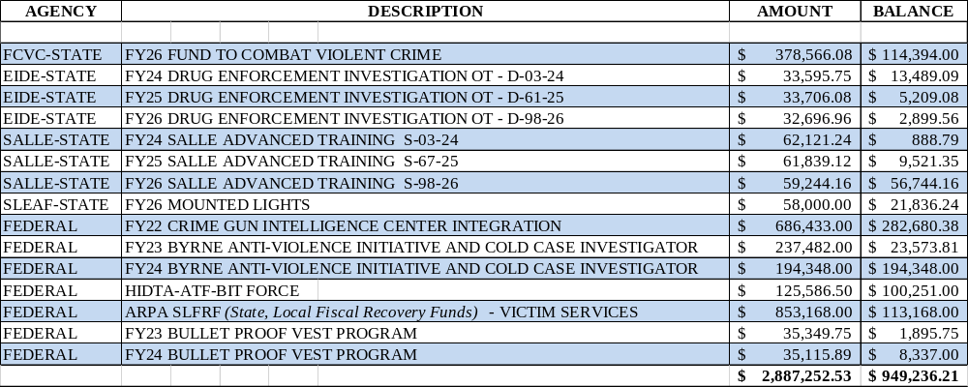
Question 15. Answer

Slide 41
Question 16.
Provide FY2027 proposed organizational chart with the total number of employees (i.e. permanent, temporary, contract, vacancies).
Outline specific duties of each employee.
If there are multiple divisions, please ensure there are sub-org charts that enumerate all the above.
Please include in the Org Chart a photo of all Directors, Managers, Division Heads, and Supervisors.

Slide 42

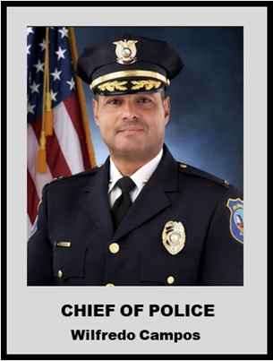
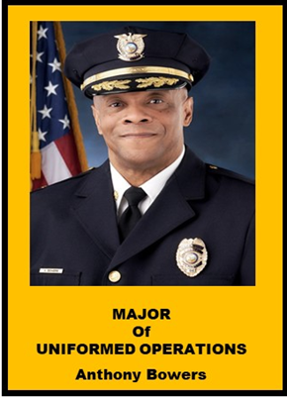
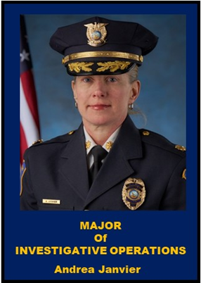
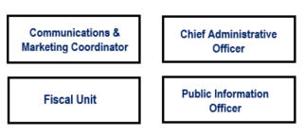


WILMINGTON DEPARTMENT OF POLICE
2027 ORGANIZATIONAL CHART

Slide 43
AUTHORIZED STRENGTH: 305
CURRENT STRENGTH: 281
 |  |  |  |  |  |  |  |  |  |  | Chief | Major | Captain | Lieutenant | Sergeant | Officer | Total
 |  |  |  |  |  |  |  | AUTHORIZED STRENGTH |  |  | 1 | 2 | 7 | 11 | 38 | 246 | 305
Administration |  |  |  |  |  |  |  |  |  |  | 1 | 2 |  |  |  | 1 | 4
Human Resources Division |  |  |  |  |  |  |  |  |  |  |  |  | 1 | 1 | 2 | 3 | 7
Office of Professional Standards |  |  |  |  |  |  |  |  |  |  |  |  | 1 |  | 5 |  | 6
Criminal Investigations Division |  |  |  |  |  |  |  |  |  |  |  |  | 1 | 1 | 6 | 22 | 30
Forensic Service Unit |  |  |  |  |  |  |  |  |  |  |  |  |  |  | 1 | 10 | 11
Drugs, Organized Crime & Vice |  |  |  |  |  |  |  |  |  |  |  |  | 1 | 1 | 2 | 15 | 18
RTCC, CGIC & Tech Resource Unit |  |  |  |  |  |  |  |  |  |  |  |  |  | 1 | 1 | 12 | 15
Support Services & Communications |  |  |  |  |  |  |  |  |  |  |  |  |  |  | 1 | 2 | 3
Special Operations-Traffic,K9,SRO,PAL, HICKS, DOWNTOWN/RIVERFRONT |  |  |  |  |  |  |  |  |  |  |  |  |  | 1 | 3 | 31 | 37
Uniformed Services Division (Administration) |  |  |  |  |  |  |  |  |  |  |  |  | 3 | 1 |  |  | 4
A Platoon |  |  |  |  |  |  |  |  |  |  |  |  |  | 1 | 4 | 31 | 36
B Platoon |  |  |  |  |  |  |  |  |  |  |  |  |  | 1 | 4 | 29 | 34
C Platoon |  |  |  |  |  |  |  |  |  |  |  |  |  | 1 | 4 | 31 | 36
D Platoon |  |  |  |  |  |  |  |  |  |  |  |  |  | 1 | 4 | 28 | 33
CEU & Partners In Care |  |  |  |  |  |  |  |  |  |  |  |  |  | 1 | 1 | 11 | 13
 |  |  |  |  |  |  |  | ACTUAL STRENGTH |  |  | 1 | 2 | 7 | 11 | 38 | 222 | 281

Slide 44
CIVILIAN PERSONNEL
Administration |  |  |  |  | 1
Human Resource Division |  |  |  |  | 2
Uniform Services Division (Patrol) |  |  |  |  | 1
Special Operations (Crossing Guards) |  |  |  |  | 32 | 13-Vacant
Support Services |  |  |  |  | 10
Criminal Investigations Division |  |  |  |  | 1 | 1-Vacant
Victim Services |  |  |  |  | 4
Communications |  |  |  |  | 33 | 6-Vacant
RTCC |  |  |  |  | 3
 |  |  |  |  | 87

