Slide 1


FY 2027 Budget Hearing
HUMAN RESOURCES

Slide 2
Proposed FY 2027 All Funds Budget
Human Resources All Funds | FY 2024 Actuals | FY 2025 Actuals | FY 2026 Budget | Proposed Budget FY 2027 | $ Change FY’27-26 | % Change FY’27-26
Personal Services | $3,054,993 | $3,127,341 | $3,680,761 | $3,789,640 | $108,879 | 3.0%
Materials, Supplies, and Equip. | 7,981,973 | 5,785,399 | 6,972,823 | 7,915,774 | 942,951 | 13.5%
Internal Services | 29,095 | 38,032 | 26,808 | 27,871 | 1,063 | 4.0%
Debt Service | 35,091 | 35,145 | 34,895 | 74,032 | 39,137 | 112.2%
Other/Special Purpose | 24,817,448 | 31,922,034 | 28,124,565 | 30,304,982 | 2,180,417 | 7.8%
Total | $35,918,600 | $36,674,146 | $38,839,852 | $42,112,299 | $3,272,447 | 8.4%
Staffing Level (FTEs) | 26.00 | 27.00 | 28.00 | 28.00 | 0.00 | 0.0%

Slide 3
Proposed FY 2027 General Fund Budget
Human Resources General Fund | FY 2024 Actuals | FY 2025 Actuals | FY 2026 Budget | Proposed Budget FY 2027 | $ Change FY’27-26 | % Change FY’27-26
Personal Services | $1,901,060 | $1,847,570 | $2,120,305 | $2,163,014 | $42,709 | 2.0%
Materials, Supplies, and Equip. | 463,869 | 386,277 | 552,398 | 577,878 | 25,480 | 4.6%
Internal Services | 16,375 | 21,029 | 13,825 | 14,370 | 545 | 3.9%
Debt Service | 35,091 | 35,145 | 34,895 | 74,032 | 39,137 | 112.2%
Total | $2,416,393 | $2,290,021 | $2,721,423 | $2,829,294 | $107,871 | 4.0%
Staffing Level (FTEs) | 16.60 | 17.10 | 17.10 | 17.10 | 0.00 | 0.0%

Slide 4
Major Funding Changes (General Fund Proposed Budget)
    Salaries and Wages (↑ $51,707)
      Regular Salaries (↑ $74,257) – COLAs, Anniversary Steps, and Annual Reviews
      Temporary Salaries (↓ $30,000) – Staffing Levels near Full Capacity
    Employee Benefits (↓ $8,584)
      City Pension Contribution (↓ $38,546) (↓ 60.3%)
      State Pension Plan (↑ $20,454) (↑ 29.1%)
Notes:
Pension Contribution – Charlotte Barnes fell off City Pension (no longer with the city)

Slide 5
Major Funding Changes (General Fund Proposed Budget)
MS&E (↑ $25,480)
  Memberships and Registration (↑ $39,880) (↑ 18.8%)
    Workshop/Seminar-Training (↑ $30,000) – Leadership and State-Mandated Trainings
    Registration Fees (↑ $9,000) – Professional Development
  Advertising (↓ $33,150)
  Miscellaneous Charges – N.O.C. (↑ $29,500) (↑ 92.2%)
    Outside Counsel for workplace investigations

Slide 6
Proposed FY 2027 Risk Management Fund Budget
Human Resources Risk Management Fund | FY 2024 Actuals | FY 2025 Actuals | FY 2026 Budget | Proposed Budget FY 2027 | $ Change FY’27-26 | % Change FY’27-26
Personal Services | $217,075 | $234,560 | $402,797 | $423,700 | $20,903 | 5.2%
Materials, Supplies, and Equipment | 6,681,932 | 4,607,710 | 5,275,873 | 6,202,489 | 926,616 | 17.6%
Internal Services | 9,852 | 13,849 | 9,340 | 9,706 | 366 | 3.9%
Special Purpose – Actuarial Adjustment | 1,738,443 | 4,020,332 | 12,554 | 12,554 | 0 | 0.0%
Total | $8,647,302 | $8,876,451 | $5,700,564 | $6,648,449 | $947,885 | 16.6%
Staffing Level (FTEs) | 1.30 | 1.30 | 2.30 | 2.30 | 0.00 | 0.0%

Slide 7
Major Funding Changes (Risk Management Fund Proposed Budget)
MS&E (↑ $926,616) (↑ 17.6%)
  Insurance Claims (↑ $668,940)
    General Liability, Auto, and Property Insurance
  Insurance Claims – Legal Defense (↑ $125,000)
    Estimates for Outside Counsel – Current Cases
  Liability (↑ $99,386)
    Premium for General Liability Excess Coverage and Cyber Insurance

Slide 8
Proposed FY 2027 Workers’ Compensation Fund Budget
Human Resources Workers’ Compensation Fund | FY 2024 Actuals | FY 2025 Actuals | FY 2026 Budget | Proposed Budget FY 2027 | $ Change FY’27-26 | % Change FY’27-26
Personal Services | $571,615 | $586,902 | $617,552 | $649,016 | $31,464 | 5.1%
Materials, Supplies, and Equipment | 629,832 | 594,352 | 894,272 | 885,127 | (9,145) | -1.0%
Internal Services | 2,033 | 2,275 | 2,731 | 2,846 | 115 | 4.2%
Special Purpose – Self-Insurance Costs | 3,205,737 | 5,189,628 | 4,366,112 | 4,795,065 | 428,953 | 9.8%
Total | $4,409,217 | $6,373,157 | $5,880,667 | $6,332,054 | $451,387 | 7.7%
Staffing Level (FTEs) | 4.30 | 4.30 | 4.30 | 4.30 | 0 | 0.0%

Slide 9
Major Funding Changes (Workers’ Compensation Fund Proposed Budget)
MS&E (↓ $9,145) (↓ 1.0%)
Self-Insurance Costs (↑ $428,953)
  Actuarial Study by Actuarial Advantage – medical claims expense, indemnity pay, rehab costs, and other Workers’ Comp expenses

Slide 10
Proposed FY 2027 Health & Welfare Fund Budget
Human Resources Health & Welfare Fund | FY 2024 Actuals | FY 2025 Actuals | FY 2026 Budget | Proposed Budget FY 2027 | $ Change FY’27-26 | % Change FY’27-26
Personal Services | $365,245 | $458,309 | $540,107 | $553,910 | $13,803 | 2.6%
Materials, Supplies, and Equipment | 206,340 | 197,060 | 250,280 | 250,280 | 0 | 0.0%
Internal Services | 835 | 879 | 912 | 949 | 37 | 4.1%
Special Purpose – Self-Insurance Costs | 19,873,268 | 22,712,074 | 23,745,899 | 25,497,363 | 1,751,464 | 7.4%
Total | $20,445,688 | $23,368,322 | $24,537,198 | $26,302,502 | $1,765,304 | 7.2%
Staffing Level (FTEs) | 3.80 | 4.30 | 4.30 | 4.30 | 0.00 | 0.00%

Slide 11
Major Funding Changes (Health & Welfare Fund Proposed Budget)
Self-Insurance Costs (↑ $1,751,464) - Utilization returned to expected levels
  Medical Costs (↑ $1,093,834) (↑ 7.2%)
  Dental Costs (↑ $129,658) (↑ 9.5%)
  Prescription Costs (↑ $254,604) (↑ 6.3%)
  Medical Stop Loss Insurance (↑ $245,458) (↑ 14.0%)
Notes:
Explain: Medical stop-loss insurance is a type of financial protection for employers who self-fund their health insurance plans. Instead of paying fixed premiums to a traditional insurer, the employer pays employees’ medical claims directly—and stop-loss insurance limits the employer’s risk if those claims get too high.

Slide 12
Mission
To provide the necessary human resources to City departments in order to promote the highest quality workforce and productive work environment and maintain the City’s operational and fiscal stability through effective risk management.

Slide 13
FY 27 Key Priorities (3)
Streamline Talent Acquisition, pre-boarding and onboarding
Update HR Policies & Procedures to strengthen employee services
Further the Administration’s goal of strengthening City government communications
Notes:
Prioritize equity by embedding diversity and inclusion into every stage of the recruitment, retention, and promotion process to build and sustain a workforce that reflects the communities we serve.
KPI
% of applicants from underrepresented groups
Compare attrition rates across racial, gender, and other identity groups to identify trends
% of underrepresented employees promoted vs. overall promotion rate
% of leadership roles held by diverse talent (track year-over-year)

Slide 14
FY 27 Key Performance Indicators (3)
Successfully negotiate five CBAs
Select and implement new Enterprise Resource Planning (ERP) platform to streamline HR processes and strengthen employee services
Workforce adoption of the new learning and performance management system at a rate of 80%.

Slide 15
1. Understanding the 5-year revenue and expenditure projections show expenditures far outpacing revenues for FY27 to FY30, and FY27 General Fund Proposed Budget uses $25.7M of the Tax Stabilization Fund, please share how this budget aligns with closing any potential budget gaps.
a. Specify any cost savings or reductions, and if this budget provides adequate resources to meet the departmental needs.
b. Specify any high-level major additions.
c. With the 5-year budgeted deficits per fiscal year, share of any potential citywide HR strategies for strategic personnel management to help defray costs and sustain operational efficiency.
This budget aligns with addressing potential budget gaps by prioritizing strategic reductions and reallocations within the department to ensure resources are directed where they are most impactful. Specifically, we have increased investments in training and ongoing professional development for employees, executives, and managers to improve organizational effectiveness, support compliance with mandatory training requirements, and strengthen recruitment and retention efforts.
Notes:
Reiterate DEI Priority:
Assess the workplace culture and practices to develop and implement a data-driven strategy to eliminate barriers to an inclusive environment where all employees can thrive.
Finalize and begin implementation of the DEI strategy by January 1, 2026.
-
Adding a talking point about the fact that we are going to be full staff by June 2025 in Employment Services, the recruitment function of the Human Resources department
The operational needs of the respective departments will dictate the impact of this ruling. If the affected employee does not routinely work overtime, there should be minimal impact.

Slide 16
1. Understanding the 5-year revenue and expenditure projections show expenditures far outpacing revenues for FY27 to FY30, and FY27 General Fund Proposed Budget uses $25.7M of the Tax Stabilization Fund, please share how this budget aligns with closing any potential budget gaps.
a. Specify any cost savings or reductions, and if this budget provides adequate resources to meet the departmental needs.
b. Specify any high-level major additions.
c. With the 5-year budgeted deficits per fiscal year, share of any potential citywide HR strategies for strategic personnel management to help defray costs and sustain operational efficiency.
  We achieved cost savings by eliminating Temporary Salaries ($30,000) in the General Fund, as staffing levels are now close to full capacity. Additionally, we reduced expenditures for Advertising (-$33,150) and reallocated those funds toward Workshops/Seminars - Training ($30,000) to strengthen staff and management training, particularly to support mandatory training requirements. We also identified offsetting costs through an increase in Registration Fees ($9,000), funded by reductions in the Consultants (-$9,500) account. Further savings were realized by reducing allocations for Food (-$4,000), Travel (-$1,300), and Subscriptions/Books (-$620) expenses. Overall, these adjustments help optimize existing resources while maintaining adequate funding to support departmental operations, workforce development, and recruitment and retention efforts.
  High-level major additions include an increase of $29,500 in Miscellaneous Charges -N.O.C. to support workplace investigations that are outsourced to outside counsel due to the sensitive nature of certain allegations or potential conflicts of interest. Additionally, funding has been increased for Workshops/Seminars - Training ($30,000) to support state-mandated training requirements, as well as leadership trainings for executives and middle management.
  Citywide HR strategies to help defray costs and sustain operational efficiency include formalizing a structured process for the critical review of vacant positions to ensure alignment with operational priorities before filling. We will implement a management-by-attrition approach, allowing for natural workforce reductions through retirements and separations where appropriate. This strategy helps control personnel costs while maintaining essential services and encouraging more efficient use of existing staff and resources
Notes:
Reiterate DEI Priority:
Assess the workplace culture and practices to develop and implement a data-driven strategy to eliminate barriers to an inclusive environment where all employees can thrive.
Finalize and begin implementation of the DEI strategy by January 1, 2026.
-
Adding a talking point about the fact that we are going to be full staff by June 2025 in Employment Services, the recruitment function of the Human Resources department
The operational needs of the respective departments will dictate the impact of this ruling. If the affected employee does not routinely work overtime, there should be minimal impact.

Slide 17
2. Share the impact to this budget as a result of Ord# 24-051 that established a temporary moratorium on the classification biennial appeal process from September 1, 2024 to September 1, 2026.​
a. Specify # of positions that were changed due to this legislation (# of positions per department, and per fiscal year).​
b. Specify the number of HR positions that were impacted, and the process to ensure no conflicts.​
c. Share # of positions that were changed through the budget process, outside of the parameters of Ord# 24-051.​
Please see the included Departmental Alignment Spreadsheet for a breakdown of departments, positions, impacted employees, and budget impact.
Only 27 of the 300 positions needed reclassification. Most positions were accurately classified based on recent revisions due to vacancies, successful appeals, and personnel budget upgrades.
All positions, including those in HR were reviewed using the updated position classification and factor ranking tools provided by PRJ Consulting during the Classification & Compensation Study.
The factors that warrant reclassification are changes in:
  Scope of responsibilities
  Required knowledge, skills, and abilities;
  Consequences of mistakes;
  Financial impact and oversight;
  Basis for interaction with the public and City officials.
Please see the included FY27 Budget Personnel Requests spreadsheet for a breakdown of departments, positions, impacted employees, and budget impact.
Notes:
Met with departmental leadership
Updated job descriptions to ensure accuracy
Met with employee groups and unions to verify accuracy and confirm acknowledgement of duties
JDs assessed based on new tool from consultant

Slide 18
3. Provide an update on the City’s 6 Collective Bargaining Agreements.
a. Specify each CBA term dates.
b. Specify timeframe for any expired or tentative contracts, and if any impact to FY2027
budget.
BARGAINING UNIT | DESCRIPTION | CONTRACT TERMS | STATUS
IAFF Local 1590 | Fire Fighters and Officers | 7/1/26 – 6/30/27 | Under Contract
FOP Lodge #1 (C&M) | Captains and Majors | 7/1/23 – 6/30/26 | Successor negotiations underway
FOP Lodge #1 (R&F) | Rank and File Police Officers | 7/1/24 – 6/30/26 | Successor negotiations underway
AFSCME Local 320 | Labor, Trades and Craftsmen | 7/1/20 – 6/30/26 | Successor negotiations underway
AFSCME Local 1102 | Clerical, Technical and Supervisory | 7/1/22 – 6/30/26 | Successor negotiations underway
AFSCME Local 1102B | School Crossing Guards | 7/1/22 – 6/30/26 | Successor negotiations underway
Negotiations have commenced with all unions except Fire, which remains under contract. All negotiations have a target completion date of June 15, 2026. HR and OMB are working closely to ensure FY27 budget impacts remain within budget.

Slide 19
4. The latest vacancy report provided to City Council has 102 vacant positions, while at this same time last year, there were 101 vacant positions. Please share the processes in place for operational efficiency for filling vacant positions so there’s minimal impact on the city’s fiscal operations.
The process for filling vacancies at the City of Wilmington is largely defined by section 40 of the Wilmington City Code.
The Department of Human Resources implemented an automated workflow for personnel requisitions, the document that initiates the hiring process, to improve operational efficiency while providing transparency and accountability by identifying the bottlenecks in the 5-step approval process for personnel requisitions
  Take a process from 2 weeks to 2-3 days
  May add an additional step to review position efficiency and need
Notes:
It is important to note that the number of vacancies alone does not adequately portray the work of the work of the Department of Human Resources to fill our positions. The positions that are on the current vacancies report are not all the same positions from the previous vacancy reports referenced in Council's question. We have a policy of promoting from within; promotions from within result in another vacancy.
Division of Employment Services has not been fully staffed since April 2024.
The digital requisition process has significantly reduced pre-posting time, from two weeks to 2–3 days. We’re also in the testing phase of an automatic termination process, which will immediately trigger a requisition upon an employee's departure, eliminating delays from manual department requests.
Additionally, we’ve adjusted our posting timelines in response to market trends. In 2023 and 2024, due to a lower volume of applicants and the need to repost over half of our positions, we extended postings from 2 to 3 weeks. With increased applicant interest and a shift in the job market, we’ve returned to a 2-week posting period to accelerate recruitment.
These improvements support our goal of maintaining service continuity and reducing operational disruptions. As reported to City Council, we currently have 101 vacant positions, compared to 122 last year and 97 the year before, demonstrating ongoing progress despite the evolving employment landscape.

Slide 20
4a. Specify if City residency requirement impacts filling vacant positions (which the residency requirement does not include union positions).
23 of the 106 vacancies are subject to the Residency Requirement
Affected Departments
  HR, IT, Law, Land Use & Planning. Mayor’s Office, Parks, City Council, Finance, Police, Public Works, and Treasurer’s Office
Notes:
It is important to note that the number of vacancies alone does not adequately portray the work of the work of the Department of Human Resources to fill our positions. The positions that are on the current vacancies report are not all the same positions from the previous vacancy reports referenced in Council's question. We have a policy of promoting from within; promotions from within result in another vacancy.
Division of Employment Services has not been fully staffed since April 2024.
The digital requisition process has significantly reduced pre-posting time, from two weeks to 2–3 days. We’re also in the testing phase of an automatic termination process, which will immediately trigger a requisition upon an employee's departure, eliminating delays from manual department requests.
Additionally, we’ve adjusted our posting timelines in response to market trends. In 2023 and 2024, due to a lower volume of applicants and the need to repost over half of our positions, we extended postings from 2 to 3 weeks. With increased applicant interest and a shift in the job market, we’ve returned to a 2-week posting period to accelerate recruitment.
These improvements support our goal of maintaining service continuity and reducing operational disruptions. As reported to City Council, we currently have 101 vacant positions, compared to 122 last year and 97 the year before, demonstrating ongoing progress despite the evolving employment landscape.

Slide 21
4.b Share the # of city employees who are city residents per department.
Notes:
Complete the breakdown for each union or non union affiliation
How many ppl are subject to the residency requirement
Increase in Public Safety Interest
Increase in decline of interview or position for non-union positions
Increase in fill time for union positions

Slide 22
4c. Share if any plans for attrition analysis to best target resources to recruit and retain employees.
Conduct department-wide attrition analysis by role, tenure, and separation trends
Develop a centralized workforce dashboard for real-time visibility into vacancies and turnover
Use data insights to tailor targeted recruitment and retention strategies by department
Notes:
Complete the breakdown for each union or non union affiliation
How many ppl are subject to the residency requirement
Increase in Public Safety Interest
Increase in decline of interview or position for non-union positions
Increase in fill time for union positions

Slide 23
4 d. Share the workforce risk for the next 3 to 5 years.
4 e. Share plans for retirement and institutional knowledge loss
Build workforce resilience: Identify critical roles and develop employee growth plans to strengthen bench depth and succession over the next 3 years
Preserve institutional knowledge: Create and maintain standardized SOPs for all key functions to ensure continuity despite turnover
Increase operational efficiency: Implement cross-training and overlapping processes to reduce single points of failure and improve service delivery
Notes:
Complete the breakdown for each union or non union affiliation
How many ppl are subject to the residency requirement
Increase in Public Safety Interest
Increase in decline of interview or position for non-union positions
Increase in fill time for union positions

Slide 24
4 f. Share the number of city employees that has participated in the tuition
reimbursement program per year for the last 2 years (specify amount for eligibility and amount budgeted).
Utilization of the education reimbursement program has been modest but steady. In FY2025, 2 employees participated, and thus far in FY2026, 2 employees have utilized the benefit.
The program provides up to $1,000 per employee and is budgeted to support up to 10 employees annually. In addition, employees may access funding for training and growth through department-specific professional development resources, which also support continued learning and skill advancement.
This is first come first serve and employees have the opportunity to use the program up to two times a year.
Notes:
Complete the breakdown for each union or non union affiliation
How many ppl are subject to the residency requirement
Increase in Public Safety Interest
Increase in decline of interview or position for non-union positions
Increase in fill time for union positions

Slide 25
5. $2M is budgeted citywide for Temp Agency cost ($1.3M GF, $800K WSF). Please share the entities the city has engaged with for temping services.
a. Specify length of any agreements for the last 2 years.
b. Specify if there are any savings for multi-year agreement.
Integrity is our City’s Temporary Services Provider.
  Departments have the opportunity to work with other vendors for more specialized roles if they do not find what they are looking for with Integrity
Initiated the RFP process
  Process initiated in January 2026
  Ads ran in the News Journal on 2/19 & 2/26/2026
  Bid Opening occurred on 4/14/26 @ 3 PM
  Only one bid was received from the current service provider
  Working with Law to draft terms for a multi-year contract
    At the recommendation of Procurement, there was no value in reposting or running additional ads
Notes:
Complete the breakdown for each union or non union affiliation
How many ppl are subject to the residency requirement
Increase in Public Safety Interest
Increase in decline of interview or position for non-union positions
Increase in fill time for union positions

Slide 26
6. With the planned launch of the new UKG Ready timekeeping system, please share your plans to modernize and streamline the payroll timecard process to improve efficiency and accuracy.
a. Share if all departments will be using this system.
UKG Ready was created to empower employees to take greater accountability for the accuracy of their timecards, asking them to approve their timecards at the end of each pay period before managers do.
Once payroll receives approved timecards, they should have already been approved by two layers, employee and supervisor, therefore reducing the amount of errors.
With the exception of WFD, which uses Telestaff to manage its schedules, all departments will use the new UKG Ready time-and-attendance platform.
Notes:
For employee led biennial reclassification process we previously used external parties
This year we allowed the C&C Director (the SME) to implement the new tool provided by the consultant

Slide 27
7. Share if any funds are set aside in this proposed budget for the Residency Assistance Fund per
Ord# 23-040.
a. Specify number of people that have used the fund since inception.
b. Specify how this fund is marketed to current and new employees.
The policy was created, reviewed, and approved Nov. 2025.
  The form and agreement need to be reviewed and approved by Law.
Although Ordinance 23-040 establishing the Relocation Assistance Fund became law without the Mayor’s signature on November 26, 2023, and the Residency Task Force Report was adopted on November 21, 2024, funding for the program did not begin until July 1, 2025. Accordingly, employees hired between July 1, 2024, and June 30, 2025, are eligible to apply for retroactive reimbursement.
It is important to have a streamlined process to ensure fairness as this will be first come first serve
Notes:
For employee led biennial reclassification process we previously used external parties
This year we allowed the C&C Director (the SME) to implement the new tool provided by the consultant

Slide 28
8. Discuss the planned use for $94K budgeted for Advertising considering actuals has not exceeded $20K for the last 3 years.
a. Share any collaborations with high schools, local colleges etc.
Recruitment Advertising
  Job fairs and community engagement events
  Trade publications, specialty advertising, paid postings, and advertising on social media
  Targeted efforts for hard-to-fill positions
Employee Referral Bonus – Policy and Form pending
Residency Assistance Fund - Form approval pending
We are actively building school collaborations to strengthen our workforce pipeline. We are partnering with Delaware State University (DSU) to develop internship opportunities, whether paid or credit-based, that give students practical, hands-on experience. We are also utilizing the Parks’ “Next Level” program to engage emerging talent, while working to expand and formalize these efforts into a broader, citywide internship and workforce development program through the Department of Human Resources. This approach supports skill development, increases exposure to public sector careers, and creates a sustainable pathway to future City employment.
Notes:
For employee led biennial reclassification process we previously used external parties
This year we allowed the C&C Director (the SME) to implement the new tool provided by the consultant

Slide 29
9. Justify the planned use of ~$203K budgeted for Cornerstone Performance Management, Statewide Mandated Harassment, and Leadership trainings.
i. Specify the # of employees per department that participated in the training last year and year to date (per classification: management, union, non-union, etc.).
Approximately $167,000 of these budget funds will cover the cost of our new performance management and learning and development platform. The remaining funds will by used for content development or ad-hoc training workshops and seminars for the workforce. The training will be for all employees.
The benefits of the all-in-one learning management and performance management system include, but are not limited to, the following:
  Workforce Development
  Streamlined performance management
  Enhanced employee engagement and retention
  Support of compliance efforts
  Streamlined onboarding
Notes:
For employee led biennial reclassification process we previously used external parties
This year we allowed the C&C Director (the SME) to implement the new tool provided by the consultant

Slide 30
10. Discuss the planned use for ~$142K budgeted in the Professional Fees and Miscellaneous Charges N.O.C. accounting categories.
Division | Amount | Purpose
Employment Services | $30,589.00 | Cornerstone training, background investigations, and administrative support for personnel file maintenance
Administration | $3,000.00 | Items for Labor negotiations arbitrations and hearings
Compliance | $58,500.00 | Investigations and lactation room compliance
Class and Comp | $30,000.00 | Maintenance and Adjustment on Compensation Tools; training and reporting for UKG; and ensuring FLSA compliance.

Slide 31
11. Discuss the plans for filling the vacant Risk Manager position that was added as a new position last fiscal year, as well as funding for a Risk Manager position in the Temp account category.
Position is authorized but not appropriated. Do not expect vacancy in FY 27.

Slide 32
12. Discuss the~ $6M in the Insurance account grouping, up~ $900K over the prior year’s budget.
The major funding changes were increases of:
(1) $628,940 in Insurance Claims, which was based upon an increase in case reserves for five large general liability cases, according to an actuarial study dated August 5, 2025 and presented to the Risk Management Committee
(2) $125,000 for Insurance Claims-Legal Defense, based upon a request from the Law Dept. based upon their expected case load, and
(3) $88,686 in Liability costs for Excess Liability, Crime and Cyber Insurance.

Slide 33
12 a. Specify the number of cases in FY25 and FY26 year to date, per claim type, for the Insurance Claims-Legal Defense
FY’25 (7/1/24 – 6/30/25)
P.I. – 21
Empl. – 14
Const. Claims – 13
Miscellaneous – 8
Total cases - 68
FY’26 (7/1/25 – 4/17/26)
P.I. – 30
Empl. – 28
Const. Claims – 14
Miscellaneous – 12
Total cases - 84

Slide 34
12.
Specify the cost driver for the increases in the chart below regarding claims:
Specify available fund balance in the reserves for this fund.
The major funding changes were increases of (1) $628,940 in Insurance Claims, which was based upon an increase in case reserves for five large general liability cases, according to an actuarial study dated August 5, 2025 and presented to the Risk Management Committee (2) $125,000 for Insurance Claims-Legal Defense, based upon a request from the Law Dept. based upon their expected case load, and (3) $88,686 in Liability costs for Excess Liability, Crime and Cyber Insurance.
There is no carryover reserve fund.
FY23 Actual | FY24 Actual | FY25 Actual | FY26 Budget | FY27 Proposed
$859,282 | $3,256,603 | $1,394,778 | $2,102,773 | $2,771,713

Slide 35
13. Discuss the planned use for ~$289K in Consultants.
  Specify if there are any DBE’s.
  See Chart
  Specify if any recurring one-year agreements.
VENDOR | AMOUNT | PURPOSE | DBE | RECURRING (Y/N)
PMA | $138,700 | Third Party Administrator | N | N
USI | $75,000 | Broker - Liability | N | N
Actuarial Advantage | $15,000 | Actuary | N | N
Gartner | $81,274 | Cyber Security | N | Y
Total | $309,974

Slide 36
14. Workers Compensation Fund
Discuss the $4.7M budgeted for Self-Insurance Costs.
Justify the unbudgeted allocation for $1.6M claims adjustment for FY25.
The adjustment was made internally when the budgeted claims amount for workers compensation was exceeded by the actual claims paid in the period.

Slide 37
15. Discuss the planned use of ~$335K budgeted for Insurance, while realizing cost has not exceeded $278K within the last 3 years.
  Specify if any funds in the reserves for any catastrophic events.
  $ 225,00 for Liability Insurance - a decrease of $25,000 from $250,000 budgeted in FY 2026. This figure better reflects anticipated cost
  $ 20,000 Surety bonds – amount remains the same as FY 2026 – an approximate 10% increase over actual cost of $18,250
  $ 90,000 Unemployment Insurance – a decrease of $10,00 to $90,000. from FY 2026. Unknown exact figure due to unforeseen possible unemployment statuses
  There are no funds in reserves for catastrophic events due to being informed that these funds can not be appropriated for legal reasons.

Slide 38
16. Share the planned use of ~$480K budgeted in Professional Fees account grouping, while realizing cost has not exceeded $348K within the last 3 years.
  Specify if there are any DBE’s.
  Specify the duration of the contract(s), vendor name, and number of years using the entity.
Rise in pricing to account for escalating medical and services cost
VENDOR​​ | CONTRACT​​ | AMOUNT​​ | LENGTH​​ | TENURE​​ | DBE (Y/N)​​
Jackie Joe Lindo | City Physician​​ | $120,000 | 1 Years​​ | 5 Years (2021) | Y
Lodestar Claims and Risk Services, Inc. (Formally PMA) | Worker’s Comp, cost and health and safety initiatives, use of Lodestar software $7,500 (users fee) Claims | $255,000 | 1 Year​​ | 19 Years (2017)​​ | N​​
Innovative | Emergency care in absence of City physician, use of annual fitness for duty diagnostic testing for sworn personnel, monthly random drug screens, Parks and Recreation – drug screenings, Defense Medical Evaluations (DME) | $105,000 | 1 Year​​ | 4 Years (2022)​​ | Y
Concentra |  |  |  | 2 Years (2024) | N
 | TOTAL | $480,000

Slide 39
17. Discuss the ~$25.5M budgeted for healthcare costs, up $1.7M over the prior year’s budget.
PROGRAM​ | FY27 PROPOSED | FY26 BUDGET | DIFFERENCE​ | JUSTIFICATION​
Medical​ | $16,292,177 | $15,198,343 | $1,093,834 | The biggest change is from high claimants in our pre-65 retiree population.
Medical Stop Loss​ | $1,998,281 | $1,752,823 | $245,458 | 14% Increase for July 1, 2026 Renewal
Prescription​ | $4,302,851 | $4,048,247 | $254,604 | Prescription costs are trending nationally at 11% increase vs our 6.3% increase.
Medical Admin​ | $521,664 | $521,664​ | $0.00 | Rate hold.
Dental | $1,501,561 | $1,371,903​ | $129,658 | Projected trend increases.
Dental Admin​ | $57,839 | $57,839​ | $0.00 | Rate hold.
Flex HRA​ | $225,000 | $225,000 | $0.00 | Utilization is holding flat.
Vision​ | $140,000 | $140,000 | $0.00 | Utilization is holding flat.
Telehealth (Teladoc)​ | $45,000 | $45,00​0 | $0.00 | Rate hold.
Life Insurance | $218,754 | $218,754 | $0.00 | Rate hold.
Long Term Disability | $120,000 | $130,726 | -$10,726 | Reducing baseline based on that historical trend.
EAP | $27,500 | $27,500 | $0.00 | Rate hold.
ACA Fees | $8,400 | $8,100 | $300 | ACA Fee (PCORI) increasing each year due to federal increases.
Total​ Self-Insurance: | $26,302,502 | $23,745,198 | $1,765,304 | Normal trend increases driven by claims projections for FY27.

Slide 40



17a: Share any preventative measures the City may offer to employees.
Notes:
The Employee Benefits Team has strategically focused on promoting preventative screenings, advocating for healthy lifestyle choices, and enhancing chronic condition management while promoting a culture of health that meets people where they are. Additionally, incentive programs, engagement initiatives, and educating our workforce through quarterly newsletters are utilized to promote a holistic approach to employee well-being and foster a culture of health. Flagship events like our Fall Fest bring fun and encourage our folks to think about their health and wellness in a more engaging manner. ​
​

Slide 41
Question 17a. Continued:
In addition to our wellness events and education, we are continuing many wellness initiatives for our workforce and their families: ​
  Well360 Clarity Program through Blue Cross Blue Shield of DE. ​
  Continuing RxBenefits360 Program through Express Scripts, our prescription provider.
  Continuing our 7th On-Site Diabetes Prevention Program through the YMCA (Turner Building). ​
  Diabetes & Weight Management Care Value Packages through our Prescription provider, Express Scripts.​
  On-site screenings.
  SWORD (MSK), Bloom (Women’s Health), Spring Health (Mental Health) are virtual therapy programs in collaboration with Highmark BCBS of DE, providing members access to no-cost virtual therapy services.​
  Wellworks Physician Engagement Program.
  Streamlined and digitalized our enrollment process for active & retirees.
  Planning regular benefits engagement events to keep wellness highly visible.
  Kicking off “Own Your Benefits” as an engagement/education promotion.
Notes:
Well360 Clarity Program through Highmark Blue Cross Blue Shield​
The concierge service, integrated into our medical plan which provides the resources and support for our individuals to make informed care decisions, manage health conditions, improve lifestyle habits, and access preventive care all while ensuring the highest quality of care while reducing risks for chronic diseases.​
RxBenefits 360 Program – Express Scripts
This program offers a more personalized, concierge-style approach to prescription care. This change will enhance support without affecting our current coverage.
On Site Diabetes​
Covered benefit through our Highmark medical insurance. ​
6 folks are enrolled in our on-site program beginning in May!
​Onsite Screenings​
Collaborate with community and minority businesses like Diamond Chiropractic and the Tau Eta Chapter to conduct on-site screenings and provide education on the significance of prevention.​
​
Virtual Therapies
We understand that we need to meet people where they are which is why we have partnered with Highmark and offer many virtual therapy options to care such as: SWORD (virtual physical therapy), Bloom (virtual women’s health therapy), Spring Health (virtual mental health therapy) that provide our members and their families access to no-cost virtual care. ​
Physician Engagement Program ​
58.2% Utilization Rate - up 2.3% from last year (55.9%) ​
Our physician engagement program stands as a cornerstone in our commitment to employee health and well-being. By facilitating annual check-ups and promoting preventative screenings, we empower our workforce to prioritize their health and catch potential issues at their earliest stages. This proactive approach not only ensures early detection and intervention but also fosters a culture of preventive care within our organization.​
​

Slide 42
Question 18. Share the planned use of ~$194K budgeted in Professional Fees.
a. Specify if there are any DBE’s.
b. Specify the duration of the contract(s), vendor name, and number of years using the entity.
c. Specify if any recurring one-year agreements
VENDOR​​ | CONTRACT​​ | AMOUNT​​ | LENGTH​​ | TENURE​​ | DBE (Y/N)​​
Omega Benefits​​ | Benefits Website ​​ | $3,500​​ | 1 Year​​ | 3 Years (2022) | N​​
USI Insurance Services, LLC​​ | Broker-Benefits​​ | $142,600 | 1 Year​​ | 11 Years (2014)​​ | N​​
Wellworks For You​​ | Physician Engagement​​ | $6,655​​ | 1 Year​​ | 7 Years (2018)​​ | N​​
FlexFacts​​ | COBRA/FSA/Flex​​ | $35,000​​ | 1 Year​​ | 13 Years (2012)​​ | N​​
Pink Lady | Event Planning (Fall Fest) | $6,400 | 1 Year | 1 Year (2025) | Y
 | TOTAL | $194,155
Notes:
​

Slide 43
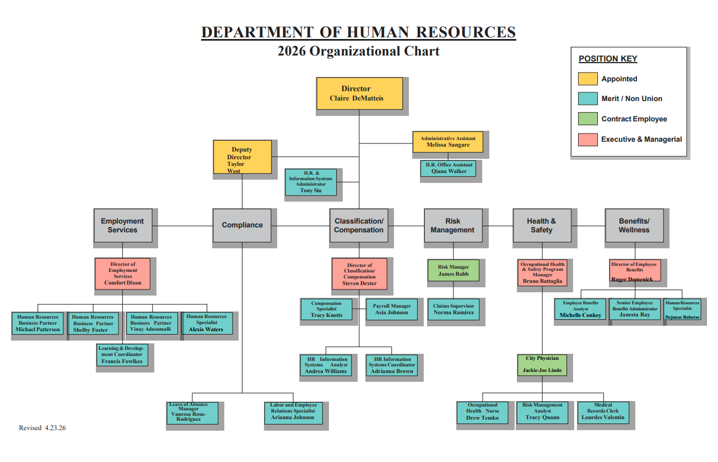
FY 2027 Organizational Chart

Slide 44
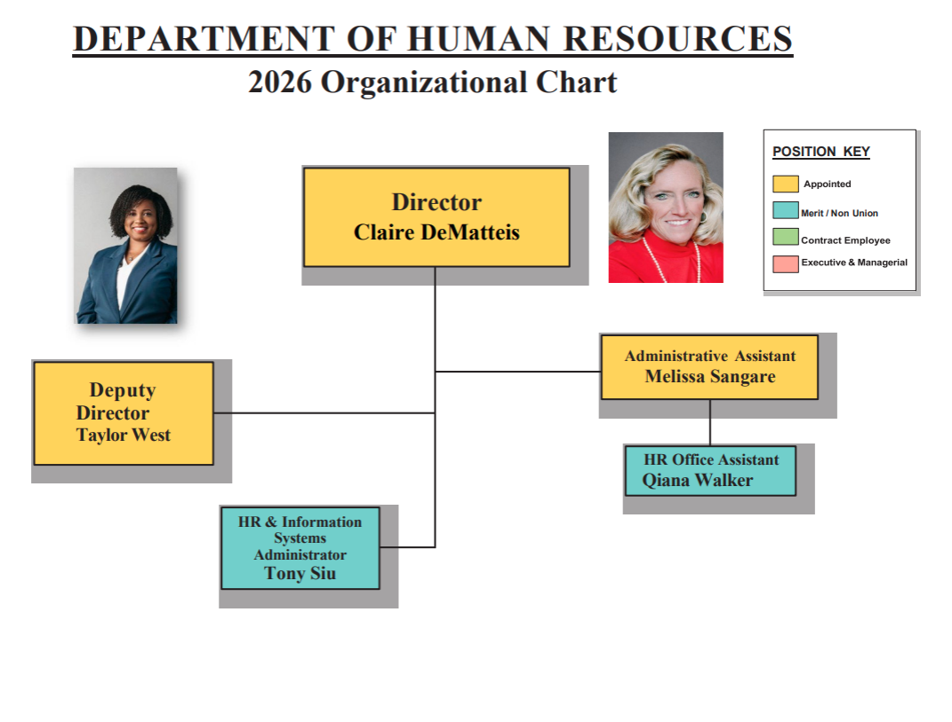
FY 2027 Organizational Chart

Slide 45
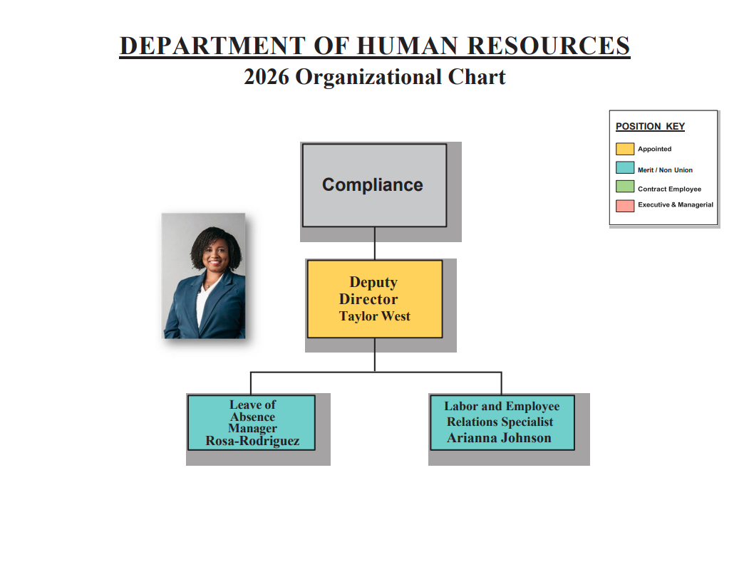
FY 2027 Organizational Chart

Slide 46
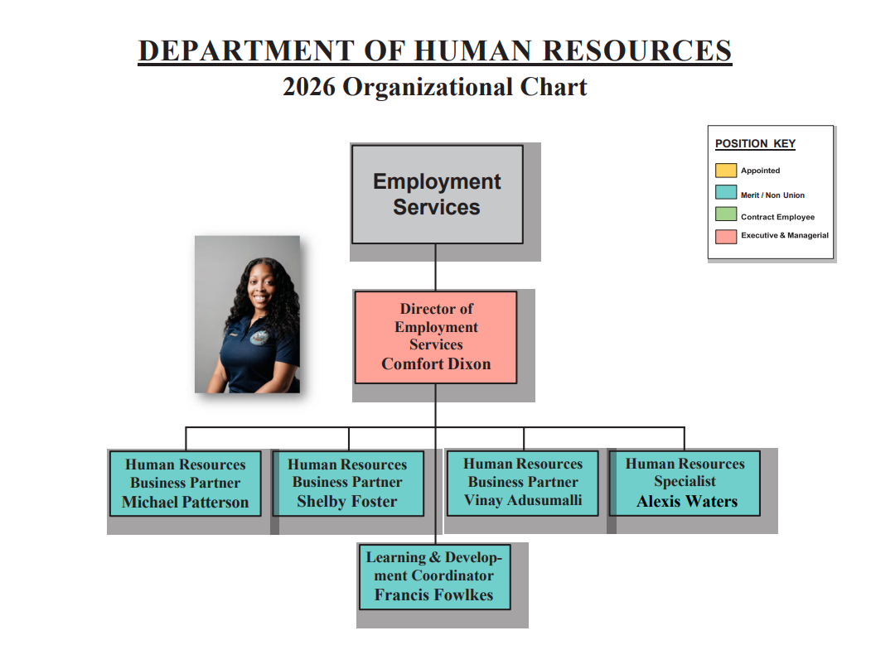
FY 2027 Organizational Chart

Slide 47
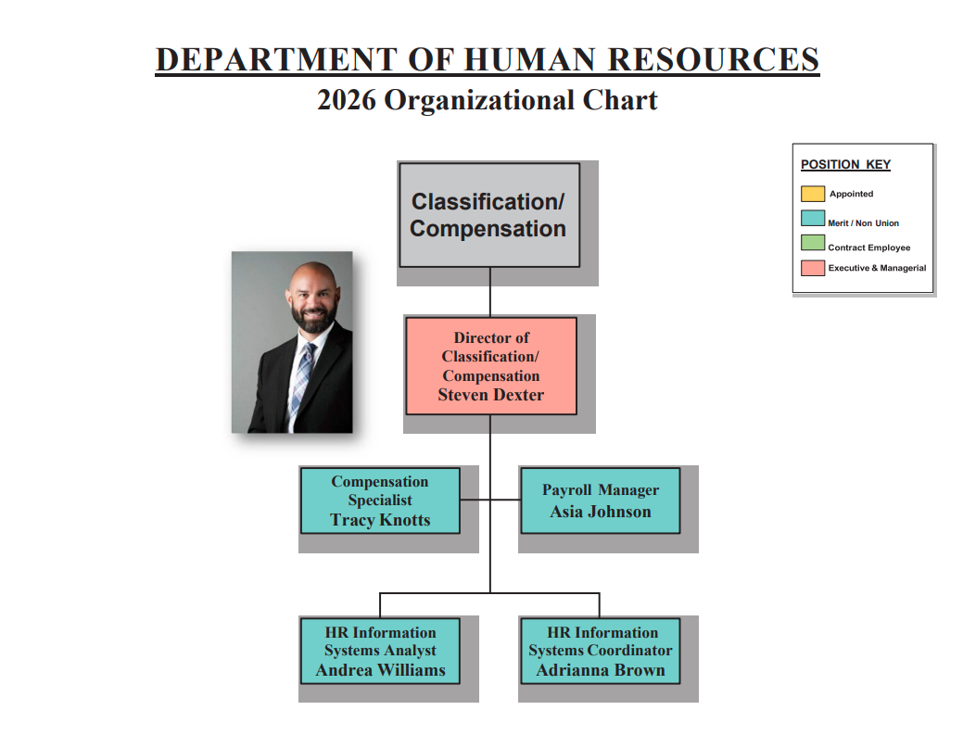
FY 2027 Organizational Chart

Slide 48
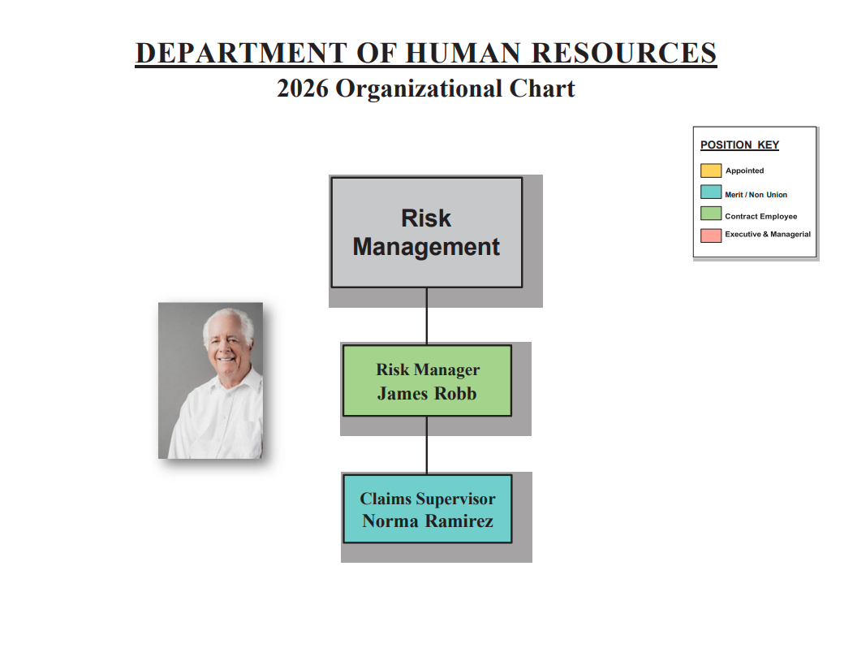
FY 2027 Organizational Chart

Slide 49
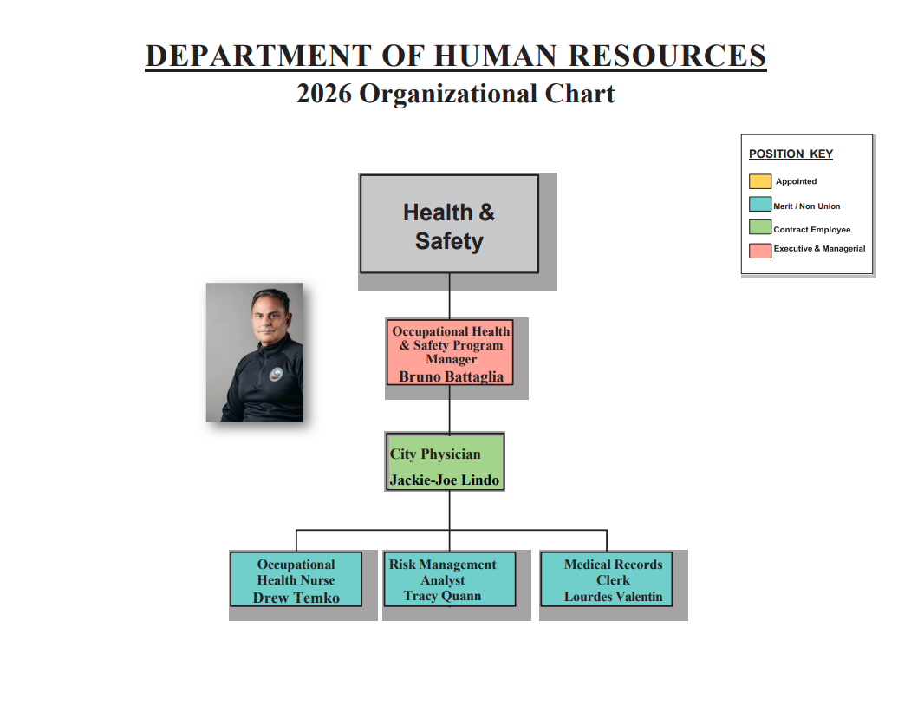
FY 2027 Organizational Chart

Slide 50
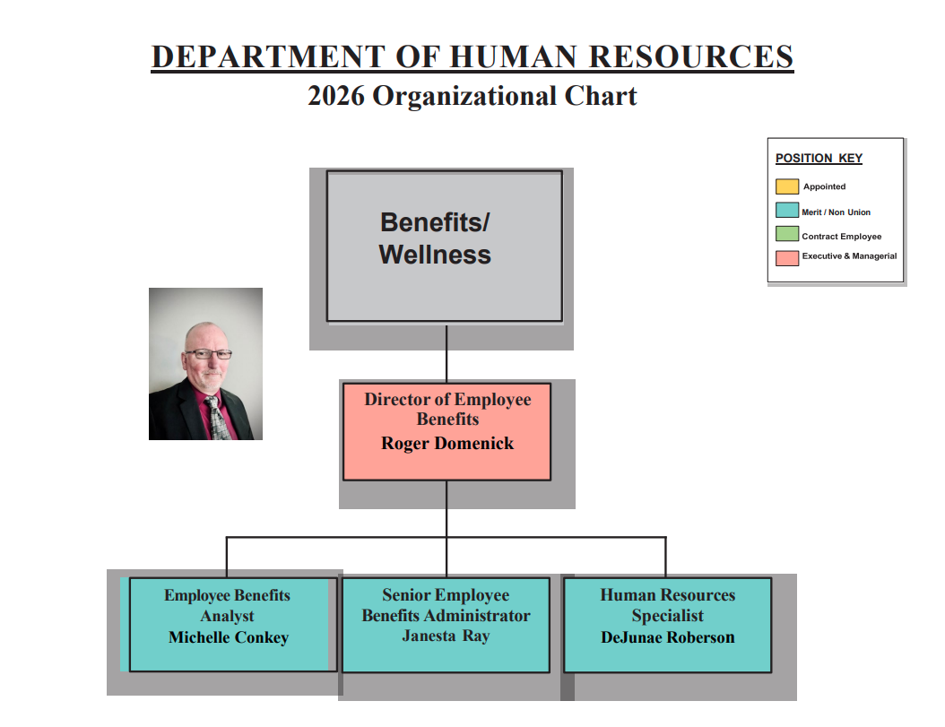
FY 2027 Organizational Chart

Slide 51
Department Overview – General Fund
Administrative
  Strategic Planning
  Budgeting
  Data & Analytics
  Purchasing & Payment
Compliance
    ADA/ FMLA
    EEOC
    Labor Management
    Policy Administration
Classification/Compensation
    Position Classification
    Compensation Analysis
    Payroll
    FLSA
Employment Services
    Talent Acquisition/Onboarding
    Succession Planning
    Performance Management
    Employee Engagement
    Career Development/Training

Slide 52
Department Overview – Internal Service Funds
Risk Management
  Risk Control
  Litigation
  Insurance
  Claims Processing
  Cyber Security
Workers Compensation
  Medical Dispensary
  Return to Work
  Occupational Health
  Safety
  Training
Health and Welfare
      Benefit Enrollment & Administration
      Retiree Healthcare
      Wellness/Population Health
      Auditing/Compliance
      Trending / Data Analytics

