Slide 1
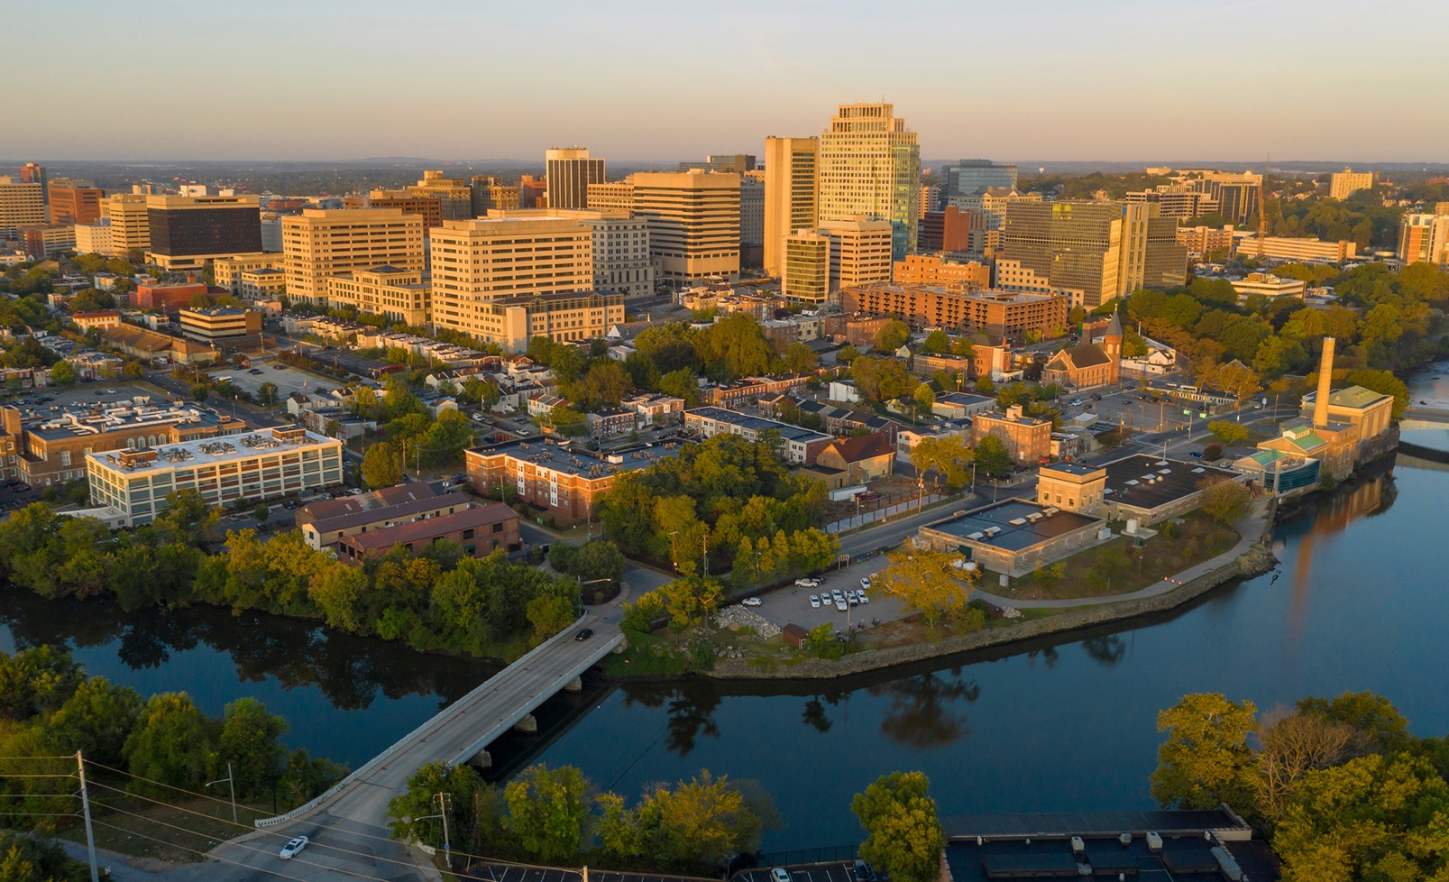
April 29, 2026
Financial resiliency in Wilmington
Fiscal year 2027- 2032
Presented to Wilmington finance and economic development committe

Slide 2

1
OUR SYSTEM & NEEDS
2
OUR PRIORITY RESILIENCE ACTIONS
We are here to discuss …
3
OUR VALUE & POSITIVE IMPACT

Slide 3
OUR SYSTEM & NEEDS

Slide 4



Our 24/7 utility services
Wastewater treatment & resource recovery
High quality drinking water
Storm water management

Slide 5









Our system and customers
37,300+
TWO
25.5B+
Water
treatment plants
ONE
Water accounts
Gallons wastewater treated
5B+
400+
Wastewater treatment plant
Gallons of water treated
Miles of sewer pipes
26K+
23,800+
400+
Stormwater accounts
Sewer accounts
Miles of water pipes

Slide 6

Utility goals and cost drivers
Goals
Cost drivers
Infrastructure Integrity
Regulatory Compliance
Capital Investments
Community Engagement
Our Goals
Community Health & Safety
OUR NEEDS
Cost Optimization
Skilled Workforce
Operating Costs
Regulatory
Mandates

Slide 7
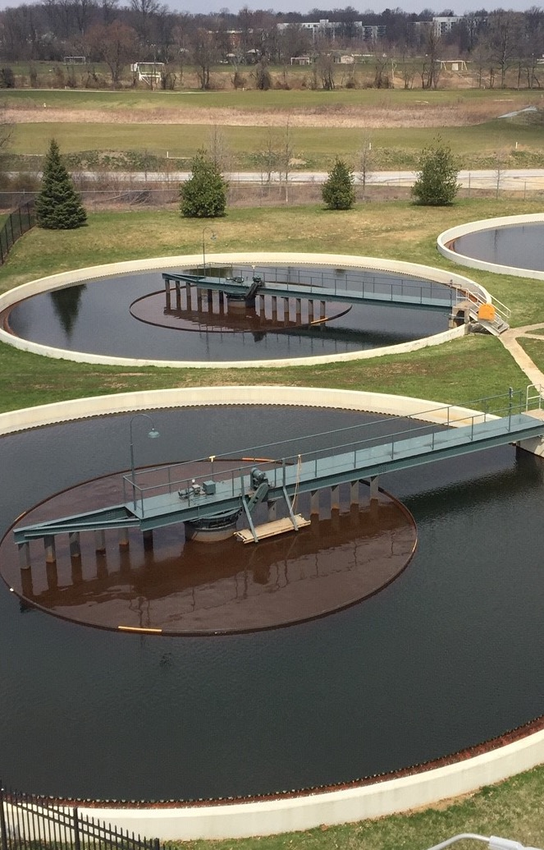
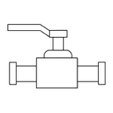
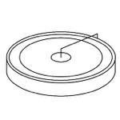
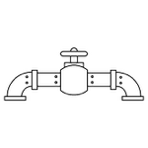
WATER SYSTEM
PIPES
$94.0M
WATER TREATMENT
$160.7M
PUPMING & OTHER
$10.4M
Six-Year Investment Need
$265.1M
Our Asset Base : $1.5 Billion

Slide 8
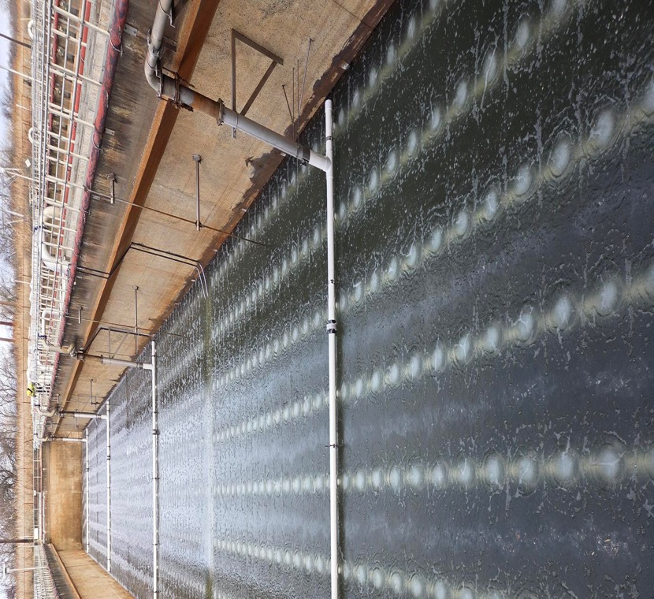
WASTEWATER SYSTEM
SEWER PIPES
$37.0M
WASTEWATER TREATMENT
$77.4M
PUMPING & OTHER
$32.7M
Six-Year Investment Need
$147.1M
Our Asset Base : $1.0 Billion

Slide 9
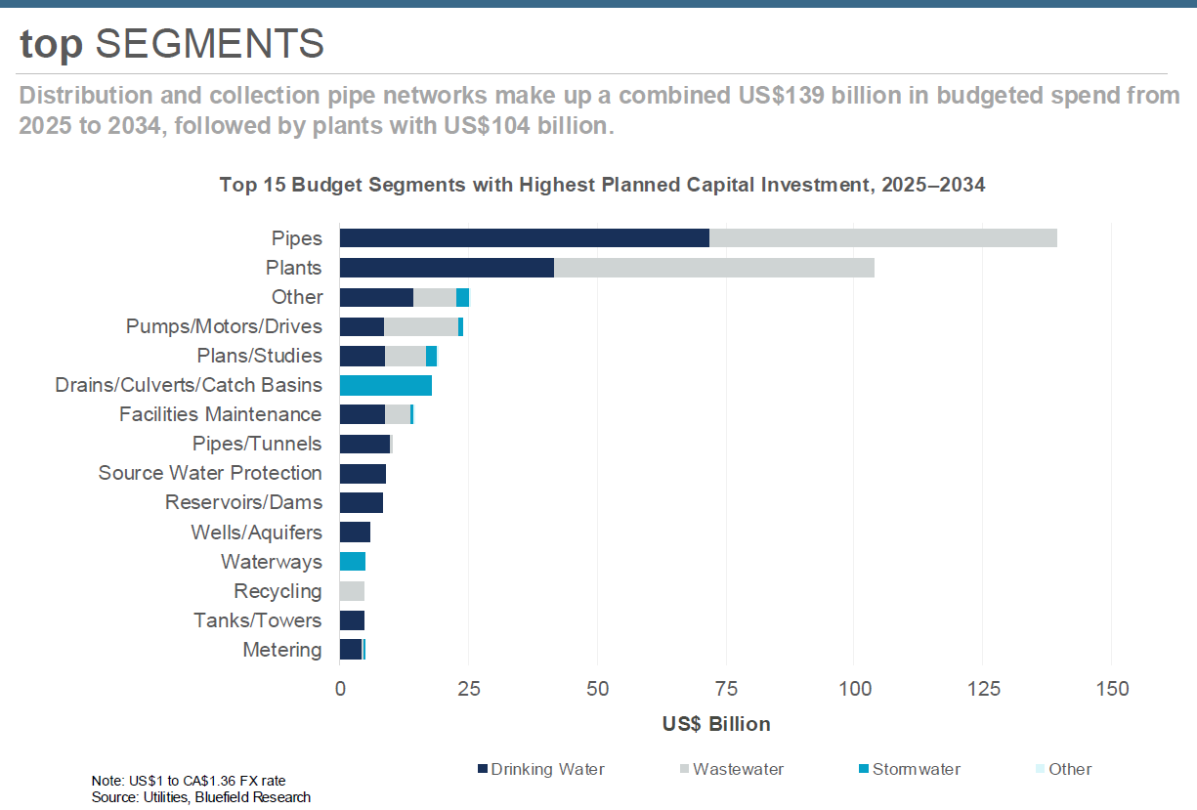
Wilmington’s investment aligns with water sector needs
Sources: Bluefield Research

Slide 10
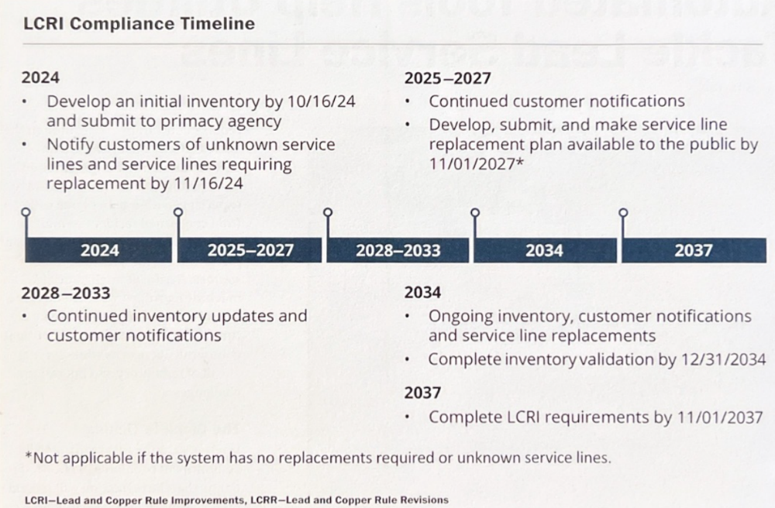

Regulatory mandate: Lead and Copper Rule Improvement (LCRI)
Lead Reduction Program | Wilmington Water Utility
(The Wilmington Water Utility website provides extensive details on the program)

Slide 11
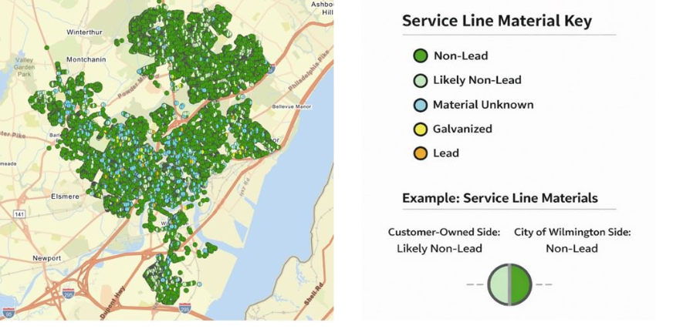
Wilmington’s LCRI compliance efforts
Won the national award from
“Lead Service Line Replacement Collaborative”
for
FISCAL SAVVY AND FUNDING INNOVATION
Inspected 100 City Blocks for lead service lines
Identified service lines in 1,700 properties
Replaced 1,000 lead service lines with 2.6 miles of copper pipes
Lead testing is required once every 3 years
Will conduct the triennial sampling at 50 locations to test for lead
Wilmington has fully complied with the Lead and Copper Rule
Cost effective funding: $10.0 Million SRF with 100% Principal Forgiveness
Service Line Inventory in progress to comply with the LCRI deadline: November 1, 2027

Slide 12

Regulatory mandate: PFAS & MDBP
46%
Per and Polyfluoroalkyl Substances (PFAS)
  Promulgated in April 2024
  Compliance deadline: 2031
of respondents report PFAS in their systems.
Microbial Disinfection By-Product Rule (MDBP) Revisions
  Anticipated in Summer 2027
Removing PFAS could mean an estimated $3.2B annually in national compliance costs.
Black & Veatch 2025 Water Report

Slide 13
Wilmington’s PFAS compliance efforts
Tested
drinking water in 29 locations for PFAS (2023)
Gathering Data through voluntary monthly water testing
Collaborating
with State and Federal regulatory agencies regarding rulemaking and ongoing research
Participating
in legal action seeking compensation for PFAS
Enhancing communication
with customers
Evaluating
treatment processes to address PFAS
Source: https://wilmingtondewater.gov/224/Water-Treatment

Slide 14

Utility operating costs
Fitch Ratings “neutral” outlook for water and sewer sector reflects an operating environment that is generally stable and no longer deteriorating.
Recent geopolitical events have added to the uncertainty
“Uncertainty that emerged in 2025 will carry into 2026.”
Fitch Ratings: U.S. Water Sector Outlook 2026

Slide 15
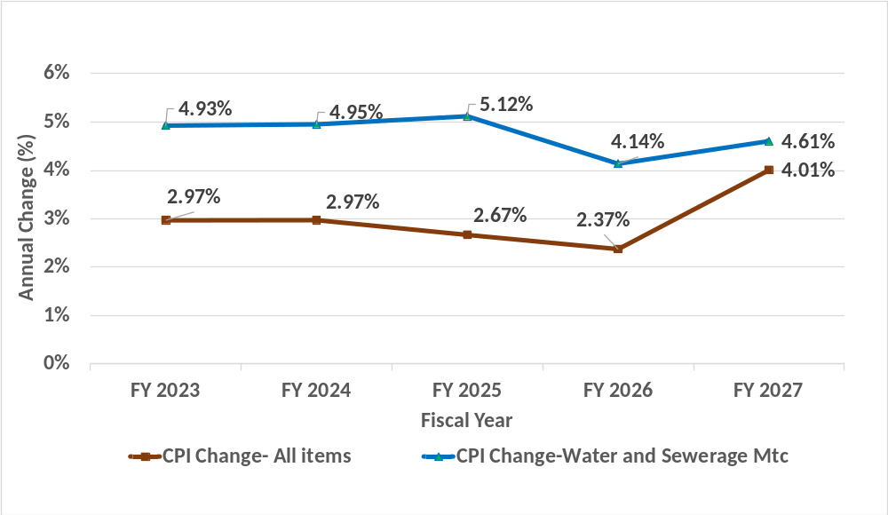
Water Sewer CPI trend
Source: CPI –U All Items, US City Average
CPI –U Water and Sewerage Maintenance in U.S., U.S. City Average

Slide 16
OUR PRIORITY RESILIENCE ACTIONS
FY 2027 – FY 2032 PLAN

Slide 17
Revenue requirements (FY 2027 – FY 2032)

Slide 18
Key cost drivers (FY 2027 – FY 2032)
Significant Capital Program
Consistent Increase in O&M Costs
$412.2 million CIP over the next 6 years
Projected annual average O&M cost increase of 3.2%
Water/Sewer Enterprise Fund
Support for Customer Assistance
Build Back
Revenues &
RSR Reserve
Support for Customer Affordability
Build Back
RSR Reserve
$3.5 million for discounts to elderly/ disabled customers &
$2.1 million for utility payment assistance for low-income customers
Build revenue recovery and RSR balance during the study period for financial resilience

Slide 19
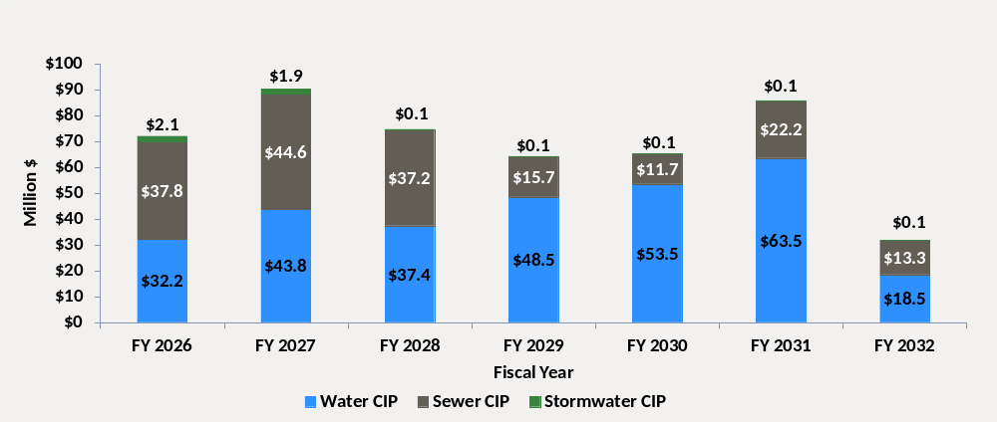
Projected capital improvement program
Six year (FY 2027-FY 2032) capital improvement program
Total Six-year
(FY 27 – FY 32) CIP:
$412.2 M

Slide 20



Proposed lower-cost CIP financing plan
SRF Loans*
* SRF loans and principal forgiveness are subject to availability of funding
GO Bonds
$ 24 . 8 M
$ 304 . 0 M
Grants
SRF Principal Forgiveness*
Cash Financing
$ 5 . 2 M
$ 51. 5 M
$ 28 . 1 M
Total CIP:
$412.2 M
Water CIP
$265.1 M
Sewer CIP $144.5 M
Stormwater CIP $2.6 M

Slide 21
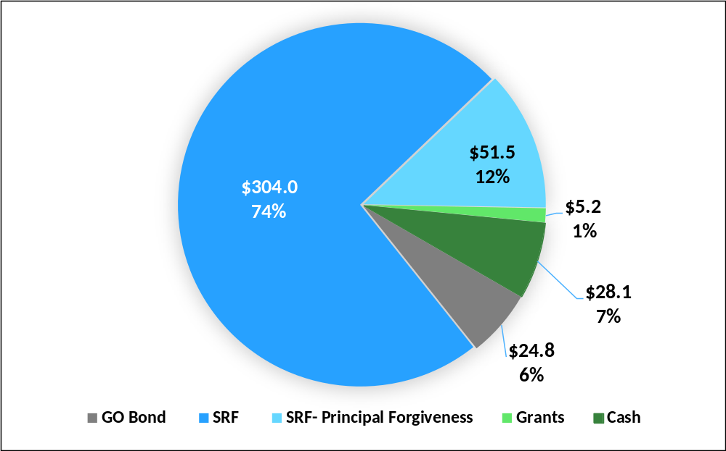
Six-Year Proposed CIP Financing Distribution*
Total capital improvement program: $412.2 M
* SRF loans and principal forgiveness are subject to availability of funding

Slide 22
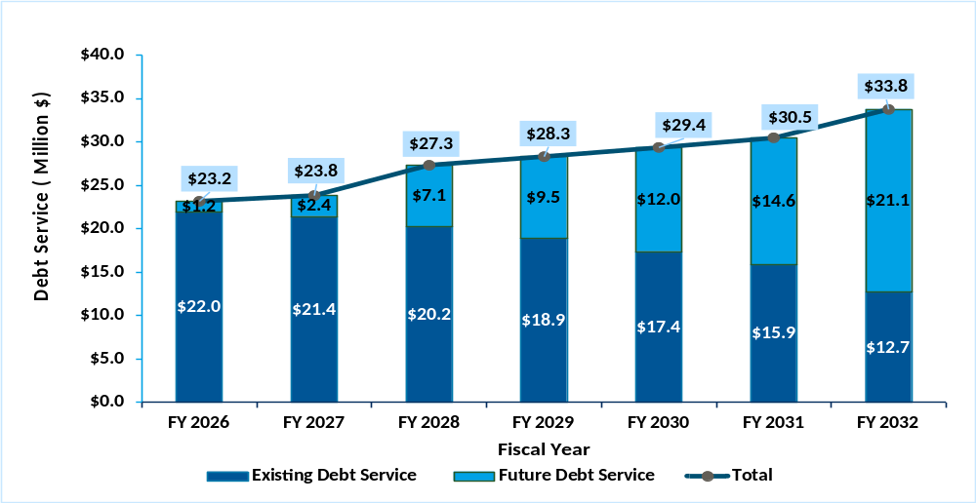
Existing and proposed debt service*

Slide 23
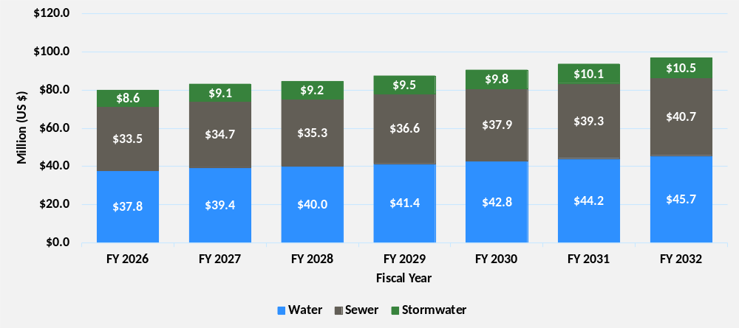
Projected operations & maintenance costs*
$79.9M
$83.1 M
$96.8 M
*Based on proposed FY 2027 O&M budget
Notes:
In

Slide 24
Revenue projections (FY 2027 – FY 2032)

Slide 25
Water/sewer fund revenues
SOURCES OF REVENUES
1
Retail user charge revenues
Water charge (facilities charge & usage charge)
Sewer charge
Storm water
2
Wholesale wastewater treatment revenues
New Castle County treatment services
3
Miscellaneous water/sewer fund revenues
Other revenues (example: cell tower lease; permit fees; penalty/interest income etc.)

Slide 26
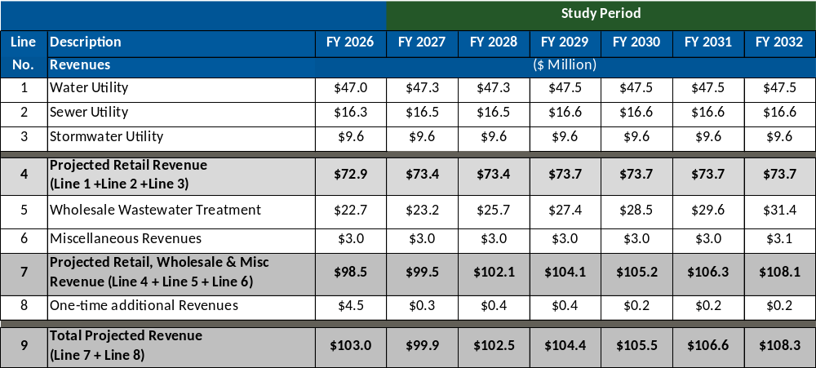
Projected FY 2026 –FY 2032 Revenues (Under Existing Rates)*
*Projected retail revenues after accounting for revenue reduction due to customer delinquency and an increased sewer factor of 0.74 beginning FY 2027.

Slide 27
Six-year financial plan (FY 2027 – FY 2032)

Slide 28
Water/sewer fund financial plan
Cash-out revenue requirements
O&M requirements
Cash-in revenue sources
Debt service requirements (for CIP)
Revenue under existing rates
Plus: rate stabilization fund withdrawal (if funds available)
Cash financing of capital (for CIP)
O&M Reserve Requirement (17% Required)
Rate stabilization deposit (future resilience)
Series of annual revenue
adjustments needed
O&M reserve balance
Rate stabilization reserve balance

Slide 29
Fiscal year 2026 beginning fund balances
Capital proceeds: $ 4.5 million
Drawn down to support planned CIP projects
17% of annual O&M to be maintained as reserve (per council ordinance)
O&M reserve: $13.6 million
Drawn down annually to mitigate rate increase volatility (per council ordinance)
Rate stabilization reserve: $4.7 million

Slide 30
Proposed financial plan revenues & expenses (FY 2027- FY 2032)
 |  |  | Study Period
Line No. | Description | FY 2026 | FY 2027 | FY 2028 | FY 2029 | FY 2030 | FY 2031 | FY 2032
1 | Revenue Increase (Water/Sewer) | 5.50% | 9.95% | 9.50% | 5.00% | 4.00% | 3.80% | 3.80%
2 | Revenue Increase (Stormwater) | 6.00% | 9.95% | 5.25% | 5.00% | 5.00% | 3.50% | 3.50%
 |  | ($M) | ($M) | ($M) | ($M) | ($M) | ($M) | ($M)
3 | Estimated Revenues | 98.5 | 106.0 | 115.6 | 122.1 | 127.1 | 131.7 | 137.1
4 | Less: O&M Expenditures | (79.9) | (83.1) | (84.5) | (87.4) | (90.5) | (93.6) | (96.8)
5 | Less: Debt Service | (23.2) | (23.8) | (27.3) | (28.3) | (29.4) | (30.5) | (33.8)
6 | Annual Operating Balance (Line 1 + Line 2 + Line 3) | (4.6) | (0.9) | 3.8 | 6.4 | 7.2 | 7.6 | 6.5
7 | Add: Beginning Year Operating Balance | 13.6 | 14.2 | 14.6 | 15.2 | 15.7 | 16.2 | 16.8
8 | Add: Other One-time Revenues | 4.5 | 0.3 | 0.4 | 0.4 | 0.2 | 0.2 | 0.2
9 | Add: Withdrawal from RSR Less: (Deposit to RSR) | 0.6 | 1.0 | (3.6) | 0.8 | 0.1 | (0.1) | 0.8
10 | Available W/S Fund Balance (Line 6 + Line 7 + Line 8) | 14.2 | 14.6 | 15.2 | 22.7 | 23.2 | 24.0 | 24.3
11 | Less: Cash Financed Capital | 0.0 | 0.0 | 0.0 | (7.0) | (7.0) | (7.2) | (6.9)
12 | Estimated W/S Fund Balance (Line 9 - Line 10) | 14.2 | 14.6 | 15.2 | 15.7 | 16.2 | 16.8 | 17.4
Revenue Increase:
Water/Sewer revenue increase beginning FY 2027 reflects the aggregated effect of annual revenue increase and the increase of sewer factor to 0.74.
Disclaimer: Projections reflect key assumptions, budget, and planned capital program and financing.
Actual results may vary.

Slide 31
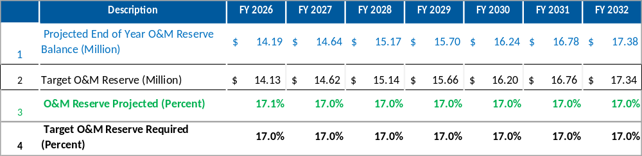
Projected O&M reserve fund balance (FY 2027 – FY 2032)
17% of annual O&M reserve balance required in the water/sewer enterprise fund, per utility rate ordinance

Slide 32
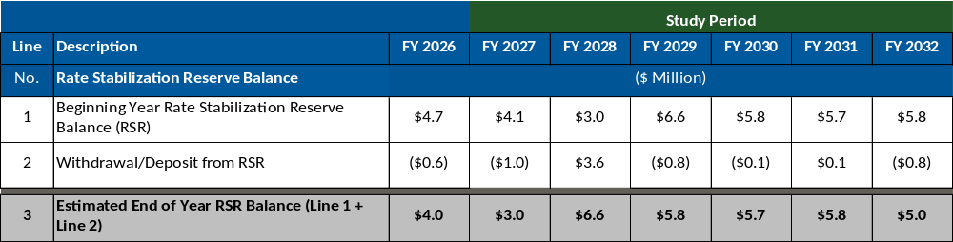
Projected RSR balance (FY 2027 – FY 2032)

Slide 33
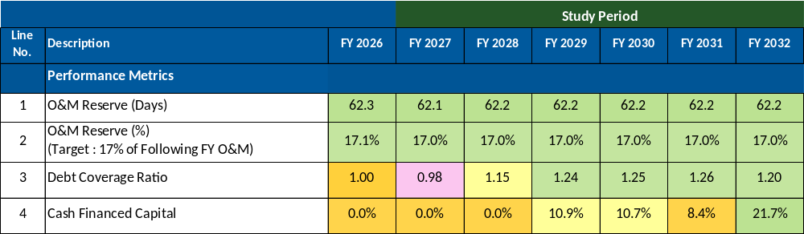
Key performance metrics (FY 2027 – FY 2032)
Target: 17%
Target: 1.2
Target: 20%
Disclaimer: Projections reflect key assumptions, budget, and planned capital program and financing. Actual results may vary.

Slide 34
OUR VALUE AND POSITIVE IMPACT

Slide 35
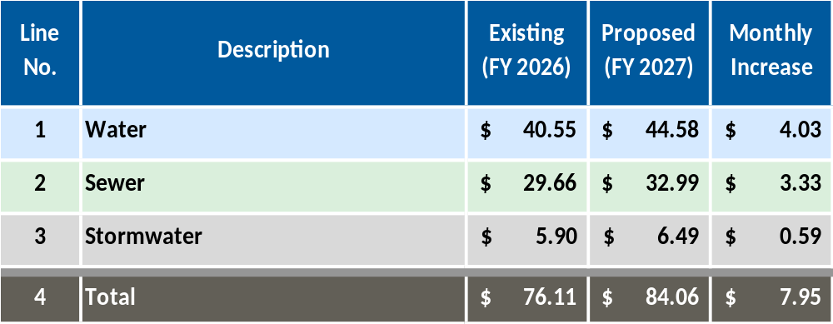
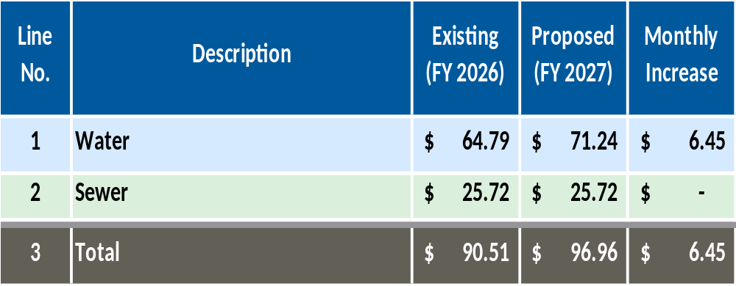
Residential FY 2027 typical monthly bill
for 5/8-inch meter and 4,000 gallons usage
Inside city
Outside city
Monthly inside city increase:
Proposed sewer monthly charge in FY 2027 reflects the aggregated effect of annual revenue increase of 9.95% and the increase of sewer factor to 0.74.
Monthly outside city sewer increase (per new castle county’s retail sewer charges)

Slide 36

What does your one dollar support in FY 2027?
68₵
20₵
12₵
0₵
Cost of equity
(Cash financing of capital)
O&M cost
(Personnel, MS&E, support services)
Infrastructure rehabilitation cost
(Debt service of capital)
Utility
resilience reserve
(O&M and rate stabilization reserves)

Slide 37
FY 2027 monthly costs for a typical household
Electric /gas
Cable TV/internet
Cell phone (2 lines)
Water and wastewater
$135
$84
$250
$140
A gallon of high-quality Wilmington tap water: $0.011 (1 cent)
  If a customer pays $1.50 for a gallon of bottled water, that would still be 150 times more expensive
Average daily cost for a typical household: $2.81
  $1.49 for drinking water
  $1.32 for wastewater disposal

Slide 38
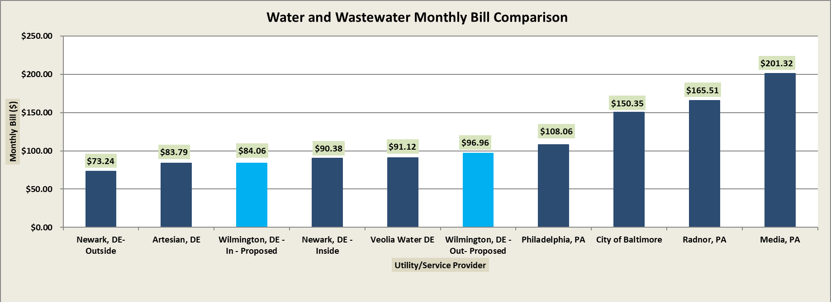
FY 2027 residential monthly bill comparison
Typical bill for residential customers with 5/8 inch meter and 4,000 gallons per month consumption; Includes stormwater.
Artesian Water, Veolia, and Wilmington Outside include an estimate of NCC sewer monthly charge.

Slide 39
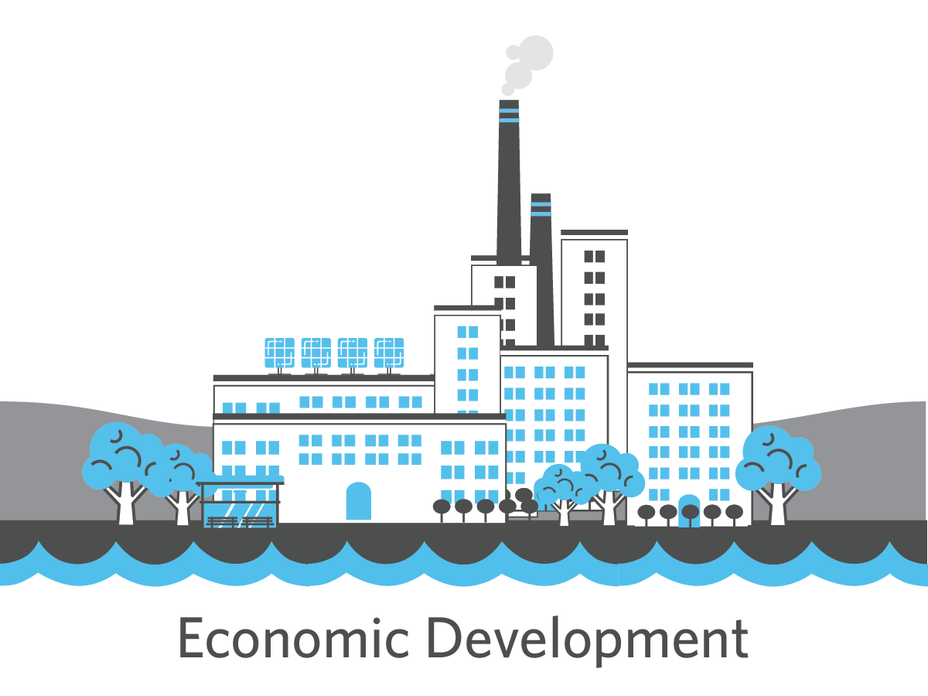
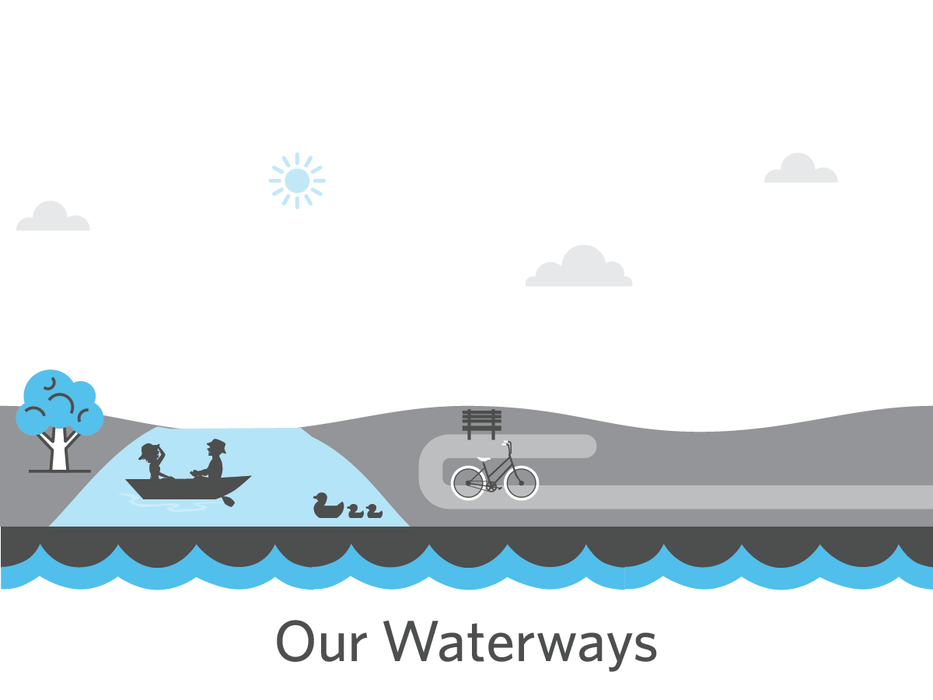
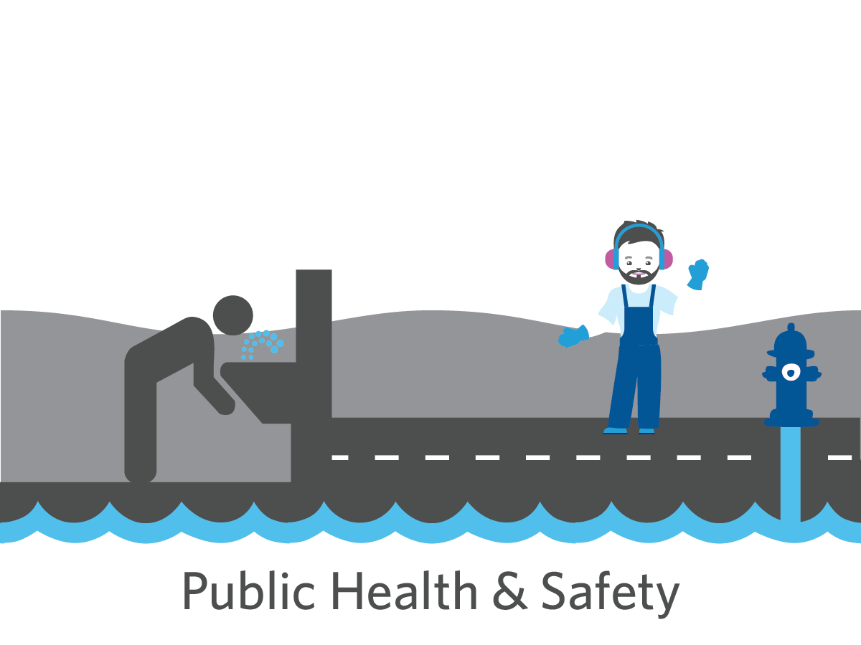

Looking ahead: our community’s resiliency depends on our utilities

Slide 40
Discussion

